Slide 1
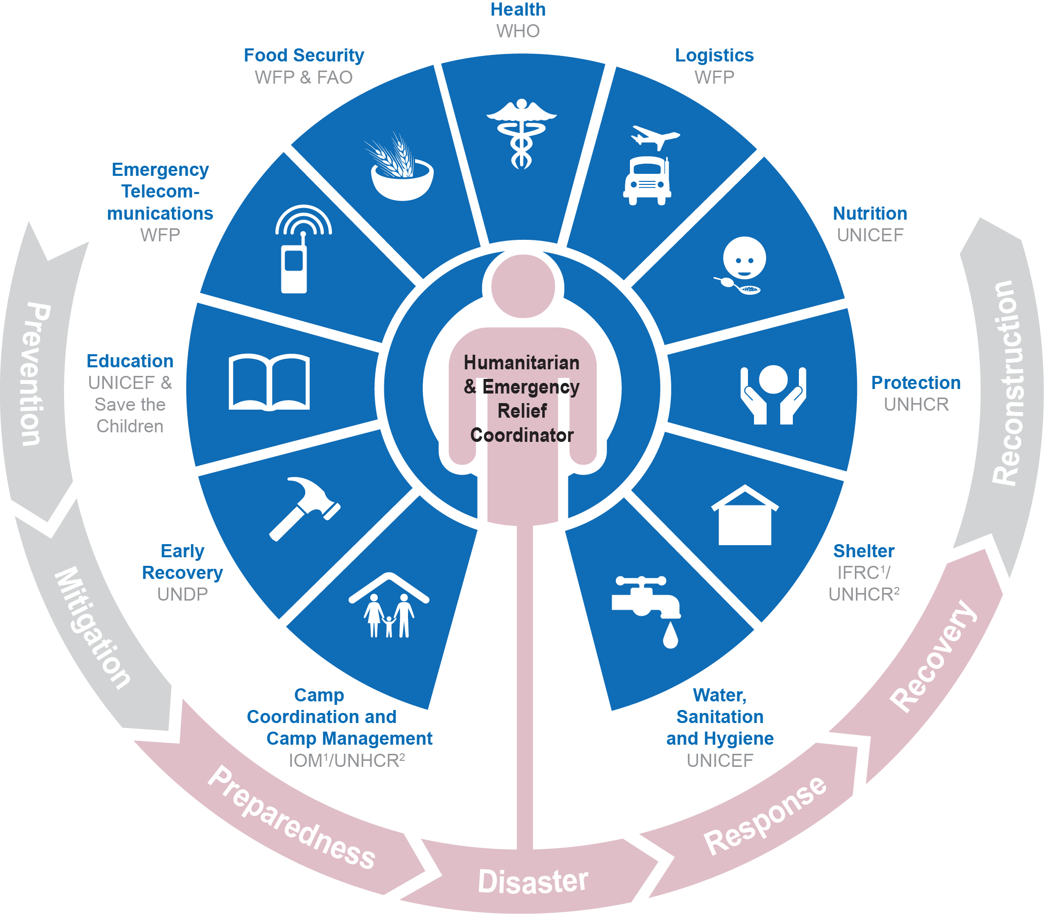
POUR UNE COORDINATION EFFICACE DE LA REPONSE HUMANITAIRE
￼

Slide 2
COORDINATION SECTORIELLE : NOTE D’ORIENTATION
http://reliefweb.int/report/world/cluster-coordination-note-d-orientation-sur-la-coordination-sectorielle-pour-les
￼

Slide 3
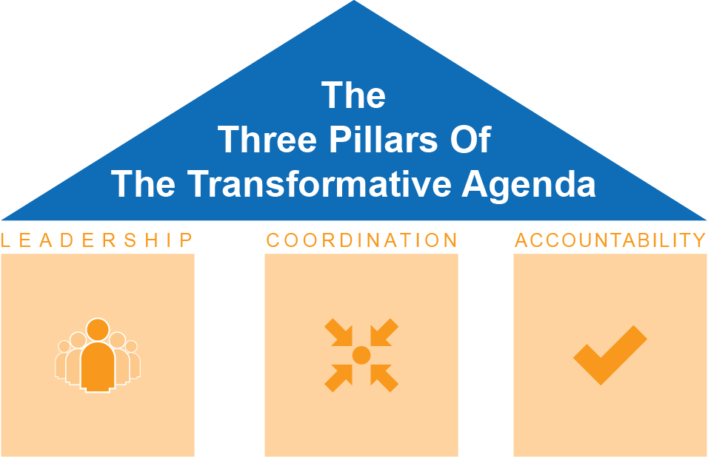
RENFORCEMENT DE LA REPONSE HUMANITAIRE
Les 3 piliers de l’Agenda Transformatif
￼
REDEVABILITE
Notes:
Humanitarian response: Where we’ve come from:
Raison d’etre d’un Cluster: Pour garantir que la communauté humanitaire répond aux besoins des personnes touchées par des conflits ou désastres de manière fiable, efficace, inclusive et en respectant les principes humanitaires.
Following the recommendations of an independent Humanitarian Response Review in 2005, the cluster approach was proposed as one way of addressing gaps and strengthening the effectiveness of humanitarian response through building partnerships. The cluster approach ensures clear leadership, predictability and accountability in international responses to humanitarian emergencies by clarifying the division of labour among organizations and better defining their roles and responsibilities within the different sectors of the response. It aims to make the international humanitarian community better organised and more accountable and professional, so that it can be a better partner for the affected people, host governments, local authorities, local civil society and resourcing partners.
However, the strength of the cluster approach relies on an understanding that this approach is not the only humanitarian coordination solution. In some cases, the cluster approach may co-exist with other “non-cluster” coordination solutions – whether national or international – or an alternative sectoral approach may be preferable. An indiscriminate application of all clusters in every emergency may waste resources and reduce opportunities for governments to exercise their primary responsibility to provide humanitarian assistance to people in need.
Coordination is a means to an end – the ultimate aim of the humanitarian community is to serve vulnerable populations effectively. Accordingly, the scale of international coordination arrangements should be tailored to the operational context, to support national efforts6 based on existing capacity in order to direct as many resources as possible towards delivering humanitarian assistance in a timely, predictable manner. Developing complicated coordination arrangements should be avoided; not all clusters need to be activated in every response.
The IASC Transformative Agenda recognizes the need for Humanitarian Coordinators (HCs), Resident Coordinators (RCs) and Humanitarian Country Teams (HCTs) to be empowered to make decisions that are right for their own country operations.
Source: The IASC Cluster Coordination Reference Module | 2014
The humanitarian assistance framework laid out in General Assembly resolution 46/182 has
been refined and expanded over the last twenty-five years through a series of reforms. The
two most recent reforms took place in 2005 and 2011. The IASC initiated a Humanitarian
Reform in 2005 which introduced a broad range of improvements, including the upgrade
of the CERF to include a $450 million grant mechanism; the establishment of the cluster
approach to ensure dedicated leadership and capacity for each sector of humanitarian work
(see chapter 4); and strengthening of the HC function.
Building on the 2005 reform and based on an internal review of humanitarian responses to
several large-scale disasters, the IASC agreed in 2011 to a set of additional improvements
known as the IASC Transformative Agenda. These included the creation of a new inter-agency
process for system-wide mobilization and response to major crises, termed “Level 3” (L3)
emergencies, and accompanying L3 measures such as the deployment of senior humanitarian
leadership at the outset of a response; the establishment of an Inter-Agency Rapid
Response Mechanism (IARRM) to deploy experienced humanitarians to fill key functions; and
the empowerment of the HC to make decisions when consensus cannot be reached in the
HCT. The Tranformative Agenda also included other initiatives applicable to all types of humanitarian
responses, such as improved preparedness and strategic response planning measures;
reinforced commitment to greater accountability to affected people; and, reaffirmation
of the centrality of protection in humanitarian response.

Slide 4
LES 6 FONCTIONS DES CLUSTERS
Les 6 fonctions principales des groupes sectoriels au niveau national
1
SOUTENIR LA PRESTATION DE SERVICES
5.
6
PLAN DE CONTINGENCE, PREPATION AUX URGENCES, RENFORCEMENT DES CAPACITES
2
3
4
GUIDER LE CH/L'EHP DANS LA PRISE DE DECISIONS STRATEGIQUES
PLANIFIER ET ELABORER UNE STRATEGIE
PLAIDOYER
SUIVI ET RAPPORTAGE
Chaque Cluster est également responsable de l'intégration des aspects de relèvement précoce et des thèmes transversaux tels que le Genre, l’âge, la diversité, le VIH/sida et l’environnement.
Notes:
Supporting service delivery
Provide a platform to ensure that service delivery is driven by the agreed strategic priorities
Develop mechanisms to eliminate duplication of service delivery
2. Informing strategic decision-making of the HC/HCT for the humanitarian
response
Needs assessment and response gap analysis (across sectors and within the sector)
Analysis to identify and address (emerging) gaps, obstacles, duplication, and cross-cutting issues including age, gender, environment, and HIV/AIDs
Prioritization, grounded in response analysis
3. Planning and strategy development
Develop sectoral plans, objectives and indicators that directly support realization of the HC/HCT strategic priorities
Apply and adhere to existing standards and guidelines
Clarify funding requirements, prioritization, and cluster contributions for the
HC’s overall humanitarian funding considerations (e.g. Flash Appeal, CAP, CERF, Emergency Response Fund/Common Humanitarian Fund)
4. Advocacy
Identify advocacy concerns to contribute to HC and HCT messaging and action
Undertake advocacy activities on behalf of cluster participants and the affected population
5. Monitoring and reporting the implementation of the cluster strategy and results; recommending corrective action where necessary
6. Contingency planning/preparedness/capacity building in situations where there is a high risk of recurring or significant new disaster and where sufficient capacity exists within the cluster.

Slide 5
DÉSACTIVATION D’UN CLUSTER
Quand au moins 1 des 2 conditions est présente:
La situation humanitaire s’améliore, réduisant de manière significative les besoins humanitaires et les lacunes d'interventions et de coordination.
2. Les structures nationales acquièrent une capacité suffisante pour coordonner et répondre aux besoins humanitaires en ligne avec les principes humanitaires.
Activation
Désactivation
Activé
Une désactivation efficace se base sur:
Un examen régulier remettant en question la nécessité des clusters par le CR/CH et l’EHP;
Une planification adéquate afin de mettre en place des mesures de transition, y compris le renforcement des capacités et les phases préparatoires.
Notes:
The de-activation of clusters is a decision to stand-down one or several clusters because either the cluster has transferred responsibility for delivery and possibly capacities, tools, systems and resources to national and/or development partners or because humanitarian needs in a particular sector have sharply decreased or ceased (e.g. when affected people have returned, reintegrated or relocated).
Clusters are supposed to be a temporary coordination solution and the aim should be to either resume or establish national, development-oriented coordination mechanisms as soon as the humanitarian emergency phase ends.
In deciding on de-activation, the RC/HC and HCT should consider the need to address any on-going humanitarian needs and the national and local context. Clusters do not all have to be deactivated at the same time; some may need to remain longer, while others are deactivated. Some clusters will have a more natural counterpart to ‘hand over to’ than others, making transition easier. Also, de-activation in sudden onset crises may be a more rapid process than de-activation in complex or protracted emergencies.

Slide 6
AGENCE CHEF DE FILE
Pour garantir que la communauté humanitaire répond aux besoins des personnes affectées par des conflits ou des désastres de manière fiable, efficace, inclusive et en respectant les principes humanitaires.
UNICEF est l’agence chef de file pour 3 Clusters et 2 domaines de compétence (AoR):
NUTRITION CLUSTER | WASH CLUSTER | EDUCATION CLUSTER | CHILD PROTECTION AOR | GENDER BASED VIOLENCE AOR
CLUSTER NUTRITION
CLUSTER WASH
CLUSTER EDUCATION
AOR PROTECTION DE L’ENFANCE
AOR VIOLENCES BASEES SUR LE GENRE
Notes:
As part of the cluster activation process, the RC/HC selects Cluster Lead Agencies (CLAs) in consultation with the HCT based on the agencies’ coordination and response capacity, as well as the location and level of its operational presence and/or ability to increase this. The selection of Cluster Lead Agency ideally mirrors the global-level arrangements but this is not always possible, and in some cases other organizations may be better placed to take the lead.7 Shared leadership, including using non-governmental organizations, should be considered.
If UNICEF does not have any operational programmes in the sector/s where clusters or AORs will be established, UNICEF will need to consider it’s position and ability to adequately fulfil the coordination function.
Alternatives: The UNICEF Country Representative and Humanitarian Country Team may decide that:
Another organisation is better placed to take full CLA responsibility of the Cluster /AOR; in which case UNICEF CR will facilitate linkages with the relevant Global Cluster Coordinators
UNICEF share CLA responsibility with another organisation (co/shared leadership)
Another organisation takes on CLA responsibility in the short term and UNICEF agrees to scale up and take on CLA responsibility in the longer term

Slide 7
PARTAGE DES FONCTIONS DE DIRECTION
Lorsque le leadership du Cluster est partagé il y a un engagement plus fort et une meilleure coordination.
La sélection devrait être basée sur:
sa pertinence opérationnelle et technique en situation d’urgence;
sa capacité à fournir un personnel ayant une expérience appropriée;
son engagement à contribuer régulièrement;
Sa capacité à contribuer stratégiquement.
Sélection des agences co-lead par un processus ouvert et transparent.
Lettres d'entente ou TdR développés pour assurer que toutes les parties ont une compréhension commune.
Plusieurs termes sont utilisés pour décrire le leadership partagé: co-lead, co-animateur, co-coordinateur, co-délégué ou co-chef de file.

Slide 8
LA GESTION DES CLUSTERS
Il n'y a pas de solution unique pour la gestion d’un cluster. En raison des tailles différentes, de la portée et de la complexité des urgences et la réponse des différents clusters, le choix d'une approche de gestion doit être adaptée aux besoins et peut changer à mesure que la réponse évolue.
Les éléments communs comprennent:
Coordinateur & IMO
Membres du Cluster
Groupe de Conseil Stratégique
(GCS)
Groupes Techniques de Travail (GTTs)
Notes:
A well-run cluster is a formal deliverable of the Cluster Lead Agency and forms a part of the agency’s work. However in practice, it has been recognized by the IASC and donors that the efficient management or functioning of clusters is the joint responsibility of the Cluster Lead Agency, the Cluster Coordinator, resourcing partners and all cluster participants at the national and sub-national level.
Efficient cluster management should encompass the following characteristics;
Monitored performance of the six core cluster functions with regard to developing programmes – which clearly contribute to the implementation of evidence-based strategic objectives – based on the identification of good field practices and agreed international benchmarks and standards;
Establishment and maintenance of an appropriate humanitarian coordination mechanism;
Strengthening pre-existing sectoral coordination through increased predictability and accountability;
Building complementarity of partner actions: avoiding duplication and gaps
Ensuring adequate resources are mobilized and are equitably allocated for the effective functioning of the cluster and its response
Effective and comprehensive integration of relevant cross-cutting issues, including age, gender, environment and HIV/AIDs;
3. Maintaining flexibility within the cluster to respond to changes in the operating environment, evolving requirements, capacities and participation;
4. The effective use and transfer of information to, from and between cluster members and other stakeholders;
5. Interaction with other clusters (including through inter-cluster coordination fora), humanitarian actors, government counterparts, and relevant authorities for operational planning, engagement and active contribution of operational partners;
6. Accountability to the affected population through effective and inclusive consultative and feedback mechanisms.

Slide 9
ENGAGEMENTS MINIMUMS DES MEMBRES DES CLUSTERS
L’IASC a défini un minimum de douze engagements en ce qui concerne la participation des partenaires aux groupes sectoriels, comme par exemple:
Suivre les Principes Humanitaires
Assurer la Protection de base des bénéficiaires dans l’exécution des programmes
Participer aux interventions permettant spécifiquement d’améliorer la redevabilité envers les populations affectées
Démontrer sa compréhension des obligations et des responsabilités associées à l’appartenance aux groupes sectoriels
Participer activement aux activités du Cluster
Avoir la capacité et la volonté de contribuer au PRH
Coopérer et partager les informations
Assurer des activités de plaidoyer et disséminer les messages de plaidoyer
Notes:
These minimum commitments DO NOT SEEK to exclude organisations from participating in clusters or to impede participation of national authorities in cluster coordination, where appropriate.
The minimum commitments for participation in clusters include:
A common commitment to humanitarian principles, the Principles of Partnership16 through for example, cluster-specific guidance and internationally recognized programme standards, including the Secretary-General’s Bulletin on Special Measures for Protection from Sexual Exploitation and Sexual Abuse.
Readiness to participate in actions that specifically improve accountability to affected populations as per the IASC Commitments to Accountability to Affected Populations17 and the related Operational Framework.
Demonstrate an understanding of the duties and responsibilities within the cluster, as defined through IASC terms of references and guidance notes18 and any guidance specific to the cluster itself, as well as country cluster terms of reference, where available.
Active participation within the cluster and commitment to consistently engage in the cluster’s collective work.
Capacity and willingness to contribute to the cluster’s strategic response plan and activities, which must include inter-cluster coordination and cross-cutting issues (age, gender, environment and HIV/AIDs).
Commitment from a relevant senior staff member to engage consistently in the cluster towards the fulfillment of its mission.
Commitment to work cooperatively with other cluster partners to ensure an optimal and strategic use of available resources, including sharing information on organizational resources.
Willingness to take on leadership responsibilities of sub-national and/or working groups, as needed and as capacity and mandates allow.
Contribute to developing and disseminating advocacy and messaging targeted at various actors, including, but not limited to, affected communities, the host government, donors, the HCT, cluster lead agencies, and the media.
Ensure interpretation and effective communication (i.e. appropriate language) in order to support diverse participation within the cluster, notably from local organizations (and national and local authorities where appropriate).

Slide 10
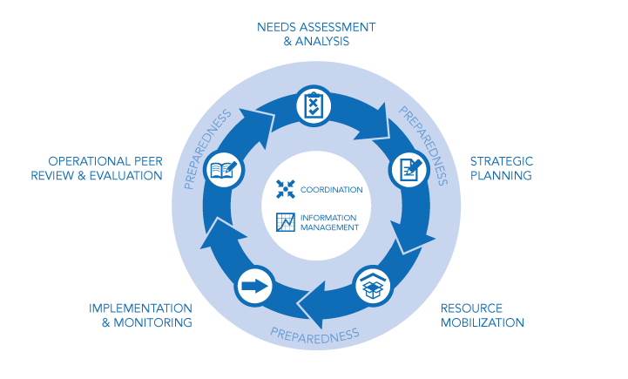
COORDINATION INTER-CLUSTER
La coordination inter-cluster est un mécanisme à travers lequel les clusters nationaux et sous nationaux se rejoignent pour coordonner la réponse à tous les niveaux du Cycle de Programme Humanitaire.
Le type de collaboration inter-cluster est determiné par le Coordinateur Humanitaire, le Coodinateur Résident et/ou l’Equipe Humanitaire Pays; soutenu par OCHA.
La coordination inter-cluster est essentielle dans le succès d’une réponse humanitaire.
Notes:
1. Advocate:
at HCT as necessary for improved inter-cluster coordination between specific clusters to address key strategic issues with multi- cluster approach – e.g. in relation to malnutrition or cholera or across all clusters in relation to inter-cluster support services /activities
at HCT as necessary for improved communication between HCT and Inter-cluster coordination mechanisms
2. Communicate:
ensure good two-way flow of information in-house - between Country Rep and UNICEF led Cluster and AORs Coordinators with briefing and debriefing before and after ICC and HCT meetings – to endorse key messages and to ensure common understanding /position on key issues discussed during these meetings.
3. Convene:
effective in-house Inter-cluster coordination across UNICEF led clusters and AORs, to enhance UNICEF-led cluster coherence of approach and collaboration and reducing duplication of effort on common issues. This will also promote programme integration within UNICEF.

Slide 11
COORDINATION SOUS-NATIONALE
La coordination des interventions d’urgence au niveau sous-national est cruciale.
Les « sous-Clusters » sont dans une meilleure position pour:
adapter des normes aux conditions locales;
travailler en étroite collaboration avec les autorités locales et autres;
mettre en œuvre le plan stratégique;
renforcer la redevabilité envers les populations affectées.
TdR
communication dans les deux directions
soutien permanent du niveau national
Notes:
The UNICEF Country Representative is responsible for:
Engaging in analysis and decision making within HCT on establishment of subnational clusters
Over-sight of establishment and management of effective subnational coordination structures
Ensuring appropriate staffing of sub-national level
Providing the required administrative support to enable the clusters to function

Slide 12
UNICEF - AGENCE DE DERNIER RECOURS
^{Lorsqu’un Cluster est activé:}
L’Agence chef de file doit être prête à assurer la fourniture des services qui va permettre de combler les lacunes majeures identifiées par le groupe sectoriel et reflétées dans le PRH dirigé par l’CH/l’EHP, une fois que l’accès, la sécurité et les fonds sont en place.
Notes:
PRH: plan de réponse humanitaire (HRP/humanitarian response plan en anglais)

Slide 13
REPRESENTATION DES CLUSTERS DANS L’EHP
A travers le Représentant de l’UNICEF qui participe activement aux discussions de l’EHP et à la prise de décisions dans toutes les phases de l’intervention, en
représentant les intérêts de l’UNICEF en tant qu’agence, ainsi que ceux des trois
Clusters et des domaines de compétence.
toujours indiquer clairement lorsqu’on parle au nom de l’UNICEF et lorsqu’on parle au nom des divers groupes sectoriels.
parler des questions relatives aux groupes sectoriels: activités, progrès, projets, défis.
Notes:
It is recommended that
where in post, the dedicated Cluster Manager attends the HCT, along with the CR but NOT in place of CR,
where the Deputy Representative or the Emergency/Field Coordinator is responsible for management of the clusters this individual attends the HCT, along with the CR, again NOT in place of CR
specific Cluster Coordinators should (on request) attend HCT meetings to provide technical and operational expertise on specific thematic / technical issues
It is also suggested that UNICEF led Cluster and AoR Coordinators periodically have the opportunity to attend HCT as observers, to gain a better understanding of the dynamic of the HCT. UNICEF Cluster Coordinator attendance at HCT could be rotated, with the Coordinator who attends then also taking some responsibility to report back/brief on the meeting to the other UNICEF-led Cluster and AoR Coordinators.

Slide 14
LA NEUTRALITE DES COORDINATEURS
Les coordinateurs de Clusters sont employés par l’UNICEF, et travaillent sous l’autorité du Représentant Pays ou de la personne désignée par lui. Toutefois, les coordinateurs des Clusters n’ont qu’un seul devoir, envers les partenaires, et dans l’ensemble devraient agir en toute neutralité en qualité de représentants des Clusters.
La neutralité peut être promue comme suit :
coordinateur spécialisé qui n’a pas d’autre responsabilité dans le cadre d’un programme de l’UNICEF
coordinateur devrait être sous les ordres directs d’une personne autre que le chef de section
la position de neutralité devrait être clarifiée auprès des partenaires régulièrement, et confirmée dans la pratique
le chef de section et les cadres supérieurs de l’UNICEF devraient participer activement aux réunions des Clusters et représenter l’UNICEF

Slide 15
DOUBLE RESPONSABILITE (DOUBLE-HATTING)
= staff d’un programme de l’UNICEF qui remplit les fonctions de coordinateur du Cluster en plus de ses responsabilités au sein du programme de l’UNICEF (dans des situations d’urgences d’une portée moyenne, prolongées ou au niveau sous-national)
Pour maintenir la neutralité, il est recommandé:
Que les deux rôles soient reflétés dans la description de poste, les PER et les réunions régulières avec le superviseur.
De toujours indiquer clairement lorsqu’on parle au nom de l’UNICEF et lorsqu’on parle au nom des divers groupes sectoriels.
Une autre personne devrait représenter l’UNICEF lors des réunions Clusters.
Essentiel qu’une autre personne représente l’UNICEF lors de l’allocation des fonds.
La double responsabilité ne devrait pas être encouragée par l’agence chef de file en absence d'une structure de coordination solide, même en cas d'urgences prolongées. Une fois que la structure est renforcée, la double responsabilité peut être envisagée.
Notes:
Cluster coordination responsibilities and allocation of time for cluster functions should be clearly articulated in the job description and in the performance appraisal of the post holder and monitored through regular meetings with supervisor(s) to ensure that the dual roles remains
A double hatting Cluster Coordinator must always make it clear when speaking on behalf of/representing the cluster and when speaking on behalf of/representing UNICEF.
Where possible another person should represent UNICEF at meetings, especially in a situation where UNICEF is likely to take a different position from other cluster partners
It is absolutely essential that another person represent UNICEF where funding allocations are being made.

Slide 16
GERER LES RESSOURCES HUMAINES
Le bureau UNICEF pays a la responsabilité de:
Sécuriser les fonds et recruter les coordinateurs des clusters et domaines de compétence ainsi que les spécialistes de la gestion de l’information (IMO)
Développer une stratégie RH pour les clusters et AoRs basée sur l’analyse des capacités de coordination et des besoins; et assurer que tous les postes de clusters et AoRs soient inclus dans les Program Budget Review et Operational Staff Matrix
Les options inclues:
Recrutement d’employés pour remplir un rôle de coordination au niveau des clusters
Détachement de personnel des ONGs dans le pays
Utilisation de différents mécanismes pour un soutien d’urgence temporaire
Etre conscient que:
La plus part des mécanismes de soutien d’urgence sont de courte durée – ils doivent donc être vus comme des options à court terme et être utilisés en intérim, pendant que des arrangements à plus long terme sont mis en place.
iI est essentiel que les bureaux pays commencent le processus de recrutement pour des postes à plus long terme, en priorité et dès le début d’une urgence – reconnaissant que le soutien d’urgence temporaire est une mesure qui comblera les besoins en RH jusqu’à la finalisation du recrutement.
Tout le personnel secondé doit être totalement intégré dans les opérations des bureaux UNICEF pays et doit être managé par l’UNICEF.
* recruter * seconder * rendre possible*
Notes:
UNICEF is responsible for ensuring the timely recruitment of adequate numbers of staff with the appropriate level of seniority, facilitation skills, and technical skills to ensure effective cluster coordination, including information management function.
In some cases it may be feasible for programme staff to take on cluster and AOR coordinator and information management specialist (IM) roles, whereas in other situations dedicated full-time cluster coordination staff (coordinator and IM) will be necessary.

Slide 17
EXPERTS EN GESTION DE L’INFORMATION (IM)
Cahier des charges
Suivi de la situation (compiler les chiffres sur les besoins, participer aux évaluations et groupes de travail concernant la gestion de l’information)
Faire la planification et le suivi de la réponse (PRH et HAC si double responsabilité)
Les deux rôles sont reflétés dans la description de poste, les PER et les réunions régulières avec le superviseur
Toujours indiquer clairement lorsqu’on parle au nom de l’UNICEF et lorsqu’on parle au nom des divers groupes sectoriels
Notes:
Cluster coordination responsibilities and allocation of time for cluster functions should be clearly articulated in the job description and in the performance appraisal of the post holder and monitored through regular meetings with supervisor(s) to ensure that the dual roles remains
A double hatting Cluster Coordinator must always make it clear when speaking on behalf of/representing the cluster and when speaking on behalf of/representing UNICEF.
Where possible another person should represent UNICEF at meetings, especially in a situation where UNICEF is likely to take a different position from other cluster partners
It is absolutely essential that another person represent UNICEF where funding allocations are being made.

Slide 18
LINE MANAGEMENT DES COORDINATEURS
En cas d’urgence de niveaux 2 ou 1, deux options se présentent :
Les coordinateurs de groupes sectoriels et domaines de compétence seront dirigés directement par le Représentant de l’UNICEF.
Si cela n’est pas possible, le Représentant devrait tenir compte des points suivants lorsqu’il décide de la manière de diriger les coordinateurs:
Tous les coordinateurs de groupes sectoriels et domaines de compétence dirigés par l’UNICEF ne devraient avoir qu’un seul supérieur hiérarchique afin d’assurer la cohérence.
Le supérieur hiérarchique devrait être d’un rang approprié et avoir la capacité requise pour diriger les coordinateurs.
Il est essentiel que le supérieur hiérarchique mette régulièrement le Représentant au courant de la situation, et qu’il accompagne ce dernier aux réunions de l’EHP.
Des réunions de l’UNICEF relatives aux groupes sectoriels devraient être tenues régulièrement avec le Représentant et le supérieur hiérarchique, pour donner aux coordinateurs des groupes sectoriels la possibilité de communiquer avec le Représentant, et de permettre au Représentant de mieux comprendre les questions relatives aux groupes sectoriels.
Notes:
The decision on the best option for direct line management of UNICEF led Cluster and AOR Coordinators will be taken at country level, based on analysis of the context and capacities, and on the following general recommendations and principles:
In L3 emergencies it is recommended that the UNICEF Country Office identify a person of an appropriate level of seniority to manage the clusters (e.g. Chief of Field Operations) or, if the scale of response requires, recruit a dedicated cluster manager. The manager of the clusters should work under the direct supervision of the UNICEF Country Representative, providing strategic direction and management and ensuring streamlined and effective coordination of the UNICEF co-led Clusters/AoRs, and responsible for direct line management of the Cluster and AOR Coordinators.
Where a Cluster Coordinator is double hatting it is recommended that the Coordinator regularly meets with and reports to the Representative on Cluster related issues (in addition to meetings with the Chief of Section who would be the line manager for programming business). Cluster coordination responsibilities and allocation of time for cluster functions should be clearly articulated in the job description and in the performance appraisal of the post holder and monitored through regular meetings with both supervisors to ensure that the dual role remains viable.

Slide 19
Avantages du bon fonctionnement des groupes sectoriels pour l’UNICEF
En plus des obligations à remplir en tant qu’Agence chef de file, c’est dans l’intérêt de l’UNICEF de s’assurer du bon fonctionnement des groupes sectoriels.
• Un groupe sectoriel énergique finira par contribuer au renforcement du programme d’urgence de l’UNICEF, et permettra aux autres programmes d’atteindre leurs objectifs. Les avantages d’une efficacité obtenue grâce au travail de coordination incluent des activités collectives de plaidoyer renforcées, des outils et des ressources partagés et l’accès à une plus grande gamme de partenaires et d’alliés.
• Lorsque la coordination des groupes sectoriels repasse au niveau du secteur, les sections des divers programmes de l’UNICEF seront chargées de soutenir les fonctions de coordination auprès des ministères/organismes gouvernementaux compétents; et la participation aux processus et aux mécanismes des groupes sectoriels permettra ainsi d’améliorer les processus de transition en douceur, la durabilité et les connaissances institutionnelles.
Notes:
Programme and Cluster/AoR staff Collaboration:
Good collaboration between the Cluster/AoR Coordinator and Chief of Section and other relevant programme staff members is essential for a well functional cluster/AoR -
Cluster Coordinators and Programme staff should work together to ensure that Cluster
and AoR Coordination activities are included the Annual Work-Plans of each of the
programme sections under the Core Commitment to Coordination
Funding for Cluster and Aor Coordination Functions (salaries and core activities) should be included in UNICEF project submissions to Strategic Response Plan and then in the relevant project proposals submitted through the various pooled funding mechanisms and when appropriate¹³, in UNICEF programme proposals submitted to bi-lateral donors. Regardless of whether coordination staff members are dedicated, full time cluster staff or double hatting with a dual role supporting UNICEF programmes and cluster; cluster coordination costs must be clearly calculated and transparently outlined in the various budgets.
Release of Cluster Funding requires collaboration and coordination between the Cluster Coordinator and budget holder. It is also important that the mechanisms for release of funding are straight forward and streamlined, that the processes are made clear to the cluster coordinators (many of whom do not have experience of UNICEF processes), and that the various sections facilitate timely disbursement of cluster funding, with an appreciation that (sometimes) cluster activities are organised at short notice, thus a lengthy process for release of funds can be problematic.
Programme and cluster staff should work together to avoid duplication and foster streamlining of information management and other reporting formats and administrative processes that Cluster and UNICEF partners may participate in..
Programme and cluster staff should coordinate on administrative support functions – to ensure shared resources are affectively used and that there is mutual understanding and agreement on work priorities of shared staff.

Slide 20
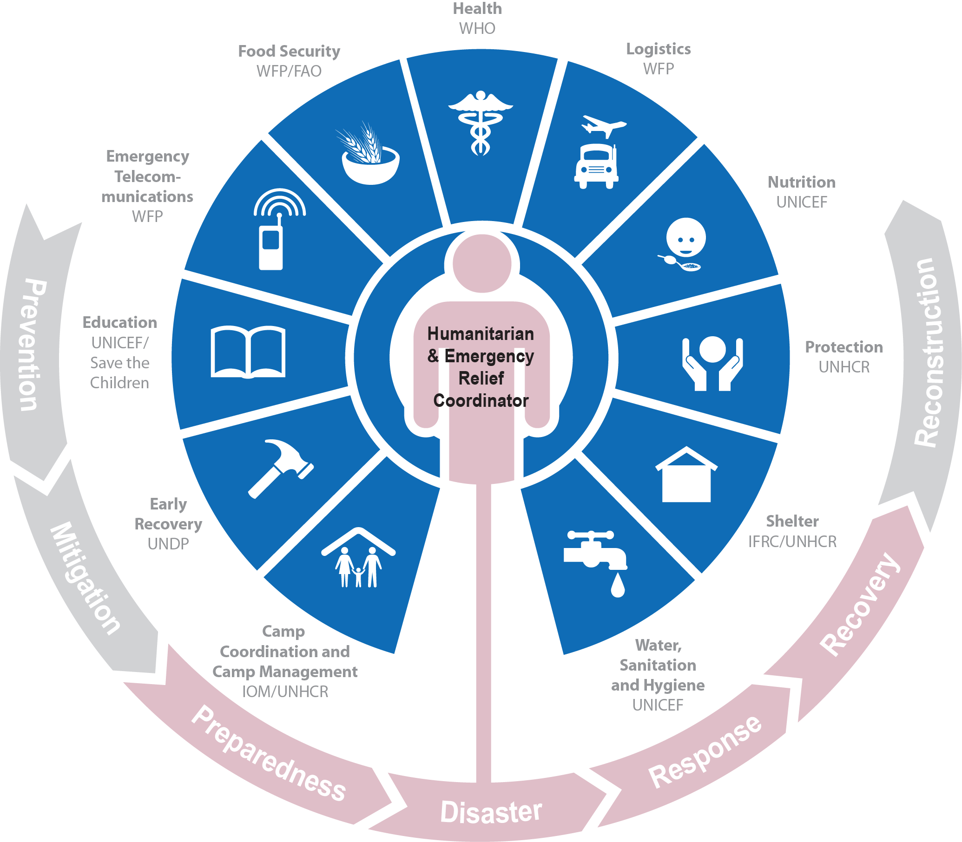
QUESTIONS

