Slide 1

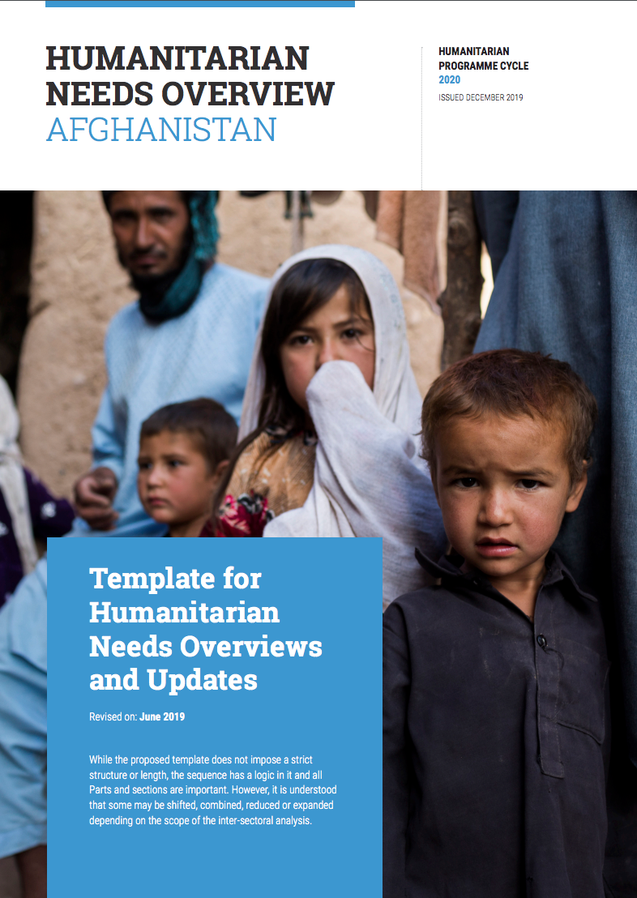
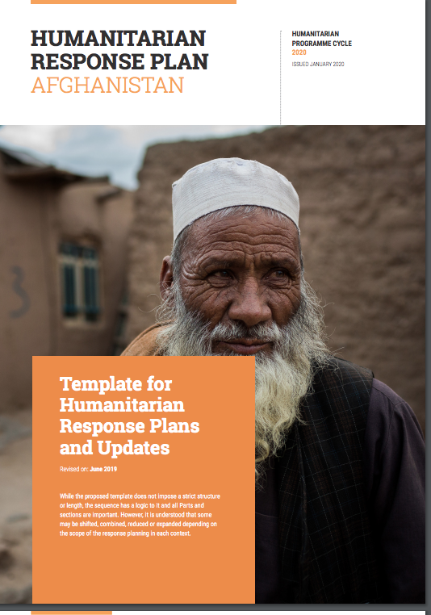
WEBINAR ON ENHANCED HUMANITARIAN PROGRAMME CYCLE APPROACH FOR 2020
30 JULY 2019
14.00-15.00 HRS CET
By
GNC Coordination Help Desk

Slide 2
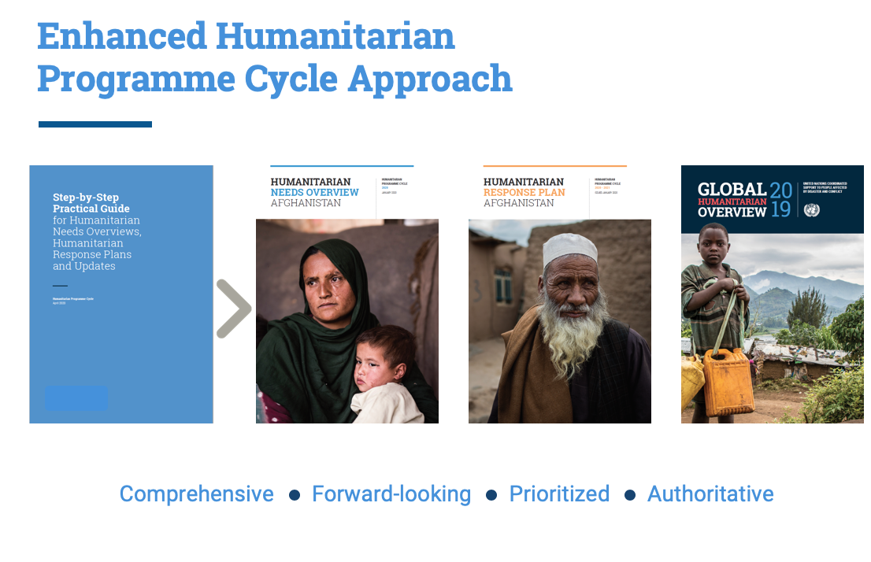

Slide 3
What does the HPC Revision Aim to Achieve?
Improve the relevance and effectiveness of humanitarian response
Increase quality and usefulness of needs analysis to inform decision-making
Enable more meaningful monitoring of needs and results
Reflect WHS & Grand Bargain Commitments
  Inter-sectoral and comprehensive analysis of needs
  Risk and vulnerability analysis
  People-centred analysis
  Integration of affected people’s voice and own priorities
  Localization of response
  Inter-sectoral analysis of response options
  Prioritization of response based on intended humanitarian outcomes
  Systematic consideration of options for cash transfer programming and other response modalities
  Humanitarian-Development Nexus
Notes:
Rationale for revision
Heavy process in need of streamlining and re-stating its original purpose
HNOs of unequal quality that lack depth of analysis of vulnerabilities, needs, capacities and response from a multi-sectoral perspective to afford an understanding of the inter-relationship between needs, with negative implications for the formulation of strategic objectives, prioritization, and multi-sectoriality of responses in the HRPs
Limited monitoring, focused on output level monitoring with weak monitoring of outcomes, and absent situation and needs monitoring
HRPs receive high donor attention but often remain poorly funded
Absence of inter-agency accountability framework or other mechanism
Individual agencies and clusters’ capacity at country level insufficient to collect/provide, analyze and utilize the information required to ensure a strong joint needs analysis and prioritized, multi-sectorial response plan
While some of the existing guidance remains relevant, it fails to reflect our current vision and ambition of having a more agile, streamlined process which is underpinned by systematic and periodic situation, needs and response monitoring. It also lends to an approach with a specific ‘start’ and ‘finish’ as opposed to ongoing reflection of whether the response remains appropriate and is resulting in the desired changes in people’s lives and livelihoods.
This increased emphasis on accountable, people-centered results-orientation informed by systematic monitoring, by definition requires an update to the HNO and HRP templates and guidance.
Donors have increased their pressure on agencies to demonstrate better collective analysis of needs, better prioritization of responses, stronger linkages with development actors, and better evidence of the results of humanitarian responses.
The reputational risk to humanitarian actors has been cited by many. As such, it was agreed that a revised package should be circulated to our field actors by April 2019 to allow for use in the 2020 HPC cycle.

Slide 4
What is new in the Enhanced HPC?
Stronger linkages between the HNO and the HRP
Increased focus on the intersectoral nature of needs and the response required
Better the understanding of causes, level of severity, and likely evolution of needs for a more holistic and effective response with linkages to development interventions
Identifying priority groups and/or geographic areas based on the needs analysis, and formulating results-based strategic objectives that define desired changes in the lives of people and inform multi-sectoral and sectoral planning
Establishing or augmenting monitoring systems that allow for on-going analysis of changes of the situation and needs together with response achievements

Slide 5
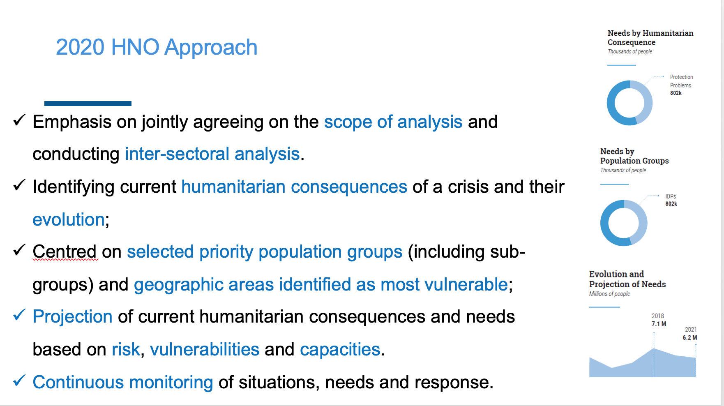

Slide 6
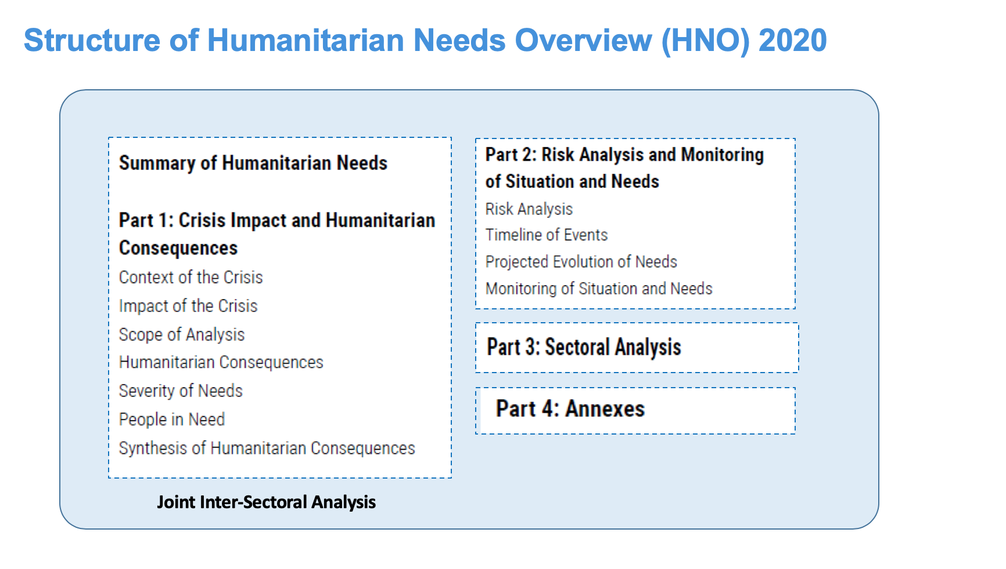

Slide 7
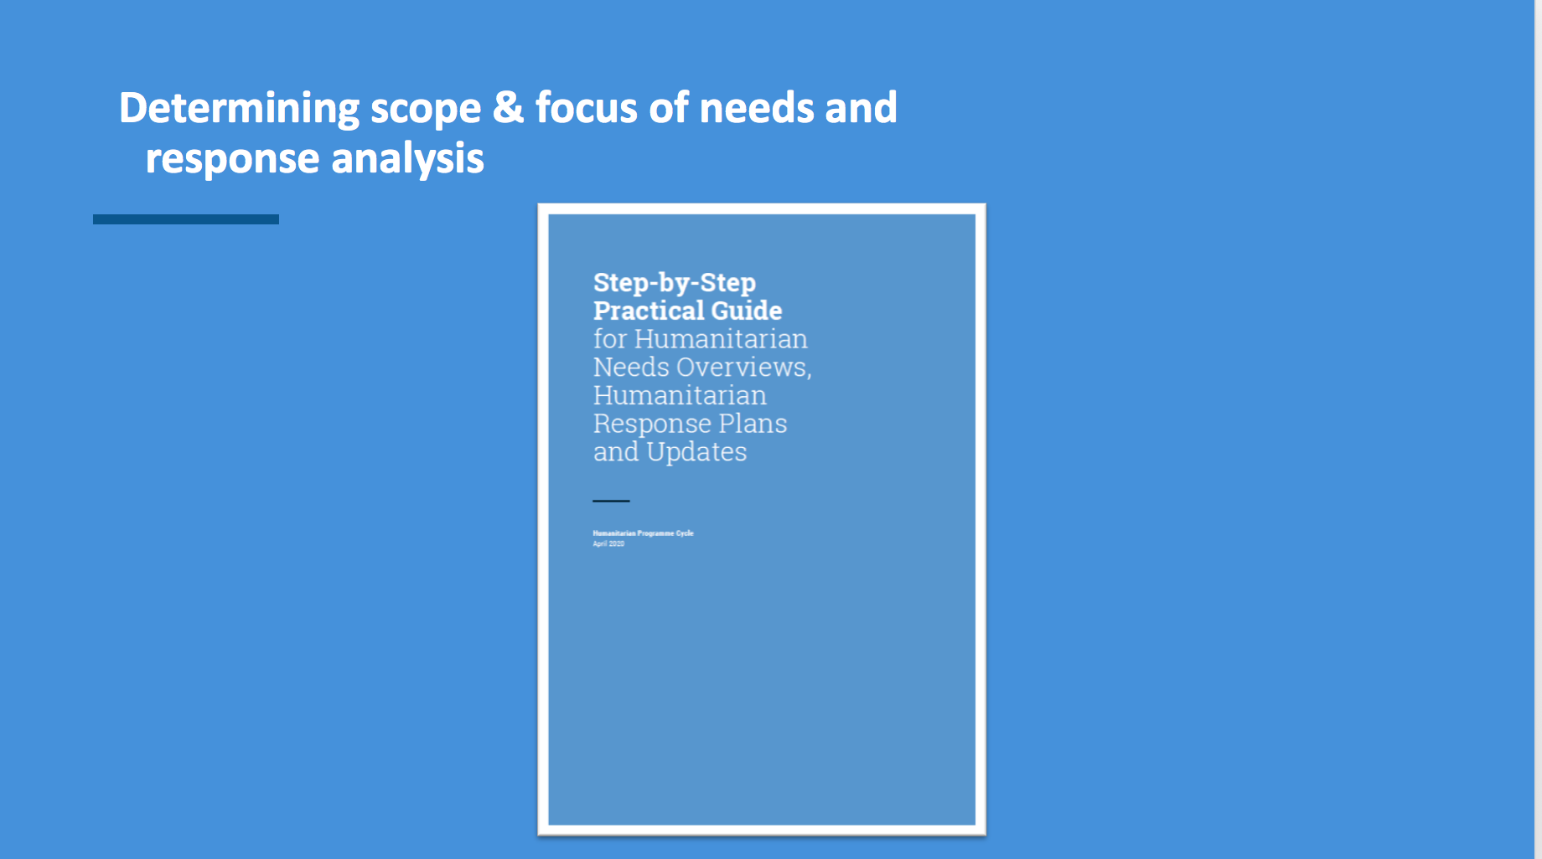

Slide 8
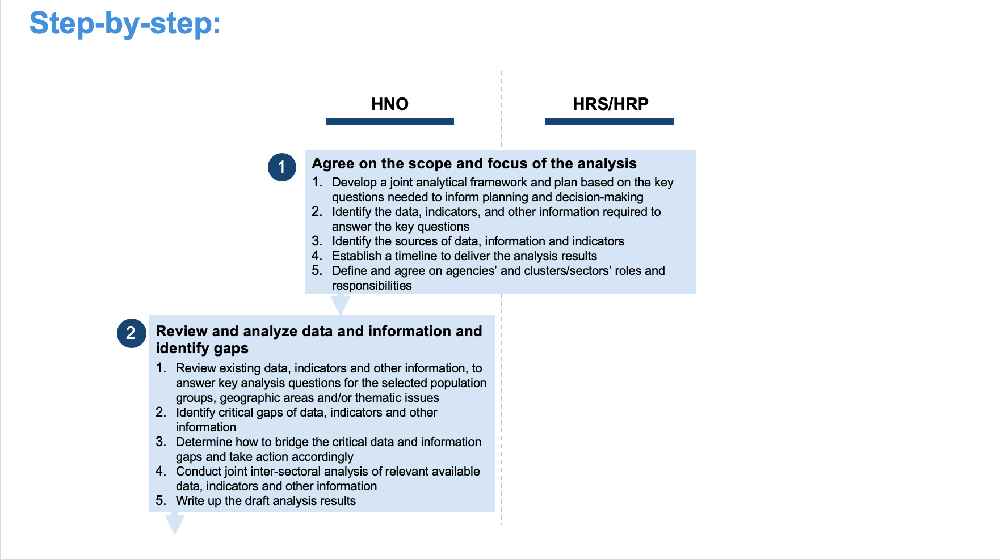

Slide 9
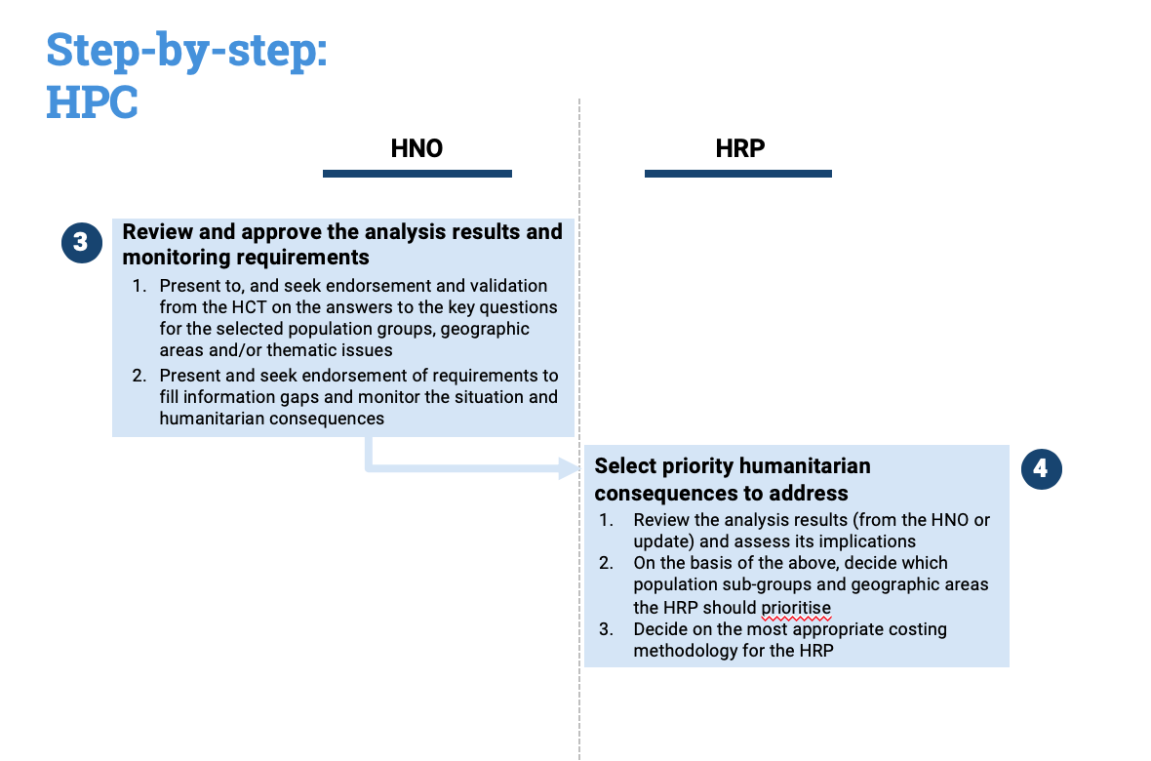

Slide 10
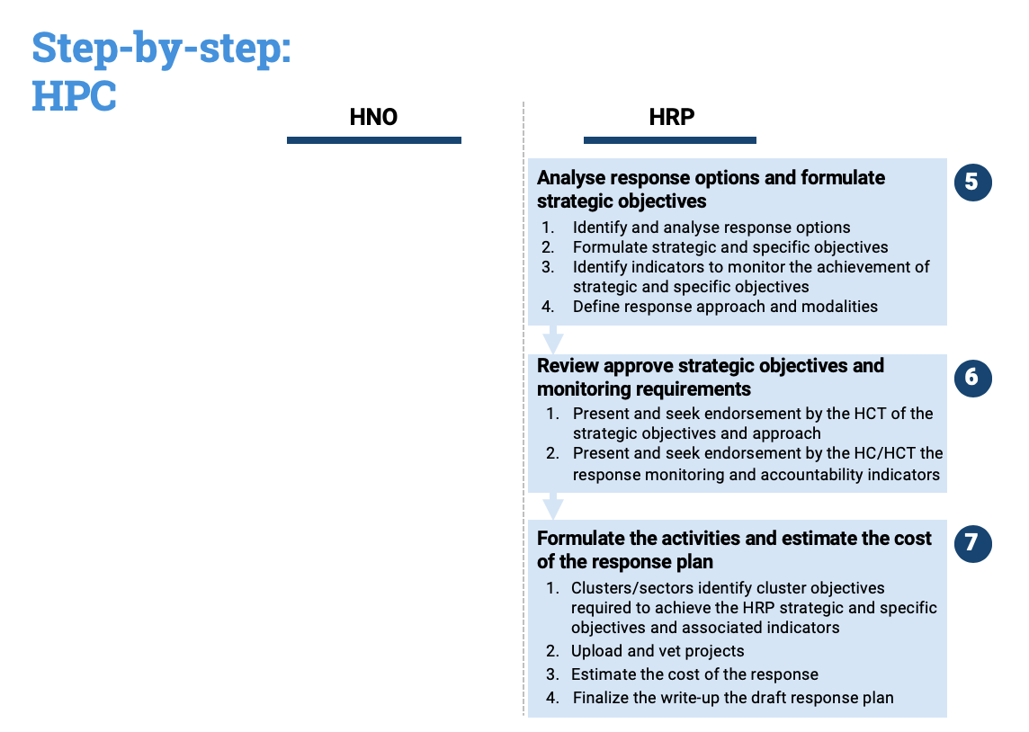

Slide 11
CHANGES IN ENHANCED HPC
Before | Now | Implication for nutrition cluster needs analysis ,prioritization and response planning’
Producing sectoral analyses, then consolidating to produce an overall picture of the situation | Greater depth and breadth of analysis, done jointly with partners and through an inter-sectoral lens showing inter-relationships between needs/causes | Clusters should adopt use of the joint inter-sectorial analysis framework in HNOs to outline the multi-sectoral nature of needs and their causes.
Disaggregation often only by gender and only at national level. Very limited or no analysis of how the crisis affects different vulnerable groups differently | Analysis of the differential impacts of the crisis for diverse groups of people (i.e. disaggregation by gender, age, disability and other diversity characteristics) | At a minimum, analyze and: disaggregate by gender, age and categories (disability) Use planning assumptions, such as the global estimates for persons with disabilities (15% of the population) where reliable data is not available

Slide 12
Before | Now | Implication for nutrition cluster needs analysis ,prioritization and response planning’
Limited or no data on disabilities meant no analysis and occasional mainstreaming | New guidance on mandatory disabilities mainstreaming (not only disaggregation). Where no data exists, the 15% international standard is to be apply | New guidance on disability inclusion should be fully utilized in the HNO and HRP. Planned assessments should include disaggregation by disability, in addition to age, gender and population type at a minimum.
AAP seen as an activity in the HRP rather than informing our analysis. | Ensuring the perspective of affected people is reflected in the situation/needs analysis and subsequent plans | AAP fully in-cooperated in the HNO based on sound joint analysis and reflected in the HRP

Slide 13
Before | Now | Implication for nutrition cluster needs analysis ,prioritization and response planning’
Consider immediate causes of needs to tailor the response | Also capture chronic and structural causes, as well as emerging risks to better define immediate and acute versus longer term needs (linking humanitarian and development) | Nutrition Cluster should seek to understand the holistic causes and drivers for malnutrition (structural, chronic and immediate), the level of severity and likely evolution to allow and effective response with linkages to development interventions
Monitoring systems focus on monitoring activities and outputs of the humanitarian response plan | Monitoring systems must follow changes in the humanitarian situation and needs, and show progress towards outcomes | The monitoring data, indicators and other information that the Cluster will regularly collect and analyze should be share to feed into/inform the joint inter-sectoral monitoring.

Slide 14
Before | Now | Implication for nutrition cluster needs analysis ,prioritization and response planning’
Inconsistent and un-transparent calculation and prioritization methodologies | Prioritization of needs based on calculation of severity using measurable indicators and clear methodologies | Clear methodology explaining Severity ranking The severity indicators selected( GAM,SAM rates, coverage, IYCF indicators, etc.) The severity categories and thresholds (critical, seriousness. ) The geographic unit /population groups used for severity ranking (District, Governorate ,IDPs) PiN and Target The NiE people in need calculation Assumptions/considerations and how estimates are done The proportion of PiN targeted and the rationale

Slide 15
Before | Now | Implication for nutrition cluster needs analysis ,prioritization and response planning’
The Protection cluster produced an overall analysis that gave insufficient visibility to specificities of the 4 AoRs. | Increased analysis and visibility for Areas of Responsibility (AoRs) under the Protection Cluster, including Child Protection. AoRs can now have their own separate People in Need calculation and severity mapping. | Indicators to define these will be agreed upon at inter-cluster technical level. Active and analytical participation in this process is essential for Nutrition Cluster.
The HNO served as a loose reference to inform the HRP | Direct link between HNO and HRP. Activities in the HRP (including their location and target groups) MUST address the priority needs identified in the HNO. | Change language to be used in the HRP with very clear links to HNO
Notes:
^{Protection AORs}
> AGE, GENDER, DIVERSITY
> CASH-BASED INTERVENTIONS TOOLS FOR IDP PROTECTION
> CHILD PROTECTION
> DROUGHT, FAMINE, CHOLERA AND DISPLACEMENT
> GENDER BASED VIOLENCE
> HOUSING, LAND AND PROPERTY
> HUMAN RIGHTS IN HUMANITARIAN ACTION
> LAW AND POLICY ON INTERNAL DISPLACEMENT
> MINE ACTION
> PROTECTION IN NATURAL DISASTER
> PROTECTION MAINSTREAMING
> PROTECTION OF CIVILIANS

Slide 16
Before | Now | Implication for nutrition cluster needs analysis ,prioritization and response planning’
Criteria for prioritizing often not only on the basis of severity of vulnerability and need (e.g. presence, access, agencies interests…) | Criteria for prioritizing physical and mental well-being (related to survival); living standards and self-sustenance capacity; recovery and resilience. | Mandatory inclusion the 3 criteria for prioritization to be reflected in HNOs. Nutrition specific indicators for this???

Slide 17
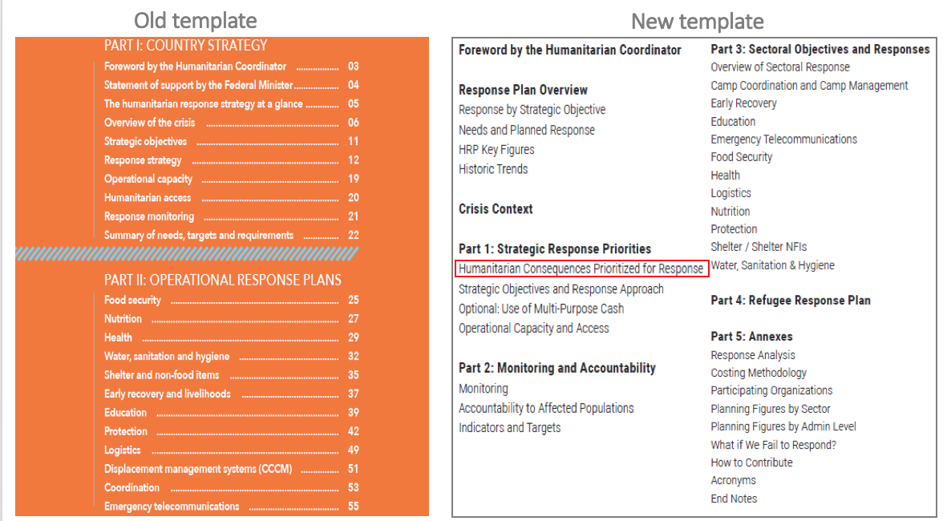
Notes:
Old HRP template: Ad hoc and non-systematic reference to HRP boundaries/priorities under Strategic Objectives, response strategy etc.
Revised template: one specific section to articulate priorities and rationale/criteria. Can visually be read in
HRP prioritization now clearly picks up from HNO analysis thread
approach crystalizes prioritization criteria / thresholds
important to document criteria/assumptions for inclusion and exclusion
leverage prioritization effort for advocacy v-a-v donors and Governments

Slide 18
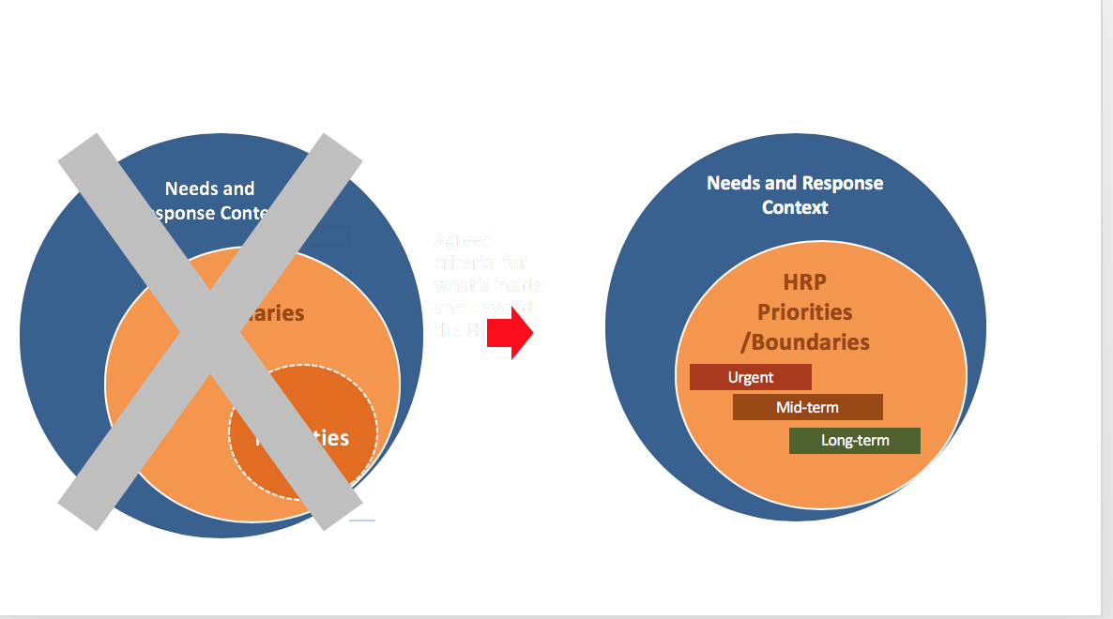
Notes:
Clear response boundaries = prioritized HRP. The HRP will include time-sensitive/urgent interventions but everything included has been prioritized and requires implementation/funding

Slide 19
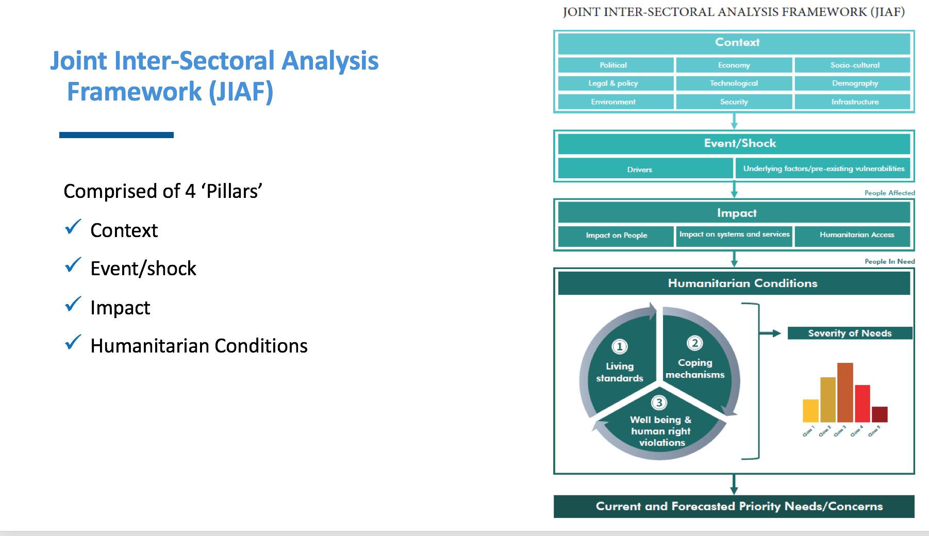
Notes:
Context: The environment in which humanitarian actors plan and operate.” HNO Annotated Template
“The environment and circumstances within which something happens and which can help to explain it. Understanding the environment and circumstances within which humanitarian crisis exists.” ALNAP
Events and Shocks: “An event/condition that disrupts the functioning of a community or society and causes human, material, and economic or environmental losses.” JIAF
Impact of Crisis: “Primary effects of the event/shock on the population, systems and services in the affected area.” HPC Step-by-step guidance 2020.
Humanitarian conditions are “the consequences are the effects of stresses and shocks on the lives and livelihoods of affected people, and their resilience to future negative events.” HPC Step-by-step guidance 2020

Slide 20
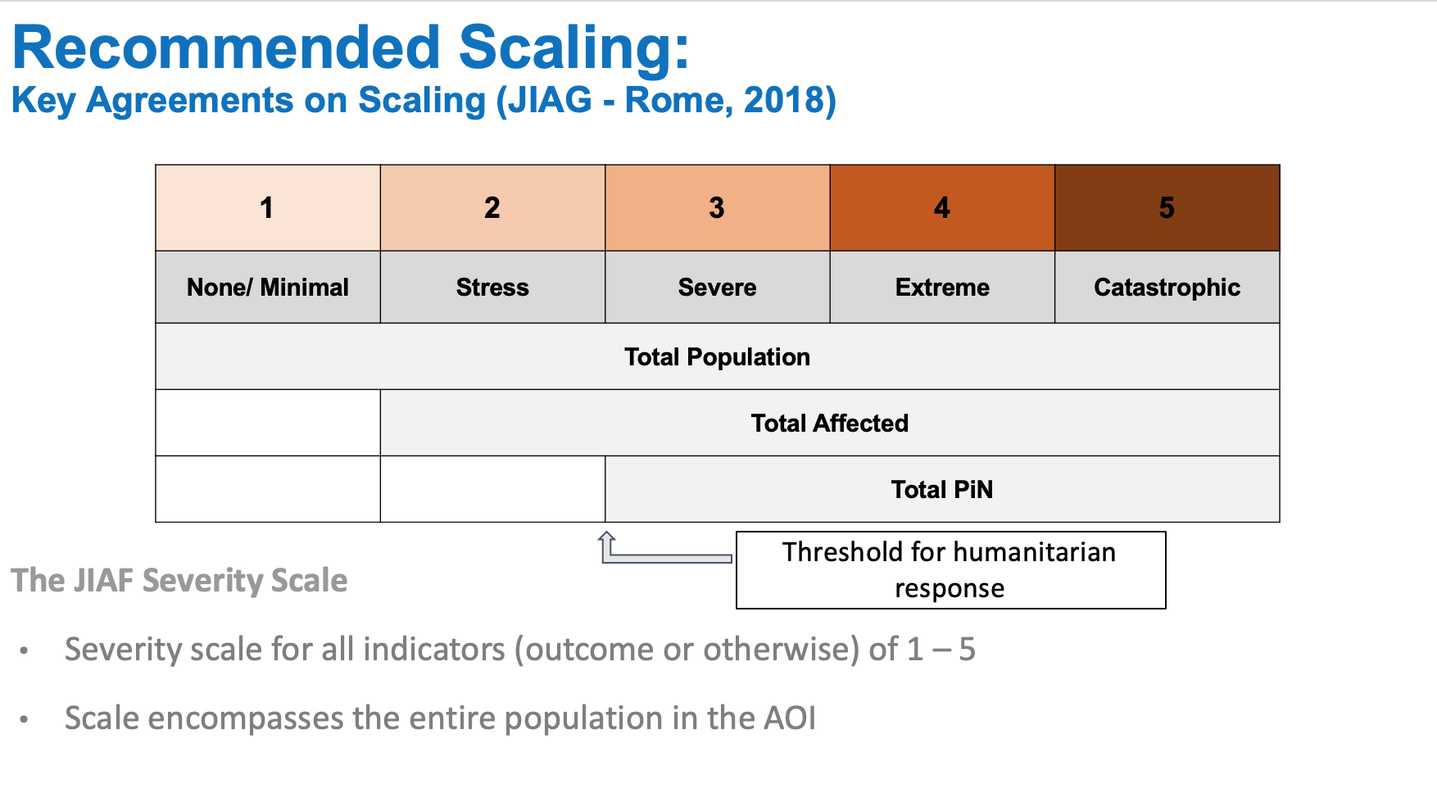

Slide 21
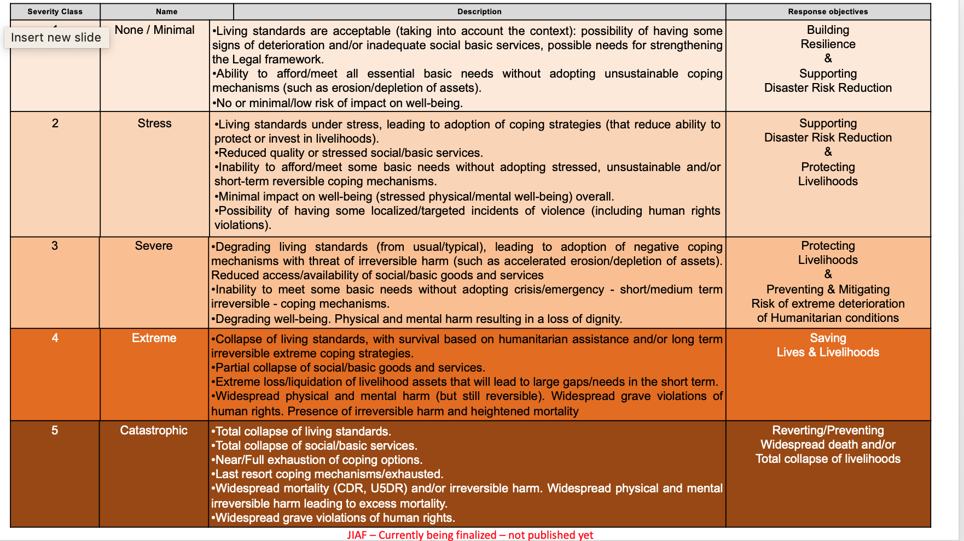

Slide 22
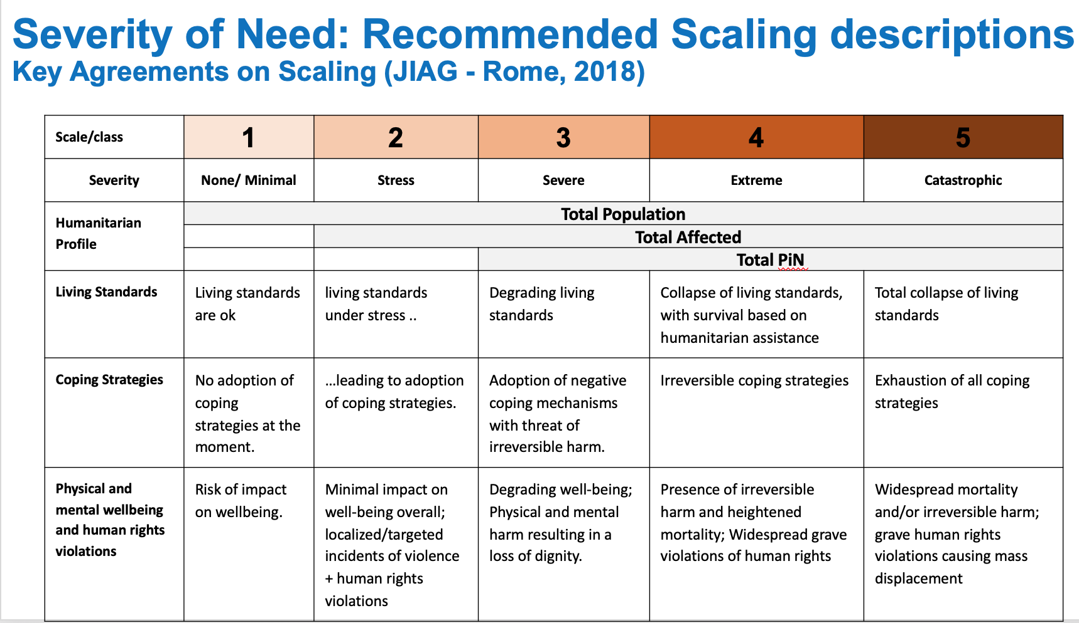

Slide 23
INTEGRATION OF DISABILITY IN HUMANITARIAN NEEDS OVERVIEWS
Include persons with disabilities as a sub-group and provide total estimated number of persons in need with disabilities
Analyze disability- related dimensions of vulnerability
Avoid focusing solely on need and vulnerability
Recognize the impact of intersectionality
Notes:
Include estimated number of persons in need with disabilities under Key Findings and Number of People in Need. In many contexts it will be difficult to collect primary data on persons with disabilities and secondary data may be unreliable- a global estimate of 15% of the population can be used in these situations. Where reliable data on persons with disabilities cannot be collected, highlight this as a gap under Information Gaps and Limitations.
Avoid creating lists of ‘vulnerable groups’ without analysis of what types of risks these individuals face, and why. Under Key Findings, Impact of the Crisis, Synthesis of Humanitarian Consequences and Sectoral Analysis, describe factors contributing to heightened risk for persons with disabilities.
Under Humanitarian Consequences Describe how the views and perceptions of persons with disabilities may differ from those of the rest of the affected population, any roles that persons with disabilities have in affected communities and how the coping mechanisms of persons with disabilities may differ from those of the rest of the affected population.
Recognize diversity among persons with disabilities. Identify individuals who face specific risks, describing how disability- related dimensions of vulnerability interact with other structural inequalities to increase or mitigate risk of persons in need

Slide 24
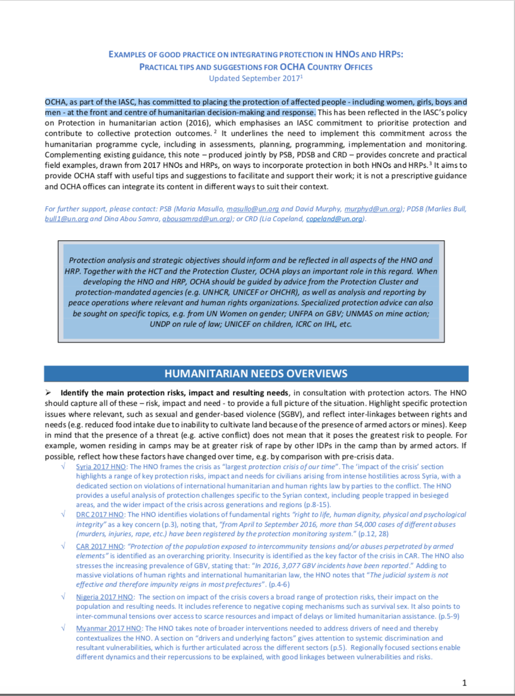
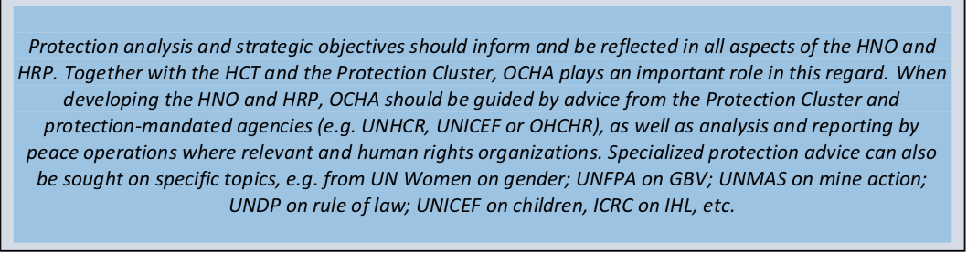
INTEGRATING PROTECTION IN HNOS AND HRPS
OCHA, as part of the IASC, has committed to placing the protection of affected people - including women, girls, boys and men - at the front and Centre of humanitarian decision-making and response.

Slide 25

Protection-Quick Definitions
Mainstreaming:
Centrality of protection in humanitarian response
All sectors take into consideration protection vulnerabilities and protection outcomes in their project planning
Integrated approach:
Recognises that vulnerably is multisectoral
Seeks to identify what indicators, relative to protection vulnerabilities other sectors are systematically collecting, How the indicators can be used to better understand protection issues and how the indicators can be used to to build a better response with other sectors.

Slide 26
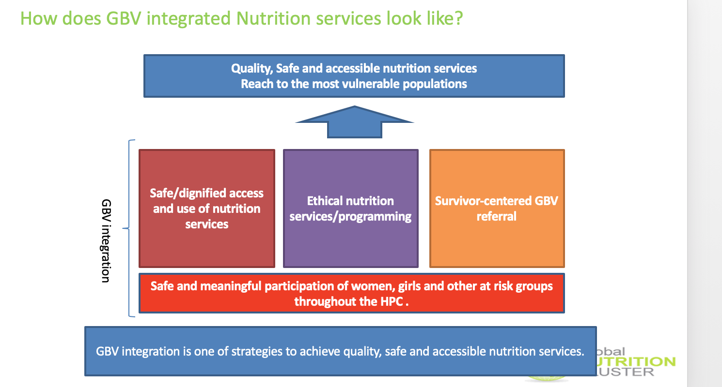
Notes:
It is part of centrality of protection:
GBV integration = GBV risk mitigation means ‘safe/dignified access and use of humanitarian services’, which means that services including facilities are safe and culturally acceptable so that the affected population i.e. women and girls can safely access and use humanitarian services. ‘ethical humanitarian services/programming’ which includes basic ethics i.e. PSEA, and GBV referral, all frontline workers are ready to refer a survivor who seek support to GBV services or other services in survivor-centered way. Then all these should be defined by participation of women/girls and other at risk group.
All these will contribute to quality programming and also help sector to reach the most vulnerable. GBV integration is a strategy to improve quality of programming and reach to the most vulnerable populations by considering these aspects. These aspects are also common to four key principles of protection mainstreaming: 1)Prioritizing safety and dignity and avoid causing harm, 2) ensuring meaningful access, 3) accountability and 4) participation and empowerment.

Slide 27
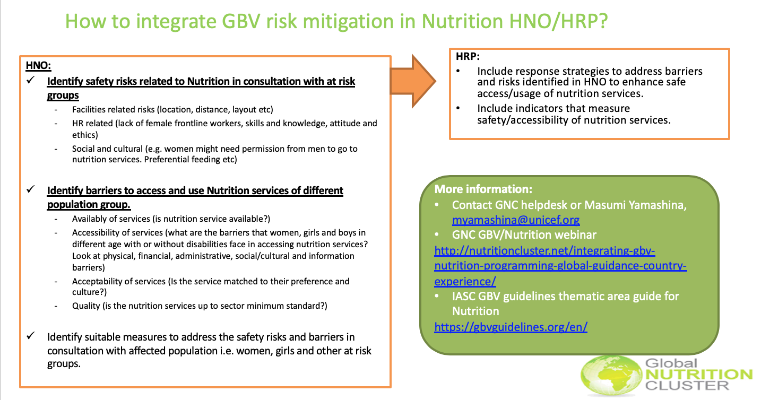
Notes:
Identify safety risks. examples
- Facilities related risks: nutrition facilities are too far away. No private space for breast feeding place etc.
- HR related: lack of female frontline workers. Frontline workers don’t know what to do if GBV survivors seek support from them. Frontline workers do not know their obligation of PSEA.
social and cultural: examples included in the slide.
Barriers:
AAAQ one pager. Consider barriers of care takers i.e. mothers who bring their children to nutrition services.
HRP:
Address barriers and risks. That’s why it’s important to do a good risk and barrier analysis so that nutrition actors can come up with good strategies. Make sure that relevant indicators are included as well. The example of indicators from Nigeria.

Slide 28
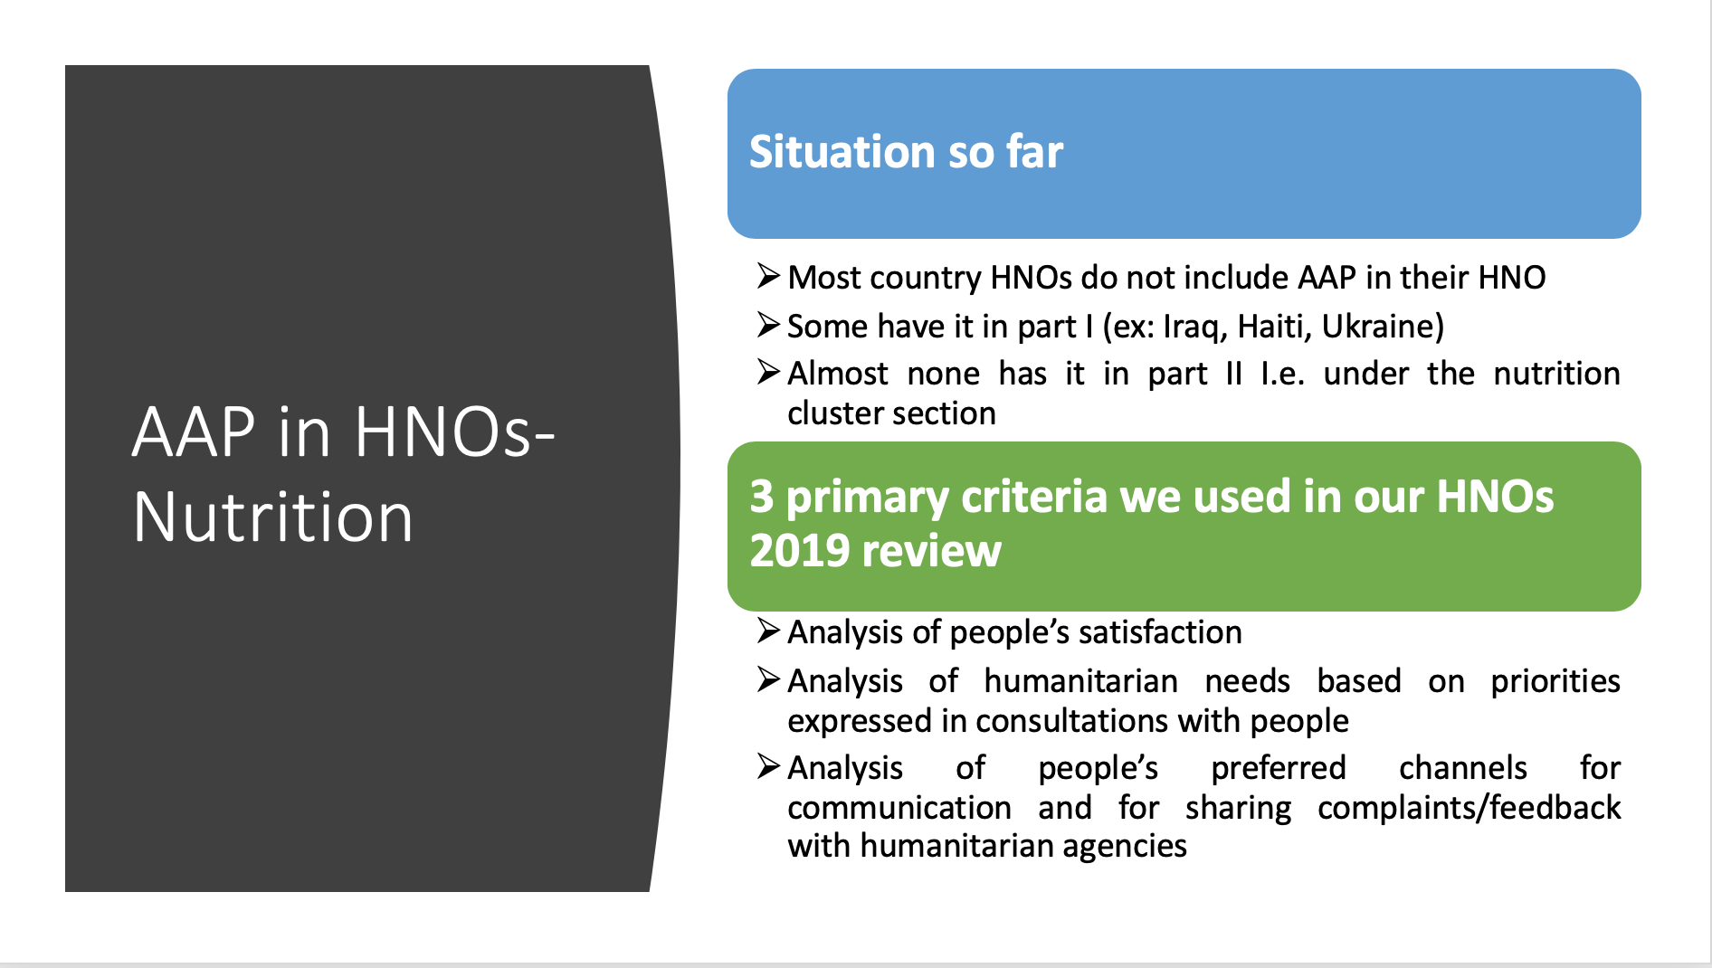

Slide 29
Recommendations for integrating AAP in MSNAs or assessments informing HNOs
Push for qualitative questions on AAP in needs assessment inform HNO (list available for you). Questions on:
  Information sharing: access to information, usefulness/relevance of info
  Participation/engagement in decision making about assistance
  Existing channels to communicate and provide feedback to humanitarian actors: existence of feedback systems, awareness about their presence, usefulness, trust, etc.
  Satisfaction with assistance
  Preferred information based on needs

Slide 30
Include an analysis of humanitarian priorities based on consultations with affected groups and not only from secondary data
Include an analysis of people’s preferred channels for communication channels and most needed information based on consultations or recent research/secondary data reviews
Analysis of feedback & complaints mechanisms: If feedback & complaints mechanisms exist in the country for Nutrition, an analysis of key issues raised through these systems and how the Nutrition cluster addressed them, what still requires work and efforts.
A “meaningful” analysis of people’s satisfaction with the Nutrition response including an analysis of reasons why they were not satisfied.

Slide 31
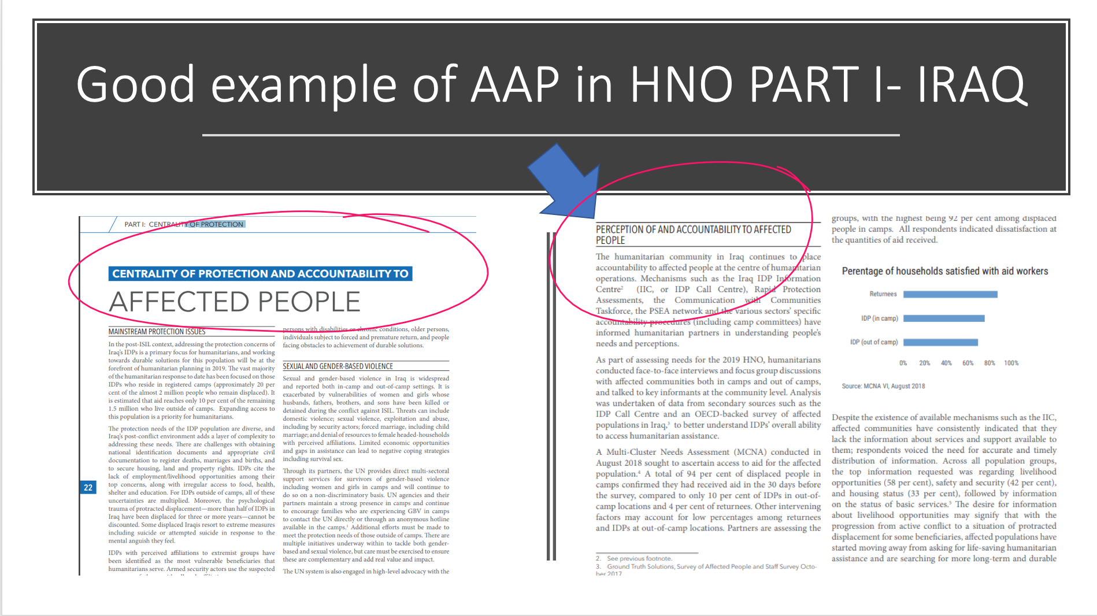

Slide 32
PBR Indicators for improving Humanitarian Coordination
High quality joint impartial and timely needs assessments. Increase the use and coordination of cash-based programming to deliver more efficient and effective responses. Manage risk more effectively, using risk analysis to target investment in emergency preparedness in high-risk countries and respond faster and better In protracted crises a common, multi-year and comprehensive response plan draws on the expertise of humanitarian & development actors. Role-model transparency on financing and operations. Focus on the protection risks of vulnerable people in assessment, planning and response Increase the accountability of humanitarian action by communicating with and seeking feedback from affected population.
Notes:
Definition of High quality:
1. Use of an up-to-date common risk assessment. Including, risk monitoring, MPAs, and when a specific imminent risk is identified APAs and contingency planning.
2. Alignment with the IASC Emergency Response Preparedness (ERP) and/or Preparedness Package for Refugee Emergencies (PPRE) guidance.
3. Integration into multi-year planning;
4. All plans must have coordinated budgets associated with them. Costing efforts done for standard key preparedness activities such as simulation, contingency planning, essential surge and pre-positioning requirements.
5. Alignment with and use of wider (disability, GBV, mental health etc) humanitarian guidance to inform minimum and advanced preparedness actions;

Slide 33
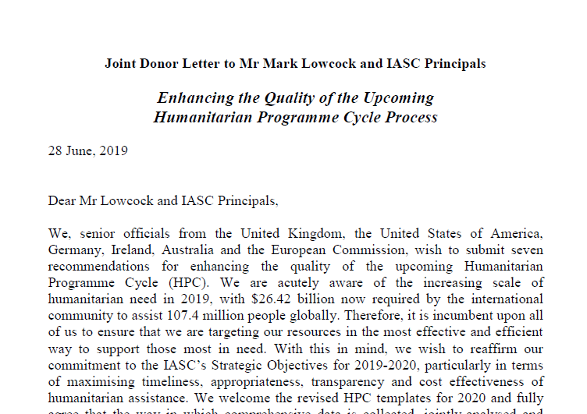
DONOR FUNDING FOR HRPs WILL BE DIRECTLY LINKED TO THE QUALITY OF THE NEEDS ANALYSIS AND PLANNING
Notes:
7 Areas of Focus
Better data and improved data collection
Improved Data Transparency
Strengthened joint needs analysis
Clear Response prioritization
Evidence costing methodologies
Enhanced Monitoring
Accountability to affected population

Slide 34
Asks
Countries to share there respective 2020 HPC Timelines with GNC Help Desk
Share drafts of developed HNOs and HRP to GNC Coordination Hep Desk for review before final submission.
Reach out to GNC Help Desk, in Country OCHA Focal Points and GNC thematic Focal persons for technical support on HPC

