Slide 1

Global Technical Assistance Mechanism for Nutrition
What does a good Infant and Young Child Feeding in Emergency intervention look like?
From assessment, to implementation and monitoring
Advice. Guidance. Expertise. Learning.
17th April 2019

Slide 2
Agenda
What type of assessments are recommended to collect data on IYCF-E?
What are the key indicators for IYCFE data collection?
Key aspects of an appropriate IYCF-E response
The checklist to run through once the emergency hits
How to be prepared for an IYCF-E response?
Monitoring tips and tools
Questions and answers

Slide 3

IYCF in Emergencies
Implementation
Checklists
Preparedness
Monitoring

Slide 4



Implementation
Protect, promote and support IYCF:
breastfeeding, complementary feeding, non-breastfed child
Notes:
Sphere 2018 says that priority interventions focus on:
breastfeeding protection and support;
appropriate and safe complementary feeding; and
management of artificial feeding for infants with no possibility to breastfeed

Slide 5

Implementation
MINIMUM KEY ACTIONS :
Establish an IYCF-E coordination authority
Include the specifications of the OGIFE on preparedness.
Support strong, harmonised, timely communication on IYCF-E.
Do not accept or solicit donations of BMS, liquid milk, bottles, teats

Slide 6
Implementation
HIV
MINIMUM KEY ACTIONS :
Prioritise PLWs for multi-sectoral service
Provide access to skilled breastfeeding counselling
Provide micronutrient supplements as necessary
Target newborns for early initiation and EBF
Prioritise vulnerable infants
PSS
Support timely, safe, adequate, appropriate CF
Provide appropriate BMS support
GBV
Notes:
As well as….PSS, HIV and Infant feeding, GBV support

Slide 7
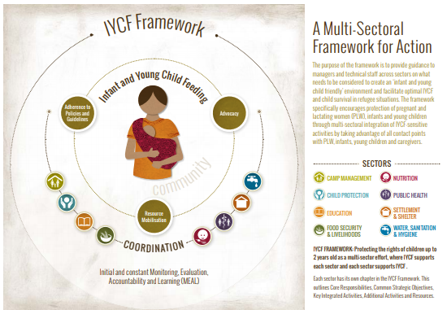
Implementation
Notes:
The Save the Children/UNHCR Infant and Young Child Feeding in Refugee Situations: A Multisectroal Framework for Action (2018)
https://www.humanitarianresponse.info/sites/www.humanitarianresponse.info/files/documents/files/unhcr_and_save_the_childrem_2018_iycf-e_-_multisectoral_framework_for_action.pdf

Slide 8
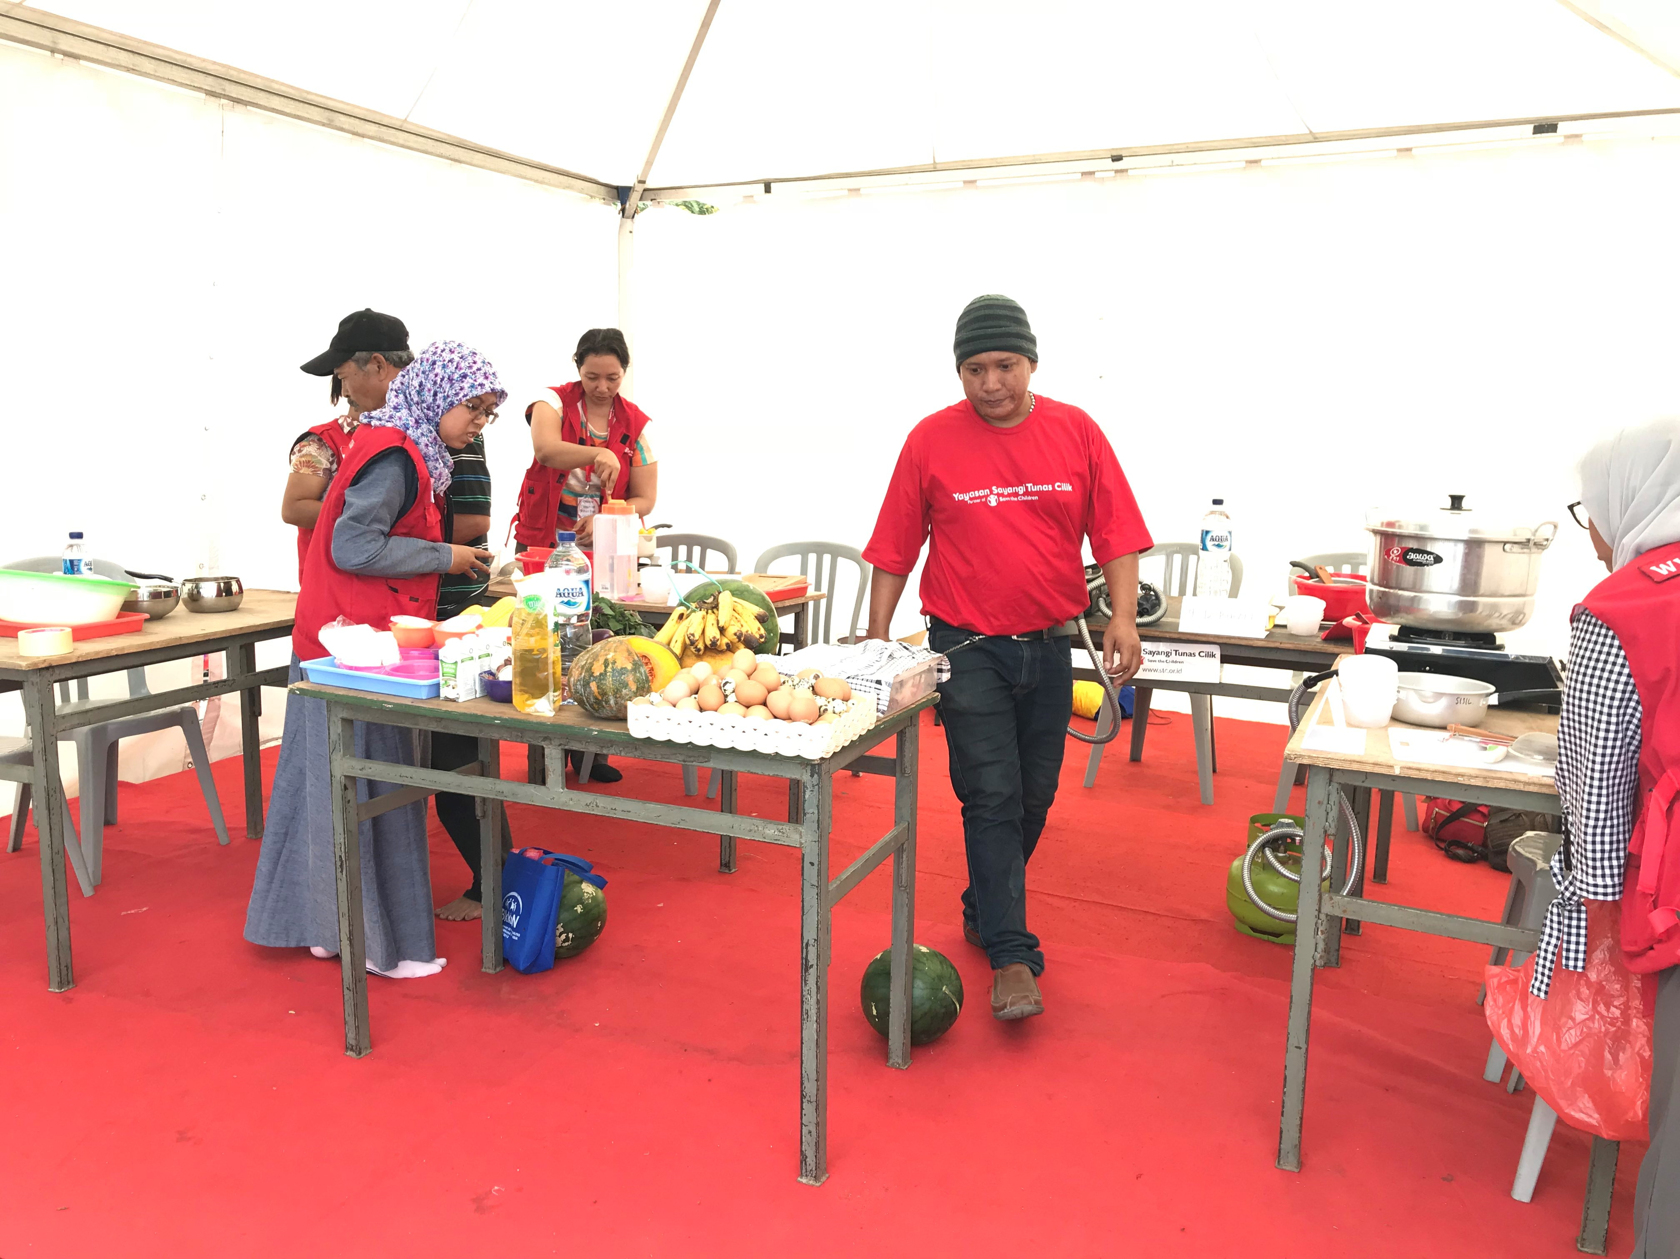
Implementation
Indonesia Response 2018
Complementary Feeding
Alice Burrell 2018
Notes:
With a minimum response that has many requirements, remember that interventions and approaches should always be context specific (e.g. displacement, drought, outbreaks). More details can be captured in the assessment phase such as particular practices pre-crisis and practices that have changed due to the emergency.
IYCF-E responses and approaches must be appropriated for the context. Interventions that may work in in one country or response, may not be appropriate in others.
Examples:
Complementary Feeding (cooking demonstrations) in Indonesia would not have worked in the Rohingya response where access to food was limited.
Interventions to support the Non-Breastfed Child in Bangladesh (Rohingya), Jordan, Europe, and Syria were designed differently for contextual relevancy, however each response had the same objective.

Slide 9
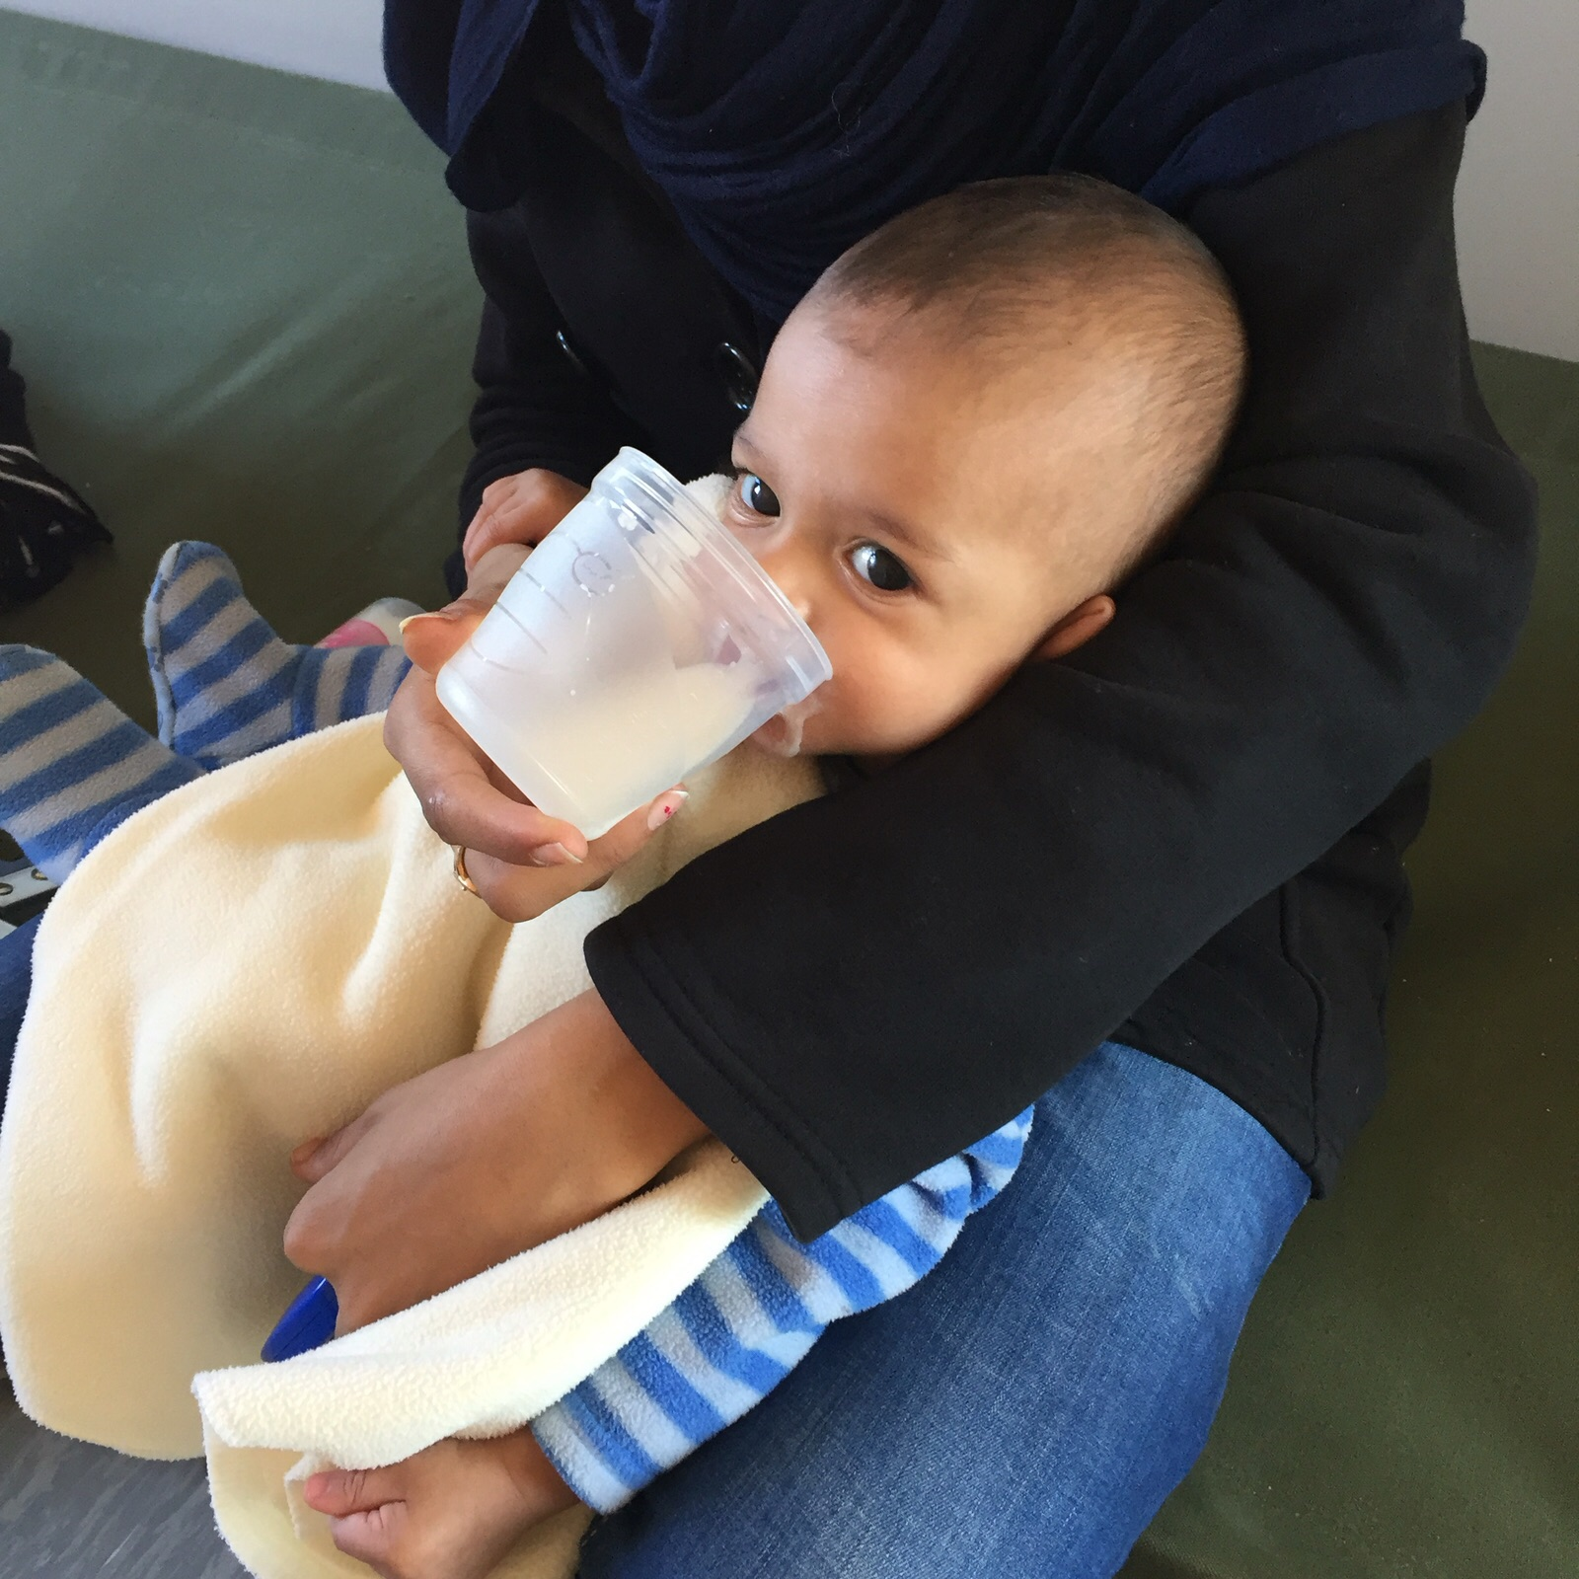
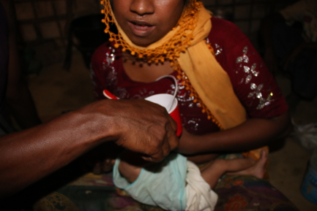
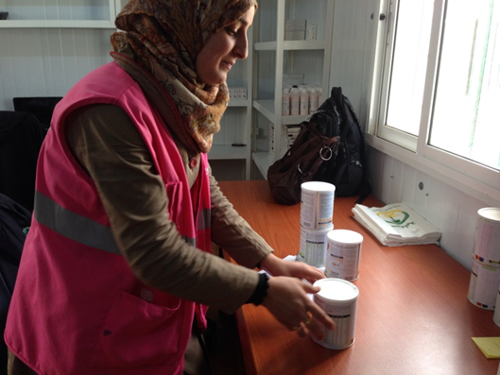
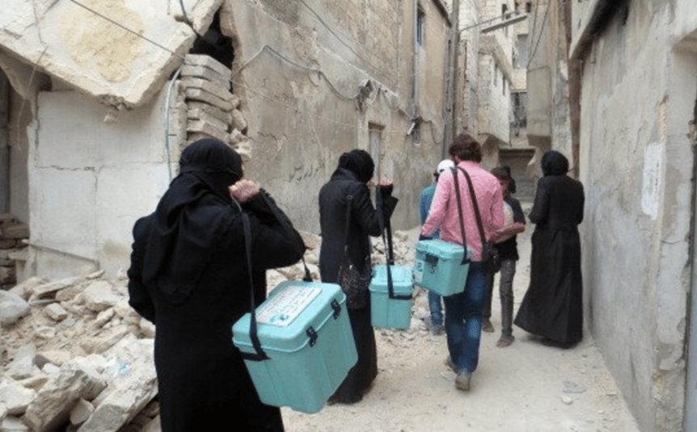
Implementation
Supporting the Non-Breastfed Child
Photo: Isabelle Modigell 2015
Croatia 2015
Photo: Alice Burrell 2017
Rohingya Response 2017
Photo: Christine Fernandes
Jordan 2014
Photo: Save the Children
Syria 2016
Notes:
With a minimum response that has many requirements, remember that interventions and approaches should always be context specific (e.g. displacement, drought, outbreaks). More details can be captured in the assessment phase such as particular practices pre-crisis and practices that have changed due to the emergency.
IYCF-E responses and approaches must be appropriated for the context. Interventions that may work in in one country or response, may not be appropriate in others.
Examples:
Complementary Feeding (cooking demonstrations) in Indonesia would not have worked in the Rohingya response where access to food was limited.
Interventions to support the Non-Breastfed Child in Bangladesh (Rohingya), Jordan, Europe, and Syria were designed differently for contextual relevancy, however each response had the same objective.

Slide 10

Implementation
Checklist?
Practical Steps:
Endorse of develop policies
Train staff
Coordinate Operations
Assess and Monitor
Protect, promote, and support IYCF with integrated, multi-sectoral interventions
Minimise the risks of artificial feeding
Notes:
Apart from miminum standards, use the practical steps of the OGIFE.
Use IYCF-E Toolkit for detailed guidance (how to). https://sites.google.com/site/stcehn/documents/iycf-e-toolkit-v3
OGIFE Version 3 Updates relevant for NCCs:
Emphasis on the lead role of government in preparedness and response
Some clarity on the respective roles and responsibilities of UN agencies
Emphasis of sectors beyond nutrition and more explicit actions to take
Incorporates accountability to affected populations
Reflects significantly evolved operational environment

Slide 11
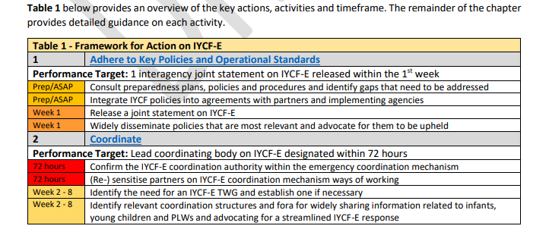
Implementation
Checklist?
Operational Guideline for Infant and Young Child Feeding in Emergencies for Bangladesh
Notes:
http://nutritioncluster.net/wp-content/uploads/sites/4/2018/10/201701-Bangladesh-IYCF-E-Guideline-Final-Draft.pdf

Slide 12
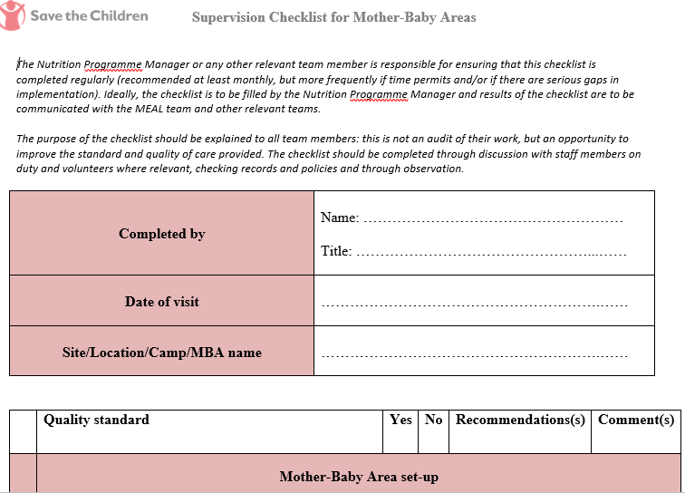
Implementation
Checklist?
Mother Baby Area Checklist, Save the Children IYCF-E Toolkit Version 3
Notes:
Checklist at activity level – includes ‘set-up’.

Slide 13
Implementation
Additional Suggestions:
Advocate/allocate funds specifically for an IYCF-E response
Keep it simple - Strategy or Action Plan for partners
IYCF-E Focal Point to support the response (agency, TWG lead, etc.)

Slide 14
Preparedness
‘Emergency Preparedness Actions’ in Operational Guidance 24-25
Relevant examples include:
Update relevant policies
(Joint Statement, BMS SOP)
Prepare rapid assessment Qs
ID and adapt M&E tools
Map existing capacities
Train partners to deliver on key response indicators
Calculate NBF infant prevalence
ID supply chain for BMS and CF
Establish links with other sectors
Develop IYCF situation profile
Coordinate Operations - see all
Notes:
Recommended ‘Emergency Preparedness Actions’ are now listed in the Operational Guidance version 3.
They are comprehensive and up-to-date and are referenced in the Sphere 2018.
NCCs – develop preparedness actions during emergency response; for spikes within protracted emergencies
Core Commitments for Children in Humanitarian Action, UNICEF
https://www.unicef.org/cholera/Chapter_1_intro/05_UNICEF_Core%20Commitments_for_Children_in_Humanitarian_Action.pdf, 2010

Slide 15


Monitoring
Assess the needs and priorities for IYCF-E response and
monitor the impact of IYCF-E interventions.
Output Indicators
To measure quality, coverage, and utilization of services and programmes
Outcome Indicators
To determine the effect of the interventions
Notes:
Sphere Standards 2018
OGIFE Version 3, 4.12 – 4.18

Slide 16
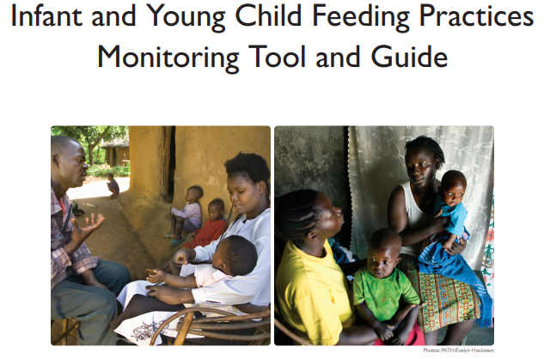
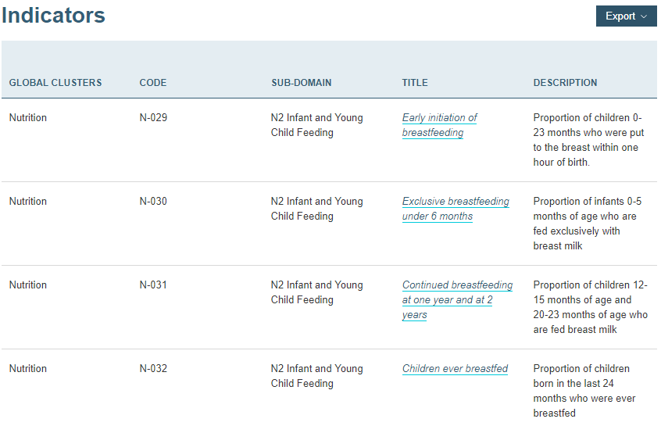
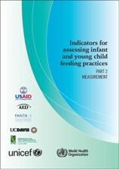
Monitoring
Outcome Indicators
To determine the effect of the interventions
Use global standard indicators + disaggregate
Representative Survey vs Feeding practices within a programme
Behaviour change indicators, consider time
Notes:
Humanitarian Indicator Registry https://ir.hpc.tools/
Disaggregate by sex; age (0-5, 6-11, 12-23 months) ; ethnicity; location (see 5.3 Operational Guidance).
Monitor and measure practices individually (behavior tracker before/during/after counselling, IYCF practices monitoring tool and guide for CHWs). This is not to replace a representative survey.
IYCF Practices Monitoring Tool and Guide (IYCN, 2011)
http://iycn.wpengine.netdna-cdn.com/files/IYCN_complementary_feeding_monitoring_tool_083111.pdf
Counselling Supervision Checklist and Guidelines (IYCN, 2011)
http://iycn.wpengine.netdna-cdn.com/files/FINAL-IYCN-Counseling-Supervision-071211.pdf

Slide 17
Monitoring
Output Indicators
To measure quality, coverage, and utilization of services and programmes.
Examples:
Primary caregivers receiving 1-1 IYCF-E counselling
H&N facilities with a dedicated IYCF counsellor
Primary caregivers (0-23 months) attending peer support groups (1st time and follow up)
Infants who have access to BMS supplies and support
Male participation in IYCF-E programmes
There are no global standard output indicators but guidance (4.14)
Use indicators agreed with the IYCF-E partners and technical experts
Include IYCF-E output indicators in the HRP
SC currently piloting minimum indicators to be standardized
Notes:
Humanitarian Indicator Registry https://ir.hpc.tools/
NCCs: Use indicators agreed with the IYCF-E partners and technical experts and contextualize for feasibility and partner’s capacity. Again, consider the context.
Disaggregation of age can consider 0-5, 6-8, 9-11, 12-24 for complementary feeding counselling.

Slide 18
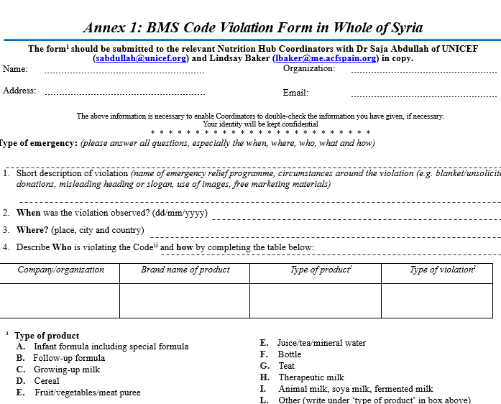
Monitoring
IYCF-E Coverage - OGIFE Semi-Quantitative Evaluation of Access and Coverage
Monitor Code (consider narrowing focus)
Monitoring Support Groups (Eg. UNICEF IYCF Community Counselling Package, Alive and Thrive)
Quality/Supervision (Checklists in WHO/UNICEF IYCF Guidance, IYCF-E Toolkit Version 3)
Notes:
IYCF Practices Monitoring Tool and Guide (IYCN, 2011)
http://iycn.wpengine.netdna-cdn.com/files/IYCN_complementary_feeding_monitoring_tool_083111.pdf
Counselling Supervision Checklist and Guidelines (IYCN, 2011)
http://iycn.wpengine.netdna-cdn.com/files/FINAL-IYCN-Counseling-Supervision-071211.pdf
Multi-Sectoral Monitoring and Evaluation Guidelines (ACF, 2016)
https://drive.google.com/file/d/0B4S4aIA1YfAXM1NuTjBibGJKLVE/view
IYCF-E Toolkit Version 3, Section H, Monitoring
https://sites.google.com/site/stcehn/documents/iycf-e-toolkit-v3

Slide 19
Monitoring
Percentage of adopted IYCF policies in emergencies that reflect the specifications of the Operational Guidance
No Code violations reported
Percentage of Code violations donations of breastmilk substitutes (BMS), liquid milk products, bottles and teats dealt with in a timely manner
Percentage of breastfeeding mothers who have access to skilled counselling
Percentage of caregivers who have access to Code-compliant supplies of appropriate breastmilk substitutes (BMS) and associated support for infantswho require artificial feeding
Percentage of caregivers who have access to timely, appropriate, nutritionally adequate and safe complementary foods for children aged 6 to 23 months

Slide 20

Monitoring
Don’t forget to LEARN - Document process along with outcomes

