Slide 1
Integrating Accountability to Affected Population in the Nutrition Cluster HPC
UNICEF AAP Team and GNC Coordination Help Desk
Geneva, Switzerland
August 26, 2019, 14.00-15.00 CET

Slide 2
Presentation Outline
What is AAP?
  Global definitions
  Practical definition
Why is AAP important for Nutrition cluster?
AAP in the Humanitarian Programme Cycle
  Preparedness
  Needs assessments and analysis and link to the HNO
  Strategic planning
  Resource mobilization
  Implementation & monitoring
  Evaluation
Country examples
  Somalia NC
  Myanmar Wash cluster
Overall Recommendations
Resources
Q&A

Slide 3
What is Accountability to Affected Population (AAP)?

Slide 4
AAP definitions
Accountability to Affected People (AAP) is the mutual responsibility aid providers and others stakeholders (donors, governments, etc.) to use their power and resources ethically and responsibly to "put people at the centre" of humanitarian actions. In essence, this simply means being accountable for making sure assistance generates the best possible outcomes for all different groups affected by a crisis.
IASC's and Core Humanitarian Standards definition of Accountability to Affected Populations (AAP) is: "An active commitment to use power responsibly by taking account of, giving account to, and being held to account by the people humanitarian organizations seek to assist” and as putting "communities and people at the centre of humanitarian action and promoting respect for their fundamental human rights underpinned by the right to life with dignity, and the right to protection and security as set forth in international law.”
Notes:
AAP is achieved through through consistently applying technical and quality standards, coordinating actions to maximise coverage and minimise risks, gaps and duplication, and listening and engaging with affected people and acting on their feedback

Slide 5
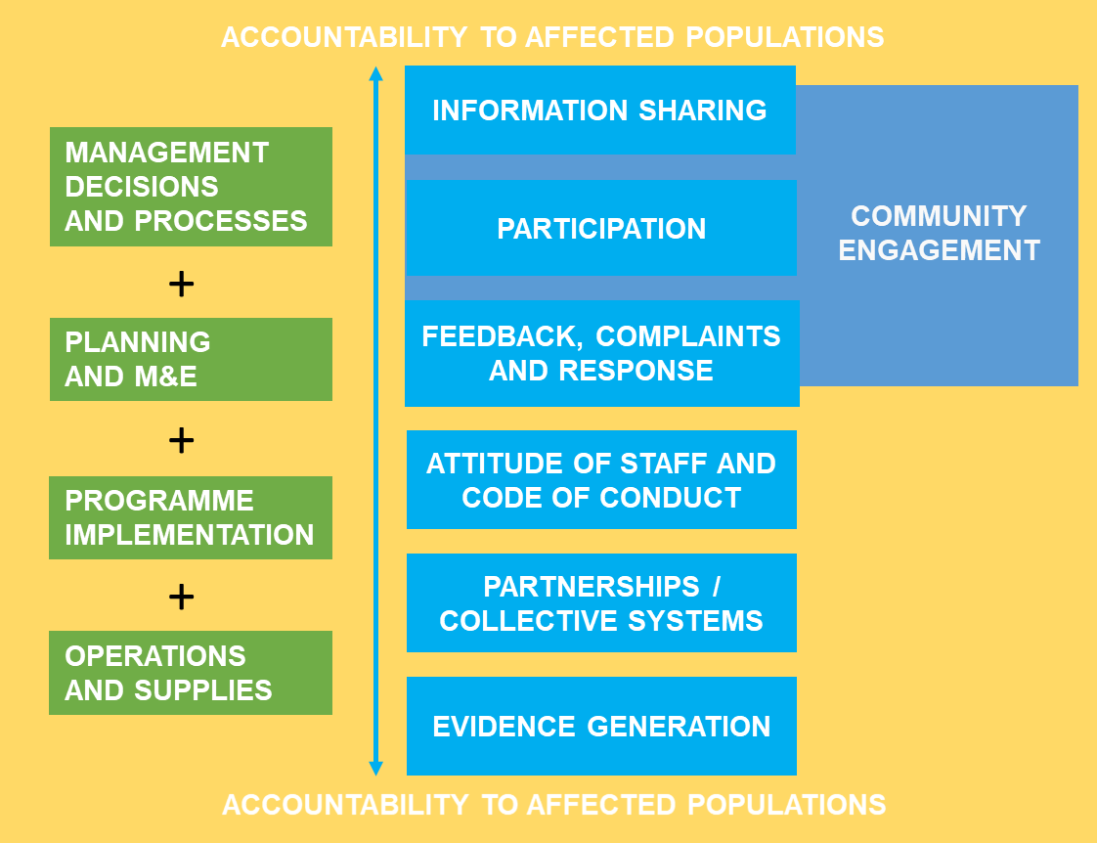
Practically, this means every organization looks at integrating accountability at many levels:

Slide 6

Why is AAP important for Nutrition Cluster?
Putting people at the centre of humanitarian coordination has become a major humanitarian criterium for donor funding and the collective humanitarian community, it is regraded as essential to an effective humanitarian response.
AAP helps ensure humanitarian coordination mechanisms and clusters are accountable for maximising the results and protecting the rights of affected people

Slide 7
AAP in the Humanitarian Programme Cycle

Slide 8
1. AAP in preparedness
Minimum Recommended AAP Actions
Identify partners’ AAP resources, learning and capacities
Review any existing preparedness plan (UNICEF, partners, IASC) and integrate them with an AAP lens in the cluster's situational analysis.
Identify in advance possible training, tools & resources to strengthen your own and cluster partner's knowledge and capacities for AAP
Additional key actions
Familiarise the team with the CHS and the updated Sphere standards and other quality and accountability standards, tools and resources
Participate in cluster coordinator and partner trainings, with a stronger emphasis on AAP
Consult with UNICEF Country and Regional Offices, cluster partners and other agencies like OCHA, IOM, UNHCR, ICRC for getting overviews on previous or existing country level AAP related interventions.
Review reports & evaluations from previous crises for insights on good AAP practice and community engagement, operational challenges, and the most effective and appropriate intervention strategies.

Slide 9
Setting the foundation for AAP in the cluster
What has worked well in other crises
  Make AAP a standing item on cluster meeting agendas
  Include AAP into the terms of reference of any Strategic Advisory Group (SAGs)
  Establish a specific Technical Working Group focused on AAP and community engagement
  Organise trainings or knowledge sharing workshop with partners and other clusters to share good AAP practices and strengthen AAP capacities
  Consider ways for affected communities and local actors to participate in cluster meetings.
  Plan regular joint field visits to communities to monitor the situation, share good practices and lessons learned, and find solutions to operational and AAP issues

Slide 10
2. Needs Assessment and Analysis
Cluster coordinators need to advocate for inclusion of AAP questions in all assessments including those informing HNO
The analysis of humanitarian priorities should be based on consultations with affected groups
Even in the most difficult and challenging environments, it is still possible to generate a "good enough" analysis of needs that includes the views and perspectives of affected people themselves.

Slide 11
Needs Assessment
Initial needs assessments are not always needed: enough existing data and information from secondary data reviews or other sources.
Look at secondary data: MSNA, HH level assessments, sector level assessments, PDMs.
Promote the use joint needs assessments if specific information gaps have been identified (e.g. views and perspectives of affected people)
Advocate that qualitative data about affected people's needs, priorities and concerns is collected as part of the assessment process, especially when people’s preferences and priorities can be overlooked or missing in the assessment
Make sure to include primary data sources with open ended questions on people’s priorities and preferences, even if in a “quick and dirty” way
Ensure that ongoing assessments to inform HNO include AAP questions
Regardless of the assessment tools used, clusters should agree on a simple set of common questions in the early stages of an emergency to identify: what people want and expect from aid providers, their needs, and any gaps or other issues that may require coordination with other clusters.
Notes:
Not every situation will require clusters to conduct an initial needs assessment at the outset of a crisis, as there may be enough existing data and information from secondary data reviews or other sources.
If specific information gaps have been identified, such as the views and perspectives of affected people themselves, you should promote the use joint needs assessments
As cluster members, you will need to advocate that qualitative data about affected people's needs, priorities and concerns are collected as part of the assessment process especially when people’s preferences and priorities can be overlooked or missing in the assessment.
Look into your secondary data: already existing assessments could include MSNA, HH level assessments, or sector level assessments, your PDMs .
Make sure to include primary data sources with open ended questions on people’s priorities and preferences, even if in a QUICK and DIRTY way
Ensure the ongoing assessments to inform HNO in your country, include AAP questions
Regardless of the assessment tools used, clusters should agree on a simple set of common initial questions in the early stages of an emergency to identify what people want and expect from aid providers, identify their needs, and any gaps or other issues that may require coordination with other clusters.

Slide 12
AAP Questions in needs assessments
Information sharing: Information aiming at understanding if households in need received quality, timely and relevant information using appropriate channels, language and in a transparent way
Core indicator:
% of households in need who have received quality information about existing humanitarian assistance in the last XX days/months
% of households in need who are sufficiently informed about how to access appropriate humanitarian assistance
Participation/engagement: assesses the extent to which the community was engaged in a meaningful way in the design of the humanitarian assistance
Core indicator: % of households in need who were engaged in a meaningful way in the design of the humanitarian assistance
Existing feedback mechanisms: assesses the extent to which the affected population accesses relevant, useful, friendly and appropriate feedback mechanisms.
Core indicator: % of households in need with access to functioning feedback mechanisms.
Satisfaction: assesses the degree to which the affected population is satisfied with the assistance received from aid providers
Core indicator: % of households in need who are satisfied with the assistance received from aid providers in the last XX days/months
Preferred information: refers to the type of information the affected population would like to receive
Core indicator: % of HHs who report XX as their preferred type of information
The recall period needs to be adjusted based on context

Slide 13
Nutrition Cluster Needs Analysis & link with HNO
HNO ANALYSIS SHOULD INCLUDE
Analysis of people’s preferred channels for communication channels and most needed information based on consultations or recent research/secondary data reviews
How do different groups prefer to receive information about aid
Is there a difference between women, men, children, people living with disability, etc.
What information is needed most
What are the barriers to access to services among different groups
What is the Nutrition Cluster going to prioritize?
Analysis of AAP systems in place
What AAP systems are in place? (AAP working group, community engagement strategy, feedback and complaints systems, collective and coordinate information sharing approach among partners, systematic briefing of the HC/HCT)
What have the feedback mechanisms and info generated from other AAP systems told us? What are the key issues raised by people in the previous response phase?
How did humanitarian agencies respond and what are the gaps?

Slide 14
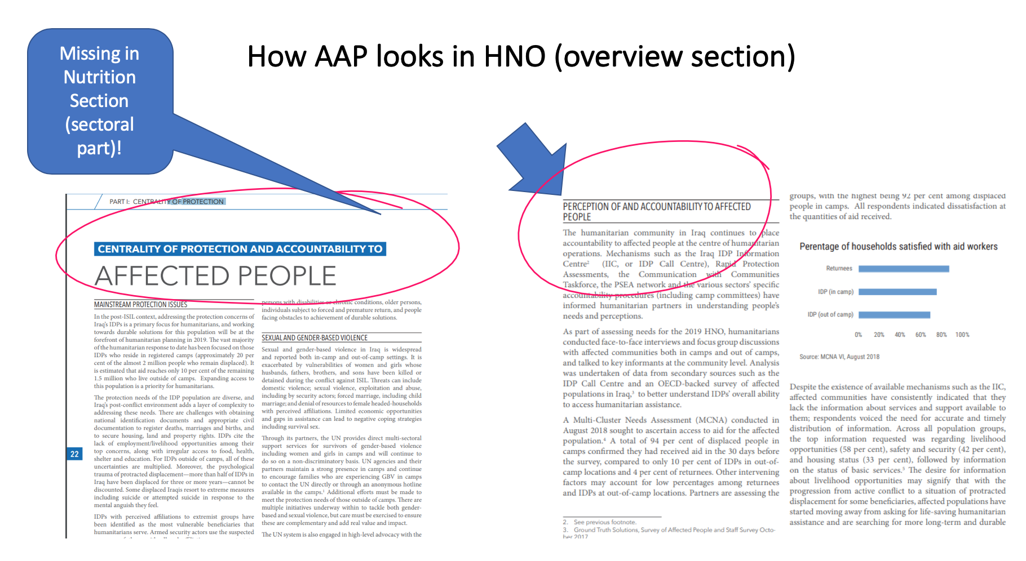

Slide 15
3. Strategic planning
Minimum Recommended AAP Actions
Include at least one AAP related strategic objective in the Cluster Strategy or Response Plan.
Define common cluster performance indicators related to response quality, consistency and accountability.
Include at least one indicator around affected people's satisfaction with responses, one on engagement of communities in decision making, and one on feedback and complaints identified and solved/responded to
Use AAP criteria to assess and review partner project proposals.
At the cluster level, the cluster will need to define its own Cluster Objectives and strategy, aligning them to overall HRP's Strategic Objectives
An explanation of how affected people have been consulted as part of the needs assessment and analysis process
The rationale for targeting and prioritising specific vulnerable groups in the population or geographic regions
Proposed interventions and how these have been informed by the views and perspectives of affected people
Proposed approach to consult and engage with communities and how feedback will be collected, analysed and acted
Define common technical and quality standards and benchmarks for all cluster partners. CHS to be adopted
Notes:
Partners project peer review criteria
Does the project reflect the expressed needs, concerns and priorities of the affected population?
Has the project been designed and validated with inputs from the affected population?
Are gender, age, disability and protection risks and other crosscutting issues fully considered and addressed in the project?
Does the project align with the HRP and cluster Response Framework priorities and objectives?
Are the gaps and/or duplication in coverage addressed
Does the project make a link to potential joint activities or integrated approaches with other partners or clusters, particularly around AAP?
Does the project apply agreed cluster technical and quality standards?
Does the project have a clear strategy for promoting community engagement, participation and feedback
Does the project have clear strategy for field monitoring and reporting including to Clusters and HCT, as well as feeding back to communities?
Does the project have a clear transition strategy that includes reinforcing and strengthening local capacity and resilience?

Slide 16
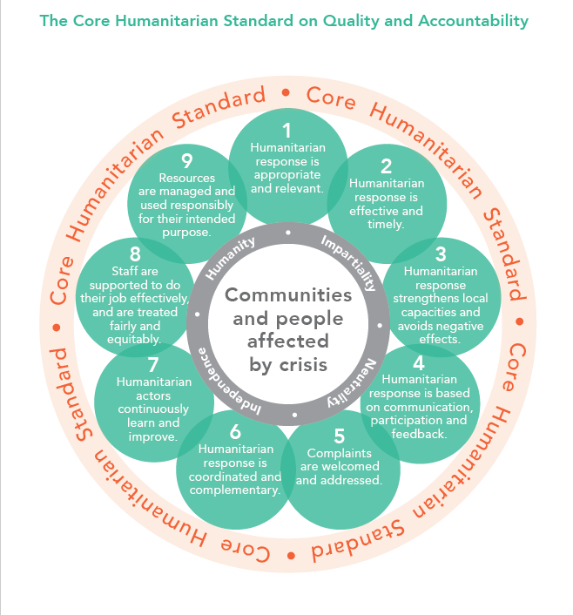
Quality and accountability standards- CHS

Slide 17
Inform communities early on about projects
Harmonising approaches among cluster partners and defining common key messages can reduce the risk of rumours, dissatisfaction, and misinformation and build trust with communities.
At a minimum, communities should be informed about:
Overall response goals and priorities
Specific program/project goals and objectives
Planned activities and deliverables, including start and end dates
Project budgets (with consideration of sensitive data)
Criteria used for selecting communities and participants
Organisational details about who are involved in project implementation and specific geographic locations of operations
Contact details, including how people can identify aid providers and provide feedback
Community members’ right to provide feedback and make complaints

Slide 18
4. Resource mobilization
Minimum Recommended AAP Actions
Use AAP criteria to review and assess funding proposals.
Ensure all partner projects include a budget for community engagement, participation and feedback mechanisms.
Include an overview of how cluster partners' projects address the expressed needs and priorities of affected people in all funding proposals and requests.
Promote the use and funding of joint or common platforms for clusters to engage with affected people, such as common feedback and response mechanisms.
Costs in terms of dedicated staff and resources to consider for AAP interventions could include
Conducting surveys and participatory needs assessments
Establishing joint or common feedback and response mechanisms
Production and dissemination of information and communication messages and materials
Monitoring of application of technical and quality standards
Peer reviews and joint learning exercises
Training of local and international partners on AAP standards and good practices
Support to local partners, staffing for coordination functions and reporting.

Slide 19
5. Implementation & Monitoring
MINIMUM RECOMMENDED AAP ACTIONS
Define a common approach on how clusters partners will engage with communities in implementation. Act on responses and complaints received from affected people, monitor trends and make changes to project as necessary
Define which relevant technical, quality and accountability indicators will be monitored. Accountability indicators to be based on the CHS.
Determine and develop the most appropriate approaches to feedback and complaints mechanisms and ensure all cluster partners have a functional system in place
Regularly monitor affected people's satisfaction with the quality and effectiveness of responses
Regularly review cluster performance to identify and resolve issues affecting coordination

Slide 20
Monitoring & reporting
Defining the most appropriate technical standards and good practices adapted to the crisis context (refer to CHS)
Monitoring and promoting consistent use of agreed quality and technical standards
Collecting, analysing and responding to monitoring data, including feedback from communities on a regular basis
Regularly share information with partners, teams on the ground, service providers and communities
Act on responses and complaints received and make course corrections and adjustments to intervention strategies and plans
Reporting back to communities and other stakeholder
Notes:
Monitoring Tools to Consider:
Collective or common feedback and response mechanisms
Joint monitoring, where 2 or more partners carry out monitoring activities in communities
Peer reviews, where 2 or more partners visit each others project to identify good practices and areas for improvement
Remote monitoring tools like SMS or other communication technologies for affected people to provide feedback on implementation
Common databases to register, analyse and aggregate monitoring and feedback data for the cluster and at the inter-cluster level
Third party monitoring, using independent organisations to monitor and benchmark programme quality and accountability of partners
Perception and satisfaction surveys that regularly assess the views of affected people on implementation

Slide 21
6. Evaluation
Minimum Recommended AAP Actions
Cluster and partner planning, monitoring and community engagement activities should be documented and available for evaluations
Evaluations should include direct consultation with affected people on their views on response quality, accountability and performance whenever possible
Evaluation findings and learning should be shared with communities, partners and other stakeholders

Slide 22

Country Examples

Slide 23
SOMALIA- NUTRITION CLUSTER
Large scale: WFP through call centers (hotlines/phone lines) and interactive voice response/recording (IVR)
Moderate scale: online facility that operates in few sites + random check on beneficiary experiences in routine M&E but no dedicates separate staff for AAP. This is called the MEAL approach
Minimum scale: all SNC partners were required to adopt it. Involves exit surveys with those discharged from programs.
Recommendations: community engagement strategy, collective feedback system rather than just WFP, joint MEAL among cluster partners, information sharing strategy with common key messages, wherever possible make sure there is connection between different feedback mechanisms of the different clusters
MYANMAR- WASH CLUSTER
Cluster facilitated the training of 50 cluster partners on AAP
Feedback and complaints mechanism in place with online dashboards
Referral to other sectors (protection and more) through the feedback system
HRP includes 2 indicators on AAP
AAP is part of the Sit rep
Inter-cluster community engagement strategy in place
Our Recommendations: Feedback and complaints system needs to be more collective currently limited to the two biggest partners, more work on community engagement needed in a tricky political context

Slide 24
Overall recommendations
Coordination on AAP interventions is key. Many hotlines among many NGOs in one geographical area is too confusing.
Cross sectoral feedback systems instead of sectoral ones are encouraged
IM capacity is essential to bring in various feedback systems together
If feedback systems remain sectoral, at a minimum there is need to establish a referral system with other sectors

Slide 25
AAP resources for GNC
Core Humanitarian Standards
Nutrition cluster operational framework on accountability to affected population
Global AAP guidance for integrating AAP in the HPC (New)
Guidance for Nutrition Cluster in Yemen
AAP in MSNA Questionnaire

Slide 26
THANK YOU!
QUESTIONS?

