Slide 1
Yemen Nutrition Cluster
Proposal writing session
24 January 2017

Slide 2
Agenda
09.00 - 09.15 Introduction and welcome
09.15 - 12.30 Session on the proposal writing
12.30 - 12.45 Briefing on the “Humanitarian Response Plan tips for nutrition interventions”
12.45 - 13.00 Briefing on the Humanitarian Indicators Registry: Nutrition Indicators
13.00 - 14.00 Lunch and prayer break
14.00 - 15.00 Session on the PCAs
15.00 - 16.00 Session on the FLAs
Note: coffee breaks will be included when time allows

Slide 3
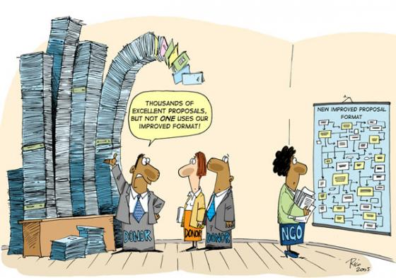

Slide 4
AGENDA
  INTRODUCTION
  BRAINSTORMING
  PROPOSALS WRITING
    CONTEXT ANALYSIS
    LOGFRAME
    RISKS AND ASSUMPTIONS
    BUDGET
  EXERCISE AND DISCUSSION
  ANNEX: ONLINE RESOURCES

Slide 5
TRAINING WORKSHOP INTRODUCTION
  This training seeks to:
Be participative
Focus on practical exercise and real-life discussion
Provide essential hints and guidance on how to improve the content and quality of proposals
  This training will not:
  Cover specific donors’ proposals: links will be provided
  Cover theory of change: it requires >1 day
  Donor reporting: it requires a separate training

Slide 6
PARTICIPANTS’ BRAINSTORMING
  WHAT ARE THE MOST FREQUENT COMMENTS YOU RECEIVE FROM DONORS AFTER THE PROPOSALS SUBMISSION?

Slide 7
PARTICIPANTS’ BRAINSTORMING
  WHICH CHALLENGES DO YOU FACE WHEN WRITING PROPOSALS?

Slide 8
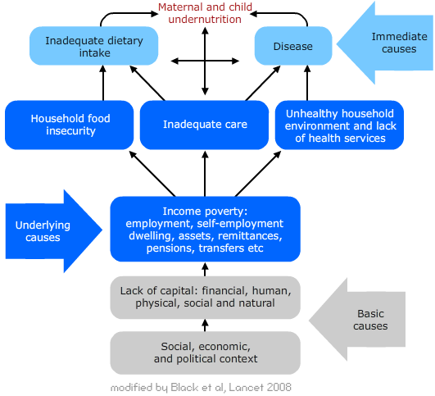
Needs analysis: UNICEF conceptual framework on malnutrition

Slide 9
CONTEXT ANALYSIS: STRATEGY
Consult Cluster Response plans and Cluster information products for:
  Agreed package of nutrition interventions
  Agreed modalities to deliver interventions
  Priority locations
  Current and future gaps
  Nutrition Information
Criteria to select the strategy of response: relevance, likelihood of sustainability, resource availability, complementarity with other partners
How to address immediate and underlying causes of malnutrition
Do not reinvent the wheel: refer to standards agreed among partners (including costs and modality of implementation)
Learn from the past and present response

Slide 10
NC agreed minimum package of interventions
CMAM (screening and referral, TFCs/SCs, OTPs, TSFPs for children and PLW, mobile clinics in hard to reach areas)
BSFP for PLW in children in priority districts
MNP distribution is areas not reached through BSFP
IYCF counselling (IYCF corners, capacity building, delivery rooms, outpatient care, TFC/OTP/TSFP, CHVs, integration with other sectors)

Slide 11
Do not forget!
Capacity building for all interventions if required
Supplies management
Reporting
Monitoring and Evaluation, including DHO/GHO visits
Government role, cluster role
Protection, including GBV
Age and Gender disaggregation and analysis
AAP

Slide 12
GROUP WORK
  HOW YOU SHOULD INVOLVE
  CLUSTER PARTNERS
  CLUSTER COORDINATOR
  GHO
  IN PREPARING YOUR PROPOSALS?

Slide 13
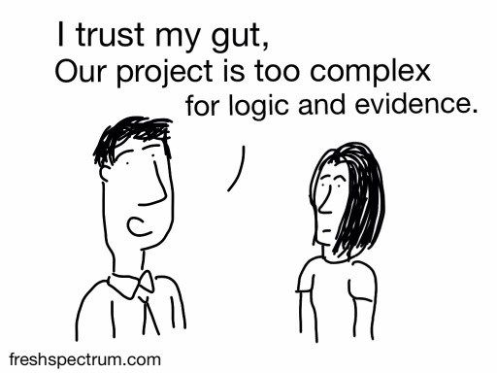
LOGFRAME

Slide 14
CONTENTS OF A LOG FRAMEWORK
A log frame summarises, in a standard format:
What the project is going to achieve?
What activities will be carried out to achieve its outputs and purpose?
What resources (inputs) are required?
What are the potential problems which could affect the success of the project?
How the progress and ultimate success of the project will be measured and verified?

Slide 15
LOGFRAME: OVERVIEW AND SEQUENCE
IMPACT
(OVERALL OBJECTIVE)
OUTPUTS
(EXPECTED RESULTS)
ACTIVITIES
(INPUTS, MEANS, PROCESSES)
OUTCOMES
(SPECIFIC OBJECTIVES)
EVALUATION
RISKS AND ASSUMPTIONS
MEANS OF VERIFICATION
MONITORING

Slide 16
LOGFRAME: IMPACT/OVERALL OBJECTIVE
Strategy of Intervention | Key Performance Indicators
Improvements of a situation responding to needs of the target population under a long-term vision. | Indicators which can be measured or at least described precisely in terms of quantity and quality and which show a change in situation.
Example of overall objective “1 million lives saved by 2018 in 22 target governorates of Yemen” | Example of impact indicator “% of life saved” “% of GAM reduction in Yemen compared to pre-crisis”

Slide 17
LOGFRAME: OUTCOMES/specific objectives
Strategy of Intervention | Key Performance Indicators
Intended situation at the end of the project in terms of gains in performance. It results from changes in knowledge & behavior. | Conditions at the end of the project indicating that the purpose was achieved.
Example of specific objectives “Improved access to and availability of nutrition services for the Yemen population in X governorate“ | Example of outcome indicator “% of population with access to quality CMAM programs”

Slide 18
LOGFRAME: OUTPUTS/EXPECTED RESULTS
Strategy of Intervention | Key Performance Indicators
Products and services produced or competences and capacities established directly as a result of project activities. | Measures of the quantity and quality of outputs.
Example of expected results “Improved understanding of IYCF and hygiene practices by caregivers of children 0-23 months” | Example of output indicator “# of PLW and caregivers of children 0-23 months received health education”

Slide 19
LOGFRAME: ACTIVITIES
Strategy of Intervention | Key Performance Indicators
Specific tasks performed using resources and methods in order to achieve the intended outputs. | Resources required to perform the planned activities and manage the project.
Example of activities “Train XX healthcare workers on CMAM” “Conduct SMART assessment in X governorate” | Example of process indicator “# of IYCF corners established” “# of SMART surveys conducted”

Slide 20
LOGFRAME: A FEW HINTS
Level of the log-frame | Hint
IMPACT | The achievement of the development objective lies outside the direct reach of the project and depends on the assumptions formulated at outcome level. However, outcomes should represent a relevant contribution to it. Impact Indicators are essentially used during evaluations.

Slide 21
LOGFRAME: A FEW HINTS
Level of the log-frame | Hint
OUTCOME | The attainment of outcome is primarily dependent on the project outputs, but depends also on factors beyond the project's control. Where projects or programmes have several components, formulate one outcome statement for each component. Outcome indicators are commonly used for project reviews and evaluations.

Slide 22
LOGFRAME: A FEW HINTS
Level of the log-frame | Hint
OUTPUT | Outputs are under the control/ responsibility of the project management. One output for each corresponding project component is recommended. Output indicators are predominantly used during monitoring and review.

Slide 23
LOGFRAME: A FEW HINTS
Level of the log-frame | Hint
ACTIVITIES | Usually, the log-frame should not comprise the entire list of project activities. The log-frame should focus on what the project is to deliver and not on how. The complete list of activities belongs to the narrative of the proposal and should be referenced by numbers to show the link between activities and results.

Slide 24
2018 HRP: Cluster Objectives
Reduce the prevalence of acute malnutrition through systematic identification, referral and treatment of acutely malnourished boys, girls under five and PLWs
Strengthen humanitarian life-saving preventive nutrition services for vulnerable population groups focusing on appropriate IYCF practices in emergency, micro-nutrient, BSFP interventions and optimal maternal nutrition
Strengthen capacity of national authorities and partners to ensure effective decentralised nutrition response
Ensure a predictable, timely and effective nutrition response through strengthening robust evidence based system and nutrition needs analysis and advocacy, monitoring and coordination

Slide 25
CO 1: CMAM
Number of children aged 0-59 mo with SAM admitted for treatment (70% of need)
Number of children aged 6-59 mo with MAM admitted for treatment (60% of need in 212 districts only)
Number of PLW with AM admitted for treatment (60% of need in 212 districts only)

Slide 26
CO2: prevention
Number of children aged 6-59 mo received vitamin A supplementation (90% of need)
Number of PLW and caregivers of children 0-23 months received IYCF counselling (60% of need)
Number of children 6-23 month received micronutrient supplementation (through MNPs or BSFP) - (60% of need)
Number of PLW received BSFP - (60% of need in 120 districts only)

Slide 27
CO 3: capacity building
Number of CHVs trained in nutrition (10,000)
Number of HWs trained in nutrition (5,000)

Slide 28
CO4: needs analysis
Number of SMARTs conducted (22)
No coverage assessments planned

Slide 29
LOGFRAME: A FEW HINTS
Level of the log-frame | Hint
MEANS OF VERIFICATION (MOVs) | How the information required for the indicator will be collected Avoid ‘wish lists’ (too many MoV, not linked to the indicators and activities). Focus on standardized MOV. Examples: Project documents: weekly/monthly report Verification by observation Ad-hoc studies or population-based surveys with representative sampling methods (MICS, DHS, SMART, KAPB) Project evaluation/ end line report

Slide 30
RISKS AND ASSUMPTIONS
RISKS
Negative statements about what might go wrong.
Examples Environmental, financial, fiduciary
ASSUMPTIONS
Positive statements about the conditions that need to be met if the project is to stay on track.
Examples Sufficient funding is available to allow implementation as planned. Health centres are accessible to the population in need.

Slide 31
Program indicators’ targets
Use population of catchment are per health facility
Use standard population distribution (i.e. % of U5, % of PLW, etc.)
Use standard formula for calculations (i.e. caseloads for SAM, MAM)
Apply standard coverage per intervention in line with cluster agreements

Slide 32
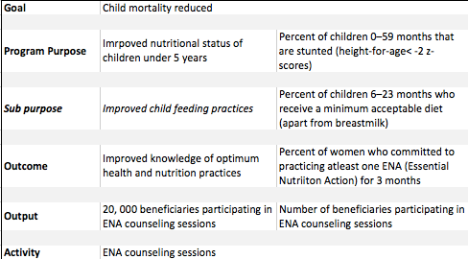
Log frame example
Nutrition Program Design Assistant: A Tool for Program Planners (NPDA) Reference Guide Version 2, Revised 2015
Notes:
SAY:
This log frame is not an exhaustive log frame but just an example. With a goal of “reducing child mortality”, the program’s purpose is to “improve nutritional status of children under five years”, an outcome of “improved knowledge of optimum health and nutrition practices” an output of “20,000 beneficiaries attending the ENA counseling sessions” and the “ENA counseling session” being the activity. Note that the purpose was subdivided into a sub purpose. This helped in further specifying our purpose. Also note that all indicators at all levels refer to percentages while only outputs have numbers.
Ask if participants can see an issue with this log frame? Answer: The program purpose is to reduce stunting but will a 3 months program (see Outcome) do this?
Of course this is taken as an example and program will have more than this, but highlights the importance of ensuring that what you suggest is REALISTIC and DOABLE!
Tell participants that there is a master IYCF-E log frame on the toolkit: https://drive.google.com/file/d/0B5uBNDhhrtqbY0xhTllHOUZXblk/view

Slide 33
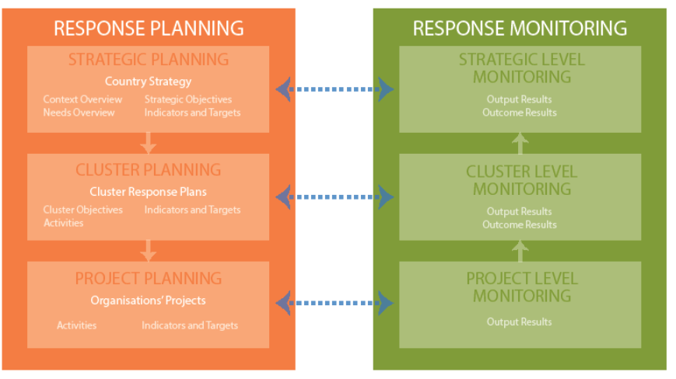
Relationship between response planning and monitoring

Slide 34
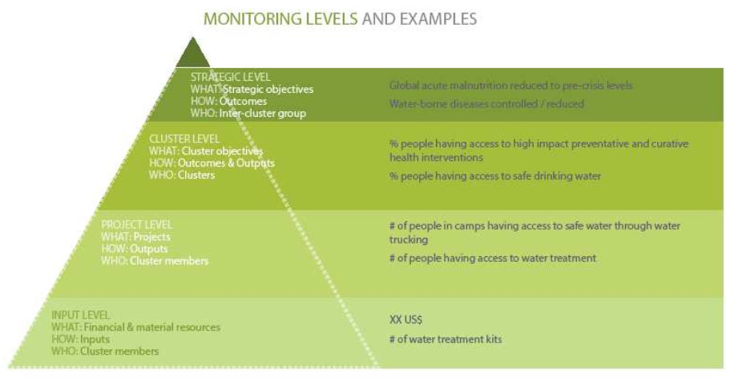

Slide 35
BUDGET-1
  Different templates from donors, BUT basic principles remain
  Use standard budget unless differently agreed with the donor
    Staff and other personnel costs
    Supplies, commodities and materials
    Equipment
    Contractual services
    Transfers and grants to counterparts
    Indirect project support costs
  Follow the standard budget structure
      Units and unitary costs
      Duration/number of units

Slide 36
BUDGET-2
  DOs
Clearly link budget to activities (inputs, targets) and adjust them to your actual needs
Budget activities according to actual/historical costs
Where feasible, use standardized costs recommended by technical agencies/partners
  DONTs
  Exceed 25/30% staff costs
  Budget components which are not linked to the project activities
  Budget funding needs under the wrong budget categories
  Different templates from donors, BUT basic principles remain
  Use standard budget unless differently agreed with the donor
    Staff and other personnel costs
    Supplies, commodities and materials
    Equipment
    Contractual services
    Transfers and grants to counterparts
    Indirect project support costs
  Follow the standard budget structure
      Units and unitary costs
      Duration/number of units

Slide 37
EXERCISE AND DISCUSSION
  Develop a log frame for the following projects:
  CMAM treatment
  IYCF program
  Outreach (health and) nutrition services
  TOTAL TIME FOR THE LOG-FRAME: 30 MINUTES

Slide 38
GENERAL ONLINE RESOURCES
SOURCE | LINK
CERF guidelines | http://www.unocha.org/cerf/resources/guidance-and- templates
DFID logframe guidelines | https://www.ukaiddirect.org/wp-content/uploads/2016/04/How-to-write-a-logframe.pdf
Operational handbook for country-based pooled funds
 | https://docs.unocha.org/sites/dms/documents/operationalhandbook.pdf
ECHO online training on proposals and budget preparation | http://dgecho-partners-helpdesk.eu/dl/start
RELIEFWEB, Yemen profile | http://reliefweb.int/country/yem
Risk register and risk analysis guidelines | https://www.humanitarianoutcomes.org/sites/default/files/ngo-risk_report.pdf
USAID guidelines on proposals writing | https://www.usaid.gov/what-we-do/working-crises-and-conflict/crisis-response/resources/guidelines-proposals

Slide 39
NUTRITION-SPECIFIC RESOURCES
Yemen Nutrition Cluster website: https://www.humanitarianresponse.info/en/operations/yemen/nutrition
HRP tips for nutrition interventions: http://nutritioncluster.net/resources/hrp-tips/
Nutrition Program Design Assistant: A Tool for Program Planners (NPDA). Reference Guide. Version 2, Revised 2015. (essential reading): http://dgecho-partners-helpdesk.eu/action_proposal/start
Humanitarian Indicators Registry: Nutrition https://ir.hpc.tools/en/applications/ir/indicators/global-clusters/9:
IYCF-E Toolkit:
C. Proposal Development
- Key Concepts: Overview of Proposal Development - https://drive.google.com/file/d/0B5uBNDhhrtqbdE9uYmN4SUpoS1E/view
- Annexes
      SC Log Frame https://drive.google.com/file/d/0B5uBNDhhrtqbY0xhTllHOUZXblk/view
      SC Master Budget https://drive.google.com/file/d/0B5uBNDhhrtqbYk50ZGVTaEFXN0k/view
- References – Guidelines and strategies.
Notes:
Note:
DG ECHO has also developed guidance for IYCF-E programming for its staff and partners. This is available at: http://ec.Europa.eu/echo/en/what/humanitarian-aid/nutrition
Previously DFID has endorsed the Operational Guidance on IYCF-E and on the years there has been a lot of advocacy with them. See in IYCF-E Toolkit, C. Proposal Development, References for various DFID strategies related to IYCF-E
The Global Nutrition Cluster (GNC) has developed tips for the Humanitarian Response Plan and it has a section on IYCF-E http://nutritioncluster.net/resources/hrp-tips/
This guidance has been developed by the Global Nutrition Cluster to support country nutrition clusters and nutrition cluster partners in preparing the Humanitarian Response Plans (HRPs). It provides tips for nutrition clusters to facilitate the planning of a collective response and the development of Nutrition in Emergencies (NiE) interventions by individual cluster partners. The HRP tips can also be used by other clusters to help guide of the inclusion of nutrition sensitive interventions in their respective sectoral plans.
Important remark: this document does not intent to prescribe to nutrition cluster coordinators or partners which kind of intervention is relevant in which context. A sounded country situation analysis must therefore be done before the development of the Humanitarian Response Plan. Once the specific sectoral objectives and type of emergency interventions have been agreed by nutrition cluster members, the HRP tips should be used as examples of how objectives, indicators and monitoring framework could be structured.

Slide 40


Acknowledgements
The session is largely based on the WHO training workshop on proposal writing and SCI IYCF-E training, session on IYCF-E proposals

