Slide 1
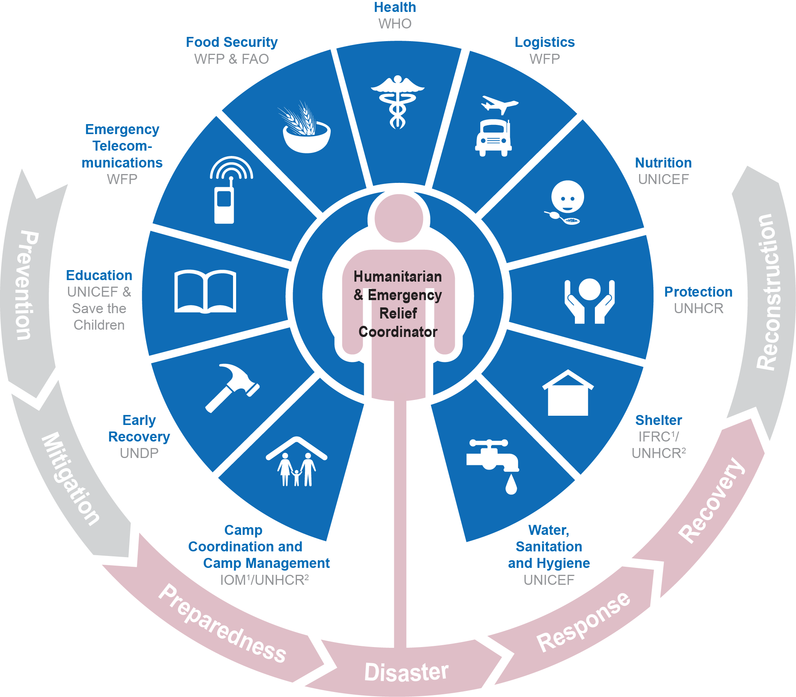
THE TRANSFORMATIVE AGENDA &
GUIDANCE FOR CLUSTER COORDINATION

Slide 2
AGENDA
IASC Structure
Transformative Agenda
  Cluster Approach
  UNICEF as Cluster Lead Agency
Cluster Coordination: Guidance for UNICEF Country Offices
  Responsibility of Country Representatives
  Responsibility of the UNICEF Country Office
  Management of Clusters
Accountability
  Accountability to affected populations
Notes:
(optional, if you wish to go through the points before diving into the presentation)

Slide 3

IASC STRUCTURE
Notes:
The overall objective of the Inter-Agency Standing Committee (IASC) is to improve delivery of humanitarian assistance, including the protection of the rights of affected people.
The primary objectives of the IASC in complex and major emergencies are as follows:
to develop and agree on system-wide humanitarian policies;
to allocate responsibilities amongst agencies in humanitarian programmes;
to develop and agree on a common ethical framework for all humanitarian activities;
to advocate common humanitarian principles to parties outside the IASC;
to advocate for the full respect for the rights of the individual in accordance with the letter and spirit of the relevant bodies of law (i.e. international human rights law, international humanitarian law and refugee law);
to identify and address areas where gaps in mandates or lack of operational capacity exist;
and to resolve disputes or disagreements about and amongst humanitarian agencies on system-wide humanitarian issues.

Slide 4
IASC PRIORITIES FOR 2014-2015
Accountability to Affected Populations
Humanitarian Financing
Preparedness and Resilience
Revitalizing Principles of Humanitarian Action
Protection Priority: Global Protection Cluster
Notes:
Since 2010, the Inter Agency Standing Committee (IASC), in an effort to strengthen the effectiveness of humanitarian response, made substantial changes to policy and operational guidance, by strengthening leadership, coordination, preparedness, advocacy and accountability within the systems and to affected populations. There are framed in what is termed as the “Transformative Agenda”.

Slide 5
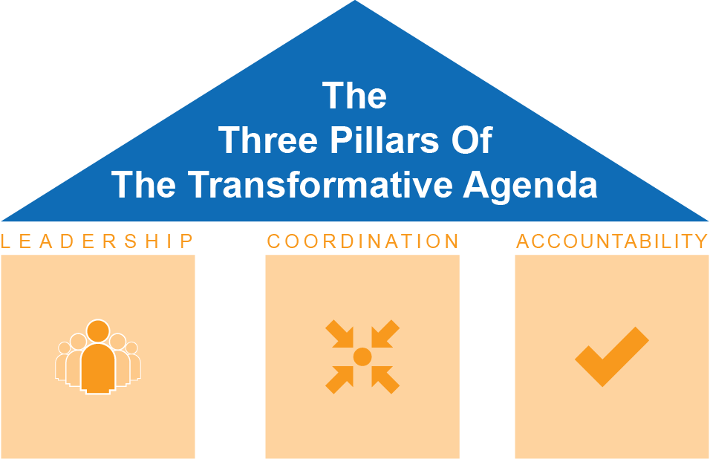
TRANSFORMATIVE AGENDA
Notes:
The IASC Transformative Agenda (2011) is a set of concrete actions aimed at transforming the way in which the humanitarian community responds to emergencies. It focuses on improving the timeliness and effectiveness of the collective response through stronger leadership, more effective coordination structures, and improved accountability for performance and to affected people.
The transformative agenda builds on the Humanitarian Reform process and on the recognition of the need to tackle persistent weaknesses in our collective response capacity.
The Humanitarian Coordinator (HC), the Humanitarian Country Team (HCT), country clusters and cluster lead agencies remain the prime actors supporting national response efforts, and the Transformative Agenda seeks to further strengthen these actors.
Concrete priority actions to strengthen all humanitarian operations include:
Strengthened leadership capacities at all levels of the response.
Improved strategic planning that clarifies the collective results that the humanitarian community aims to achieve.
Strengthened needs assessments, information management, planning, monitoring and evaluation for a more effective and strategic response.
Improved cluster coordination, performance and participation, as well as a more clearly defined cluster-activation procedure.
Enhanced accountability for the achievement of collective results, based on an agreed performance and monitoring framework linked to the strategic plan.
Strengthened accountability to affected communities, to be implemented at field level through a defined inter-agency operational framework.

Slide 6
THE CLUSTER APPROACH
The purpose of Clusters and Areas of Responsibility (AoRs) is to ensure a well coordinated, strategic, adequate, coherent and effective humanitarian response.
Activation
Activated
Deactivated
Notes:
For the first time, the IASC has agreed on how to respond collectively to a major, sudden-onset Level 3 emergency that requires the activation of a system-wide response with agreed mechanisms, tools and procedures. Level 3 emergencies are judged by their scale, complexity, urgency, the capacity required to respond and the reputational risk to humanitarian organisations and responders if we don’t get them right. Many elements of the Transformative Agenda will also be applied as appropriate to non-Level 3 contexts (including protracted crises, slow-onset, and smaller- scale disasters), to strengthen existing response operations.
The purpose of Clusters and Areas of Responsibility (AoRs) is to ensure a well coordinated, strategic, adequate, coherent and effective humanitarian response.
The IASC appoints individual agencies to lead the clusters. Their task is to clarify the roles, responsibilities and accountability of UN and non-UN partners responding to specific emergencies and to streamline communication with the host government.
The decision to activate clusters and AORs is made by the HCT in consultation with national partners and is based on analysis of the context, including the scale of the humanitarian needs and the capacity of existing coordination structures on the ground. The IASC Principals agreed that the activation of clusters must be more strategic and less automatic and time limited.
In a level 3 response, clusters may be activated - if they do not already exist – with the support of personnel deployed through the Inter-Agency Rapid Response Mechanism (IARRM). The IARRM ensures there are sufficient experienced people on the ground working within agreed structures to either augment or fill the core coordination functions required for an effective response. All clusters should be prepared to deploy in a level 3 response, but the decision of which clusters to activate will be taken within 72 hours from the level 3 declaration by the HCT (if existent), supported by the IASC emergency/operational directors at headquarters, and on the basis of analysis of coordination mechanisms in place. Cluster activation will be regularly reviewed thereafter (as per the table in Section 2 on cluster de-activation).
Decisions on the activation of clusters to fill operational gaps should take into account the protection needs of the affected population including the “areas of responsibility” of the Protection Cluster (i.e. child protection; gender-based violence; mine action; and housing, land and property).

Slide 7

UNICEF AS A CLUSTER LEAD AGENCY (CLA)
Tasks of the Cluster Lead Agencies (CLAs)
clarifying the roles, responsibilities and accountability of UN and non-UN partners responding to specific emergencies
streamlining communication with the host government
in accordance with the IASC guidelines, accountable to the Humanitarian Coordinator and Provider of Last Resort (PoLR)
UNICEF is the Global Lead Agency for 3 Clusters and 2 AoRs:
Notes:
UNICEF has a significant role in ensuring a strategic, better coordinated and effective response, not least because UNICEF is responsible for leading/co leading three Clusters: Water and Sanitation (WASH), Nutrition, Education (co-lead with Save the Children); and two Areas of Responsibility (AoR):- Child Protection, and Gender Based Violence (GBV) (co-lead with UNFPA); under the Protection Cluster.
UNHCR is lead agency and responsible for sector coordination in refugee settings. UNHCR can call on partners such as UNICEF to provide sectoral coordination support. In mixed IDP/ refugee situations, the UNICEF Country Office needs to ensure coordination structures are in place and support those structures as needed.
^{Provider of Last Resort (PoLR)}
Where a UNICEF-led cluster is activated, UNICEF must be ready to ensure provision of services to fill critical gaps, identified by the cluster and reflected in the HC-HCT led Strategic Response Plan; when access, security and funds are in place.

Slide 8
6 CORE CLUSTER FUNCTIONS
1
SUPPORTING SERVICE DELIVERY
5.
6
CONTINGENCY PLANNING/PREPAREDNESS/CAPACITY BUILDING
2
3
4
INFORMING STRATEGIC DECISION MAKING OF THE HC/HCT
PLANNING AND STRATEGY DEVELOPMENT
ADVOCACY
MONITORING AND REPORTING
Notes:
The purpose of clusters and AORS is to ensure a well-coordinated, strategic, adequate, coherent and effective response, as outlined in the IASC Reference Module for Cluster Coordination at Country Level and in accordance with the Principles of Partnership.
Supporting Service Delivery
Provide a platform to ensure that service delivery is driven by the agreed strategic priorities
Develop mechanisms to eliminate duplication of service delivery
2. Informing Strategic Decision-Making of the HC/HCT for the Humanitarian
Response
Needs assessment and response gap analysis (across sectors and within the sector)
Analysis to identify and address (emerging) gaps, obstacles, duplication, and cross-cutting issues including age, gender, environment, and HIV/AIDs
Prioritization, grounded in response analysis
3. Planning and Strategy Development
Develop sectoral plans, objectives and indicators that directly support realization of the HC/HCT strategic priorities
Apply and adhere to existing standards and guidelines
Clarify funding requirements, prioritization, and cluster contributions for the
HC’s overall humanitarian funding considerations (e.g. Flash Appeal, CAP, CERF, Emergency Response Fund/Common Humanitarian Fund)
4. Advocacy
Identify advocacy concerns to contribute to HC and HCT messaging and action
Undertake advocacy activities on behalf of cluster participants and the affected population
5. Monitoring and Reporting the implementation of the cluster strategy and results; recommending corrective action where necessary
6. Contingency Planning/Preparedness/Capacity Building in situations where there is a high risk of recurring or significant new disaster and where sufficient capacity exists within the cluster.

Slide 9
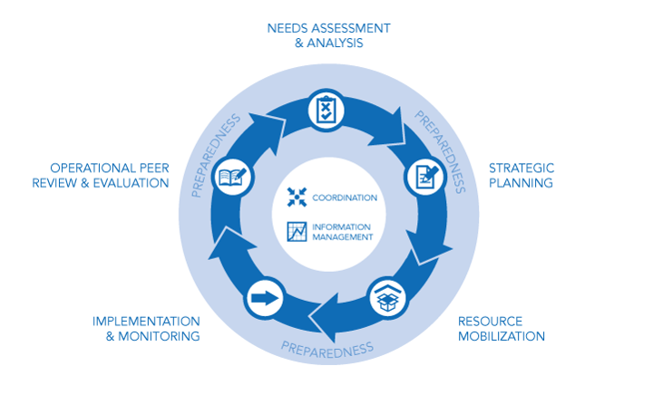
INTER-CLUSTER COORDINATION
Notes:
Inter-cluster coordination is the mechanism through which clusters come together at national and sub-national level to coordinate the response through each stage of the Humanitarian Programme Cycle. The shape of inter-cluster collaboration is determined by the Humanitarian Coordinator, Resident Coordinator and/or Humanitarian Country Team; supported by OCHA, which are all critical to the success of an emergency response.
It is essential to:
1. Advocate:
at HCT as necessary for improved inter-cluster coordination between specific clusters to address key strategic issues with multi- cluster approach – e.g. in relation to malnutrition or cholera or across all clusters in relation to inter-cluster support services /activities
at HCT as necessary for improved communication between HCT and Inter-cluster coordination mechanisms
2. Communicate:
ensure good two-way flow of information in-house - between Country Rep and UNICEF led Cluster and AORs Coordinators with briefing and debriefing before and after ICC and HCT meetings – to endorse key messages and to ensure common understanding /position on key issues discussed during these meetings.
3. Convene:
effective in-house Inter-cluster coordination across UNICEF led clusters and AORs, to enhance UNICEF-led cluster coherence of approach and collaboration and reducing duplication of effort on common issues. This will also promote programme integration within UNICEF.

Slide 10
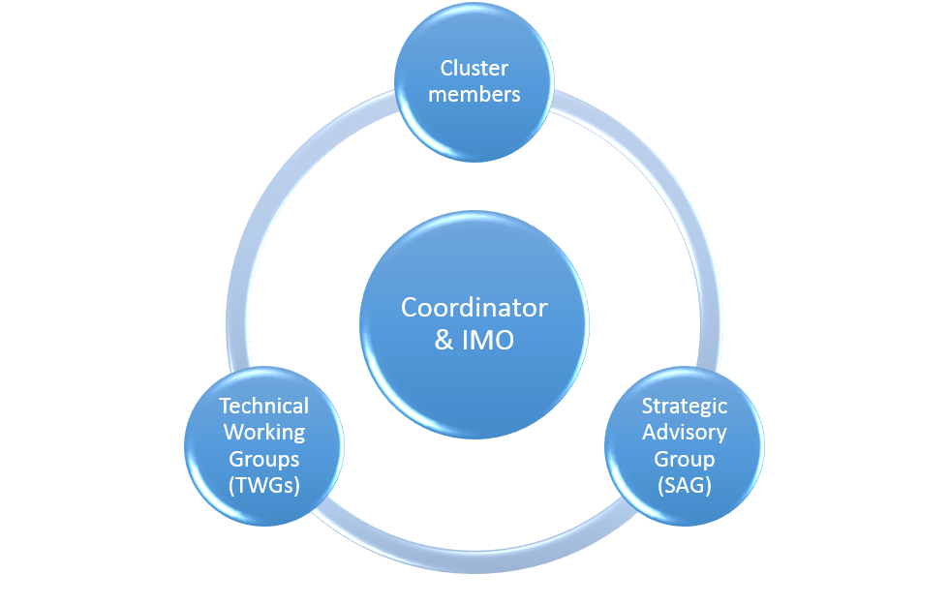
Management of Cluster
Notes:
There is no ‘one-size fits all’ approach to cluster management. Due to the varying size, scope and complexity of disasters and cluster response, the choice of a management approach must be adapted to need and may change as the response evolves.
A well-run cluster is a formal deliverable of the Cluster Lead Agency and forms a part of the agency’s work. However in practice, it has been recognized by the IASC and donors that the efficient management or functioning of clusters is the joint responsibility of the Cluster Lead Agency, the Cluster Coordinator, resourcing partners and all cluster participants at the national and sub-national level.
Efficient cluster management should encompass the following characteristics;
Monitored performance of the six core cluster functions with regard to developing programmes – which clearly contribute to the implementation of evidence-based strategic objectives – based on the identification of good field practices and agreed international benchmarks and standards;
Establishment and maintenance of an appropriate humanitarian coordination mechanism;
Strengthening pre-existing sectoral coordination through increased predictability and accountability;
Building complementarity of partner actions: avoiding duplication and gaps
Ensuring adequate resources are mobilized and are equitably allocated for the effective functioning of the cluster and its response
Effective and comprehensive integration of relevant cross-cutting issues, including age, gender, environment and HIV/AIDs;
3. Maintaining flexibility within the cluster to respond to changes in the operating environment, evolving requirements, capacities and participation;
4. The effective use and transfer of information to, from and between cluster members and other stakeholders;
5. Interaction with other clusters (including through inter-cluster coordination fora), humanitarian actors, government counterparts, and relevant authorities for operational planning, engagement and active contribution of operational partners;
6. Accountability to the affected population through effective and inclusive consultative and feedback mechanisms.

Slide 11

ACCOUNTABILITY
CLAs are responsible and accountable to a range of actors, including the:
affected populations by providing them with timely and appropriate assistance;
HC for building up and ensuring a more predictable and effective response capacity;
national and local authorities to build capacity, prepare and coordinate a response;
donors for a cost-effective and efficient use of funds received; and
cluster members for a well-structured and managed coordination mechanism.
Notes:
Successful and effective AAP measures ensure that gender-sensitive approaches are systematically employed and that the diversity and varying needs within all communities are recognised and responded to appropriately.
In addition to Cluster accountabilities, UNICEF has also other IASC accountabilities that have been articulated under the Transformative Agenda in order to strengthen the system-wide response in country.
The following slides list the key accountabilities as they relate to humanitarian leadership. Coordination and accountabilities to affected population for ensuring an effective humanitarian response in country.

Slide 12
COMMITMENTS TO ACCOUNTABILITY TO AFFECTED POPULATION (AAP)
There is a need for a more coordinated setting of priorities between key stakeholders and regular communication with affected populations throughout an emergency response.
Leadership/Governance
Transparency
Feedback and Complaints
Participation
Design, Monitoring and Evaluation
Notes:
(OPTIONAL, CAN TAKE OUT IF NEEDED).
Leadership/Governance: Demonstrate their commitment to accountability to affected populations by ensuring feedback and accountability mechanisms are integrated into country strategies, programme proposals, monitoring and evaluations, recruitment, staff inductions, trainings and performance management, partnership agreements, and highlighted in reporting.
Transparency: Provide accessible and timely information to affected populations on organizational procedures, structures and processes that affect them to ensure that they can make informed decisions and choices, and facilitate a dialogue between an organisation and its affected populations over information provision.
Feedback and Complaints: Actively seek the views of affected populations to improve policy and practice in programming, ensuring that feedback and complaints mechanisms are streamlined, appropriate and robust enough to deal with (communicate, receive, process, respond to and learn from) complaints about breaches in policy and stakeholder dissatisfaction Specific issues raised by affected individuals regarding violations and/or physical abuse that may have human rights and legal, psychological or other implications should have the same entry point as programme-type complaints, but procedures for handling these should be adapted accordingly.
Participation: Enable affected populations to play an active role in the decision-making processes that affect them through the establishment of clear guidelines and practice s to engage them appropriately and ensure that the most marginalised and affected are represented and have influence.
Design, Monitoring and Evaluation: Design, monitor and evaluate the goals and objectives of programmes with the involvement of affected populations, feeding learning back into the organisation on an ongoing basis and reporting on the results of the process

Slide 13


WHAT DOES THIS MEAN FOR UNICEF?
Humanitarian Leadership
Coordination
Quality and accountability
Notes:
In support of government and/or national authorities, the HC and HCT lead the humanitarian response. The HCT provides the forum for decision makers to agree and direct the strategic direction of the humanitarian response, under the leadership of the HC.
1) The UNICEF representative is an active member of the HCT and contributes to defining the strategic direction of the response – taking into consideration what how needs can be best addressed and response prioritised. He/she has the responsibility to engage with in HCT business and decision making in all phases of the response, representing both interests of UNICEF as an organisation and Clusters and AoRs. When an L3 is declared and Empowered Leadership is agreed, The UNICEF Representative recognizes that leadership role and abides by UNICEF’s defined commitments, roles and responsibilities.
2) Ensure effective Coordination: The Country Representative has the responsibility to
Advocate in the HCT, as necessary, for improved inter-cluster coordination between specific clusters to address key strategic issues through a multi-cluster approach, e.g. in relation to malnutrition or cholera, or across all clusters in relation to inter-cluster support services or activities;
Advocate, as necessary, for adequate representation of UNICEF-led AORs in inter- cluster mechanisms; and
Convene effective in-house inter-cluster coordination across UNICEF-led clusters and AORs, thus enhancing UNICEF-led cluster coherence of approach and collaboration and reducing duplication of effort on common issues. This will also promote programme integration within UNICEF.
3) Quality and Accountability: During a response UNICEF and UNICEF cluster partners are expected to listen to, engage with, and communicate transparently with affected populations throughout all the phases of the Humanitarian Programme Cycle. System wide efforts to enhance protection and response to affected populations requires applying a right-based approach and ensuring protection-driven strategic analysis and priority-setting.

Slide 14


GUIDANCE FOR UNICEF COUNTRY OFFICES
Guidance Document (2015)
Part One: The cluster approach –
how it works and UNICEF country representative responsibilities.
Part Two: The cluster approach – UNICEF country office responsibilities
Notes:
The following document has been created in order to assist UNICEF country offices to better fulfill CLA responsibilities in level 3 and other emergencies with relevant IASC protocols and guidance.
Purpose and structure of the guidance document
This document has been developed to assist UNICEF country offices to better fulfil CLA responsibilities in level 3 (L3) and other emergencies, with reference to relevant IASC protocols and guidance8 and relevant internal UNICEF reviews and evaluations.
This document should be used in conjunction with and to augment other reference materials.
The functions and responsibilities of the focal point agencies for AORs under the protection cluster are identical to the functions and responsibilities of the CLA for clusters. Therefore, UNICEF needs to ensure the same level of investment and support for AORs as is given to clusters.
More precisely, it describes the key responsibilities of UNICEF country representatives and country offices to support cluster and area of responsibility coordination functions.
The document is divided into two parts to provide guidance:
Part One: The cluster approach – how it works and UNICEF country representative responsibilities.
→ Informs about the Cluster approach; the activation, transition and deactivation, the function of the Clusters and explains the inter-Cluster Coordination
Part Two: The cluster approach – UNICEF country office responsibilities
→ Informs about HR -Mobilisation, UNICEF in line management, UNICEF programms working with Clusters and the operational support by Country Offices to the Clusters

Slide 15
Responsibility of UNICEF Country Representative
The UNICEF Country Representative is ultimately accountable to the Humanitarian Coordinator for the effective functioning of the Cluster(s).
The Country Representative has responsibility to enable cluster(s) through:
timely appointment of adequate number of experienced staff
availability /accessibility of adequate administrative, logistical and office services to clusters
ensuring funding is available for coordination functions
ensuring effective management of cluster staff
representation of and advocacy on behalf of cluster(s)
The UNICEF Country Representative should:
Engage in HCT business and decision making in all phases of the emergency response
Represent both the interests of UNICEF as an Organization and the interests of the 5 Clusters/AoRs it leads
Differentiate when speaking on behalf of UNICEF or clusters
Be knowledgeable about cluster issues: activities, progress, plans

Slide 16
Responsibility of the UNICEF Country Office
HR Mobilisation:
secure funding for and recruit Cluster and AoR Coordinators and IM specialists
develop a strategy for staffing for clusters and AORs based on analysis of the coordination capacity and need
UNICEF programmes working with Clusters:
Strong functional clusters will strengthen UNICEF emergency programme. Programme sections should work with, support and strengthen the respective clusters:
The Chief of Section(s) represents UNICEF in the Cluster(s) as member of a Strategic Advisory Group (SAG) and/or act as OiC for the Cluster when the Cluster Coordinator is not in the duty station
Technical staff members should also actively participate in Cluster Meetings and Technical Working Groups (TWGs)
Notes:
UNICEF is responsible for ensuring the timely recruitment of adequate numbers of staff with the appropriate level of seniority, facilitation skills, and technical skills to ensure effective cluster coordination, including information management function.
In some cases it may be feasible for programme staff to take on cluster and AOR coordinator and information management specialist (IM) roles, whereas in other situations dedicated full-time cluster coordination staff (coordinator and IM) will be necessary.
Options include:
recruitment of staff to fulfil cluster roles for cluster coordination
secondment of staff from NGOs in-country
using various mechanisms for temporary surge support
(OPTIONAL)But being aware that:
most of the mechanisms for temporary surge support are for relatively short periods of time –hence they should be viewed as short term options to be used on an interim basis while arrangements for longer term appointments are being processed.
it is essential that the CO starts the process of recruitment for longer term positions as a priority at the outset of an emergency - recognising that the temporary surge mechanisms are gap filling measures to support the CO until they can recruit staff
all seconded staff should be fully integrated into the UNICEF Country Office operations and should be line managed by UNICEF

Slide 17
Recommendations in the Guidance Document
The Cluster Coordination Guidance further contains useful recommendation for the various aspects of working with the Clusters and AoRs:
UNICEF in-line management of Cluster and AoR coordination
UNICEF-led Cluster Management meetings
UNICEF attendance/representation in Cluster and AoR relevant meetings (Coordination Meetings, HCT Meetings, emergency management team conference calls)
Monitoring of Cluster performance and functioning
Planning and budgeting for Cluster activities
Operational support
Notes:
The Guidance document includes relevant recommendations for the Management of Clusters/ Management of Clusters and AoRs within UNICEF

Slide 18
Management of Cluster within UNICEF
Neutrality of Cluster Coordinators
“Cluster and AoR coordinators have an overriding duty to the partners and should act as neutral representatives of the cluster as a whole rather than as representatives of UNICEF.”
Double Hatting
Operational and administrative support
It is essential that space is created to allow cluster related issues to be adequately discussed and addressed within UNICEF, to ultimately enhance UNICEF support of cluster coordination.
It is the responsibility of the Country Representative to ensure that the various sections of the organization prioritize provision of operational and administrative support services for effective coordination.
Notes:
Cluster coordinators are employed by or seconded to UNICEF and report to the country representative or his/her designate.
The neutrality of coordinators can be promoted through:
Appointment of a dedicated Coordinator
The Cluster Coordinator reporting to someone other than Chief of Section
Clarification of position of neutrality the with partners on periodic basis; backed up by practice, e.g. not taking on aspects of UNICEF programme work
UNICEF Chief of Section and senior staff active participation in cluster meetings, representing UNICEF as a cluster partner
Where appropriate, locating cluster offices outside of UNICEF premises
In some situations Double Hatting may occur – This is Is when in some situations (e.g. in smaller scale or some protracted emergencies) it is appropriate for a UNICEF programme staff member to functions as Cluster Coordinator in addition to their UNICEF programme responsibilities. It is important that in such a scenario, neutrality is maintained.
Cluster coordination responsibilities and allocation of time for cluster functions should be clearly articulated in the job description and in the performance appraisal of the post holder and monitored through regular meetings with supervisor(s) to ensure that the dual roles remains
A double hatting Cluster Coordinator must always make it clear when speaking on behalf of/representing the cluster and when speaking on behalf of/representing UNICEF.
Where possible another person should represent UNICEF at meetings, especially in a situation where UNICEF is likely to take a different position from other cluster partners
It is absolutely essential that another person represent UNICEF where funding allocations are being made.
Operational and administrative support
As UNICEF-led clusters and AoRs are established in country, there is a clear need for UNICEF to scale up administrative and logistical functions to ensure that the office has the capacity to provide the required level of support for effective cluster coordination
It is the responsibility of the Country Representative to ensure that the various sections of the organization prioritise provision of operational and administrative support services for effective coordination.
Includes the provision of:
Office space and furnishings, enabling effective team working and meetings with partners
Communication, ICT equipment and technical support
Technical support to maintain Cluster/AoR website
Logistics support, i.e. transport
Access to translation services
Ensuring appropriate administrative support is available to clusters. Options include:
The appointment of a designated admin officer, to support all UNICEF-led clusters
Existing UNICEF administrator providing double hatting support (same HR best practice applies)
Guidance on how to manage Clusters within UNICEF CO
Recommendations:
Include cluster issues as a regular item on the agenda of existing UNICEF internal weekly
meetings
Chair periodic UNICEF cluster meetings
3. Alternate the above

Slide 19

QUESTIONS
Further information:
Global Cluster Coordination Unit (GCCU), EMOPS Geneva
Cluster Coordination: Guidance for Country Offices on INTRANEThttps://intranet.unicef.org/emops/EMOPSSite.nsf/root/Page0201 (Guidance and Tools)

