Slide 1
1.3 Information Management in the Humanitarian Landscape
INFORMATION MANAGEMENT

Slide 2

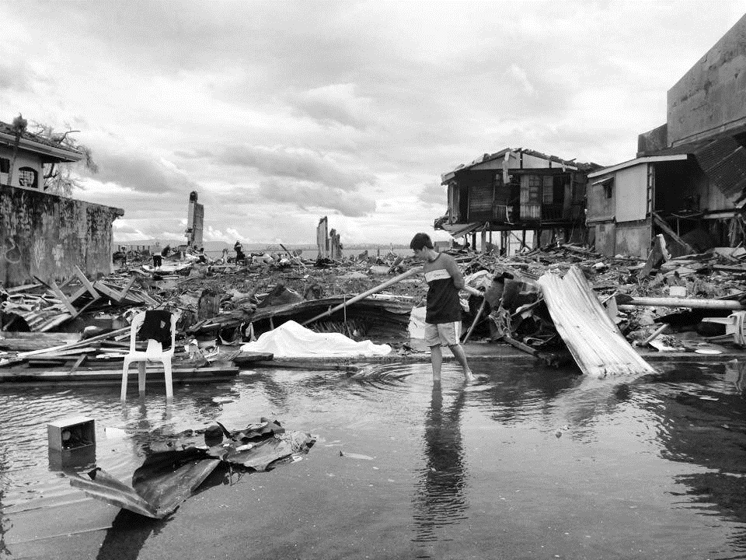

Slide 3
Objectives:
Describe the types of decisions being made by various strategic and operational actors and how IM fits into this.
Explain how the IMOs support decision making by establishing an effective IM system based on the key IM building blocks.
Define information management and describe the difference between data, information and knowledge.
Define how IM tools can collect information on the cross-cutting issues as gender and GBV (GBVIMS) and share within the humanitarian actors in respect to do no harm principle for a better response programme.
List IM tools and processes that support nutrition cluster response.
Identify tools, templates and guidelines that are available in the GNC IM toolkit.

Slide 4
The Situation
WHO is affected?
WHERE are they located?
WHAT are priority areas and needs?
Existing resources and gaps
Hazards, infrastructure, security and access
Notes:
Impact - type of crisis, areas, people affected
Resources - existing, required, Infrastructure (ports, airport, logistics routes, accessibility, roads)
Priority areas/needs
Hazards and security

Slide 5
The Response
WHO is responding?
WHAT are they doing?
WHERE are they located?
HOW do I get and share information on the response?
Notes:
WHO needs to know WHICH information?
WHERE do we find information - Baselines, relevant ministries and dedicated government emergency management structures, civil society groups, media
HOW do we share it and WHAT is the information environment like?

Slide 6


Slide 7
Decision Types: Needs, Response, Gaps
-
Needs
Response
=
Gaps
People in need not yet reached by aid
Total people in need reached with aid
Total people in need as result of crisis
Notes:
In an OCHA Situation Report, “needs”, “response”, and “gaps” refer only to crisis-affected people. Ideally, for each cluster, these figures represent total estimates.

Slide 8
Decision Types: Targets, Response, Gaps
As Nutrition Cluster usually does not have capacity to address all population in need, partners set up targets that are less than 100% of people in need
-
Targets
Response
=
Gaps
People targeted not yet reached by aid
Total people in need reached with aid
Total affected people targeted
Notes:
In an OCHA Situation Report, “needs”, “response”, and “gaps” refer only to crisis-affected people. Ideally, for each cluster, these figures represent total estimates.

Slide 9
Decision-types: Operational, Strategic and Advocacy
Operational Decisions
Strategic Decisions
Advocacy
Prioritization
Informing
Cluster did not have latest information on IYCF practices and agreed to focus early IYCF assessments on 20 municipalities in Province B as 70 per cent of displaced people have moved there.
Based on the IYCF assessment 120,000 boys and girls under age of two in Province B were prioritize for IYCF-E interventions
Nutrition cluster advocates for immediate release of 900K to provide skilled life-saving IYCF-E interventions to 120,000 boys and girls under age of two in Province B

Slide 10


Slide 11
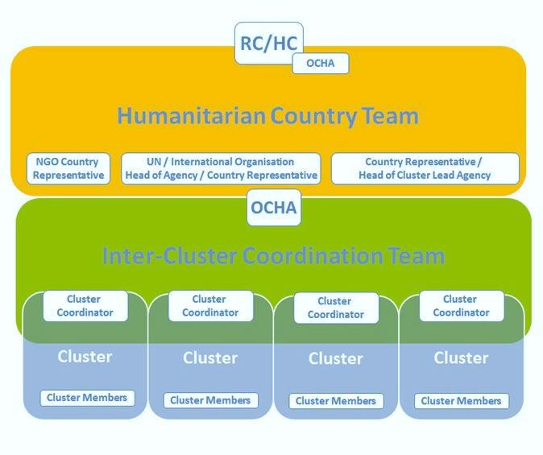
Humanitarian Decision-Making Hierarchy
Strategic decisions for overall response
Inter-cluster decisions
Cluster decisions

Slide 12
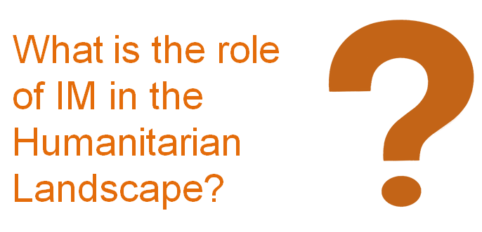

Slide 13
Information Management Definition
Information management is a systematic process for the collection, collation, storage, processing, verification, and analysis of data and dissemination to humanitarian stakeholders, to support effective and timely humanitarian action.

Slide 14
Definitions
Knowledge
Information
Data
Interpretation

Slide 15
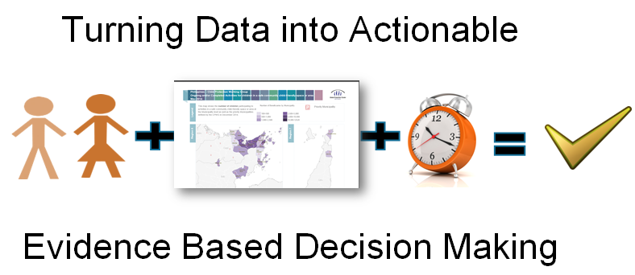
IM Function

Slide 16
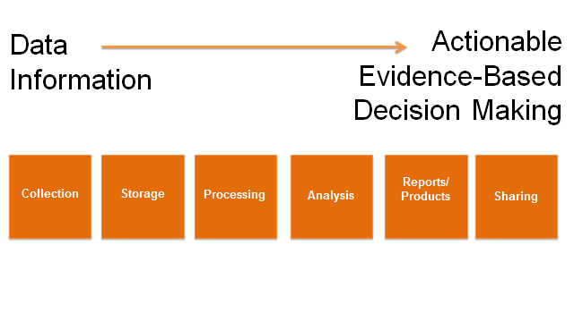
The Building Blocks of Information Management

Slide 17
Exercise: IM Tools in the HPC
Make a list of the IM tools and information that are used for your assigned stage of the HPC

Slide 18
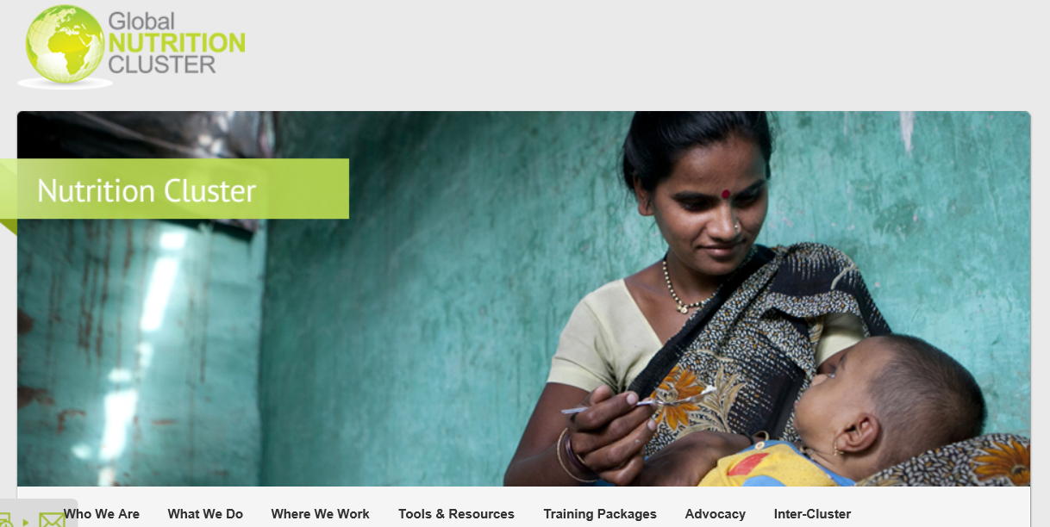
GNC Tools & Resources to Enhance IM
www.nutritioncluster.net

Slide 19
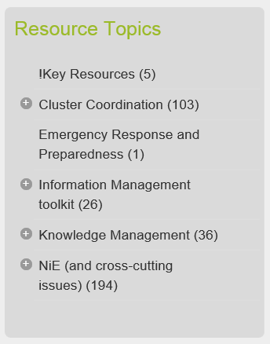
GNC Tools & Resources
This website is intended to serve as a repository of relevant tools, guidance and resources for Nutrition Cluster Coordinators and partners working at country and global levels.
Key resources on:
Cluster Coordination
Information Management
Knowledge Management
Nutrition in Emergencies
Inclusion of cross-cutting issues are suggested to update IM data (e.g. gender analysis)

Slide 20
What is the GNC IM Toolkit?
A resource to help Information Managers, Coordinators, Partners or other interested groups improve the flow of critical information during an emergency response.

Slide 21
GNC IM Toolkit
Dashboards templates
Key datasets
Surveys database
IM Checklist
HRP tips
4 W
HIR
Map examples/ templates
Gap analysis tool
M&E Framework
Caseload targets & supplies
IM Update PPT template
Partners reporting tool
Capacity mapping
Financial tracking tool
BMS Code Violations tracking
Country bulletin template
ToR for IMO
Meeting agenda template
Web-site for HR.info Guide
Meeting minutes template
NC Style Guide
Contact list template
IMO handover template

Slide 22
IM Toolkit: Resources for all stages of the HPC
General Tools:
Map and dashboard templates
ToR for IMO
Meeting agenda template
Meeting minutes template
NC Style Guide
Contact list template
IMO Handover template
IM Checklist
Surveys database
Key datasets
Indicators registry
Capacity mapping tool
4W
M&E Framework
HRP tips
Gap analysis
BMS code violations tracking tool
Country bulletin template
Web-site for HR.info Guide
IM Update PPT template
Partner reporting tool
Caseload, targets and supplies calculation tool
Financial tracking tool
Capacity mapping tool
Notes:
Discuss variation between quick onset and protracted crises and clarify differences between them and what this means for preparedness, response and recovery.
Ask participants to look at the HPC Reference Module in their files
Big change is to put the emphasis back at country level to determine the time-line and mechanisms they will employ.
22

