Slide 1
1.5 Information Management Officer
Interpersonal Skills
INFORMATION MANAGEMENT

Slide 2
Inter-personal Competencies
Working effectively with people from all backgrounds (e.g. women, men, boys, girls, LGBT, people living with disabilities etc.)
Understanding and considering diverse opinions
Identifying partners’ needs and matching them with appropriate solutions
Tailoring language, tone, style and format to match audiences
Actively listening to perspectives of partners and stakeholders
Interpreting messages and responding appropriately
Leading and influencing partners and stakeholders

Slide 3
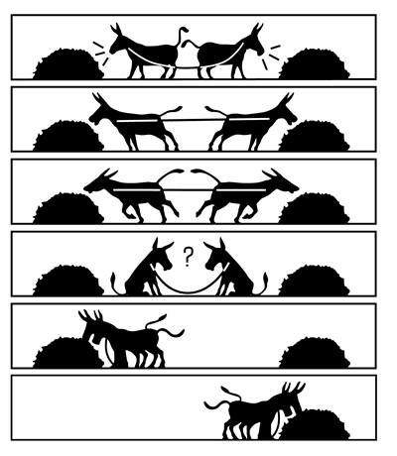
The Challenges of Working with IM Stakeholders
What are some examples of inter-personal challenges faced by IMOs?
Notes:
Emphasis on empathy

Slide 4
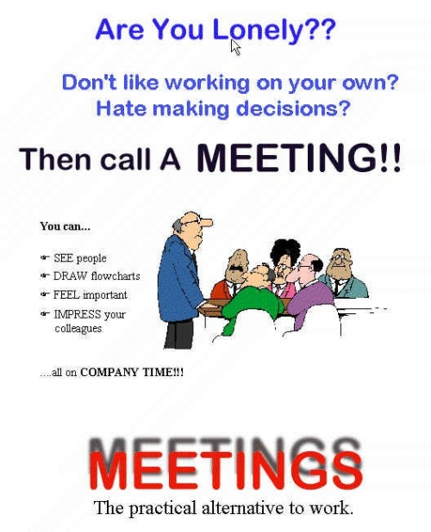

Slide 5
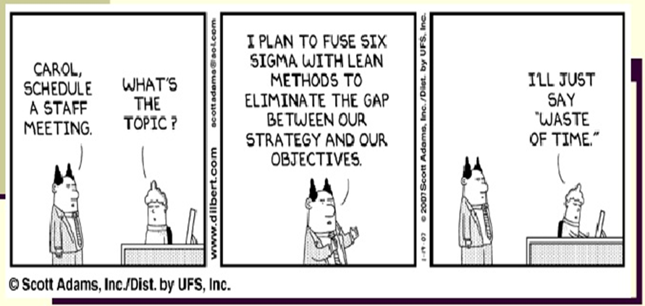

Slide 6
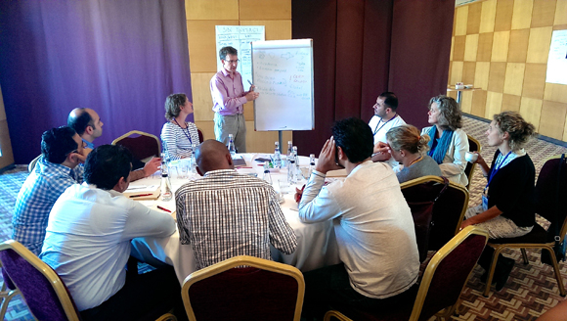
Communicating in Meetings
Notes:
During the course we’ve talked about cultural awareness and listening skills and the hum reform process, the need for coordination to maximize effective delivery of assistance and minimize gaps and duplication of effort. Meetings are the forum in which these elements come together on the most regular basis during emergency operations.
One of the consequences of improved coordination has been the expansion of the need for meetings to coordinate operational and planning efforts. Sadly, many continue to be poorly organized and run, resulting in frustration and a belief that at the practical level coordination falls over because we waste our time doing nothing but meeting without purpose or effective outcome Meeting for meetings sake). For the remainder of this session we’re going to focus on how we can better prepare for and get the most out of these meetings to ensure they assist rather than frustrate coordination and operations.
We’ve focused on some of the issues, influencing factors for how we communicate and how active listening can be used to help improve the way we communicate.
Having talked about some of the ways we can be more effective at communicating we’re going to talk now a bit now about skills that can help us improve how we run meetings and how to get the most out of those we attend.

Slide 7
Worst meeting
Think about the worst meeting you have been to.
  Why was it so bad?
  Make a list of the worst things about it

Slide 8
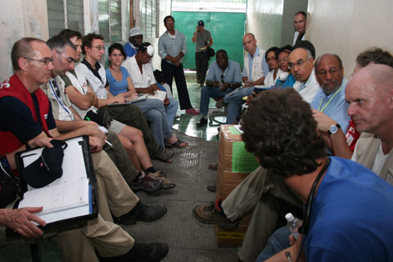
What makes a bad meeting?
No clear purpose or agenda or poorly communicated
Wrong people in attendance
Too many or too few people
Poor preparation by facilitator or participants
Space is inappropriate (size, location, equipment)
People overlooked/not given space to speak (no translation)
Some people dominate the meeting
Not a safe space for people to share information
Not enough participation
Doesn’t run to time/too short for agenda
No clear outcomes/next steps
Notes:
Ask group to talk through some examples of bad meetings.
Discuss communication techniques for managing these issues:
Seek direct input from each participant
Break the group up and get them to feed back at a plenary
Use active listening to understand what the issues are for dominant participants
Paraphrase back and then decide if it is something that can be managed in the meeting or needs to be dealt with in side or additional meetings.
Remind participants of the agenda for this meeting and the intended outcomes

Slide 9

Effective Meeting Management
It’s a process
Notes:
Meetings need to be thought through, like any other important task, if you want to get results.
We complain that humanitarian work involves too many meetings and that they are often a waste of time.
This is largely because they are poorly planned, organized and run. This PPT runs through some simple tips for improving meetings planning and organizing.
But most importantly, before you get people in a room think DO WE NEED TO MEET?
Thinking about this means its might be possible to avoid unnecessary meetings and it’s the first step to making your work better.
Often we meet regularly just because someone, sometime decided a weekly meeting was a good idea.
Think about purpose first of all, everything else flows from there.
Preparation for both facilitators and participants helps to get the most out of meetings Preparation for both facilitators and participants helps to get the most out of meetings
Why
What’s the purpose of the meeting: Decision making, information gathering, information sharing, problem solving, coordination?
Who
Who should attend the meeting to ensure the purpose/goal can be achieved? Decision makers, information managers. Technical personnel?
What roles are needed (e.g. presenters, facilitators, translators, lead and participants)
What
What is on the agenda for the meeting?
Use the agenda to outline how topics are tobe handled, decision making, info sharing etc
Where
Will the location suit everyone?
Is it in a neutral location or will it cause some people to not attend?
Is it big enough?
Does it have the equipment you need?
How will you lay out the room to suit the meeting
When
Clear start and end times
Will the timing inhibit attendance?
How
As the facilitator how will you manage the meeting to ensure the ground rules are clear, objectives are met, people participate, that dominant people done over-ride others, that the outcomes are recorded, that translation is available if needed

Slide 10
As a meeting facilitator
Define the purpose, invite (right) people
Manage the meeting (location, equip, timing)
Circulate and collect attendance sheet for further communication
Ensure meeting is minuted and translators are available
Ensure an open and comfortable environment for the participants to participate effectively considering their identity (e.g. women and men)
Manage lack of interest/dominant participants
Document/clarify action items
Circulate minutes and action items
Seek feedback from participants to inform next meeting to meet needs
Notes:
Manage the meeting as it progresses (keep to objectives, timing)
Use communication skills to manage lack of interaction or overly dominant participants (use techniques such as direct questioning, group work, flipcharts and suggest side meetings when dominant personalities are going off track)
Ensure meeting is minuted
Circulate and collect attendance sheet for further communication
Circulate minutes and action items
Seek feedback from participants to inform next meeting

Slide 11
As a meeting participant
Participation: It is more than just showing up and signing the attendance sheet
Be clear on what your role is
Be clear on what you want to get out of it
Use communications skills to get the most from the meeting
Clarify any action points
Notes:
Participation is more than just showing up and signing the attendance sheet
Be clear on what your role is as well as what you need to get out of the meeting for your agency.
Use communications skills such as active listening to get the most out of what other participants bring to the meeting, to meet your objectives for attendance and manage your role in the meeting
Clarify any action points for you/your agency or that will affect your operations

Slide 12
Go back to your worst meeting
Think back to the meeting you described at the start
  Using the tips we have just discussed, what could have been done to make that meeting better?
  Make a list of the tips you would give the organiser.

Slide 13




Slide 14
Three Phases Of A Negotiation:
Preparation (Analysis & Strategy)
Face-to face
Follow-up

Slide 15
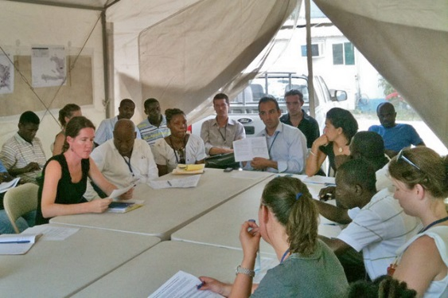
Entering the Negotiation
“I don’t use the cluster reporting format.”
POSITION
“My agency work takes priority and they have people who can re-format the data”
INTEREST
“I need to avoid difficulties
with my supervisor by following our agency systems, and need to retain my team’s autonomy”
NEED

Slide 16
Focus on interests and needs, not POSITION
ME
YOU
POSITION
I WIN, YOU LOSE
YOU WIN, I LOSE
INTEREST
Zone
Of
Possible
Agreement
NEED
WIN / WIN
Notes:
Brainstorm multiple options first (ideally in a collaborative way), decide on the option later… using objective criteria or standards

Slide 17
Think carefully what you will do if you cannot reach agreement…
Know Your BATNA:
Best
Alternative
To a
Negotiated
Agreement
“The reason you negotiate is to produce something better than the results you can obtain without negotiating.” - Roger Fisher

Slide 18
Three Phases Of A Negotiation:
Preparation (Analysis & Strategy)
Face-to face
Follow-up

Slide 19
Communication elements
Effective Listening
Assertive Commun-ication
Body Language
Notes:
The second component for reducing tension in a negotiation: non-verbal cues…

Slide 20
Active Listening
Listen for feelings as well as facts
Repeat, paraphrase, reframe back to the speaker
Avoid:
  interrupting
  assuming you already know what is going to be said
  mentally rehearsing what to say next
Are you really listening or just waiting for your next turn to speak?

Slide 21
Communication elements
Effective Listening
Assertive Commun-ication
Body Language
Notes:
The second component for reducing tension in a negotiation: non-verbal cues…

Slide 22
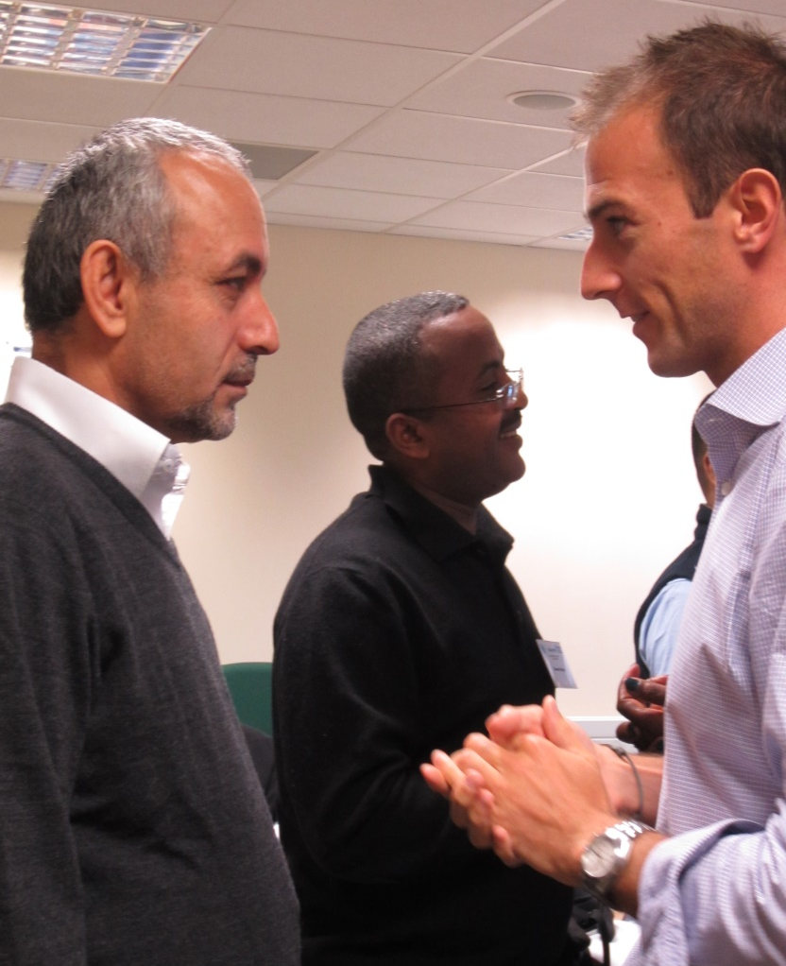
What do you observe about the body language in this photo?

Slide 23
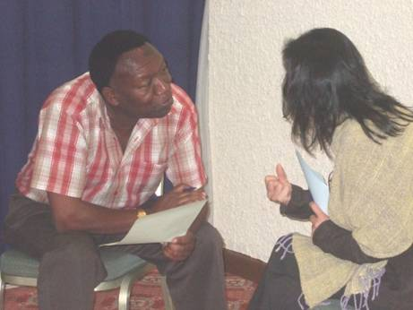
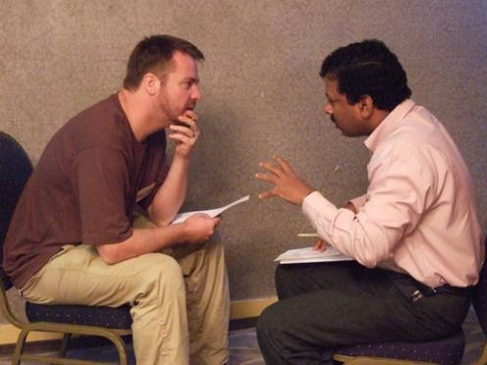
Angling of upper body
conveys interest and empathy

Slide 24
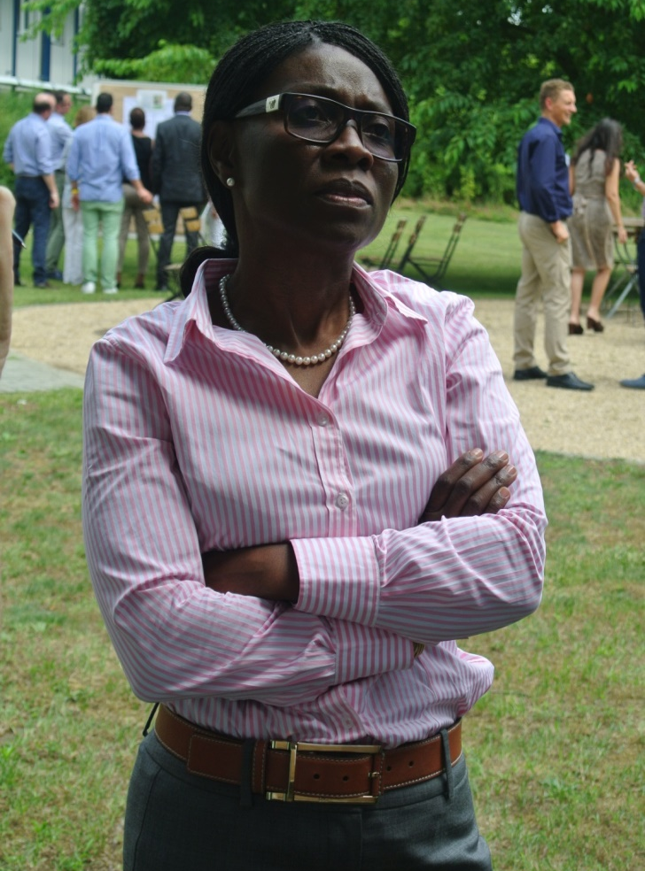
What do observe about the body language in this photo?
She’s not buying it?
Notes:
The guy on the left is trying to build rapport through non-verbal mirroring

Slide 25
Communication elements
Effective Listening
Assertive Commun-ication
Body Language
Notes:
The second component for reducing tension in a negotiation: non-verbal cues…

Slide 26
Conveying interests in an assertive communication style…
“You”
  Can sound accusatory
Remember “I” statements!
“Why”
  Can sound challenging
“How”; “what are your concerns,” etc.
“But”
The “verbal eraser”: invalidates everything that before it!
Instead of “yes, but,” try “yes, and...”
“Should have” or “ought to have”
  Sounds judgmental
“Next time we can…”(reframe as a future proposition)
“As I’ve already said…”
  Sounds impatient
Be prepared to repeat yourself

Slide 27

Separate People From Problems
Be hard on the issue, soft on the person… and adopt a problem-solving approach

Slide 28

Respect Diversity
Remember, there are diverse ways of communicating across cultures!!!

Slide 29
Three Phases Of a Negotiation:
Preparation (Analysis & Strategy)
Face-to face
Follow-up

Slide 30
?

Slide 31
Negotiation Exercise
Take a few minutes to read the sheet you have. It tells you about YOU in the negotiation.
Your partner has the alternate position in this negotiation problem.
Work as a pair to identify the issues from both sides.
Think about more than just your position.
Come up with possible solutions to the problem (think win-win)

Slide 32
Self-reflection against competencies
Identifying partners’ needs and matching them with appropriate solutions
Understanding and considering diverse opinions
Working effectively with people from all backgrounds
Interpreting messages and responding appropriately
Tailoring language, tone, style and format to match audiences
Actively listening to perspectives of stakeholders
Leading and influencing partners and stakeholders

