Slide 1
2.3 Nutrition in Emergencies Foundations
INFORMATION MANAGEMENT

Slide 2
We care because…..
Increased risk of morbidity and mortality
Undernourished children are more likely to become short adults and to give birth to smaller babies
Evidence links stunting to cognitive development, school performance and educational achievement and is irreversible
Poor foetal growth or stunting in the first 2 years of life leads to reduced economic productivity in adulthood
Leads to increased costs in health and education services

Slide 3
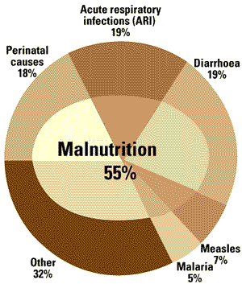
Malnutrition-related Mortality
Approximately 55% of the 11 million deaths among under-five children each year in the developing world are associated with malnutrition
(WHO 2004)
Notes:
3
A reminder that this is the work of Pelletier who, using a 40 year sample, was able to prove the correlation between malnutrition and mortality and placed nutrition up the public health agenda.
Individuals who suffer from acute malnutrition are much more likely to become sick and to die. At the same time, sick individuals are more likely to become malnourished.

Slide 4
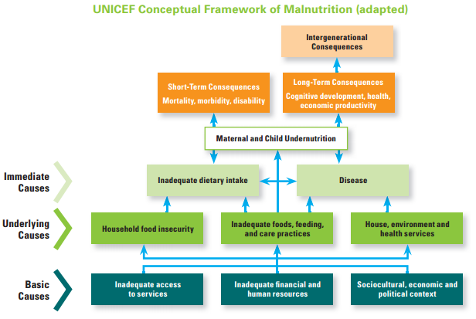

Slide 5
Impact of emergencies on malnutrition
Increased mortality and disease epidemics
Deteriorated health environment
Household access to food is often reduced leading to:
  displacement,
  over-crowded settlements,
  loss of earnings and access to clean water, sanitation and health services.
Deteriorating care practices
Donations of infant formula and other powdered milk products endangers lives

Slide 6
Who are the most vulnerable in emergencies related to Nutrition?
Physiological vulnerability: boys and girls 0-5 years, pregnant and lactating women, elderly and chronically ill
Geographical vulnerability: flood or drought-prone areas, conflict front lines
Political vulnerability: discrimination, persecution
Internal displacement and refugee status: 38 million IDPs, 15.1 million refugees (UNHCR 2015)

Slide 7
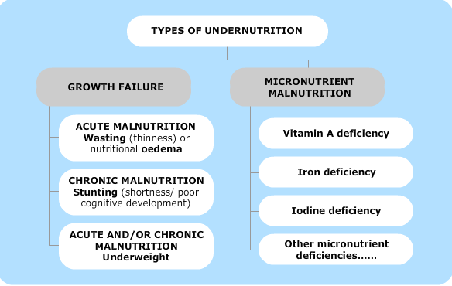

Slide 8
Exercise: Building the Conceptual Framework for Malnutrition
How well can you remember the UNICEF Conceptual Framework for Malnutrition we showed earlier?
Using the pieces, build the framework using sticker notes for arrows between boxes.
5 minutes!

Slide 9
Does your framework look like this?

Slide 10

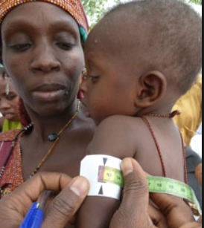
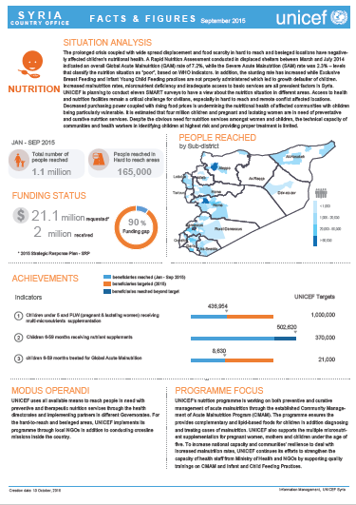
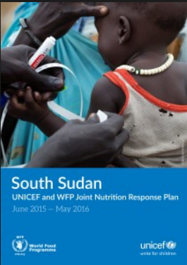
3 Steps for nutrition programming

Slide 11
Nutrition information systems (NIS) collect, analyze, interpret and report on information about the nutritional status of the population.
Sample sources for NIS:
Demographic Health Survey
Multi-cluster Indicator Survey
SMART Survey
LQAS
Clinic-based monitoring report
Sentinel site surveillance
School census data
Rapid nutrition assessments
MUAC measurement
CMAM database
Information from other sectors (WASH, Food Security, Health, etc.)

Slide 12
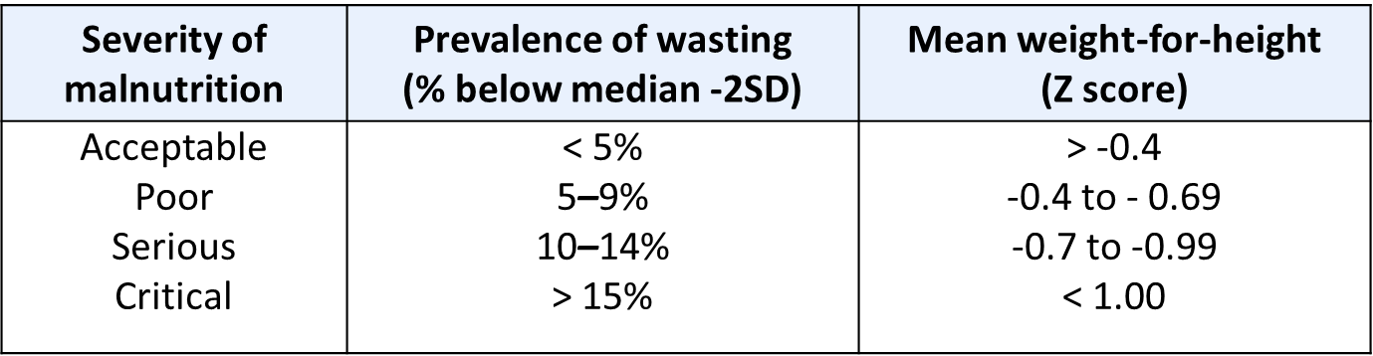
Key indicators used to assess the severity of an emergency in general include: mortality, acute malnutrition, morbidity, food security and livelihood indicators.
Different frameworks and tools exist for classifying an emergency and analysing the situation (IPC, WHO threshold).
WHO threshold for severity of acute malnutrition:

Slide 13


Exercise: Matching indicators to the malnutrition framework
Link the Humanitarian Indicators Registry Indicators to the right block on the malnutrition framework!
Stick your indicator cards where you think they belong on the framework

Slide 14
While analysing, pay attention to:
  Malnutrition trends over time
  Underlying causes of malnutrition
  The relationship between malnutrition and mortality
  Seasonal interpretation
  Attempt to predict trends

Slide 15
Nutrition interventions in emergencies
Nutrition-specific
Nutrition-sensitive

Slide 16
Nutrition interventions in emergencies
Nutrition-specific
Nutrition-sensitive and/or addressing underlying causes of malnutrition
Addressing household food insecurity (such as General Food distribution, cash or voucher programmes)
Prevention and management of acute malnutrition
Prevention and treatment of micronutrient deficiencies
Ensuring access to safe water and promotion of appropriate sanitation and hygiene practices
IYCF-E
Ensuring adequate access to health services

Slide 17
Nutrition-specific
Community mobilization and active case-finding
Outpatient treatment of SAM
Inpatient treatment of SAM
Targeted supplementary feeding programmes
Blanket supplementary feeding programmes
Prevention and management of acute malnutrition
Prevention and treatment of micronutrient deficiencies
IYCF-E

Slide 18
CMAM approach
Community-based management of acute malnutrition endorsed by WHO in 2007
Its components are:
  Community mobilization and active case-finding
  Outpatient care for SAM without complications
  Inpatient care for SAM with complications
  Management of moderate acute malnutrition (MAM)
  Preventative services (BSFP, IYCF-E)
Selective feeding programmes
Supplementary feeding
Therapeutic care
Blanket feeding
Outpatient treatment of SAM
Targeted supplementary feeding
Inpatient treatment of SAM
UNICEF Harmonised Training-Mod 12

Slide 19
Classification of acute malnutrition
Acute malnutrition
Severe acute malnutrition
With medical complications
Weight for height <-3 ZS
Or
MUAC <11.5 cm
Or
Bilateral pitting edema
and medical complications
Severe acute malnutrition
Without medical complications
Weight for height <-3 ZS
Or
MUAC <11.5 cm
Or
Bilateral pitting edema
and no medical complications
Moderate acute malnutrition
Weight for height ≥-3 ZS
and <-2 ZS
Or
MUAC ≥11.5 and <12.5 cm
Inpatient therapeutic care
Outpatient therapeutic care
Outpatient supplementary feeding
UNICEF Harmonised Training-Mod 12

Slide 20
Community mobilization and active case-finding
To find cases of children with acute malnutrition and refer them for treatment
MUAC is usually used for children 6-59 months and for pregnant and lactating women to determine eligibility for programme admission
UNICEF Harmonised Training-Mod 13
Notes:
IFE concerns the protection and support of safe and appropriate (optimal) feeding for infants and young children in all types of emergencies, wherever they happen in the world.
The well-being of mothers is critical to the well-being of infants and young children. So the needs of mothers - or primary caregivers – is also a key consideration in IFE.

Slide 21
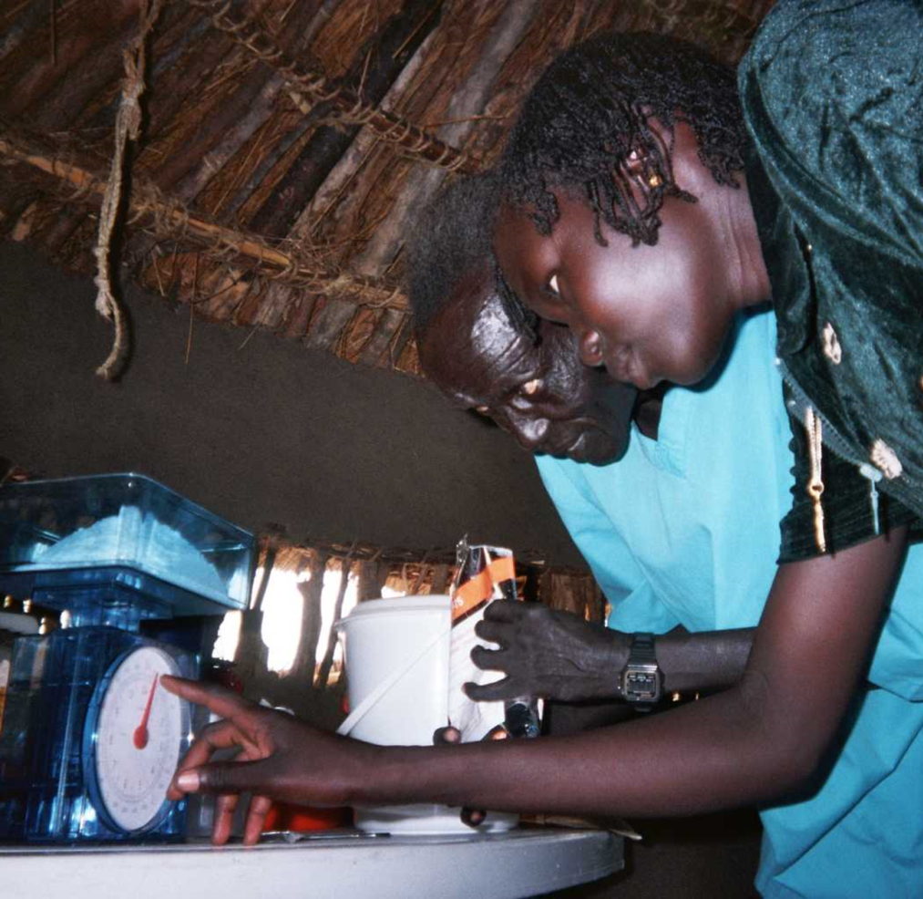
Inpatient treatment of SAM in Stabilization Centers
For children with SAM with complications and infants with SAM 0-5 months
Stabilization phase: treatment of medical complications and commencement of cautious feeding
Transition phase: RUTF is introduced gradually, together with feeds of F100 or F75 to foster child’s weight gain
Rehabilitation phase: or catch up growth phase. In most cases this phase is now replaced by outpatient therapeutic care
UNICEF Harmonised Training-Mod 13
Notes:
IFE concerns the protection and support of safe and appropriate (optimal) feeding for infants and young children in all types of emergencies, wherever they happen in the world.
The well-being of mothers is critical to the well-being of infants and young children. So the needs of mothers - or primary caregivers – is also a key consideration in IFE.

Slide 22
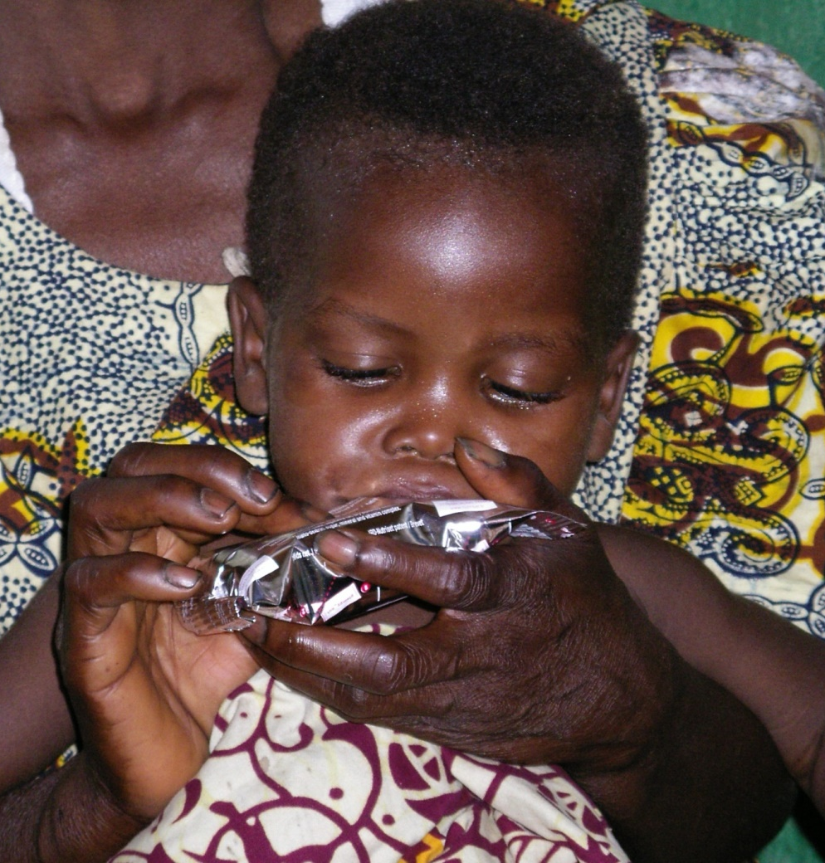
Outpatient treatment of SAM
For children with SAM without complications
Used when child will take RUTF (Ready to use therapeutic food) with a little encouragement.
Includes registration, a series of treatments and checks including vaccination, medical care and health education
UNICEF Harmonised Training-Mod 13
Notes:
IFE concerns the protection and support of safe and appropriate (optimal) feeding for infants and young children in all types of emergencies, wherever they happen in the world.
The well-being of mothers is critical to the well-being of infants and young children. So the needs of mothers - or primary caregivers – is also a key consideration in IFE.

Slide 23
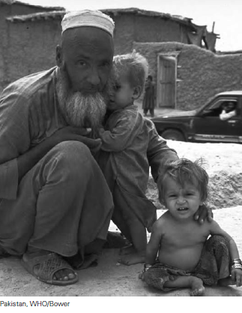
Targeted supplementary feeding programmes
For children with MAM, malnourished pregnant and breastfeeding mothers, and other nutritionally at-risk individuals
Provides nutritional support (Ready to use supplementary food – RUSF) and routine treatment to individuals with MAM.
Notes:
IFE concerns the protection and support of safe and appropriate (optimal) feeding for infants and young children in all types of emergencies, wherever they happen in the world.
The well-being of mothers is critical to the well-being of infants and young children. So the needs of mothers - or primary caregivers – is also a key consideration in IFE.

Slide 24
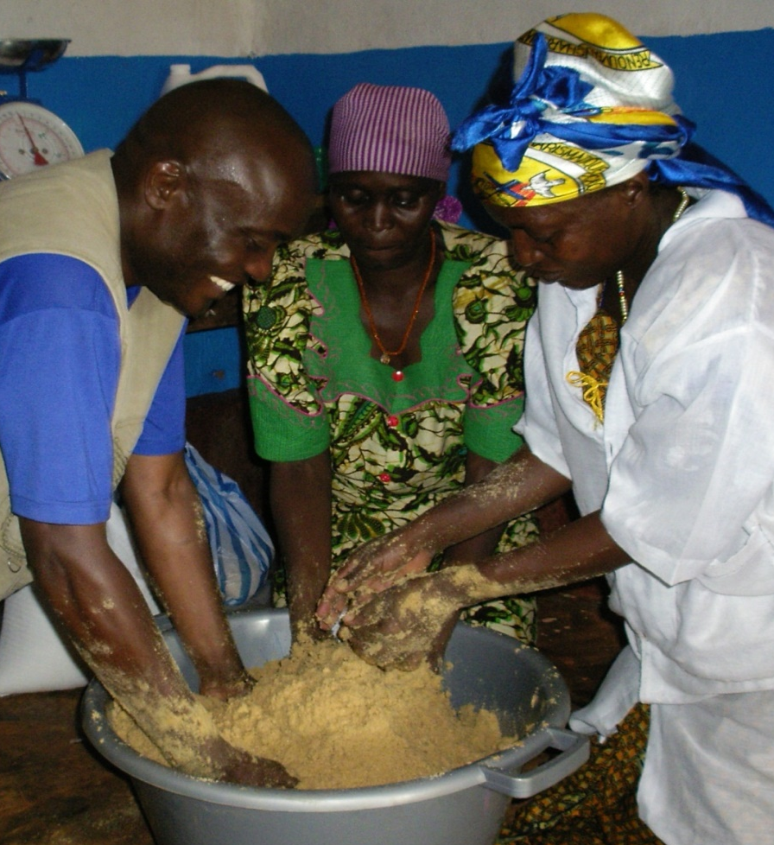
Blanket supplementary feeding programmes
Targets a food supplement to all members of a specified at risk group (age or status), regardless of whether they have acute malnutrition.
Could be distributed as a wet or dry ration.
It aims at prevent further deterioration of the group and reduce GAM.
UNICEF Harmonised Training-Mod 12
Notes:
IFE concerns the protection and support of safe and appropriate (optimal) feeding for infants and young children in all types of emergencies, wherever they happen in the world.
The well-being of mothers is critical to the well-being of infants and young children. So the needs of mothers - or primary caregivers – is also a key consideration in IFE.

Slide 25
Nutrition-specific
Providing food supplementation products for home-based fortification
Distribution of micronutrient supplements
Promotion of recommended infant feeding practices
Deworming
Prevention and management of acute malnutrition
Prevention and treatment of micronutrient deficiencies
IYCF-E

Slide 26
The Nutrition Cluster partially covers MNDs…
Increasing income and improving access to markets
Promotion of homestead food production and agricultural development
Providing food supplementation products for home-based fortification
Providing fortified foods
Deworming
Including nutrient-rich foods
Prevention and treatment of MNDs
Distribution of micronutrient supplements
Providing fresh food items
Increasing the size of the general food ration to facilitate diet diversification by exchange or trade
Promotion of recommended infant feeding practices
Ensuring adequate health care and environment

Slide 27
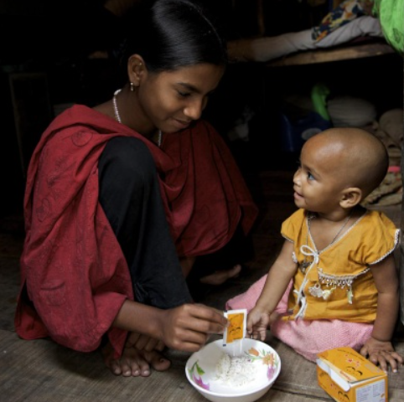
Providing food supplementation products for home-based fortification
Micronutrient powders for children
Lipid-based Nutrient Supplements (LNS) for children and/or other groups
UNICEF Harmonised Training-Mod 17
Notes:
IFE concerns the protection and support of safe and appropriate (optimal) feeding for infants and young children in all types of emergencies, wherever they happen in the world.
The well-being of mothers is critical to the well-being of infants and young children. So the needs of mothers - or primary caregivers – is also a key consideration in IFE.

Slide 28
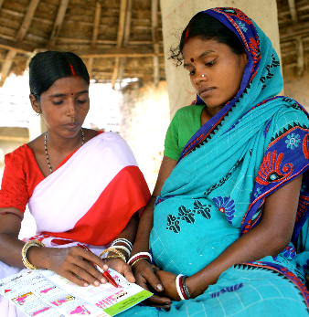
Distribution of micronutrient supplements
Vitamin A capsules for children
Iron and folic acid or micronutrient tablets for pregnant women
UNICEF Harmonised Training-Mod 17
Notes:
IFE concerns the protection and support of safe and appropriate (optimal) feeding for infants and young children in all types of emergencies, wherever they happen in the world.
The well-being of mothers is critical to the well-being of infants and young children. So the needs of mothers - or primary caregivers – is also a key consideration in IFE.

Slide 29
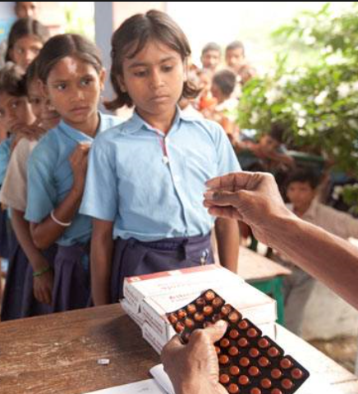
Deworming
Periodic treatment with anthelminthic (deworming) medicines, without previous individual diagnosis to all at-risk people living in endemic areas.
People at risk are:
preschool-aged children
school-aged children
women of childbearing age
UNICEF Harmonised Training-Mod 17
Notes:
IFE concerns the protection and support of safe and appropriate (optimal) feeding for infants and young children in all types of emergencies, wherever they happen in the world.
The well-being of mothers is critical to the well-being of infants and young children. So the needs of mothers - or primary caregivers – is also a key consideration in IFE.

Slide 30
Complementary feeding support
Handling milk and milk products including donations
Skilled breastfeeding support
Infant feeding in context of HIV
Policy guidance and framework
Management of artificial feeding
Orientation and training on IYCF-E
Communication
Nutrition-specific
Prevention and management of acute malnutrition
Prevention and treatment of micronutrient deficiencies
IYCF-E

Slide 31
Optimal IYCF recommendations
Early initiation of breastfeeding (within 1 hour of birth)
Exclusive
breastfeeding
(0-<6m)
Safe and appropriate infant and young child feeding in emergencies
Continued breastfeeding
(2 years or beyond)
Timely introduction of quality complementary
food (from 6 months)
Notes:
What are optimal IYCF recommendations?
Safe and appropriate IYCF practices are optimal practices to minimise morbidity and mortality:
Optimal IYCF recommendations are:
Early initiation of exclusive breastfeeding (EBF) – this means breastfeeding within 1 hour of birth
EBF for 6 months – exclusive breastfeeding means an infant receives only breastmilk, no other liquids or solids, not even water, with the exception of necessary vitamins, mineral supplements or medicines.
Continued breastfeeding to 2 years or beyond.
Complementary feeding encompasses continued breastfeeding, the introduction of complementary foods, and how that is done in the nutritional and developmental interests of the child.

