Slide 1
2.4 Inter-cluster Coordination and IM
INFORMATION MANAGEMENT

Slide 2
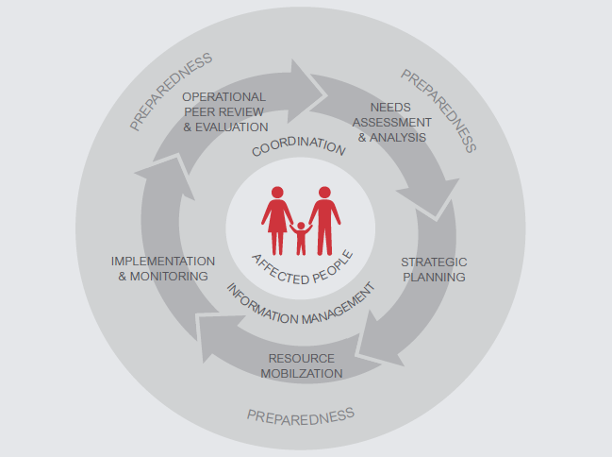

Slide 3
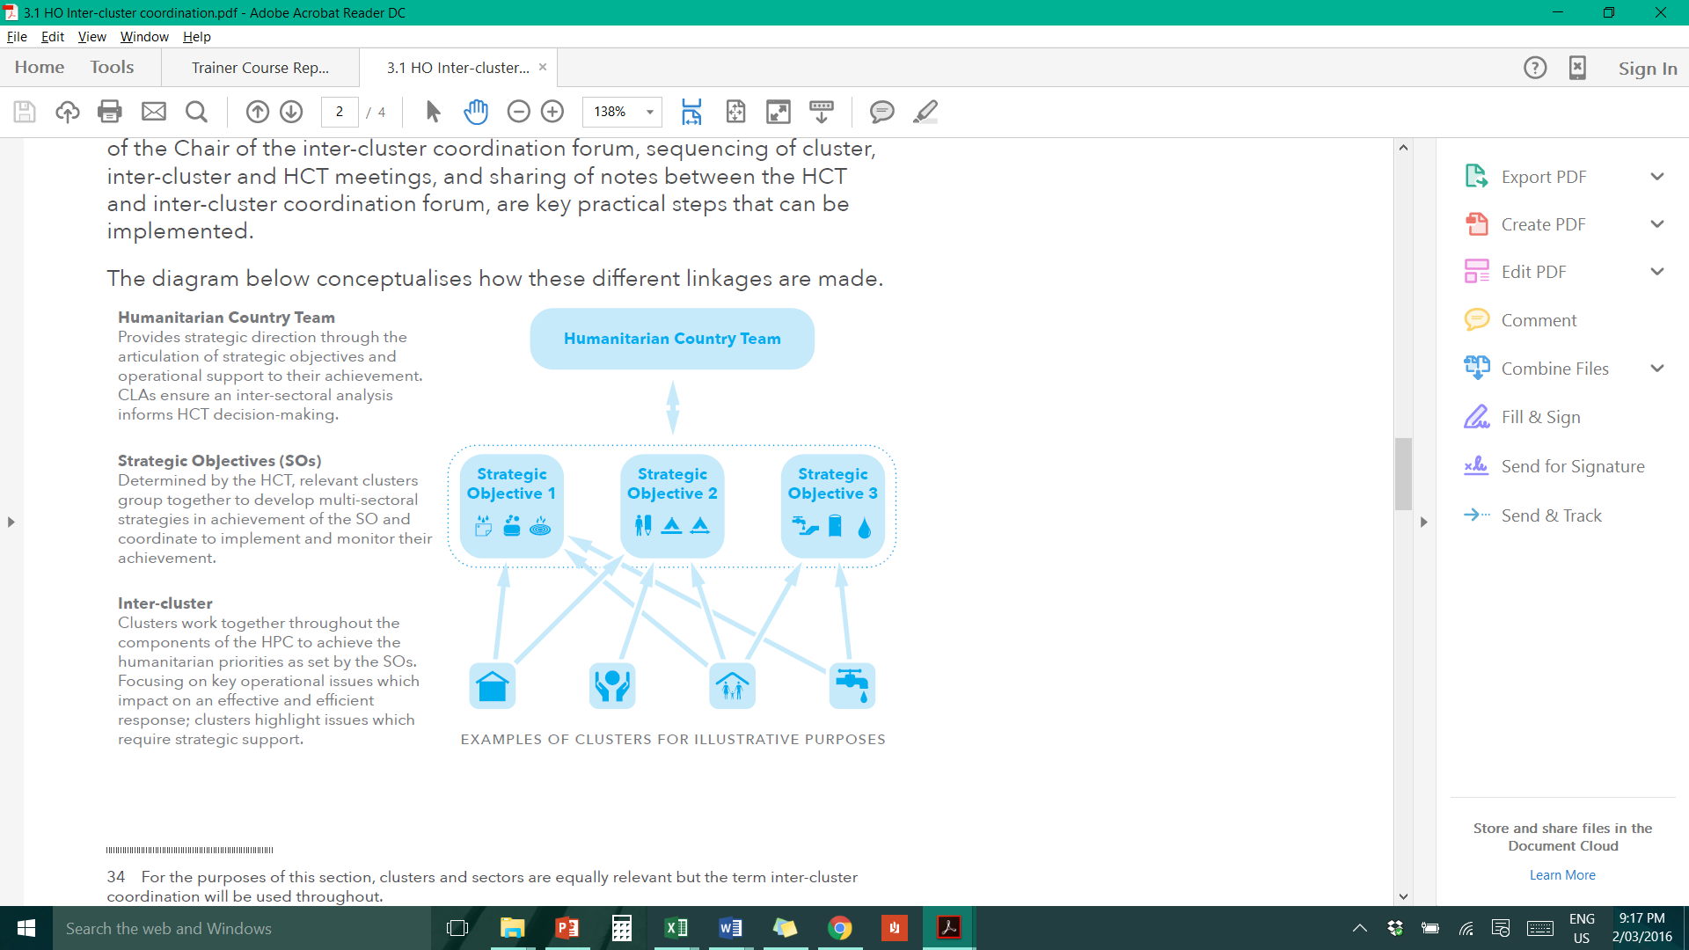
Inter-Cluster Coordination

Slide 4
Inter-Cluster Coordination Mechanism
Convened regularly by the RC/HC
Coordinated by OCHA
Opportunity for clusters to meet through each CC’s representation.
Shared planning and outputs, including HNO, HRP, Flash Appeal, needs assessments and Pooled Funds, among others.

Slide 5
Intercluster IMWG Objectives
In order to provide the humanitarian community with improved information management guidance and tools, the primary objectives of the IMWG are to:
Strengthen needs assessments efforts from an Information Management perspective;
Enhance the effectiveness of data and information sharing and management within the cluster approach;
Produce agreed guidance and information systems to implement humanitarian information management in the field;
Develop a framework for monitoring the effectiveness of IM in humanitarian emergencies.

Slide 6
Examples of IMO inter-cluster work
What examples can you give?
Needs assessments and analysis: nutrition survey – include hygiene practices
Strategic planning: provide CC data on proportion of SCs that do not have adequate WASH facilities for discussion with WASH cluster
Resource mobilisation: Exchange info on funding for inter-cluster projects with other clusters/sectors
Implementation and monitoring: Exchange programme and monitoring data on inter-cluster interventions with e.g. GBV sub cluster or PSEA task force

Slide 7
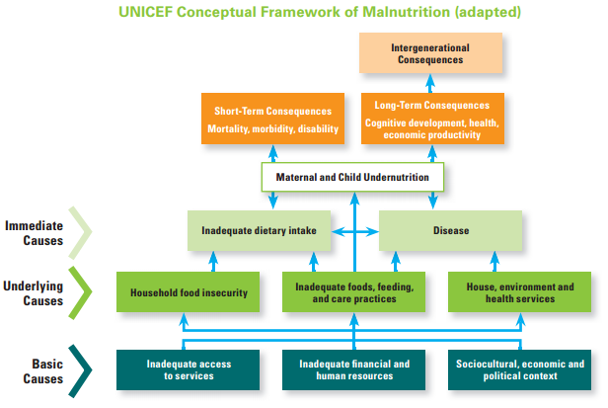

Slide 8
GNC IM Toolkit
Dashboards templates
Key datasets
Surveys database
IM Checklist
HRP tips
4 W
HIR
Map examples/ templates
Gap analysis tool
M&E Framework
Caseload targets & supplies
IM Update PPT template
Partners reporting tool
Capacity mapping
Financial tracking tool
BMS Code Violations tracking
Country bulletin template
ToR for IMO
Meeting agenda template
Web-site for HR.info Guide
Meeting minutes template
NC Style Guide
Contact list template
IMO handover template

Slide 9
GNC IM Toolkit
Dashboards templates
Key datasets
Surveys database
IM Checklist
HRP tips
4 W
HIR
Map examples/ templates
Gap analysis tool
M&E Framework
Caseload targets & supplies
IM Update PPT template
Partners reporting tool
Capacity mapping
Financial tracking tool
BMS Code Violations tracking
Country bulletin template
ToR for IMO
Meeting agenda template
Web-site for HR.info Guide
Meeting minutes template
NC Style Guide
Contact list template
IMO handover template

Slide 10



Key datasets tool
 | The key datasets tool is an Excel-based spreadsheet which was created to inform decision-making and assist in producing useful information.
 | Contains a list of key datasets and sources of information Classified according to geo-data, food security, WASH, health, nutrition and people
 | GNC maintains the tool and IMO/NC use it as needed.

Slide 11
Exercise: Identifying multi-cluster key datasets to inform responses
Using your assigned scenario, identify key datasets that would be used to inform planning
  Group 1: Cyclone Haiyan, Philippines
  Group 2: Conflict, IDPs and food security, South Sudan
  Group 3: Ebola crisis, Sierra Leone, Liberia and Guinea
  Group 4: Syrian refugee crisis, Jordan
  Group 5: Sahel-Food insecurity

Slide 12
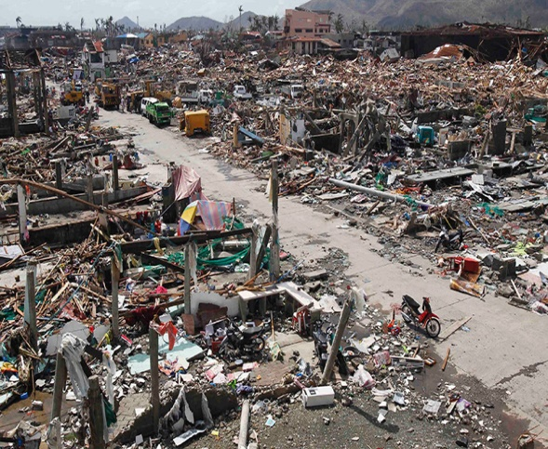
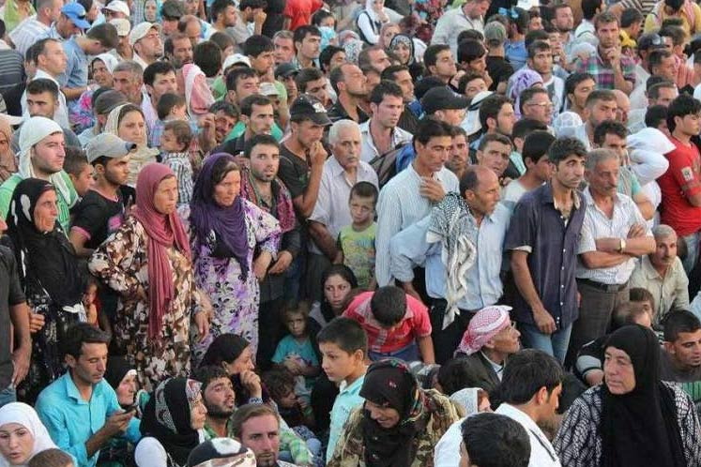
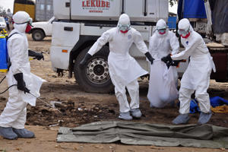
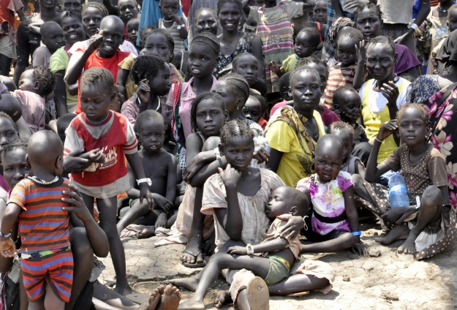
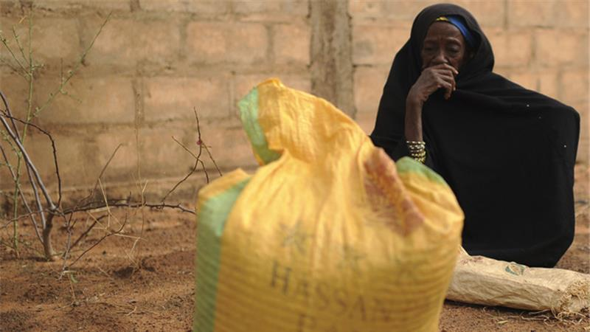
Cyclone Haiyan – Philippines 2014
You are here
Syrian Refugees in Amman, Jordan, 2014/2015
Ebola response Sierra Leone, Liberia, Guinea 2014/2015
Conflict IDP and food security crisis South Sudan 2014/2015
Sahel Food insecurity 2011-2015
Notes:
Divide participants into teams of four (can reduce number of photos depending on group size)
10mins to identify who would be the key players involved in a response to their particular emergency
Note these on a flip-chart and designate someone to briefly summarise in plenary
Debrief by going through and highlighting any gaps as well as country-specific differences and similarities
LEAVE UP FOLLOWING SLIDE DURING THE EXERCISE

Slide 13
Tips for Inter-Cluster IMOs
Draw support
from OCHA
Use matrices to identify
overlap/gaps
Be
Proactive!!
Advocate for
Nutrition
Share information
Be prepared to compromise
Encourage attendance
at other cluster meetings
Build relationships
outside meetings
Notes:
- Ensure regularity and joint decision-making
Understand role of cluster leads, chairs & co-chairs: Demand lead agency and HC support and engagement - Coordination requires Cluster leads to be pro active and not wait for HC/RC to direct them.
Advocate for support (from HC/RC and OCHA) but also support their roles!
Be willing to compromise (a little!) in inter-cluster prioritisation of resources
Encourage attendance at other cluster meetings
Regular Bilateral connections between cluster leads are required in addition to cluster leads meetings – do you (or your cluster members) need to be attending other cluster meetings??
Identify areas of potential overlap/gaps: Awareness of and identification of areas of potential overlap/gap with other clusters is necessary to deal with issues through the cluster rather than on crisis management basis. To support this Matrices have been developed with other key clusters e.g. Nutrition
Share information
Share strategies, plans, and initiatives as widely as possible
Spend time on strategic and contingency planning (it may feel like a waste of time but it is critical to the response)
Contribute to inter-cluster IM (3W, sitreps, mapping) – it’s in everyone’s interest
Be proactive
REMEMBER: Your internal cluster activities will be much more effective if the inter-cluster environment is robust and effective!
Ensure common messaging to donors on priority needs and response plans
Speak with a common voice to govt, NSAs, military, and other entities

