Slide 1
2.6 Emergency Response Preparedness
INFORMATION MANAGEMENT

Slide 2
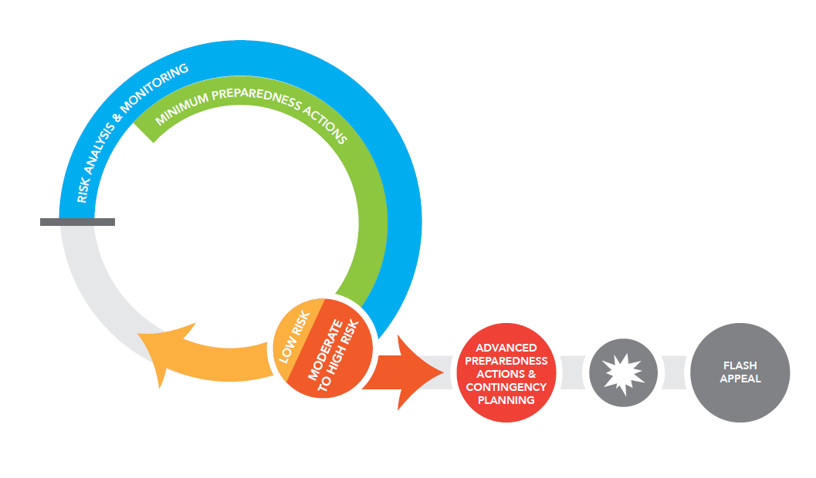
Emergency Response Preparedness

Slide 3
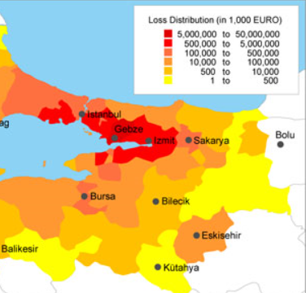
1. Risk Analysis and Monitoring
A clear and common understanding of the risks which may trigger a crisis significant enough to require a coordinated humanitarian response is fundamental to the entire ERP process.
It involves analysis of risks (hazards, likelihood and impact), development of contingency plans for higher-level risks.
Notes:
At the global level, cluster leads are responsible for:
up-to-date assessments of the overall needs for human, financial, and institutional capacity;
reviews of currently available capacities and means for their utilisation;
links with other clusters, including preparedness measures and long-term planning, standards, best practice, advocacy, and resource mobilisation;
taking action to ensure that required capacities and mechanisms exist, including rosters for surge capacity;
training and system development at the local, national, regional, and international levels.

Slide 4

2. Minimum Preparedness Actions
A set of activities that every country team must implement in order to establish a minimum level of emergency preparedness
Not risk or scenario-specific and usually do not require significant additional resources to accomplish.
Includes establishment of coordination and management arrangements, preparing for joint needs assessments, response monitoring, information management.
Notes:
At the global level, cluster leads are responsible for:
up-to-date assessments of the overall needs for human, financial, and institutional capacity;
reviews of currently available capacities and means for their utilisation;
links with other clusters, including preparedness measures and long-term planning, standards, best practice, advocacy, and resource mobilisation;
taking action to ensure that required capacities and mechanisms exist, including rosters for surge capacity;
training and system development at the local, national, regional, and international levels.

Slide 5

3. Advanced Preparedness Actions and Contingency Planning
Two sets of complementary activities that should be initiated together to plan for specific risks when risk analysis and monitoring indicate moderate or high risk.
APAs are risk-specific and are designed to advance HCT readiness.
A CP sets out the initial response strategy and operational plan to meet the humanitarian needs during the first three to four weeks of an emergency.
Notes:
At the global level, cluster leads are responsible for:
up-to-date assessments of the overall needs for human, financial, and institutional capacity;
reviews of currently available capacities and means for their utilisation;
links with other clusters, including preparedness measures and long-term planning, standards, best practice, advocacy, and resource mobilisation;
taking action to ensure that required capacities and mechanisms exist, including rosters for surge capacity;
training and system development at the local, national, regional, and international levels.

Slide 6
Emergency Response Preparedness
Led by the RC/HC and HCT
Role of the NCC
  Risk analysis and monitoring
  Minimum preparedness actions
  Advanced preparedness actions and contingency planning

Slide 7
Nutrition ERP Exercise
In 30 minutes prepare a presentation with the following sections:
What ERP actions could the NC take to improve resilience to the hazard?
What IM products could inform these actions?
What would be the benefits of effective preparedness in the scenario?

