Slide 1
3.2 Strategic Planning & IM Tools
Part 1: Gap Analysis
INFORMATION MANAGEMENT

Slide 2
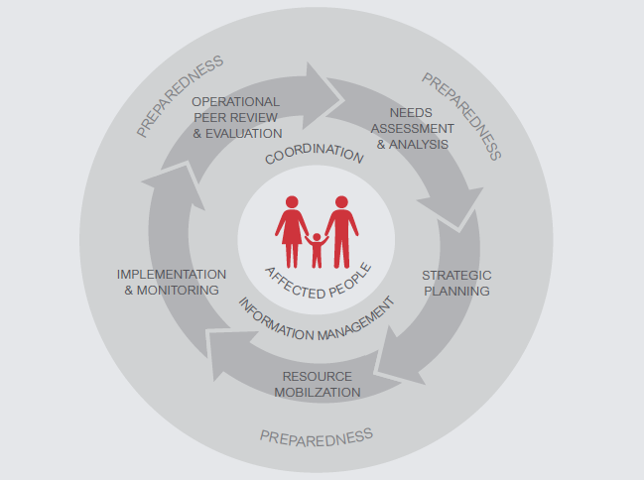
The HPC

Slide 3
Flash Appeal
Concise, top-line analysis directly related to rapid needs assessment
  Sudden onset: issued three to five days
  Protracted or slow onset: when there is an unforeseen ‘spike’ in needs or a change in the context
Sets out priority actions and preliminary requirements
Used to allocate funds for a 3-6 month duration
Project-based with financial requirements
A Flash Appeal may sit separately to an existing country HRP.

Slide 4
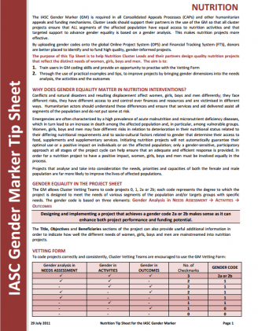
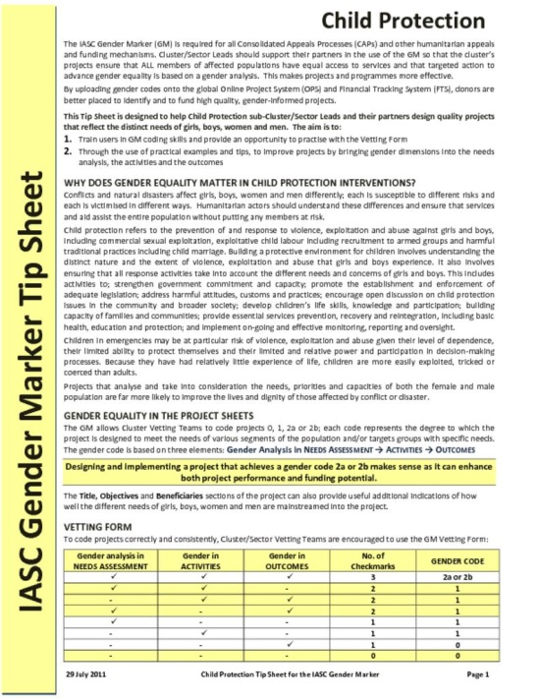
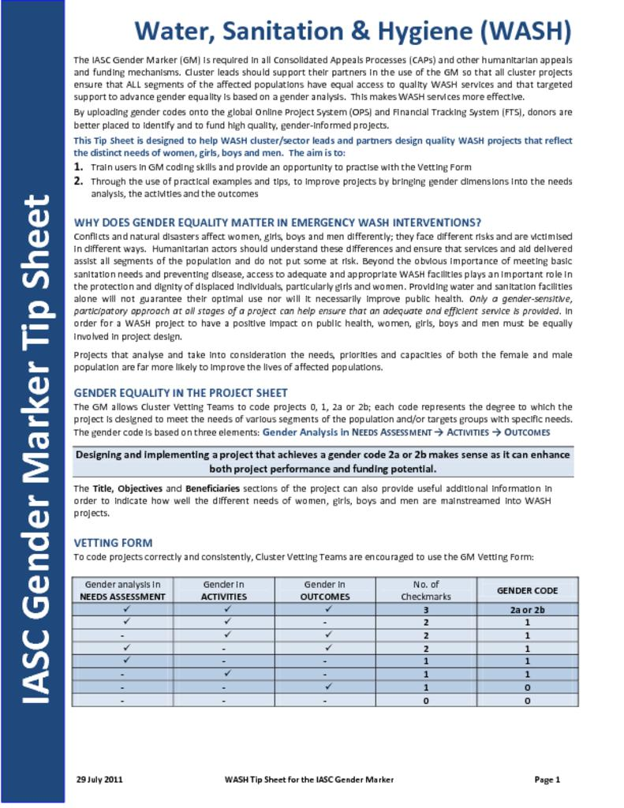
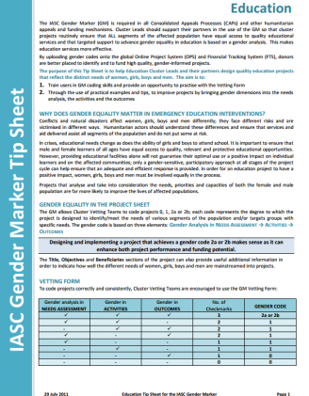
Gender considerations for planning any project
The IASC Gender with Age Marker codes projects proposals for gender equality programming.
The IASC Gender and GBV Guidelines for protection and prevention.
Because the Flash Appeal is project-based, projects must be assessed using this tool.

Slide 5
Humanitarian Response Plan
Directly related to needs assessment (HNO or occasionally a MIRA)
  Sudden onset emergencies: Revised/developed within 30 days.
  Protracted emergencies: a yearly or multi-year plan.
Sets overall direction and strategic objectives of response
2 Parts: 1) a country strategy and 2) cluster/sector response plans.
  Roles & Responsibilities
  HC/HCT define overall strategic objectives and sets priorities
  OCHA supports the planning process by consolidating data, agreeing planning figures, drafting and finalising the plan.
  The inter-cluster coordination group supports these efforts
  Clusters and cluster partners contribute to development of the plan
  And IMOs???

Slide 6
Secondary data
Needs analysis
Capacity mapping
1. Identify gaps including gender and GBV
2. Review the priority needs considering women and most marginalized
3. Establish the scope or boundaries
4. Take into account those needs being addressed by others.
5. Determine the target caseload
6. Describe the response priorities
Implement plan
Advocacy and communication
Resource mobilisation
Monitor and review

Slide 7
What GNC IM Tools inform the Strategic Planning stage?
Surveys database
Key datasets
HRP tips
4 W
HIR
Gap analysis tool
M&E Framework
Caseload targets & supplies
IM Checklist

Slide 8
What GNC IM Tools inform the Strategic Planning stage?
Surveys database
Key datasets
HRP tips
4 W
HIR
Gap analysis tool
M&E Framework
Caseload targets & supplies
IM Checklist

Slide 9



HRP Tips
 | Assists NCC and partners in strategic and project planning For IMOs: Information to support caseload calculation, indicators for interventions
 | All chapters organised in similar way with guidance on Objectives and Specific Objectives, target groups, calculating expected caseload, sample activities and tips and suggested indicators. Also provides guidance for monitoring CC and AAP
 | Guidance tool maintained by the GNC

Slide 10
Humanitarian Indicators Registry
 | Menu of indicators for countries to select relevant standard indicators. These indicators can also be adapted when needed
 | Contains needs assessment and performance monitoring indicators for all clusters Contains over 100 indicators for nutrition-specific indicators and also other sector indicators that can be relevant for the nutrition cluster
 | Maintained and managed at global level for the use at country level

Slide 11
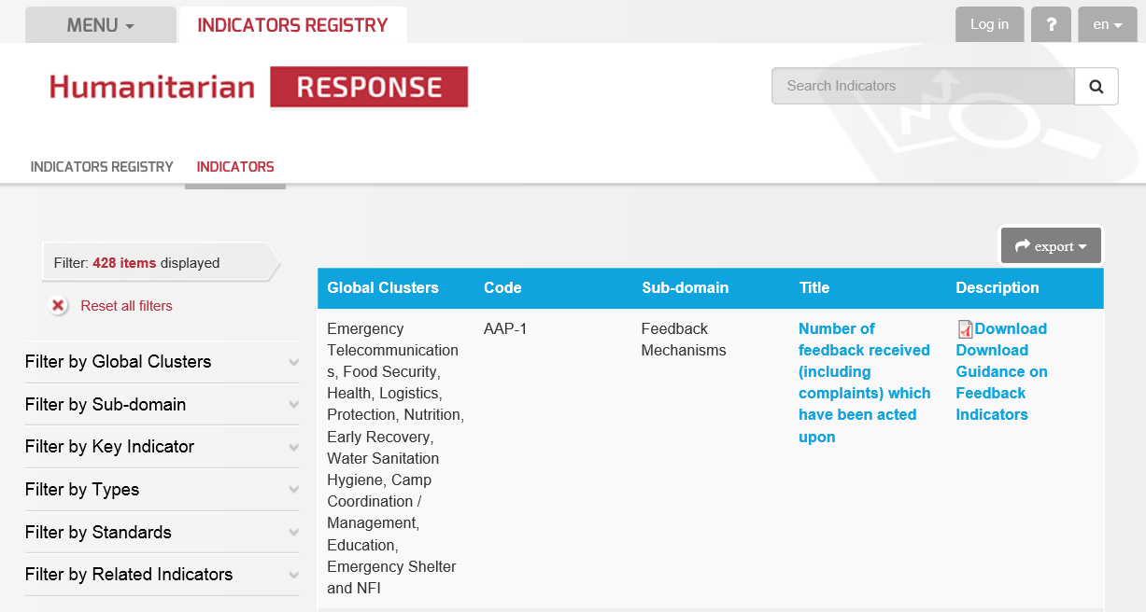
https://www.humanitarianresponse.info/applications/ir/indicators

Slide 12
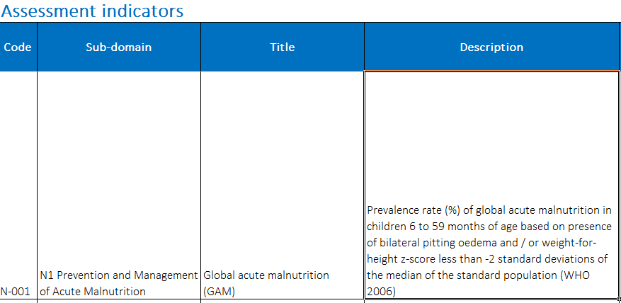
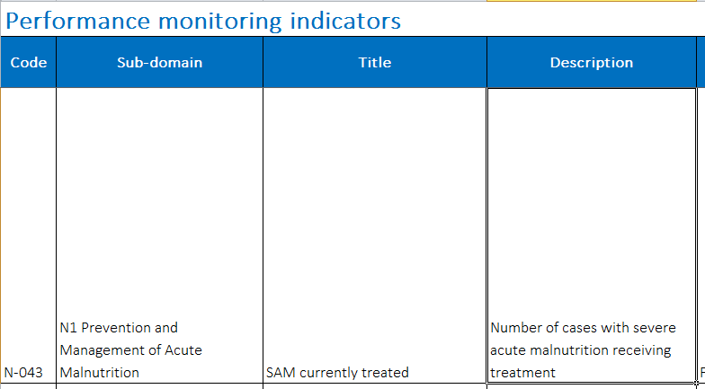
Nutrition-related indicators available as Excel file in IM Toolkit

Slide 13
3W/4W-Who’s doing what, where and when
 | Shows operational presence of NC partners and locations within an emergency. It is a tool that is used to avoid duplications and to identify gaps.
 | Adaptable to the context Can be used in other forms, such as web-based platform
 | Cluster partners submit 4W data to be analysed by the IMO IMO compiles, analyses and validates the information and produces information products on the basis of it Submitted to OCHA to produce inter-cluster reports

Slide 14
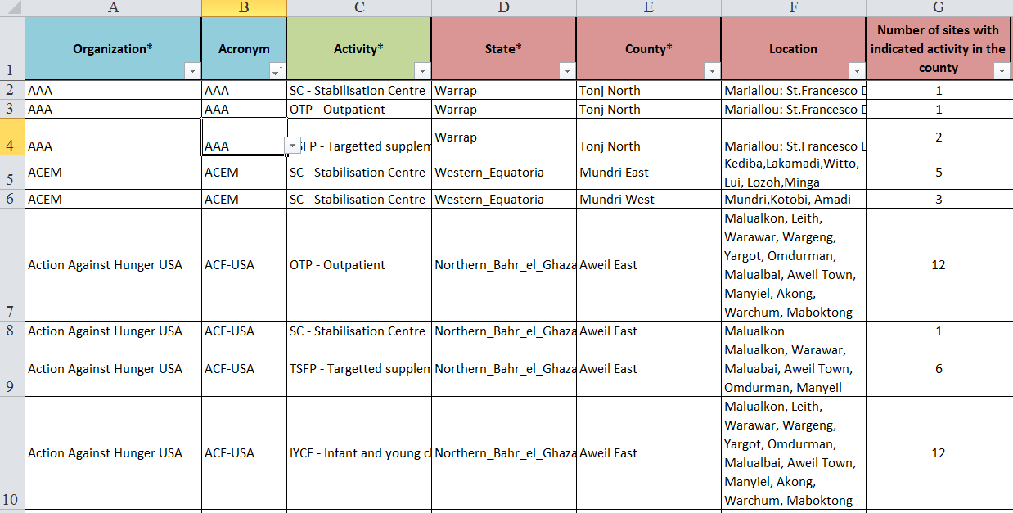
Input Sheet on 4W

Slide 15
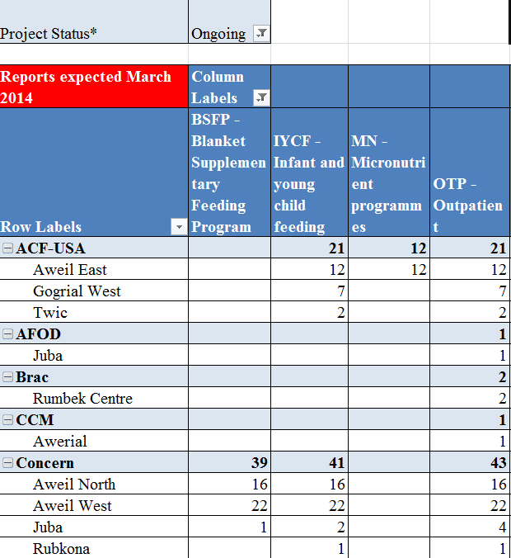
4W Information
Organisation details
Organisations by county
Nutrition organisations per programme
Agencies per county per programme
Ongoing programmes

Slide 16
Gap Analysis Computer Lab
INFORMATION MANAGEMENT

Slide 17
Gap analysis tool
 | The Gap analysis tool is an adaptable Excel database tool It was created to easily identify gaps to in resources, geographical coverage, guidelines, funding, assessments, progress towards targets.
 | Contains spreadsheets with information about geographical coverage, guidelines, funding, assessments, progress towards targets. The GNC is currently developing a word template for consolidated gap analysis report, that is based on the use of current tool
 | The Gap analysis tool would likely be maintained by IMO

Slide 18
Exercise: Gap analysis tool
Using the 3W, complete what you can in the Geographic Coverage spreadsheet in the Gap analysis tool (15 minutes)
Debrief questions
What information is missing to be able to fully complete the Geographic Coverage?
What would be possible sources of information to complete the spreadsheet?
What strategies could be used for gathering the missing data?

