Slide 1
3.3 Strategic Planning & IM Tools
Part 2: M&E Framework
INFORMATION MANAGEMENT

Slide 2
Focus on INDICATORS
Notes:
Source: UCL + Makerere University School of Public Health, Uganda

Slide 3
Indicators
An indicator is a measure that is used to show change in a situation, or the progress in/results of an activity, project, or programme.
Indicators:
  enable us to be “watchdogs”;
  are essential instruments for monitoring and evaluation.
  are objectively verifiable measurements
Notes:
Source: UCL + Makerere University School of Public Health, Uganda

Slide 4
Common terminology
Baseline indicators measure the baseline or current situation e.g. numbers of participation for women and men from different age.
Process indicators measure how the delivery of goods and/or services is done. These indicators can be used for individual project monitoring (not in the HRP), e.g. the numbers of women and men staff to provide services
Output indicators measure the delivery of goods and/or services to a targeted population. (not in the HRP), numbers of women and girls participation in reproductive health services
Outcome indicators are the likely or the achieved short-term and medium-term effects of an intervention’s outputs. usually used in HRPs, e.g. % of women and girls have improved nutrition situation

Slide 5
What are the qualities of a good indicator?
Specific
Measurable
Achievable
Relevant
Time-bound
The Sphere Project provides the most
accepted indicators for nutrition and
food security interventions in emergencies: see Module 21.
And there is also the SMART initiative….
Standardised Monitoring and Assessment in Relief and Transition
Initiative - interagency initiative to improve the M&E of humanitarian assistance
Notes:
Source: MTV for UCL + Makerere University School of Public Health, Uganda
What are the characteristics of a good indicator?
A good indicator is SMART:
S for SPECIFIC:
By specific, we mean that it specifies the magnitude of the attribute that we’re measuring in a particular time frame and for a particular population
In other words, that they measure what they’re supposed to measure… blood retinol measures vitamin A status (not iron status, not any other vitamin…)
Can you think of another word starting with “S” that describes a good indicator? Good! it’s SIMPLE: clearly and precisely defined
M for Measurable:
Measurable indicators are objective: we are able to quantify them
You can measure the temperature, you can count how many correct answers students get on a test, you can observe if someone is washing their hands before they handle food
Can you think of other examples of indicators and how to measure them?
A for Achievable:
Achievable indicators means that we can actually obtain them: you need to have the resources and capacities to collect, store and process the information obtained from that indicator
R is for relevant:
Relevant to you project, your situation
And T is for Time bound:
Always stating the time period in which that indicator was measured
Beginning and end of projects are commonly used time-marks
Seasons and seasonality too: amount of grain produced in the month of July, total sales in the pre-holidays season, malnutrition rates in the lean (or hungry) season preceding the harvest.
Can you think of other examples of indicators that are time-bound?
SMART Initiative[1]
The Standardised Monitoring and Assessment in Relief and Transition (SMART) Initiative - is an interagency initiative, begun in 2002, to improve the M&E of humanitarian assistance interventions through:
• The development of standardised methodologies for determining comparative needs based on nutritional status, mortality rate and food security.
• Establishing comprehensive, collaborative systems to ensure reliable data is used for decision-making and reporting
A Standardised Training Package (STP) for SMART methodology has recently been released.
[1] More information available at http://www.smartmethodology.org/

Slide 6
Types of indicators
Indicators exist in many different forms:
Examples?
Direct
Direct indicators correspond precisely to results at any performance level.
Indirect or "proxy" indicators demonstrate the change or results if direct measures are not feasible.
Indirect / proxy
Quantitative
Indicators are usually quantitative measures, expressed as percentage or share, as a rate, etc.
Indicators may also be qualitative observations (e.g. Changes in gender roles within the HH food consumption).
Qualitative
Global / standardised
Standardised global indicators are comparable in all settings.
Other indicators tend to be context specific and must be developed locally.
Locally developed
Notes:
Source: UCL + Makerere University School of Public Health, Uganda
Direct - Number of children with acute malnutrition
Proxy – diet composition for nutritional status

Slide 7
Impact
Malnutrition rates amongst young
children reduced
Related to Goal
Outcome
Related to Objectives (or Purposes)
% of young children
getting appropriate
complementary food
Output
X number of mothers
know about good
complementary food and
how to prepare that
Related to results
of activities
Input
Related to Activities/Resources
Nutritional education to mothers on complementary food
Notes:
Source: UCL + Makerere University School of Public Health, Uganda

Slide 8
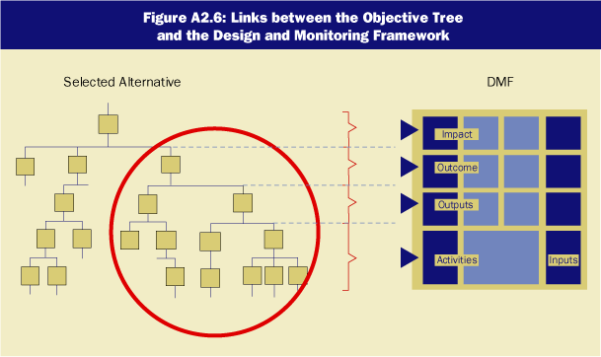



Notes:
All the previous terms, such as impact, outcome, etc can be put in this ‘tree’. It is just a different way of putting them together.

Slide 9


What is a Log Frame?
The logical framework or logframe is an analytical tool used to plan, monitor, and evaluate projects.
We use a results-based approach
?
?
?
Victim of a log frame?
?
Notes:
The logical framework or logframe derives its name from the logical linkages set out by the planner(s) to connect a
project’s means with its ends.

Slide 10
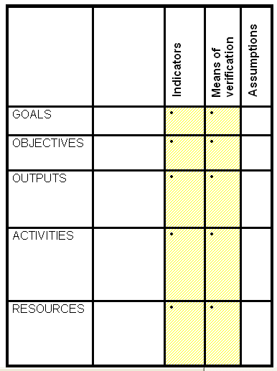
Results-based approach
IMPACT
OUTCOME
INPUTS
Notes:
Log frames appear in different shapes and with different names sometimes, but overall they look like this.

Slide 11
Results-based approach for M&E
Project description | Indicators | Source / means of verification | Assumptions / risks
Goal
Objectives / outcomes
Deliverable outputs
Activities
If the OBJECTIVES are produced, then this should contribute to the overall GOAL
If OUTPUTS/RESULTS are produced, then the OBJECTIVES are accomplished
If adequate ACTIVITIES are conducted, then OUTPUT/RESULTS can be produced
If adequate RESOURCES/INPUTS are provided; then activities can be conducted
Notes:
This is another way of showing a log frame
11

Slide 12
Activities versus Results
Completed activities are not results.
e.g. a hospital was built, does not mean that injured and sick people can be treated in the hospital, maybe the hospital has no water and the beds have not been delivered.
Service providers behaviour are gender insensitive or safety issues for women and girls, in particular are poor.
Results are the actual benefits or effects of
completed activities:
e.g. Injured and sick people have access to a fully functional health facility.
Increased number of women and girls from reproductive age availed services and or,
increased number of GBV cases are responded.
*

Slide 13
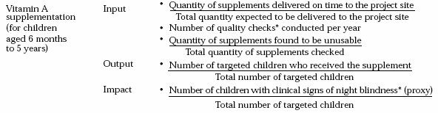
Example
Need to align language should be outcome not impact
Notes:
More examples to illustrate the aforementioned theory. This example shows Vit A supplementation, but in a reversed order, starting with input and then subsequently working its way down to impact.

Slide 14
Another Example…
Need to align language should be outcome not impact
*

Slide 15
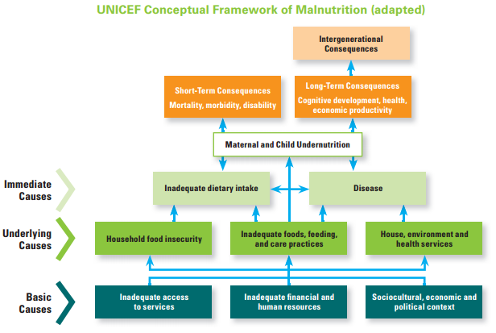

Slide 16
Key messages
The monitoring of nutrition interventions in emergencies is an integral part of saving lives and maintaining nutrition status of the affected population.
Successful monitoring systems allow for improvements in interventions in ‘real time’.
Involving communities in M&E places the affected population at the heart of the response, providing the opportunity for their views and perceptions to be incorporated into programme decisions and increases accountability towards them.
A common mistake of designing M&E systems is creating a framework which is overly complex. Always make an M&E system practical and doable.
The logical framework or logframe is an analytical tool used to plan, monitor, and evaluate projects. We use a results-based approach.
Notes:
The logframe structure is the structure of the HRP and MF

Slide 17
M&E Framework computer lab
INFORMATION MANAGEMENT

Slide 18



M&E Framework
 | Used to agree on what and how should be monitored and to track cluster progress toward targets defined in the HRP Encourages a participatory approach to M&E with partners Encourages a participatory approach to M&E with the representation from the affected people, particularly women and marginalized
 | Defines what is to be monitored The activities required and who is responsible When M&E will take place and methodologies to be used What resources are required and committed
 | The IMO manages the data in the spreadsheet and leads the discussions with cluster coordinator and partners and regularly updates the data on cluster achievements

Slide 19
Exercise: M&E framework tool
The resources for the exercise will be the Nutrition Indicators Registry and the M&E Framework tool from the IM Toolkit and the M&E Exercise Handout.
Complete the M&E Framework spreadsheet for your assigned objective.
You will present back to the plenary on one specific objective.
(45 minutes)

