Slide 1
3.4 Resource Mobilisation & IM Tools: Part 1: Finance
INFORMATION MANAGEMENT

Slide 2
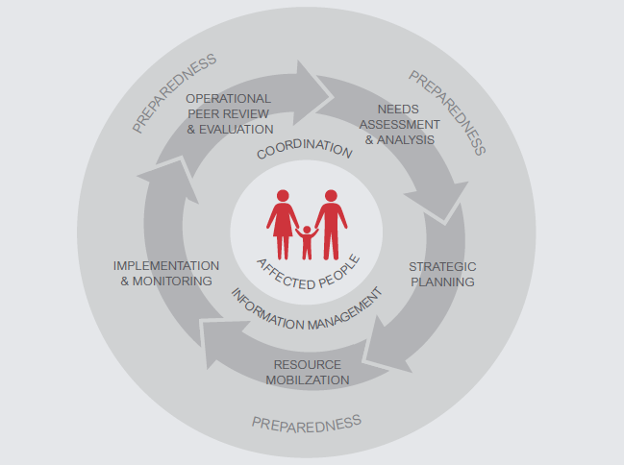
The HPC

Slide 3
IMO Role in Resource Mobilisation stage of the HPC
IMO responsibilities include support to the NCC in resource mobilisation by ensuring availability of the up-to-date information on:
Financial Resources
Human Resources
Supplies

Slide 4

Role of the Cluster Coordinator
Have an overview of funding requirements and available funds with inputs from partners through Financial Tracking System (FTS)
Establishes the funding gaps and advocates on behalf of the cluster
And the role of IMO?
Notes:
NCC has overarching responsibility to ensure that the Cluster mobilizes the funding necessary to address priority needs for nutrition in emergencies. The NCC needs to have overview of funding requirements to fulfill the strategic response plan.

Slide 5
Role of the IMO
Consolidates inputs from the partners on funding received through Cluster financial tracking tool
Establishes the funding gaps and presents to the CC and the cluster partners

Slide 6
What GNC IM Tools inform the Resource Mobilisation stage?
HRP tips
Financial tracking tool
Capacity mapping
Caseload targets & supplies
IM Checklist

Slide 7

Humanitarian Financing
  Financing of strategic objectives and cluster plans through…
    Agency, issue and situation specific resource mobilization, particularly for women and girls e.g. nutrition spending by groups (women, men, boys and girls etc.).
    Central Emergency Response Fund (CERF)
    Country-based Pooled Funds
    Private sector / civil society
    National governments
  bilateral donations
  multilateral donations
    NOTE: Financing is per SO (budget per SO!)

Slide 8
Central Emergency Response Fund (CERF) (approx.10% of funding)
Rapid Response Grant and Grant for Underfunded Emergencies;
Disbursed by OCHA only to UN agencies and IOM;
Grant to jump start critical operations and fund life-saving operations based on Strategic Statement / HRP objectives, considering gender and protection criteria;
Cluster in consultation with partners identify priority areas for funding, including funds for cluster coordination;
Cluster Coordinator ensures the inclusion of nutrition cluster interventions in the CERF application submitted by CLA on behalf of UN partners;
NGOs can receive funds as implementing partners of UN agencies.
Notes:
It is administered by the Emergency Response Coordinator (ERC) in consultation with CLA agencies and HCs.
Note that the bar on NGOs receiving funds directly from CERF is not OCHA’s idea.
It came from a block of Member States in the General Assembly , and probably relates to a general uneasiness among some Member States governments about the role of NGOs in relief and development.
Perhaps it should be reviewed when the CERF is evaluated – the GA change amend its own resolutions.

Slide 9
Country-based Pooled Funds (approximately 20% of funding)
Country-based pooled funds (CBPFs) are multi-donor humanitarian financing instruments established by the Emergency Relief Coordinator (ERC).
Replacing all other country-level funds including ERF and CHF.
Managed by OCHA at country-level under the leadership of the HC.
Donor contributions to each CBPF are un-earmarked and allocated by the HC through an in-country consultative process.
Allocated based on identified humanitarian needs and priorities at country level
Allocations go to all partners of the response.
Four principles underpin the use of CBPFs:
  Inclusiveness.
  Flexibility
  Timeliness
  Efficiency

Slide 10
What GNC IM Tools inform the Resource Mobilisation stage?
HRP tips
Financial tracking
Capacity mapping
Caseload targets & supplies
IM Checklist

Slide 11
Financial tracking tool
INFORMATION MANAGEMENT

Slide 12


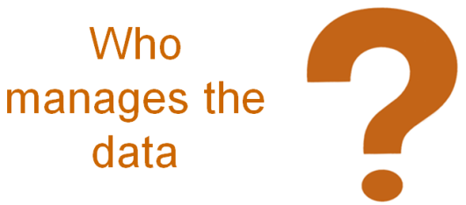
Financial tracking tool
 | The Financial Tracking tool assists the NCC to identify and communicate high priority funding gaps quickly and efficiently to enhance humanitarian response. Helps to avoid common challenges such as corruptions, double-counting of funding received.
 | Identifies: Funding requirements Funding received / committed from different sources Funding gaps for both UN agencies and implementing partners.
 | It is typically completed by partners on a regular basis. IMO consolidates and validates the data and ensure that double-counting is avoided.

Slide 13
Exercise: Financial tracking tool
In your groups review the Financial tracking tool on your computers (approx 10 minutes).
Create a flip chart answering the following questions in your group (approx 15 minutes):
What challenges do you face with regards to financial tracking in your location?
How would you collect this information?
How you collect the information on corruption among the partners and implementers?
How you calculate the loss of money and resources because of corruption?
What would be the benefits and constraints of using the Financial tracking tool?
How you will track and monitor the corruptions using the Information Management Tools?

