Slide 1
4.2 Resource Mobilisation Part 3: Supply
INFORMATION MANAGEMENT

Slide 2
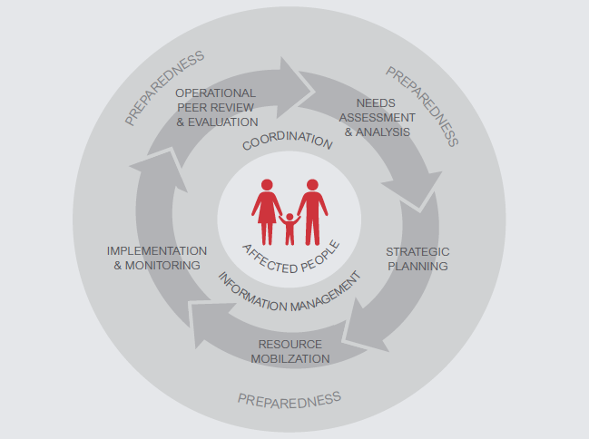
The HPC

Slide 3
IMO Role in Resource Mobilisation stage of the HPC
IMO responsibilities include support to the NCC in resource mobilisation by ensuring availability of the up-to-date information on:
Financial Resources
Human Resources
Supplies

Slide 4
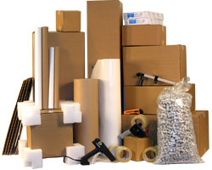
Supply
The procurement, transport and distribution of commodities necessary for programme implementation to meet the affected population’s needs.

Slide 5
Role of NCC
Coordinate between Nutrition Cluster partners…
to ensure that overall supply and equipment needs for the emergency response are regularly identified…
and that the Nutrition Cluster as a whole can identify and address any pipeline issues (‘stock-out’, temporary gaps, etc.).

Slide 6
In practical terms, the NCC responsibilities are to:
Identify supply needs and update planning figures (based on the HRP)
Promote standards for nutrition supplies and equipment.
Facilitate information exchange on type/quantity of supplies/equipment.
Anticipate import procedures and requirements.
Manage products and facilitate the planning for preposition and delivery of supplies.
Notes:
NCC Handbook Chapter 8.3

Slide 7
In practical terms, the IMO responsibilities are to:
Support NCC and cluster partners in calculating caseload, targets and supplies for the nutrition cluster response by providing technical assistance
Consolidate supplies needs, availability and gaps and share with partners
Consolidate nutrition cluster requests for supplies to be shared with logistics cluster
Notes:
NCC Handbook Chapter 8.3

Slide 8

What is the role of cluster partners in supply?
  Share information with the NCC to ensure that overall Nutrition Cluster needs for stocks of supplies and equipment are identified. Pipeline managers: share information on supplies availability and gaps. This includes information on expected pipeline breaks, risks of shortage, etc.
  Note: Some agencies have their own independent supply/equipment pipelines and do not necessarily participate in joint supply planning via the Nutrition Cluster. However, these agencies are still encouraged to share!
Willingness to make temporarily available supplies to other organisations (‘lending’)

Slide 9
Which supplies?
Supplies to:
treat and prevent SAM and MAM
address or prevent micronutrient deficiencies (iron/folate, sprinkles, vitamin A, etc.)
meet needs for IYCF-E (BMS, baby-tents, etc.)

Slide 10




Exercise: Terminology Carousel
Agree and record a definition for the term on the flip chart you are standing beside:
People Affected
People in Need
People Targeted
People Reached
People Covered
When you move to the next flip chart, add to or edit the definition that is already there.
Notes:
The following slides go more in detail on PRACTICAL roles of CLA and NCC

Slide 11
Affected people include all those whose lives have been affected in some way by the crisis. Not all affected people are in need of humanitarian assistance. This figure is often the first available after a sudden onset emergency but says little about the number of people in need for humanitarian aid

Slide 12
People in need include those affected people who require humanitarian assistance in some form. People in need represent a sub-group of affected people and may differ from sector to sector. Establishing this figure across sectors often requires a method and collaborative analytical process
People in Need = Caseload

Slide 13
The ‘need’ perspective also includes the diversified need from different groups of people, women and men, based on their age and sex, physical and mental ability and identity, social-economic background, risks of violence and vulnerabilities etc.

Slide 14
People targeted include all people the cluster system is trying to assist. This will likely be a sub-group of people in need, as there are many actors providing assistance that do not participate in the cluster system (affected communities, national authorities, Red Cross/Red Crescent movement, and NGOs).

Slide 15
The targeted people can be prioritized within the affected population and the vulnerable groups e.g. pregnant and lactating mothers, children and infants based on their nutritional and live-saving requirements.

Slide 16
People reached include those who have received some form of assistance from a cluster member. This figure says nothing about how long and how well this assistance covers the needs of the beneficiary. A more meaningful picture provides the estimate of people covered.

Slide 17
People covered indicates the number of people whose needs, defined by a humanitarian standard such as Sphere, have been met.
E.g. There is a significant difference between the two statements:
  1,000 people received water (people reached), or
  1,000 people received enough water to cover their needs (15 litres per day) for the next two weeks.

Slide 18
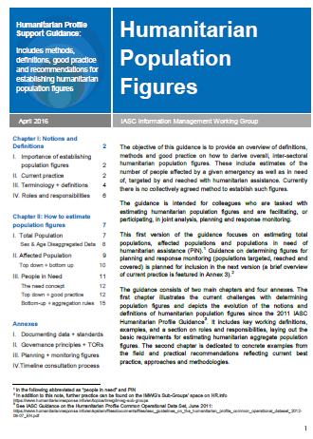
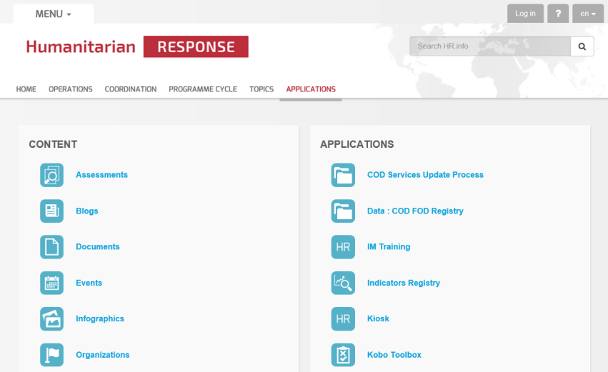
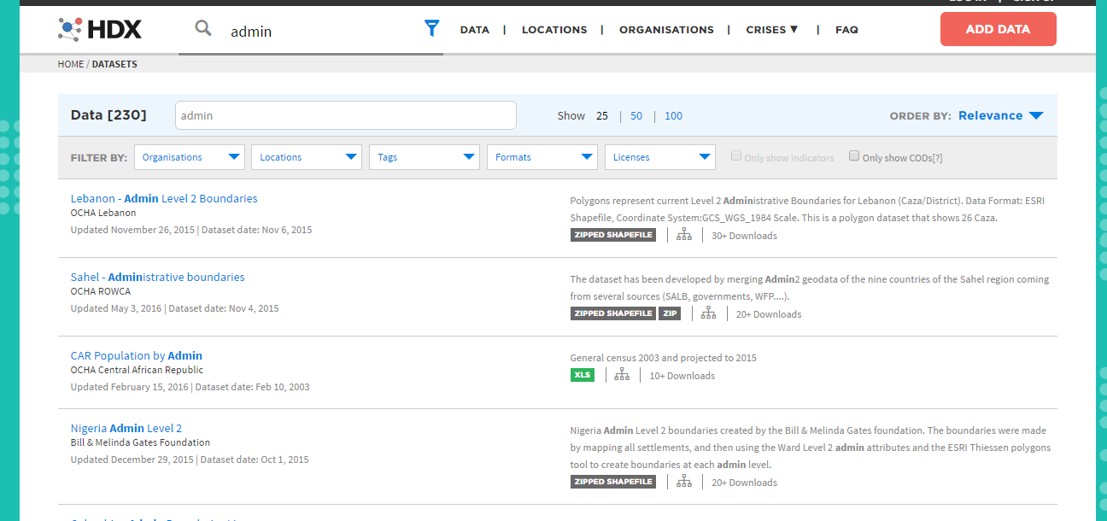
Sources for calculations

Slide 19
Caseload, targets and supplies calculation tool
INFORMATION MANAGEMENT

Slide 20
What GNC IM Tools inform the Resource Mobilisation stage?
HRP tips
Financial tracking
Capacity mapping
Caseload targets & supplies calculator
IM Checklist

Slide 21



Caseloads, targets and supplies calculation tool
 | The Caseload, targets and supplies calculation tool is designed to support calculations for planned an NC intervention. It is meant to give the cluster coordinator and partners an overview of affected population in need, population targeted with NC interventions and main supplies needed to reach the target
 | The data is entered by NCC or IMO during planning and resource mobilization stages May need to be adapted to take national standards into account
CMAM
Other interventions (BSFP, MN programmes, IYCF-E, etc.)
Selected supplies
CMAM Summary
Other interventions summary

Slide 22
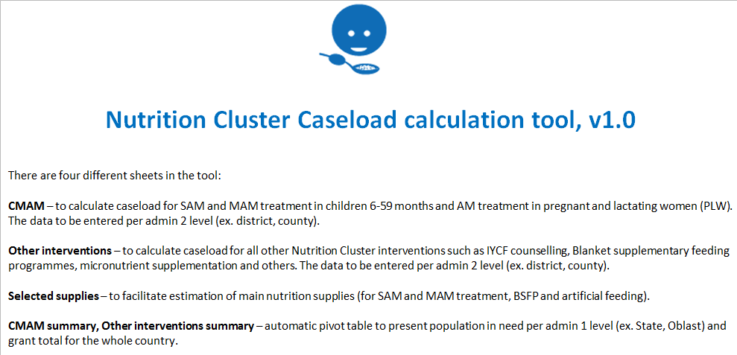
4 Sheets in the Caseload calculation tool

Slide 23
Exercise Part 1: Caseload targets calculation
Estimate the caseload and cluster target for
  SAM treatment (children 6-59 months)
  MAM treatment (children 6-59 months)
  BSFP (children 6-23 months)
  IYCF counselling (caregivers of children 0-23 months)
use “NC Caseload targets and supplies calculator” in “IM toolkit” folder
and “4.3 R Caseload Calculation Exercise Data” in “4.3 Res Mob Part 3. Supply” folder

Slide 24
Exercise Part 2: Supply calculations
Estimate the number of essential commodities needed for the activities

