Slide 1
Nutrition Cluster Advocacy

Slide 2
OBJECTIVES OF THE WEBINAR
Nutrition Advocacy in the GNC – Overview of the GNC Advocacy Strategic Framework and opportunities for global advocacy
GNC Advocacy Toolkit – A sneak peek of this tool developed to support nutrition clusters
GNC advocacy case studies – Country examples, achievements, challenges

Slide 3
Nutrition Advocacy in the GNC

Slide 4


NUTRITION ADVOCACY IN THE GNC
NUTRITION CLUSTER
ADVOCACY STRATEGIC
FRAMEWORK (2016-2019)
NUTRITION CLUSTER ADVOCACY
TOOLKIT (2016)
Notes:
Advocacy is a core Nutrition Cluster function and the Nutrition Cluster Advocacy Strategic Framework 2016-2019 is intended as a roadmap to bring direction and focus to Nutrition Cluster advocacy efforts at all levels

Slide 5
NUTRITION CLUSTER STRATEGIC FRAMEWORK - A GNC DEFINITION FOR ADVOCACY
Humanitarian nutrition advocacy is a strategic and evidence-based process aiming to influence policies, practices and behaviours that safeguard and improve the nutrition of individuals affected by emergencies.

Slide 6
NUTRITION CLUSTER ADVOCACY STRATEGIC FRAMEWORK - ADVOCACY GOALS

Slide 7
GLOBAL COMMITMENTS AND KEY NUTRITION INITIATIVES
Lancet series on maternal and child nutrition (2008, 2013)
Global nutrition targets – SDGs/WHA global nutrition targets
ICN2 – The Rome Declaration calls for the UN system to work more effectively together to support national and regional efforts, and enhance international cooperation and development assistance to accelerate progress in addressing malnutrition.
Nutrition for Growth Compact (2016) & Annual Global Nutrition Report
UN decade of action on nutrition (2016) – aims to galvanising international action on nutrition, including governments setting national nutrition targets for 2025
Notes:
SUN and REACH are platforms that help to achieve global targets and commitments

Slide 8
GNC Advocacy Toolkit

Slide 9
GNC ADVOCACY TOOLKIT
It is a practical tool developed to support the Nutrition Cluster country teams in the development of their advocacy strategies and plans and to support their implementation.
It has a focus on advocacy for nutrition in humanitarian contexts
http://nutritioncluster.net/resources/en-nutrition-cluster-advocacy-toolkit/

Slide 10
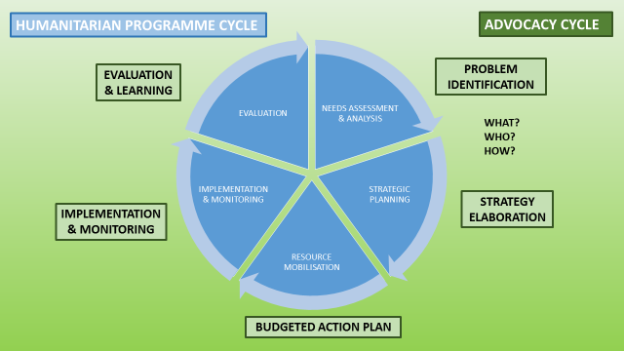
THE ADVOCACY CYCLE

Slide 11
THE ADVOCACY CYCLE
STEP 1: PROBLEM IDENTIFICATION
Selecting the issue to advocate for
  Based on the Nutrition Cluster mission and mandate and with the GNC Advocacy Strategic Framework 2016-2019 as a reference frame

Slide 12
THE ADVOCACY CYCLE
STEP 1: PROBLEM IDENTIFICATION
How do we select the advocacy issue?
Brainstorming sessions amongst partners with several exercises:
Trends Window. Helps map out and analysed potential issues for advocacy
Prioritisation checklist. Helps prioritize among the potential issues identified with the previous exercise
ONLINE SURVEYS CAN ALSO BE PREPARED AHEAD OF THE BRAINSTORMING SESSIONS TO FOCUS DISCUSSIONS

Slide 13
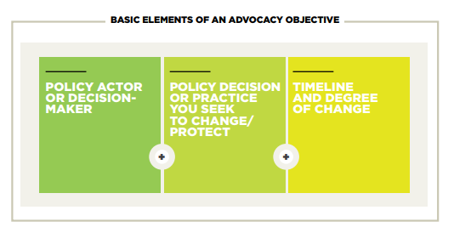
THE ADVOCACY CYCLE
STEP 2: DEFINING ADVOCACY
GOALS AND OBJECTIVES
ADVOCACY GOAL. Broad and formulated as a vision of change
ADVOCACY OBJECTIVES. Contribute to the achievement of the “bigger” goal (SMART)

Slide 14
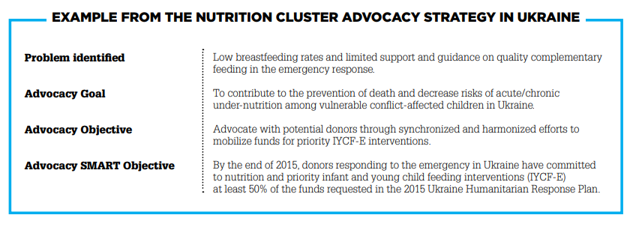
THE ADVOCACY CYCLE
STEP 1: PROBLEM IDENTIFICATION

Slide 15
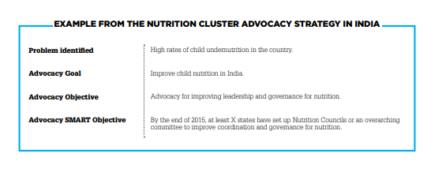
THE ADVOCACY CYCLE
STEP 2: DEFINING ADVOCACY GOALS AND
OBJECTIVES

Slide 16
THE ADVOCACY CYCLE
STEP 3: IDENTIFICATION OF
TARGETS AND ALLIES
Includes definitions of key stakeholders (targets, influencers, allies)
Includes tool for stakeholders analysis (power analysis)

Slide 17
THE ADVOCACY CYCLE
STEP 4: KEY MESSAGES
→ Examples of key messages included in the Advocacy Toolkit

Slide 18
THE ADVOCACY CYCLE
STEP 5: OPPORTUNITIES
FOR ADVOCACY
Right place, right time, talking to the right people
Important to keep track of external opportunities for advocacy (upcoming conferences, meetings, international days, … )
Tool: Advocacy Calendar – mapping processes, places, timing and actors involved

Slide 19
THE ADVOCACY CYCLE
STEP 6: ADVOCACY TACTICS
EXPERTISE AND RESEARCH
Develop research on the needs and the solutions to an issue
e.g. Policy report, policy briefing, position paper
LOBBYING
Working directly with decision-makers and influencers
e.g. Meetings with decision-makers, participation in coordination & WGs, organisation of side-events
MEDIA
Raise public awareness, influence opinion, give visibility to your issues
e.g. Press releases, media interviews, social media, blogs
PUBLIC MOBILISATION
Generate public support for your issues
e.g. Petitions, organisation of events/exhibitions
Objective of each activity, as well as key targets, examples and practical tips to develop each activity included in the Advocacy Toolkit

Slide 20
THE ADVOCACY CYCLE
STEP 6: ADVOCACY TACTICS – EXAMPLE

Slide 21
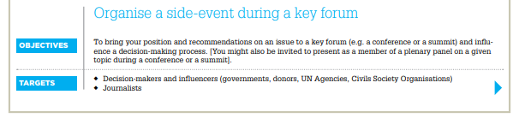
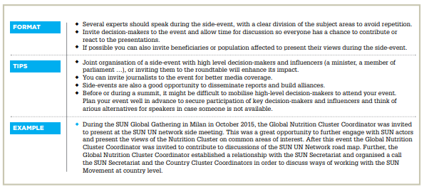
THE ADVOCACY CYCLE
STEP 6: ADVOCACY TACTICS - EXAMPLE

Slide 22
WHAT ELSE IS INCLUDED IN THE ADVOCACY TOOLKIT?
Advocacy annual action plan
How to develop an annual action plan? How much does advocacy cost?
Funding sources for advocacy
Advocacy Monitoring and Evaluation
Tools and templates to support the monitoring of advocacy activities
Indicators for evaluation of impact
Advocacy Risk Assessment
Includes examples of potential advocacy risks and mitigation strategies

