Slide 1
Preparedness Guidelines for Nutrition in Emergencies Coordination
GNC monthly webinar – 25 February 2020

Slide 2
Preparedness webinar
The hosts
David Rizzi
Anteneh Dobamo
Cecile Basquin
The agenda
GNC Preparedness Guidelines Presentation
Case study 1: Afghanistan
Case study 2: Ethiopia

Slide 3

Preparedness Guidelines
Why?

Slide 4
Preparedness Guidelines
Who?
When?

Slide 5
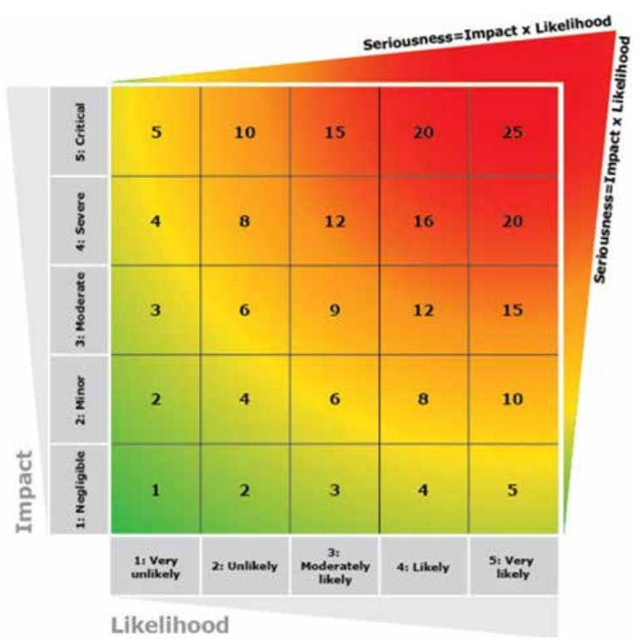
Risk Analysis and Monitoring
Identify risk factors
Estimate likelihood and impact
Monitoring and taking actions

Slide 6
Afghanistan case study – risk an. 1

Slide 7
Afghanistan case study - risk a. 2
Hazard | Likelihood | Impact | Risk | Risk level | Action
Climate-Drought | 4 | 5 | 20 | Very High | Contingency plan
Armed Conflict | 4 | 4 | 16 | High | Preparedness
Flood | 3 | 3 | 9 | Moderate | Preparedness and frequent monitoring
Earthquake | 2 | 4 | 8 | Low | Monitoring
Epidemic | 2 | 3 | 6 | low | Monitoring

Slide 8
Afghanistan case study – scenario pl.
Hazard | Affected Population | In need of nutrition assistance Children U5 | In need of nutrition assistance PLW
Climate-Drought | 3.4 million | 550,000 | 250,000
Armed Conflict | 250,000 | 42000 | 20,000
Flood | 100,000 | 17,000 | 8,000

Slide 9
Preparedness action 1.
Coordination mechanism
  TORs for staff
  TWG, SAG
  Forum
Information management
Notes:
Builds on the history of the sector attempting to improve performance and address failures of the "system"
Looked for more reliable, predictable responses to major crises
Emphasized that the "system" was more than the UN, and that it needs to build on the different roles and competencies of other actors, including the Red Cross Red Crescent, NGOs and national and local actors
The reform also aimed at strengthening and clarifying mutual accountabilities of actors for results
Humanitarian reform introduced three important concepts that are still used today:
The role of Humanitarian Coordinators - to provide better strategic oversight and accountability for the overall response
The Cluster Approach - to provide more consistent quality and coherence in different programming sectors
Humanitarian Financing - to ensure more timely, flexible and predictable funding for responses (for example, CERF, HRF, CHF, ERF, etc.)
A core outcome was the cluster approach.
The role and purpose of clusters is to provide an integrated, consistent, coherent and coordinate means to address the needs, priorities and rights of affected people.
While the slide shows the HC in the centre, in reality, the whole purpose of the cluster approach is to ensure more timely, predictable, consistent responses and better outcomes for affected people.
Do the short quiz about clusters (T/F) and give a brief overview of what the cluster approach is and what UNICEF leads, highlighting that it is underpinned by partnership. Link this element to the rest of the course structure where they will explore: the what and how of coordination and the inter-personal skills needed to be successful.

Slide 10
Preparedness action 2.
Need assessment and analysis
- Methods
- Resources
- Tools
- Surveillance/screening
Financial resources
- donor relationship
- funding opportunities
Notes:
Builds on the history of the sector attempting to improve performance and address failures of the "system"
Looked for more reliable, predictable responses to major crises
Emphasized that the "system" was more than the UN, and that it needs to build on the different roles and competencies of other actors, including the Red Cross Red Crescent, NGOs and national and local actors
The reform also aimed at strengthening and clarifying mutual accountabilities of actors for results
Humanitarian reform introduced three important concepts that are still used today:
The role of Humanitarian Coordinators - to provide better strategic oversight and accountability for the overall response
The Cluster Approach - to provide more consistent quality and coherence in different programming sectors
Humanitarian Financing - to ensure more timely, flexible and predictable funding for responses (for example, CERF, HRF, CHF, ERF, etc.)
A core outcome was the cluster approach.
The role and purpose of clusters is to provide an integrated, consistent, coherent and coordinate means to address the needs, priorities and rights of affected people.
While the slide shows the HC in the centre, in reality, the whole purpose of the cluster approach is to ensure more timely, predictable, consistent responses and better outcomes for affected people.
Do the short quiz about clusters (T/F) and give a brief overview of what the cluster approach is and what UNICEF leads, highlighting that it is underpinned by partnership. Link this element to the rest of the course structure where they will explore: the what and how of coordination and the inter-personal skills needed to be successful.

Slide 11
Preparedness action 3.
Implementation
- Capacity mapping, 4W, gap analysis
- Training
- Program specific: NIE checklist
Communication and advocacy
AAP, cross cutting issues (GBV, disability, resilience
Notes:
Builds on the history of the sector attempting to improve performance and address failures of the "system"
Looked for more reliable, predictable responses to major crises
Emphasized that the "system" was more than the UN, and that it needs to build on the different roles and competencies of other actors, including the Red Cross Red Crescent, NGOs and national and local actors
The reform also aimed at strengthening and clarifying mutual accountabilities of actors for results
Humanitarian reform introduced three important concepts that are still used today:
The role of Humanitarian Coordinators - to provide better strategic oversight and accountability for the overall response
The Cluster Approach - to provide more consistent quality and coherence in different programming sectors
Humanitarian Financing - to ensure more timely, flexible and predictable funding for responses (for example, CERF, HRF, CHF, ERF, etc.)
A core outcome was the cluster approach.
The role and purpose of clusters is to provide an integrated, consistent, coherent and coordinate means to address the needs, priorities and rights of affected people.
While the slide shows the HC in the centre, in reality, the whole purpose of the cluster approach is to ensure more timely, predictable, consistent responses and better outcomes for affected people.
Do the short quiz about clusters (T/F) and give a brief overview of what the cluster approach is and what UNICEF leads, highlighting that it is underpinned by partnership. Link this element to the rest of the course structure where they will explore: the what and how of coordination and the inter-personal skills needed to be successful.

Slide 12
Contingency Planning 1.
What for?
When?
The plan:
  Situation analysis
  Objectives
  Response → → →
  How?
  Coordination
  Gaps
  Funds

Slide 13
Contingency Planning 2.
The response
  In addition to basic preparedness
  HR, Coordination
  Supplies
  Scaling up on NIE actions
  Training/refresher

Slide 14
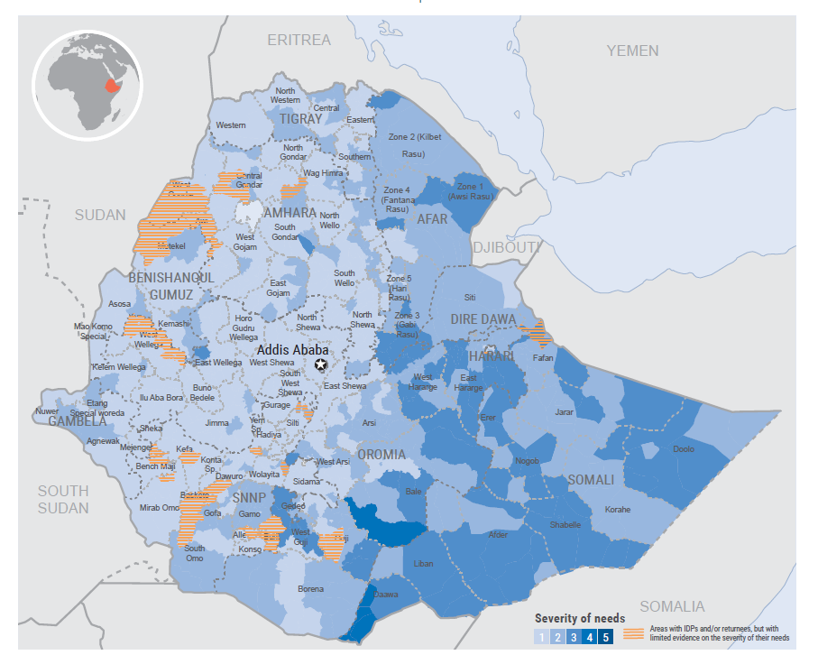

Ethiopia case study
Malnutrition is a chronic and stagnant problem with several forms of undernutrition at high and very high levels.
Multiple risks / hazards exacerbating chronic vulnerabilities: disrupted rainfall patterns (recurrent and prolonged dry spell, drought, floods), inter-communal conflicts, recurrent disease outbreaks, high price inflation, locust infestation, etc.

Slide 15
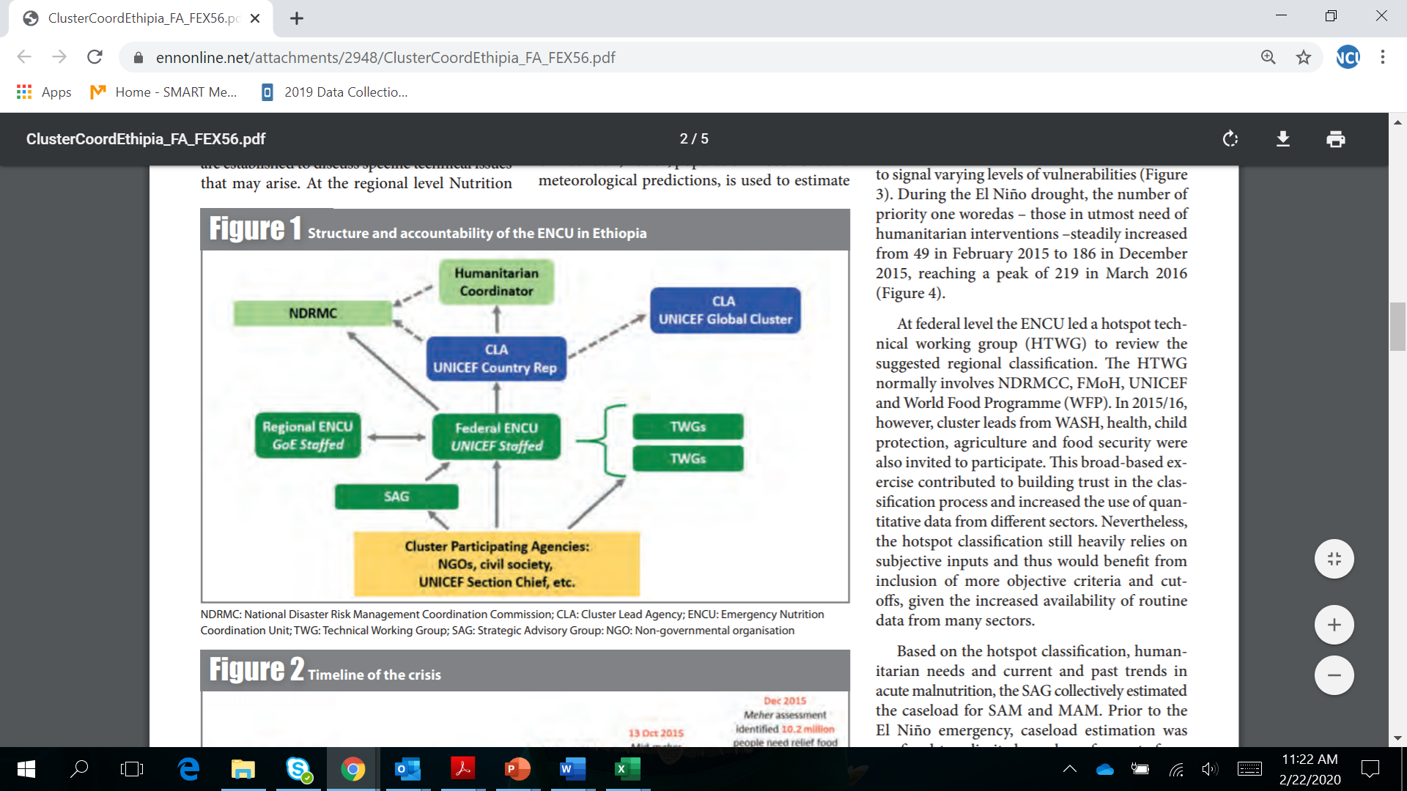
GoE and humanitarian structure overview
NDRMC: DRM + assessments +Food aid + emergency coordination mandate (supported by OCHA) including at sub-national level
FMoH: national policy formulation mandate and Regional and Woreda Health Bureau implements the strategy/policy goals / are in charge of health care services delivery.
EPHI: disease surveillance responsibilities as well as rapid response to public health emergencies.
ENCU/Nutrition cluster (UNICEF-supported) is embedded within the NDRMC at federal level and the Disaster Prevention and Preparedness Bureau (DPPB) in the six main regions.
From FEX 56 article link: https://www.ennonline.net/attachments/2948/ClusterCoordEthipia_FA_FEX56.pdf

Slide 16
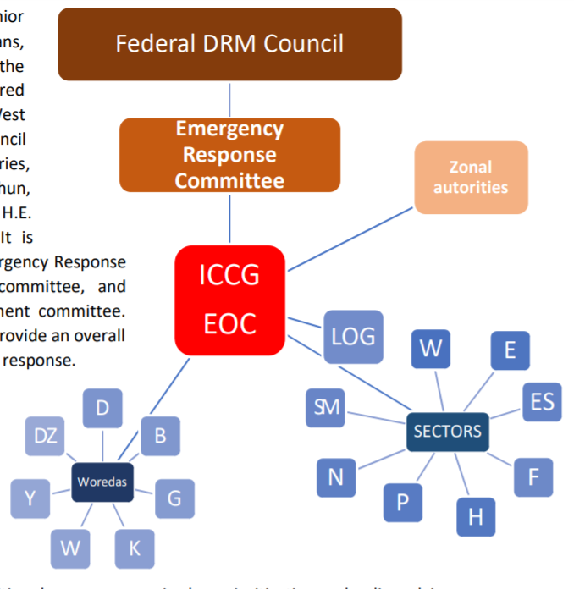

Ethiopia approach to EPRP 1
  National DRM policy with resilience building goals.
  Woreda level Disaster risk profiling and risk reduction plans and CP in half the country.
  However WDRRPs haven't been executed at the local level as expected and hence, humanitarian responses have continued to be ad-hoc and/or responses to shocks not so effectively anticipated.

Slide 17
Ethiopa approach to EPRP 2
Strengths | Weaknesses
Coordination mechanisms: arrangements at Federal, regional and even zonal level with activation of intersectoral and sector specific EOC/task force/Cluster
Assessments capacities MUAC screening; RNA and Nutrition SMART surveys; Monitoring of SAM admissions | Weak nutrition surveillance system and delays in responding to peaks of acute malnutrition
Mapping of needs and gaps Hotspot woreda classification; 4W | Need for more flexibility in re-prioritizing the Nutrition response
Management of SAM integrated in the Health system and SAM treatment services available country wide | Limited capacities for rapid scale-up of nutrition services Weak IYCF-E programming
EPRP: Nutrition is reflected in OCHA-led Contingency plans, also in Unicef-led EPR plans jointly developed with Regions once a year, in Partner-specific EPR plans | often disconnect between the Emergency preparedness efforts done at Federal level versus those done at Regional level Room for better formalization of actionable Nutrition EPR Plans

