Slide 1
Global Nutrition Cluster Webinar on 2021 HNO process
August 25th, 2020

Slide 2
Overview of the Session
Welcome and Introduction – (2') Anteneh (GNC-CT)
Briefing on the 2021 HPC process(25') – Marcus (OCHA)
Nutrition Humanitarian Needs Guidance(35') – Victoria (GNC-CT)
Mainstreaming cross-cutting issues in needs analysis – (10')Masumi (UNICEF)
Roles and responsibilities, GNC-CT support to countries – (10')Anteneh (GNC-CT)

Slide 3
Objectives of the Session
By the end of this session, participants will be able to:
Outline key considerations regarding the upcoming 2021 HNO process based on newly released Nutrition Humanitarian Need Analysis, Global 2021 HPC, and JIAF guidance.
Identify the activities and roles of the coordination team and partners across the analysis.

Slide 4
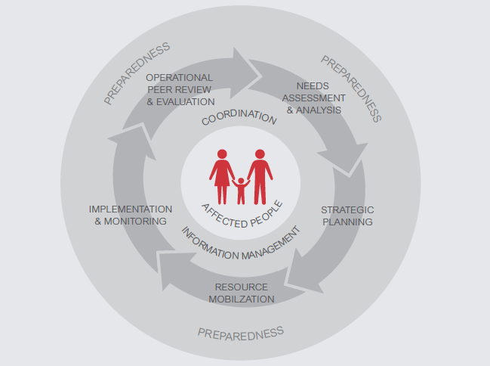
Humanitarian Programme Cycle

Slide 5
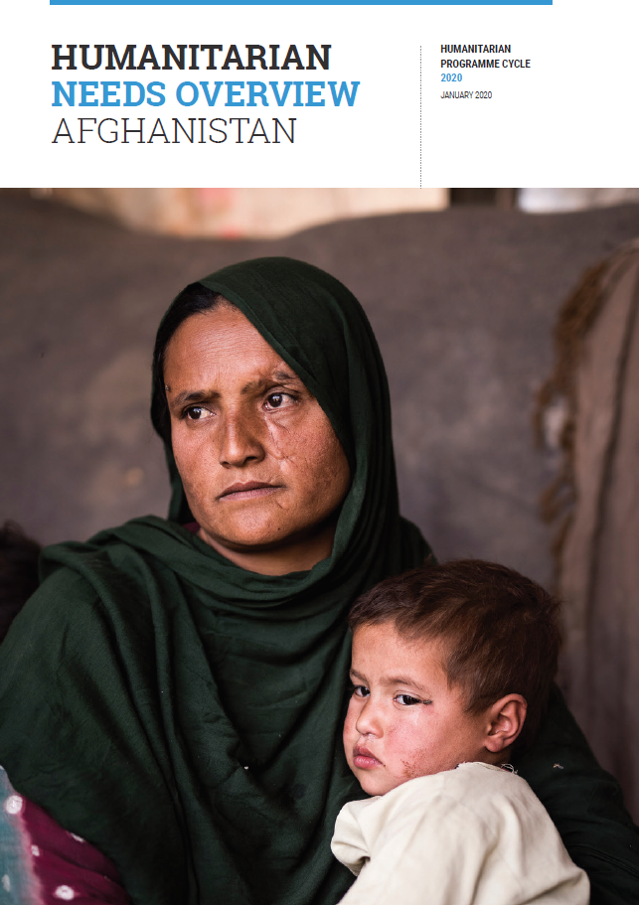
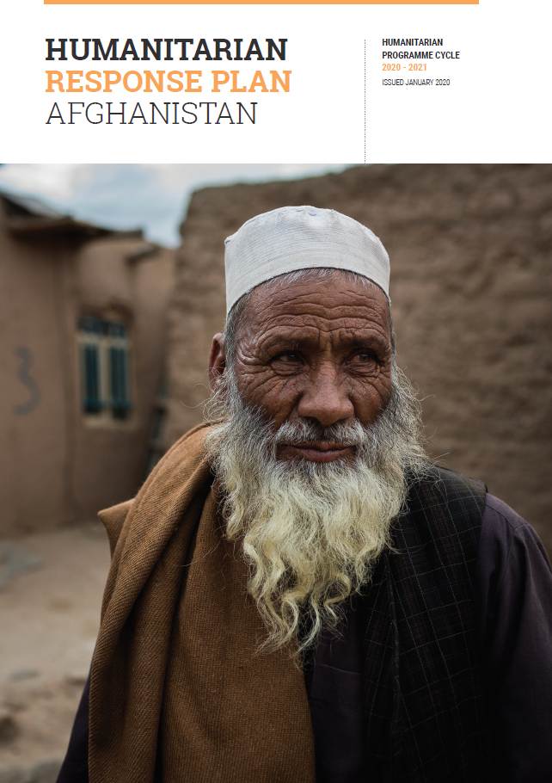
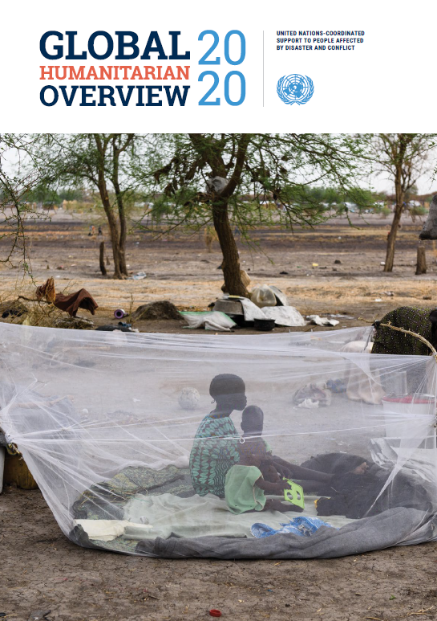

THE HUMANITARIAN
PROGRAMME CYCLE
Comprehensive
Forward-looking
Prioritized
Authoritative
Notes:
Intro:
Reminder of the key delieverables of the HPC (particularly for colleagues in non-HPC countries)

Slide 6

ENHANCED HPC
Multi sectoral vs Intersectoral
Sector 1
Sector 2
Sector 3
Sector 4
Sector 5
Sector 6
Sector 7
Sector 8
Provide a single, comprehensive, cross-sectoral, methodologically sound and impartial overall assessment of needs
Notes:
Inter Sectoral / Cross sectoral: Approaches that highlight the importance of system thinking and considering issues as a whole, across sectors, and the range of factors that collectively influences humanitarian conditions or how situations in one sector influences or impact upon one or more other sector. Focused on intersectoral interventions and coordination (SDGs 2030, health 2020).
Objective is to build synergies across sectors so as to tackle complex issues for achieving inter-related humanitarian/development goals and targets,

Slide 7
ENHANCED HPC - Complementary guidance FOR 2021
Prioritization, response analysis, formulation of strategic and specific objectives, and targeting
Joint Inter-Sectoral Analysis Framework (JIAF), including calculating people in need (PiN)
Risk Analysis and Projections
and
Revised Step by Step Guide, and HNO and HRP templates that reduce repetition and align with complementary guidance.
Notes:
Based on the results of the 2020 HPC Multi-Partner Review and 2020 HPC Quality Scoring, and under the guidance of the HPC Steering Group, in consultation with the Global Cluster Coordination, the following updates were made to the 2021 HPC.

Slide 8
HPC 2021 Process
HNO
HRP
1
Agree on the scope of the analysis and costing approach
2
Undertake secondary data review
3
Collect primary data
4
Conduct joint inter-sectoral needs analysis
Define the scope of the HRP and formulate initial objectives
5
3
Conduct response analysis
6
Finalize strategic and specific objectives and indicators, and prioritise
7
Formulate projects/activities and estimate cost of the response plan
8
9
Undertake After Action Review
Elaborate the rest of the response plan
Clusters/sectors elaborate action required to achieve the strategic objectives of the HRP
Estimate the cost of the response
Write-up the draft response plan

Slide 9
HPC 2021 Process
HNO
HRP
1
Agree on the scope and focus of the analysis and costing approach
Adapt HNO analysis framework to context and develop analysis plan based on key questions needed to inform planning and decision-making
Decide on most appropriate costing methodology for 2021
Present analysis framework and costing plan to HCT for endorsement
2
Undertake secondary data review
Compile evidence base
Further refine timeline for delivery of analysis results, agree on roles and responsibilities
Analyze secondary data
Indentify and determine how to bridge critical information gaps
3
Collect primary data

Slide 10
HPC 2021 Process
HNO
HRP
4
Conduct joint inter-sectoral analysis
Conduct inter-sectoral needs and severity analysis
Analyze risk and arrive at projections, identify indicators to monitor situation and needs
Calculate current and projected number of people in need (PiN)
Write up draft analysis results
Present, validate and seek endorsement from HCT (and government, where appropriate) on analysis results and monitoring requirements
Define the scope of the HRP and formulate initial objectives
Determine the scope of the HRP based on the needs and risk analysis
Draft preliminary (inter-sectoral) strategic and specific objectives
5

Slide 11
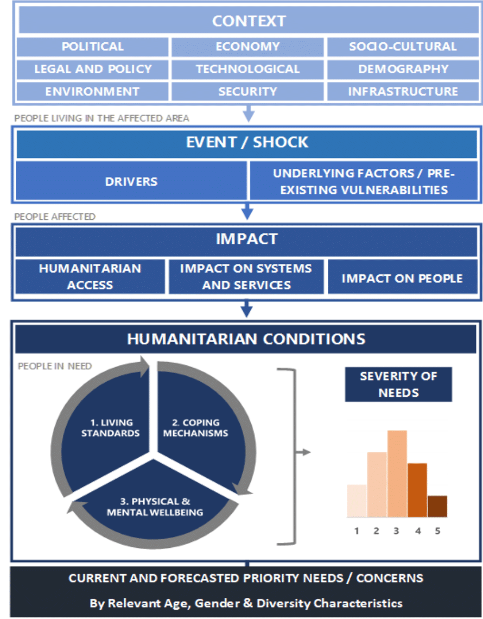
JIAF Conceptual Framework

Slide 12
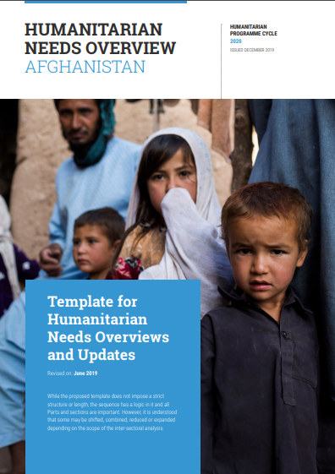
HNO STRUCTURE
Summary of Humanitarian Needs and Key Findings
Part 1: Impact of the Crises and Humanitarian Conditions
Context of the Crisis
Impact of the Crisis
Scope of the Analysis
Humanitarian Conditions, Severity and People in Need
Number of People in Need
Notes:
This document is consolidated by OCHA on behalf of the Humanitarian Country Team and partners. It provides a shared understanding of the crisis, including the most pressing humanitarian need and the estimated number of people who need assistance. It represents a consolidated evidence base and helps inform joint strategic response planning.

Slide 13
HNO STRUCTURE
Part 2: Risk Analysis and Monitoring of Situation and Needs
Risk analysis
Monitoring of situation and needs
Part 3: Sectoral Analysis
Part 4: Annexes
Data sources
Methodology
Information gaps and limitations

Slide 14




Nutrition Humanitarian Needs Analysis Guidance for Piloting
  Steps of the Guidance
  List of indicators
  Nutrition Situation Analysis
  PiN Calculations
This publication was made possible through support provided by the U.S. Agency for International Development under the terms of Award No 720FDZ20IO00019. The opinions expressed in this publication are those of the author(s) and do not necessarily reflect the views of the U.S. Agency for International Development.
Notes:
The Global Nutrition Cluster (GNC) is working to improve the quality of the needs’ assessment and analysis for nutrition in emergencies at country level, including data collection, data analysis and preparation of the Humanitarian Needs Overviews (HNO).
GTAM: A common global mechanism endorsed by over 40 Global Nutrition Cluster partners to provide systematic, predictable, timely and coordinated nutrition technical assistance in order to meet the nutrition rights and needs of people affected by emergencies.
A Nutrition Information Systems (NIS) Global Thematic Working Group (GTWG) has established in 2019 to guide the work of the GNC in needs assessments and analysis for nutrition in emergencies. In October 2019 the GTWG established a task force to work on the improvement of the nutrition analysis in the HNOs and agreed on the main recommendations to the country coordination platforms on how to conduct needs analysis and preparation of the HNOs.
Taskforce under the Nutrition Information Systems Global Thematic Working Group established in October 2019
Work started in January till end of May 2020
Consultative process based on recommendations for needs analysis and preparation of the HNOs

Slide 15
Relevant steps of the guidance
Conduct a Nutrition Situation Analysis
Prepare key figures for the HNO and subsequent HRP
Led by the in-country NIS TWG or equivalent
Key considerations (e.g. seasonality) and reliability of data collection methods
Scenario-based approach:
Situations where an IPC Acute Malnutrition analysis can be conducted or utilized;
Situations where an IPC Acute Malnutrition cannot be conducted and GAM for children U5 is of primary concern (i.e. prevalence ≥5%)
Situations where GAM for children is <5%
Notes:
The purpose of a Nutrition Situation Analysis is to define/classify the severity of a given humanitarian situation across affected geographical areas based on the magnitude of the nutritional needs of the population in order to guide strategic and operational decision-making. It addresses the following questions: How severe? When and Where are the worst affected areas? How many? Why? Who? What are the key characteristics of the situation?
This analysis aims to build consensus on classifying the severity based on the magnitude of nutritional needs (e.g. prevalence of different forms of malnutrition) of vulnerable population groups (i.e. those more at risk/affected) and their key drivers (contributing factors) into meaningful categories to support the response. This entails a critical review of the available data (e.g. results from the annual nutrition assessment plan), context and existing trends for each affected geographical area. Nuanced information may also be needed to inform the need for action to scale up malnutrition treatment and prevention for affected populations
Done based on IPC Acute Malnutrition Framework.

Slide 16
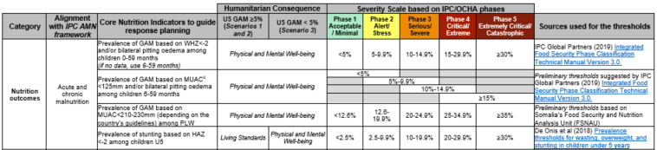
Recommended « core » list of indicators
  For phase characteristics and thresholds of international standards for GAM and its contributing factors
  Meant to streamline this analysis process, not to override the extensive list of indicators that can be used for programming/monitoring purposes
Notes:
Category
Alignment with IPC Acute Malnutrition Framework
Humanitarian consequence depending on the Scenario
PMWB: these consequences have a direct effect on people’s survival, mental and physical integrity and/or dignity in the short term (within the next six months), recognizing they also have longer term effects (e.g. acute and/or chronic malnutrition, death and morbidity). For Nutrition, “Physical and Mental Well-being” consequences are based on anthropometric data. The urgency of the response can differ based on the timeframe of their effect (short term versus longer term survival) and their degree of irreversibility in the absence of response.
Living standards: these consequences have a direct effect on people’s ability to pursue their normal productive and social activities and meet their basic needs in an autonomous manner. They manifest in different types of deficit and the use of various coping mechanisms to meet basic needs (e.g. lack of food, income, access to health care, water, sanitation, shelter and education).
Severity scale based on IPC AMN and OCHA Phase Classification
Thresholds (some being preliminary in nature) and their sources
Primary nutrition outcomes with optional contextual factors focusing on common vulnerable groups to be considered
Where information is available. Underlying causes = guided by the UNICEF Conceptual Framework – colleagues to analyse in terms of situations for response planning
Also includes indicators of:
WASH
Immunization
Health Status
Availability of and access to health services
Food Consumption
Acute and chronic malnutrition
Other causes
Acute malnutrition
Micronutrient deficiencies
Mortality indicators
Immediate causes
(Food consumption)
Underlying causes (Caring and feeding practices)

Slide 17
Conduct a Nutrition Situation Analysis
Prevalence of U5 GAM ≥5%
Ideally use IPC Acute Malnutrition Analysis – otherwise:
Severity classification uses U5 GAM based on WHZ (as thresholds are provided)
  If not available, then U5 GAM based on MUAC
    If not available, then PLW GAM based on MUAC
Qualitative analysis of contributing factors
Prevalence of U5 GAM <5%
Severity classification uses a proposed scoring system based on 10 indicators that takes into account both vulnerability of the target groups and indicators’ reliability
Qualitative analysis of contributing factors

Slide 18
Prepare key nutrition figures for the HNO
Identification of the number of People in Need (PiN) for each specific nutritional need in each geographical area based on the situation analysis of data/information disaggregated by age, gender and disability.
A minimum sub-set of key nutrition-specific interventions:
Acute and chronic undernutrition, overnutrition
Infant and Young Child Feeding Practices
Micronutrient Deficiencies
Notes:
The results of the Nutrition Situation Analysis lay the foundation for a coherent and efficient humanitarian response based on the magnitude identified,
understanding the magnitude of the situation at different levels of severity supports the response planning by identifying the number of People in Need (PiN), conducted per sector and inter-sectorally (to be addressed in upcoming Addendum 1 on JIAF).
the PiN needs to be calculated for each specific nutritional need and expressed as such, where the HNO already serves as a projection of nutritional needs for the coming year. The calculation is based on the estimated incidence or prevalence of people that need the specific service
three categories of nutritional needs respectively: Acute and chronic undernutrition, overnutrition; IYCF Practices; and Micronutrient Deficiency. PiN calculations for particular population groups for a minimum sub-set of key nutrition-specific interventions

Slide 19
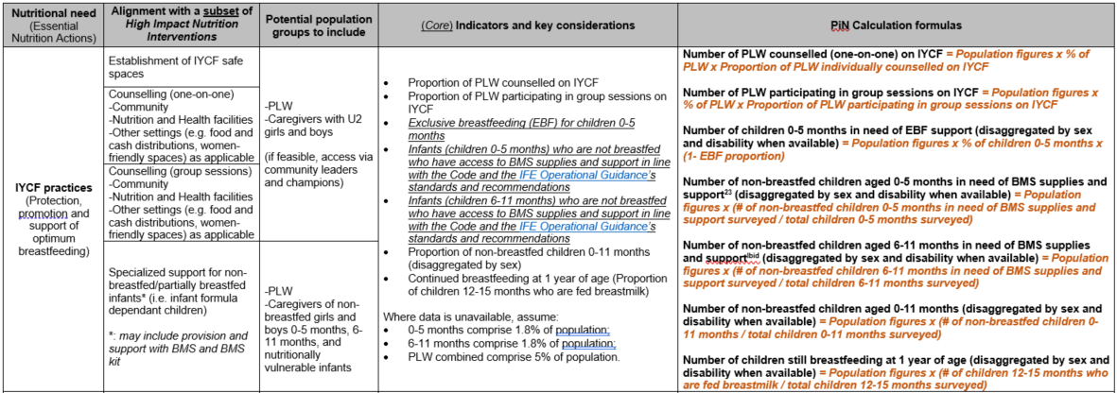
Notes:
a series of nutrition-specific interventions promoted by the WHO to address these nutritional needs;
Clear formulas per relevant indicator are included. Disaggregation by sex, age group and disability should be done when data are available.
How to add it all up by target group and pillar – upcoming with accompanying JIAF guidance

Slide 20
Accompanying Spreadsheet Calculation tool
Develop an annual nutrition assessment plan
Conduct a Nutrition Situation Analysis
Prepare key figures for the HNO and subsequent HRP
Indicator Registry
Classification Thresholds
Evidence Repository, Reliability
Analysis team composition
Scenario 2 Nutrition Analysis + contributing factors
Scenario 3 Nutrition Analysis + contributing factors
Population Figures disaggregated by disability, sex and age group
PiN Speadsheets with automatic calculation
Notes:
Template all the indicators and what is needed to do = ONE-STOP SHOP – just fill in the data, ability to calculate the figures automatically – increase the frequency of nutrition analysis and can then write up the report in a more streamlined manner. Do the write-up, evidence is ready and can keep updating as you go along and standardizes the process.

Slide 21
Assessments/Analysis & AAP
ALWAYS opportunities to engage with affected communities in the assessment/needs analysis process, regardless of the crisis type.
Consider the diversity of the affected population and specific vulnerabilities, needs, and views of different groups – e.g girls, boys, women, people with disabilities, displaced people, refugees.
Also consider ways to check and validate the results of assessments and needs analysis – do they match the expressed needs and priorities of different groups of the population?
If possible this can be done during assessment or during need analysis stage through consultation with key informants and focus group discussions.
Use joint approaches to needs assessment and analysis validation whenever possible to avoid burdens on communities

Slide 22
GBV Risk Analysis Nutrition
Required information for GBV risks associated with nutrition services
Purpose of GBV risk mitigation:
Nutrition services are ethical, safe and accessible/usable to all affected population i.e. women, girls and other at risk groups such as persons with disabilities.
Required Information | Information sources
Women and girls’ GBV risks related to nutrition services | Safety audit data MSNA – protection, health GBV sub-clusters SDR GBVIMS data Gender analysis
Capacity of nutirtion frontline workers –Gender balance, Code of Conduct, GBV referral | Record of Code of Conducts Record of GBV referral training
Coping mechanism | MSNA-Food security, protection
What we need to know?
Identify GBV-related safety risks specific to Nutrition services in consultation with women and girls and other at-risk groups
Identify barriers to access and use Nutrition services of different population group. (AAAQ framework.)
Coping mechanism of women and girls
Notes:
Purpose od GBV risk mitigation is to make nutrition services safer and more accessible to women and girls who are likely to excluded. These women and girls and their children are vulnerable to malnutrition. Because of COVID-19, women and girls are facing increased risks of GBV and also barriers to access nutrition services.
To identify GBV risks, nutrition actors need data related women and girls’ safety risks to nutrition services. Some of information might be available (read the list). If the data is not available, consider including a monitoring activity to measure safety perception. Capacity of nutrition frontline workers could include gender balance – at least 50%. It could be 100% women. Whether they have signed and trained Code of Conduct. Whether they were trained on GBV referrals. If nutrition actors couldn’t find any records of those, you could consider including response strategy to build capacity of nutrition frontline workers re. GBV referrals and PSEA.

Slide 23
Barrier analysis to Nutrition services
AAAQ framework
Required information for barrier analysis
Required data | Information sources
Data related to access to nutrition services | Add a question related to access/barriers in MSNA is possible. Data from health cluster. MSNA - health, protection Safety audit data Gender analysis repport
Data related quality of nutrition services. | Nutrition monitoring data
Data related to availalbity of nutrition services | 3/4 Ws of nutirtion and/or health clusters
If none of these data are available, at least consult with local women’s organizations – specific barriers to nutrition services.
Notes:
At very least, consider specific barriers that women including mothers who bring their children and girls to nutrition services. AAAQ framework is a good framework to help nutrition actors to understand various barriers that women and girls face. For example Accessibility look at different barrier including social barrier. For nutrition, a common barrier is husband’s approval to access to nutrition services.
For barriers analysis we need data related to access to nutrition/health services, quality of nutrition services and availably of nutrition services. You could add some questions to MSNA or other data collection if possible. If not possible, there are other information sources that nutrition actors could use.
If none of those data are available, at least consulta with local women’s orgs about their opinions about specific barriers to nutrition services. If nutrition actors do not have contacts of local women’s orgs, GBV sub-cluster and/or gender specialists might be able to support.
A link to AAAQ framework https://gbvguidelines.org/wp/wp-content/uploads/2019/11/AAAQ-framework-Nov-2019-WEB.pdf
Examples of questions related to AAAQ
Availability:
How long does it take to go to nutrition facilities and services
Access:
What are the main barriers that women including mothers who bring their children to nutrition services, girls who are not able to access sanitation facilities? Consider different barriers i.e. physical including safety, administration, finance, social and information.
Acceptability:
What are the cultural norms related to diet, breast feeding et?
Quality:
Does Nutrition sector standard consider specific needs and barriers of women, girls and other at risks? If not, how to address the gaps?
How do Nutrition actors assure the quality of Nutrition services?
Use
Who are NOT using Nutrition facilities and distributed NFIs and why?
What are the patterns of food consumption at home (any difference between male/female)?

Slide 24
Disability Inclusion in the HNO
What do we need to know? | How can we get this information?
•How do persons with disabilities experience humanitarian consequences differently? | •Needs assessment data disaggregated by disability, age and gender
•What are the factors contributing to heightened risk for persons with disabilities? | •Focus Group Discussions and key Informant Interviews with persons with disabilities
•What are the barriers and facilitators to persons with disabilities accessing assistance? | •Barriers and facilitators assessments
•What are the views and perceptions of persons with disabilities? | •Accessible AAP mechanisms

Slide 25
Roles and Responsibilities
Cluster Partners
Collect and share secondary nutrition-related data
Review quality of data and carry out a joint analysis and interpretation
Ensure affected people’s views are collected as part of assessments
Ensure cross-cutting issues are included in analysis
Contribute to HNO processes
Regularly review and update situational and needs analysis
NCC (and IM) should:
Coordinate and facilitate participation of partners in needs analysis
Consolidate assessment data and present analysis through IM tools
Share and integrate nutritional assessment and analysis results with partners, OCHA and CLA.
Facilitate discussions around results and intervention strategies
Notes:
Phase I and II are supported by the MIRA methodology
Phases III and IV are supported by Cluster-specific assessment methodologies

Slide 26
Contact Details and Resources
Remote support in both HNO and HRP:
  One-on-one call based on needs
  Review of draft HNO and HRP documents
English-Speaking Countries | French/Spanish Speaking Countries
Briony Stevens bstevens@unicef.org | Victoria Sauveplane vsauveplane@unicef.org
Reference tools and guidance
https://www.nutritioncluster.net/Coordination_Toolkit
Notes:
Phase I and II are supported by the MIRA methodology
Phases III and IV are supported by Cluster-specific assessment methodologies

