Slide 1






Official Launch Event
Evidence and Guidance Note on the Use of CVA for Nutrition Outcomes in Emergencies
18 August 2020

Slide 2

Agenda of the Webinar
Minutes | Agenda Item
5’ | Welcome and housekeeping
15’ | Opening remarks by the host (GNC) and co-hosts (NORCAP and SDC) Global Nutrition Cluster: Anna Ziolkovska, Deputy Global Nutrition Cluster Coordinator NORCAP: Stine Horn, Director of the Partnership and Development Section SDC: Philippe Besson, Head of Multilateral Division Humanitarian Aid
35’ | Presentation of Evidence and Guidance Note
10’ | Q&A on Evidence and Guidance Note
35’ | Experiences and initiatives from the field: Nigeria: Use of CVA for nutrition outcomes in North-East Nigeria Columbia: Multipurpose cash transfers with a nutrition lens Guidance development for nutrition practitioners in West Africa
20’ | Panel discussion with presenters

Slide 3
Introduction
Recognition that CVA can support nutrition outcomes
CashCap support to the GNC since August 2019
Reference Group, consisting more than 15 organizations
Results: Evidence and Guidance note
  Evidence and practice review
  More than 50 key informant interviews
  Two case studies: Nigeria and Somalia
  Structure of document
  Target audience

Slide 4
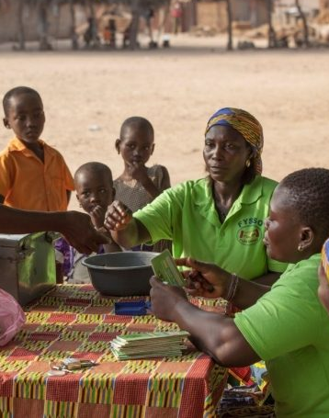
Part 1: Evidence Note

Slide 5
CVA the conceptual framework
CVA can impact underlying determinants in three main ways:
allows HHs and individuals to purchase goods and access services that can have a positive impact on maternal and child nutrition
Conditional CVA can be an incentive to participate in nutrition SBC activities and attend to free priority health services.
Increased household income can reduce household tensions, economic pressures, enhance decision-making power of women, improve health and well-being of caregiver, etc.
Notes:
Items and services with positive impact on nutrition: healthy diet, items to prepare food, hygiene items, safe water, health services and medication, transportation, and productive inputs
CVA primarily acts on the underlying determinants

Slide 6
CVA impact on maternal and child nutrition
Level of impact | Mostly positive | Mixed | None
Impact on nutrition status of children
Child nutrition status |  | **
Impact on immediate determinants
Dietary diversity of children | **
Health status of children | *
Impact on underlying determinants
Household food expenditure | ***
Household food consumption and dietary diversity | ***
Uptake in preventative health services | **
Water, sanitation and hygiene | *
Feeding behaviours and practices |  |  | *
Psychosocial care for children |  |  | *
Intra-household decision making | **
Intimate partner violence | **
Caregivers’ mental health |  |  | *
Strength of evidence: * none or limited, ** growing, *** moderate, **** strong

Slide 7
Economic barriers to adequate nutrition
Demand side barriers | Supply side barriers
Economic barriers: Affordability: Nutritious diet, cooking utensils and fuel, hygiene items, safe water and water treatment, transportation, other costs related to accessing health and nutrition services Opportunity costs: providing adequate care, seeking health and nutrition services Behavioural barriers: Insufficient knowledge and skills on preparation of nutritious diet adequate complementary foods, caring practices, WASH practices, etc. Other demand side barriers: Markets not accessible due to distance, safety concerns, etc. Inadequate health seeking behaviour due to lack of knowledge of malnutrition, traditional beliefs, etc. | Markets for food and non-food items Availability and quality Local production Supply chains Health and Nutrition Services Availability and quality of preventative services Availability and quality of treatment services IYCF support Availability of adequate drugs, supplies (e.g. therapeutic foods) and equipment for maternal and child health services Transportation services
Notes:
CVA can help to address demand side economic barriers to adequate nutrition, but is less effective on the supply side
CVA alone unlikely to be successful strategy to improve nut status of children. It should be combined with other nutrition sensitive or specific interventions

Slide 8
Most common approaches to integrate CVA in nut response
Based on a review of studies and opreational examples, five main appraoches to integrate CVA in nutrition response were identified:
Using CVA modalities for household assistance and/or individual feeding assistance
  CVA can be used for both components, with limitations for individual feeding
  Household cash plus SNF promising; positive experience with FFV
Pairing household CVA and context-specific SBC
  CVA modalities that aim to contribute to nutrition outcomes need to be accompanied with context-specific SBC activities
Providing conditional cash transfers to incentivize attendance to priority health services
  CCTs can improve attendance and provide household income

Slide 9
Key messages
Provide CVA to facilitate access to treatment services
  frequently used to cover transport costs but poorly documented
Provide household CVA to caregivers of SAM children
  CVA can improve treatment outcomes (reduce relapse and non-response to treatment, improve recovery), but anecdotal evidence for perverse incentive
Can be combined with each other and be a component of a broader nutrition response!
Example from Nigeria: Integrated Nutrition Response plus (INP+)

Slide 10

Part 2: Guidance Note
How to Incorporate Cash and Voucher Assistance into Nutrition Response
How to Apply a Nutrition Lens to a Cash-Based Response

Slide 11
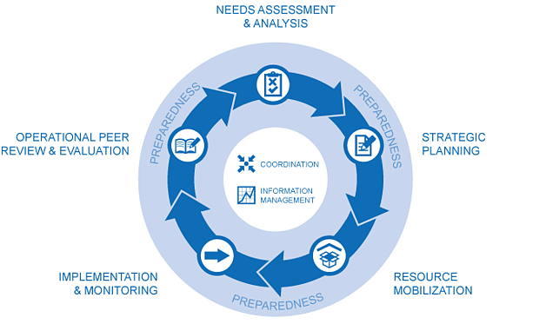
Steps to incorporate CVA into nutrition response
Transversal issues:
Preparedness
Coordination
Information Management
Risk analysis and mitigation
Step 1: Determine whether CVA can contribute to nutrition outcomes
Step 2: Determine the feasibility of CVA as part of a nutrition response
Step 3: Determine and select response options and response modalities
Step 4: Design the CVA component
Step 7: Monitoring of a CVA component
Step 6: Implement a CVA component
Step 5: Mobilize resources for the response
Notes:
If you want to consider CVA in nutrition, you don’t need to start from scratch
CVA is implemented by organisations, not by cash specialists

Slide 12
How to incorporate CVA into nutrition response
Step 1: Determine whether CVA can contribute to nut outcomes
Entry point: Demand-side economic barriers to adequate nutrition
Opportunities of nutrition assessment tools to contribute to an understanding of economic barriers
To be complemented by assessments from other sectors (FSL, health, WASH, Prot)
Step 2: Determine the feasibility of CVA
Market capacity and functionality for food and non-food items
Health and transportation services
Delivery mechanisms
Community considerations: preferences, safety, HH decision making, etc.
Additional: Acceptance of authorities, organizational capacity, risks, costs
Most information probably available (secondary info), consult with others!
Notes:
To what extent is the lack of purchasing power impacting the ability of households to access and prepare nutritious foods, access health services, access safe water, improve hygiene conditions
can a nutritious diet be achieved using locally available foods? Are goods required for adequate WASH available?
Are relevant health and nutrition services for the prevention and treatment of malnutrition available and of acceptable quality? Are transportation services available to access health and nutrition services?
Is there a safe and reliable way to deliver cash or vouchers?
data protection, preference on ways to be assisted, protection risks and safety considerations, access to money, access to markets, household decision making, possible tensions within households or communities

Slide 13
How to incorporate CVA into nutrition response
Step 3: Determine and select response options and modalities
CVA does not change the way nutrition practitioners define objectives and select nutrition response options in order to address identified nutritional needs
Important economic barriers to the underlying determinants → feasible CVA modalities and approaches should be considered as part of response options analysis
Step 4: Design the CVA component
Targeting
Conditionality
Timing, duration and frequency
Expenditure basket and transfer amount
Notes:
Eligibility criteria are largely determined by the programme objectives and type of response rather than the assistance modality
Not really different to targeting of in-kind assistance
Socio-economic criteria can be considered on top of other criteria
Options: hard vs soft conditionality
Consider when it is expected to improve participation in SBC interventions and the uptake of priority preventive health service
Expected benefits vs additional costs and resources
Longer duration, higher cumulative transfer amount → better impact
Safety net response: throughout first 1000 days; no less than 3 months
transfer amount for CVA should reflect what recipients are expected to be able to purchase on local markets → depends on objective of CVA component
Common expenditure baskets: MFB (→ access nutritious diet at household or individual level), MEB (→ access nutritious diet and other nutrition relevant goods and services at household level)
In reality: MFB composition reflects energy-based diet. It often lacks diversity and falls short of addressing micronutrient requirements.
Transfer amount = expenditure basket – HHs own contribution
Nutrition practitioners should work with existing contextualized MEB/MFB and transfer amounts, adjust these as required in accordance to programme objectives, and if necessary advocate for adjustments to reflect a stronger nutrition lens.

Slide 14
How to incorporate CVA into nutrition response
Step 5: Mobilize resources for the response
Step 6: Implement the CVA component
Step 7: Monitoring of the CVA component
Monitor nutrition outcomes largely depends on the programme objective and is as such not tied to the assistance modality
When CVA is provided to give access to healthy and diverse diet, move beyond HH level indicators and include indicators at individual level
Expenditure information important to collect (money spend on good and services relevant to nutrition outcomes?)
Notes:
Market price monitoring and risk monitoring

Slide 15
Crosscutting considerations
Preparedness
Coordination
  Need to closely coordinate with CWG and other relevant sectors
  CVA components as part of nutrition response should be coordinated by the nutrition cluster/sector
Information Management
  CVA component of nutrition response should be reported under the nutrition cluster
Risk analysis and mitigation
  CVA modalities are not ‘riskier’ that other modalities and most risks are not specific to CVA
  Pay particular attention to protection risks
Notes:
Steps 1-6 at based on identified scenarios
Organisational readiness, partnerships in place
CVA coordination architecture

Slide 16
How to Apply a Nutrition Lens to a Cash-Based Response
Main focus: household cash transfers (including MPC)
Remember: Household cash transfers alone should not be expected to contribute to nutrition outcomes of individual household members.
However, different measures can be taken to increase the likelihood that they do:
  Integrating context-specific SBC with household cash transfers
  Appropriately reflecting nutrition in the minimum expenditure basket and transfer amount calculation
  Choosing nutrition sensitive targeting criteria
  Including nutrition objectives and indicators in the project design
Example from Columbia

Slide 17
Recommendations
To the nutrition cluster/sector coordination teams
To nutrition practitioners and partners
To the GNC and the Global Technical Assistance Mechanism (GTAM)
To cash practitioners and Cash Working Groups
To donors
Key messages:
Look out for economic barriers to adequate nutrition
Consider CVA modalities if there are important economic barriers
Coordinate and collaborate among sectors and with CWG
Build programmes based on a thorough understanding of context and current best practice
Build capacity of nutrition practitioners on CVA

Slide 18

Questions and Answers

