Slide 1
Module 1: Disability inclusion in HNOs/HRPs
What do we know?
HPC 2021 Training on Disability Inclusion
21st July 2020

Slide 2
Organization:
Facilitators:
Kimberly Lietz (OCHA) lietz@un.org
Kirstin Lange (UNICEF) klange@unicef.org
Steve Perry (UNICEF) sdperry@unicef.org
Ricardo Pla cordero (UNHCR) placorde@unhcr.org
Ahmed Ghanem (UNICEF) aghanem@unicef.org
Presentation
Participation
Q&A
Polls
Interactive working groups

Slide 3
Introduction
Objectives:
To learn how disability fits into the HNO and HRP processs
To share good practices and actionable experience
Structure:
Understanding disability & who are persons with disabilities
Disability inclusion in HNOs
Disability inclusion in HRPs
COVID-19 implications

Slide 4
Why is disability inclusion important in HNOs/ HRPs?

Slide 5
Who are persons with disabilities?

Slide 6
Social/Rights model of disability
Person with
impairment
Interaction
Environment
(institutional, attitudinal,
physical, communication barriers)
=
Obstacles to Participation and Inclusion
“Disability is an evolving concept, ... Disability results from the interaction between persons with impairments and attitudinal and environmental barriers that hinders their full and effective participation in society on an equal basis with others.” (UN CRPD 2006)

Slide 7
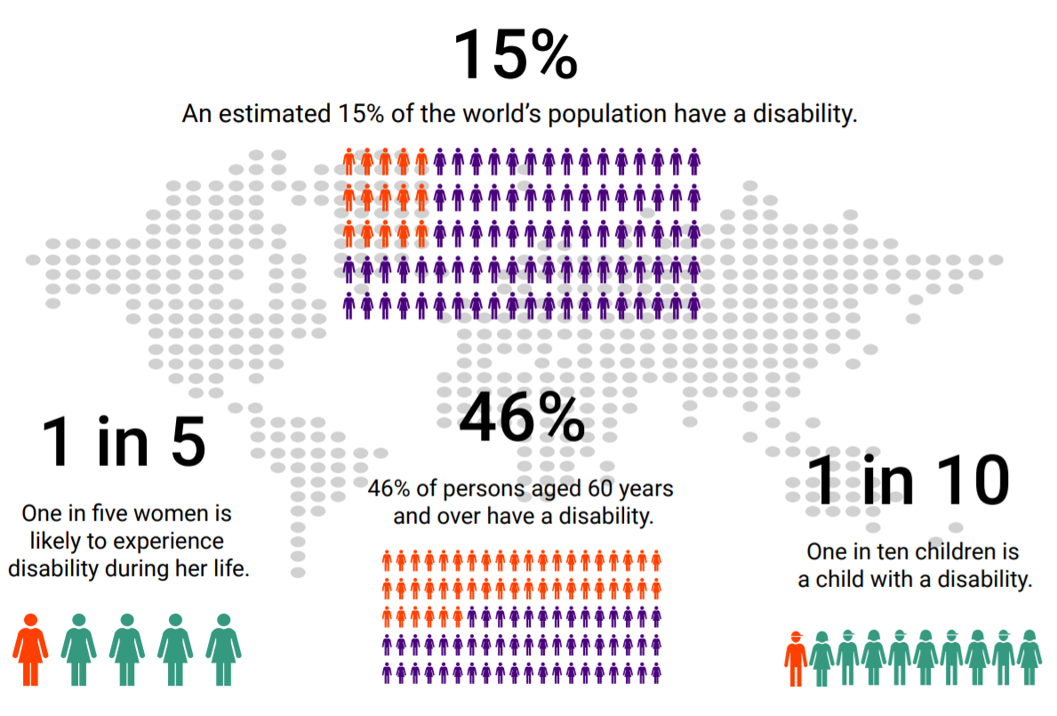
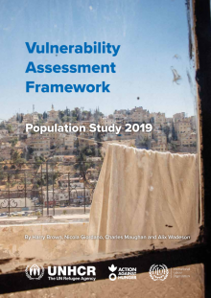
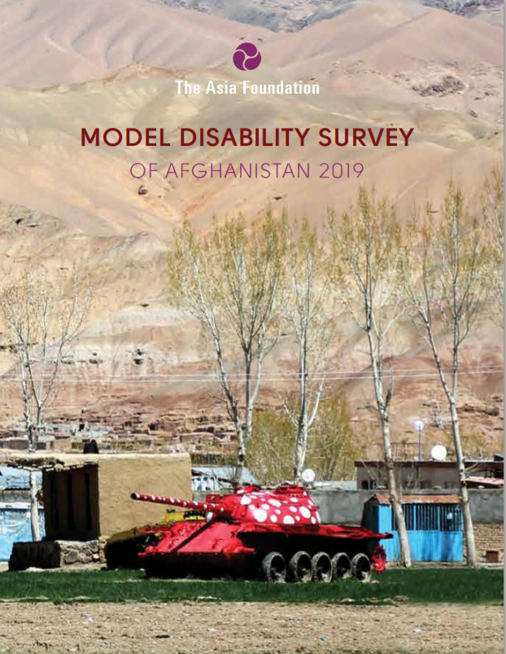
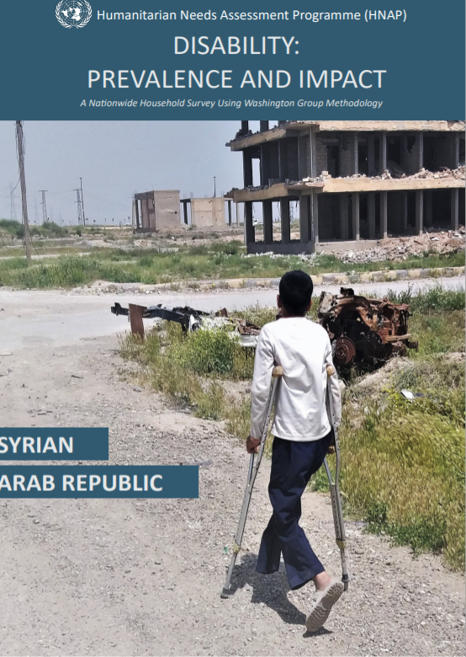


Why disability inclusion in HNOs/HRPs?
Jordan 21%
Afghanistan adults 13.9% “severe” – 65% “moderate/mild disability”
Syria 27%
Afghanistan children 17.3% “mild / moderate / severe” disability”
9% 65 or over
46%
54%
Notes:
Persons with disabilities are estimated to represent 15 per cent of the world’s population (higher in humanitarian contexts)
Among the most marginalized people in crisis-affected communities and are disproportionately affected by conflict and emergency situations.
Attitudinal, physical and communication barriers impede their participation and inclusion in humanitarian action.
Greater marginalization and discrimination due to the intersectionality (age, gender, ethnicity, location and race).
Sources:
Infographic: IASC Guidelines (estimate from 2011 WHO World Report on Disability)
Afghanistan: Model Disability Survey of Afghanistan 2019 https://reliefweb.int/report/afghanistan/model-disability-survey-afghanistan-2019
Jordan: Vulnerability Assessment Framework 2019 https://reliefweb.int/report/jordan/vulnerability-assessment-framework-population-study-2019
Jordan: GHRP COVID-19 In Jordan, a survey reported that 88 per cent of respondents could not go to the hospital for their regular checks or additional medical needs
Older age: According to data from World Population Prospects: the 2019 Revision, by 2050, one in six people in the world will be over age 65 (16%), up from one in 11 in 2019 (9%).
Percentage older women/men: https://www.helpage.org/blogs/florian-juergens-32033/social-protection-for-older-women-1092/

Slide 8
Do persons with disabilities experience humanitarian context differently?
While the same hazards impact on all members of the community, persons with disabilities may experience them differently
due to barriers they face and intersecting structural inequalities
We need to explore the specific disability-related dimensions of vulnerability and other intersecting structural inequalities
that contribute to a more nuanced understanding of risks facing persons with disabilities
Notes:
Key message- vulnerability is created by contextual factors and the way assistance is designed and delivered. Vulnerability is not inherent.

Slide 9
Analytical model for vulnerability analysis

Slide 10
HNO/HRP process overview
Agree on scope of the analysis
1
Undertake secondary data review
2
Collect primary data
3
Conduct joint inter-sectoral analysis
4
Define the scope of HRP & identify initial objectives
5
Conduct response analysis & prioritization
6
Finalize strategic & specific objectives and indicators
7
Formulate projects/activities & estimate cost
8
Conduct After Action Review
9
Disability inclusion doesn’t mean having add-on steps, it means including disability in the already existing steps

Slide 11
Agree on Scope and Focus of the Analysis
What do we need to know?
How do persons with disabilities experience humanitarian consequences differently?
What are the factors contributing to heightened risk for persons with disabilities?
What are the barriers and facilitators to persons with disabilities accessing assistance?
What are the views and perceptions of persons with disabilities?
How can we get this information?
Needs assessment data disaggregated by disability
Focus Group Discussions and key Informant Interviews with persons with disabilities
Barriers and facilitators assessments
Accessible AAP mechanisms
Notes:
Key message: not only about ‘counting’- going beyond PiN estimates

Slide 12
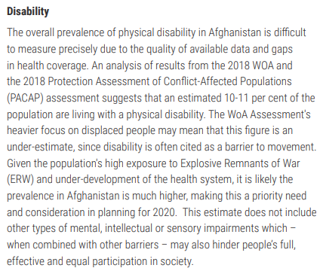
Good Practices : Afghanistan HNO 2020
Included a specific sub-section on disability (and on mental health) under the section Critical Problems.
A subsection provided specific, quantified analysis of factors contributing to risks for persons with disabilities (and their families)

Slide 13
Review and Analyze Data and Information
Analytical Insights | Secondary Data Source | Considerations
Women had significantly less access to WASH facilities if living in a household headed by someone with a disability | Afghanistan REACH Protection Assessment 2018 | Survey data disaggregated by disability can give an indication of barriers to access
About half people with disabilities surveyed experience discrimination and barriers to accessing health services | Central African Republic Humanity and Inclusion Pilot Survey in Bambari 2019 | Small-scale studies on disability by partners can give voice to the affected population
Health care costs for households with a member with one or more disabilities are twice as high as those without a member with disability | Iraq REACH Multi-Cluster Needs Assessment 2019 | Access to big datasets can be helpful to compare different characteristics of the population
Notes:
Key message: Don’t always need to collect new data, start with information that already exists. BUT use with caution
Note- Washington Group questions are addressed in the next slide

Slide 14
Identify and Address Information gaps
Washington Group short question set as a tool for disaggregation by disability
Including persons with disabilities in focus group discussions and key informant interviews- tips
Work with organizations of persons with disabilities from the affected and/ or host community
Budget and plan for accessibility, including training on accessible communication for interviewers
Provide options for different forms of participation
Aim to reflect diversity among persons with disabilities- men, women, youth, older persons, and different types of disabilities
Aim to understand how the crisis is experienced differently, barriers to accessing assistance, and roles/ capacities of persons with disabilities
Do you have difficulty seeing, even if wearing glasses?
Do you have difficulty hearing, even if using a hearing aid?
Do you have difficulty walking or climbing steps?
Do you have difficulty remembering and concentrating?
Do you have difficulty with (self care, such as) washing all over or dressing
Using your usual (customary) language, do you have difficulty communicating, for example understanding or being understood?
Notes:
Key message: not effective to simply ask ‘do you have a disability?’

Slide 15
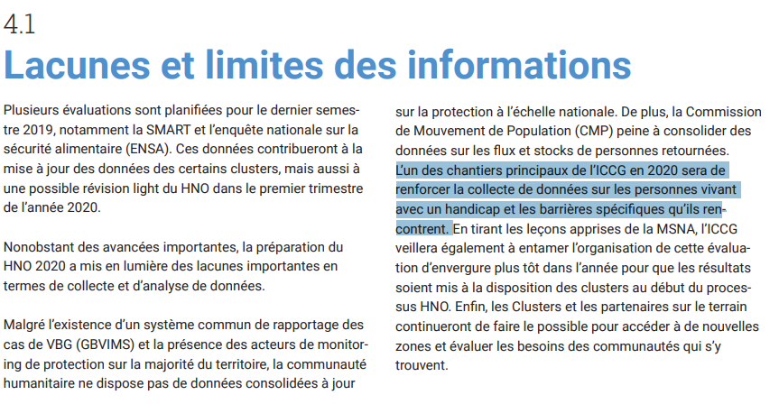
Good Practices : HNOs 2020
Nearly 63% of HNOs acknowledge the need to strengthen the collection and analysis of data. e.g.:
There is strong recognition in CAR, which identified as one of the highest priorities of ICCG to collect data on barriers faced by persons with disabilities.
In Burundi and Niger, the HNOs acknowledge that disability needs to be better integrated and that there are few studies and publications that integrate vulnerabilities linked to gender and disability.

Slide 16

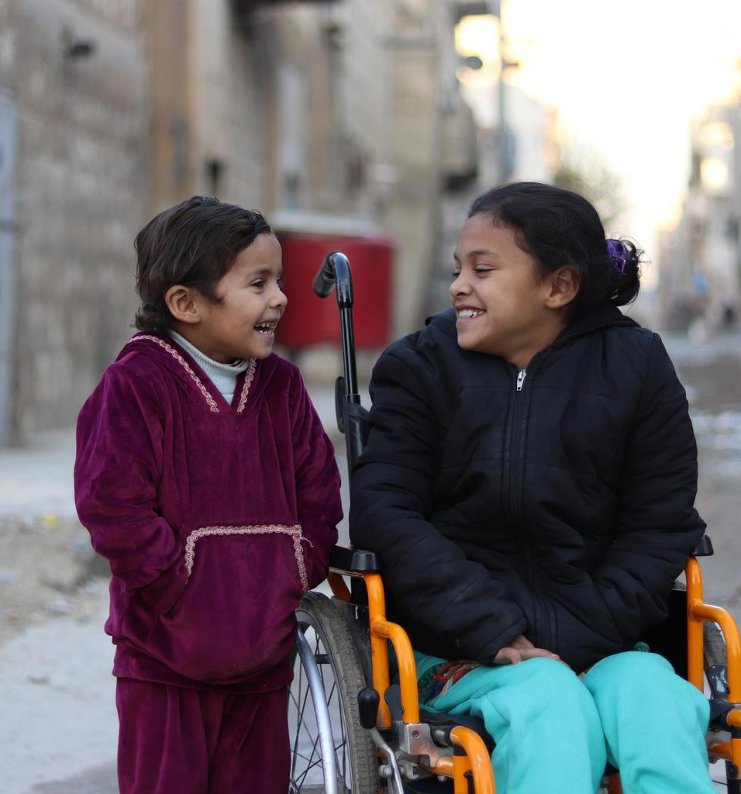

Questions & thoughts
©UNICEF/UN0177789/Al-Issa

Slide 17
Identify Response Options
Example critical problems (HNO)
Example response options (HRP)
Women with disabilities face heightened risk of GBV due to information about GBV prevention and response being inaccessible
Girls with disabilities are out of school due to limited capacity of teachers to meet their learning requirements
Persons with disabilities have limited access to WASH facilities due to physical barriers
Households of persons with disabilities have higher rates of poverty, including due to their lack of access to work opportunities
Development of GBV prevention and response information in multiple and accessible formats
Training to teachers on inclusive education
Improve physical accessibility of WASH facilities, in consultation with persons with disabilities
Conduct a detailed assessment of barriers and enablers to access to work for persons with disabilities and their households
Notes:
Key messages: Multi- sectoral approach
Connection between HNO and HRP (respond to factors contributing to risk, not ‘stock standard’ interventions such as ‘target persons with disabilities’)
Also highlight that critical problems identify the factors contributing to heightened risk

Slide 18
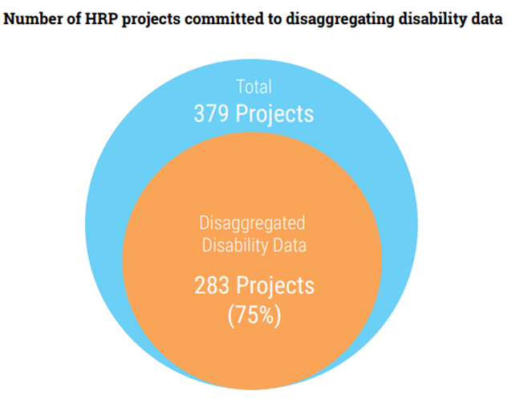
Good practices : Somalia HRP 2020
Increase efforts to identify barriers, risks and enablers for people with disabilities
Strengthen the inclusion of people with different types of disabilities:
  Additional resources to be allocated
  Data collection on disability
  Build and strengthen partnerships and capacity building with organizations for persons with disabilities (OPDs)
  Improve monitoring, reporting and learning.
All projects under the HRP to have identified disability considerations (disaggregate data by disability; consult with people with disabilities; address additional risks; and address barriers)

Slide 19
Identify Response Options
Guided by a twin- track approach
Notes:
Key message: need to develop both mainstreaming and targeted actions

Slide 20
Monitoring and Accountability
At the output level, actions to address critical problems for persons with disabilities can be reflected through specific indicators
# of persons with disabilities receiving health-related rehabilitation services, including assistive technology
# of staff, partners and communities trained in working with people with disabilities
While outcomes in terms of equal access and inclusion may be better reflected through the disaggregation of all relevant indicators by disability
# of girls and boys benefiting from distance learning programmes (Disaggregated by disability)
# people reached with risk communications (disaggregated by disability)

Slide 21
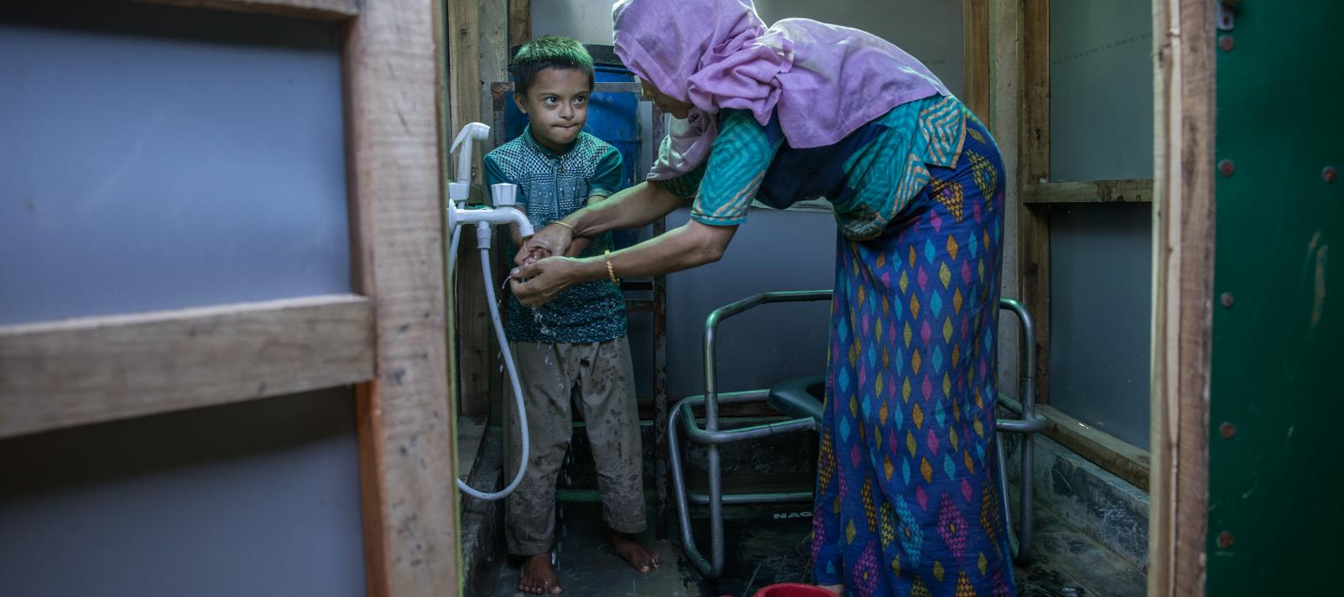
Questions & thoughts
©UNICEF/UNI227529/Al-Issa

Slide 22
Related resources and guidance
Disability & HNOs/HRP
Guidance on strengthening disability inclusion in Humanitarian Response Plans
Tip Sheet: Integration of Disability in HNO
Tip Sheet: Integration of Disability in HNO
GPC webcast on disability inclusive HNO and HRP
Disability & humanitarian response
IASC Guidelines, Inclusion of Persons with Disabilities in Humanitarian Action
UNICEF: Including children with disabilities in humanitarian action
Disability & COVID-19
Disability Inclusion: Tip sheet for GHRP update
Note on applying the IASC Guidelines on Inclusion of Persons with Disabilities in the COVID-19 response

Slide 23
Follow-up exercise

Slide 24
Follow-up exercise for country teams
‘Homework’ to do as individuals or as Country Teams
Participants are encouraged to meet with their HCT team members
Take four weeks through the end of August,
budget about 2 hours time
Idea is to localize or contextualize topics covered in today’s session
Three topics, try and attempt each one
Aligned and relevant to the HNO/HRP process,
not extra work (?)
Provides a context to possibly identify technical assistance needs
Completed homework will provide a foundation for Session 2 training
Self-organized, independent work

Slide 25
Follow-up exercise for country teams
Three topics, attempt each one
Identify 3-5 key questions about the situation, needs and priorities of persons with disabilities, that should be answered by the 2021 Humanitarian Program Cycle needs assessment
Reach out to a local organization of persons with disabilities (OPD), or other representative group of persons with disabilities among affected population, to understand their role, membership and opportunities for engagement in the response
Describe practically how the ‘twin-track approach’ could be applied to the 2021 Humanitarian Program Cycle response plan

