Slide 1
HPC 2021 Training on Disability Inclusion
Module 2 : Practical implementation

Slide 2
Organization:
Facilitators:
Kimberly Lietz (OCHA) lietz@un.org
Kirstin Lange (UNICEF) klange@unicef.org
Steve Perry (UNICEF) sdperry@unicef.org
Ricardo Pla Cordero (UNHCR) placorde@unhcr.org
Ahmed Ghanem (UNICEF) aghanem@unicef.org
Presentation
Participation
Q&A
Polls
Case studies

Slide 3
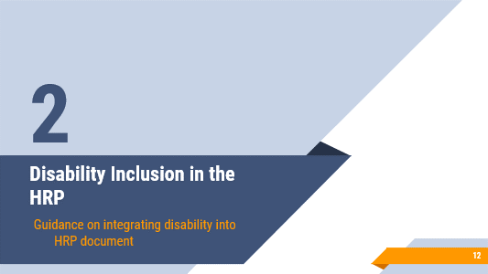
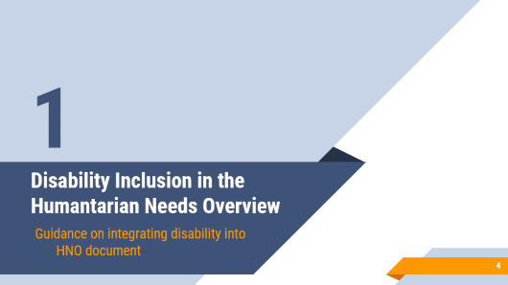

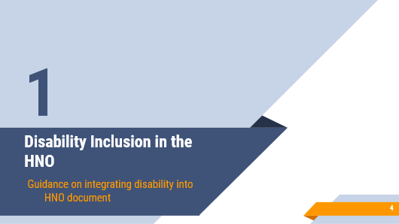
Structure:

Slide 4
Disability Inclusion in the Humantarian Needs Overview
1
Guidance on integrating disability into HNO document

Slide 5
Sections of the HNO Document
Summary of Humanitarian Needs and Key Findings
Part I: Impact of the Crisis and Humanitarian Conditions
Part II: Risk Analysis
Part IV: Sectoral Analysis
Annexes
Part III: Monitoring of Situation and Needs

Slide 6
Summary of Humanitarian Needs and Key Findings
Key findings
- Disaggregate total number of PiN by disability
- Understand the concerns and priorities of persons with disabilities
Humanitarian consequences
- Describe the specific or heightened risks faced by sub-groups of the population due to disability
- Report on existing capacities and coping mechanisms of persons with disabilities

Slide 7
Part I: Impact of the Crisis and Humanitarian Conditions
Context of the crisis
Describe: Key problems,
How the crisis impacts differently on persons with disabilities (including existing capacities/coping mechanisms),
Factors contributing to heightened risk,
Their priorities and needs from their perspective
Humanitarian consequences and causal factors associated with needs
Persons with disabilities should be identified as a sub-group.
Reflect diversity & intersectionality
Severity of humanitarian needs
The impact of disability-related factors on humanitarian consequences and needs.
Number of persons in need
Highlight the number of PiN with disabilities with a visual representation
Disability-related factors
Structural inequalities
Contextual factors
Including Barriers
age, socio-economic status, gender, ethnicity, or religion-
related to the context & the crisis
Heightened risk for persons with disabilities
within
the prioritized population groups
(e.g. IDPs with disabilities, women with disabilities).

Slide 8
To estimate PiN with disabilities
In situations where the collection of primary data is planned, ensure using internationally recognized methods, such as the Washington Group Set tools (WGQs)
In principle, where data on age and sex is collected, data related to disability should be collected as well
Where the primary data collection is not feasible, and secondary data sources on disability are not available or reliable, evidence-based estimations can be used:
  Assess whether secondary data sources (such as administrative data or national prevalence rates) are reliable.
  If secondary data sources are not reliable, use the global estimate (15%) , adjusting if needed
  Remember: in humanitarian contexts, the number of persons with disabilities may be significantly higher than the global average

Slide 9
Part II & Part III
Part II: Risk Analysis | Part III: Monitoring of Situation and Needs
Describe the broad risk context that persons with disabilities face Seek out perspectives from DPOs & local/international NGOs working with persons with disabilities to understand the risks and barriers & to monitor protection concerns | Identify how humanitarian consequences and needs may evolve for persons with disabilities, with consideration for access to assistance and other factors that heighten risk. Reflects consultation with the persons with disabilities and their representatives’ organizations

Slide 10
Part IV: Sectoral Analysis
"Drought exacerbates vulnerability of persons with disabilities"
Persons with disabilities are at heightened risk of drought-induced food insecurity due to their more limited access to employment as a coping mechanism
Persons with disabilities are experiencing poor health outcomes due to difficulties reaching health posts and limited availability of rehabilitation service providers in conflict-affected areas
"Persons with disabilities are more exposed in situations of insecurity"
"Persons with disabilities experience disproportionate impacts of food shortages"
"Persons with disabilities have specific health-related needs which remain unmet"
In situations of insecurity, persons with disabilities are at heightened risk of experiencing violence due to their difficulties in fleeing to safe areas
Limited access to land due to disability- related discrimination increases the risk of food insecurity and malnutrition for persons with disabilities
Examples of how risk is often described
Suggested reformulation
Describe:
How the crisis impacts differently on persons with disabilities
Factors contributing to heightened risk, with regard to each sector

Slide 11
HNO’s Annexes: Information gaps
Reflect on what additional information is needed for programming and how it will be used.
If reliable data on persons with disabilities is not already available, describe how this will be integrated into planned needs assessment and other data collection processes.
If disability cannot be integrated into planned needs assessment processes, consider conducting a dedicated primary data collection exercise.
Specific references to local disability actors may be appropriate.

Slide 12
Disability Inclusion in the Humanitarian Response Plan
2
Guidance on integrating disability into HRP document

Slide 13
Disability Inclusion in the HRP Document
Summary
Part I: Strategic Humanitarian Priorities
Part II: Strategic Objectives Response Approach
Part IV: Sectoral Objectives and Responses
Annexes
Part III: Monitoring and Accountability
Forward by the Humanitarian Coordinator

Slide 14
Forward by the Humanitarian Coordinator & Summary
In the forward: Make a reference to:
the need to ensure the response is fully inclusive, including for persons with disabilities, as an important statement of leadership and commitment to inclusion.
In The Humanitarian Response Plan at a Glance:
Include total estimated number of persons with disabilities in need. Where reliable primary or secondary data is not available, use the global estimate of 15% of the population

Slide 15
Part I: Strategic Humanitarian Priorities
Priority Humanitarian Outcomes, population groups and geographic locations
key outcome: strengthen inclusiveness of the humanitarian response for all prioritized sub-groups (at a minimum, include persons with disabilities).
Describe how the crisis impacts persons with disabilities:
capturing their priorities and needs from their perspective
considering disability-related dimensions of vulnerability and other structural inequalities,
including a summary of the identified barriers to inclusion.
Consider including a text box highlight the specific outcome, with rationale, for prioritized sub-groups, including persons with disabilities (e.g. “age, gender and disability”, or “reaching the furthest left behind”).

Slide 16
Part I: Strategic Humanitarian Priorities
Strategic Priorities
Ensure that the needs analysis including persons with disabilities undertaken during the HNO process is reflected in the strategic priorities of the HRP, including:
  Impacts of social exclusion or marginalization due to disability-related discrimination
  Obstacles to accessing humanitarian assistance (including due to lack of physical access or inaccessible information)
  Unmet needs, including those faced by all affected population and those specific to persons with disabilities
  Heightened risk of violence or abuse, including targeted violence against persons with disabilities

Slide 17
Part II: Strategic Objectives
e.g. Somalia HRP 2020
In the description of each strategic objective: make reference to persons with disabilities in the explanation of how this result or change will impact all affected populations, or how it will specifically benefit groups who are most at-risk.
Consider having a specific SO on quality under which people with disabilities can be better highlighted.

Slide 18


Part II: Response Approach and costing
NO
Simply listing persons with disabilities as a group to be targeted or prioritized
YES
Describe how the response will address the factors contributing to vulnerability and the barriers to inclusion of persons with disabilities
YES
Review responses to determine if:
persons with disabilities have adequate access to the response,
if there are specific barriers faced, and
what adjustments are needed in order to improve access.
The response includes BOTH mainstreaming AND targeted interventions

Slide 19
Part III: Monitoring and Accountability
Mainstreaming: Disaggregated indicators
Capturing information about access by persons with disabilities or the accessibility of services to them
Capturing data about services directly addressing the needs and priorities of persons with disabilities
Targeting: Disability-specific indicators
Response monitoring:
Indicate if there is need to strengthen collection and use of data on persons with disabilities to monitor access to assistance.
Describes measures to ensure accessibility of mechanisms to collect feedback and complaints from people affected by the crisis

Slide 20
Part IV: Sectoral Objectives and Responses
Strategic
Operational
Projects level
Inclusion of disability more relevant & impacts more directly
Disability is a cross-cuting issue: reference to result & changes for persons with disabilities is included in all sectors
In every sector:
  Add a specific sub-heading for each sector describing the prioritized sub-groups, with attention to age, gender and disability at a minimum.
  Consider how disability can be reflected, particularly at output indicator level.

Slide 21
HRPs’ Annexes
Response Options Analysis
  Indicate if there is need to strengthen collection and use of data on persons with disabilities
Costing Methodology
  Ensure that the requirements include budgeting for inclusion and quality.
What if we fail to respond?
  Where relevant, note how a failure to respond will impact persons with disabilities, referencing the heightened risks identified in the HNO.
  Emphasize that without resourcing for inclusion, the most at-risk populations (including persons with disabilities) will not be reached and will be placed at heightened risk.

Slide 22
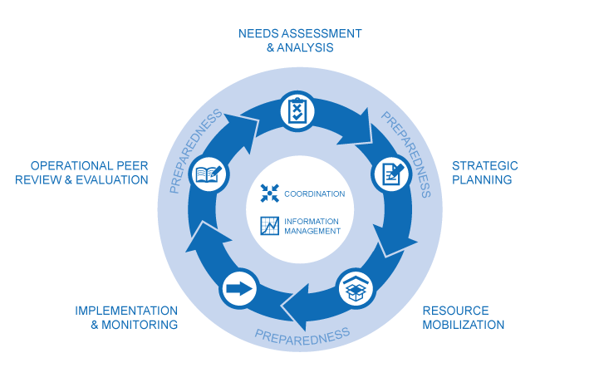
Don’t forget:
HPC
Coherence
Implementation

Slide 23
THANKS!
More Info!

Slide 24
Scenarios-Based Discussion

Slide 25
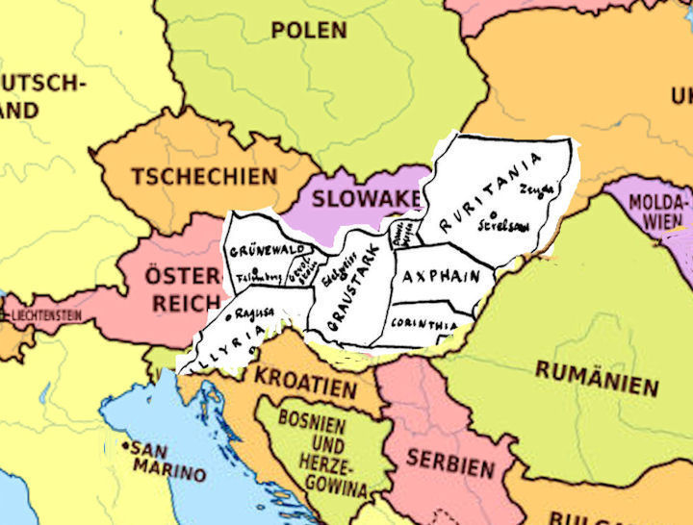
Scenario 1: strengthen collection and analysis of data on disability in Ruritania HNO/HRP
Ruritania (fictional country) is on a positive trajectory towards peace and stability after many years of conflict. Nevertheless,
progress is hampered by cyclical recurrences of climatic shocks, continued conflict in pockets of the country, creating an insecure environment, and continuous displacement,
all compounded by political and socioeconomic instabilities which have been exacerbated by the COVID-19 pandemic.

Slide 26
Scenario 1: strengthen collection and analysis of data on disability in Ruritania HNO/HRP
This creates a complex environment where persons with disabilities face additional barriers and risks and are often excluded from humanitarian assistance due to pre-existing discrimination, and stigma or societal exclusion.
Given these factors and the extreme levels of poverty experienced by persons with disabilities, it is therefore important to identify persons with disabilities as a group at risk-based data and evidence, rather than on perceptions and anecdotes.
The Humanitarian Coordinator has committed to strengthening information on disability during HPC 2021, but the HPC process has been set back due to COVID-19.

Slide 27
Can you support Ruritania HCT to take a decision?
A quality humanitarian response is built on an understanding of the requirements and priorities of persons with disabilities during a crisis.
How can we ensure that there are accurate and meaningful information and data about disability during the HNO process?

Slide 28
What you will do?
Access this link in the chat to select the best option
Every option will show you the consequence of your choice
Read these consequences carefully and reconsider your answer (you can go back & select another option)

Slide 29
Scenario 2: Involvement of OPDs in Ruritania 2
Ruritania 2 is another fictional country,
This is a complex protracted crisis involving large numbers of IDPs. Because of the on-going war, a large proportion of the population is affected by disability in one way or another.

Slide 30
Scenario 2: Involvement of OPDs in Ruritania 2
This has led to the emergence of a few strong and articulate local organizations of persons with disabilities. As well, given the huge amount of humanitarian funding, many large INGOs and the RC/RC also prioritize programming responding to the needs of persons with disabilities.
As in many humanitarian contexts, the coordination architecture is two-tiered:
  The Humanitarian Country Team is at a higher level and involves UN agencies, some donors, and selected NGOs.
  The Inter-Cluster Coordination Team is more technical, involving Cluster Coordinators and INGOs as co-leads

Slide 31
Can you support Ruritania HCT to take a decision?
How to ensure an effective Humanitarian Coordination and participation that support Disability Inclusion within HNO/HRP process ?

Slide 32
What you will do?
Access this link in the chat to select the best option
Every option will show you the consequence of your choice
Read these consequences carefully and reconsider your answer (you can go back & select another option)

Slide 33

THANKS!
Q&A

