Slide 1
Accountability, Inclusion and Protection HPC 2021
7th September 2020
Notes:
Zoom poll profile
Mentimetor or zoom – current practices

Slide 2
Overview of the webinar
Why Cross-Cutting issues and UNICEF and UNICEF-led clusters/AoR’s commitment to cross-cutting issues integration?
How can we achieve the commitment?
Cross-cutting issues integration into HNO
Cross-cutting issues integration into HRP
Cross-cutting issues integration into Resource Mobilisation
Q&A
Notes:
Mentimetor after this.

Slide 3
Mentimeter
Go to menti.com
Code: 36 44 32 7
Or click the link https://www.menti.com/1k9tohcw39 in the chat box to go to mentimeter
What is your current practices and interests in cross-cutting issues integration into HNO and HRP?

Slide 4
Focus of the webinar
Cross-cutting issues focus on particular areas of concern in humanitarian response and address individual, group or general vulnerability issues.
This webinar does not cover ALL cross-cutting issues.
Main focus will be on AAP, Disability and Protection i.e. GBV risk mitigation.
However this common approach was developed jointly with child safeguarding/child participation and localization specialists and based on years of collaboration with gender specialists.
This presentation focuses on a common approach in HNO and HRP across cross-cutting issues mentioned above but does not replace specificities of each cross-cutting issue.

Slide 5
Why integrating cross-cutting issues are critical in COVID-19 context?
Secondary effect of COVID-19
Increased burden of women and girls at home, community and at work
Restriction of movement globally and domestically
UN and INGOs are not able to move as before.
Primary data collection is limited.
Persons with disabilities have challenges receiving necessary services and modified services are not accessible.
Information collection through ICT but there are digital divide i.e. children, women and persons with disabilities have less access to ICT.
Increased cases and risks of GBV i.e. DV/IPV
GBV risks needs to be identified and mitigated in all sectors.
Links to GBV services from non-traditional entry points.
Needs of persons with disabilities have to be well integrated.
Partnership with local organizations are key to ensure participation of women, children and persons with disabilities.
Local actors and community-based organizations play more critical roles in humanitarian response than before.

Slide 6
Integration of Cross-Cutting issue is for Good Programming/reach to your cluster’s objective
Opinions of children, women and persons with disabilities are not included
Feedback mechanism is not accessible to all.
Not private/ not accessible (e.g. visual and/or physical disabilities).
Children, women and person with disabilities were not consulted.
Girls are harassed while waiting for latrine
Not safe at night time
taboos
Not safe at night time
More private, closer to home BUT increases oral-faecal disease
Notes:
Sometimes there can be a negative response to ”gender” work or “mainstreaming” work. Some people have had negative experiences either because it created more work, seemed to be just a lot of jargon with no real practical value, didn’t seem relevant to their work, etc.
My goal for every element of this project is to make it as relevant as possible to the sections’ work and as useful as possible, particularly to meet the realities of the field.
COLLABORATION
AAP – feedback mechanism

Slide 7
UNICEF’s Commitment to Accountability, Inclusion and Protection
UNICEF ED Fore made a commitment at the Oslo SGBV conference to increase the visibility of GBV in UNICEF-led clusters’ Humanitarian Needs Overviews (HNO) and Humanitarian Response Plans (HRPs); at least 10 HNO/HRPs for 2020 include GBV risk analysis and risk mitigation measures across all UNICEF-led clusters.
UNICEF leads the inter-agency commitment to ensure that by the end of 2020, at least 70% of HNO/HRP use a common recognized methodology and routinely disaggregate data on disability in order to make programming more responsive to the needs of people with disabilities.
IASC Policy on Protection in Humanitarian Action and Centrality of Protection, UNDIS & UNSG’s commitment to put GBV and Disability at the center of the GHRP.
UNICEF abides to IASC and Grand Bargain commitments in relation to AAP (also strongly reflected in the CCCs).

Slide 8
UNICEF-led clusters’ and AoR’s commitment to Accountability, Inclusion and Protection
UNICEF-led Clusters and AoR will commit to:
Place affected people at the center of humanitarian action so that they can inform the response.
Support the localisation of humanitarian aid by encouraging and supporting local partner engagement and building their institutional capacity in humanitarian response.
Identify and address different needs, barriers, risks and capacities of girls, boys, women including those with disabilities to make humanitarian response safe and accessible for all throughout the Humanitarian Programme Cycle.
Make special efforts to support the affected population i.e. boys, girls, women including those with disabilities to participate in decision making throughout the HPC and ensure that their views are considered in the HNO/HRP and its implementation.

Slide 9
Common key principles for cross-cutting issues
Reduce risks and Do no harm: eliminate or minimize the risks of humanitarian interventions negatively impacting on different population groups and sub-group of the affected population and to the overall protection and human rights situation
Participation of affected populations i.e. children, women and persons with disabilities into the decision-making processes throughout the HPC.
Safe Access of different population groups and sub-groups to humanitarian response services/goods/information and feedback mechanisms
Notes:
Thoughts for cross-cutting issues team.
We might want to compare key principles or each cross-cutting issues and identify common principles.

Slide 10
Summary of the analysis of HNOs/HRPs
APP
GBV
Disability
50% of 2019 HNOs had AAP covered in Overview (Part I). None in sector/cluster sections
Only 22% of 2019 HRPs have AAP reflected in Part II and 67% in Part I
GBV risk and barrier analysis in HNO and GBV risk mitigation measures in HRP in 2019 /2020 HPC.
EC: 13 HNOs/9HNOs, 15 HRPs and 8 HRPs
NC: 5HNOs/4HRPs, 4HNOs/3HRPs
WC: 13 HNOs/9HNOs, 10HRPs/11HROs.
Compared to the 2018 review, 2020 HNOs & HRPs showed substantial progress in disability inclusion, However in 2020:
Only 31% of HNOs reflects consultation with the persons with disabilities / ODPs
Only 56% of HRPs mentioned disability in the results framework, with indicators using data disaggregated & specific indicators
Reference to disability in the sectors: Education 11, Protection 11, WASH 7, Nutrition 5
Notes:
HNOs/HRPs with reference to disability in the sectors: Education 11, Protection 11, WASH 7, Nutrition 5

Slide 11
HNO 2020 - Strengths and Weakness
Barrier analysis is done in most of clusters but rarely disaggregated by age, gender and disabilities.
Children, women and persons with disabilities are listed as vulnerable population but little analysis is made on what factors make them vulnerable.
Recognition of coping mechanisms/ capacities by age, gender and disabilities.
Participation: Inclusive processes for consulting with women, girls and persons with disabilities
Data: Use of global disability prevalence estimates, 50/50 for women and men and not really reflect actual numbers.
Increased recognition of AAP, Disabilities and Protection i.e. GBV

Slide 12
HRP 2020 - Strengths and weakness
Discrepancy between identified risks/barriers/needs and response strategies and indicators.
Lack of engagement of local orgs e.g. youth, women, disabilities in HRP process
Lack of response that corresponding special needs of girls, women i.e. MHM and persons with disabilities. .
Lack of strategies for inclusive Feedback and Complainants mechanisms -
Lack of strategies to address information gaps
More and more HRPs consider specific needs of children, women and persons with disabilities.

Slide 13
How can we achieve UNICEF-led clusters/AoR’s commitments to AAP, Inclusion and Protection?

Slide 14
HNOs/HRPs in the light of COVID-19: what to expect:
Strong links to the GHRP that will be integrated into 2021 GHO
Benefit from the GHRP analysis and monitoring conducted over last months to feed into the HPC 2021
Increased focus on risk analysis and projections
Anticipate increased focus on the use of secondary data and expert judgment
Partnership with local women’s organizations, organizations of persons with disabilities and other local actors to collect descriptive and qualitative data and design feasible response strategies
Support efficient and comprehensive approach through more emphasis on:
Joint intersectoral analysis and
Multi-sectoral responses
Linkages with development plans and actors
Localization

Slide 15
Common approach – Needs Assessment and Analysis for HNO
Work with local women’s organizations, organizations of persons with disabilities and other local actors for needs assessment, needs analysis and validation of the findings to facilitate participation of boys, girls, women including those with disabilities.
Conduct a barrier analysis –identify key barriers that women, men, girls and boys of different age and disabilities face when they access/use services/goods and feedback mechanisms in consultation with affected populations.
Identify risks and different coping mechanisms that women, men, girls and boys of different age and disabilities use to understand their different impact and capacity to cope with the shock.

Slide 16
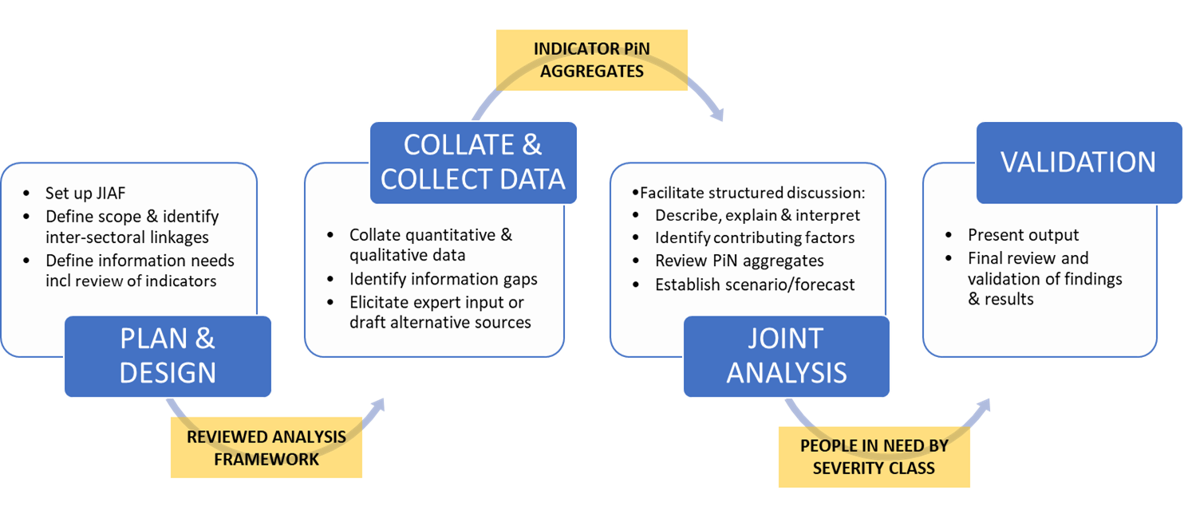
- Involve disability, gender and GBV specialists for data interpretation.
- Intersectional analysis- understanding how aspects of diversity (age , gender, disability,…) intersect to impact risk
- avoid creating lists of ‘vulnerable groups’ without analysis of what types of risks these individuals face, and why
Entry points in JIAF
Integrate questions related to GBV, disability and AAP
into the joint analysis plan to inform planning decisions
Invite local orgs for data validation.
Primary data collection include children, women and persons with disabilities.
At very least consult with local actors – youth orgs, org for persons with disabilities.
Make use of data available from protection sectors etc.

Slide 17
Examples: Working with local organizations in needs identification in Somalia
In 2019, the Global CP AoR Needs Identification and Analysis Framework (NIAF) Team supported the Somalia CP AoR HNO needs analysis and prioritization.
National partners actively participated in the HNO needs analysis, prioritization and validation
Somalia CP AoR learnt to use existing operational and prevalence data to measure child protection indicators
There were several sessions of joint analysis and interpretation sessions to prioritize the locations with the most severe child protection needs.
Notes:
August 2019, the Global CP AoR Needs Identification and Analysis Framework (NIAF) Team supported the Somalia CP AoR HNO needs analysis and prioritization.
Somalia CP AoR has over 76 members at national level and 11 sub-national structures, which are co-chaired by local NGOs and government.
National partners actively participated in the HNO needs analysis and prioritization and validation
Data used included UNHCR’s IDP population data, data from a nation-wide monitoring and reporting system, and data from the Who does What, Where, and When (the 5Ws).
The NIAF Team and REACH strengthen the capacity of the Somalia CP AoR in the use of existing operational and prevalence data to gather information about the number of IDPs, the current services, and how accessible they were.
Somalia CP AoR learnt house to use the existing data to measure child protection indicators such as the estimated number of unaccompanied and separated children and the number of children associated with armed forces and armed groups.

Slide 18
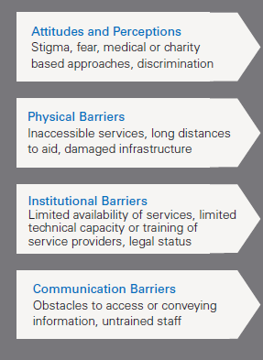
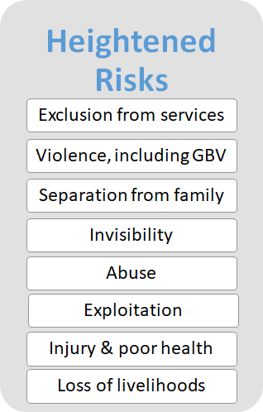
Barrier analysis – what data do you need?
Age
Gender
Disability
Poverty
Ethnicity or Religion
Notes:
Handout: AAAQ framework

Slide 19
Examples of barriers and risks identified in HNO 2020
Distance and location to facilities and services
Lack of financial resources
Lack of services targeting special needs of women and girls i.e. MHM, SRH, and those with disabilities, gender segregated latrines
Violence at schools
Cultural norms/social norms – lack of respect for girl’s education, movement restriction of women and girls, husband approval
Design of facilities (universal design /accessibility)
Lack of information/ available information are not understandable among certain population groups .
Negative attitudes and discrimination
Affordability of the services extra cost
Notes:
Dissagregation is rare.

Slide 20
WASH: good examples from Syria
Specific Barriers of women and girls
“ Assessment results in some of the IDP sites in northern Syria confirmed that protection issues including the lack of door locks and adequate lighting, lack of gender segregated facilities, long distances to the facilities as well as the lack of privacy and the fear of harassment on the way to WASH facilities are considerable concerns for women and girls…
In addition, IDP and returnee female headed households are more vulnerable in terms of access or affordability of WASH items, including sanitary napkins and other hygiene items traditionally provided by WASH actors and services.
Continuous efforts are required for WASH staff to be trained on basic GBV concepts and referral pathways to properly refer GBV survivors” (WoS)
Most vulnerable.
Access to WASH items
Capacity of WASH actors re. GBV risk mitigation
Notes:
Only 5 countries (Burundi, Ethiopia, Nigeria, Wos, Yemen) have an analysis. 6 countries (Myanmer, oPT, Somalia, South Sudan, Ukraine, Cameroon) mentioned risks or barriers without analysis. 2 countries (CAR, Libya) mentioned specific needs women.
WoS has the most comprehensive analysis. This is an excerpt from the HNO. Why they are good? They have barriers analysis based on assessments. They also checked who is the most vulnerable among women. This para also include an analysis of barriers to NFIs which are rarely included. WoS is the ONLY HNO that mentions capacity of WASH actors related to GBV in HNO. There is no capacity analysis but at least it shows the gaps in capacity.

Slide 21
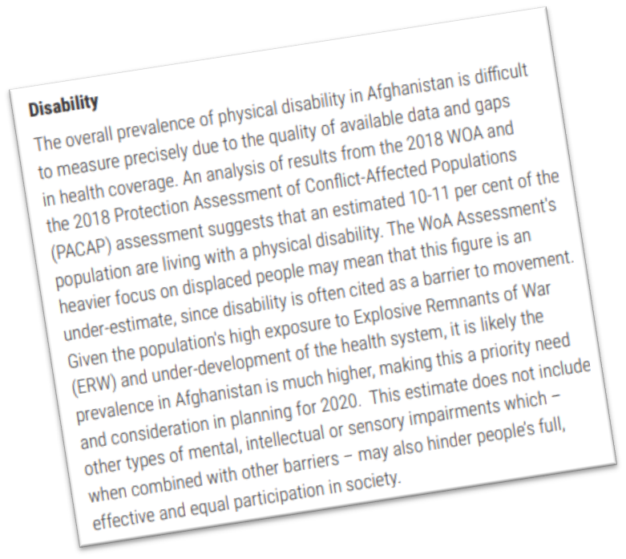
Examples of inclusion Good Practices 2020 HNOs
Afghanistan HNO 2020
Review and Analyze Data and Information
Included a specific sub-section on disability (and on mental health) under the section Critical Problems.
A subsection provided specific, quantified analysis of factors contributing to risks for persons with disabilities (and their families)
Analytical Insights | Secondary Data Source | Considerations
Women had significantly less access to WASH facilities if living in a household headed by someone with a disability | Afghanistan REACH Protection Assessment 2018 | Survey data disaggregated by disability can give an indication of barriers to access
About half people with disabilities surveyed experience discrimination and barriers to accessing health services | CAR HI, Pilot Survey in Bambari 2019 | Small-scale studies on disability by partners can give voice to the affected population

Slide 22
Mentimeter
Go to menti.com 36 44 32 7
Or click the link https://www.menti.com/1k9tohcw39 in the chat box to go to mentimeter
Are you with us?

Slide 23
Common approach – strategic planning
Country-level planning is systematically participatory, including all affected community groups. This includes people’s own expression of their prioritization and satisfaction in aid.
Include response strategies which address identified barriers and protection risks incl. GBV to the services/facilities in consultation with boys, girls, women including those with disabilities. This could include a monitoring of safe access to and use of services/facilities/feedback mechanisms such as safety and inclusion audits.
Include strategies for strengthening the institutional capacity local actors in the cluster response
The indicators suggested use sex, age and disability disaggregated data (SADDD) and include at least one indicator related to access to services/facilities.

Slide 24
What are the qualities of a strong cluster/sector response plan?
Where and how can you integrate a safety lens & twin track?
Cluster obj’s
PiN
Priority actions
Activities
Funding reqs
Monitoring
Emphasize safety, access, inclusiveness, affordability, acceptability, quality, dignified etc.
At very minimum age, sex and disability disaggregated data
Do No Harm, reduce and respond to GBV risks, address special needs of persons with disabilities, women and girls, mainstream them in all actions
Engage women, girls and persons with disabilities.
Address their barriers and critical needs
Include budget for GBV risk mitigation and Disability inclusions according to the planned activities.
Specific indicator related to safe and dignified access (SADDD),
Reducing risks,
Improving safety,
Achieving cluster/sector goals (disaggregated)
Notes:
Need to update to include disabilities.

Slide 25
Examples of identifying response options guided by a twin- track approach
Example critical problems (HNO)
Example response options (HRP)
Women with disabilities face heightened risk of GBV due to information about GBV prevention and response being inaccessible
Girls with disabilities are out of school due to limited capacity of teachers to meet their learning requirements
Persons with disabilities have limited access to WASH facilities due to physical barriers
Households of persons with disabilities have higher rates of poverty, including due to their lack of access to work opportunities
Development of GBV prevention and response information in multiple and accessible formats
Training to teachers on inclusive education
Improve physical accessibility of WASH facilities, in consultation with persons with disabilities
Conduct a detailed assessment of barriers and enablers to access to work for persons with disabilities and their households
Mainstreaming
Targeted
Mainstreaming
Targeted
Notes:
Key messages: Multi- sectoral approach
Connection between HNO and HRP (respond to factors contributing to risk, not ‘stock standard’ interventions such as ‘target persons with disabilities’)
Also highlight that critical problems identify the factors contributing to heightened risk

Slide 26
Example of response measures including AAP, Disability and Protection
Highlights monitoring of GBV awareness and prevention activities; and promoting the dissemination of information on human rights and protection services available with the active participation of women and persons with disabilities.
Accountability mechanisms to include persons with disabilities.
Conducting safety audit (both sector specific and multisectoral)
Training of frontline workers on GBV referrals
Building capacity of persons with disabilities.

Slide 27
Sample indicators
Disaggregate other relevant indicators by gender, age & disability
Barriers and risks of services
# of a safety audit/monitoring conducted./% of safety audit recommendations implemented
# of people used/accessed (SADDD)
Capacity of frontline workers
% of female frontline workers in the sector.
% of frontline workers trained on AAP, GBV referrals, Disability
Participation/perception of services
# or % of community members reporting improved safety and comfort accessing humanitarian services/facilities
% of staff/frontline workers who have signed Code of Conduct
# or % of facilities established in consultation with children, women and persons with disabilities.
% of sites with feedback mechanisms.
% of gender segregated WASH facilities
% of inclusive WASH facilities
# of women with disabilities recruited to participate in community leadership structures
Notes:
Third indicator is actually very important but second one would be easier and more acceptable.

Slide 28
Good examples: South Sudan WASH
Sector objective includes GBV risk mitigation in 2019 and 2020.
Safety audit embedded in WASH planning and monitoring
Two specific indicators related to GBV risk mitigation.

Slide 29
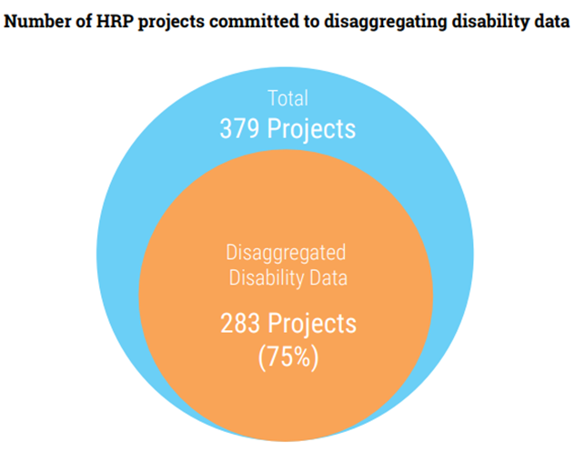
Good practices : Somalia HRP 2020
Increase efforts to identify barriers, risks and enablers for people with disabilities
Strengthen the inclusion of people with different types of disabilities:
Additional resources to be allocated
Data collection on disability
Build and strengthen partnerships and capacity building with organizations for persons with disabilities (OPDs)
Improve monitoring, reporting and learning.
All projects under the HRP to have identified disability considerations (disaggregate data by disability; consult with people with disabilities; address additional risks; and address barriers)

Slide 30
Common approach – Resources Mobilization
Include adequate budget related to cross-cutting issues such as AAP, disability inclusion and GBV risk mitigation in sector-specific response plan.
Include Cross-cutting issues i.e. AAP, Disability Inclusion and GBV risk mitigation in the Cluster’s Fund Allocation Strategy for pooled funding.
Prioritize local actors including women’s, and youth organizations and organizations with persons with disabilities to receive funding and support their institutional capacity strengthening.

Slide 31
Examples of inclusion of cross-cutting issues in Project Vetting - 2019 Guidance & Project Vetting Criteria for the HRP, Shelter, Palestine
Cross-cutting issues
Gender mainstreaming and the Gender and Age Marker code
Projects should include information on gender in their narrative on needs analysis, activities and indicators. Clusters have been provided with gender guidance documents, which partners should have consulted and adhered to. The guidance includes information on the Gender and Age Marker code, which partners will have self-assessed in their OPS project sheet application. Cluster Gender Focal Points will support the vetting panels, which will review the Gender and Age Marker coding. The score range is:
Protection mainstreaming
Partners should demonstrate a commitment to mainstreaming protection in their programme delivery, and the project sheet should have evidence of protection mainstreaming, including in the narrative sections on needs analysis, activities and indicators, as appropriate. The score range is:
Community Engagement
Projects that enhance Community Engagement (which includes the concepts of Accountability to Affected Populations (AAP) and Communication with Communities (CwC)) should be considered favourably by vetting panels. Community Engagement should be reflected in the project design, implementation, monitoring and evaluation phases of a project to the extent possible. Partners will answer a number of questions through drop-down options to identify their level of Community Engagement. The score range is
Local partnerships
Implementing partners / partnerships with local NGOs
Wherever possible, projects shall include partnerships with local NGOs and other national partners as implementing partners. Projects submitted directly by local NGOs will receive the highest score in this field. The score range is:
Cross-cutting issues are included in the Prohect vetting sheet. It encouraging to integrate cross-cutting issues in project sheets.

Slide 32
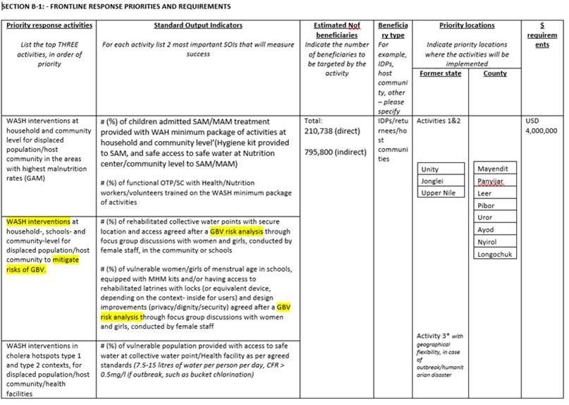
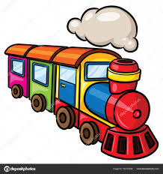
South Sudan Humanitarian Funding 2018/2019

Slide 33
Questions?
Notes:
At the end, Mentimetor

Slide 34
Mentimeter
Go to menti.com Code: 36 44 32 7 Or click the link https://www.menti.com/1k9tohcw39 in the chat box to go to mentimeter What is your priority now for the HPC 2021 and technical support?

Slide 35
Disability Related resources and guidance
Disability & HNOs/HRP
Guidance on strengthening disability inclusion in Humanitarian Response Plans
Tip Sheet: Integration of Disability in HNO
Tip Sheet: Integration of Disability in HRO
Webcast: Disability inclusion in HNOs/HRPs 2021 training
Disability & humanitarian response
IASC Guidelines, Inclusion of Persons with Disabilities in Humanitarian Action
UNICEF: Including children with disabilities in humanitarian action
Disability & COVID-19
Disability Inclusion: Tip sheet for GHRP update
Note on applying the IASC Guidelines on Inclusion of Persons with Disabilities in the COVID-19 response

Slide 36
Resources for GBV risk mitigation
IASC GBV guidelines thematic area guide and GBV guidelines website
https://gbvguidelines.org/en/
GBV pocket guide
https://gbvguidelines.org/en/pocketguide/
Inter-agency GBV integration tipsheet in COVID-19 context
https://gbvguidelines.org/wp/wp-content/uploads/2016/10/2015_IASC_Gender-based_Violence_Guidelines_full-res.pdf
GWC Quality Assurance and Accountability Initiative
GWC Guidance Document on QAA
GWC Analytical Framework for QAA
GWC Quality Assurance and Accountability TWG
GEC Need Assessment and Identification
Nutrition Draft Gender and GBV responsive Nutrition training, GBV risk mitigation measurement etc
Notes:
Need to add

Slide 37
Resources for AAP
Core Humanitarian Standard on Quality and Accountability
Accountability to Affected Populations: A handbook for UNICEF and Partners (forthcoming)
IASC Commitments on Accountability to Affected People and Protection from Sexual Exploitation and Abuse
Collective Communication and Community Engagement in Humanitarian Action
Engaged and Heard! Guidelines on Adolescent Participation and Civic Engagement
Guidelines for Children's Participation in Humanitarian Programming
Feedback Starter Kit
Child Friendly Feedback Mechanisms: Guide and Toolkit
Protection from Sexual Exploitation and Abuse (PSEA): A Practical Guide and Toolkit for UNICEF and Partners
Notes:
Need to add

Slide 38
More information, questions and request for support: Contact helpdesks of each cluster/AoR
CP AoR: https://www.cpaor.net/HelpDesk
Global Education Cluster: https://www.educationcluster.net/Helpdesk
Global WASH Cluster: globalwashcluster@gmail.com
Global Nutrition Cluster: https://www.nutritioncluster.net/Ask_question
Notes:
Evaluation Mentimetor

Slide 39
Thanks
Notes:
At the end, Mentimetor

