Slide 1



Lessons Learned from Humanitarian-Development Nexus Reviews
Myanmar, Niger and Afghanistan
3 December 2020

Slide 2
3 COUNTRY CASE STUDIES:
NIGER, AFGHANISTAN AND MYANMAR
OBJECTIVES
METHODOLOGY
TIMELINE
How could humanitarian and development actors collaborate around the nexus?
How could the NC and SUN MSP support these processes?
Review of existing information: policies, funding, coordination, programmes…
Key Informants Interviews / Consultations
August – September 2020

Slide 3
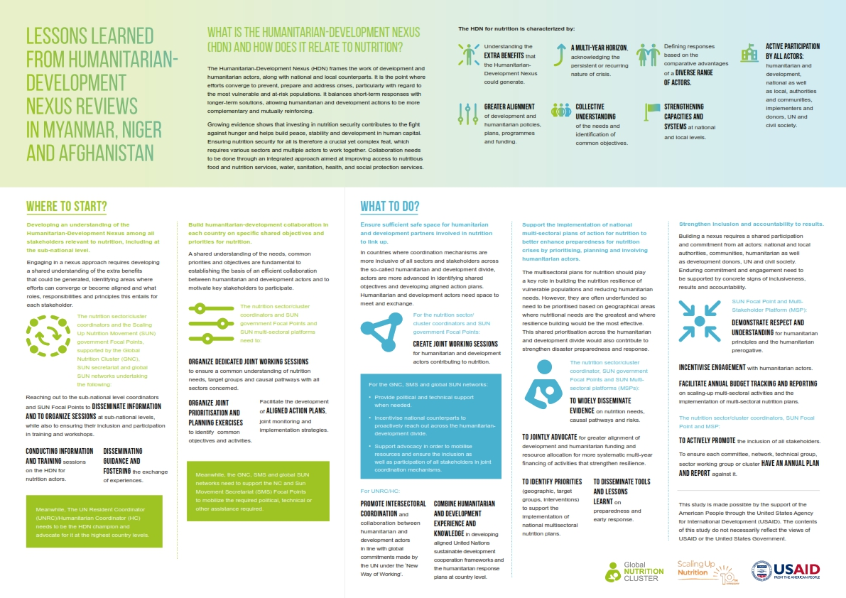
POLICY BRIEF

Slide 4
KEY FINDINGS
Political Commitment for nutrition
Policies, strategies and coordination mechanisms
Colocation of humanitarian and development actors in priority areas and in the public health system
Increasing flexibility from financing instruments
No shared vision of the HDN for nutrition: benefits and areas of convergence
Lack of investments into nutrition and disaster preparedness and response.
Commitments and plans are not implemented at scale
Some organisations are not able to participate and to bring their potentially valuable inputs due to the lack of resources
Notes:
Reduce the opportunities to find areas of convergence and incentives to collaborate

Slide 5
Develop an understanding of the HDN among all stakeholders
Conduct information and training sessions on the HDN for nutrition actors.
Disseminate guidance and fostering the exchange of experiences.
Reach out to the subnational level coordinators and SUN focal points to disseminate information and to organize sessions at subnational levels, while also to ensuring their inclusion and participation in training and workshops.
Notes:
Engaging in a nexus approach requires developing a shared understanding of the extra benefits that could be generated, identifying areas where efforts can converge or become aligned and what roles, responsibilities and principles this entails for each stakeholder.

Slide 6
Build humanitarian-development collaboration in each country on specific shared objectives and priorities
Organize dedicated joint working sessions to ensure a common understanding of nutrition needs, target groups and causal pathways with all sectors concerned.
Organize joint prioritisation and planning exercises to identify common objectives and activities.
Facilitate the development of aligned action plans, joint monitoring and implementation strategies.
Notes:
A shared understanding of the needs, common priorities and objectives are fundamental to establishing the basis of an efficient collaboration between humanitarian and development actors and to motivate key stakeholders to participate.

Slide 7
Ensure sufficient safe space for humanitarian and development partners to link up
Create joint working sessions for humanitarian and development actors contributing to nutrition.
Support advocacy in order to mobilise resources and ensure the inclusion as well as participation of all stakeholders in joint coordination mechanisms.
Promote intersectoral coordination and collaboration between humanitarian and development actors in line with global commitments made by the UN under the ‘New Way of Working’.
Notes:
In countries where coordination mechanisms are more inclusive of all sectors and stakeholders across the so-called humanitarian and development divide, actors are more advanced in identifying shared objectives and developing aligned action plans. Humanitarian and development actors need space to meet and exchange.

Slide 8
Support the implementation of national multisectoral plans of action and disaster preparedness
Disseminate evidence on nutrition needs, causal pathways and risks
Disseminate tools and lessons learnt on preparedness and early response
Jointly advocate for greater alignment of development and humanitarian funding
Identify priorities (geographic, target groups, interventions) to support the implementation of national multisectoral nutrition plans
Notes:
The multisectoral plans for nutrition should play a key role in building the nutrition resilience of vulnerable populations and reducing humanitarian needs. However, they are often underfunded so need to be prioritised based on geographical areas where nutritional needs are the greatest and where resilience building would be the most effective. This shared prioritisation across the humanitarian and development divide would also contribute to strengthen disaster preparedness and response.

Slide 9
Strengthen inclusion and accountability to results
Demonstrate respect and understanding for humanitarian principles and the humanitarian prerogative
Incentivise engagement with humanitarian actors
Facilitate annual budget tracking and reporting on scaling-up multi-sectorial activities and the implementation of multisectoral nutrition plans
To actively promote the inclusion of all stakeholders
To ensure each committee, network, technical group, sector working group or cluster have an annual plan and report against it
Notes:
Building a nexus requires a shared participation and commitment from all actors: national and local authorities, communities, humanitarian as well as development donors, UN and civil society. Enduring commitment and engagement need to be supported by concrete signs of inclusiveness, results and accountability.

Slide 10
OUR SPEAKERS TODAY
Dr Said Shamsul Islam Shams
Coordinator of the Technical Secretariat of the AFSeN-A - AFGHANISTAN
SUN Movement Technical Focal Point - AFGHANISTAN
Mrs Karima Al-Hada’a
From the Ministry of Planning and International Cooperation – YEMEN
SUN Movement Technical Focal Point – YEMEN

Slide 11
Next steps
Review the recommendations in the policy brief
Organize a meeting between Cluster/Sector Coordinator and SUN Focal point in the coming 2 months
Include the SAG and representatives from the SUN movement in country
Agree on what is and how they want collaborate based on the recommendations
After the meeting send the summary agreements to the GNC & SUN movement secretariat and request any support as needed:
  GNC: Briony Stevens bstevens@unicef.org
  SUN movement: Stephen Williams Stephen.Williams@scalingupnutrition.org

