Slide 1


What is Predictive Analytics?
OCHA Centre for Humanitarian Data
Leonardo Milano, Tinka Valentijn, 13 January 2021

Slide 2
What are we going to cover today?
Introduction to Predictive Analytics
Concrete applications of Predictive Analytics in humanitarian sector
Example of machine learning model applied to food security (we can look at the Artemis model for instance)
What predictive analytics can/cannot do
Questions and Answers

Slide 3
What is predictive analytics?
Predictive analytics involves the analysis of current and historical data to anticipate an event or some characteristic of an event (the probability, severity, magnitude, or duration).
Notes:
Talking points
Provide a simple definition of predictive analytics (this is taken from the glossary)
Highlight that predictive analytics is a type of *analysis* and the types of questions it can be used to (what will happen next?, what if x?)
3 key elements:
Analysis: there is a methodology behind which include analysis assumptions
Historical and current data: Usually based on observations, quantitative or qualitative data
With a specific goal
probability of flooding, and the timing
Severity of a food security crisis
Magnitude and duration: COVID-19 cases and when the peak is expected

Slide 4
Common predictive applications
Virtual assistants (Siri, Alexa, Google Now)
Weather
Traffic information
Social Media
Marketing
Notes:
Talking Points
There are countless examples of predictive analytics
Highlight that predictive analytics is not a new field in general, maybe provide a quick history of the field and/or situate it within the fields of computer science and statistics
Make the point that even though it not a new field, its application in Humanitarian setting is still quite new.
Models are part of our daily life (example of a typical morning):
Checking news while having a coffee and virtual assistant tries to predict what is interesting to us
Checking weather to know if it’s going to rain - weather model
Checking the traffic and there are models behind it
Feed on social media is filtered by an algorithm
Check email and we get targeted advertisements

Slide 5
Let’s talk about Predictive Models
Notes:
Talking Points
A transitional sentence on the role of predictive models within predictive analytics

Slide 6
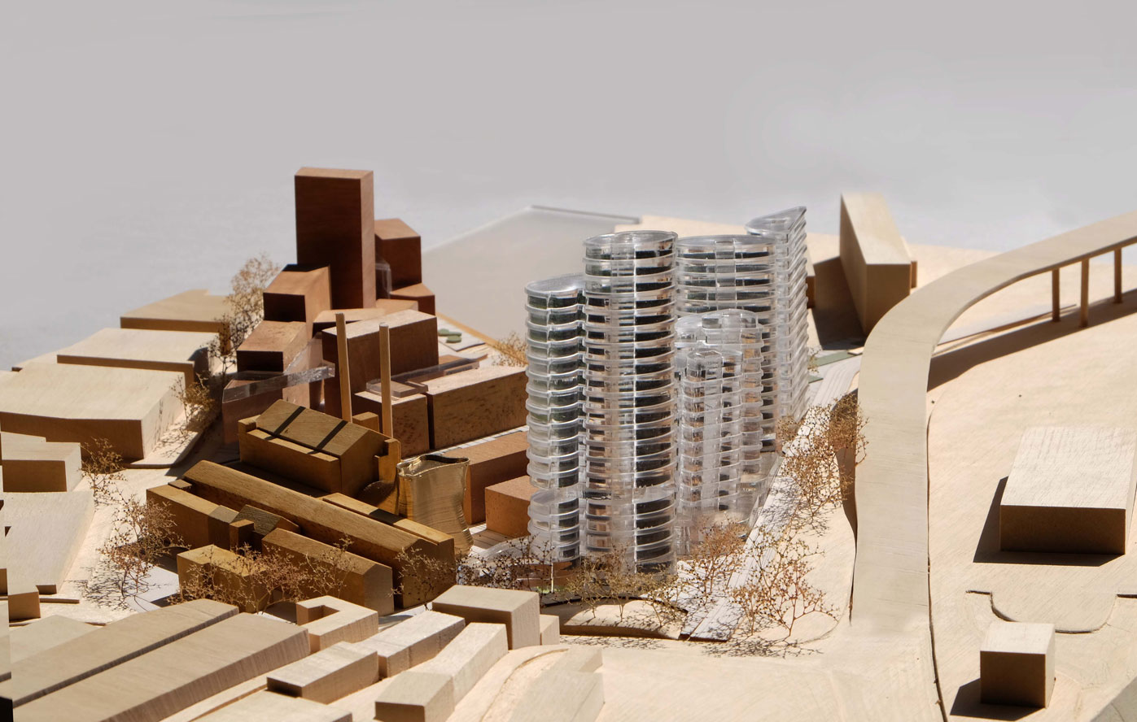
What is a model?
Notes:
( I see a lot of confusion around the idea of a model. Sarah’s ‘Run the model’ anecdote is a good example of this and taking a step back to try to explain what a model is, should be helpful)
What is a model? We often think of models in structural terms. A model, in the most basic sense, is any simplified representation of a system. We use predictive models to study that system and to make predictions about the systems expected behaviour.
In predictive analytics, we are using mathematical models - models in which we describe a system using mathematical concepts.
Optional - talk about the many types of models (ie like you did here: https://docs.google.com/presentation/d/1OMx6BZRVA_jKNKdtKkNCeiq_cNDpLPBC_82WqHsvE1Q/edit#slide=id.g61875d15e9_0_316)

Slide 7
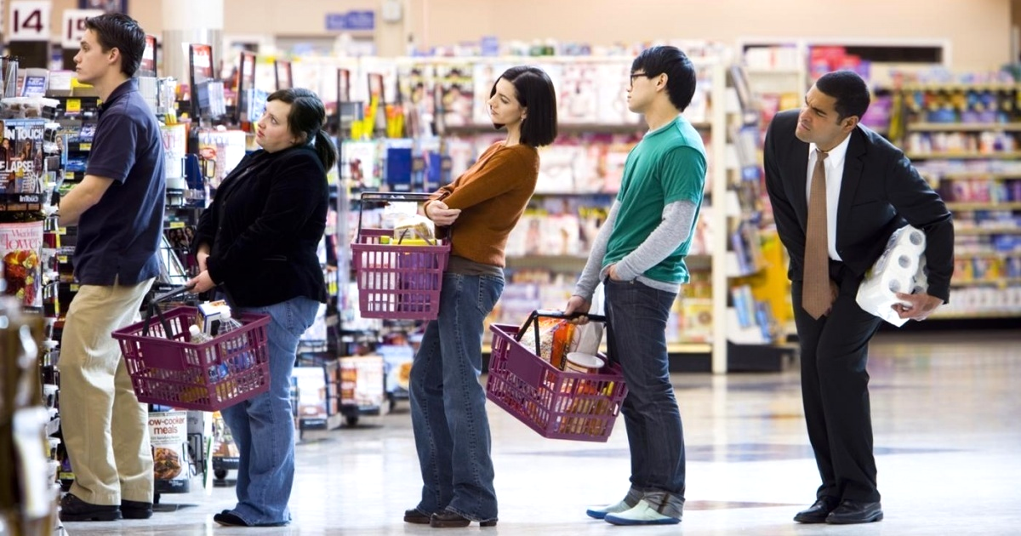
Notes:
Talking Points
Provide a simple example of how a predictive model work, highlighting that it’s not so different than how human brains work.
Predicting the Shortest Line at the Supermarket
Sophisticated methods aside, predictive models are not so different from the human brain. Both are great at identifying patterns based on past data (our experiences) and then use this to help make decisions about what will happen in the future.
Let's take a look at the process we go through when we want to join the quickest line at the supermarket.
The expected output of our internal predictive model is the fastest line. We need help choosing the fastest line and going to use assumptions and our past experience to predict which line we think will be the fastest this time.
The target variable is the ‘time spent in the line’. A target variable is the variable whose values are to be modeled and predicted by other variables (predictors).
We have historical data gathered from all of our past experiences at the supermarket.
Predictors, or features, are the variable whose values will be used to predict the value of the target variable. These are variables such as the length of line, number of items in the baskets. All the factors we believe will impact the time we spend waiting in the line (our target variable).
Our predictive model is the process we go through as we weigh how these different predictors will impact the target variable and ultimately this spits out a ‘prediction’ as to which line will be the fastest.
That's the line we get in.

Slide 8
Ingredients of a predictive model
Data: the algorithms that underpin predictive models are data hungry.
Assumptions: Every predictive model has assumptions built into it, a key of which is the assumption that the future will continue to look like the past.
Statistics & Machine Learning: Predictive models use a range of computational methods to make predictions.
Notes:
If this slide doesn’t speak to you, feel free to remove. My thinking here was basically that, for people from non-technical backgrounds, it can often be hard to know what parts of PA you need to understand to really be able to interpret/use the results and it's very easy to become overwhelmed by the statistical wizardry. Knowing a little bit about these components can be useful for thinking about predictive analytics/modelling
Data: Maybe provide an example here - for example, the importance of subnational data for the COVID-19 model. Generally, highlight the fact that high quality data is critical for predictive analytics and how bad data impacts the results.
Assumptions - Bring back the point that a model is necessarily a simplification and how assumptions impact the results.
Methods/Math - Predictive analytics, as it is commonly defined today, is a combination of forecasting and machine learning. Forecasting comes from the field of statistics, and includes techniques such as time series analysis and regression. Machine learning comes from the field of computer science, and is an algorithmic method for improving prediction accuracy over time. Both combined together allow us to make much more relevant and accurate predictions than was possible in the past.

Slide 9
How a predictive model works
What do we want to model?
Labels, Outcomes
What are its causes?
Features
Train: Learn from past events
Test: Hindcast past events with known outcome
Predict: Use what we learned to predict new data
Improve: Was the prediction right?
Notes:
Describe, in simple terms, how a predictive model works
I’d focus here on the train/test bit. I think that people have heard of ‘training an algorithm’ for example but don’t actually know what that means.

Slide 10
What makes a model successful?
Technical development
Understand the problem
Evaluation
Action!
Most models fail here >
Notes:
Quick sentence on how understanding the problem, technical development and evaluation all help models successful
And, why most models fail at the action bit (this could be a nice place to foreshadow elements of the bangladesh example that will be talked about after you)

Slide 11
Key questions
What is it that we want to predict?
How are we intending to use the results?
How much do we know about the system we want to model, and the factors influencing it?
What degree of accuracy/lead time do we need to achieve for the predictions to support critical decision making?
What are the datasets we need and are they available?
Notes:
Talking Points
How can being clear on these questions help get us to a model that can be used to take action
Option: Use the COVID-19 Model here
Eg country offices needed for a ‘operational tool’ and we therefore focused on short-term projections

Slide 12
Predictive models are only as good as...
The data we have
The assumptions that we make
Notes:
Always a nice reminder :)

Slide 13
What is Machine Learning?

Slide 14
PREDICTIVE ANALYTICS
ARTIFICIAL INTELLIGENCE
MACHINE LEARNING
DEEP LEARNING
Notes:
Predictive analytics: predict a value based on data
Artificial intelligence: mimic human behaviour
Machine learning: learn from experience
Deep learning: use a technique called neural networks and enables to see complicated patterns from vast amounts of data (e.g. images)

Slide 15
How does it work
Data
Model
Prediction
mismatch
Real value
Notes:
Learns from the past → be aware of the biases in your data (e.g. climate change). Won’t know what to do in circumstances never seen before (e.g. pandemic)

Slide 16
Classification and regression
Is more than 20% of the population in IPC3+
What percentage of the population is in IPC3+
Random forest
Linear regression

Slide 17
Example model
Artemis

Slide 18
Approach
Will the IPC phase of an admin2 region change from IPC2- to IPC3+
Structural factors
Environmental factors
Violent conflict
Food price inflation
Random forest
Prediction (classification)
Data
Model
Notes:
Structural factors e.g. population, terrain, land coverage, seasons

Slide 19
Considerations
Data availability and quality
Lead time
Sensitivity
Might differ per country
Higher is less certainty
Rather have over- or underpredicting
Notes:
Structural factors e.g. population, terrain, land coverage, seasons

Slide 20
What predictive analytics can
and cannot do

Slide 21
A prediction always has an uncertainty.
Uncertainty within a model but also different assumptions or scenarios.

Slide 22
Predictive models can understand causal relationship between variables.
But they don’t always provide good explanations.

Slide 23
Predictive analytics can be used for more than just predicting future events.
Fill data gaps. Look for anomalies in current data.
Understand underlying risk.

Slide 24
Predictive analytics learns from the past.
Models assume the dynamics of the past to apply in the present, including biases of the past.

Slide 25
“Algorithms are opinions embedded in math.”
-Cathy O’Neil, Author of Weapons of
Math Destruction
Notes:
Models can be unfair and unethical.
Bias in data and/or assumptions
Evaluation of model
Definition of success
Some models can decide if you get a job or not, if you get a loan, or even worse can influence the judicial system
Bias in data and/or assumptions
Definition of success: What is the goal of the model?
Imagine a COVID model developed to reduce the economic impact of COVID and one the impact of public health. The policy interventions suggested by these two models would be significantly different.

Slide 26
The biggest challenge is not technical
Ask the right question
Get reliable data to answer it
Build confidence in the model
Clearly define how to use the model’s output

Slide 27

Add photo / icon
Our peer review process creates standards around the use of predictive models against three criteria: technical, operational and ethical.
Through peer review, the Centre seeks to ensure models can be understood and trusted by all stakeholders including affected people.
2.2
Notes:
To avoid these pitfalls, the Centre has established a draft Peer Review Framework for Predictive Analytics in Humanitarian Response. The goal of the peer review process is to create standards around the use of predictive models against three criteria: ethical, humanitarian relevance and technical.
The ethical review involves identifying all stakeholders and concerns related to how the model could be used. For instance, a model may need to be adjusted in a scenario in which a false negative is unacceptable for affected populations or a false positive is unacceptable for a donor.
Through peer review, the Centre seeks to ensure models can be understood and trusted by all stakeholders including affected people.

Slide 28
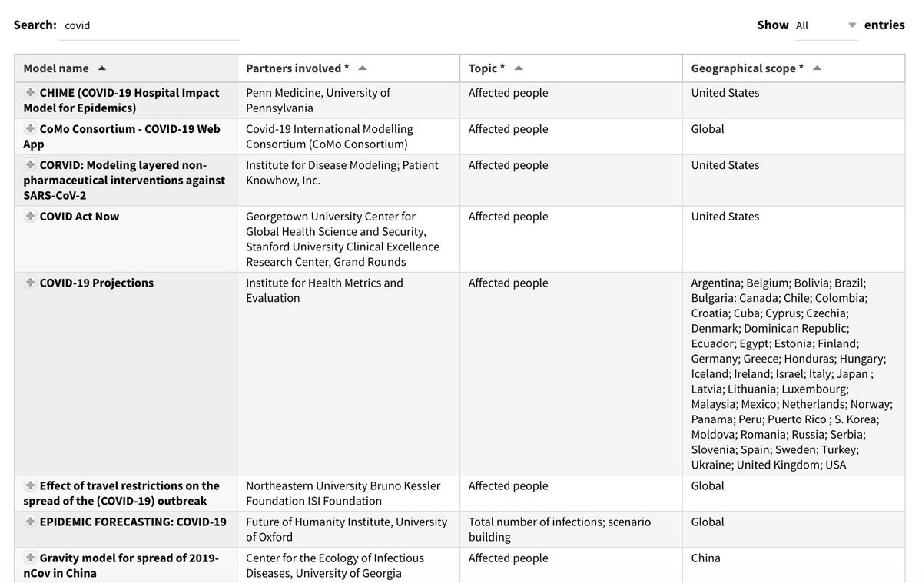
The Centre has created a catalogue of predictive models with information on ‘who is doing what, where and when’.
It provides a quick overview of the models that are available and their current state of development.
2.2
Notes:
For those of you who are more advanced and would like to see what models are out there, check out our catalogue

Slide 29

“One of the biggest opportunities we have is to try to use data, and especially the tools of predictive analytics to get ahead, to be more anticipatory, to predict what is about to happen and to trigger the response earlier.”
-Mark Lowcock, United Nations Under-Secretary-General for Humanitarian Affairs
Notes:
You’ll hear more from Daniel about how OCHA is using predictive analytics and anticipatory action
Types of models of interest for the UN
Based on natural sciences (flood forecasting, cyclone impacts, climate change): example from Daniel
Based on past data (Machine learning, statistical models): Hunger map from WFP
Based on behaviours (Social/Sentiment analysis): Hate speech by OHCHR
Based on experts’ knowledge (Scenarios based approach, system dynamics): Food security analysis from IPC
...and a mix of the above

Slide 30






What does traditional response look like?
Assessing needs
Planning and prioritizing
Mobilizing & Allocating Funding
Severe Crisis
Aid Delivery

Slide 31


What does anticipatory action look like?
Assessing needs
Established Action Plans
Pre-arranged Financing
A robust Forecasting
& Decision- making Framework
Planning and prioritizing
Mobilizing & Allocating Funding
Severe Crisis
Aid Delivery

Slide 32


Impact reduction & anticipatory action
Traditional response
Anticipatory Action

Slide 33
Rationale for anticipatory action
Reduce the humanitarian impact and the response cost
More dignified
Protect development gains

Slide 34
The mission of the Centre is
to increase the use and impact of data in humanitarian response.
Notes:
Centre mission slide

Slide 35



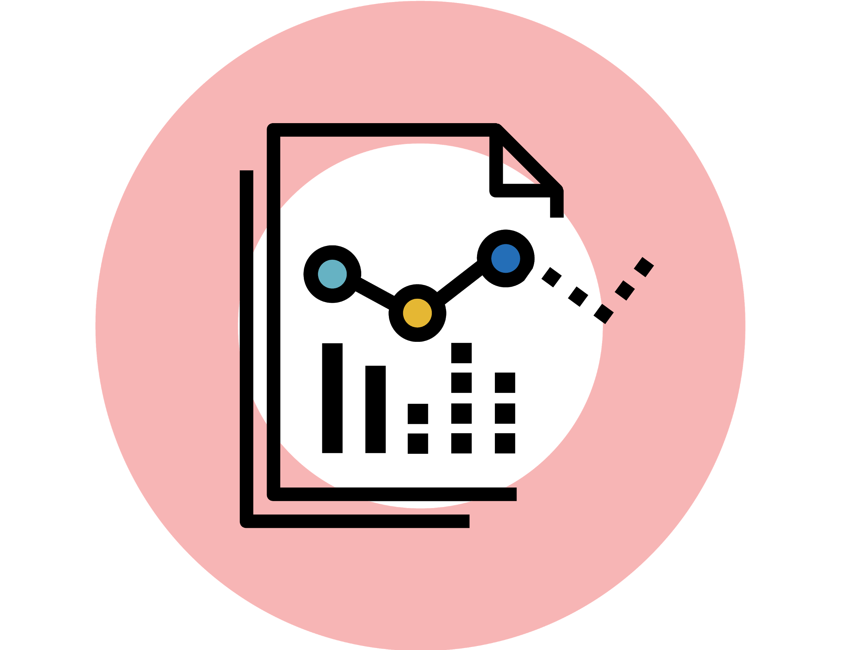
Focus Areas for the Centre
DATA
SERVICES
DATA
RESPONSIBILITY
DATA
LITERACY
PREDICTIVE
ANALYTICS
Notes:
Predictive Analytics is one of four focus areas areas for our team at the Centre.
Data Services- Increase the interoperability of data through shared standards and integrated systems
Data Responsibility- Increase trust and cooperation across organisations sharing data in humanitarian response
Data Literacy- Increase the capability of people to access and use data in support of humanitarian efforts
Predictive Analytics- Increase OCHA’s ability to anticipate crises before they happen

Slide 36

Q & A
centre.humdata.org humdata | leonardo.milano@un.org
| tinka.valentijn@un.org | centrehumdata@un.org

