Slide 1
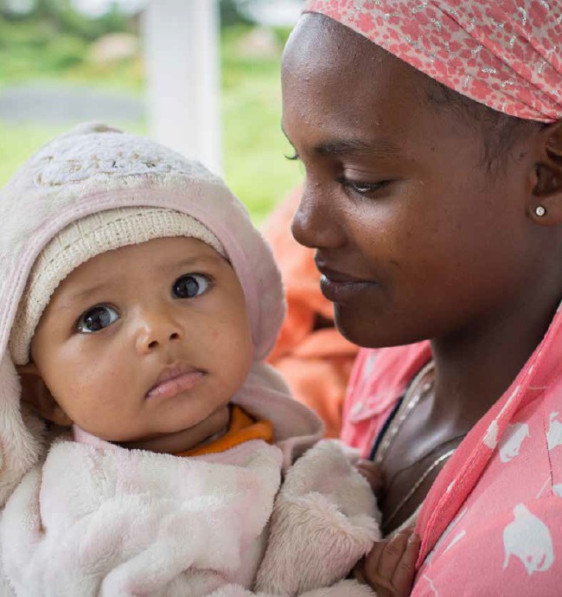
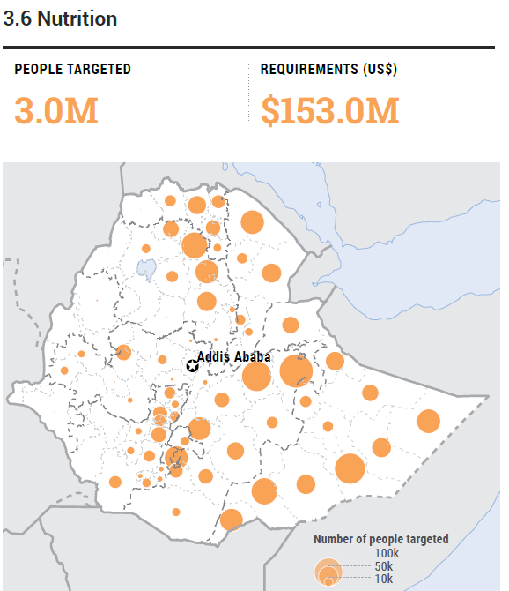
GNC Partners Call
2.1
Ayalech Eshetu and four-month-old Galane Shumai
wait for her baby to receive a vaccine at Chalaba
Silassie health post Bishoftu, Oromia Region.
Photo: UNICEF Ethiopia 2019/Mulugeta Ayene
2021 Ethiopia HRP
16.1 million people targeted - 1.49 billion USD
Emergency Nutrition Response in Ethiopia (focus on Northern Ethiopia)
Notes:
Insert map of the country with affected areas/districts or photos
Update red text

Slide 2
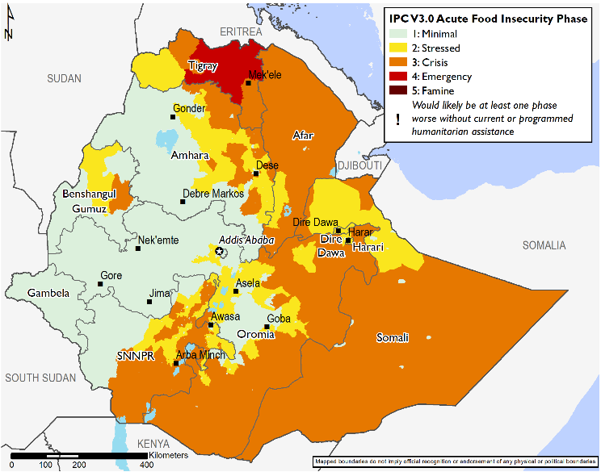
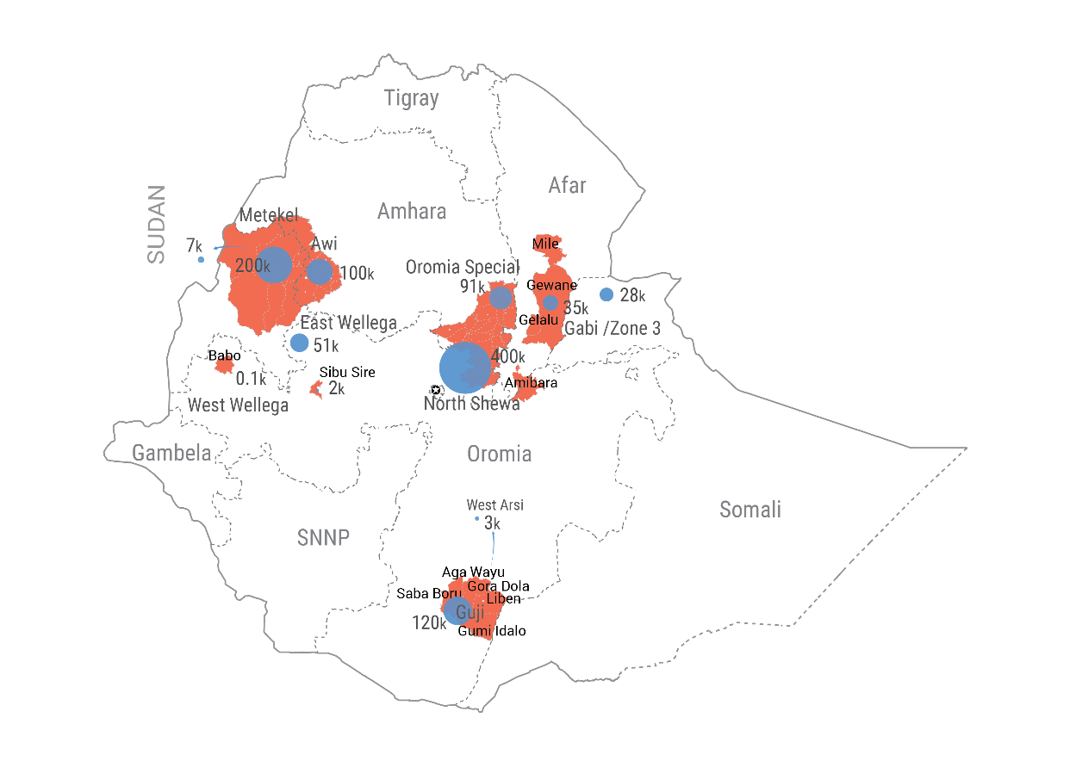
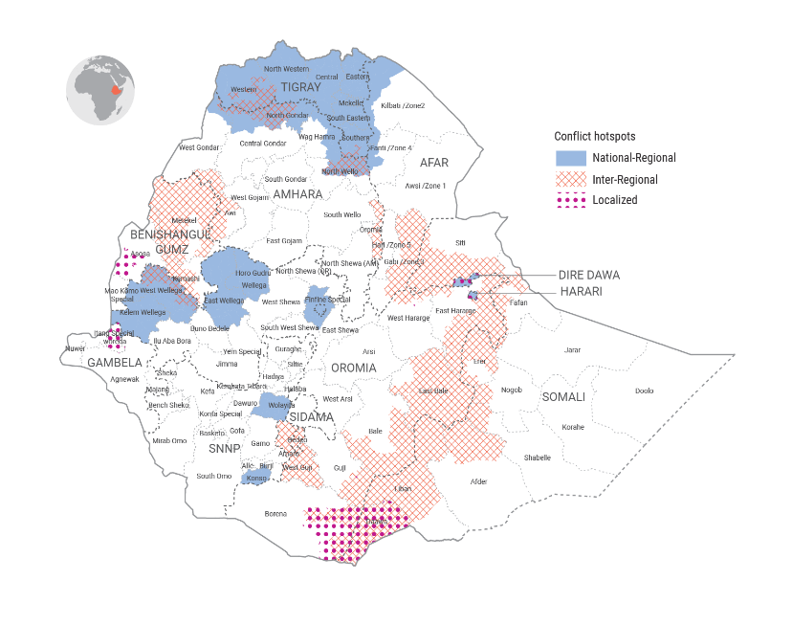

Current situation in Ethiopia and projected trajectory
FEWS NET Projected Food security outcomes - Feb to May
Massive loss of livelihoods and large food consumption gaps in Tigray
Belg rainfall has been significantly below average
In northern, southern, and southeastern pastoral areas, below-normal pasture and water availability.
High staple food prices and inflation across Ethiopia
Higher than normal levels of conflict in 2021 across Ethiopia leading to increased population displacement.
OCHA – Conflict hotspots and recent displacements
2
Ethiopia ENCU / Nutrition Cluster
Notes:
Briefly describe the current situation and trajectory, highlighting information pertaining to nutrition and other relevant key sectors (intersectorality).
Keep information in ONE slide only.
Please adjust name of cluster/sector where font is RED.

Slide 3
Current situation in Ethiopia and projected trajectory
Ethiopia ENCU / Nutrition Cluster
Notes:
Briefly describe the current situation and trajectory, highlighting information pertaining to nutrition and other relevant key sectors (intersectorality).
Keep information in ONE slide only.
Please adjust name of cluster/sector where font is RED.

Slide 4
Current response in Ethiopia (as end of March 2021)
NUMBER OF
PARTNERS
22
22% of target
Key achievements:
21% of target
18% of target
31% of target
Adoption of revised Acute Malnutrition management guidelines
National IYCF-E operational guide development
Family MUAC pilot
Ethiopia ENCU / Nutrition Cluster
Notes:
Update all graphs with most recent data.
Please insert other key activities, including intersectoral.

Slide 5
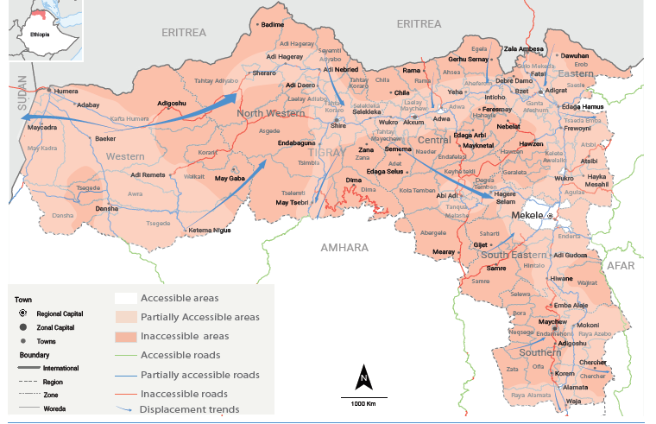
Current response in Tigray
OCHA – Access Map Tigray (as 5th May 2021)
Ethiopia ENCU / Nutrition Cluster
Notes:
Briefly describe the current situation and trajectory, highlighting information pertaining to nutrition and other relevant key sectors (intersectorality).
Keep information in ONE slide only.
Please adjust name of cluster/sector where font is RED.

Slide 6
Current response in Tigray (as end of March 2021)
NUMBER OF
PARTNERS
18
10% of target
Key achievements:
19% of target
9% of target
10% of target
14% of target
19% of target
Ethiopia ENCU / Nutrition Cluster
Notes:
Update all graphs with most recent data.
Please insert other key activities, including intersectoral.

Slide 7
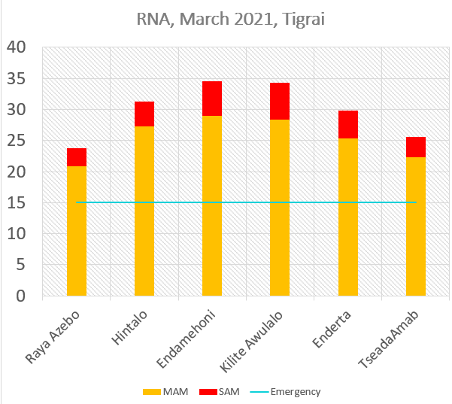
Strategic nutrition priorities (focus on Northern Ethiopia)
To support coordination mechanism for timely and effective nutrition emergency response
To support timely identification, referral and treatment of severe and moderate acute malnutrition among children under five years of age, and pregnant and lactating women
To strengthen promotion, support and protection of adequate maternal, infant and young child feeding (MIYCF) and prevent micronutrient deficiencies
To implement Blanket Supplementary Feeding (BSFP)
To monitor and assess the nutrition situation notably through rapid nutrition assessments
UNICEF | Action Against Hunger | GOAL | Islamic Relief
WHO | Catholic Relief Services | International Medical Corps | Mothers and Children Multisectoral Development Organization
WFP | Concern Worldwide | International Rescue Committee | World Vision
Samaritan Purse | MSF-Holland | MSF-Spain | Plan International
 | FHI360 | Transform PHC | Action for Social Development and Environmental Protection Organization
Ethiopia ENCU / Nutrition Cluster
Notes:
List nutrition cluster/sector priorities aligning with HRP (if applicable)
Keep information in ONE slide only.
Please adjust name of cluster/sector in the text box (bottom right of the slide).

Slide 8
Gaps in resources
Resourcing gaps (focus on Northern Ethiopia)
  Key gaps:
    Human Resources:
      Lack of local health extension workers at health post level; lack of skilled health and nutrition personnel
      Lack of Nutrition in Emergencies personnel
    Financial Resources:
      Additional financial resources for the nutrition response in Tigray and across the whole country
    Supplies:
    Additional Nutrition supplies, medicines and equipment for the management of acute malnutrition for Q3 and Q4 2021
RUTF cartons in Adi Arush health Center at Mai Tsebri IDP site – 23 April 2021@UNICEF/Ethiopia/Mabasa
Ethiopia ENCU / Nutrition Cluster
8
Notes:
List key gaps in maximum 6 bullet points.
Keep information in ONE slide only.
Please adjust name of cluster/sector in the blue text box (bottom right of the slide).

Slide 9
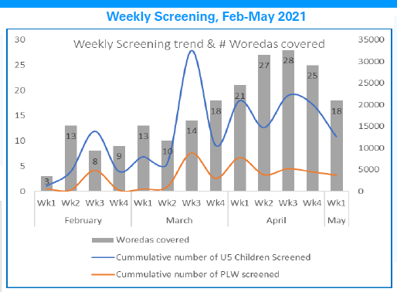
Challenges in achieving strategic priorities (focus on Northern Ethiopia)
    Access constraints:
      Ongoing armed conflict and denial of movements hampering efforts to deliver essential services, to undertake needs assessment
      Very volatile security situation, looting of health facilities
    Collapsed / fragilized health system:
      30% of Health facilities functional, network of MHNT too limited, health and nutrition services not provided in hard-to-reach areas
    Inadequate GFD
      Leading to sharing of RUTF and CSB++ among household members and/or selling
IRC-run Mobile Health and Nutrition Team tent at Mai Tsebri IDP site – 23 April 2021@UNICEF/Ethiopia/Mabasa
Ethiopia ENCU / Nutrition Cluster
Notes:
List challenges and constraints toward achievement of objectives.
Keep information in ONE slide only.
Please adjust name of cluster/sector in the blue text box (bottom right of the slide).

Slide 10
Key asks of GNC Partners
    To mobilize resources and expertise
      Partners to deploy international Nutrition in Emergencies Experts for surge support
      All stakeholders to mobilize funds for additional personnel and supplies
        30 million USD for Tigray
        15 million USD for prepositioning of Nutrition supplies in preparation for post-Election violence
      Donors to allow for flexible and adaptive response design / response modifiers
    To accelerate the emergency nutrition response scale-up
      To intensify efforts to deliver beyond towns and reach rural communities
      Calling all partners to support the adoption of simplified approaches for the management of acute malnutrition at times of acute crisis
      To implement comprehensive emergency nutrition response (IYCF-E, nutrition assessments, support cluster coordination, information management, etc.) with stronger linkages with other sectors’ response
Ethiopia ENCU / Nutrition Cluster
Notes:
Highlight three key asks that you wish to raise GNC partners.
Please adjust name of cluster/sector in the text box (bottom right of the slide).

