Slide 1
Pakistan
Partners presence, drought and flood effected areas Maps

Slide 2
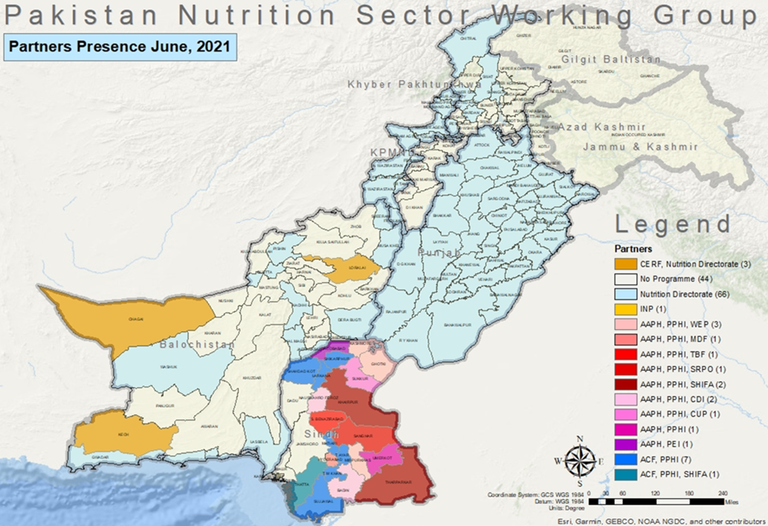

Slide 3
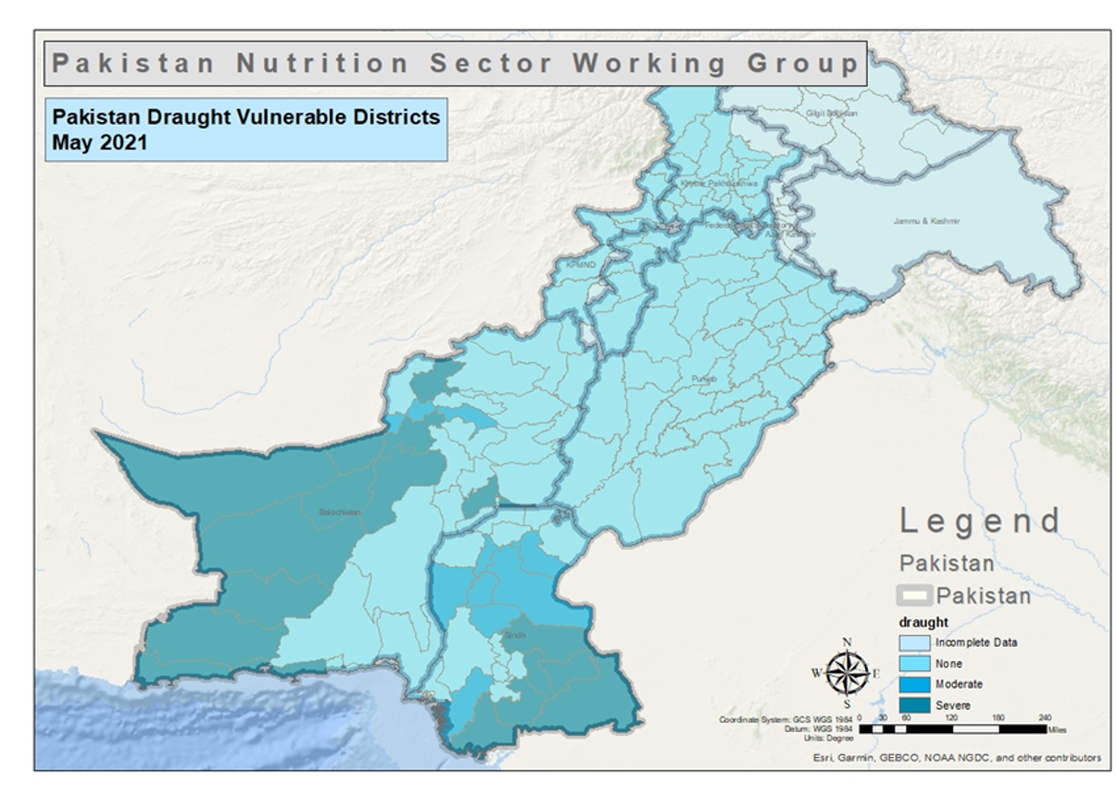

Slide 4
