Slide 1
REVIEW OF
DISBAILITY INCLUSION
IN 2021 HNOs/ HRPs
UN-FCDO Humanitarian Single Business Case
Disability results area Advisory Group

Slide 2
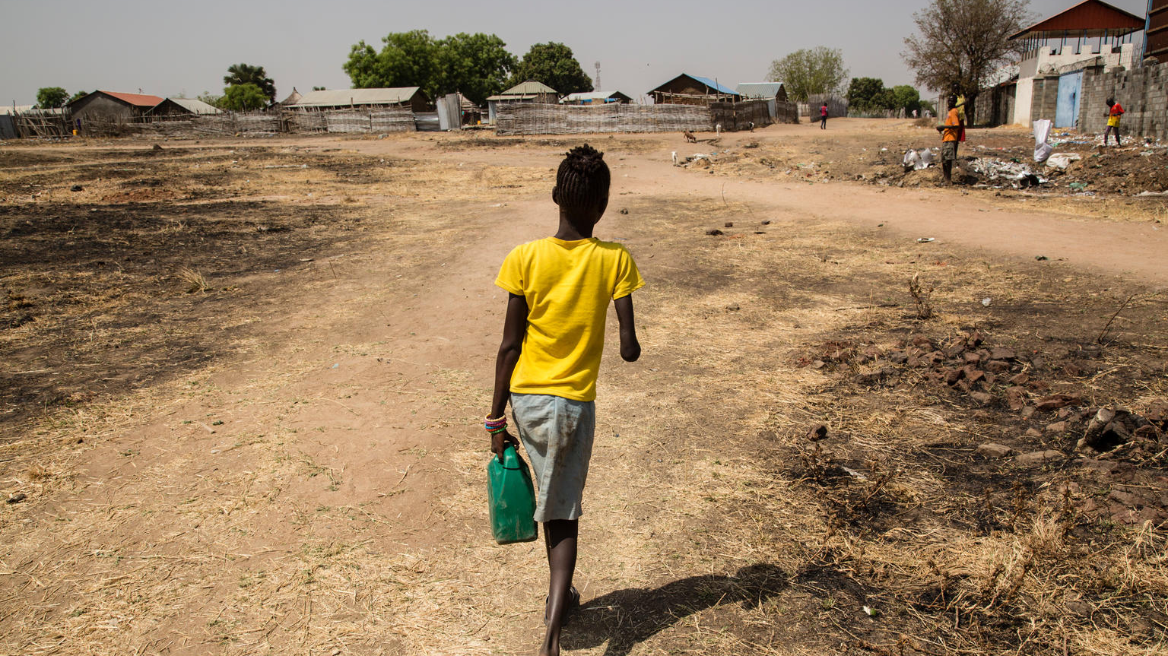
HNOs

Slide 3
Which are the strongest HNOs?

Slide 4
What are HNOs doing well?

Slide 5
Reliability of data
Use reliable secondary data
Collect primary data using recognized approaches (such as the Washington group Question sets)
Use global estimate- 15% of the population expected to have a disability

Slide 6
Risk/ needs analysis
Ethiopia: “Isolation, a lack of social support/peer networks and physical, technological and communication barriers put an extra challenge for people with disabilities in obtaining information and receiving guidance. This exclusion increases the risk of GBV”
DRC: “Stigma, discrimination and social exclusion by communities due to certain socio-cultural attitudes and practices, which has the consequence of restricting [persons with disabilities’] access [to] employment, education and certain activities [in the] community."

Slide 7
Cross sectoral attention
Syria: (Education chapter) "Children with disabilities are less likely to access learning. Insufficient investment in learning facilities, specialized teachers and materials to provide adequate support to children with disabilities continues to contribute towards excluding these children“
Ethiopia: (WASH chapter) “Sub-standard WASH facilities such as latrines without locks or disability access, and remote and unsafe locations of WASH facilities increase GBV and SEA risks.”

Slide 8
Recognition of diversity
Syria: "For women with disabilities, the opportunity to participate in decision making is even further reduced, particularly for women with psychosocial and intellectual difficulties“
Somalia: (education chapter) Girls with disabilities face additional barriers in accessing education due to gender stereotypes based on discriminatory and cultural norms such as marginalisation, stigma, and the preference for boys to access education."

Slide 9
Recognition of information gaps
Afghanistan: “The ICCT has committed to also better monitor perceptions of response from people with physical and mental disability.“
Cameroon: “Furthermore, it was agreed at the Inter-Sector level that multi-sectoral as well as sectoral assessments carried out need to pay more attention to gender specific needs and the needs of persons with disabilities”.

Slide 10
What needs more work- HNOs?

Slide 11
Capacities and coping mechanisms
Niger: “64% of people with disabilities (in Diffa) feel that they have responsibilities in the various activities of the community”.
Zimbabwe- "Recent assessments have highlighted negative coping mechanisms, including children being forced into child labour… Similar coping strategies were employed by households with people disabilities and those with a chronically ill person."

Slide 12
Monitoring situation & needs
Disability specific indicators. E.g. Yemen health indicator: # of vulnerable men, women, boys, girls, the older persons and disabled benefiting from the Minimum Service Package (MSP)
+
Disaggregation of indicators by disability

Slide 13
Reporting of priorities
Describe consultation processes and how expressed priorities have been taken into account
DRC: "65% of people with disabilities feel that their needs have not been taken into account by humanitarian actors"

Slide 14
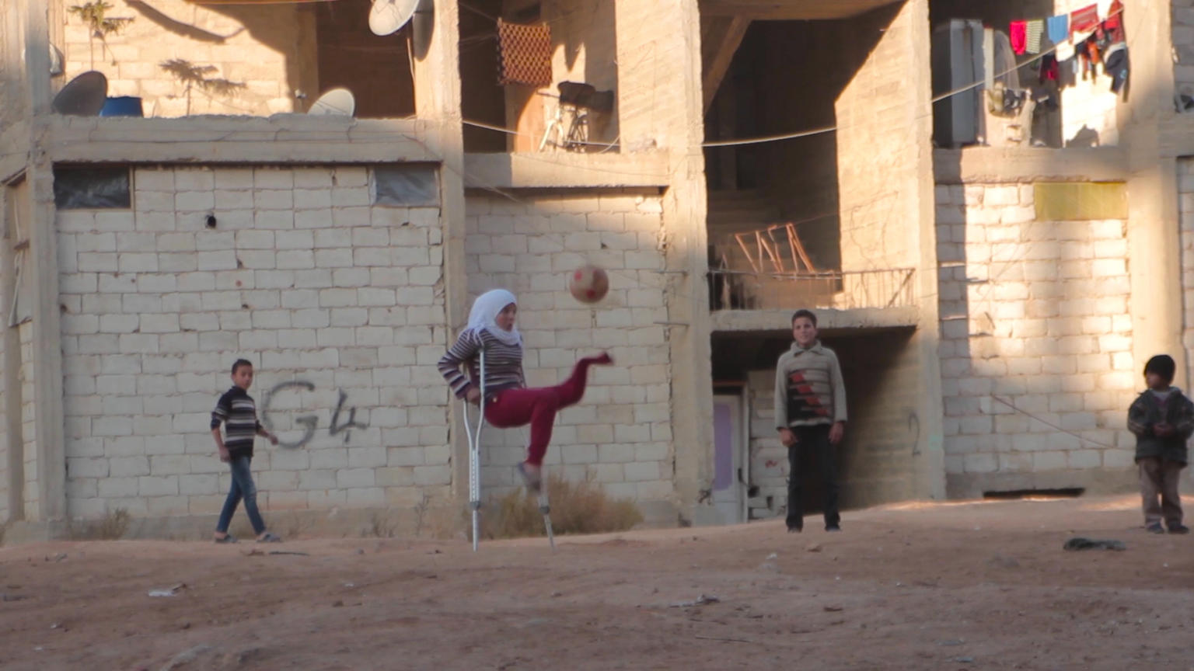
HRPs

Slide 15
Which are the strongest HRPs?

Slide 16
What are HRPs doing well?

Slide 17
Strategic objectives
Yemen:
Introduction to S.O.s- "As humanitarian partners pursue the strategic objectives, they will apply response approaches that prioritize protection, gender and disability mainstreaming“
Each strategic objective disaggregates people targeted by disability (using 15% estimate)
Disability explicitly mentioned in the narrative for strategic objectives 2 and 3. E.g. “At risk groups facing the most severe forms of food insecurity will be targeted. These include Muhamasheen, female-headed households, people with disabilities...".

Slide 18
Sectoral coverage
Zimbabwe:
(CCCM) "CCCM will strengthen partnerships and capacity building with organizations working with people with disabilities in order to better identify their needs and ensure data is disaggregated and that shelter interventions are tailored to any specific needs identified.”
(Health) " The cluster will continue to embrace diversity and inclusion by ensuring that vulnerable groups, including people with disabilities, have equal access to emergency health services…"
(Protection) "The provision of life-saving GBV services through roving, mobile, disable friendly One Stop centres and clinics, in remote and hard to reach areas".

Slide 19
Reflection of diversity
DRC: "During conflicts, women with disabilities in particular are more at risk of being victims of violence, including gender-based violence, and children with disabilities are more exposed to the protection risks associated with the separation of their carers and their caregivers."

Slide 20
What needs more work- HRPs?

Slide 21
Monitoring the response
Somalia:
Disaggregation- "To monitor the reach and accessibility of the response, the collection of sex, age and disability disaggregated data will be undertaken in relation to each Strategic Objective”.
+
Specific indicators- "Number of school children (M/F) living with disabilities benefiting from inclusive education"

Slide 22
Reflection of priorities
Nigeria: "The findings from the community-level consultations indicate that the people prioritized their needs as (i) food, (ii) health, (iii) livelihood, (iv) WASH and (v) protection. People with disability ranked their needs in that order too"

Slide 23
Description of capacities
Myanmar (Protection chapter) "The Protection Sector will continue enhancing communities’ capacities to prevent and mitigate protection risks through the strengthening of community-based protection including community-based child protection mechanisms, greater and equitable participation of all groups, especially women, adolescent girls, young people and persons with disabilities in public life and decision-making processes..."

Slide 24
Twin track approach
Mainstreaming activities E.g. Sudan: “…adapting the environment and the development of infrastructure … in order to enable people with disabilities to have appropriate access to goods and essential services.”
+
Targeted activities E.g. Iraq “partners will include measures to mitigate the challenges and address the barriers faced due to age, gender or disability, including through provision of assistive devices to enable physical access, transportation and communication. "

Slide 25
Feedback & complaints
Iraq: "Humanitarian organizations will continue to tailor messaging to meet targeted information needs, given the variances in information needs and access to information sources among different groups, including children, women, older people, people with disabilities and minorities. This includes consideration of where and how to provide complaints and feedback and adapting communication methods to ensure accessibility for all by catering for those with visual and/or hearing impairments."

Slide 26
Impact of response modalities
Ukraine “Discussions with communities have revealed that cash or voucher modality is not always preferred, particularly among the people living in isolated settlements along the ‘contact line’ or people with disabilities, due to logistical and physical constraints to access markets or during certain periods of the year."
Burundi [in relation to cash transfers] “In particular, the following will be taken into account: access to distribution points for people living with disabilities, pregnant women and / or with young children”

