Slide 1




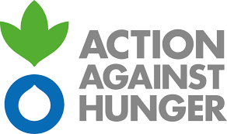

Ethiopia MIYCF with COVID-19

Slide 2
The immediate causes of undernutrition are disease and/or inadequate food intake, which result from underlying poverty, household food insecurity, inadequate care practices at household or community levels, poor water, hygiene and sanitation (WASH) and insufficient access to healthcare.
Disasters such as cyclones, earthquakes, floods, conflict, displacement and drought all directly affect the underlying causes of undernutrition; including COVID-19.

Slide 3
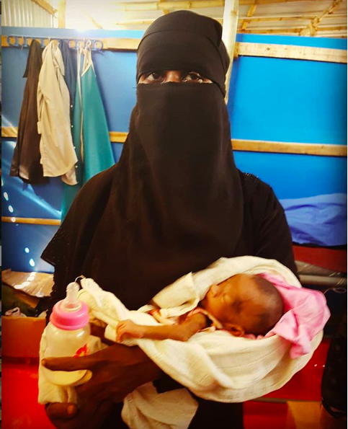
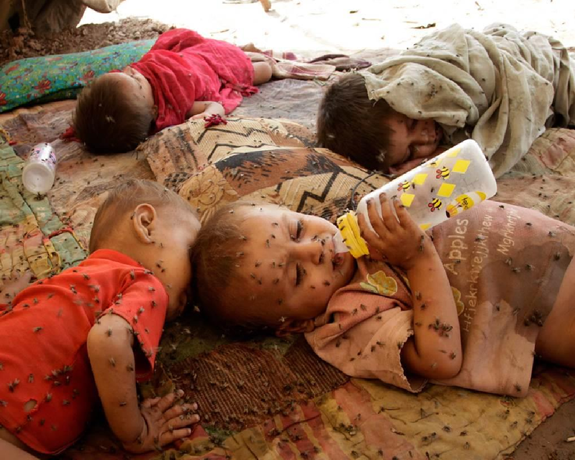
Traditionally in humanitarian operations a lot of nutrition resources
go to treatment of acute malnutrition.
Protection, promotion and support of MIYCF practices are increasingly part of humanitarian responses, but specific resource mobilization and raising general attention to IYCF have still proven to be difficult.

Slide 4
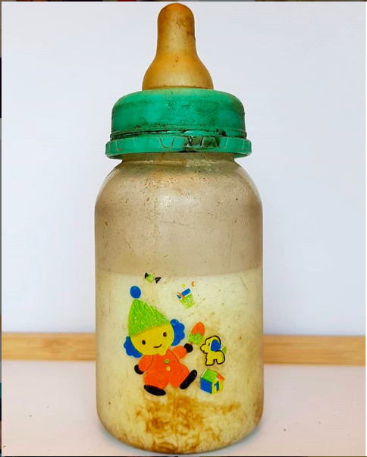
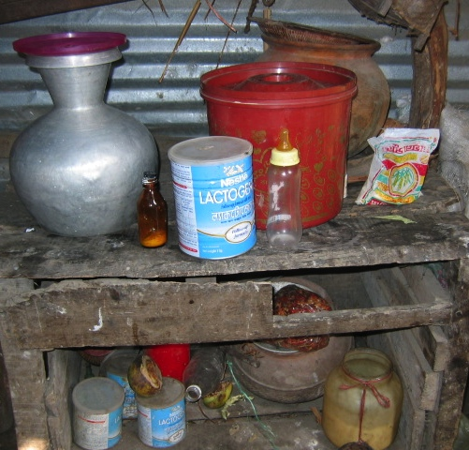
In Ethiopia:
40% of infants age 4-5 months are exclusively breastfed
6% of infants under 6 months are not breastfed at all
9% of infants under 6 months using a bottle with a nipple, a dangerous and life-threatening practice.
Only 11% of pregnant women take Iron tablets for the recommended time
9

Slide 5
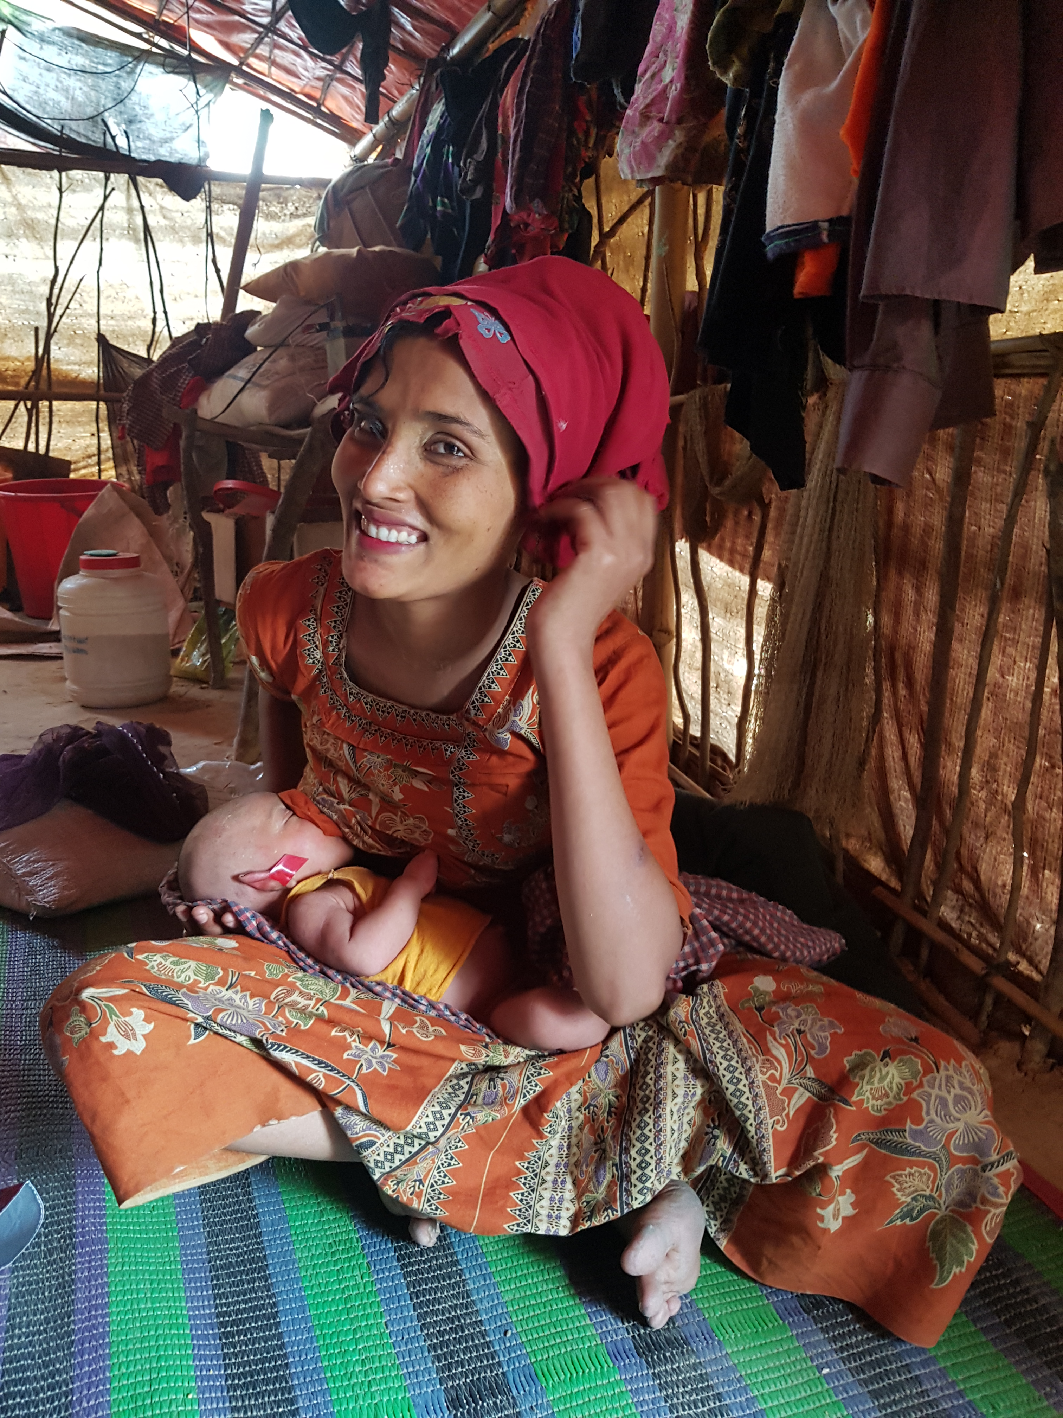
Breastfeeding is a child’s food security

Slide 6
Maternal, Infant and Young Child Nutrition:
Advocate for continuing breastfeeding (regardless of COVID-19 status of the mother or the child) as the benefits of breastfeeding far outweigh risks, even if the child or mother is probable or confirmed.
Recommended for mothers with symptoms to use of a face mask when near a child, if possible, perform hand hygiene before and after contact with the child, and routinely clean and disinfect surfaces with which the symptomatic mother has been in contact.
If a mother is too ill to feed directly a caregiver can give expressed milk in a cup.
Breastfeeding mothers with suspected COVID-19 infection and their infants are an exception to the recommendation to maintain a distance of 2 meters.
Continued provision of specific guidance on age appropriate and safe complementary foods and feeding practices
Integrate IYCF in different Food, Health, WASH platforms especially in food insecure areas where prevention of wasting among under 2 is a priority
Monitor, report and address unsolicited donations of BMS

Slide 7

Some things we are seeing globally
  Separation of infant and mother for days after birth
  Increase in formula and milk donations or inclusion in general distribution
  Delayed complementary feeding for the child
  Decreased ANC/PNC visits and increase in home birth in some contexts

Slide 8
MIYCF requires multi-sectoral support
During COVID:
Stress may affect milk let down leading mothers to worry about inadequate supply
Without support families may resort to infant formula or other breastmilk substitutes which expose infants to additional risks
School closures are likely to increase the care burden and diminish time for adequate IYCF/care practices.
MIYCF programmes are often pathways for protection referrrals and this will likely change with the reduction in women-only IYCF groups or peer support groups
Household visits by CHW/Vs are changed/reduced/suspended.
Infant formula producers may attempt to gain access to markets, often in the first instance via donations, undermining breastfeeding practices and endangering infant health.
Hastily ordered quarantine measures may leave households with insufficient water, BMS, and feeding supplies for the non-breastfed child

Slide 9
MIYCF requires multi-sectoral support
During COVID:
Disruptions in food systems can limit the availability of and access to nutritious foods and affect quality of diets and impact the nutritional status of women.
In food insecure households, COVID-19 may also exacerbate discriminatory gender and social inequalities around food with adverse impacts on the nutritional status of women.
The COVID-19 response may limit the availability and access to essential nutrition services for women due to mobility restrictions and reduced capacity of already overstretched healthcare systems.
Social exclusion, limited decision-making power, and hampered physical mobility may constrain the needs and concerns of women from being identified and hinder access to information and participation in food and nutrition, counseling and financial assistance.
Women may face increased stress, trauma, depression and other mental health concerns along with gender-based violence resulting from loss of social support structures and disruptions during physical distancing.

Slide 10
Especially in this time it is important to
Integrate MIYCF activities into other sector interventions and integrate other sector activities into IYCF interventions:
  Establish an inter-sectoral referral system
  Organise orientations/trainings on MIYCF for relevant field staff and volunteers from all sectors and ensure they have access to a one page reminder of the key MIYCF points
  Identify and train MIYCF Champions who can support MICYF programmes throughout the country
It is all stakeholders responsibility to protect, promote, and support MIYCF

