Slide 1

nutritioncluster.net
Global Nutrition Cluster Webinar on 2022 HRP process​
​
Session Title
October 2022
Notes:
Welcome participants to the webinar.
Introduce speakers – self, Faith Nzioka – GNC RRT, Uta Filz from OCHA, Briony Stevens – GNC Coordination Helpdesk, and CAroline Abla – ISC Helpdesk.
Share purpose of webinar – to disseminate latest updates and guidance on the 2022 HPC process, and to reiterate the GNCs ongoing support to country-level coordiantion teams in this process.
Highlight that the 2022 HRP process is very similar to the 2021 HRP process, with no significant changes.
Highlight that while we recognise that the 2022 Global Humanitarian Overview is still under development, and therefore the determination of which countries will have active HPCs in 2022, this does not matter, as the processes completed by nutrition coordination teams towards the HNO and HRP can be used for their annual planning.
Disseminate information on new CCCs and how they better articulate UNICEFs commitment to coordination.
Advocate the need for Nutrition Cluster colleauges to work together with their UNICEF Programme colleagues; particularly on the methodology used to determine the SAM PiNs, to ensure that HRP and HAC PiNs align.
Highlight the importance of including both humanitarian and development partners into HRP cluster-level discussions, to ensure malnutrition is addressed in all its forms.

Slide 2
Overview of the Session
Welcome and Introduction (GNC-CT)​
Overview of 2022 HPC and HRP Process (OCHA) ​
Development of 2022 Humanitarian Response Plans by NC coordination teams (GNC-CT) ​
Key considerations:​ GBV, Gender, Disability, AAP, & ISC (GNC-CT) ​
Available support from the GNC (GNC-CT) ​
Q&A
Global Nutrition Cluster Webinar ​on the 2022 HRP process​
October 2022
Notes:
Run through the webinar overview:
Timing:
Welcome and introduction (5 min)
Overview (OCHA) (20 min)
Nutrition and HRP (20 min)
Key considerations (20)
R&R (10)
Q&A (15)

Slide 3
Overview of 2022 HPC and HRP Process
Global Nutrition Cluster Webinar ​on the 2022 HRP process​
October 2022
Notes:
Slides 3-9 to be led by OCHA (Uta)

Slide 4
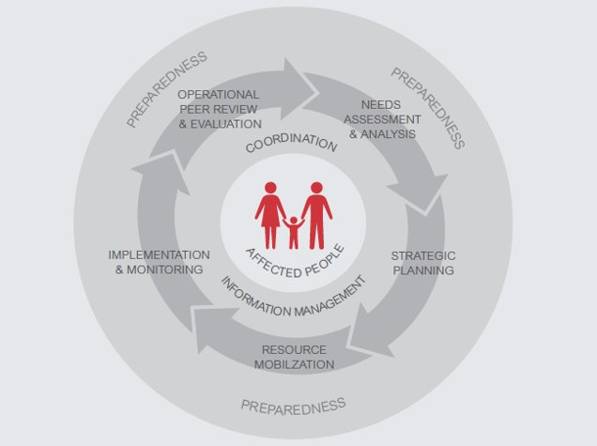
Updates to the 2022 HPC
Global Nutrition Cluster Webinar ​on the 2022 HRP process​
October 2022
Notes:
Same as for the entire HPC package, only limited modifications were made for the HRP template and instructions for 2022.

Slide 5
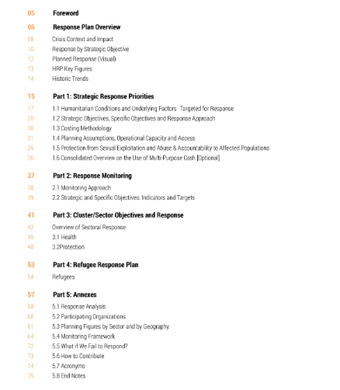
PSEA
Monitoring
Response Analysis
Notes:
As discussed earlier, the HRPs build on the HNO which provides the evidence base and analysis of the magnitude of the crisis and identifes the most pressing humanitarian needs. These needs inform the strategic objectives in the HRP, as well as the specific objectives, and the Cluster plans follow from these strategic objectives. While the HRPs are primarily recognized as management tools, they also act as a resource mobilization tool.
In terms of the structuring of the HRP, good news - there are no significant changes in the 2022 HRP template compared to last years. So, for those that participated in this process last year – the HRP template and process will be somewhat familiar. The document consists of an executive summary and 5 parts. While the Cluster and Sector Plans are listed under Part 3, its important to highlight that the other sections are inter-sectoral, and the inputs of the nutrition cluster/sector are required to ensure that nutrition is adequately addressed in the inter-sectoral parts of the document. `How` to do this exactly, will be discussed by GNC colleagues during this webinar.
So for 2022, the main adjustments – besides corrections, line edits, updating reference documents and formatting issues - include the following:
- There is a separate chapter on Protection from Sexual Exploitation and Abuse in the updated HRP guidance. Many of the current HRPs already include such a separate chapter, under Accountability to Affected Populations.
The monitoring chapter was reviewed for improved guidance and clarity. The full monitoring framework has to be provided in the annex, which comes with a suggested template.
Further, the response analysis chapter annex 5.1 was updated for improved guidance on what needs to be documented in this chapter. It serves to document the response analysis process undertaken from the HNO to the HRP, as well as the outputs of the response analysis.

Slide 6
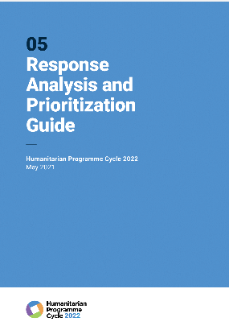
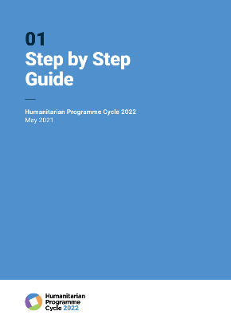
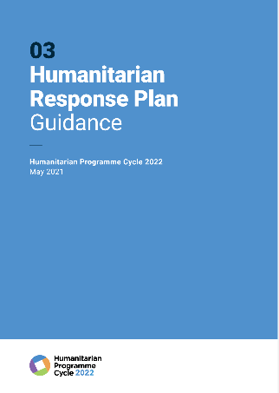
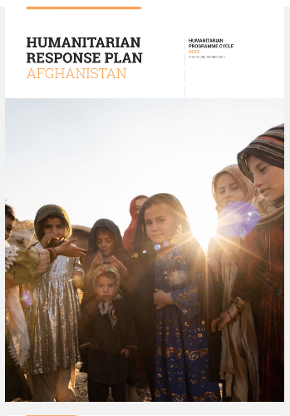
Linking the needs analysis to the response analysis
https://kmp.hpc.tools/content/hpc-2022-facilitation-package
Global Nutrition Cluster Webinar ​on the 2022 HRP process​
October 2022
Notes:
Here you see the three key guidance documents for the development of the HRP:
The first document is the Step-by-Step Guide.
The 2nd document is the HRP guidance and template, which indicates what information to present and how to present it.
The 3rd document is the HRP response analysis and prioritization document.
The documents are published on the Knowledge Management website, under the link indicated on the slide.

Slide 7
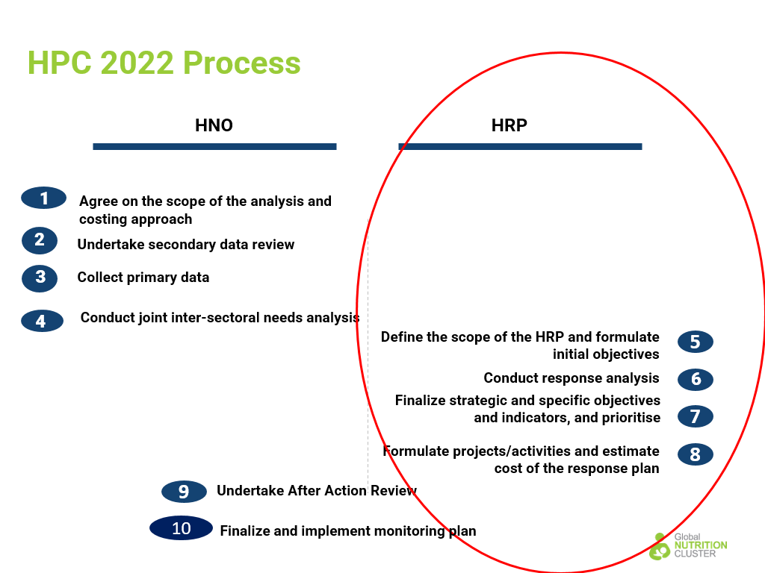
Global Nutrition Cluster Webinar ​on the 2022 HRP process​
October 2022
Notes:
This slide follows the Step-by-Step guide.
The webinar on the development of HRPs follows on from the earlier GNC webinar on the development of HNOs, which discussed Steps 1 to 4 of the 2022 HPC process. As for the HNOs, the development of HRPs consist of 4 steps which corresponds to steps 5 to 8 of the HPC process. This webinar will focus on each of these steps in detail.
Step 5: `Define the Scope of the HRP and formulate initial Objectives` includes the initial scoping of the HRP based on the results of the HNO, as well as the drafting of the preliminary inter-sectoral strategic and specific objectives,
Step 6: `Conduct Response Analysis` consists of a review of possible responses options and estimation of target population number
Step 7: `finalise strategic and specific objectives and indicators` includes the finalization of the strategic and specific objectives, the identification of indicators to monitor the response and the development of the cluster response plans
And lastly, Step 8 includes the drafting of the HRP, project development and costing.

Slide 8
2022 HPC TIMELINE​
The HPC timeline differs across countries.
POLL: What step of the HPC are you at?​
Step 1. Agreed on the scope of the analysis and costing approach​
Step 2. Secondary data review completed​
Step 3. Primary data collected​
Step 4. Joint inter-sectoral needs analysis completed​
Step 5. Defined scope of the HRP and formulated draft strategic objectives​
Step 6. Response analysis conducted​
Step 7. Strategic and specific objectives and indicators finalised and prioritised​
Step 8. Projects formulated and HRP costed​
Global Nutrition Cluster Webinar ​on the 2022 HRP process​
October 2022
Notes:
Poll will be launched with this slide.

Slide 9
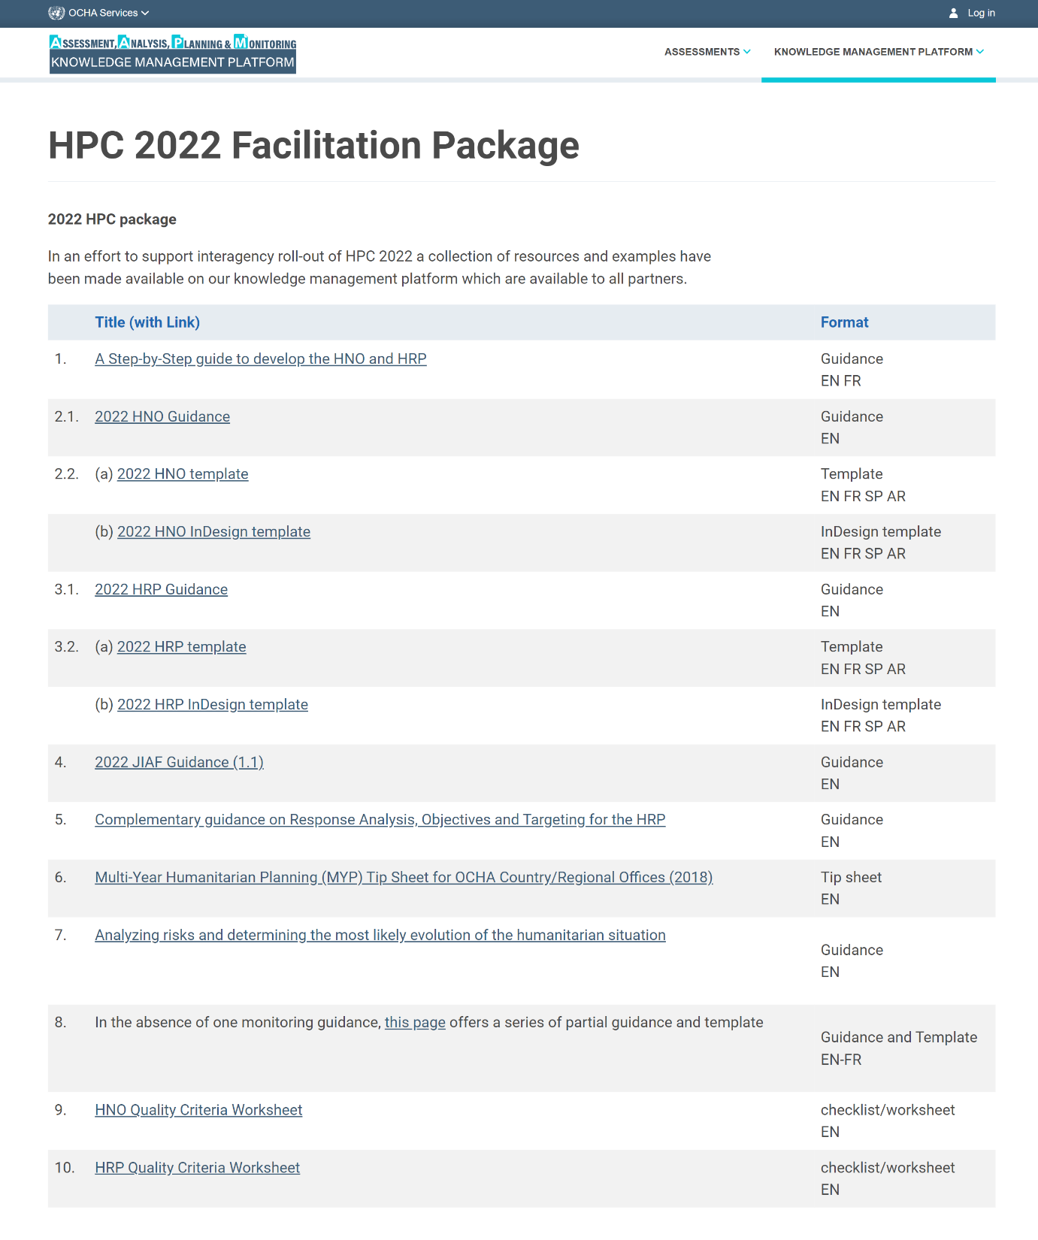
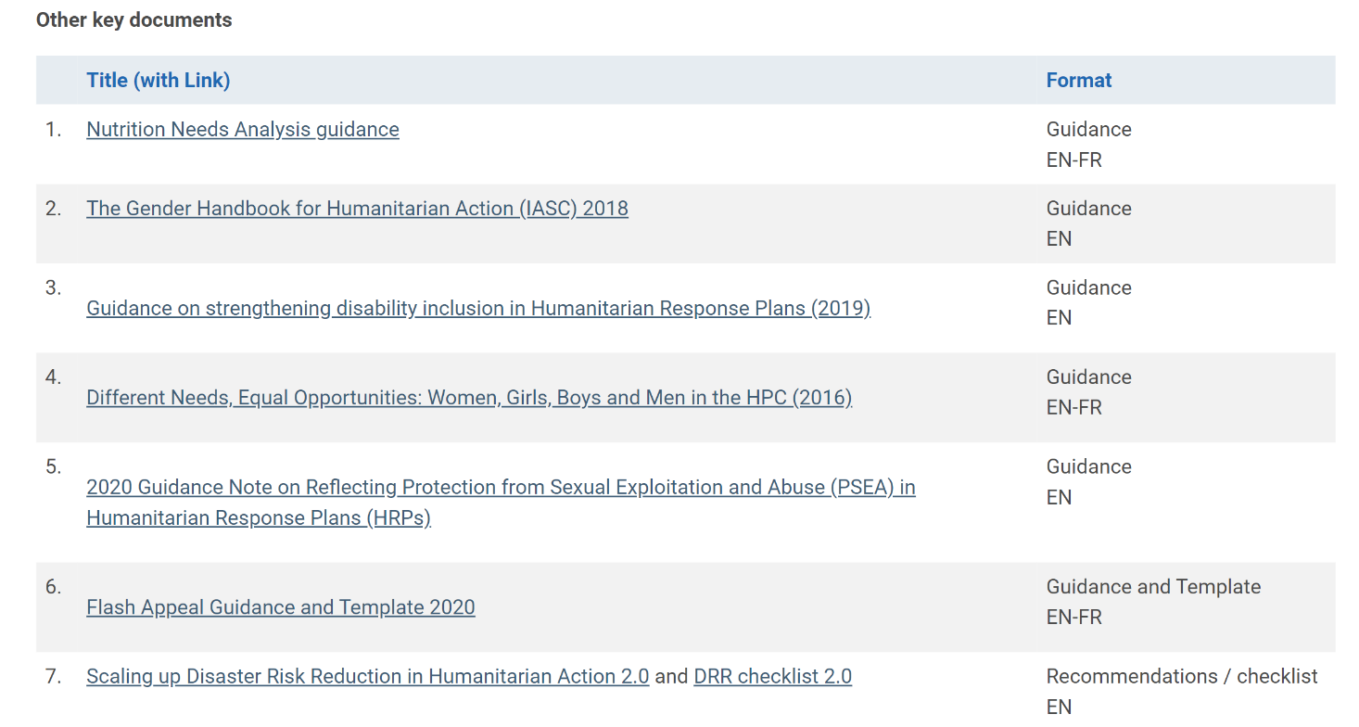
Available guidance
https://kmp.hpc.tools/content/hpc-2022-facilitation-package
Global Nutrition Cluster Webinar ​
on 2022 HNO process​
Date: 10.08.21​
Notes:
On this website (copy into chat) you’ll find the full HPC 2022 facilitation package, including the SBS and the HRP instructions which we just discussed.

Slide 10
Questions
Global Nutrition Cluster Webinar ​on the 2022 HRP process​
October 2022

Slide 11
Development of 2022 Humanitarian Response Plans through a nutrition lens
Global Nutrition Cluster Webinar ​on the 2022 HRP process​
October 2022

Slide 12
Role of the Nutrition Cluster in the development of the HRP
HPC Step | Cluster-level action | Inter-Cluster Action
5. Define scope of the HRP and formulate initial objectives | Consult Cluster members on Cluster priorities and possible interventions that could contribute to strategic objective; develop prioritisation matrix/heat map. | NCC to contribute to intersectoral discussions on priorities by sharing nutrition priorities ​ and potential interventions, identifying complementarities and synergies across sectors.
6. Conduct response analysis | Consult Cluster members on proposed interventions based on appropriateness, relevance and feasibility​ | NCC to participate in inter-sectoral review of proposed interventions and critically analyse based on appropriateness, relevance and feasibility​
7. Finalise strategic and specific objectives and indicators, and prioritise | Clusters/sectors to develop response plans and identify cluster objectives and quantify number of people targeted​ | NCC to participate in Intersectoral level discussion to finalise intersectoral and specific objectives ​
8. Formulate projects/activities and estimate cost of response plan | Cluster to support partners to develop project sheets and subsequent costing | No additional action.
Global Nutrition Cluster Webinar ​on the 2022 HRP process​
October 2022

Slide 13


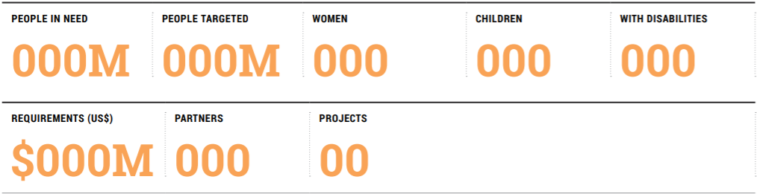
Nutrition Cluster/Sector Response Plans - Outline​
Nutrition
malnutrition in children under 5, treatment of acute malnutrition in children and pregnant women, community engagement and mobilization activities etc.​
​
Cost of response​
Discuss cost parameters and cluster estimates.​
​
Monitoring​
Discuss routine and ad hoc monitoring. Consider SPHERE standards, routine monitoring through prevention and treatment programmes and various assessments and partner surveys including SMART, KAP and SQUEAC/SLEAC etc. ​
Objectives​
Insert text on nutrition objectives, based on nutrition needs analysis, linking with specific objectives and strategic objectives. Include text on geographic location, cross cutting issues (such as gender ad disability, and their impacts no sector services and context) and intended achievement.​
​
Response​
Insert text on subgroups targeted for nutrition response with geographical locations. Include data on number targeted (disaggregated by sex, age and disability). Insert data on main response strategies and modalities. Consider the humanitarian development nexus, and programming adaptations in light of COVID-19. Highlight intersectoral activities and explicitly link with respective Clusters. Expand beyond data disaggregation for sex, age and disability and discuss these cross-cutting issues.​
Early recovery must be addressed in Nutrition Cluster/Sector Plans.
Global Nutrition Cluster Webinar ​on the 2022 HRP process​
October 2022

Slide 14
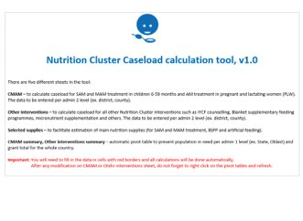

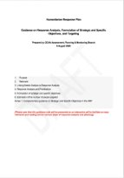
Nutrition Cluster/Sector Response Plans - Outline​
Global Nutrition Cluster Webinar ​on the 2022 HRP process​
October 2022

Slide 15
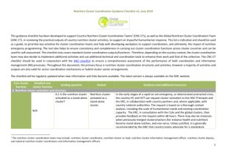
Nutrition Cluster/Sector Response Plans - COSTING​
​
Global Nutrition Cluster Webinar ​on the 2022 HRP process​
October 2022

Slide 16
Developing a nutrition cluster workplan
Global Nutrition Cluster Webinar ​on the 2022 HRP process​
October 2022

Slide 17
Commitment: Effective leadership and coordination are established and functional
Benchmarks
1. Nutrition cluster/sector coordination and leadership functions are adequately staffed and skilled at national and sub-national levels.
2. Core leadership and coordination accountabilities are delivered
CCC1 Leadership and coordination
Global Nutrition Cluster Webinar ​on the 2022 HRP process​
October 2022

Slide 18
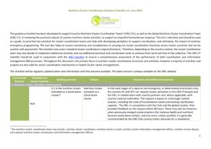
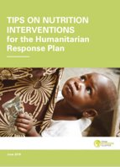
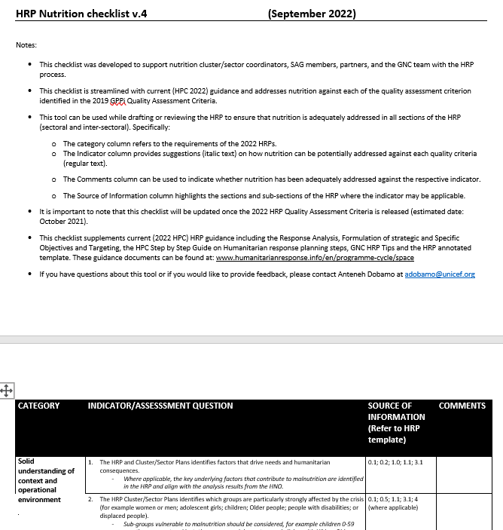
Available Guidance​
Global Nutrition Cluster Webinar ​on the 2022 HRP process​
October 2022

Slide 19
Global Nutrition Cluster Webinar ​on the 2022 HRP process​
October 2022

Slide 20
Key Considerations and Practical Tips
for Cross-Cutting Themes
Global Nutrition Cluster Webinar ​on the 2022 HRP process​
October 2022

Slide 21
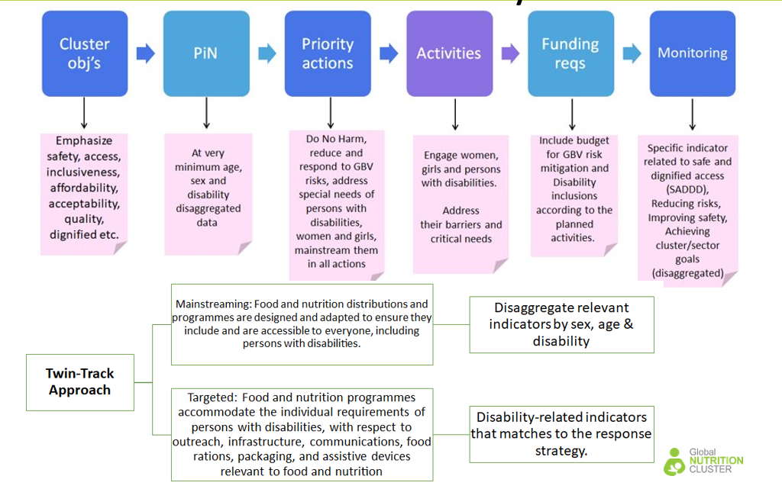
Where and how can you integrate GBV & Disability?
Global Nutrition Cluster Webinar ​on the 2022 HRP process​
October 2022
Notes:
Two of the main thematic issues that we need to consider for the HRP development include GBV and disability. Both GBV and disbility need to be integrated throughout the HRP including the intersectoral nd sectoral specific chapters. For the intersectoral chpters, this process will be guided by OCHA, however, for the sectoral, we will need to ensure that we adequately address these two thematic issues in the cluster objectives, PIN calculations, response modalities and even the monitoring plan.

Slide 22
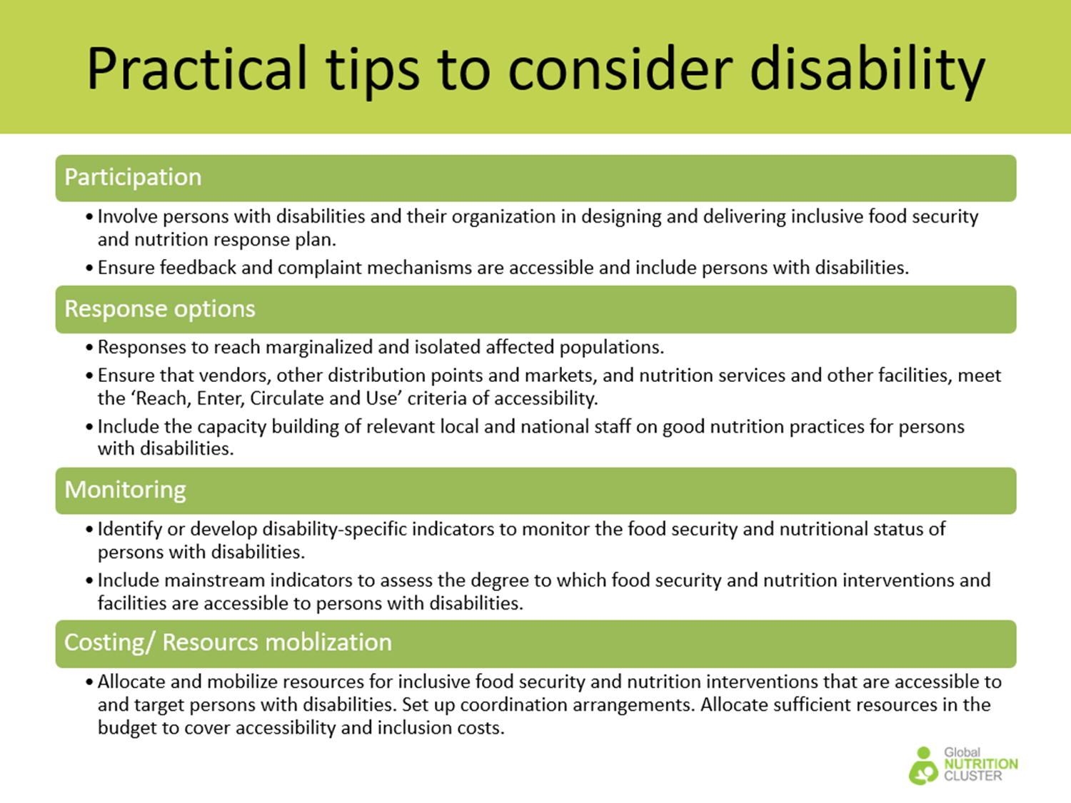
Practical Tips for Disability
Global Nutrition Cluster Webinar ​on the 2022 HRP process​
October 2022
Notes:
This slide lists tangible examples of how disability can be addressed in your respective response plan. Disability can be integrated in the response options, in monitoring, and should be considered in costing and resource mobilization. Further, people with disabilities need to be involved in program design and delivery.

Slide 23
Practical Tips for GBV
Include at least one response strategy and indicator that address identified risks and barriers.
Include standards GBV risk mitigation response and indicators.
GBV risks and barriers related to nutrition are identified and included in the HNO
Some women cannot go to nutrition services because their husbands don’t approve because they don’t understand the importance of nutrition service.
Conduct specific nutrition outreach or education targeting men and community leaders.
Improved GBV risk mitigation in HRP in nutrition.
Include at least one standard GBV risk mitigation responses and indicators.
Address the data gaps (safety audit, include questions re. barriers in nutrition monitoring, assessments)
No data related to GBV risks and barriers to nutrition services.
Global Nutrition Cluster Webinar ​on the 2022 HRP process​
October 2022
Notes:
GBV must be recognised and addressed in the HRP, with GBV related needs identified in the HNO addressed in the HRP under respective cluster response plans and indicators.
In 2021, only one HRP fully met the GBV grading criteria (Burkina Faso), and four partially met this criteria (CAR, South Sudan, DRC and Zimbabwe). However, three partially met plans had a solid narrative but did not incorporate corresponding indicators, (Mali, Sudan and Yemen).
That said, we have seen significant improvement in terms of addressing GBV in HRPs. And in 2021, the NC conducted the most number of safety audits globally compated to other clusters. And Overall, nutrition is the sector demonstrating the strongest improvement in terms of GBV measure.
However, as identified through this years GBV stocktaking and review, there are a few key areas that we need to better address. For example,
Capacity-building of women-led organizations remained very low and should be prioritized in the 2022 HPC to ensure a more localized and gender-sensitive approach, and to guarantee that risks and vulnerabilities are effectively tackled.
With regards to HRP indicators, despite a relatively good narrative overall (and improvement from previous year), only 4 countries (and 3 partially) included relevant indicators (and only 1 corresponded to that GBVRM narrative).

Slide 24

Practical Tips for GBV
Standard GBV risk mitigation measures for nutrition:
Training of nutrition frontline workers on GBV referral/disclosure
Safety audit – multisectoral or nutrition specific
Examples of indicators related to GBV risk mitigation in Nutrition:
Number of nutrition sites with GBV safety audits conducted at least once (South Sudan)
Percent of nutrition staff who have received orientation on the GBV referral pathway and can refer survivors to appropriate care (Nigeria)
% of women and girls who feel safe when accessing nutrition services (outcome level)
https://gbvguidelines.org
Nutrition site safety audit tool (S. Sudan)
https://knowledgeagainsthunger.org/wp-content/uploads/2019/09/Nutrition-Site-Safety-Audit-Tool-EN.pdf
GNV website (GBV)
Global Nutrition Cluster Webinar ​on the 2022 HRP process​
October 2022
Notes:
This slide illustrates additional tangible examples of how we can better address GBV in our HRPs.
Regarding guidance:
Finally there are lots of resources for GBV risk mitigation. Please visit GNC’s website and search for GBV for more resources or simply contact the helpdesk. Who can link you with our GBV colleugs for specific guidance and support.

Slide 25
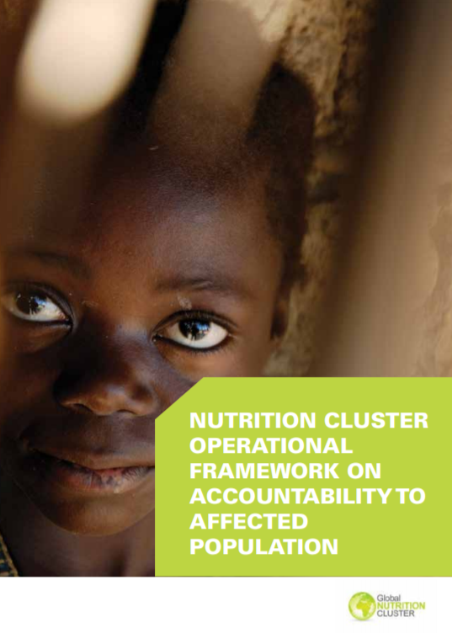
Practical Tips for AAP
Global Nutrition Cluster Webinar ​on the 2022 HRP process​
October 2022
Notes:
For AAP, Whenever possible, the cluster/sector should make use of civil society to test and validate assumptions made in the response plan. Relevant key actors who may be able to represent the interests of affected populations should be identified and means to facilitate feedback and discussion at sub-national level should be explored. In addition, the response plan should identify key activities (which can then be resourced) that can enhance the accountability of the nutrition response for affected populations. This should include activities related to setting up feedback and complaints mechanisms and community consultations, at a minimum.
One of the tools included in the AAP toolkit, which is found on the GNC website, is the Tip Sheet to Monitoring AAP Performance in Clusters. This tool specifically looks at monitoring AAP performance in clusters, using the CCPM as a framework. This tool could be useful when developing HRPs as it provides tangible examples of how AAP can be addressed across cluster core functions. For example, have local key informants been engaged in the development and validation of the nutrition cluster/sector response plan? Does the Cluster/Sector carry out regular peer reviews and field monitoring exercises?
Another useful resource is the document to the right of the slide – the nutrition cluster operational preparedness on AAP.

Slide 26
Practical Tips for CVA
Combine household assistance with individual feeding assistance
Combine household cash or vouchers with SBC interventions
Provide conditional cash transfers to incentivize attendance to priority preventative health services
Prevention of malnutrition
Treatment of malnutrition
Provide cash or vouchers to facilitate access to treatment of malnutrition
Provide household cash or vouchers assistance to caregivers of children with SAM
Global Nutrition Cluster Webinar ​on the 2022 HRP process​
October 2022
Notes:
When considering response modalities, we must consider CVA. Cash or vouchers are distributed to address economic barriers to goods and services related to underlying determinants of nutrition. In the HNO you have already assessed if CVA is a viable intervention option in your context (market analysis of availability of goods, population access to markets, etc). If it is, there are several entry points for Cash and voucher assistance in nutrition programs. In the prevention and treatment of malnutrition.
Consider for the Prevention of malnutrition to
Combine household assistance with individual feeding assistance (cash or vouchers can be considered for both components)
Combine household cash or vouchers with SBC interventions
Provide conditional cash transfers to incentivize attendance to priority preventative health services
There are many uses for cash and vouchers to assist with treatment of malnutrition:
Provide cash or vouchers to facilitate access to treatment of malnutrition- such as for transport
Provide household cash or vouchers assistance to caregivers of children with SAM- for food purchase for the child and family to decrease RUTF sharing

Slide 27
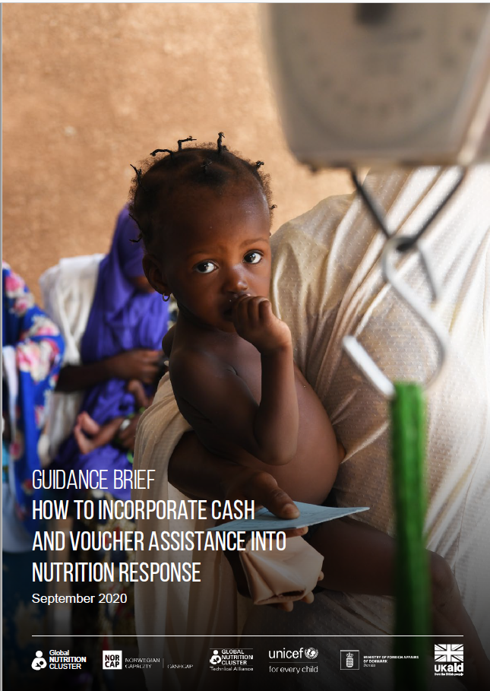
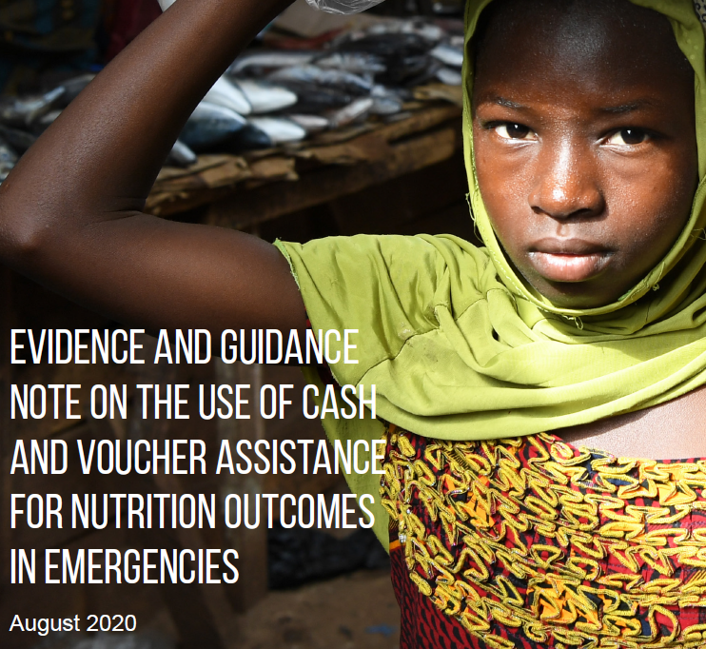
Practical Tips for CVA
HRPs:
Clarify whether CVA will be used to deliver planned programmes
Include information on evidence used to determine use of CVA
State the percentage of the response delivered by using CVA and number of people targeted with CVA
Include outcome-based, non-CVA specific indicators for the monitoring of sector-level objectives.
Guidance Brief
Evidence and Guidance Note
OCHA Guidelines for cash inclusion into the 2020 HPC (and 2021, 2022)
Global Nutrition Cluster Webinar ​on the 2022 HRP process​
October 2022
Notes:
Clarify whether CVA will be used to deliver planned programmes
Include information on evidence used to determine use of CVA (i.e. market functionality, financial barriers encountered when accessing nutritious food, safe water and hygiene items, transportation to reach health and nutrition services)
State the percentage of the response delivered by using CVA and number of people targeted with CVA: Percentage of the response delivered by using CVA; Percentage of targeted groups that receives CVA for nutrition outcomes
Include outcome-based, non-CVA specific indicators for the monitoring of sector-level objectives.
Further guidance can be found in the CVA guidance published last yearé

Slide 28
Practical Tips for Inter Sectoral Collaboration
and Programming (ISCP)
It is the convergence of effort, at the same time and in the same geographic locations built on severity ranking and prioritized needs, to achieve an agreed upon outcome based on agreed standards.
Jointly analyse the results of the HNO joint NA
Together identify and target affected populations
Jointly identify IS technical interventions and a minimum package of inter sectoral interventions ​
Decide on delivery modalities of specific technical ISP
Decide on where and how to resource share
Jointly decide on specific indicators to collect for ISP​
Jointly discuss an inter sectoral monitoring plan​
Jointly agree on inter-sectoral reporting system
Global Nutrition Cluster Webinar ​on the 2022 HRP process​
October 2022
Notes:
https://assessments.hpc.tools/km/hno-hrp-step-step-guidance-2021
file:///C:/Users/carol/Downloads/05.HPC_2021-ResponseAnalysisPrioritization_Guide-Final%20draft.pdf
ISCP are the joint actions taken by different sectors to improve outcomes for disaster affected populations.
The Food Security, Health, Nutrition, and WASH clusters need to jointly work on the following before joining the OCHA led inter sectoral (ICCG) needs analysis meeting.
Jointly analyse the results of the HNO joint needs assessment
Jointly identify and target affected populations with inter sectoral programs that are delivered at the same place and at the same time
Jointly identify inter sectoral technical interventions in response to agreed and prioritized needs and delivered at the same place/same time
Decide on delivery modalities of specific technical inter sectoral interventions at community, household and health facility levels, a minimum package of inter sectoral interventions where appropriate.
Decide on where and how to resource share (community health workers salaries, community health volunteer incentives)
Jointly decide on what specific indicators to collect for inter-sectoral programming (who will collect what indicators, and how often)
Jointly discuss an inter sectoral monitoring plan (when and who from each cluster will conduct joint monitoring visits using agreed upon monitoring check list)
Jointly discuss and agree on a simple easy to use inter-sectoral reporting system that is accessible to all clusters and partners

Slide 29
Available Support (virtual)
Bilateral support calls (continuous throughout process)
Review of draft HNO and HRP document
HNO | Inter-sectoral (HNO and HRP)
Núria Salse nsalse@unicef.org | Caroline Abla cabla@unicef.org
HRP
English-speaking countries | French-speaking countries | Spanish- speaking countries
Briony Stevens bstevens@unicef.org | Angeline Grant agrant@unicef.org | Núria Salse nsalse@unicef.org
Reference tools and guidance
https://www.nutritioncluster.net/Coordination_Toolkit
Global Nutrition Cluster Webinar ​on the 2022 HRP process​
October 2022

Slide 30
Questions?
Global Nutrition Cluster Webinar ​on the 2022 HRP process​
October 2022

Slide 31
Thank you
nutritioncluster.net

