Slide 1


nutritioncluster.net
Session Title
GNC E-Learning Platform ​
Pilot Launch
October 2021

Slide 2
Overview of the Session
Background to the e-learning project
  → How the content was developed, structured and hosted
Orientation on e-learning platform
→ How to identify and access learning content
Overview of the pilot and how to participate
→ Why engagement is needed from the community of NCCs and IMOs
Support available during the pilot
→ Technical and learning support
GNC E-Learning Platform
Pilot Launch Workshop

Slide 3

Background to the GNC E-Learning Project
GNC E-Learning Platform
Pilot Launch Workshop

Slide 4
Rationale for the Project
High demand:
Large cohort of coordination teams and partners
COVID-19 crisis increased overall needs
Local level CB needs not adequately addressed
High staff turnover
F2F training approach needed to be revised:
Costly
Unsafe
Limited reach
Needs required renewed focus on NiE, CC and IM capacity development, starting with development/updating of CFs
Limitations of F2F trainings required online approaches to be increased
Project built on previous experiences and achievements, i.e. Meeker et al. NiE CF; development of HTP; LSHTM/DFID open-access course on programming for nutrition outcomes; NIERTI project (regional NiE training); NiE pre-service and in-service training (NutritionWorks)

Slide 5
How the Project Evolved
May 2019 – Discussions on need to enhance CB
July 2019 – Consultation on the initial draft strategy (v1)
October 2019 – March 2020 – Mapping GNC partner and global clusters’ CB initiatives; finalization of CC and IM CFs.
August 2020 – Creation of NCC & IM CD TF; creation of TF for updating NiE CF
September 2020 – April 2021 – Mapping content and developing storyboards for e-learning
April – June 2021 – E-learning content on GNC website
July – September 2021 – Migration of modules to Agora, further testing and customisation

Slide 6






CAPACITY BUILDING FRAMEWORK
NCC
IMO
Partner
INTRODUCTORY LEVEL
(LEVEL 1)
Initial orientation
Online orientation:
by NCC helpdesk
by tech helpdesk
NCC checklist
Online orientation:
by IMO helpdesk
IMO checklist
Country specific welcome package
90 minute regular orientations
On-demand e-learning through GNC learning platform
Defining recommended learnings as per GNC Competency Framework (self-evaluation)
 | Level 1 | Level 2 | Level 3
Competency 1 | - | ✓ | -
Competency 2 | ✓ | -
 | ” | ” | ”
Competency N | ✓ | ✓ | -
optional competencies evaluation by a supervisor
report on the recommended learnings (plus access to all learning materials)
GENERAL LEVEL
(LEVEL 2)
 | Level 1 | Level 2 | Level 3
Competency 1
Competency 2
” | ” | “ | “
Competency N
online test on all competencies with multiple choice questions (graded automatically)
Further learnings identified?
no
yes
keep access to resources + regular updates when new additional e-learning materials are posted
Feedback for NCCs: “light” 360 from supervisor, SAG, OCHA, team, subnational CCs
Feedback for IMO: “light” 360 from the NCC, any other partners identified by the NCC/IMO
Certification
Individual learning
ADVANCED LEVEL
(LEVEL 3)
Face to face simulations in the country with other clusters (?)
Case studies and one on one feedback
Individual partners programs
Mentoring
(as a mentee)
NCC/IMO
Individual e-learning
Partners
NCC / IMO
Mentor’s training
2 mentees & positive feedback
One webinar with NCCs/IMOs on sharing experience (GNC helpdesk support) OR
Preparing case studies recordings for online learning platform
Feedback on the individual e-learning activities to 2 people
Documentations and publications of minimum 2 case studies (primary author)
MASTER LEVEL
(LEVEL 4)
GNC certified mentor
Professional development (?)
(pool for the next level jobs (?)

Slide 7
Level 2 (General) - How Would it Work?
On-demand e-learning through GNC learning platform
Defining recommended learnings as per GNC Competency Framework (self-evaluation)
 | Level 1 | Level 2 | Level 3
Competency 1 | - | ✓ | -
Competency 2 | ✓ | -
 | ” | ” | ”
Competency N | ✓ | ✓ | -
For those not seeking formalised learning process → dip-in, dip-out learning content
Optional competencies evaluation by a supervisor
GENERAL LEVEL
(LEVEL 2)
Report on the recommended learnings (plus access to all learning materials)
 | Level 1 | Level 2 | Level 3
Competency 1
Competency 2
” | ” | “ | “
Competency N
Online test on all competencies with multiple choice questions (graded automatically)
Further learning identified?
No
Yes
keep access to resources + regular updates when new additional e-learning materials are posted
Feedback for NCCs: “light” 360 from supervisor, SAG, OCHA, team, subnational CCs
Feedback for IMO: “light” 360 from the NCC, any other partners identified by the NCC/IMO
CERTIFICATION

Slide 8
Development of Content for the E-Learning Platform
Based on the Competency Frameworks for Cluster Coordination and IM
Initial focus on functional competencies
Content created for each functional competency area
To support flexible learning, content split into smaller, independent, bite-size modules

Slide 9
Content Creation for the E-Learning Platform
Each functional competency has definition, behaviours and underlying knowledge & skills
Behaviours listed at three cumulative levels
Behaviours translated into online learning modules
Level 1 Modules | Level 2 Modules | Level 3 Modules
Introduction to nutrition cluster needs assessment Integrating the needs of vulnerable groups into nutrition cluster needs analyses …etc. | Conducting a nutrition cluster HNO analysis Establishing a nutrition information systems governance structure Triangulating and analysing nutrition cluster information and data | Aggregating nutrition cluster data and conducting meta-analysis Identifying nutrition trends and analysing future risks …etc.

Slide 10
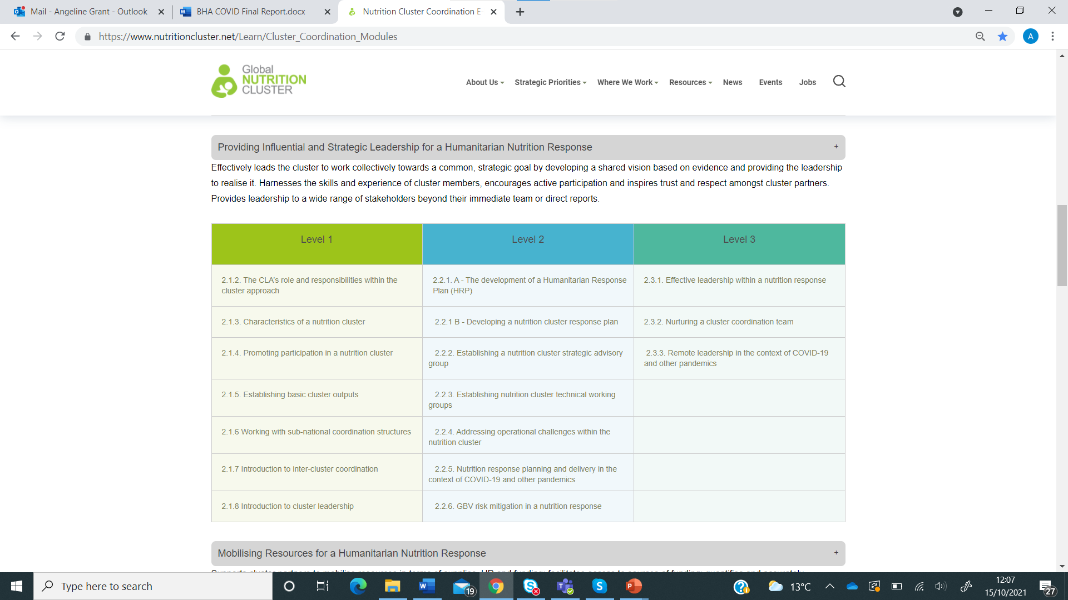
Content Creation for GNC E-Learning Platform
69 CC modules and 50 IM modules created
20+ modules ongoing (ISC+ERP)
HPC & core cluster functions broken down into detailed modules
Short, bite-size content
Modules stand alone → learners can pick & choose
E-learning package structured around defined competency areas & cumulative levels

Slide 11
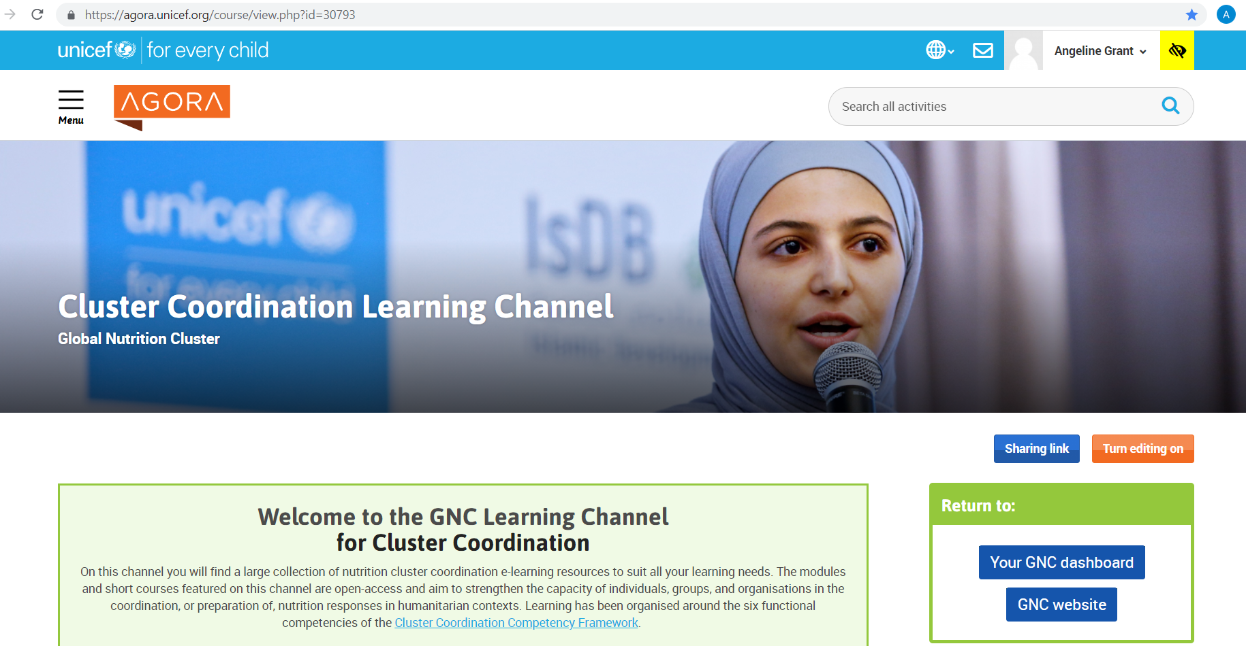
GNC Online Learning
Platform Development
Consultancy to define platform requirements, business case & solutioning workshop
Adoption of a distinct GNC LMS within UNICEF Agora featuring CC, IM and NiE learning channels.
Learning channels broken down into: module catalogue, short courses & learning pathways
Modules uploaded to GNC Agora LMS in Jul 21
LMS structure and modules tested in Aug 21
Additional changes based on pilot feedback incorporated in Dec 21

Slide 12

Quick poll – How do you approach e-learning?
I like to take my time
I like to complete it quickly
I like a defined learning package
I like to pick and choose my learning activities
I access learning content to respond to my day-to-day needs
I access learning content because I enjoy learning

Slide 13
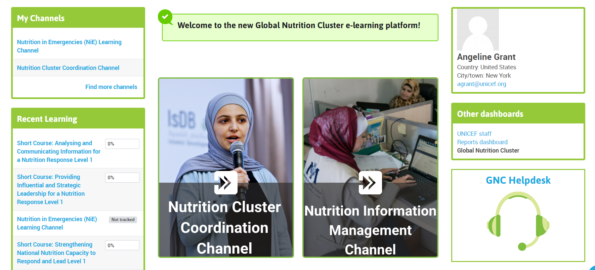
Orientation on the new GNC E-Learning Platform
GNC E-Learning Platform
Pilot Launch Workshop

Slide 14

Overview of the E-Learning Pilot
GNC E-Learning Platform
Pilot Launch Workshop

Slide 15
GNC E-Learning Pilot
What is it? A means to pilot the content and functionality of the GNC E-learning platform before its launch in December 2021
Participants: GNC NCCs and IMOs with an interest in e-learning
Duration: 4 weeks 19.10.2021 –12.11.2021
Purpose:
1) Gather feedback on the content and how it is packaged, to finalise content and platform design
2) Use new e-learning content for staff development
Approach: Blended: a combination of self-paced learning on the platform and some facilitated sessions to support learning and gather feedback
GNC E-Learning Platform
Pilot Launch Workshop

Slide 16
Why Participate in the Pilot?
Meet your learning needs & access the latest content relevant to your work
Your ongoing professional development
Opportunity to help to shape the GNC learning offer
GNC E-Learning Platform
Pilot Launch Workshop

Slide 17

How can I participate in the pilot?
Log in to the new GNC Learning platform on Agora
Select and complete at a minimum one e-learning module within the next 4 weeks (1 hour max)
Attend optional learning support workshop if needed (02.11.21)
Attend the end of pilot workshop to discuss your feedback 12.11.2021
Or complete the end of pilot survey
GNC E-Learning Platform
Pilot Launch Workshop

Slide 18
Next steps
Finish pilot and gather feedback on content and functionality from community of NCCs and IMOs
Use feedback to adjust/edit content and functionality of platform
Finalise additional modules
Translation of all content into French and Spanish – parallel project, to be completed by December 2021
Public launch December 2021
GNC E-Learning Platform
Pilot Launch Workshop

Slide 19

Support available
Optional learning support workshop on 02.11.2021
  Navigating the platform and accessing the learning content you need
  Completing and following up learning activities
  For ad-hoc queries on content or functionality during the pilot contact : agrant@unicef.org
  Happy learning!
GNC E-Learning Platform
Pilot Launch Workshop

Slide 20
Questions?
& Closing Poll
GNC E-Learning Platform
Pilot Launch Workshop

Slide 21
Thank you!
nutritioncluster.net

