Slide 1







Slide 2
Accessing support and Services
Since Dec 2020 The Alliance website has had :
6700 Unique users
Our website has been viewed 24,000 times
Users from 153 countries

Slide 3

41 requests for support submitted
23 -Quick Remote Technical Support
4-In-depth Remote Support
5- In-country Support
6- Consultant roster
1- Cluster coordination
2- Cluster IM(new)
0-Unclassified

Slide 4
Request received since Jan 2021
154 requests for support have been submitted
84 -Quick Remote Technical Support
16-In-depth Remote Support
11- In-country Support
24- Consultant roster
11- Cluster coordination
2- Cluster IM(new)
6-Unclassified

Slide 5
What thematical areas is support being requested for :
Coordination = 3
Cross cutting themes = 4
Information management = 1
IYCFE = 13
Micronutrients = 1
NIS = 8
Other NIE = 4
Social Behaviour Change = 1
Wasting = 9
Nutrition Sensitive Interventions = 1
No classification = 0
*Requests may have multiple thematic tags

Slide 6
Who is requesting Support?
The Alliance receives requests from UN, NGOs, Network agencies, Local NGOs, Governments and more.
This slide provides an overview of who has been requesting support from the Alliance.

Slide 7
Where are requests coming from?
The Alliance Receives requests for support from all over the World.
This slide provides an overview of where requests for support come from

Slide 8
Communications & Knowledge Management
Webinars:
1 webinar took place “A Learning and Sharing Café: Shared Responsibilities for Infant and Young Child Feeding in Emergencies - Experiences implementing the IYCF Multi-sector Framework for Action”.
It was attended by 123 participants, 44 (36%) where from local NGOs
Learning Needs & Products
1 technical product need was identified this quarter: Resumption of pre-COVID guidelines for wasting
2 learning needs: LAC learning needs, and Learning on Nutrition Sensitive work Yemen,
Work continues on learning brief and podcast regarding local NGOs using the Alliance to support their technical capacity gaps and needs and guidance on Using MUAC and/or anthropometric classification, Yemen NIS Taskforce evaluation

Slide 9
Thought Leadership Updates
Work continued during the quarter in each of the GTWGs based on needs emerging within the Alliance.
Funding gaps were noted for each of the GTWGs and next steps to fill these gaps outlined.
A cross- chair quarterly call was held in September to explore areas of collaboration across the GTWGs.
Work began to set up a new taskforce on Nutrition guidance for Ebola Treatment Units. This taskforce will be co-chaired by WHO and CDC/ John Hopkins University.

Slide 10
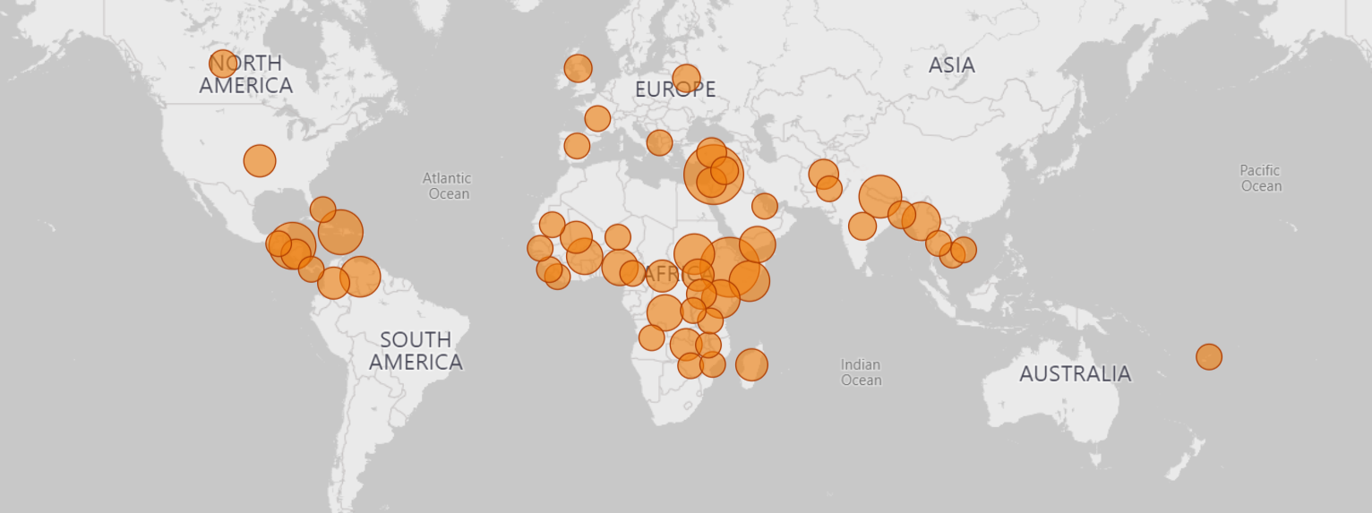
The Alliance’s Work to date
Since April 2020 – Sept 2021 the Alliance has:
Received 210 requests for support
From 59 countries across 9 Regions
39 requests are on-going

Slide 11
Thematic Tags since April 2020:
This slide provides an overview of the tagged thematic areas for which technical support has been requested .
*Requests may have multiple thematic tags

