Slide 1
GNC structure
2022–2025 GNC Strategy
© UNICEF/UN0436787/Pedro

Slide 2
Agenda
GNC SOP
GNC Partnership
Communications
Decision-making
GNC Structure at global level
SAG
Focal Points and Workstreams for cross-cutting themes
Funding WG
GNC Meeting
Key asks
© UNICEF/UNI389000/Mussapp

Slide 3
© UNICEF/UN0436787/Pedro

Slide 4
GNC Partner vs observer
GNC Partners are entities (organizations, agencies, networks, groups or individuals) committed to respecting fundamental humanitarian principles, working in Nutrition in Emergencies, who are willing to actively help the GNC fulfil its role and who:
Support the fulfilment of the GNC Strategic Plan by collectively developing and contributing to the GNC Work Plan via funding contributions or in-kind person time;
Do not have a conflict of interest with the GNC;
Support the monitoring of activities in the GNC Work Plan towards which they are actively contributing;
Contribute to GNC discussions through participation in GNC meetings and teleconferences, as well as commenting on any documents;
Support a sense of equality and mutual respect for all other partners;
Are mutually accountable; and
Contribute to decision-making in the best interests of the GNC.
“GNC Observers are organizations or individuals who choose not to contribute directly to the GNC’s work, but who are interested in receiving and sharing information on the GNC’s activities. Where appropriate, they may be invited to attend GNC meetings. They have no voice or vote regarding GNC decisions.”

Slide 5
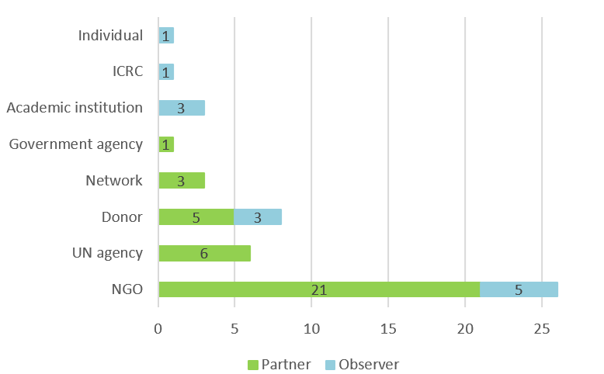
Current GNC membership
36 partners
13 observers
© UNICEF/UN0436787/Pedro

Slide 6
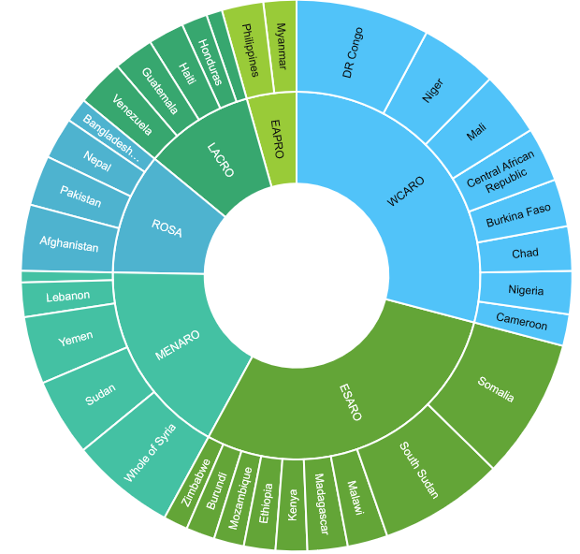
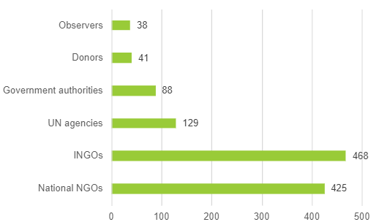
Current nutrition cluster/sector membership (33 countries)
37 partners/country
15 INGO+13 LNGO+4 UN + 3 gvt +1 donor
© UNICEF/UN0436787/Pedro

Slide 7
2022 Partnership Review
Reconfirm partner/member status
Update contacts
Consultancy to review current partnerships*
* GNC core initiative: Review current engagement of communities, local NGOs/CBOs, private organizations, academic institutions and local authorities in the NiE Sector, and develop recommendations for better engagement at all levels.

Slide 8
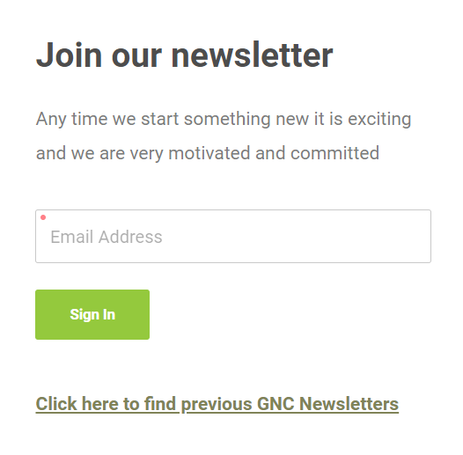
https://www.nutritioncluster.net/news
communications
Website
Monthly newsletter
Emails; mailing lists
Social media
News and job opportunities
Webinars
Conference calls
Reporting; Annual and Mid-year reports
GNC meetings
Communications in the WGs, GTWGs, SAG, TFs, the Alliance
Individual communications

Slide 9
Decision-making and document endorsement
Strategic decisions
The GNC-CT and the Alliance LT, in consultation with the SAG, commits to share drafts and final drafts of all strategic documents, as well as key decisions to be made, with GNC partners for their input and feedback.
Where possible, strategic documents and key decisions to be made will be shared prior to and discussed in the GNC Annual Meeting. Where the timing of document endorsement does not correspond with the GNC Annual Meeting, feedback will be solicited from partners via email or internet survey.
Where conflicting feedback is provided or issues arise, these will be discussed within the SAG and the SAG will advise the GNC-CT or the Alliance on the best course of action to finalize the issue/document.
Once finalized, all strategic documents will be shared with GNC partners via email and posted on the GNC website.
Decisions in specific areas
In areas where the relevant GNC structure exists (i.e., the Alliance LT, Wasting GTWG or Advocacy & Communications WG), the decision-making process is automatically delegated from the GNC partners to such entities.

Slide 10
GNC strategic objectives
people
Operational and technical support
Enabling environment
To support countries, UNICEF as a Cluster Lead Agency, and nutrition partners at subnational, national, regional, and global levels to ensure they are adequately staffed and skilled in order to prepare for, respond to, and recover from, situations of fragility.
To provide adequate NiE coordination, IM, and programme operational and technical support to ensure that decisions at all levels are guided by timely sound technical advice, while documenting experiences and generating new evidence.
To be a driver of change for:
1) improved collaboration, partnerships, and innovation on nutrition to prepare for, respond to, and recover from, shocks to the nutrition situation at the global, regional, national, and subnational level; and,
2) creating a supportive financial and policy environment, both internally and externally, for strengthened technical and coordination capacity for nutrition in situations of fragility.

Slide 11
GNC structure at global level
GNC Coordination Team
(UNICEF-hosted)
Strategic Advisory Group
GNC Technical Alliance Leadership Team (UNICEF + NGO co-lead)
new
new
new
new
new
new
Funding WG
Advocacy and Communications WG
Intersectoral collaboration
Technical Support Team
Nutrition Information Systems GTWG
Nutrition and Cash and Voucher Assistance GTWG
IFE Core Group
Wasting GTWG
Capacity Strengthening WG
Talent pool of Coordinators and IMs
new
new
NiE Sector roster of consultants
Deployable:
Nutrition technical advisers
Rapid-response team (coordination & IM)
Partner technical staff (ad hoc)
Focal points
Gender and GBV
Disability
HDN
AAP
Localization
Helpdesks:
Intersectorial coordination
Nutrition information systems
Sectorial/cluster coordination
Information management
NiE
Partner technical staff (ad hoc)
Nutrition in Emergencies sub- WG
Coordination and IM sub-WG
SO3: Enabling environment
SO2: operational and technical support
SO1: people
GNC structure element under accountability of the Alliance
GNC structure element under accountability of the GNC-CT
GNC structure element under the accountability of both the GNC-CT and the Alliance
Structure element managed by the Alliance, whose members (i.e., consultants) are not part of the GNC partnership
Structure element managed by the GNC-CT, whose members (i.e., coordinators and information managers) are not part of the GNC partnership
Non-WG element of the GNC structure
Direct management
Accountability

Slide 12
SAG role
“Ensure that the GNC partners benefit from strategies that are consistent with the public interest of the Nutrition Cluster members and the vulnerable populations we serve.
Provide strategic guidance for the delivery of the strategy by the GNC partners, GNC-CT and the Alliance partners, in line with the defined Vision, Mission and Strategic Objectives, and to support monitoring progress on the workplans.”

Slide 13
SAG representation of the GNC partners
SAG members to actively seek interaction with GNC partners and represent their issues and concerns to the other SAG members and the GNC-CT and the Alliance LT.
Each SAG member will be allocated a group of partners (not observers!) with whom they will regularly engage.
Random allocation of 2-3 partner per SAG member.
The wider cluster membership, including observers, will maintain the right to approach any of the elected SAG members directly with issues of concern, which may be tabled at SAG meetings.

Slide 14
SAG ALLocation of GNC partners
UNICEF | WHO | WFP | UNHCR | BHA | ECHO | The Alliance | Stefano Fedele (GNC-CT Coordinator) | ACF | Concern
Action for Development | AVSI - People for Development | Help Age International | Emergency Nutrition Network (ENN) | Eleanor Crook Foundation (ECF) | Centers for Disease Control (CDC) | iMMAP | FHI 360 | GOAL | Food and Agriculture Organisation (FAO)
Mercy Corps | Nutrition Works | INTERSOS | International Medical Corps (IMC) | Nutrition International | JAM | International Orthodox Christian Charities (IOCC) | RedR-UK | International Rescue Committee (IRC) | Institut Bioforce
UN Nutrition |  |  |  |  | West African Institute of Public Health | Valid International | Samaritan's Purse | Save the Children

Slide 15
SAG membership
Permanent members
Elected members
GNC Coordinator
the Alliance LT
UNICEF
WFP
WHO
UNHCR
BHA (was elected)
ECHO (was elected)
1 NCC > 2 NCCs
3 NGOs

Slide 16
SAG membership
Membership is for organizations, not individuals.
Organizations must have been a GNC partner for 12 months or longer.
Yearly nomination process:
Organizations to submit an expression of interest and identify the individual.
A brief outline of the added value of the organization’s participation in the SAG + a short bio
NCCs may self nominate and/or can be nominated by their peers. A short bio should be included along with the expression of interest.
Election process:
NGOs and donors to be elected by the GNC partners (one vote per organisation).
NCCs to be elected by NCCs (one vote per country).
Voting (if required) will take place through an on-line survey.
SAG membership (elected members) is for two years. If no nominations are received to replace current elected members, they can be extended in the SAG for one more period of two years.
No more than four members are rotated in a year.
Individuals require:
significant relevant work experience at a strategic level
solid understanding of the humanitarian aid sector
commit to represent the interests of the GNC and not their own agency’s interests.

Slide 17
2022 SAG nomination and election
2 NCCs
1 NGO

Slide 18
GNC priority cross-cutting THEMES for 2022–2025
Cross-cutting THEMES
1
5
2
4
3
1.
2.
3.
4.
5.
accountability to affected populations
disability
gender mainstreaming
humanitarian-development nexus
localization

Slide 19
Workstreams for cross-cutting Themes
Current workstreams in TST:
Gender and GBV risk mitigation
Anti-racism and Localization
Additional workstreams to be established
Humanitarian-Development Nexus
Accountability to Affected Populations
Disability
Generic ToR for a workstream on the Alliance website

Slide 20
Focal points for cross-cutting Themes: key tasks
Lead workstreams’ discussions (i.e., organize monthly meetings and track APs)
Act as a key focal point for questions on a selected cross-cutting themes, i.e.,
receive questions, answer them directly and/or channel them to appropriate mechanism to answer
receive requests to comment on documents from global and country level and provide feedback (either reviewing directly or consolidating feedback from workstream members)
Develop GNC approach on these cross-cutting themes (i.e., sensitising on their importance, collating recommended best practices, developing key actions for NiE programming and coordination)

Slide 21
Funding WG
Key tasks:
Develop mapping of the current and prospective NiE resource partners, funding opportunities and entry points for increased advocacy for NiE funding;
Jointly, with traditional NiE resource partners, develop a more robust understanding of the administrative and legislative challenges that prevent current funding from being more rapid, more flexible, and covering longer periods than it currently does;
Based on the above, develop a communications strategy (lobbying) and narrative around NiE for global and country level financing, including how to demonstrate the impact of NiE programmes, coordination and IM;
Identify and implement solutions to promote equitable sectoral funding in support of multi-sectoral programming (jointly with the Advocacy and ISC WGs).

Slide 22
GNC meetings
Annual Meeting - May/ June 2022 - Online
all national coordination teams
all partners
other experts
side meetings as required (i.e., WGs & GTWGs )

Slide 23
GNC workplan 2022-2023 - draft
UNICEF | Budget needed for 2022. | Budget available for 2022 | Gap for 2022 | Budget needed for 2023
GNC-CT led part (excluding Funding WG needs) | $2.8 M | $1.6 M | $1.2 M | $2.3 M
The Alliance’s led part (excluding NIS WG needs) | $2.2 M | $1.4 M | $0.8 M | $2.4 M
Total | $5.0 M | $3.0 M | $1.8 M | $4.7 M
© UNICEF/UN0376829/Esiebo

Slide 24
Key asks
Review your status in the GNC (i.e., partner vs observer, contacts)
Apply to be a SAG member
Volunteer as a focal point or member of the workstreams on AAP, HDN, localization, disability, gender & GBV
Join the financing and / or other WG(s) or GTWG(s)
© UNICEF/UN0376829/Esiebo

