Slide 1

www.nutritioncluster.net ​
Global Nutrition Cluster |
Information Management Webinar
for Non-IM
7 December 2021

Slide 2
Overview of the session
Welcome and objectives → 05 min
IM toolkit overview → 15 min
Contact list → 15 min
Map & Dashboard → 15 min
Nutrition Humanitarian Needs Analysis → 15 min
KoBoToolbox for data collection → 15 min
Next steps and available support → 10 min

Slide 3
Overview of the session
Welcome and objectives → 05 min
IM toolkit overview → 15 min
Contact list → 15 min
Map & Dashboard → 15 min
Nutrition Humanitarian Needs Analysis → 15 min
KoBoToolbox for data collection → 15 min
Next steps and available support → 10 min

Slide 4
Welcome and objectives
Brief about the IM tools and practices that require simple IM skills
Highlight the available IM support to countries with limited IM capacities

Slide 5
Overview of the session
Welcome and objectives → 05 min
IM toolkit overview → 15 min
Contact list → 15 min
Map & Dashboard → 15 min
Nutrition Humanitarian Needs Analysis → 15 min
KoBoToolbox for data collection → 15 min
Next steps and available support → 10 min

Slide 6
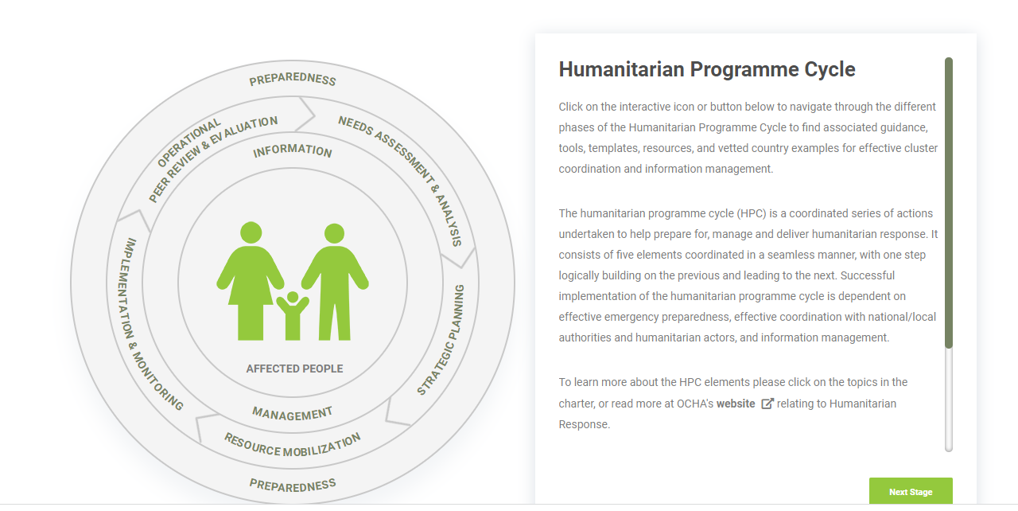
IM toolkit overview
https://www.nutritioncluster.net/IM_Toolkit

Slide 7
Overview of the session
Welcome and objectives → 05 min
IM toolkit overview → 15 min
Contact list → 15 min
Map & Dashboard → 15 min
Nutrition Humanitarian Needs Analysis → 15 min
KoBoToolbox for data collection → 15 min
Next steps and available support → 10 min

Slide 8
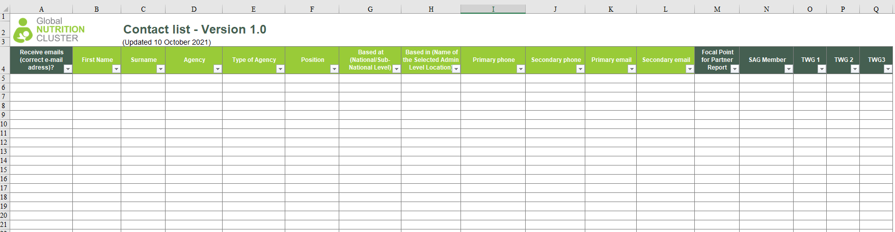
Contact list template
Helps to have an overview of who the nutrition coordination group members are
Helps when members need to be contacted and information shared and can also be used to keep track of attendance at meetings
As a minimum contact list should include the following information:
  Name
  Organization
  Position
  Email address(es)
  Telephone number(s)
  Membership of WGs

Slide 9
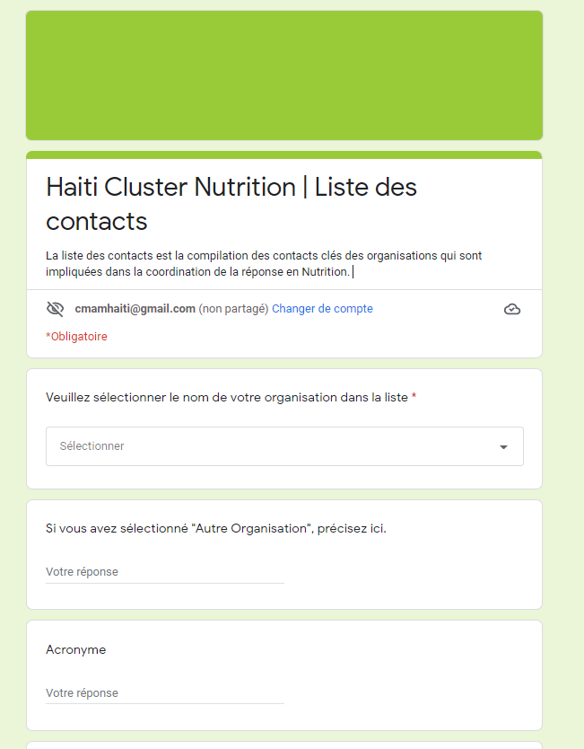


Contact list inscription using Google Form
Set up a new form using Google Form
Add the link to HR info webpage (if applicable)
Publish the contact list on HR info web page with agreed fields to be displayed online >>> all updates will be applied online when refreshed!

Slide 10
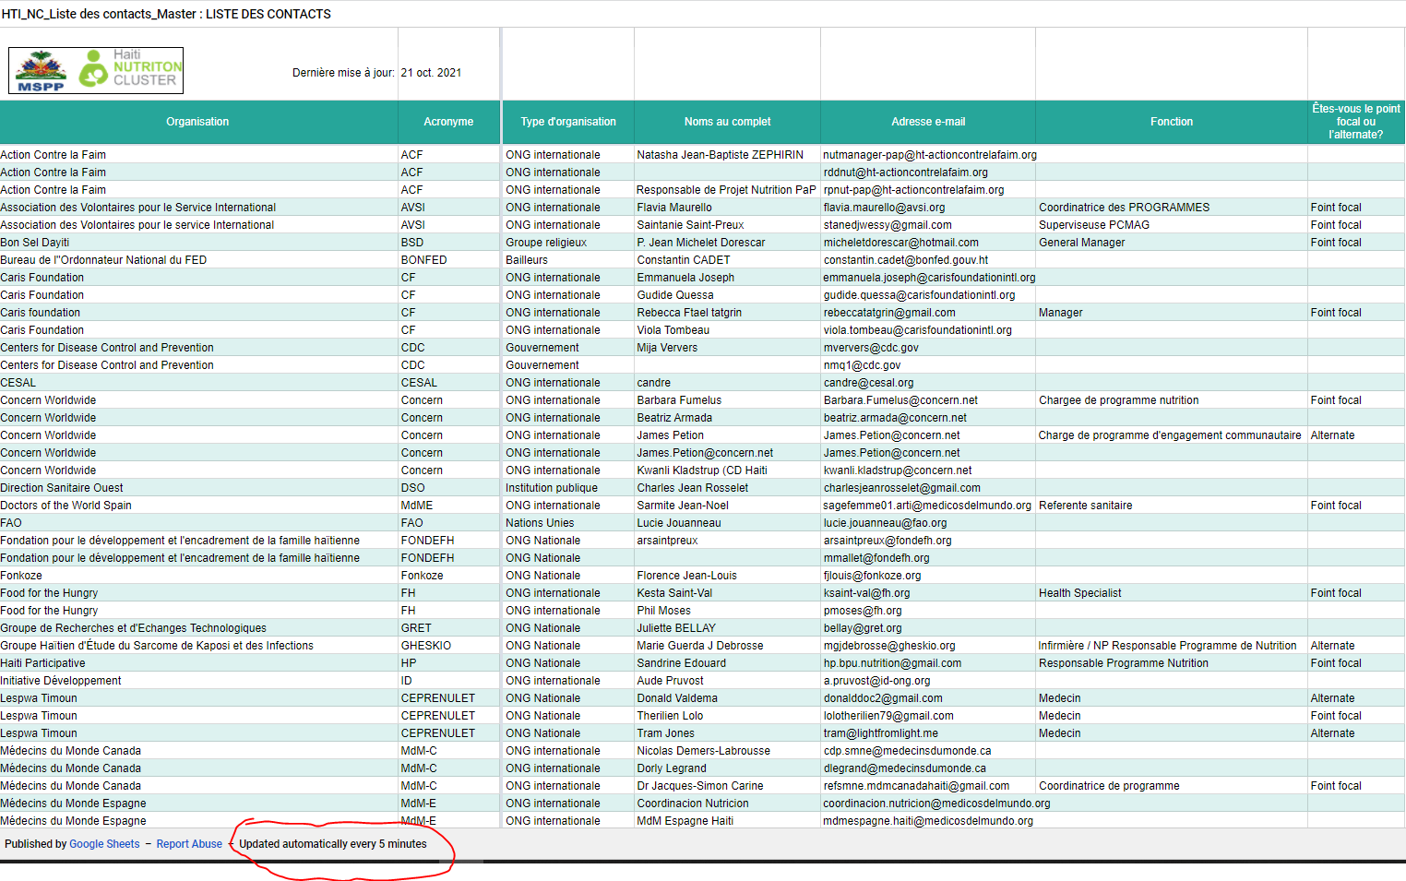
Contact list published on HR info webpage

Slide 11
Overview of the session
Welcome and objectives → 05 min
IM toolkit overview → 15 min
Contact list → 15 min
Map & Dashboard → 15 min
Nutrition Humanitarian Needs Analysis → 15 min
KoBoToolbox for data collection → 15 min
Next steps and available support → 10 min

Slide 12
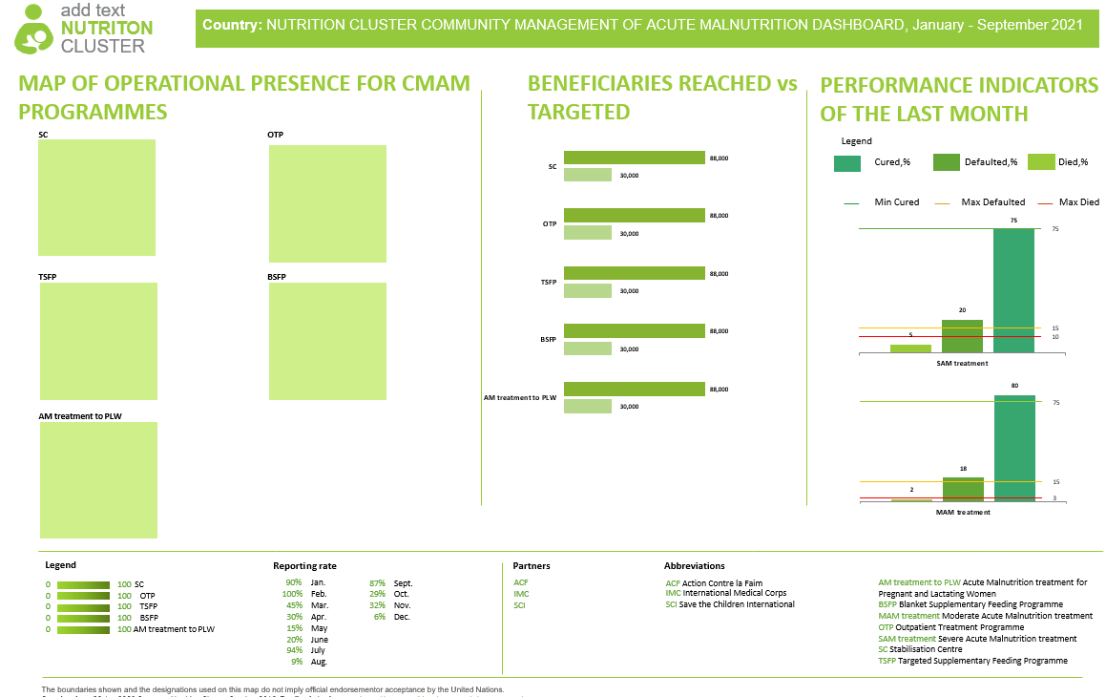
Map & Dashboard
The package includes five dashboards (with a guidance on how to edit them) in the MS Power Point, that makes it easy to edit them.
All templates are designed in the same style (according to the NC Style guide) and include five dashboards that are most often used in nutrition clusters:
HRP launch dashboard
Cluster progress towards HRP
CMAM dashboard
IYCF-E dashboard
MN programmes dashboard

Slide 13
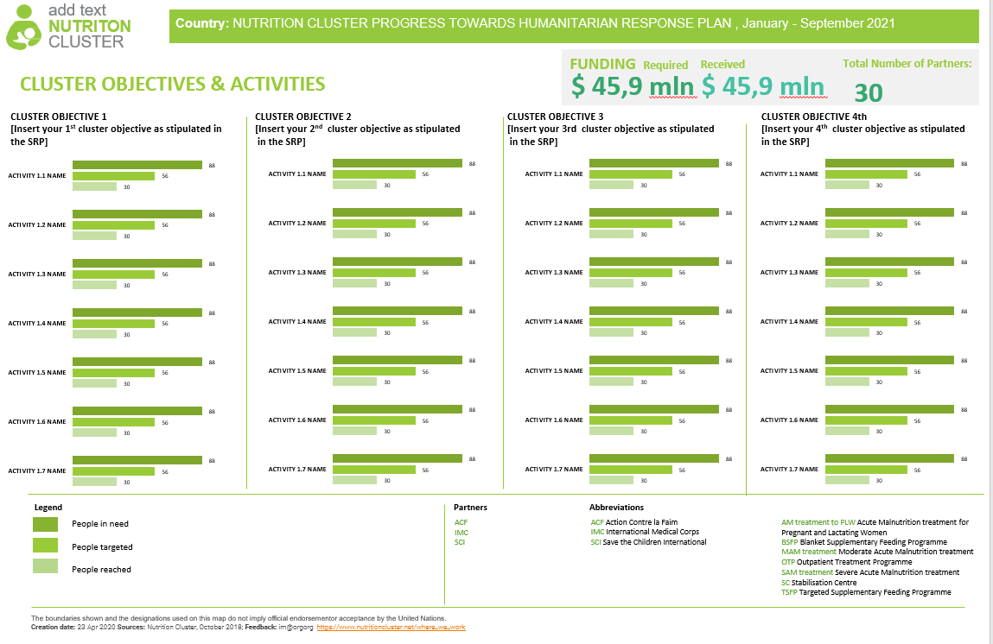
Map & Dashboard

Slide 14

Map & Dashboard
add text NUTRITON CLUSTER
Country: NUTRITION CLUSTER MICRONUTRIENT DASHBOARD, January - September 2021
MAP OF OPERATIONAL PRESENCE FOR MICRONUTRIENT PROGRAMMES
BENEFICIARIES REACHED vs TARGETED
Awdal
Sanaag
Bari
Woqooyi Galbeed
Togdheer
Sool
Nugaal
Mudug
Galgaduud
LATEST MICRONUTRIENT INDICATORS
Bakool
Hiraan
INDICATORS
YEAR MEASURED
METHOD
VALUE
Gedo
Middle Shabelle
VAD prevalence | 2012 | Survey | 20%
Vitamin A supplementation coverage | 2016 | Administrative | 89%
Anaemia prevalence in children | 2012 | Survey | 17%
Anaemia prevalence in PLW | 2012 | Survey | 21%
MNP coverage | 2016 | Administrative | 74%
MNT/FeFo [choose one which is relevant] coverage | 2016 | Administrative | 56%
Bay
Banadir
# of organizations by Admin1
Middle Juba
Lower Shabelle
0 organization
1 organization
2 organizations
Lower Juba
3 organizations
4 organizations
Legend
Legend
People in need
Reporti 90% | ng rate Jan.
100% | Feb.
45% | Mar.
30% | Apr.
15% | May
20% | June
94% | July
9% | Aug.
Partne ACF
IMC
SCI
rs
Abbreviations
87% | Sept.
29% | Oct.
32% | Nov.
6% | Dec.
ACF Action Contre la Faim
IMC International Medical Corps
SCI Save the Children International
AM treatment to PLW Acute Malnutrition treatment for Pregnant and Lactating Women
BSFP Blanket Supplementary Feeding Programme
MAM treatment Moderate Acute Malnutrition treatment
OTP Outpatient Treatment Programme
SAM treatment Severe Acute Malnutrition treatment
SC Stabilisation Centre
TSFP Targeted Supplementary Feeding Programme
People targeted
People reached
The boundaries shown and the designations used on this map do not imply official endorsementor acceptance by the United Nations.
Creation date: 23 Apr 2020 Sources: Nutrition Cluster, October 2018; Feedback: im@orgorg https://www.nutritioncluster.net/where_we_work

Slide 15
Overview of the session
Welcome and objectives → 05 min
IM toolkit overview → 15 min
Contact list → 15 min
Map & Dashboard → 15 min
Nutrition Humanitarian Needs Analysis → 15 min
KoBoToolbox for data collection → 15 min
Next steps and available support → 10 min

Slide 16
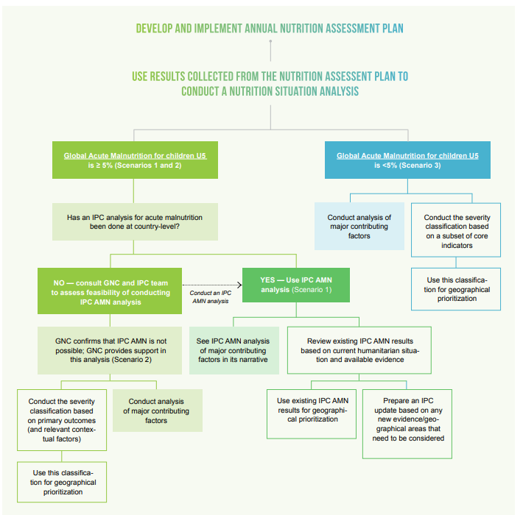
Nutrition Humanitarian Needs Analysis
Aimed at NCCs, IMOs and AWG Chairs, GNC-CT prepared this iterative guidance to outline the steps for conducting a Nutrition Situation Analysis, identifying information for the Humanitarian Needs Overview, which feeds into response plans and updates, whether IASC Cluster system has been activated or not.
This includes the development and implementation of an annual nutrition assessment plan and a nutrition situation analysis (or align it with IPC’s Acute Malnutrition results) along with major contributing factors, and calculation of the number of People in Need and other key figures.

Slide 17
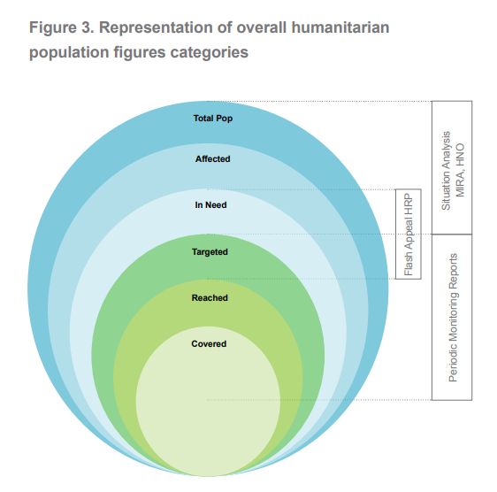
Nutrition Humanitarian Needs Analysis

Slide 18
Overview of the session
Welcome and objectives → 05 min
IM toolkit overview → 15 min
Contact list → 15 min
Map & Dashboard → 15 min
Nutrition Humanitarian Needs Analysis → 15 min
KoBoToolbox for data collection → 15 min
Next steps and available support → 10 min

Slide 19
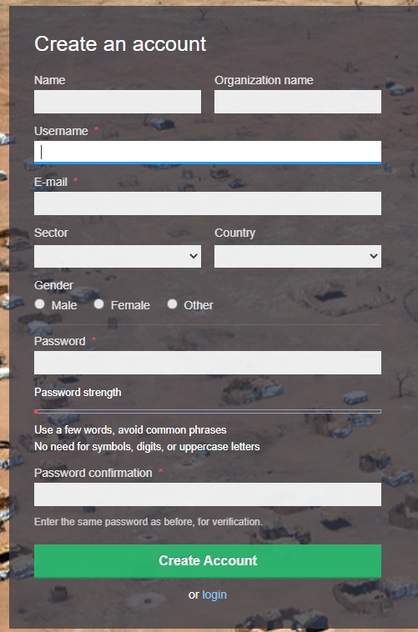
KoBoToolbox
KoBoToolbox is an integrated set of tools for building forms and collecting interview responses. It is built by the Harvard Humanitarian Initiative for easy and reliable use in difficult field settings, such as humanitarian emergencies or post-conflict environments.
This instance of KoBoToolbox is hosted and supported by UN OCHA and can be used without limitations by any humanitarian organization.
Please sign up with your organization's email address!

Slide 20
Why KoBoToolbox
It is a ready-to-use all-in-one platform for developing, storing, managing and
sharing forms, as well as managing and sharing collected data.
It is based on OpenDataKit (ODK). KoBo Toolbox is fully compatible and
interchangeable with ODK Collect and XLSForm, but delivers more functionality such
as an easy-to-use formbuilder, question libraries and integrated data management. It
also integrates other open-source ODK-based developments such as formhub and
Enketo.
It is being continuously improved and optimised particularly for the use of
humanitarian actors in emergencies and difficult field environments, in support of
needs assessments, monitoring and other data collection activities.
It is free. All humanitarian actors can create accounts on the dedicated server and
use them without limitations on data or time. There is no need to install any server,
but if there is a need, organisations can install it on their own servers.

Slide 21
Overview of the session
Welcome and objectives → 05 min
IM toolkit overview → 15 min
Contact list → 15 min
Map & Dashboard → 15 min
Nutrition Humanitarian Needs Analysis → 15 min
KoBoToolbox for data collection → 15 min
Next steps and available support → 10 min

Slide 22
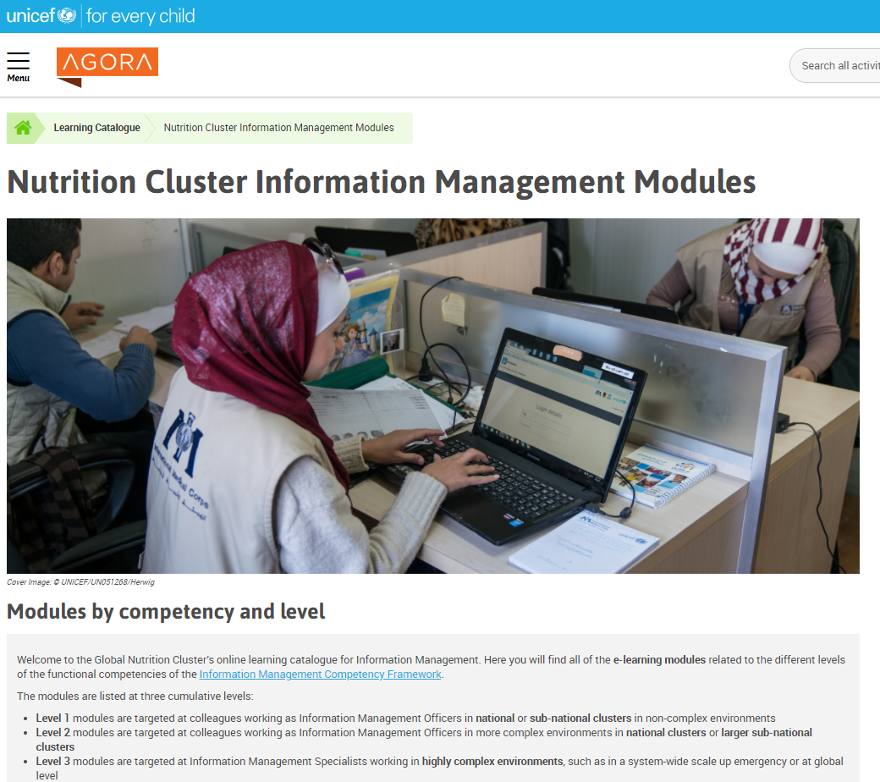
Next Step and available support
GNC’s online learning catalogue for IM
https://agora.unicef.org/course/view.php?id=33031
Help desk support
https://ta.nutritioncluster.net/request-support
Notes:
Awareness session
it's for countries without IM but will be good for NCC

