Slide 1





QUARTERLY UPDATE:
Q3 1 July – 30 Sept 2022

Slide 2
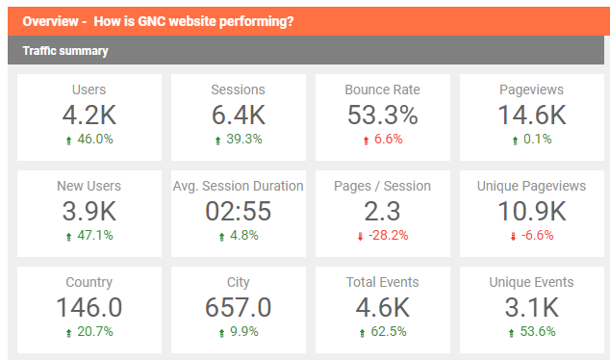
Accessing support and Services
In July – September 2022 The Alliance website has had :
Notes:
Users up from 2.4k in Q1 to 2.8K in Q2, 4.2 K users in Q3
Bounce rate has slight increased again in Q3 from Q2 and Q1
Unique page views up to 14.6 in Q3 from 11.5k in Q2 from 8.1 K Q1

Slide 3
138 requests submitted
93 - Quick Remote Technical Support
23 - In-depth Support
14 - Consultant roster
6 – Other
2 - Unclassified
Requests Submitted for Support – Quarter 3
Notes:
Drop in number of QRS quests from Q1. 94- 67

Slide 4
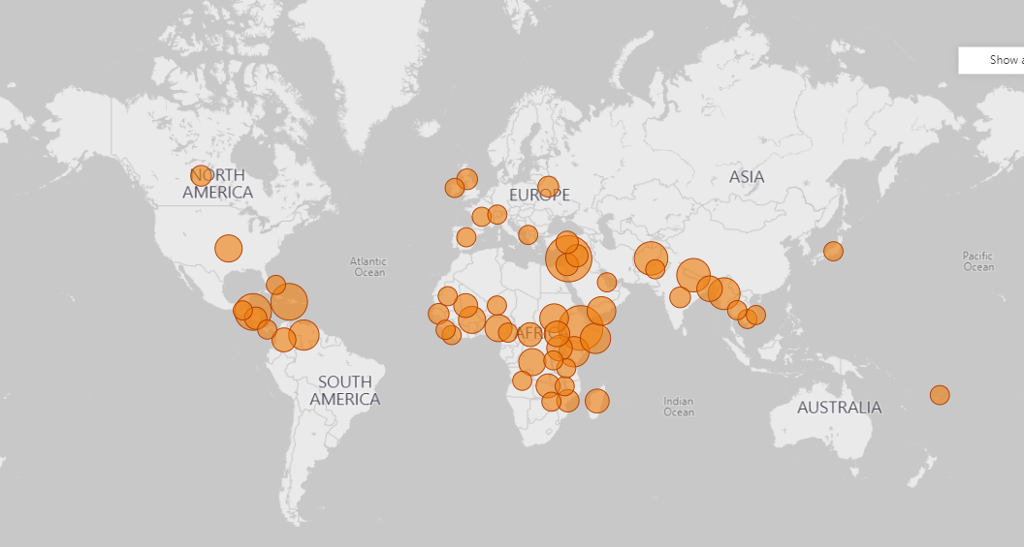
The Alliance’s Work to date
From April 2020 – to September 2022 the Alliance has:
Received 614 requests for support
From 72 countries across 9 Regions
210 requests are on-going

Slide 5
In which thematic areas is support being requested?
Coordination = 36
Information management = 36
NIS = 37
NiE General = 22
No classification =11
IYCF-E = 9
Wasting = 6
SBC = 5
Cross-cutting themes: 2
Nutrition Sensitive Interventions = 1
Micronutrients= 1
Inter-cluster coordination=1
NiE =0
*Requests may have multiple thematic tags
Notes:
Big increase in NIS requests this quarter
Reduction in IYCFE compared to Q2
Reduction in inter-cluster coordination request
Increase in no classification request

Slide 6
Who is requesting Support?
The Alliance provides technical support to the UN, NGOs, Network agencies, Local NGOs, Governments, and more.
This slide provides an overview of who has been requesting support from the Alliance in Quarter 3 2022
Interested in support?
You can “request support” through our website

Slide 7
Where are requests coming from?
The Alliance Receives requests for support from all over the World.
This slide provides an overview of where requests for support come from
Notes:
Significant increase in number of request from South Asia in this quarter, as well as East Asia and the Pacific

Slide 8
Cross-cutting themes workstreams
There are 6 established workstreams looking at cross-cutting themes
Anti-racism and Localization (A&L); Gender & GBV; Disability; Humanitarian Development Nexus (HDN); Accountability to affected populations (AAP) and Climate change
Some key achievements this quarter include:
4of 6 of the groups have an annual work plan established.
Disability Workstream developed:
  Disability FAQ document
  HNO/HRP review guidance and tip sheet
7 Partners are engaged in the CCT workstreams in addition to Alliance core agencies with a total of 56 members across the 6 Groups.

Slide 9
Webinars & Knowledge Management
Webinars:
2 webinars took place this quarter on GBV Risk Mitigation in Nutrition and inclusion in the HRP
These were attended by 134 participants, 60 (45%) were from local NGOs
Learning Needs & Products
This quarter work continued on the learning review piece about the IYCF response in Ukraine
Two new potential learning pieces were identified
  Signposting document to IMAM repository
  A piece on Supply chain scale up

Slide 10
Thought Leadership Updates
5 Global thematic working groups with 215 members ran in Q3 – IFE core group, Wasting GTWG, NiS GTWG, CVA GTWG, and MAMI GTWG
2 pieces of interim guidance developed in the last quarter and 1 resource
  Guidance on Nuclear Radiation
  IFE & Promising practices in CVA for Nutrition report
  MUAC vs WFH – a brief overview of the debate
2 funding requests for research by the Wasting GTWG were approved during the last quarter
A Women’s Nutrition in Emergencies taskforce was set up, in response to a need recognized by UNICEF Country Offices, the ToR was finalized and members were invited to join the task force. UNICEF and ENN will co-chair this group.

