Slide 1

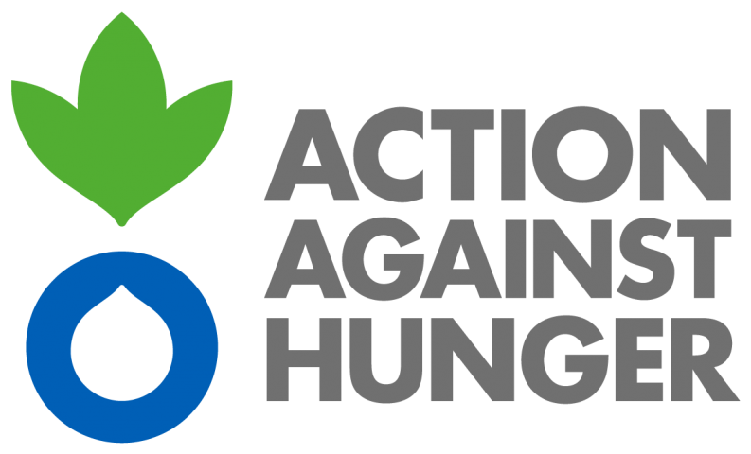



QUARTERLY UPDATE:
Q4 1 Sept – 31 Dec 2022

Slide 2
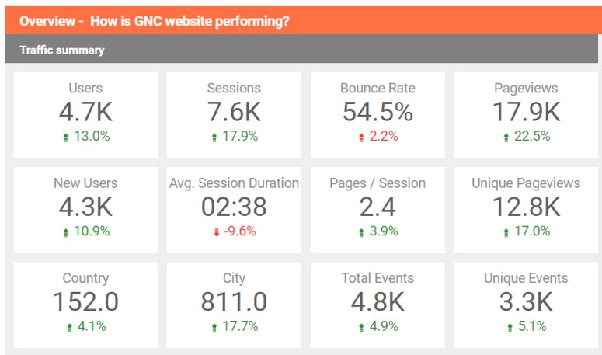
Accessing support and Services
In September to December 2022 The Alliance website has had :
96% in website users comparing Q1 to Q4 2022
82% increase in website users over 2021
Notes:
Users up from 2.4k in Q1 to 2.8K in Q2, 4.2 K users in Q3, 4.7 users in Q4
Bounce rate has slight increased again in Q4, from Q3 - Q1, an optimal bounce rate is between 26-40%
Unique page views up to 12.8K in Q4 from 10.9K in Q3, 11.5k in Q2 from 8.1 K Q1
Website users 2021: 7443 2022: 13553

Slide 3
91 requests submitted
72 - Quick Remote Technical Support
5 - In-depth Support
11 - Consultant roster
3 – Other
Requests Submitted for Support – Quarter 4
132% increase in requests submitted over 2021
Notes:
Total request submitted 2021 = 190 2022 = 442

Slide 4
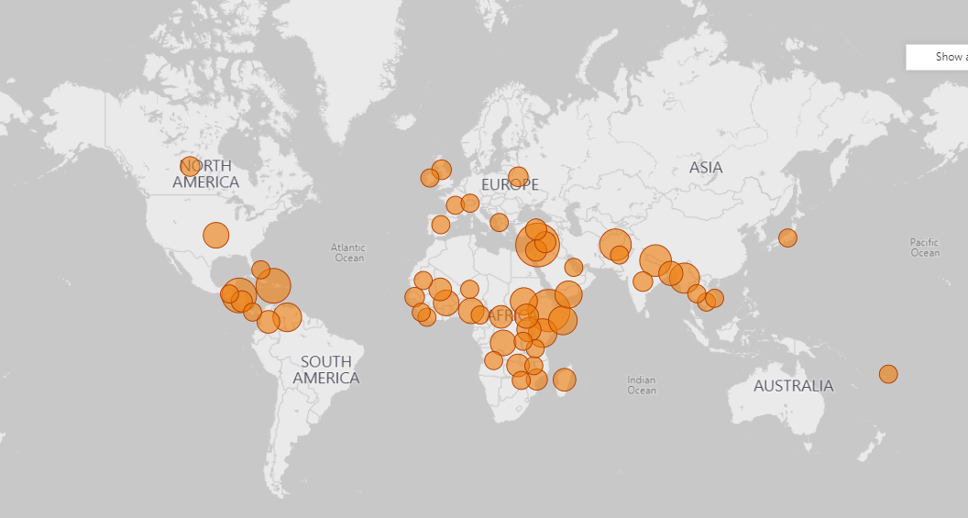
The Alliance’s Work to date
From April 2020 – to September 2022 the Alliance has:
Received 723 requests for support
From 83 countries across 9 Regions

Slide 5
In which thematic areas was support requested for Q4?
NiE General = 22
Coordination = 20
NIS = 18
Wasting = 12
Information management = 11
IYCF-E = 10
No classification =5
Nutrition Sensitive Interventions = 4
SBC = 2
Inter-cluster coordination=2
Micronutrients= 2
Cross-cutting themes=1
*Requests may have multiple thematic tags
Notes:
50% increase in wasting requests over Q3
Increase in nutrition sensitive requests over Q3
NIS requests decreased from Q3

Slide 6
Who is requesting support?
The Alliance provides technical support to the UN, NGOs, Network agencies, Local NGOs, Governments, and more.
This slide provides an overview of who has been requesting support from the Alliance in 2022, by quarter
Interested in support?
You can “request support” through our website

Slide 7
Where are requests coming from?
The Alliance Receives requests for support from all over the World.
This slide provides an overview of where requests for support come from shown as a percentage of the total number of requests submitted each quarter

Slide 8
Cross-cutting themes workstreams
There are 6 established workstreams looking at cross-cutting themes
Anti-racism and Localization (A&L); Gender & GBV; Disability; Humanitarian Development Nexus (HDN); Accountability to affected populations (AAP) and Climate Change
Some key achievement this quarter include:
Gender and GBV workstream supported the UNICEF Humanitarian Needs Overview/Humanitarian Response Plan GBV webinar in December
All workstream produced posters summarizing their work
10 Partners are engaged in the CCT workstreams with a total of 61 members across the 6 Groups.

Slide 9
Webinars & Knowledge Management-Q4
Webinars:
8 webinars took place this quarter on the topics of IYCF in Emergencies, Breastfeeding counselling in emergencies, and on Cost of Child Wasting Treatment.
These were attended by 872 participants, 467 (54%) were from local NGOs
Learning Needs & Products
This quarter work continued on three learning pieces:
  A signposting document on IMAM/CMAM resources
  A learning brief on inter-cluster coordination in Somalia
  A learning brief on the harmonization of CVA approaches in Nigeria
A total of 12 webinars were hosted by the Alliance in 2022, with 1293 participants, with 50% of participants from local NGOs

Slide 10
Thought Leadership Updates
5 Global thematic working groups with 216 members ran in Q4 – IFE core group, Wasting GTWG, NiS GTWG, CVA GTWG, and MAMI GTWG
One interim guidance was developed in the last quarter, and one is in progress:
  Breast-washing guidance update
  Wet-nursing (in progress)
3 funding requests were on-going during the quarter (2 for the Wasting GTWG and 1 within the NIS GTWG)
GTWG membership increased by 40 members over 2021

