Slide 2






Ukraine Infant and Young Child Feeding (IYCF) technical update calls
10th May 2022
Photo credit: UNICEF

Slide 3

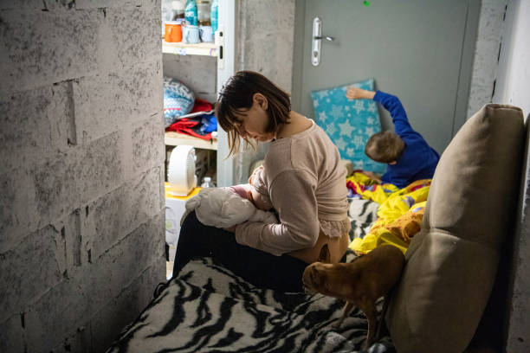
Our goal
To provide a platform through which those responding to the Ukraine crisis can benefit from technical support that is in line with global guidance and minimum standards and share critical information relating to the needs of infants, young children and their caregivers.
The function of this group is NOT coordination.
Photo credit: UNICEF
Photo by Laurel Chor/SOPA Images/LightRocket via Getty Images

Slide 4
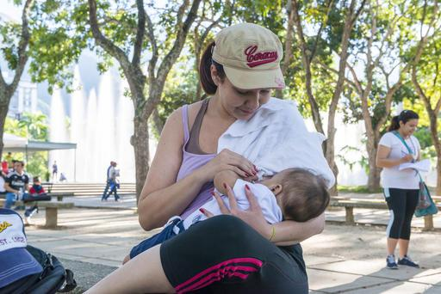

Objectives
Hear from responders what are the current challenges, gaps and emerging needs.
Receive top-line technical updates from partners / participants.
Disseminate IYCF-E programmatic tools and guidance
Provide updates on advocacy and communication initiatives
Provide rapid sensitisation and orientation on context-specific IYCF-E issues.

Slide 5
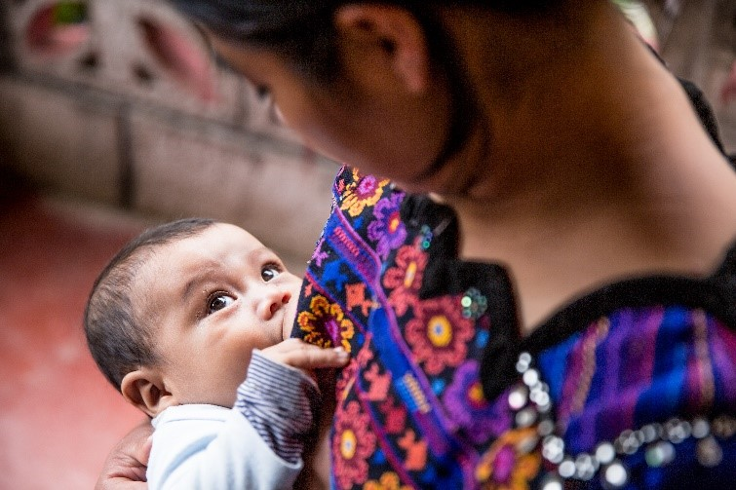
Who Can Attend
Representatives from organisations responding to the Ukraine crisis either within Ukraine or within neighbouring host countries.
Basic experience in Infant and Young Child Feeding (in emergency or non-emergency settings) is required.
Requested all participants to declare COI
Notes:
we asked all participants to declare COI. There is no one from the Baby Food Industry on the call, but not everyone attending today's call is Code compliant, many are new to IYCF-E, we are also here to bring awareness and therefore request respectful discussion etc.

Slide 6
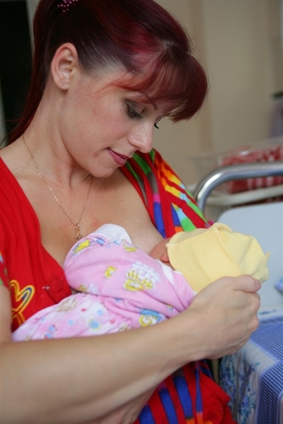
Agenda
Introduction (10 min) - Nicki Connell, IFE Core Group Facilitator, Emergency Nutrition Network
Updates for the Programmatic Working Group (5 min) – Brooke Bauer, Maternal, Infant and Young Child Nutrition in Emergencies Advisor, GNC Technical Alliance
Updates from the Communications and Advocacy Working Group (5 min) – Brooke Bauer, Maternal, Infant and Young Child Nutrition in Emergencies Advisor, GNC Technical Alliance
Orientation on the Ukraine Nutrition Cluster (10 min) - Oleksiy Gushchi, Ukraine Nutrition Cluster Coordinator, UNICEF
Breastfeeding practice, attitudes and experiences from Ukraine (10 mins) - Victoria Nesterova IBCLC, ISIDA IVF
Q&A session (15 minutes) – Nicki Connell, IFE Core Group Facilitator, Emergency Nutrition Network
Photo credit: UNICEF

Slide 7
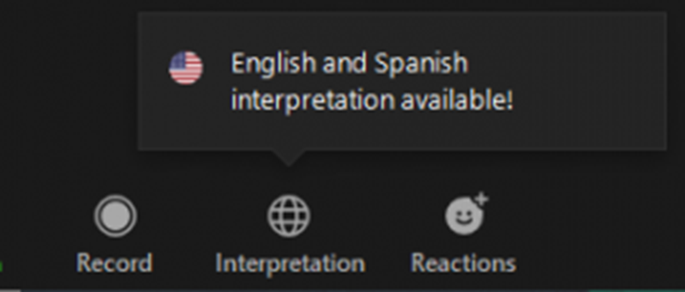
Welcome to the call!
Call is recorded (& will be shared)
Please stay on mute
Difficulties with call: Chat Box
IYCF-E Technical Questions: Q&A
Follow-up email
Translation is accessible by clicking the globe icon on the bottom of your screen.
Feedback please
Для перекладу натисніть іконку глобуса у нижній частині екрана
Photo credit: UNICEF
Notes:
o Reminding participants that a follow up email will be sent that contains the Zoom recording, minutes, presentations, resources shared, and all questions asked with answers.

Slide 8
Why protect, promote and support infant feeding in emergencies
In all emergencies, the youngest children are at the highest risk of illness and mortality.
  Child deaths could increase 2-70 times higher than the average
Infants not breastfed are especially vulnerable
In Ukraine, rates of exclusive breastfeeding are low, and a high percentage of infants are partially or fully dependent on infant formula.
  Support the nutritional needs of infants and young children from birth up to 2 years or beyond
  Support and protect the needs of infants and young children who are not breastfed
  Support the wellbeing of mothers

Slide 9
Updates on the IFE Core Groups Working Groups

Slide 10
IFE Core Group - Programmatic Working Group
Meeting has been ended due to change in need and hand over to established country team.
All priority documents will continue to be completed and emerging issues will be taken up by the wider IFE Core Group.
Objectives:
An improved understanding of the contextual challenges related to prevalent feeding and care practices and greater commitment and consensus on how to address these in the context of the Ukraine Crisis.
Ongoing priority documents:
MBS Resources
Complementary Feeding Guidance
Nuclear Radiation Guidance and Key Messages
Biological/chemical warfare guidance
Emerging Needs:
Wetnursing
Building milk supply and relactation
Maternal nutrition (contextualised operational guidance)
Specialised infant formula guidance
Generic BMS labeling
Finalised resources will continue to be handed over to the cluster and can be found on the OCHA Ukraine Nutrition Cluster website at: https://www.humanitarianresponse.info/en/operations/ukraine/nutrition. These documents are applicable to the whole of the Ukraine response including refugee contexts.
Notes:
This group is open to IFE Core Group members whose organisations are directly involved in the Whole of Ukraine Response (in Ukraine or neighbouring countries) and who are available to regularly attend meetings and contribute to developing/reviewing the group’s outputs / deliverables.
Note: Non-working group members will be invited to contribute to deliverables and to attend ad-hoc meetings to discuss deliverables, as needed. This can include both IFE Core Group members and Ukraine/Host Country Nutrition Cluster members with specific expertise/experience.

Slide 11
IFE Core Group - Advocacy & Communications Working Group
Meeting has been ended due to change in need and hand over to established country team.
All priority documents will continue to be completed and emerging issues will be taken up by the wider IFE Core Group.
Objectives:
Contributing to the gaps, challenges and issues identified, experiences and lessons learned are documented and brought to the IFE Core Groups’ wider membership and other stakeholders for action and support.
Key Outputs:
Lactation support mapping exercise complete and contact details for breastfeeding, birth, and parent support have been given to the cluster
Joint Statement version 2 released
BMS Monitoring System in place
Inclusion of GBV risk mitigation for non-GBV actors into nutrition response
IYCF-E Key Messages released and currently being translated
Finalised resources will continue to be handed over to the cluster and can be found on the OCHA Ukraine Nutrition Cluster website at: https://www.humanitarianresponse.info/en/operations/ukraine/nutrition. These documents are applicable to the whole of the Ukraine response including refugee contexts.

Slide 12
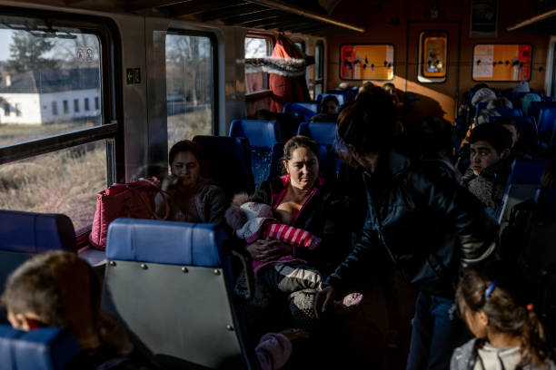
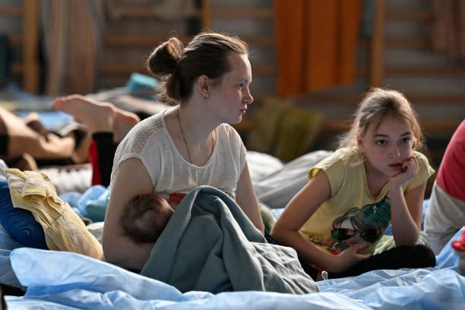
IYCFE in the Media
Avoid images of feeding bottles, teats, and commercial brand promotion including infant formula and commercial complementary foods.
Infant and young child feeding in emergencies is a complex area of aid, but effective communications can make a significant contribution to the wellbeing of the most vulnerable.
Remember that children are at increased risk of malnutrition, illness and death in emergencies.
State clearly that donations of products such as infant formula, milk powder and feeding bottles are harmful.
Advocate for pregnant and breastfeeding women to receive the support they need
Remember that breastfeeding saves lives in emergencies and that non-breastfed infants are at increased risk.
Photo by Janos Kummer/Getty Images
Photo by Louisa GOULIAMAKI / AFP

Slide 13

IFE Core Group - Technical Support
What technical gaps are you seeing?
Is there anything that you need guidance on?
Please let us know in the chat box
Notes:
i.e. what programmatic IYCF-E challenges are they facing? For what is there currently a gap in terms of technical tools / resources / guidance? We will review the inputs during our next PWG meeting and discuss which we can potentially address.

Slide 14
Ukraine Nutrition Cluster

Slide 15
Response March to April 2022
FLASH APPEAL March to August 2022 (IN NEED - 624,959; TARGETED - 288,655; Funding Requirements - 23,5 m)
6 organisations in 17 regions (oblast)
39,442 children 6-23 months receiving the recommended basket of complementary foods
19,667 pregnant women receiving MMS or IFA
347,430 people receiving media messages on IYCF

Slide 16
Other ongoing work to be finalized in the coming weeks:
Guidance for Complementary Feeding in Emergencies
Advocacy strategy and IYCF E training plan
Guidance on MIYCN for nuclear radiation, for chemical warfare weapons and other related pieces of work
SOPs to support response for other vulnerable groups with specific nutritional needs (PLHIV, the elderly, disabled, TB, NCDs)
Comprehensive plan for intersectoral collaboration with other relevant clusters, including Health,WASH, Protection and FSL to ensure a convergence of efforts and the delivery of a holistic response to support people in need saving lives and reducing vulnerability

Slide 17
Breastfeeding attitudes, practices and experiences from Ukraine

Slide 18
Who are our mothers
•Literate: 99.98% for females who are now 25-34 (https://countryeconomy.com/)
•Internet access: 71.8 % of the total population (https://datareportal.com/)
•Social media use 64.6% of the total population (https://datareportal.com/)
•Close to 100% deliveries attended by skilled health staff (https://data.worldbank.org/)
•Low Fertility rate, total (births per woman): 1.2 in 2020 (https://data.worldbank.org/) and getting lower
•High breastfeeding initiation, good any breastfeeding, low EBF rates

Slide 19
Who are Ukrainian consultants
•Lactation consultant is currently not a formally recognized profession
•Most LCs (over 200) are not certified but many are skilled and experienced. Different backgrounds.
•3 IBCLCs in Ukraine in 2021 + 1 Ukrainian IBCLC in Canada (but there is potential for growth)
•Lots of volunteer work. Articles, support groups for parents, videos, social media activity
•Professional association is in the under construction state. Informal community exists and is active
•Health workers are highly regarded by mothers and families as a source of breastfeeding information.

Slide 20
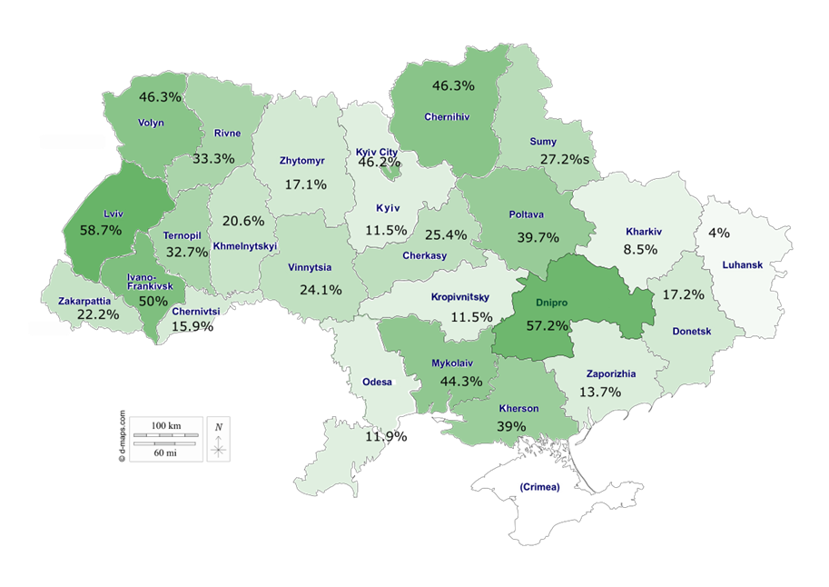
Contact for BFHI in Ukraine: Lidia Romanenko l_romanenko@ukr.net
•Long history of BFHI implementation (since 1995)
•Expanded BFHI since 2006 Not only maternities, but all healthcare facilities that help mothers and babies can be certified
•MoH is actively involved. Protocols.
BFHI coverage (all eligible facilities). 2019

Slide 21
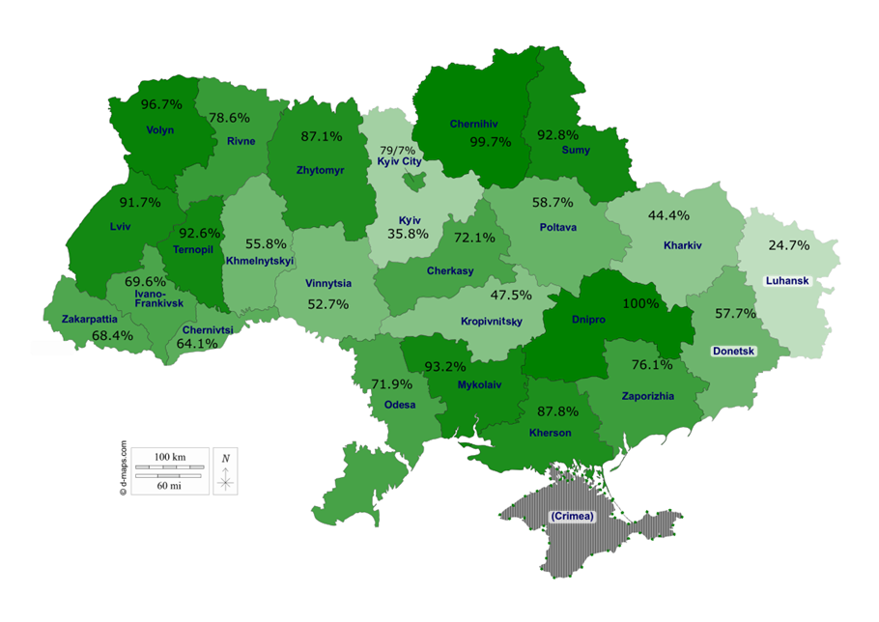
Contact for BFHI in Ukraine: Lidia Romanenko l_romanenko@ukr.net
Maternity BFHI coverage is high
12 principles since 2011:
#11 Code compliance
#12 Effective perinatal care practices implemented: partner delivery, free delivery positions, free visits in maternity etc.
Center for resources and monitoring with regional centers. (Методично-організаційний моніторинговий центр НДСЛ "ОХМАТДИТ“)
Trainers in each region
Challenge: Currently no website to assess all information in one place
% of babies born in BFHI maternities. 2019

Slide 22
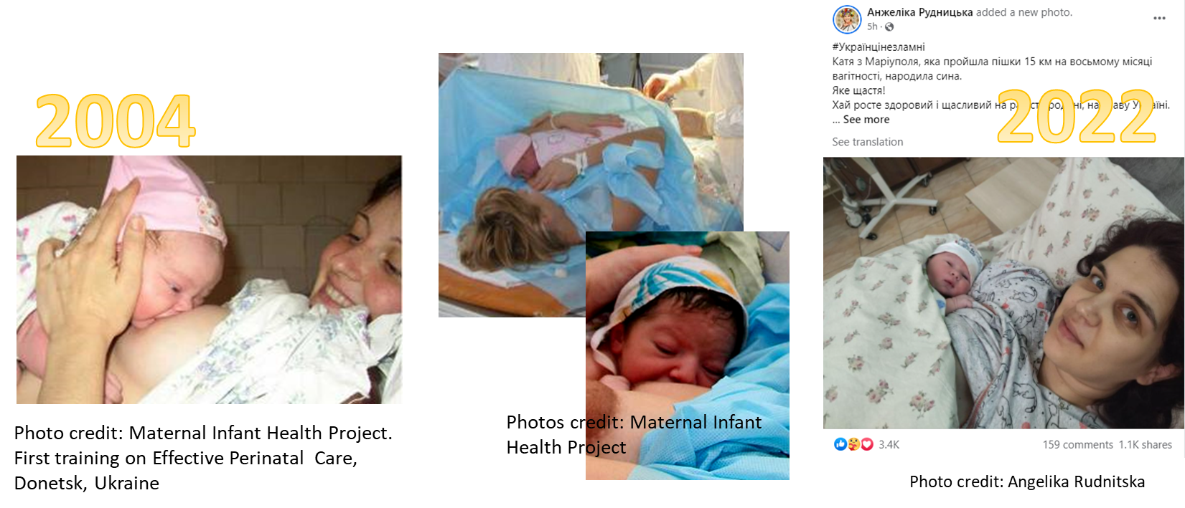
Strengths
Effective perinatal care implementation since 2004.
Joint work: Maternal and Infant health Project JSI/USAID and MoH. National protocols
Warm chain: one of elements is immediate uninterrupted skin to skin for 2 hours after delivery

Slide 23
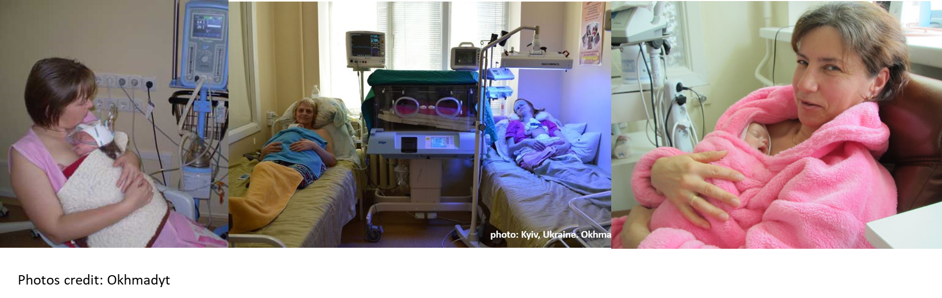
Strengths
KMC implementation in some perinatal centers

Slide 24
Some of our myths
•Milk can dry up due to stress or just dry up without a cause
•Babies under 6 months need water
•Mother should adhere to strict diet for breastfeeding mothers. Most vegetables and (especially!) fruits can make baby gassy or allergic.
•Quality of milk depends on mother’s diet and her stress level. Baby can get stress hormones with milk when mother is nervous or stressed
•(Relatively new) Do not nurse to sleep. Falling asleep and breastfeeding should be separated
•In case of mixed feeding it is better to switch to formula feeding completely
•Once stopped, breastfeeding should not be resumed because baby will have an “evil eye”/prone to an “evil eye”/bad eyesight. Especially for older babies.
•Engorgement, blocked ducts or mastitis should be massaged out (often roughly)
Women should limit their fluid intake during engorgement or mastitis. They should drink lot of water to increase milk production
•All mother’s medications are incompatible with breastfeeding

Slide 25
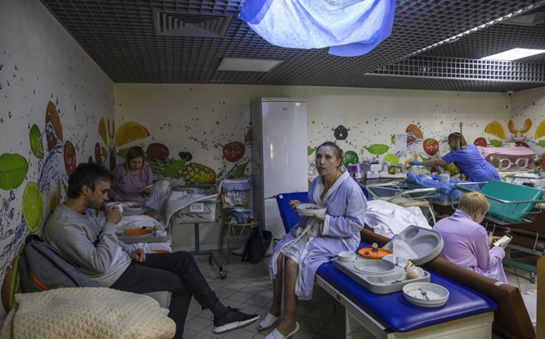
New since 24/02
•Mothers are more nervous about losing milk due to stress (and very relieved to learn that it is not true) (reported by all my colleagues).
•Mothers are generally eager to learn. More compliant.
•More willing to keep babies close, in their bed or skin to skin. More interested in safe bedsharing guidelines
•Staff is stressed and overworked (shortages). Unable to spend much time with individual couples. Hard to change practices.
•Due to early discharge women sent home before milk came in and babies still losing weight. Some left straight into evacuation. Need for follow up and easily accessible online recommendations.
Need for more Ukrainian teaching videos for mothers.
•Basement is not comfy for teaching positions😟
•Complaints after travelling in cars for several days. Blocked ducts symptoms. Fussiness at the breast. Cases of nipple trauma and infection
Expectant mothers are cared for in a makeshift underground maternity ward of the Isida clinic in Kyiv on March 2. In normal times, the room is a staff cafeteria (Photo credit Heidi Levine/For The Washington Post)
No coordination.
Hard to find information on IYCF-E and dangers of donations of breastmilk substitutes.
Need for a resource center.

Slide 26
LC’s experiences since 24/02
•Mothers from Europe prefer to connect with Ukrainian LCs in messengers and social media to get information in their language. T.Yaremko
•“The same amount of consultations but 90% are gratis” N.Movchan. Other respondents also note increase in free online consultations
•Formula donations are widespread. Pregnant women are often given formula, bottles and pacifiers “just in case”.
•Doctors prescribe formula more often, sometimes in big quantities. Mothers report bizarre recommendations. (5 respondents)

Slide 27
LC’s experiences since 24/02
•There is some interest in relactation but most of the women are just asking. L.Babych O.Cherednichenko Successful cases of relactation are also reported. O.Perkin
•Mothers, who planned to stop breastfeeding and were working on gradual weaning decided to continue breastfeeding (4 respondents)
•More cases of low weight gain in 1st month where mothers were missing infant signals. O.Baranenko
•Space for mothers who wish to donate milk and those who need it was created (Telegram chat , created and managed by K.Mazurok).
•Milk sharing cases in places where families were hiding from shelling O.Cherednichenko
•Many mothers are not ready to use donor milk, even from milk bank. O.Stetsuk

Slide 28

•Need for continuous education and trainings for health workers and volunteers
•Lina Barska IBCLC opened access for MDs to her comprehensive course on breastfeeding management. Currently 170 MD are learning, at least 10 plan to become IBCLCs.
•Need for simple scripts and key messages
•Mothers need to know where to get help with breastfeeding (contacts of consultants and support groups, sources of reliable breastfeeding information)
•Regulation of breastmilk substitutes distribution is needed
Online workshop on breastfeeding support during wartime by L.Barska, L.Babych, A.Shelevytska

Slide 29
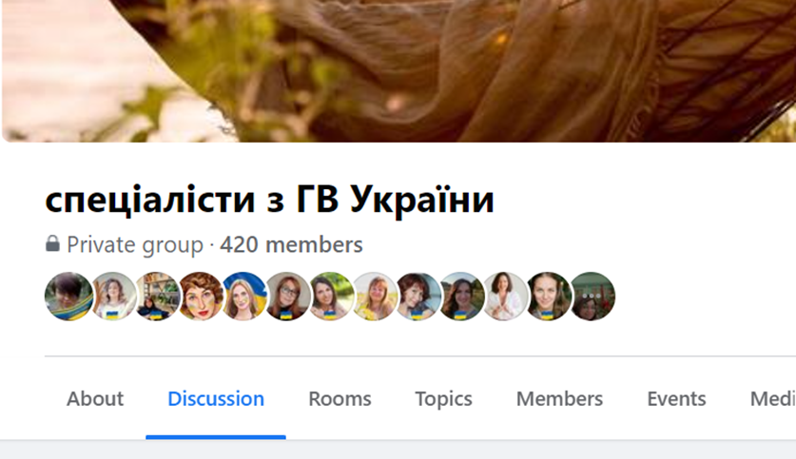
How to connect
FB group for Ukrainian breastfeeding consultants

Slide 30
Questions and answers

Slide 31

We welcome your feedback

