Slide 1
GNC Webinar on the 2024 HRP process
September 6, 2023
Anteneh Dobamo
Faith Nzioka
Shabib AlQobati

Slide 2
AGENDA
Introduction and overview 10m(Anteneh)
Define the scope of the HRP and formulate initial objectives 20 m(Anteneh)
Determine the scope of the HRP
Draft preliminary strategic objectives.
Identify initial specific objectives based on draft strategic objectives
Conduct Response Analysis 20M(Faith)
Review the appropriateness, relevance and feasibility of interventions
Articulate intersectoral and multi-sectoral response approaches
Estimate the number of people to be targeted
Sectoral response plan 20M(Anteneh)
Formulate objectives
Formulate projects/activities
Estimate the number of people to be targeted
Estimate cost of the response
Key considerations:​ GBV, gender, disability, AAP, & ISC (GNC-CT) 10 M(Faith) ​
Wrap Up And GNC Support - 5 M ( Anteneh)
Notes:
Welcome
Introduce facilitators
Please Introduce yourself by writing: Name ; Position and Country.
Brief about the Objective: Continuation of the Introductory JIAF. This is part of the GNC webinar series. We will be demonstrating how the JIAF Manual , tools, and platform is applied in the HNO process.
We will have 5 main sessions. First I give you overview of the process, contributing factors and scope, Sectoral level analysis, Intersectoral level analysis
Duirng the session we have allocated up to 5 minutes for Q&Q. Please post questions at the chat; box during the sessions, facilitators respond to the questions during Q&A.

Slide 3
Introduction and overview
Tools
Reference documents
Steps

Slide 4
STEPS
Which one of the following is the correct step of the HRP process at country level?
Conduct response analysis - formulate strategic objectives - formulate sectoral objectives and activities - estimate cost of response plan.
Define the scope of HRP and formulate strategic objectives - conduct response analysis - - formulate sectoral objectives and activities - estimate the cost of response plan.
Conduct response analysis -define the scope of HRP - formulate strategic objectives - formulate sectoral objectives and activities - estimate cost of response plan.
None of the above

Slide 5
Steps:
HPC CALENDAR

Slide 6
STEPS : process
Define the scope of the HRP and formulate initial objectives
Conduct Response Analysis
Sectoral response plan

Slide 7
TOOLS
GNC HRP targeting tool

Slide 8
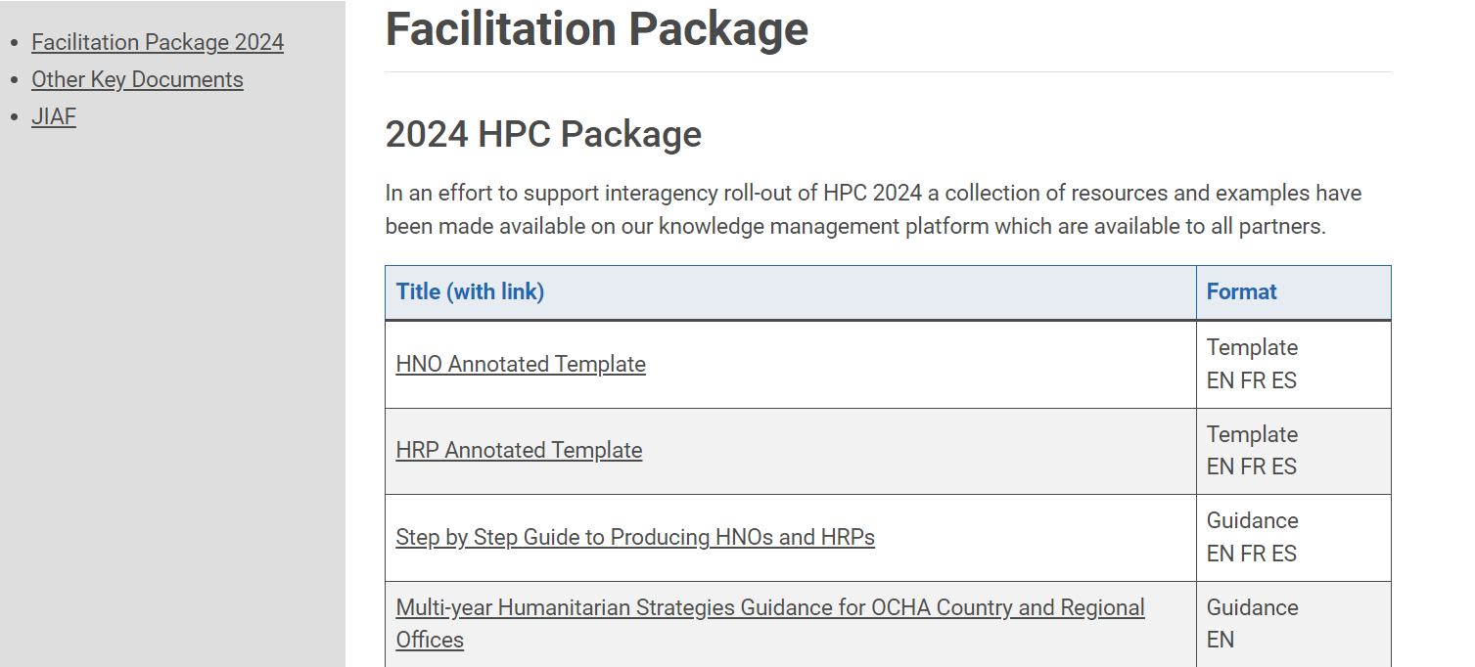
Reference materials:
HPC 2024 Facilitation Package Facilitation Package – Humanitarian Programme Cycle (hpc.tools)
Strategic Objectives and Indicators Examples HRP EN (humanitarianresponse.info)
Nutrition HRtips.pdf (nutritioncluster.net)
Notes:
HPC 2024 Facilitation Package Facilitation Package – Humanitarian Programme Cycle (hpc.tools)
JIAF MANUAL JIAF-2.0-Manual_Final-unformatted.pdf
GNC Needs Analysis Guidelines
EXERCISE REFERENCE
North Eastern Nigeria HNO 2023: Nigeria Humanitarian Needs Overview 2023 (February 2023) - Nigeria | ReliefWeb

Slide 9
Q&A

Slide 10
1. Define the scope of the HRP and formulate initial objectives: INDICATIVE TIMELINE AUGUST-SEPTEMBER 2023
1.1. Determine the scope of the HRP based on the analysis of needs and risks
1.2. Draft preliminary intersectoral strategic objectives
1.3. Identify initial specific objectives based on draft strategic objectives
Participants: Key participants ICCG with expertise from data and IM staff, analysts, subject-matter experts, planning and programming staff, affected communities

Slide 11
1.1. Determine the scope of the HRP based on the analysis of needs and risks
All people in need identified in the HNO should be considered when starting the planning process given their needs are ‘humanitarian’ by definition and their severity has been determined through the analysis in the HNO.
Decisions On The Scope(What Population Groups and locations should be included) Should Be Based On Consideration Of :
Magnitude of need
The severity of need
Extent of overlap of needs and potential of compounding each other.
Potential of deterioration.
The extent of immediate, underlying and root causes of needs and severity are linked to a crisis defined by HNO: causes that are not directly related to the crisis may indicate that the problems are structural or outside the scope of a humanitarian response.
Notes:
Extent to which humanitarian conditions and needs overlap and potentially compound each other - particularly where someneeds will not be solved unless others are addressed in the best sequence

Slide 12
1.2. Draft preliminary intersectoral strategic objectives
Draft initial 3-5 strategic objectives
That articulates the intended improvements in people’s lives and livelihoods which ensure full respect for their rights.
These should be outcome-based
Reflect the short- to medium-term end result or changes in the lives of targeted individuals resulting from the humanitarian response during the HRP period.

Slide 13
Strategic OBJECTIVES
POLL
Which one of the following can be considered an appropriate strategic objective for HRP at a country level(choose all that apply)
Reduce mortality and morbidity amongst displaced people to pre-emergency levels.
Improve coping capacities and enhance affected people access to livelihoods, self-sufficiency, early recovery and resilience by addressing the underlying causes of vulnerability
Reduce the national poverty rate by 0.75% by end of response period.
Improve the living conditions and dignity of internally displaced people, through provision of essential commodities

Slide 14
Examples of Good Strategic OBJECTIVEs
STRATEGIC OBJECTIVE 1: LIFE SAVING: Reduce mortality and morbidity amongst displaced people to pre-emergency levels.
STRATEGIC OBJECTIVE 2: IMMEDIATE ASSISTANCE: Improve the living conditions and dignity of internally displaced people, through provision of essential commodities
STRATEGIC OBJECTIVE 3: BASIC SERVICES Ensure access of affected people to basic community services including education, health care, social services and public facilities
STRATEGIC OBJECTIVE 4: LONGER TERM RECOVERY : Improve coping capacities and enhance affected people access to livelihoods, self-sufficiency, early recovery and resilience by addressing the underlying causes of vulnerability
STRATEGIC OBJECTIVE 5: PROTECTION :Reinforce the protection of civilians, in particular as it relates to women and children.

Slide 15
1.3. Identify initial specific objectives based on draft strategic objectives
Formulate An Initial Set Of Specific Objectives That Articulate Intermediate Changes In People’s Lives.
Specific Objectives Are Formulated For Each Strategic Objective And Offer Specificity On How The Strategic Objective Will Be Achieved

Slide 16
Q&A

Slide 17
2. Response Analysis
Poll
It is very likely that Cluster partners will cover/respond to all needs/gaps that are identified in the HNO process.
A. Yes
B. No
C. Do not know

Slide 18
2. Response Analysis
2.1. Review the appropriateness, relevance and feasibility of interventions
2.2. Estimate the number of people to be targeted.

Slide 19
2.1. Review the appropriateness, relevance and feasibility of interventions
Appropriateness:
Interventions Most Likely To Meet The Humanitarian Needs
Non Duplicative Of, Or Complementary To, Other Plans By The Government (Humanitarian And Development), The Red Cross And Red Crescent Movement, And Development Actors.
Relevance : Refers to the extent to which interventions address the priorities and preferences of a population.
Feasibility :
Analysis Is Based On Logistical, Market Functionality And Support Systems, Capacity, Legal, Political, Security, Cultural, Etc. Constraints.
The Result Of The Feasibility Review Is A Clear Understanding Of What Interventions Can Be Delivered Within The Timeframe Of The Response Plan And How

Slide 20
2.2. Estimate the number of people to be targeted.
A quantification of the number of people eventually targeted is made as an outcome of the appropriateness, relevance, and feasibility review
People targeted is a subset of pin and represents the number of people humanitarian actors aim to assist during the planning period.
Estimate population initial targets per specific objective ( usually a proportion of PiN per each cluster by admin unit)

Slide 21
Q&A

Slide 22
3. Sectoral response plan
Identify Priority Intervention areas and Population Groups
Formulate sectoral objectives
(In alignment with intersectoral SO)
Articulate Response Strategy
Identify
Activities/ projects Monitoring indicators
Estimate the number of people to be targeted
Estimate cost of the response

Slide 23
Identify Priority Intervention areas and Population Groups SEVERITY/HEATMAP: Afghanistan NUTRITION CLUSTER

Slide 24
Formulate sectoral objectives (In alignment with intersectoral SO)

Slide 25
SECTORAL OBJECTIVE
POLL
Which one of the following can be a nutrition sector HRP objective?
To reduce the risk of excess mortality and morbidity among children aged 6-59 months
To ensure a predictable, timely, and effective nutrition in emergency response.
To decrease the risk of acute morbidity and mortality due to common micronutrient deficiencies that occur during the emergency.
To improve iron status and reduce anaemia prevalence among children aged 6-23 months of age.
All of the above

Slide 26
Examples of Sectoral OBJECTIVEs
To Reduce The Risk Of Excess Mortality And Morbidity Among Children Aged 6-59 Months
To Ensure A Predictable, Timely, And Effective Nutrition In Emergency Response.
To Decrease The Risk Of Acute Morbidity And Mortality Due To Common Micronutrient Deficiencies That Occurs During The Emergency
To Improve Iron Status And Reduce Anaemia Prevalence Among Children Aged 6-23 Months Of Age

Slide 27
Response strategy may include
Integrated in Health Facilities
Mobile Health and Nutrition Teams
Intersectoral collaboration
Cash-based assistance

Slide 28
NiE services
Nutrition Screening And Referral
Inpatient Management Of Severe Acute Malnutrition
Outpatient Management Of Severe Acute Malnutrition
Management Of Moderate Acute Malnutrition (MAM) In The Targeted Supplementary Feeding Programmes (TSFP)
Prevention Of Moderate Acute Malnutrition – Blanket Supplementary Feeding Programmes (BSFP) Infant And Young Child Feeding In Emergencies (IYCF-E)
Managing Older People’s Malnutrition

Slide 29
NiE services
Cash Or Voucher Programmes For The Prevention Of Malnutrition
Multiple Micronutrient Supplementation
Iron Or Iron/Folic Acid Supplementation 69 Vitamin A Supplementation
Deworming
Zinc Supplementation For Diarrhoea Management Iodine Supplementation And Salt Iodization
Calcium Supplementation
Nutritional Care And Support Of Hiv-infected Children

Slide 30
NiE services
Cluster Coordination
Accountability To Affected Populations (AAP) – For All Projects
Nutrition Survey
Nutrition Surveillance

Slide 31
NiE services Monitoring indicators

Slide 32
Estimate the number of people to be targeted

Slide 33
What HRP costing approach was used in your country’s 2023 HRP?

Slide 34
costing
1. Activity(Unit) based Costing : using standard UNIT cost for each activity (e.g., IYCF, Wasting treatment, Vitamin A supplementation…etc.)
2. Project-based costing : Takes into account organisation-specific costs and uses the OPS system
3.Hybrid approach : Conduct an activity-based costing exercise, while still requiring that partners submit project sheets to track partner contributions.

Slide 35
COSTING
POLL
Which one of the following is true about HRP costing? (Choose all that apply)
A. As unit based costing involves peer review, it promotes coherence with sector response plans
B. Unit-based costing approach simplifies cluster partners’ funding and activity tracking through FTS.
C. Project based costing is less time-consuming
D. Unit-based costing is more time-consuming and heavy.
E. Costing of inter-cluster activities is problematic

Slide 36
costing
 | UNIT BASED COSTING | PROJECT BASED COSTING
Advantage | Less time consuming. Promotes improved strategic coordination. The planning and budgeting process of the HRP is less influenced by individual organisation budgeting benchmarks. | Peer review of projects, quality control and coherence with sector response plans. Provides visibility to participating organizations. Financial tracking is simplified
Disadvantage | As there is no peer review and vetting process, there is weaker quality control in the project planning phase. Difficult for tracking funding and activities. Costing of inter-cluster activities is problematic | Process can be time consuming and heavy. May lead to over or under budgeting as organizations may inflate or underestimate funding needs to cover their project costs.

Slide 37
Q&A

Slide 38
KEY CONSIDERATIONS:​ GBV, GENDER, DISABILITY, AAP, & ICSC (GNC-CT)
Poll
Which of the following statement is true? (Choose all that apply)
Nutrition cluster should provide general statements on targeting of persons with disabilities and inclusive programming in the HRP.
To reflect the diverse needs of individuals, response activities should include those that are cross-sectoral, implemented through collaboration across clusters.
In nutrition cluster we are doing gender because our activities are focused on women and girls
AAP should be mainstreamed throughout the HPC process.

Slide 39
Key considerations:​ GBV, gender, disability, AAP, & ICSC (GNC-CT)
Checklist on integrating cross-cutting issues in Humanitarian Needs Overview (HNOs) and Humanitarian Response Plans (HRPs) for Nutrition Cluster/Sector Coordination Teams As of 16 August 2023
Gender:
IASC Gender Handbook for Humanitarian Action (2018, in EN, AR, FR, ES, and TR)
Guidelines For Integrating Gender-Based Violence Interventions In Humanitarian Action (multilanguage).
UNICEF Availability, Accessibility, Acceptability and Quality (AAAQ)
Guidelines For Integrating Gender-Based Violence Interventions In Humanitarian Action
GBV Risk Analysis Guidance 2021
Webinar: Gender and GBV Core Concepts for Nutrition
Age:
Minimum Standards for Age and Disability Inclusion in Humanitarian Action
Minimum Standards for child protection in Humanitarian Action, Standard 25 “Nutrition and Child Protection”, page 265.
UNICEF Core commitments for children, Nutrition
IYCF and Child Protection Framework
Disability:
Nutrition chapters on Disability inclusion in HNO and HRPs (EN).
Disability Checklist for Emergency Response (Handicap International), few considerations on disability and nutrition on page 4.
HIV/AIDS:
WHO/UNICEF HIV and infant feeding in emergencies: operational guidance

Slide 40
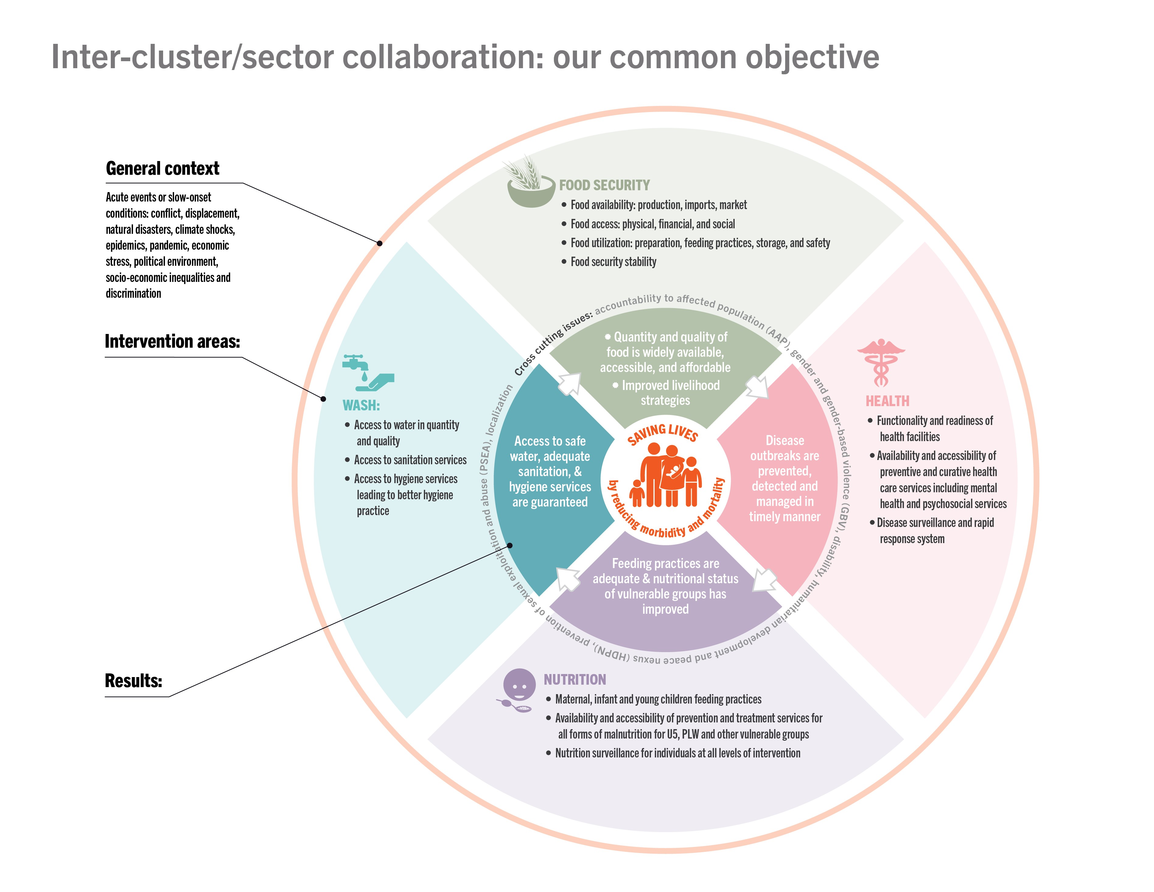
Inter-cluster/sector collaboration (ICSC)
1) Most of the time ICSC is between Nutrition, WASH, Health and Food security. But not only, collaboration between clusters/ sectors is based on population needs, so any clusters/ sectors can collaborate
2) Follow the steps explained in the document to develop some ICSC activities along the HPC - What is inter-cluster / sector collaboration? | Global Nutrition Cluster
3) If you agreed to develop some ICSC activities, here are examples of joint ICSC indicators to include in your HRP ICSC Monitoring and Evaluation Guidance Note | Global Nutrition Cluster
4) Write a joint paragraph on the ICSC in your HRP to make sure this is well reflected across the clusters involved
The ICSC framework

Slide 41
Q&A

Slide 42
GNC SUPPORT
CONTACT for one-on-one support
Anteneh Dobamo : adobamo@unicef.org
Faith Nzioka : fnzioka@unicef.org
Geraldine Bellocq : gbellocq@unicef.org
SHABIB AL-QOBATI : salqobati@unicef.org
FILL request FORM
Create Request form | Global Nutrition Cluster: Technical Alliance
Resources :
Nutrition HRtips.pdf (nutritioncluster.net)
GNC CROSS_CUTTING CHECKLIST
Strategic Objectives and Indicators Examples HRP EN (humanitarianresponse.info)
HPC 2024 Facilitation Package Facilitation Package – Humanitarian Programme Cycle (hpc.tools)

