Slide 1
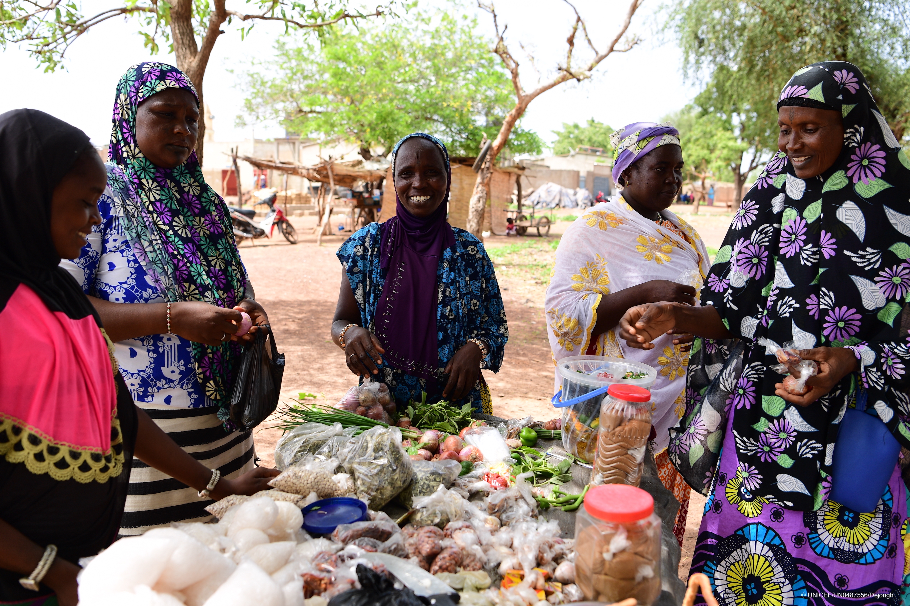
WCARO Regional Call​
Burkina Faso
19 September 2023
Burkina Faso

Slide 2
Agenda
Welcome and introduction – GNC-CT
Coordination experiences in Burkina Faso –
Successes, challenges / gaps and the way forward
Key points
Q&A
Burkina Faso

Slide 3
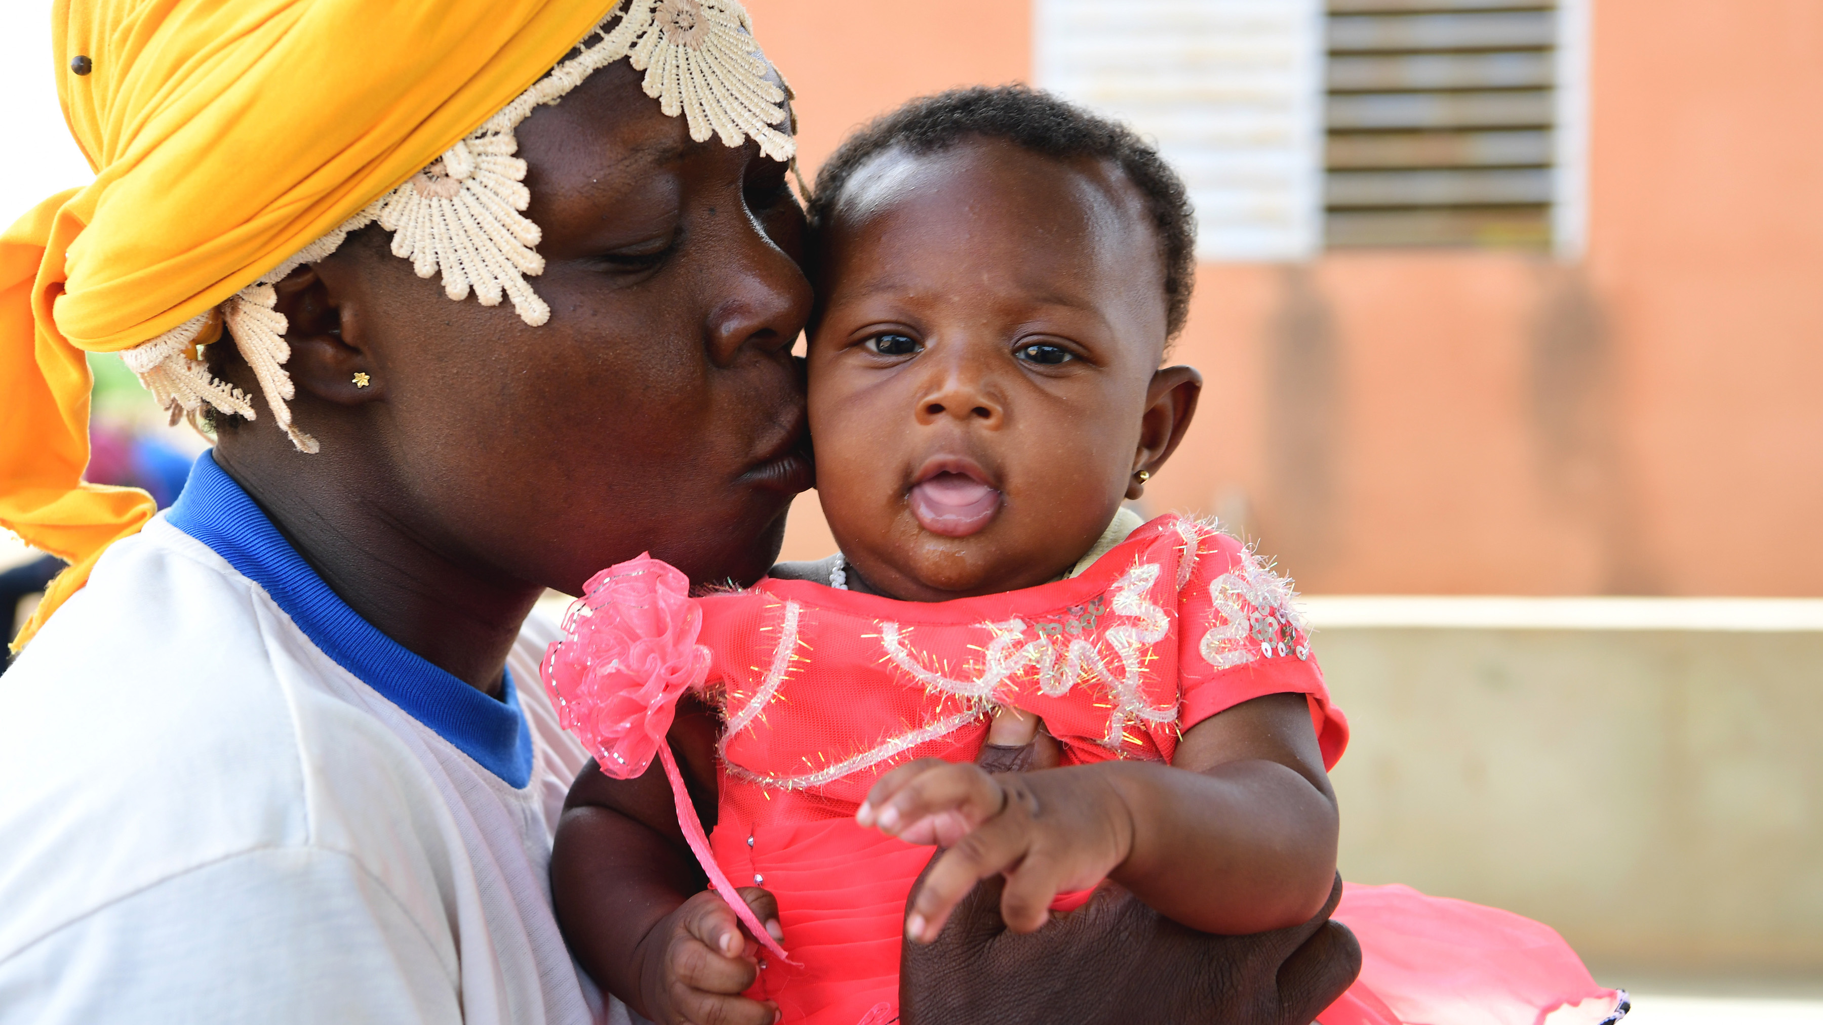
Introduction

Slide 4
Introduction
Importance of regional level calls
Purpose of this session – Coordination & IM success in Burkina Faso (national and subnational)
Importance of coordination
Burkina Faso

Slide 5
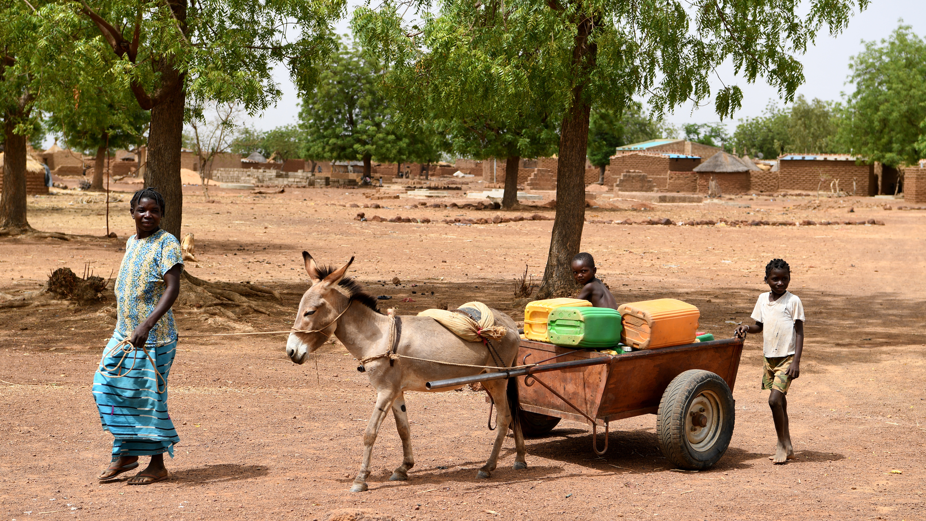
Burkina Faso
A more coordinated response

Slide 6
The Structure
Burkina Faso is facing nutritional emergencies in a context of food insecurity, epidemics, natural disasters (floods) and poverty
Insecurity has led to displacement of people
Poor access to healthcare and external drought factors
The Nutrition Cluster is part of the humanitarian architecture and are coordinated by OCHA
The Nutrition Cluster has a national coordinator and 6 regional health and nutrition coordinators (North, East, Sahel, Boucle du Mouhoun, Centre-East, except for Centre-North)
The cluster has working groups (SIN, WIN, ANJE U, PCIMA) and a strategic steering committee
Burkina Faso
Notes:
Following the security crisis of 2018 and its spread throughout the country, BFA is facing nutritional emergencies
Insecurity has led to displacement of people living in precarious conditions, with Poor access to healthcar due to the closure and minimal functioning of health facilities and Difficult geographical and hydrographic location exposes it to external drought factors.
The nutrition clusters activated in December 2019, clusters are accountable to the humanitarian country team and the country's highest authority.
The aim of the nutrition cluster is to provide a coordinated, unified, efficient and effective nutrition response for the populations affected by the crisis
Meetings are held every 2 weeks at national level and every 4 weeks at regional level.

Slide 7
Past response efforts
Multi-sector coordination of nutrition interventions:
Platform of technical and financial partners
National multi-stakeholder platform for nutrition: National Nutrition Council (CNAN)
Sub-national coordination mechanism
The main challenges were:
Mobilization of resources
Operational coordination
Burkina Faso
Notes:
Multi-sector coordination of nutrition interventions :
National multi-stakeholder platform for nutrition: National Nutrition Council (CNAN) - => Technical secretariat for nutrition anchored by the presidency
Sub-national coordination mechanism
The main challenges were :
Mobilization of resources for the multisectoral response
Operational coordination of the large number of partners

Slide 8
Coordination & IM successes
Intersectoral collaboration for an inclusive and multisectoral response
Sectoral frameworks and common guidelines to align partners' operational approach
Multisectoral advocacy (nutrition, food security) to strengthen the impact of interventions
Institutionalization of the triple nexus, placing the authorities at the center of the humanitarian response
Burkina Faso
Notes:
Intersectoral collaboration with the Wash, health and food security sectors and the GBV, cash working group and AAP working groups for an inclusive and multisectoral response

Slide 9
Coordination & IM successes
Harmonization of :
Planning of interventions in priority areas,
Multi-sectorial minimum package of interventions,
Monitoring and evaluation
Information management support has contributed to :
Identifying GAPs for needs orientation;
Transforming data into information for better cluster coordination;
Facilitating IM inter-cluster coordination (RPM, humanitarian needs, multi-sector prioritization);
Setting up an information system using standard tools (5W, Dashboard);
Cluster-specific information generation and sharing (Cluster Bulletin & SIS)
Burkina Faso
Notes:
Institutionalization of the triple nexus, placing the authorities at the center of the humanitarian response - Participation of governments in national and regional coordination structures
Harmonization of :
Monitoring and evaluation of the program's effectiveness and quality.

Slide 10
Gaps, challenges & the way forward

Slide 11
Gaps & Challenges
Increase in hard-to-reach areas and supply difficulties, limiting the coverage of nutrition services
Assessing new nutrition needs of displaced populations
Effective integration of nutrition interventions into regional emergency plans
Insufficient coverage of multisectoral nutritional services for affected populations
Burkina Faso

Slide 12
The Way Forward
More coordination of the rapid health and nutrition response at regional level to improve needs assessment and ensure an effective response.
Improve the completeness of the nutrition specific and sensitive interventions package in emergency
Maintain capacity building with dedicated GNC Technical Alliance referents and support for regional clusters in emergency preparedness and response nutrition
Burkina Faso
Notes:
With the changing humanitarian landscape, we need to maintain capacity building with dedicated GNC Technical Alliance referents and support for regional clusters in emergency preparedness and response nutrition

Slide 13
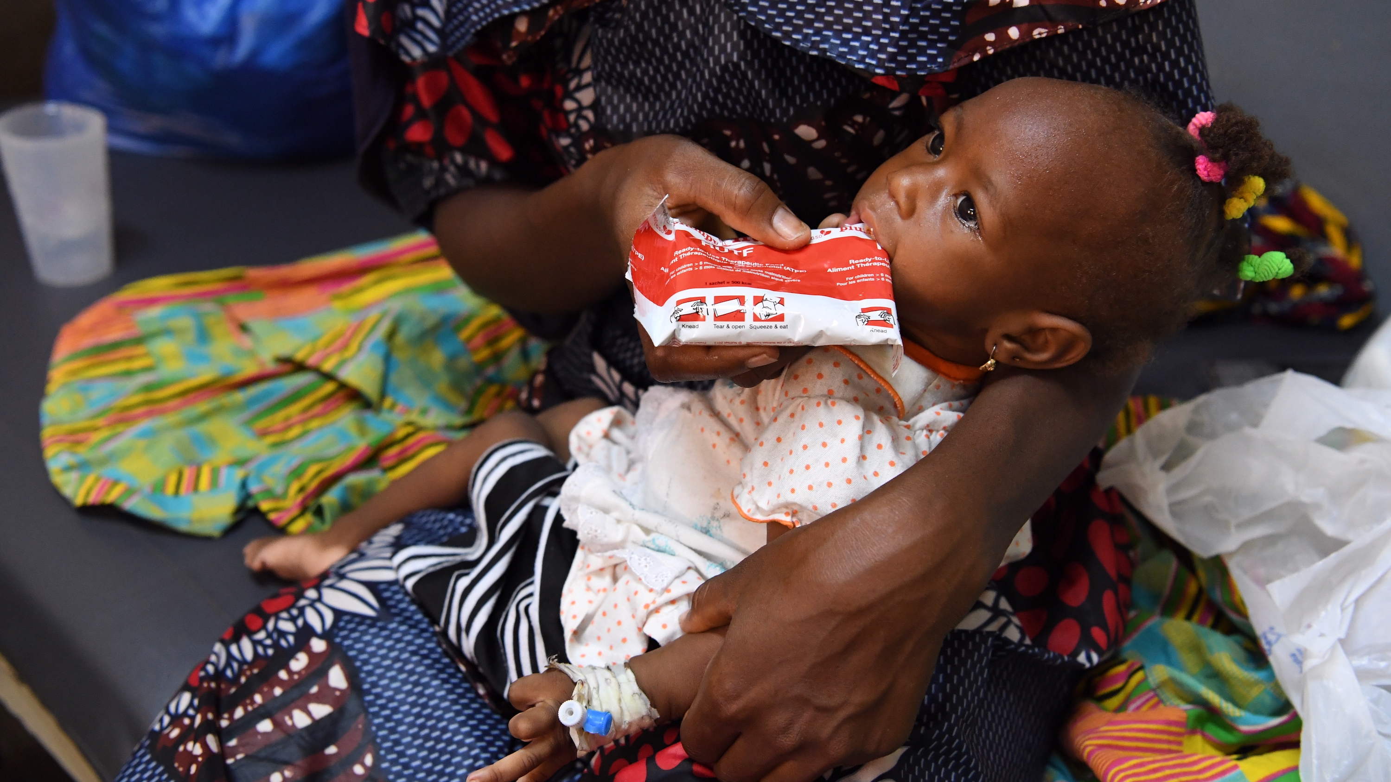
Key points
Having strong coordination at the national and subnational level affects the quality of the overall emergency response and leads to more effective coordination activities that saves lives.

Slide 14
Key Points
Clusters members are implementing similar response approaches based on the guidelines developed, leading to better evaluation of the impact of the response
The cluster has ensured that data is available and accessible to members in useful formats, and has helped to guide decisions
The cluster ensures that organizations cover areas in nutritional crisis with emergency responses to reach groups affected by malnutrition
The cluster mobilizes human, material and financial resources to bring healthcare closer to communities and improve access to nutrition services in inaccessible areas
Burkina Faso

Slide 15
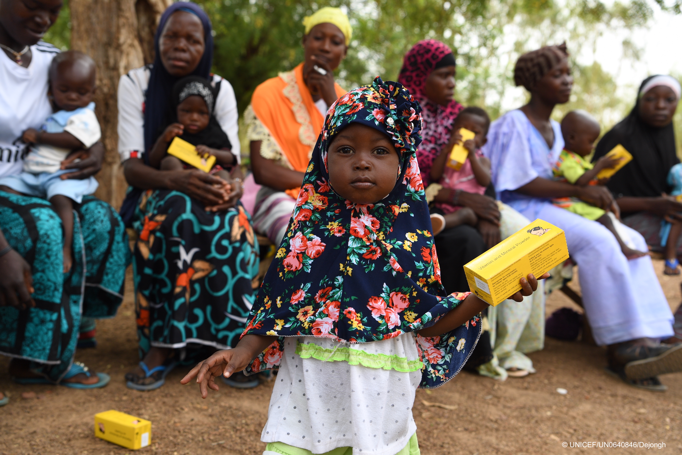
Thank you
Burkina Faso
Notes:
Insert own photo

