Slide 1
GNC-ESAR Regional Call​
26 September 2023
Ethiopia

Slide 2
Agenda
Welcome and introduction – Rasha
The GNC strategic direction for the regional deployments of GNC RRT– Stefano
Coordination experiences in Ethiopia – Ethiopia Nutrition Cluster NCC, Ines Lezama
Successes, challenges / gaps and the way forward
Q&A

Slide 3
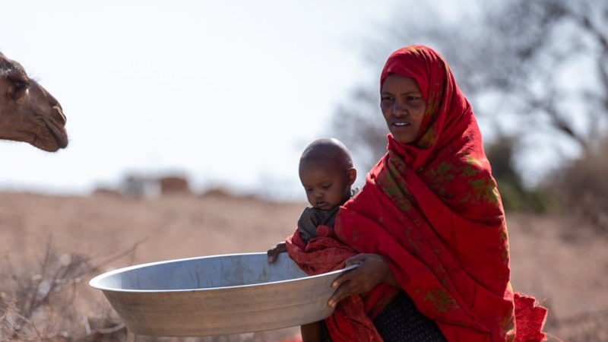
The GNC strategic direction for the regional deployments of GNC RRT

Slide 4
Ethiopia
A more coordinated response

Slide 5
The Structure
National level: Dedicated CC (senior position), deputy cluster coordination and information management officer
Subnational level: hybrid with GoE and UNICEF capacity (activated cluster and sector coord)
Regional local coordinators and IMO (in 5 regions)
Dedicated CC and IM (international positions) in Tigray and Somali (only CC)
Strategic capacity of CC position
Key leadership position with EDRMC- Ethiopian disaster risk management commission
Ethiopia

Slide 6
Past response efforts
ENCU/nutrition cluster seconded staff at EDRMC office
Structure of up to 5 staff in Addis Abeba
Gaps:
In regions there was no international skilled & experienced dedicated CC seconded of UNICEF
Challenges:
Alignment & proximity with UNICEF as CLA vs being considered as GoE staff in ENCU
Autocratic leadership from GoE
Ethiopia

Slide 7
Coordination & IM successes
Independence and transparency of information
More rapid and informed decision-making capacity
Impartiality of CLA
Enhanced partnership of UN agencies (3)
NGO given space and ownership *avoiding UN centric approaches
Increased visibility of all actors
Sense of community vs just participation
Ethiopia

Slide 8
Coordination & IM successes
Flexible dynamics of coordination and leadership- SAG
More consensus around common narrative, analysis of situation and needs
Use of new technologies
Best practices in operational planning (Tigray)
Reduce knowledge gaps with best practices in Oromia and Somali regions
Increase of advocacy events and efforts
Ethiopia

Slide 9
Key enablers
Sufficient resources (funding for adequate response, for coordination and IM capacity) - not systematised or assured. Coordination is a hidden force and critical for the response to function. Establishing contribution quotas related to the complexity or magnitude of the response may be an alternative.(90/10)
"The consequences of an unfunded coordinated nutrition response are increased severity of needs and an ineffective and incoherent response that can lead to instability and harm to affected communities"
Ethiopia

Slide 10
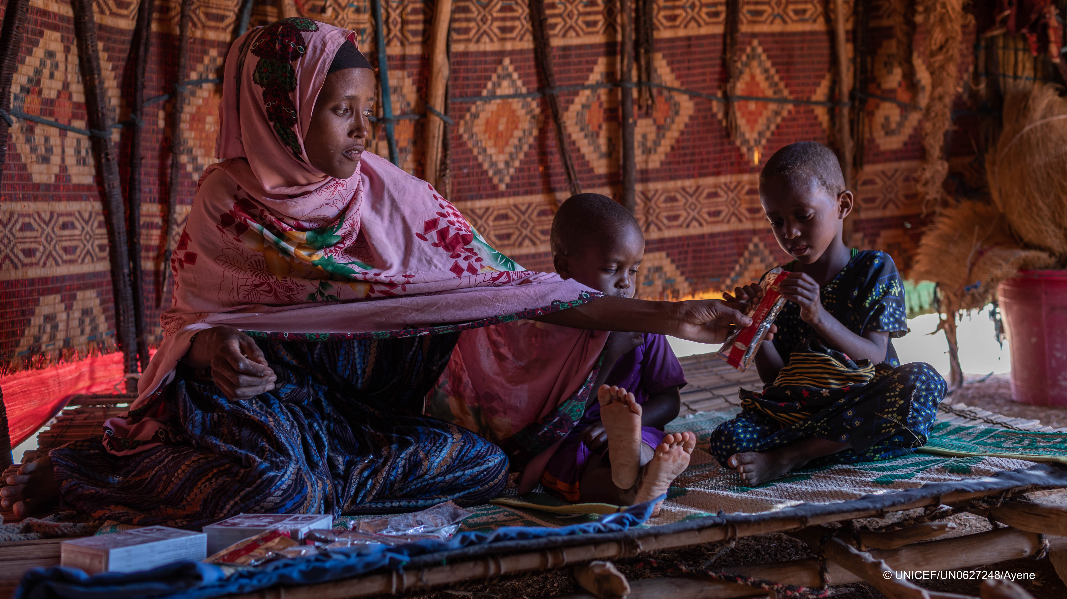
Gaps, challenges & the way forward

Slide 11
BHA supplemental funding in 2022
Scaling up wasting programming
Best practices
Ethiopia

Slide 12
Gaps & Challenges
Competition amongst partners due to lack of sufficient resources. Opportunistic scale up & down
Speed and flexibility of some partners limited/ Response capacity quite variable
Weak accountability to affected populations
More complex emergencies – there is more insecurity and access problems
Insufficient predictivity of funding
Reporting and tracking of prevention interventions is a challenge – transition to HIMS
Ethiopia

Slide 13
Gaps & Challenges
Innovative and creative approaches and alternatives to response, more showcases
In the last 3 years the allocation of adequate resources to ensure the effective functioning of the Nutrition Cluster has been reduced
Reduction in staff
Reduction in capacity at regional level (RENCU)
Reduction of budget for main activities and assessments
Ethiopia

Slide 14
The Way Forward
Leadership:
ENCU/nutrition Cluster evaluation proposed
Structure and capacity: Avoid turnover in coordination NCC- Some positions are FT
Strategic planning
Influence of child wasting agenda in Ethiopia – strategic shift in humanitarian response- implementation of innovative interventions
Strategic reflection and planning in community led solutions in crisis prone areas
Focus on data analytics= hub, and capacity, more modelling and prediction
POLR definition
Ethiopia

Slide 15
Thank you
Ethiopia
Notes:
Insert own photo

