Slide 1
MIYCAN Operational and Programmatic Guideline
Basic training and orientation slides
MARCH, 2023
By Clementina Ngina
MIYCN-E Advisor, Consultant
Global Nutrition Cluster

Slide 2
Background
Global Context
Estimated 170 million women are underweight
610 million are overweight
40% of pregnant women are anaemic (South East Asia (49%), Africa (46%) and the Eastern Mediterranean (41%)
Estimated 14% of adolescent girls gave birth before age 18 in 2021
In LMICs adolescents 15–19 years of age, 21 million pregnancies with approximately 50% unintended

Slide 3
Background and Context cont….
47% initiated to breastfeeding within one hour of birth
48% exclusively breastfeed
70% breastfeed their infant for at least one year
45% breastfeeding by two years of age declined

Slide 4
Background & Context:
Women’s Nutritional status in Somalia
Causes
Anaemia prevalence 40% of pregnant women
Gaps in preconception care
Poor quality diets
Insufficient access to essential nutrition services
Suboptimal practices
Source: FAO

Slide 5
IYCN & Nutritional Status of children in Somalia

Slide 6
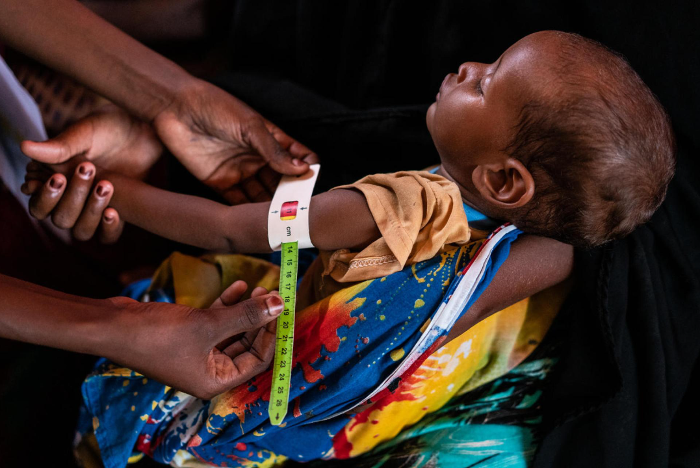
Causes of Malnutrition
Contributors to malnutrition- global
Poor quality diets
Insufficient access to essential nutrition services
Suboptimal practices
Gender inequalities
Causes of micronutrient malnutrition in Somalia include;
Household food insecurity
Inadequate care
Unhealthy household environment
Lack of health services
Low education levels or illiteracy
High poverty levels
Severe drought
Source: UNICEF Somalia- Knowles Coursin

Slide 7
Adolescent health
Global
Adolescent pregnancies 14%
50% of pregnancies unintended
GBV affects 1 in 3 women
Somalia
Adolescents at high risk of;
  Child marriage
  Early pregnancy
  Female Genital Mutilation/Cutting (FGM/C)
Risk factors for GBV;
Mental health issues; multiple displacements, flooding, droughts and armed conflicts.
93% of GBV cases in women, adolescent girls and children
Exposure to GBV contributes to suboptimal nutrition outcomes e.g. stunting, LBW and sub optimal breastfeeding.

Slide 8
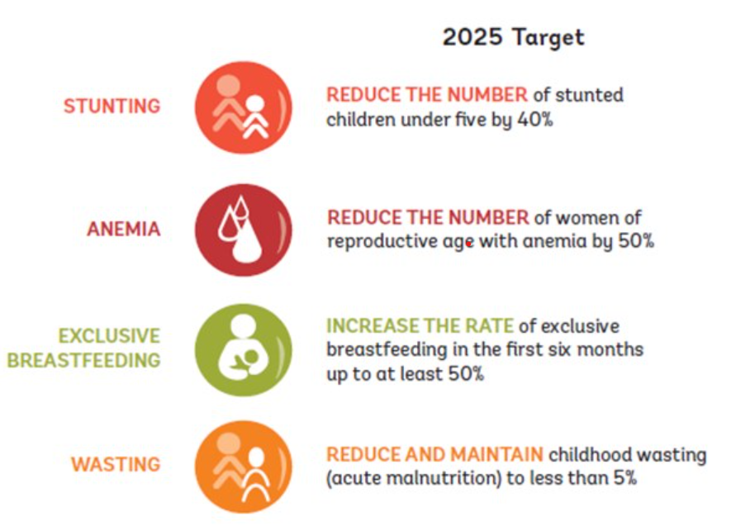
Global Targets
Reduce stunting among under 5s by 40%
Reduce anemia in women of reproductive age by 50%
Reduce low birth weight by 30%
No increase of childhood overweight
Increased rates of EBF in the first six months by up to at least 50%
Reduce and maintain childhood wasting by 5%

Slide 9
Goal and Objectives
Goal
Reduce all forms of malnutrition in children < 5 years of age, adolescent girls, pregnant and lactating women in Somalia by enhancing, knowledge, skills and competencies to improve the health and nutrition.
Objectives
Provide guidance to HWs & CHWs in protection, promotion, & support for optimal MIYCAN
Improve knowledge, skills, & competencies of MIYCAN among HWs & CHWs
Enhance integration of MIYCAN interventions within existing health & community services and across sectors.
Enhance optimal MIYCAN in difficult circumstances.
Promote gender mainstreaming in MIYCAN interventions.
Enhance community linkages and referrals.

Slide 10
Guiding Principles
Implementation within the human rights context including;
Mother & child care is a legal duty of the state in Article 28 (2) family care in the Constitution of Somalia
Every child has the right to care from their parents
Strengthening Gender & Social Equity
Building Resilience of households with mothers, infants, young children & adolescents
Life-cycle approach to MIYCAN interventions
Public health approach to MIYCAN
Comprehensive, integrated & equitably distributed interventions
Adherence to the international code of marketing of breastmilk substitutes

Slide 11
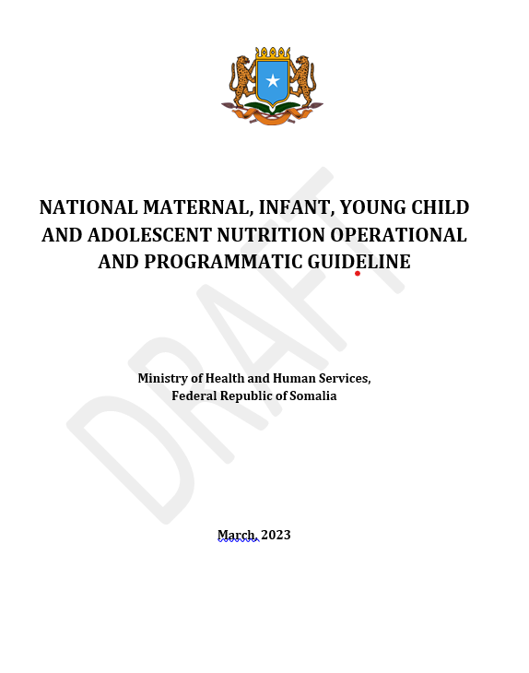
Scope of the Implementation Guidelines
Maternal nutrition in pregnancy and lactation
Adolescents nutrition
Infant and young child nutrition
  Micronutrient supplementation
  Feeding in difficult circumstances
Growth Monitoring and Promotion
Infant and Young Child Feeding in Emergencies (IYCF-E)
Breastmilk substitutes (BMS)
Counselling
Roles and responsibilities of different stakeholders
Linkages and referrals
Monitoring and evaluation

Slide 12


