Slide 1
NATIONAL MATERNAL, INFANT, YOUNG CHILD AND ADOLESCENT NUTRITION OPERATIONAL AND PROGRAMMATIC GUIDELINE
COUNSELLING

Slide 2
Counselling
Interchangeably used with ‘information’ & ‘education’
A process & interaction between counsellors & pregnant women/ mothers
Form of interpersonal communication
Helps influence individuals to adopt & maintain positive practices
People-centred counselling - responds to individual mothers’ & families’ needs, preferences & values
Maternal Nutrition Counselling
An interactive process between a service provider, a woman & her family during which information is exchanged & support is provided
Helps women & their families make decisions, take action to improve nutrition
Many women do not receive quality nutrition counselling

Slide 3
Maternal Nutrition Counselling
Women to be prioritized for more intensive counselling support
All pregnant or breastfeeding adolescent girls (<20 years of age)
Those with any form of malnutrition (e.g., short stature, underweight, overweight, obesity, anaemia)
Women pregnant or breastfeeding for the first time
Other at-risk groups;
  Women with disabilities
  Chronic diseases (e.g., HIV and tuberculosis)
  Mental health problems
  Those affected by the harmful use of drugs or alcohol

Slide 4
Skilled Breastfeeding Counselling
Skilled breastfeeding counselling;
A key interventions to improve breastfeeding rates
Aims to empower women to breastfeed
Respects women's personal situations & wishes
Sensitive & effective counselling assists mothers overcome challenges

Slide 5
Skilled Breastfeeding Counselling
Recommendation for skilled breastfeeding counselling
Provided to all pregnant women & mothers with young children
Provided in antenatal & postnatal period, & up to 24 months or longer
Provided at least six times, & additionally as needed
Provided through face-to-face counselling
Provided as a continuum of care
Anticipate & address important challenges & contexts for breastfeeding
Establish skills, competencies & confidence among mothers

Slide 6
Target audiences for counselling
Women planning to conceive
Pregnant adolescents & women
Postpartum adolescents & women (between birth & at least six months after delivery)
Family members targeted as they influence decisions about women’s diets, use of essential nutrition services and practices

Slide 7
Counselling modalities
Individual Counselling
Most effective form of counselling
Focus on specific problems & needs of a woman
Delivered face to-face
Prioritized to women at nutritional risk (e.g., women with underweight or obesity);
Time-consuming & challenging to provide the physical space & privacy
Remote approaches (i.e., telephone helplines, mobile phones & internet) help where face-to-face counselling capacity or access is limited or absent

Slide 8
Counselling modalities cont….
Group counselling
Facilitated by HW, CHW or lay person
At facility or community level
Most effective when group members have similar issues, problems & sociocultural backgrounds
Allows interaction with multiple clients
Participants share experiences
Builds socially supportive relationships
Doesn't cater to specific needs
Doesn’t provide an environment to feel comfortable or share problems
Provided to women at lower risk of nutrition challenges

Slide 9
Timing, frequency & duration
Begins three months before planning a pregnancy, as early as possible in pregnancy
The minimum of six breastfeeding counselling contacts are;
Before birth (antenatal period)
During & immediately after birth (perinatal up to first 2–3 days after birth)
At 1–2 weeks after birth (neonatal period)
In the first 3–4 months (early infancy)
At 6 months (at the start of complementary feeding)
After 6 months (late infancy & early childhood)
Additional contacts as necessary
  Planning to return to school or work
  When concerns or challenges related to breastfeeding arise
  When opportunities for breastfeeding counselling occur e.g. child immunization visits, home visits

Slide 10
Timing, frequency & duration of counselling
 | Timing | Content
Pre conception | At least three months before planning a pregnancy | Healthy diets, IFA supplementation
Pregnancy | As early as possible in pregnancy ANC contacts up to the start of the third trimester | Dietary intake, physical activity, adherence to supplementation regimens, hygiene
 | Towards the end of pregnancy | Breastfeeding counselling in preparation for the birth
Lactation | Postnatal care contacts in the first six weeks postpartum | Healthy dietary intake, adherence to dietary supplements to replenish nutrient stores following pregnancy, meet nutrient requirements during breastfeeding, and attain and maintain a healthy weight
 | At least six months following the birth Linked with nutrition & health services for infants & young children (e.g., immunization contacts, monthly growth monitoring & promotion, sick child visits & other community nutrition platforms)

Slide 11
Counselling contacts
Counselling contacts are used for:
Follow-up on agreed actions
Discuss new challenges & actions
Identify & refer women to address underlying conditions
Referrals to other services (e.g., social protection programs for very low-income households)

Slide 12
Barriers to counselling
Inadequate integration into primary health care
Sub optimal access to health & community services by women
Insufficient knowledge, competencies, motivation or time among HWs & CHWs to provide quality counselling
Counselling approaches, materials & messages not adapted to the local setting – including the economic context, social norms & sociocultural practices that influence maternal nutrition practices
Lack of clear counselling targets
Lack of monitoring to measure progress & hold managers, HWs & CHWs to account

Slide 13
Counselling in humanitarian contexts
Adolescent girls & women are vulnerable to undernutrition
Include, deliver & prioritize counselling in emergencies
Start counselling (breastfeeding & maternal nutrition) from the onset of emergency response actions
Staff trained to be sensitive to psychosocial issues, nutrition screening & referral to more specialist support
Positive feedback & emotional support to support the mothers’ confidence & self-efficacy in breastfeeding

Slide 14
Counselling in humanitarian contexts
More specialist capacity to counsel mothers with heightened needs
Stressed or traumatized mothers
Malnourished infants & mothers
Low-birth-weight infants
Infants with disability & feeding difficulties
Consider other options where movement restricted or interrupts routine services

Slide 15
Counselling Dos and Donts
Counselling should anticipate & address important challenges that may affect a woman’s capacity to adopt positive practices e.g. her age, experience, sociocultural & economic context
Focus on small doable actions that a woman can take
Focus on small doable actions that a woman’s family members can take
Focus on concrete actions that other individuals (e.g., husbands/ partners, grandmothers, etc.) can take to support the woman’s actions
Do not try to change too many practices at once

Slide 16
Peer to peer support groups
Mother to mother support group (MtMSG)
A meeting where pregnant women & mothers with young children, and people with similar interests, come together in a safe place to exchange ideas, share experiences, give & receive information, offer & receive support in IYCF and women’s health
Model optimal breastfeeding practices
Characteristics of MtMSGs
8-15 people per group
Audience: pregnant & lactating women, caretakers or parents of children under 5 yrs
Hold regular meetings
Grandmothers, mother-in laws, partners/ spouses invited to attend sessions quarterly

Slide 17
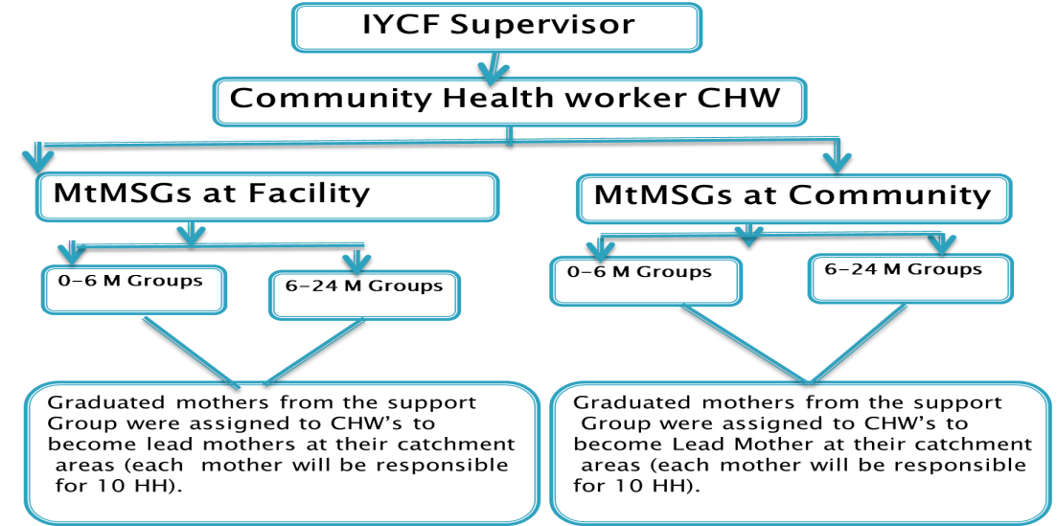
MtMSGs
Formation of MtMSGs
A support group is formed when people come together with a common interest or life experience
May be informal or formal
Provides:
Safe environment
Sense of respect
Sharing information
Availability of practical help
Sharing responsibility
Acceptance
Learning together and from each other
Emotional connection
Structure of MtMSG
Source: UNICEF MoH & Partners 2022

Slide 18
Implementation of MtMSGs
Implementers should be trained in breastfeeding, young child feeding, counseling skills & dynamics of support groups
Each district should have a lead mother trained on 12 IYCF key messages
The training done by counselors
Lead mother responsible for 8 - 15 members
Each group has one session / week &
Sessions on key messages to be completed in 12 weeks within 3 months & make follow up
IYCF CNVs supports lead mothers at community level, staff at facility & community level

Slide 19
Implementation of MtMSGs cont……
Possible groups for mobilization MTMSGs;
Women’s groups
Religious groups
Married adolescent groups
Breastfeeding groups
Groups for preventing mother-to-child transmission (PMTCT) of HIV
Groups for people living with HIV/AIDS (PLHA)

Slide 20
Implementation of MtMSGs cont……
Where, when, & how interactions between mothers happen
One-on-one
Groups
Informally
Formally
Anytime
Anywhere
MtMSGs occurs in a variety of settings including;
  Chance contacts with mothers in the community
  Groups of pregnant women & breastfeeding mothers
  Telephone counseling, hospital, & home visits
  Interactive presentations at service club meetings, schools, universities

Slide 21
Sustainability of MtMSGs activities
Challenges to sustainability
Shortage & turn-over of volunteers
Financial constraints
How to address challenges;
Focus on one or two activities
Match tasks to available time
Provide incentives e.g. stipends, food, free medical services, a graduation ceremony, training certificate, special clothing & other articles to distinguish the volunteers
Initiate IGAs, e.g sale of tee-shirts, posters, & educational materials
Support from donors for training & program grants & in-kind contribution of goods (such as NFIs & equipment) & services
Network & collaborate with government agencies & NGOs to facilitate two-way referrals, shared training, & technical assistance opportunities
Establish a solid & consistent support structure, with committed individuals to support growth

Slide 22
Care Groups (CG)
A community-based strategy for promoting behavior change
A group of 10–15 community-based volunteers
Meet regularly with project staff for training & supportive supervision
Multiplying effect & equitably reach every beneficiary household through neighbor to neighbor peer support using interpersonal behavior change activities
Care Group Volunteers (CGVs)
  Provide greater peer support to one another
  Develop stronger commitments to health activities
  Find creative solutions by working as a group vs volunteers working independently
CGs provides structure for a community health information system that reports on new pregnancies, births & deaths detected during home visits

Slide 23
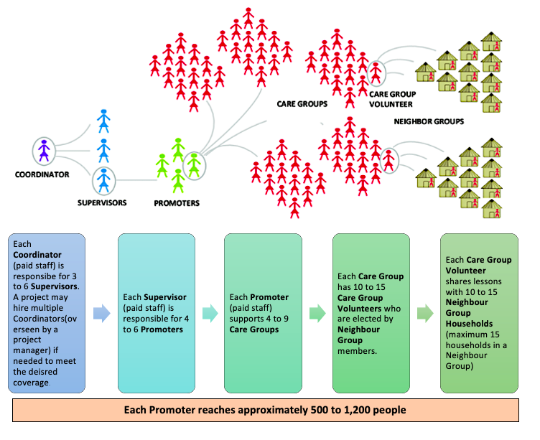
Care Group Structure
Source: A training Manual for Program Design and Implementation- 2014

Slide 24
Care group Implementation
Care group criteria -critical to the effectiveness of the CG approach
Formative research to strengthen care groups
Organize beneficiaries into Neighbor Group (NG) & CGs, community list or gathering
Define responsibilities for CGVs, Promoters, Supervisors & Maternal and Child Health & Nutrition Coordinators
Volunteers’ motivation & incentives

Slide 25
Care group Implementation
What happens in a care group meeting, neighbor group & home visit
Home Visit: the audience, timing and content
The meeting schedules
Supportive supervision: checklist & supervisory work plans
Quality improvement & verification checklist (QIVCS) & giving feedback
Calculate scores & using data from quality improvement & verification checklist (QIVC)
CG monitoring information system: Introduction to registers, promoter, supervisor & coordinator reports
Plan for sustainability

Slide 26
Father to Father Support Group (FTFSG)
Men play an important role in MIYCN
Comprise of ;
  Partners of pregnant women
  Male caregivers of children under 2 years
Groups hold regular meetings
Learn about and discuss;
  The importance of MIYCN practices
  The critical role men play in child care
The group size varies from 3 to 12
Facilitated by an experienced & trained facilitator who listens and guides the discussion.
The facilitator and the participants decide the length and frequency of the meetings

Slide 27
MIYCAN Training
Equip HWs & CHWs with the knowledge, skills & competencies to provide quality nutrition services
Supervisors & managers to attend training, to familiarize with content & skills
Supportive supervision, mentorship & on job training
Newly trained HWs supervised within 6 weeks to 2 months after training
Post-training follow-up determination need for reinforcement of specific participant’s knowledge, skills & competencies through additional or refresher training, ongoing supportive supervision, mentorship, OJT, continuous nutrition education
Trained facilitators, supervisors should observe & evaluate participants at their workplace

Slide 28
MIYCAN Training Cont…..
Objectives of supportive supervision, mentorship & OJT
Supportive supervision, OJT & mentorship used to:
Monitor & promote quality standardized services
Assess performance in relation to quantity (i.e., reach- coverage, volume, service utilization)
Use knowledge & skills to counsel mothers/caregivers with accurate information & facilitate group work
Ability to use recording & reporting tools
Identify difficulties in knowledge & skills learned & support to resolve the issues
Share best practices, experiences & lessons learnt

Slide 29
MIYCAN Training Cont…..
Timing for Supportive Supervision, mentorship and on job training
Supportive supervision/mentorship part of routine monitoring activities
Initial visit to fit into a schedule of ongoing supportive supervision to promote integration
If no system of ongoing supportive supervision or mentorship
  All newly trained on MIYCAN should receive a minimum of 2-3 visits
  Participate in regular meetings to share experiences, mutual support & on-going or refresher training
  Support supervision conducted by trained facilitator, supervisor, or project manager

Slide 30
MIYCAN Training Cont…..
Where to hold supportive supervision, mentorship and on job training
Provide on-the-job support or mentorship
A counselling with a mother/father/caregiver & child in a community or home
During group education (action-oriented groups)
During support group facilitation

Slide 31





