Slide 1

 | State of Palestine
 | NUTRITION
 | CLUSTER
IM Toolkit
15-November-2023

Slide 2
Overview
Contact List
3Ws Nutrition Cluster Template
Nutrition cluster Capacity mapping
BMS Code Monitoring in Emergency Situations
Website updates
What is needed from partners

Slide 3
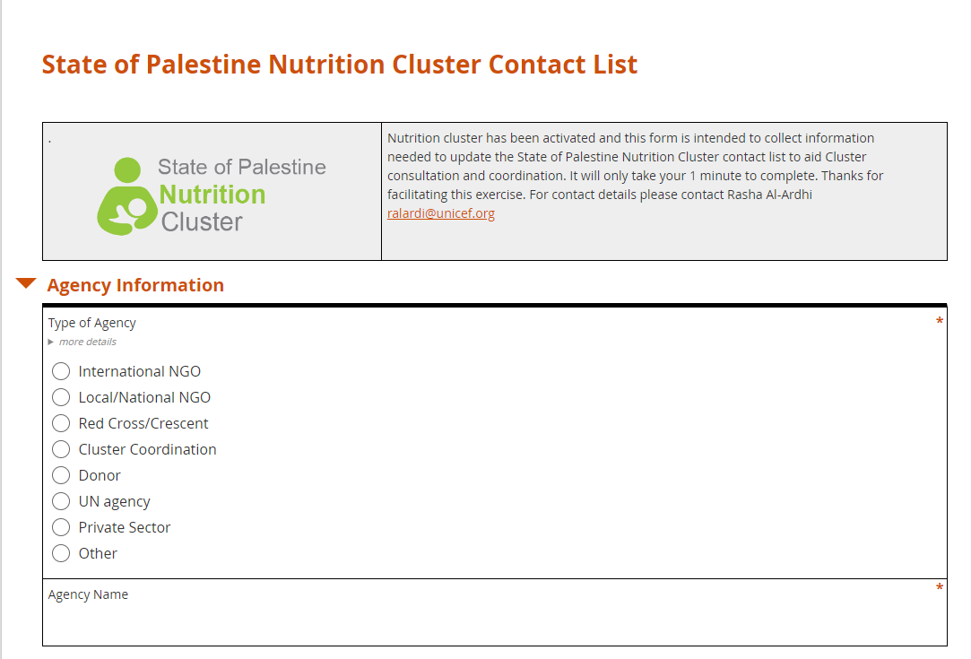
Contact List
Contact List
Nutrition cluster has been activated and this form is intended to collect information needed to update the State of Palestine Nutrition Cluster contact list to aid Cluster consultation and coordination.
It will only take 1 minute from your time to complete.
3

Slide 4
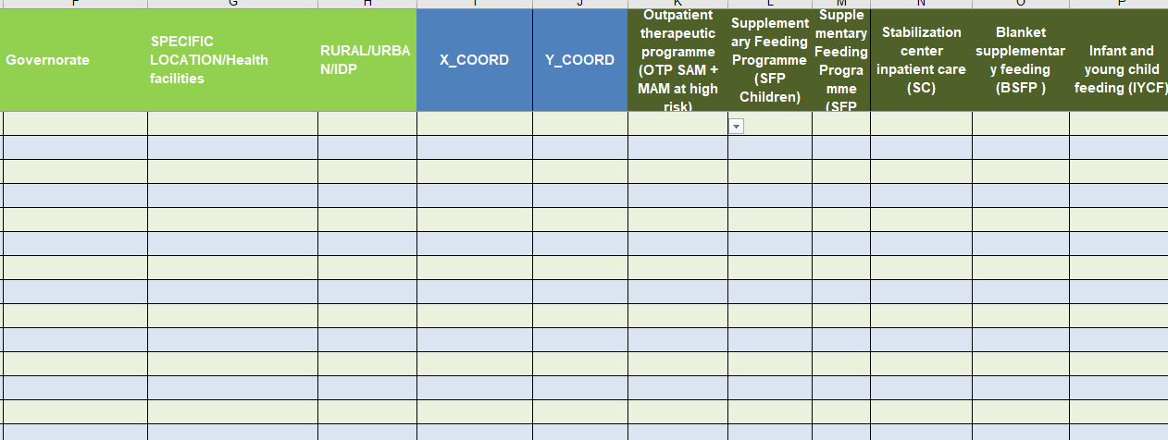
3Ws Nutrition Cluster Template
3Ws Nutrition Cluster Template
The 3Ws matrix aims to understand the operational presence and activities of the Nutrition Cluster partners in response to humanitarian emergencies. The tool refers to What, Who & Where
It enables organizations to identify potential partners, quickly give an understanding of the on-going response, and identify potential overlaps or gaps in response.
4

Slide 5
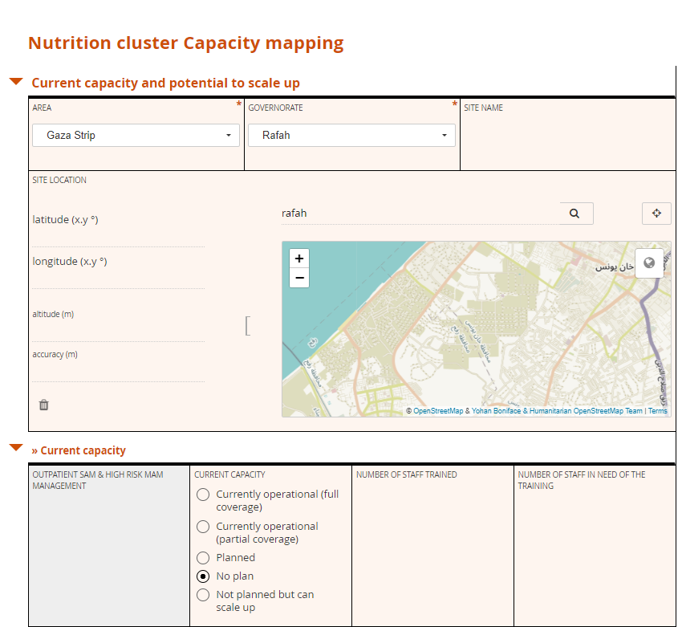
Nutrition cluster Capacity mapping
Nutrition cluster Capacity mapping
This tool is intended to map the existing capacity on the ground for covering current and potential future needs. the tool is targeting any stakeholder Implementing or intend to implement nutrition activities in the field : Government, NNGOs, IMGOs, UN agencies, institution, CSOs or red cross organization.
5

Slide 6
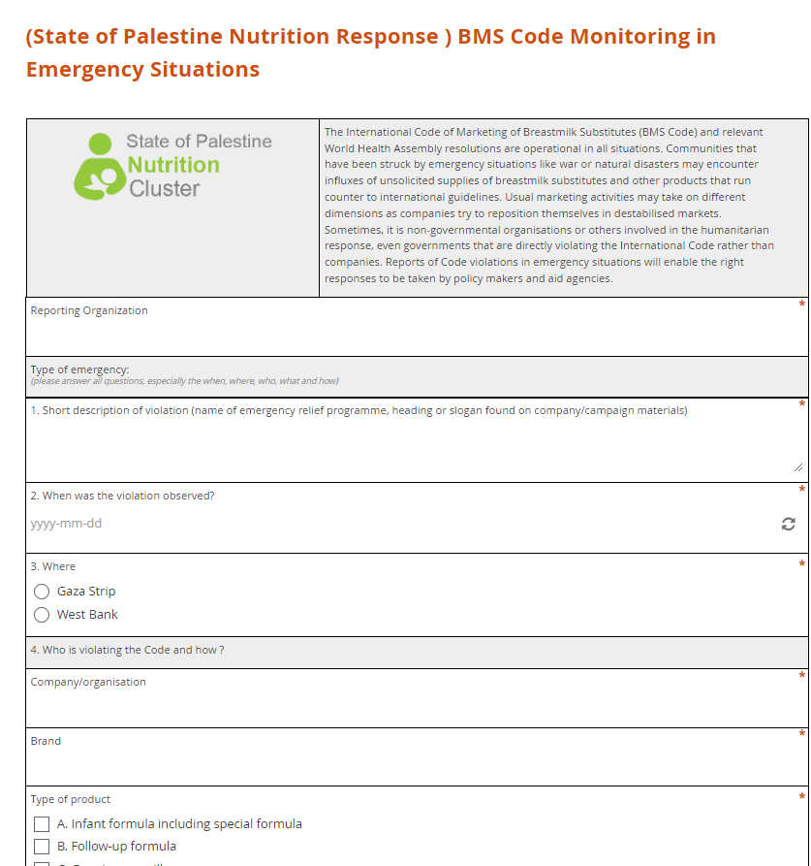
BMS Code Monitoring in Emergency Situations
BMS Code Monitoring in Emergency Situations
The International Code of Marketing of Breastmilk Substitutes (BMS Code) and relevant World Health Assembly resolutions are operational in all situations.
Communities that have been struck by emergency situations may encounter influxes of unsolicited supplies of breastmilk substitutes and other products that run counter to international guidelines..
Reports of Code violations in emergency situations will enable the right responses to be taken.
6

Slide 7
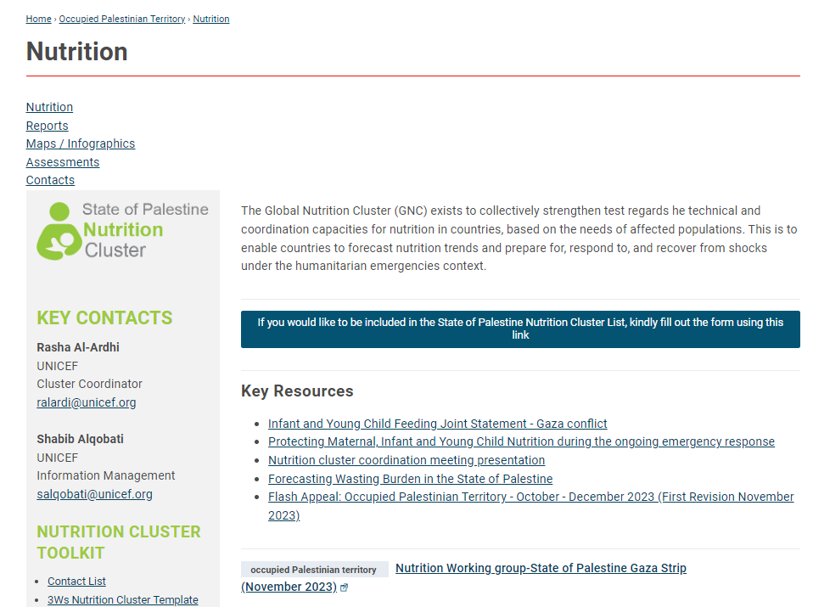
Website updates
https://response.reliefweb.int/palestine/nutrition
About Nutrition Cluster Websites
Contacts
Nutrition Cluster Toolkit
Key Resources
Infographic
Global Nutrition Cluster
7
Notes:
[highlight here any changes made to the website from the last meeting and the main documents uploaded]

Slide 8
What is needed from partners
Kindly provide your inputs to:
The contact list
The capacity mapping
The 3Ws database

Slide 9
Other updates
Work with Health cluster to include nutrition data in HeRAMS Questioners
Working to finalize Nutrition partner update (5Ws) with OCHA 5Ws Plus

Slide 10
ANY QUESTION ???
what
why
where
when
who
how
10

Slide 11
Contact Us
Cluster Coordinator
Rasha Al-Ardhi
Information Management
Shabib Alqobati
ralardi@unicef.org
salqobati@unicef.org
https://response.reliefweb.int/palestine/nutrition
011

Slide 12
