Slide 1
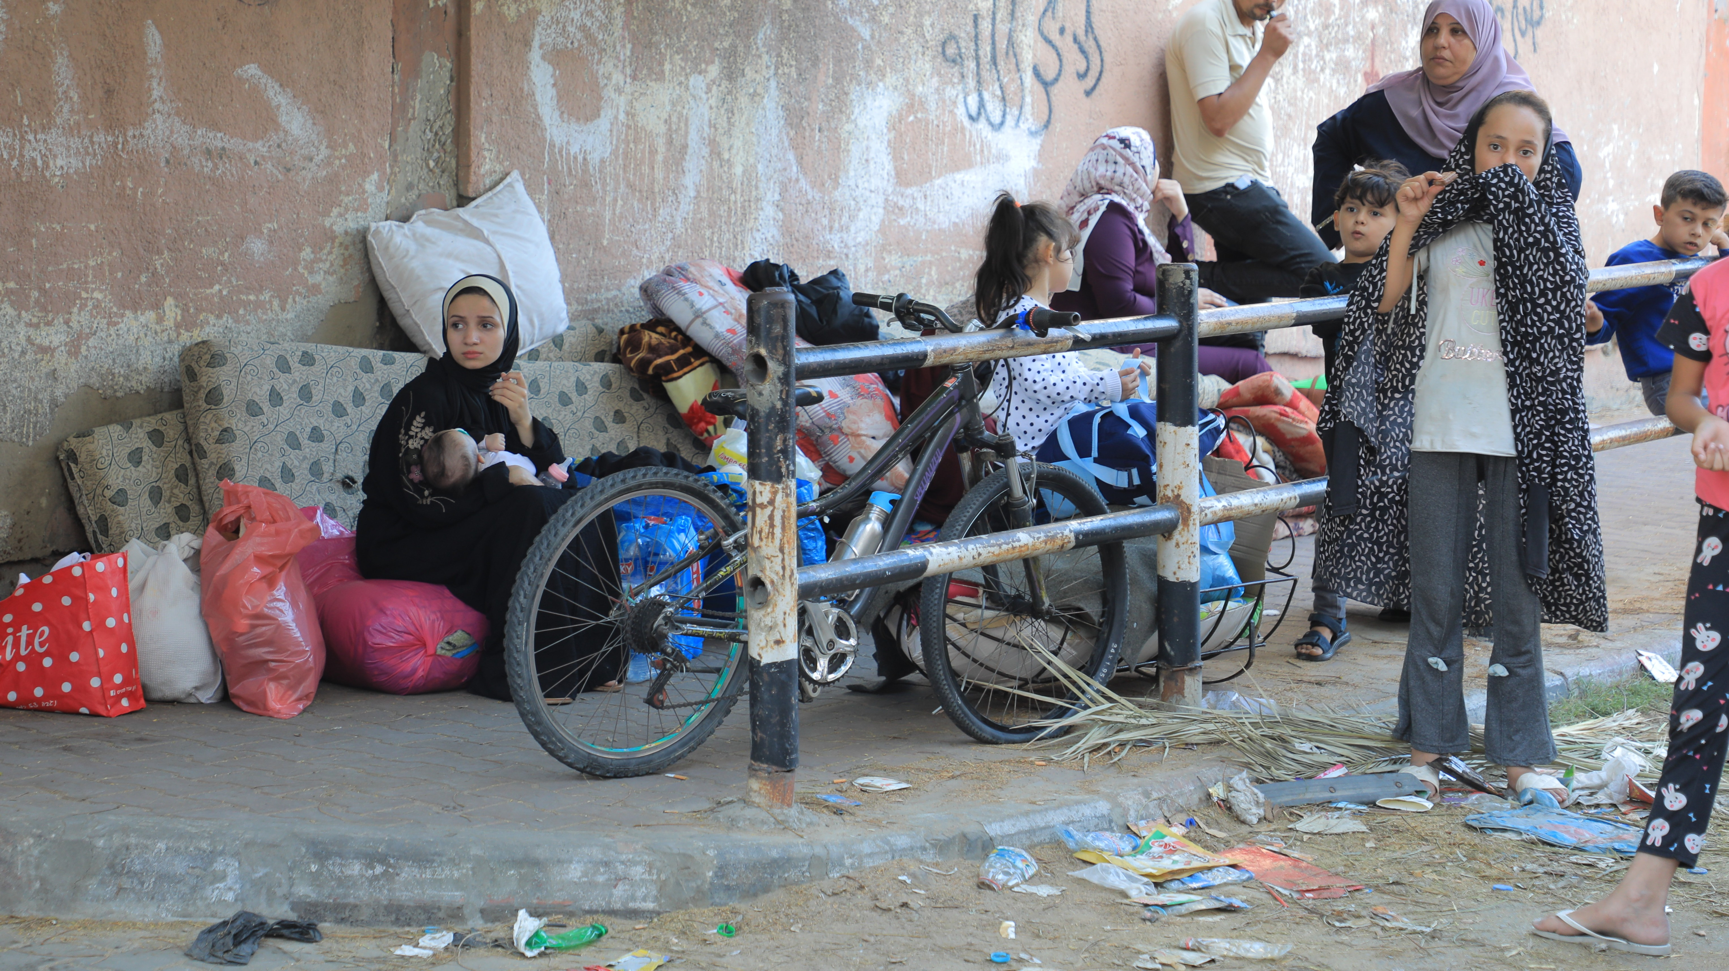

SoP nutrition working group meeting 1st of November 2023

Slide 2
Nutrition contribution to the FA

Slide 3

Flash appeal- Nutrition
23.4 million USD is needed for 3 months response (out of that 19.3 million is needed for Gaza)
83 million is needed for 12 months response (out of it 68.6 million is needed for Gaza)
100% oF Gaza population considered as PiN (over 2 million) in addition to 600,000 as PiN from WB

Slide 4
Nutrition FA main interventions
Infant 0-6 mo.
Secure RUIF for non-breastfeed infants
IYCF-E
ECD-E
Management of Wasting
Children 6-24 mo.
Provide MQ-LNS/ SQ-LNS
Vit A supplementation
IYCF-E
ECD-E
Early detection & management of Wasting
Children 24-59 mo.
Provide HEB
Provide MNPs
Vit A supplementation
Early detection & management of Wasting
Deworming
PLWs
Provide MQ-LNS/HEB
Provide MNPs
Iron/folate or MMS supplementation
CVA for Nutrition

Slide 5
Projections/ Assumptions

Slide 6
Food insecurity:
Pre conflict, WFP estimated that 1.8 million Palestinians were food insecure In Gaza (64%).
Post conflict, 100% of Gaza population (approximately 2 million) are considered food insecure
Water and sanitation:
Pre conflict, UNRWA reported that over 90% of the water in Gaza has been deemed unfit for human consumption.
Post conflict, WASH cluster estimated 94% of reduction in the water supply. Health:
Pre conflict: service coverage index as measured by the Universal Healthcare
Coverage (UHC) is 64 and has remained essentially unchanged over the past two decades. UNRWA provides health-care services to the vast majority of the over 1.2 million Palestine refugees in Gaza through 22 centers
Post conflict, according to WHO, only 37% of MOH primary care facilities are operational, and those which are operating are facing severe shortages
of medical supplies, damage from airstrikes, and extended electricity outages. 15 out of 22 UNRWA Health Centers across the Gaza Strip are providing PHC services
Due to the deterioration of the underlying determinants of malnutrition, there is a need to estimate the increase of burden of wasting

Slide 7
The scenarios we are expecting ??
With the current situation and the expected significant deterioration on nutrition vulnerability and need for nutrition services, it is important to project and estimate the expected increase in wasting burden
To Estimate the projected wasting burden and because of the anticipated further deterioration of the underlying determinants of malnutrition,
Current incidence correction factor of used 2.6 & 3 for the WB and Gaza, respectively
Projection incidence correction factor of 3 and 3.8 to be used for the WB and Gaza, respectively
By this projection, nearly 30,000 children across the State of Palestine are at risk of suffering from wasting and 15,000 of these children are projected to face severe wasting, putting them at imminent risk of death.

Slide 8
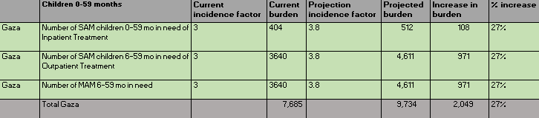

Child wasting is projected to increase by 27% in Gaza– meaning that nearly 10,000 children across Gaza are at risk of suffering from wasting and 5,000 of these children are projected to face severe wasting, putting them at imminent risk of death.

Slide 9
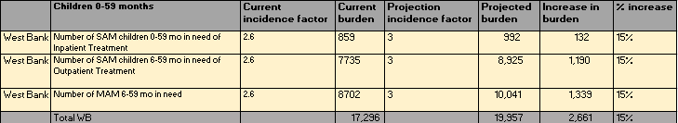
Child wasting is projected to increase by 15% in West Bank– meaning that nearly 20,000 children across West Bank are at risk of suffering from wasting and 10,000 of these children are projected to face severe wasting, putting them at imminent risk of death.

Slide 10

Priorities
Release nutrition WG infographic and advocacy messages
Working on SoP specific SOPs for BMS, safe spaces, MNs supplementation & Wasting management Finalize the Partners capacity mapping/ Capacity development needs
Finalize the projections on the impact of the current situation on the nutrition Develop & update Nutrition WG Partners mapping- 4Ws
Support the establishment of BMS code monitoring system
Further strengthen nutrition coordination, how best we maximized partners capacity and mobilize resources for nutrition Follow up the nutrition commodities pipeline status, to ensure the timely delivery of nutrition supplies.

Slide 11




Important matrixes/ forms have been shared
SoP nutrition working group 3Ws database
SoP nutrition working group contact list
SoP Nutrition working group capacity mapping matrix (capacity strengthen+ Supplies)
SoP nutrition working group BMS code violation reporting form

Slide 12


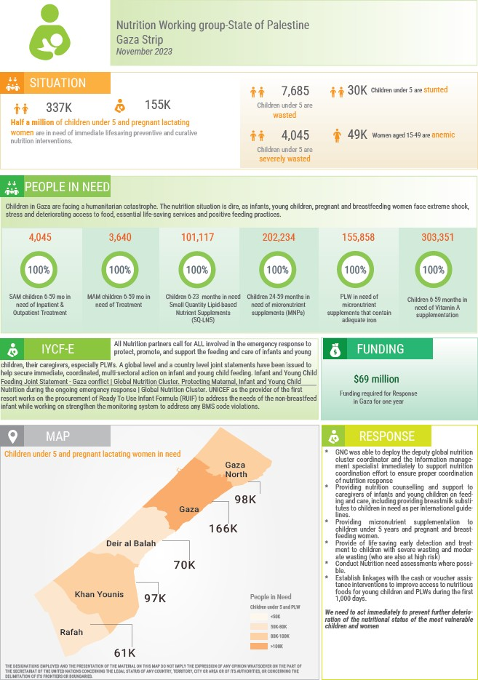


Nutrition WG infographics to be released today

Slide 13
Partners updates
MOH will provide all the needed technical support in developing the simplified SoP guidelines to hide the nutrition response.
UNRWA is working on a 90 days response including nutrition interventions per age group, the interventions include the provision of ready to use food (details on quantities to be shared later)
WFP managed to move ready to use ration to Gaza, while planning to introduce the special nutritious age-appropriate food for children and mothers (details on quantities to be shared later)
UNICEF managed to secure the needed quantities of RUTF for the FA needs, as well as procuring the needed quantities of RUIF in baches to address the need of non-breastfed infant. UNICEF is working on scaling up nutrition preventive and curative interventions, UNICEF is interested to expand their partnerships on the ground to strengthen service delivery capacities

Slide 14
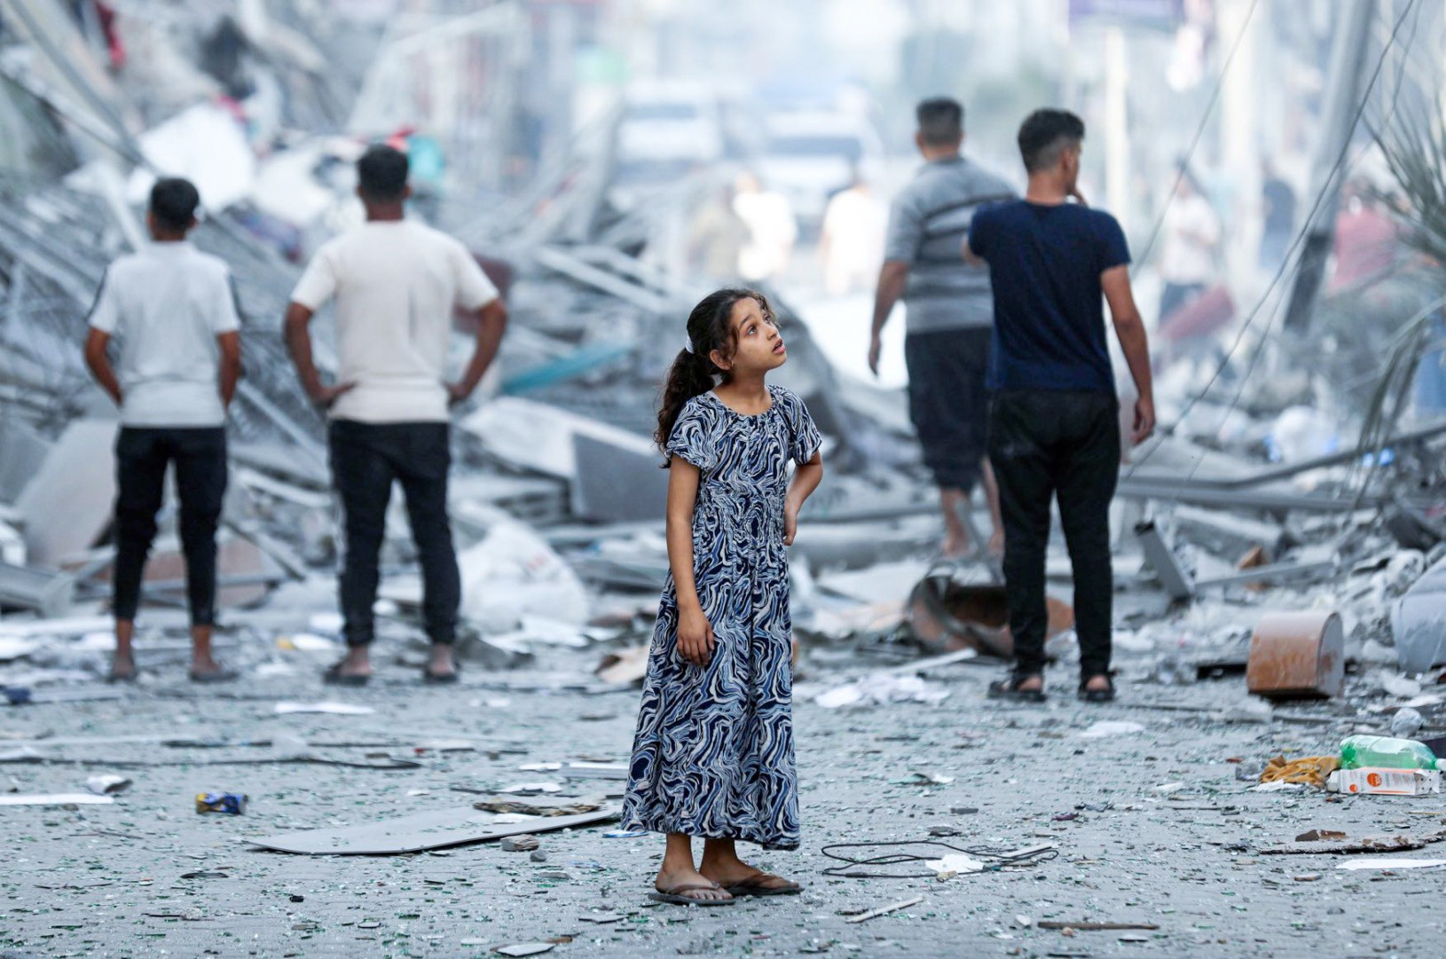
We need to act
immediately to
prevent further deterioration of
the nutritional
status of the
most vulnerable
children and women

