Slide 1
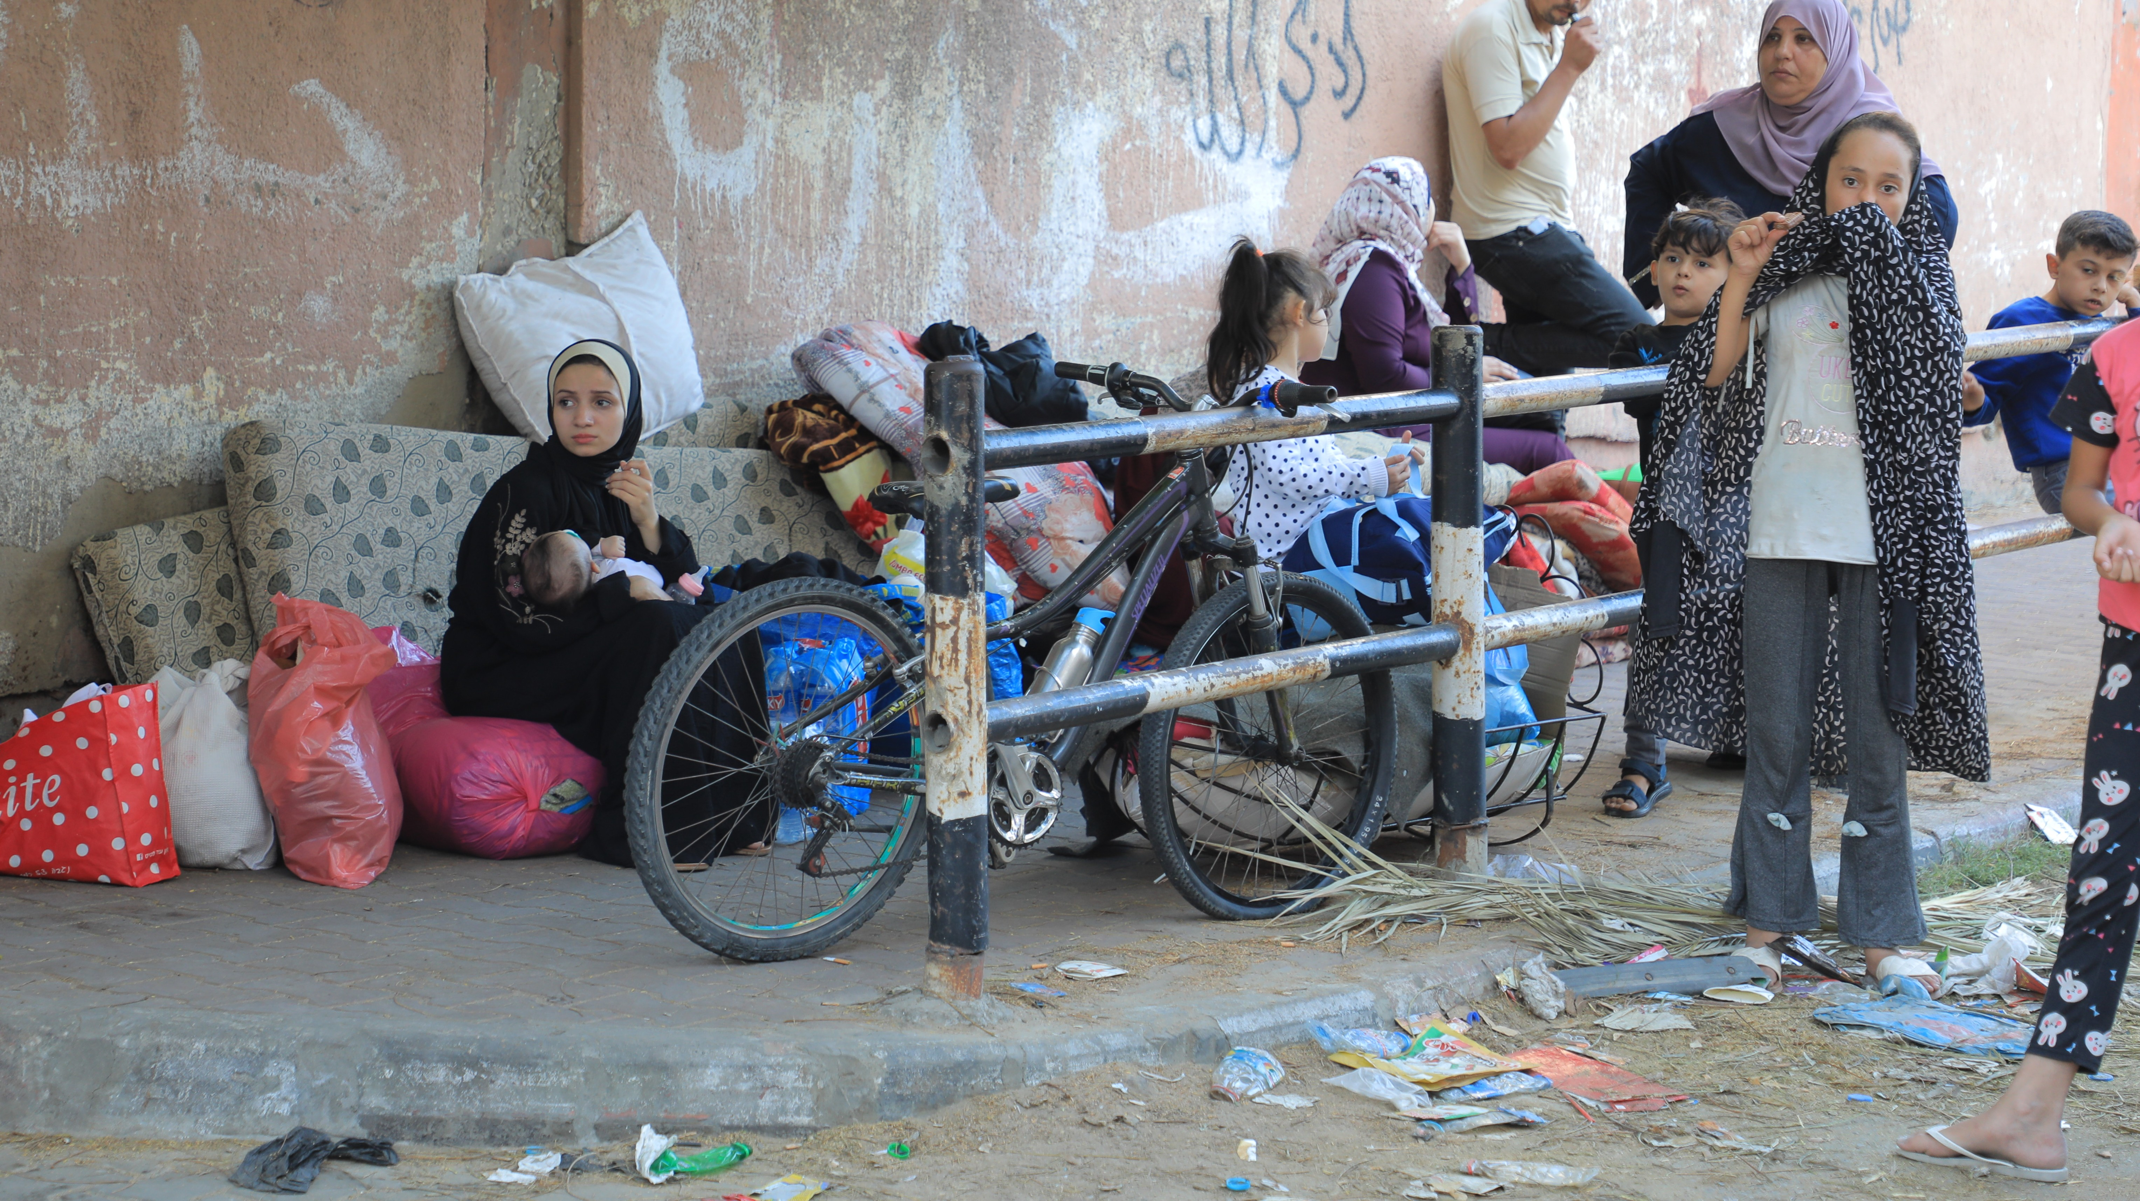
SoP nutrition working group meeting 23rd October 2023
SoP nutrition working group meeting 23rd October

Slide 2
SoP was already facing concerning levels of malnutrition even before the recent conflict
 | CHILDREN U5 |  |  | CHILDREN 6-23 months | WOMEN
 | Stunting | Wasting | Severely Wasted | Food poverty-ate less than five of the eight recommended food groups | Anemia
SoP | 65,000 | 24,981 | 12,639 | 124,500 (1 in 2) | 131,252 ( 1 in 3)
GAZA | 30,000 | 7,685 | 4,045 | 56,000 | 49,316
WEST- BANK | 35,000 | 17,296 | 8,594 | 68,50 | 82,936
MICS 2019, Population figures- UNOCHA 2023 relief-web, WHO report 2019 (Anemia figures), Child Food Poverty: A
Nutrition Crisis in Early Childhood, October 2022

Slide 3
People in need in Gaza and WB
Indicator | Gaza Strip | West Bank
Number of SAM children 0-59 mo in need of Inpatient Treatment
 | 404 | 859
Number of SAM children 6-59 mo in need of Outpatient Treatment | 3,640 | 7,735
Number of MAM children 6-59 mo in need | 3,640 | 8,702
Number of children 6-23 mo in need of BFSP | 101,117 | 123,958
Number of children 0-5 months in need of EBF support | 33,706 | 41,319
Number of children 6-23 months in need of Dietary Diversity support (or Minimum Acceptable Diet for children 6-23 months if available) | 101,117 | 123,958
Number of children 0-5 months in need of BMS support | 13,378 | 16,486
Number of children 6-59 months in need of micronutrient supplements that contain adequate iron | 303,351 | 371,875
Number of PW in need of micronutrient supplements that contain adequate iron | 89,062 | 130,276
Number of PW in need of calcium supplements during pregnancy | 89,062 | 130,276
Number of PW in need of multiple micronutrient supplements during pregnancy | 89,062 | 130,276
Number of PLW in need of balanced energy protein supplements during pregnancy and breastfeeding | 155,858 | 227,983
Number of children 6-59 months in need of Vitamin A supplementation | 303,351 | 371,875
Number of children 6-59 months in need of Zinc supplementation | 303,351 | 371,875
Number of children 12-59 months in need of deworming | 269,646 | 330,555

Slide 4
Supplies need in Gaza and WB: (the needs for 3 months
except for Wasting management supplies, matched the wasting burden)
Supply | Unit | Gaza Strip | West Bank
Biscuit high energy+protein CAR 100x100g | CAR | 145,609 | 223,125
Biscuit high energy+protein CAR 100x100g | CAR | 112,218 | 164,148
LNS-SQ Lipid Nut. Suppl. Sml 20g/CAR-600 | CAR | 12,134 | 14,875
Multiple micronutrient pdr,sach./PAC-30 | PAC | 728,043 | 892,499
Micronutrient tabs, pregnancy/BOT-100 | PAC | 41,562 | 60,796
Iron 60mg + Folic ac. 400mcg tab/PAC-100 | PAC | 41,562 | 60,796
Retinol 100,000IU soft gel.caps/PAC-100 | PAC | 539 | 661
Retinol 200,000IU soft gel.caps/PAC-500 | PAC | 863 | 1,058
F-75 Therap.milk CAN 400g/CAR-24 | CAR | 40 | 86
F-100 Therap.milk CAN 400g/CAR-24 | CAR | 40 | 86
Therapeutic spread,sachet 92g/CAR-150 | CAR | 2,912 | 6,188
MAM 6-59 mo high risk in need RTUF | CAR | 971 | 2,320
MUAC,Child 11.5 Red/PAC-50 | PAC | 24 | 30
MUAC,Adult,without colour code/PAC-50 | PAC | 12 | 18
Scale, electronic,mother/child, 150kgx100g | EA | 24 | 30
Portable baby/child L-hgt mea.syst/SET-2 | EA | 24 | 37
Ready to Use Infant Formula (RUIF) | PAC | 35,000 | 40,251

Slide 5
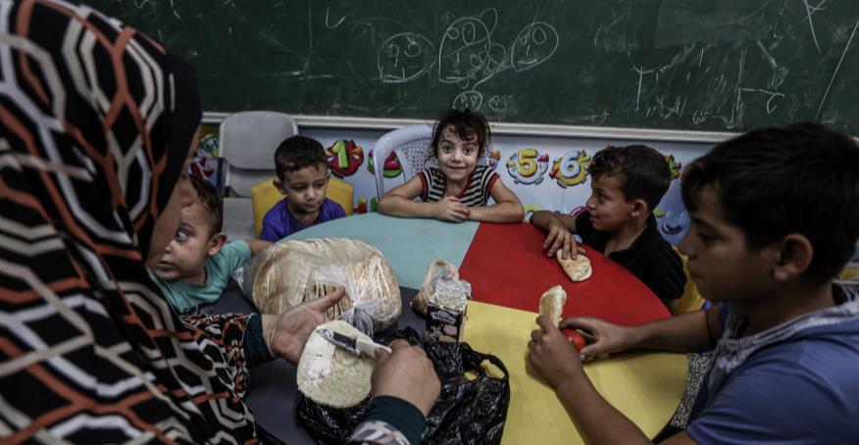
The crisis has disrupted access to essential prevention and curative nutrition services to about 337,057 children under 5 years and 155,858 PLWs in Gaza. Given the suspension of services in Gaza, these children and women face an increased risk of malnutrition, disease and death
About 1.4 million internally displaced people (IDPs) are estimated in Gaza, with nearly 580,000 sheltering in 150 UNRWA shelters. Overcrowding is a growing concern, as the average number of IDPs per shelter has reached more than 2.5 times their
designated capacity”.

Slide 6
The Crisis effect on the underlying factors of malnutrition
In Gaza, about 60 percent of households were food insecure or vulnerable to food insecurity before the October hostilities.
The food system in Gaza has been highly damaged by the war if not destroyed, and this
needs to be reconstructed.
Gaza Strip population vulnerable to food insecurity; as the food stock is almost finished and the food assistance is not covering all the needs,
Food security sector estimates that 2M people are food insecure, this number can
change to arrive to the total population in the coming days, if things remain the same.

Slide 7
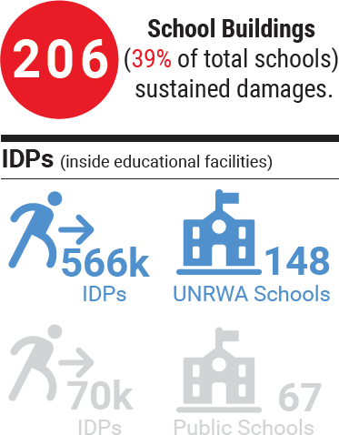
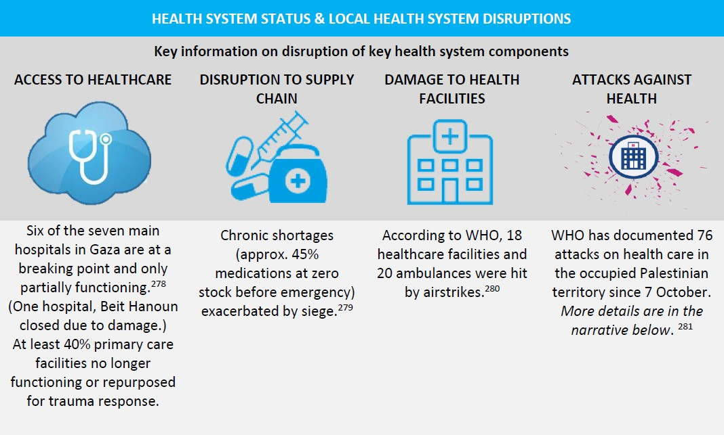
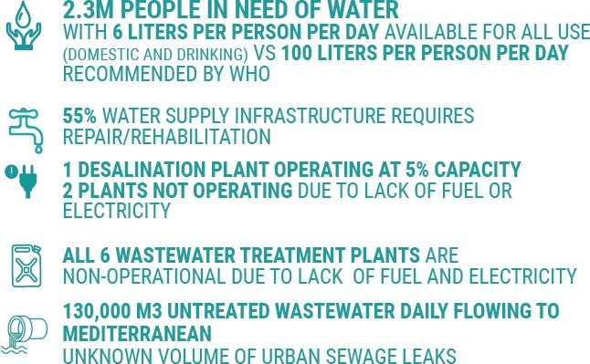
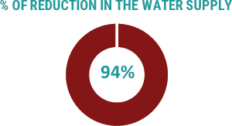
The Crisis effect on the underlying factors of malnutrition

Slide 8
HUMANITARIAN NEEDS
MAIN INTERVENTIONS
Access to lifesaving nutrition interventions including prevention, early detection, and treatment of wasting.
Need for the protection, promotion & Support to infant and young child feeding including management of breast milk substitutes, through skilled counseling and psychosocial support
Need to ensure access to age-appropriate and safe complementary food including provision of specialized food for children
Need to meet the additional nutritional needs of pregnant women and breastfeeding mothers
Securing the pipeline for the lifesaving nutrition supplies including RUTF, RUIF, MNs supplementation, MQ/SQ-LNS…etc for children and women
IYCF-E: Provide nutrition counselling and support to caregivers of infants and young children on feeding and care (skilled counseling and support on breast feeding, complementary feeding and early simulations and responsive care giving(ECD-E); Provision of age-appropriate complementary food for children
Provide BMS/ ready to use infant formula (RUIF) to address the needs of the non-breastfeed infants less than 6 months as per international guidelines. Establish a monitoring/reporting system to address any BMS code violation and any random distribution of infant formula;
Provide complementary feeding to PLWs to address their nutritional needs
Provision of Micronutrient supplementation for children U5 (vitamin A, MNP, lipid-based supplements (LNS-MQ/SQ) as well as iron-foliate supplementation to PLWs.
Wasting management: early detection and treatment to children with wasting
Linkages with Cash-Voucher assistance
Nutrition assessments where possible

Slide 9
Priorities
Elevate the nutrition related needs against the sense that nutrition is not a real issue in SoP.
Review the PiN to be reflected in the Flash appeal for 3 months and 2024 HRP
Finalize SoP IYCF-E Joint
statement
Strengthen nutrition coordination, how best we maximized partners capacity and mobilize resources for nutrition
Develop /update Nutrition Partners mapping- 4Ws
Follow up the procurement of RUIF and support the establishment of BMS code monitoring system
Finalize/ disseminate Nutrition specific advocacy paper and work on other sectors coordinators to develop inter-cluster/sector infographic product/ advocacy paper
Follow up the nutrition commodities pipeline status, to ensure the timely delivery of nutrition supplies.

Slide 10
Registered NWG Partners!!
Partner name
Ard El Insan (AEI) | Local NGO
Campaign for the Children of Palestine (CCP) Japan | International NGO
International Medical Corps (IMC) | International NGO
Japan International Volunteer Center (JVC) | International NGO
Juzoor | Local NGO
Medical Aid for Palestinians (MAP) | International NGO
Near East Council of Churches | Local NGO
Palestinian Medical Relief Society (PMRS) | Local NGO
Peace Winds Japan (PWJ) | International NGO
Save the Children International | International NGO
UNICEF | UN
UNRWA | UN
World Food Programme (WFP) | UN
World Health Organization | UN

Slide 11
Partners updates
UNRWA supports 145 shelters with almost 400,000 population, which are very crowded. UNWA team provides PHC services inside the shelters and food ration. There are displaced population within the host community which are also deprived from their basic needs; hence, urgent action is needed to address their multi-sectoral needs. UNRWA contracted a bakery to provide all people with bread with half price in south and middle area of Gaza
Jouzoor: working on providing vouchers assistance through Paypal to enable them to get food from specific locations, the help line was activated, the team provides IYCF related messages, providing iron supplements for PLWs and children & providing medications for children with diarrhea
UNICEF stated that out of the implementing partners, only Jouzoor was able to attend the meeting,
unfortunately, other 2 partners can’t reach out to their sites due to security/ access constrains and staff capacities. UNICEF started the procurement process of curative & preventive nutrition supplies (RUTF, Therapeutic milk, MNs & SQLNS) in addition to the procurement of RUIF to address the need of non- breastfeed infants 0-6 months
WFP shared that 20 MTs of high energy biscuits will be distributed in Gaza to reach all population, as well as supporting complementary feeding activities for children 6-23 months & PLWs
ACF is exploring two options for intervention: CVA and the Provision of fresh food baskets to PLWs in Gaza as well as contributing to the provision of essential curative and preventive nutrition commodities through Egypt

Slide 12
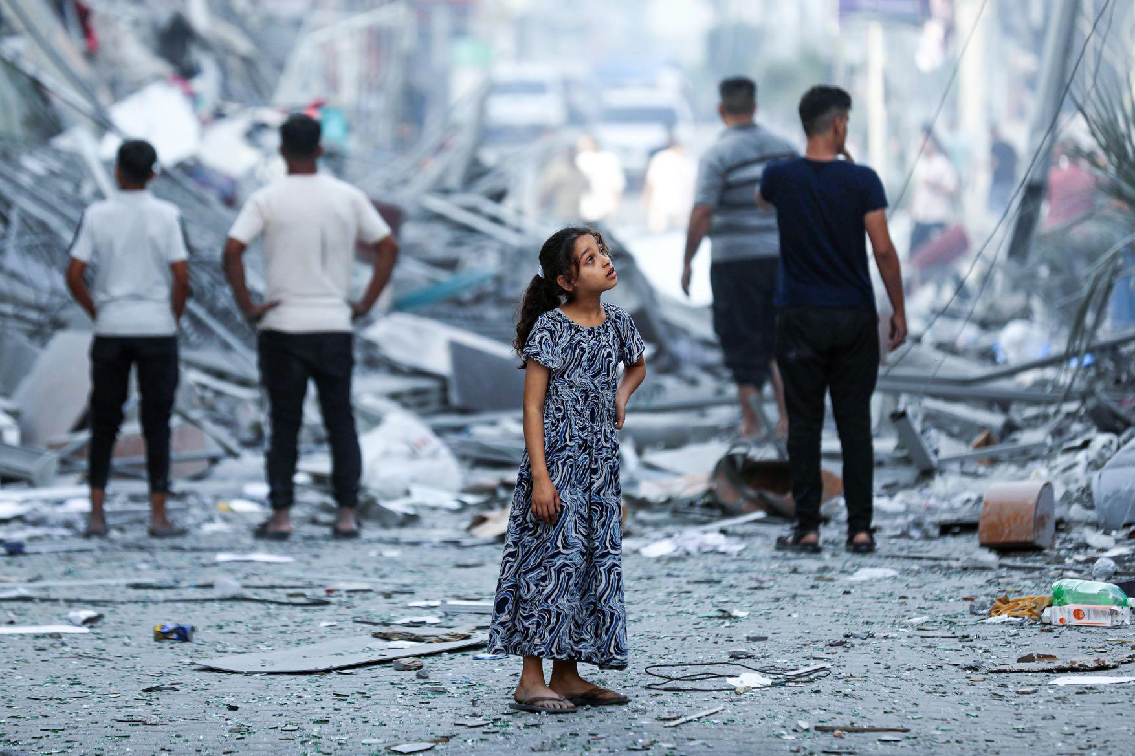
We need to act immediately to prevent further deterioration of the nutritional status of the most vulnerable children and women

