Slide 1






Link NCA
NUTRITION CAUSAL ANALYSIS
Introduction to Quantitative Data Management and Analysis
Alexandra Humphreys
9 August 2019

Slide 2
Objectives of this Training
Review current best practices for Link NCA Quantitative Data Management and Analysis
Review descriptive statistics for samples
Review analysis of statistical associations
Note: this training does not cover the selection or operationalization of hypothesized risk factors, as this training is catered towards the handling of data post quantitative data collection.
Global Technical Assistance Mechanism for Nutrition
Notes:
Global Technical Mechanism (GTM), a newly launched, overarching body with the objective to provide a predictable, flexible, systematic and effective approach to respond to nutrition technical gaps and meet the nutrition needs and rights of vulnerable populations including children, adolescents and women in humanitarian crisis.

Slide 3
A Note on Data Cleaning
Data cleaning is a critical step in quality results. The removal or modification of observations in the dataset during cleaning should be justified and documented. This serves to:
Increase accountability of the analyst
Ensure that results can be replicated (ensuring validity)
(Using STATA, for example, this is recorded through a .do file. What is this process for R or Excel?)
Global Technical Assistance Mechanism for Nutrition
Notes:
Global Technical Mechanism (GTM), a newly launched, overarching body with the objective to provide a predictable, flexible, systematic and effective approach to respond to nutrition technical gaps and meet the nutrition needs and rights of vulnerable populations including children, adolescents and women in humanitarian crisis.

Slide 4
Missing and Unknown Data
Missing data should never be filled in without a strong justification. Empty variables should be left blank, and if a large proportion of the responses are missing (rule of thumb: >20%), this should be discussed because this may risk data quality.
HOWEVER: for calculating statistical associations “unknown” responses should be made blank as they do not contribute to the analysis.
Note: having an “unknown” option for quantitative questions is very important, this avoids respondents/surveyors being forced to make a response fit into a “yes/no” answer.
Global Technical Assistance Mechanism for Nutrition
Notes:
Global Technical Mechanism (GTM), a newly launched, overarching body with the objective to provide a predictable, flexible, systematic and effective approach to respond to nutrition technical gaps and meet the nutrition needs and rights of vulnerable populations including children, adolescents and women in humanitarian crisis.

Slide 5
Analysing and Reporting Prevalence
When basing the quantitative data collection on the SMART Methodology, it is possible to analyse and report the prevalence of categorical or binary indicators for the area/population of interest.
However:
The prevalence must be calculated in consideration of the sampling methodology (i.e. ENA uses SUDAAN procedures for cluster surveys and Wilson confidence intervals for random sampling).
The area/population for the prevalence must be clearly stated (i.e. if calculating the prevalence uniquely among households with children <5 yrs)
Global Technical Assistance Mechanism for Nutrition
Notes:
Global Technical Mechanism (GTM), a newly launched, overarching body with the objective to provide a predictable, flexible, systematic and effective approach to respond to nutrition technical gaps and meet the nutrition needs and rights of vulnerable populations including children, adolescents and women in humanitarian crisis.

Slide 6
Example: Analysing Prevalence
Prevalence STATA coding example:
svy: tab outcome_variable, ci obs
svy: tab outcome_variable if independent_variable=x, ci obs
Notes:
“svy” command accounts for pre-set sampling design
“tab” tabulates the prevalence/proportion
“ci” calculates the confidence interval based on the “svy”
“obs” tallies the number of observations
If male, for example
Global Technical Assistance Mechanism for Nutrition
Notes:
Global Technical Mechanism (GTM), a newly launched, overarching body with the objective to provide a predictable, flexible, systematic and effective approach to respond to nutrition technical gaps and meet the nutrition needs and rights of vulnerable populations including children, adolescents and women in humanitarian crisis.

Slide 7
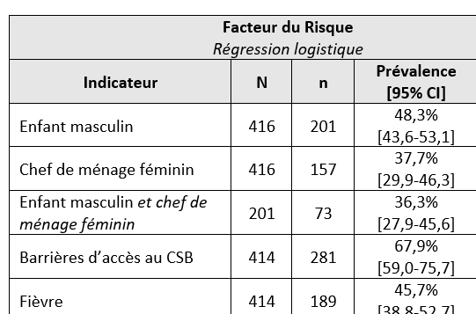
Example: Presenting Prevalence
Prevalence and 95% CI should be presented for each binary or categorical variable, with the population clearly noted in the report.
n=affected sample subset
N=overall sample
For this example from Madagascar, the prevalence is based only on households with children under five and was reported as such.
95% CI in accordance with sampling design
Global Technical Assistance Mechanism for Nutrition
Notes:
Global Technical Mechanism (GTM), a newly launched, overarching body with the objective to provide a predictable, flexible, systematic and effective approach to respond to nutrition technical gaps and meet the nutrition needs and rights of vulnerable populations including children, adolescents and women in humanitarian crisis.

Slide 8
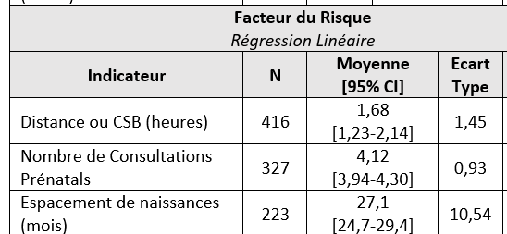
Example: Presenting Average
The average and 95% CI should be presented for each continuous variable, with the population clearly noted in the report.
Average and 95% CI in accordance with sampling design
For this example from Madagascar, the average is based only on households with children under five and was reported as such.
N=overall sample
Standard deviation
Global Technical Assistance Mechanism for Nutrition
Notes:
Global Technical Mechanism (GTM), a newly launched, overarching body with the objective to provide a predictable, flexible, systematic and effective approach to respond to nutrition technical gaps and meet the nutrition needs and rights of vulnerable populations including children, adolescents and women in humanitarian crisis.

Slide 9

Analysing and Reporting Design Effect
Reporting the design effect (DEFF) allows us to understand the heterogeneity of the risk factor.
DEFF STATA Coding Example (binary variable):
svy: tab outcome_variable, ci obs deff
DEFF
≤1.00 DEFF indicates homogeneity, around 1,50 some heterogeneity, ≥2.00 high heterogeneity.
Global Technical Assistance Mechanism for Nutrition
Notes:
Global Technical Mechanism (GTM), a newly launched, overarching body with the objective to provide a predictable, flexible, systematic and effective approach to respond to nutrition technical gaps and meet the nutrition needs and rights of vulnerable populations including children, adolescents and women in humanitarian crisis.

Slide 10
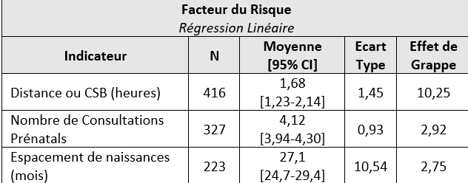
Analysing and Reporting Design Effect
Reporting the design effect (DEFF) allows us to understand the heterogeneity of the risk factor.
DEFF STATA Coding Example (continuous variable):
svy: mean outcome_variable
estat effects
DEFF
≤1.00 DEFF indicates homogeneity, around 1,50 some heterogeneity, ≥2.00 high heterogeneity.
Global Technical Assistance Mechanism for Nutrition
Notes:
Global Technical Mechanism (GTM), a newly launched, overarching body with the objective to provide a predictable, flexible, systematic and effective approach to respond to nutrition technical gaps and meet the nutrition needs and rights of vulnerable populations including children, adolescents and women in humanitarian crisis.

Slide 11
Logistic Regression
Logistic regression is a method of demonstrating statistical significance between an independent variable (risk factor) and an outcome variable.
Requirements:
The outcome and independent variable must be binary (0/1, yes/no, stunted/not stunted)
Logistic Regression (STATA example):
logistic outcome_variable independent_variable
Global Technical Assistance Mechanism for Nutrition
Notes:
Global Technical Mechanism (GTM), a newly launched, overarching body with the objective to provide a predictable, flexible, systematic and effective approach to respond to nutrition technical gaps and meet the nutrition needs and rights of vulnerable populations including children, adolescents and women in humanitarian crisis.

Slide 12
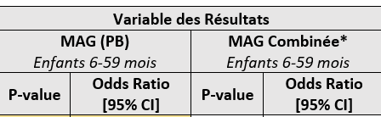
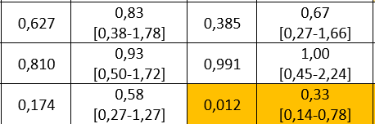
Logistic Regression
For a logistic regression, the sampling method is not considered because we are interested in the statistical association (p-value), not in representativeness.
Odd ratio and 95% CI to show scale and precision.
P-value to demonstrate statistical significance (<0,05)
Significance highlighted for audience
Global Technical Assistance Mechanism for Nutrition
Notes:
Global Technical Mechanism (GTM), a newly launched, overarching body with the objective to provide a predictable, flexible, systematic and effective approach to respond to nutrition technical gaps and meet the nutrition needs and rights of vulnerable populations including children, adolescents and women in humanitarian crisis.

Slide 13
Linear Regression
Linear regression is a method of modelling the relationship between an independent variable (risk factor) and an outcome variable.
Requirements:
The outcome and independent variable must be continuous
Linear Regression (STATA example):
regress outcome_variable independent_variable
Global Technical Assistance Mechanism for Nutrition
Notes:
Global Technical Mechanism (GTM), a newly launched, overarching body with the objective to provide a predictable, flexible, systematic and effective approach to respond to nutrition technical gaps and meet the nutrition needs and rights of vulnerable populations including children, adolescents and women in humanitarian crisis.

Slide 14
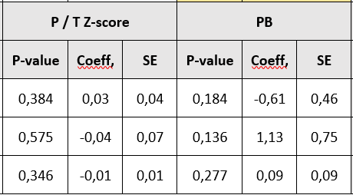
Linear Regression
For a linear regression, the sampling method is also not considered because we are interested in the statistical association (p-value), not in representativeness.
Coefficient can infer directionality (interpret with caution)
P-value to demonstrate statistical significance (<0,05)
Standard Error (SE) functions similarly to a standard deviation (SD)
Global Technical Assistance Mechanism for Nutrition
Notes:
Global Technical Mechanism (GTM), a newly launched, overarching body with the objective to provide a predictable, flexible, systematic and effective approach to respond to nutrition technical gaps and meet the nutrition needs and rights of vulnerable populations including children, adolescents and women in humanitarian crisis.

Slide 15
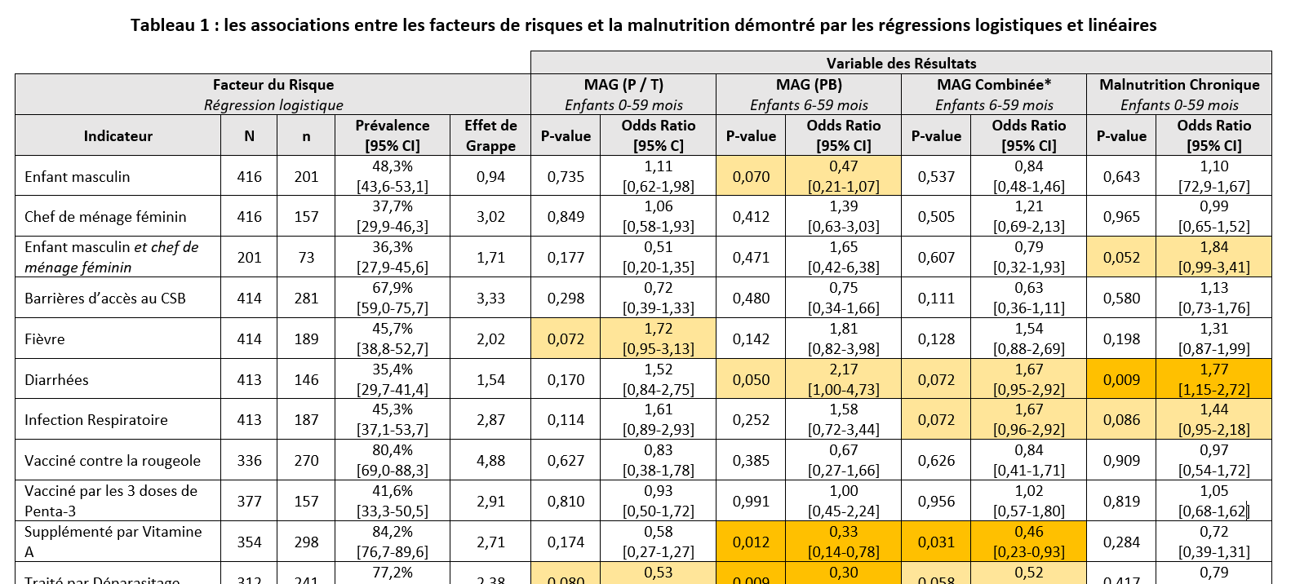
Example Annexed Table of Analyses (Link NCA Mada 2019)
Global Technical Assistance Mechanism for Nutrition
Notes:
Global Technical Mechanism (GTM), a newly launched, overarching body with the objective to provide a predictable, flexible, systematic and effective approach to respond to nutrition technical gaps and meet the nutrition needs and rights of vulnerable populations including children, adolescents and women in humanitarian crisis.

Slide 16
Concluding Thoughts
The Link NCA Methodology has recently been updated to a more rigorous analytical process of analysing the associations between risk factors and outcome variables in order to demonstrate pathways.
Data should be carefully managed and cleaned
Descriptive statistics should be presented for every risk factor variable
It is recommended that P-values be derived from logistic and linear regressions
All analytical results should be annexed in the final Link NCA report
Global Technical Assistance Mechanism for Nutrition
Notes:
Global Technical Mechanism (GTM), a newly launched, overarching body with the objective to provide a predictable, flexible, systematic and effective approach to respond to nutrition technical gaps and meet the nutrition needs and rights of vulnerable populations including children, adolescents and women in humanitarian crisis.

Slide 17
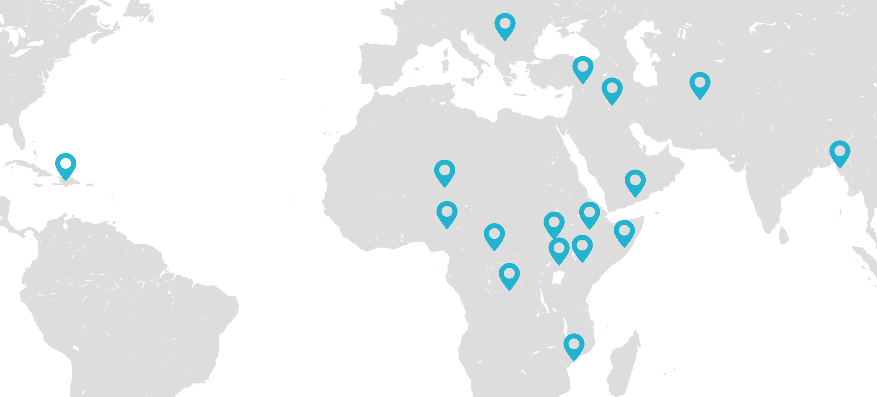
Your Questions are Welcome
Thank you!
Alexandra Humphreys
ahumphreys@actioncontrelafaim.ca
Check us out at TechRRT.org or Twitter: @TechRRT

