Slide 1
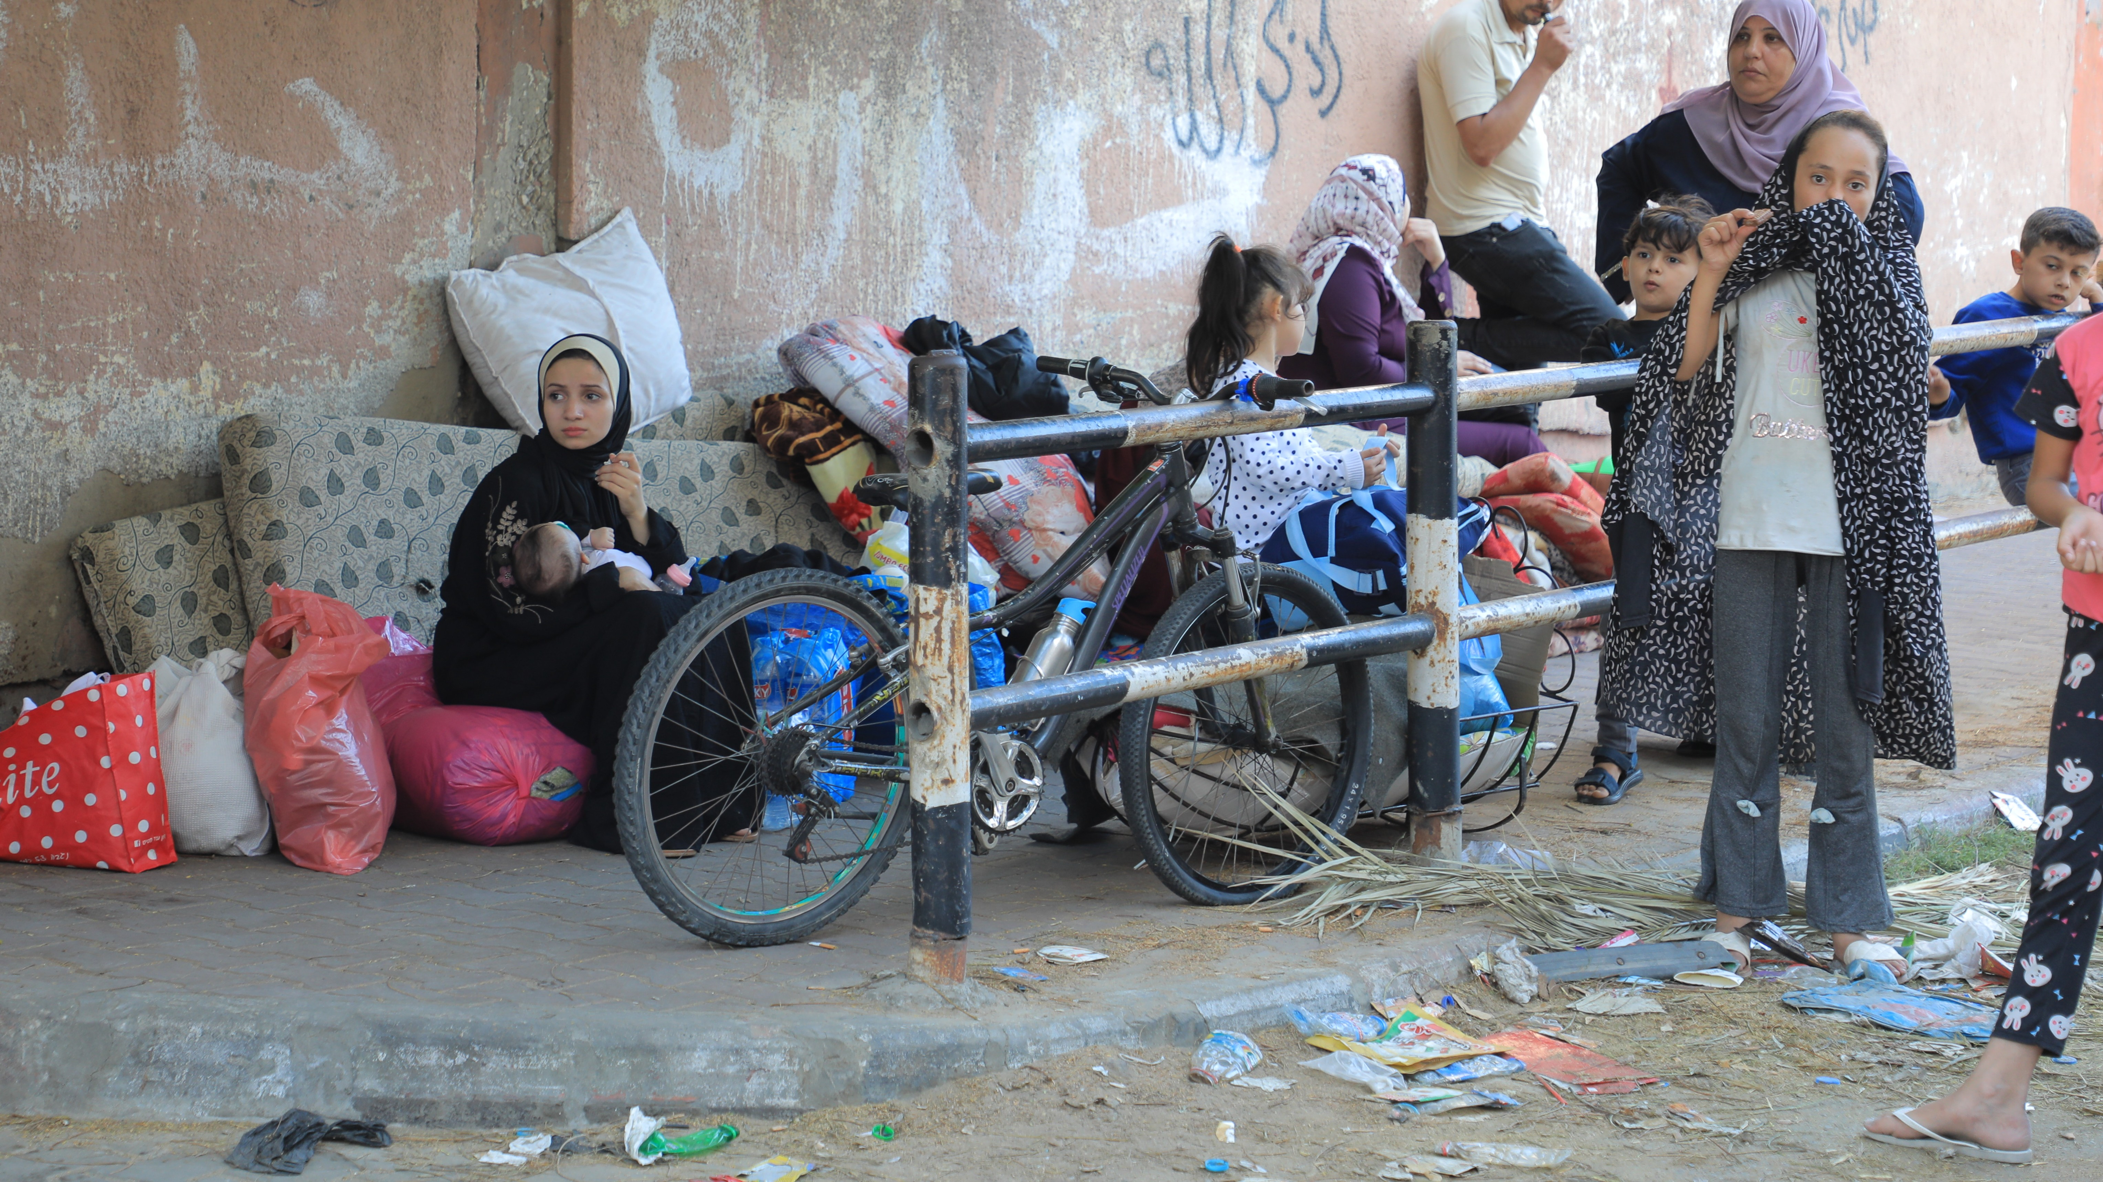
SoP nutrition Cluster
SoP nutrition working group meeting 23rd October

Slide 2
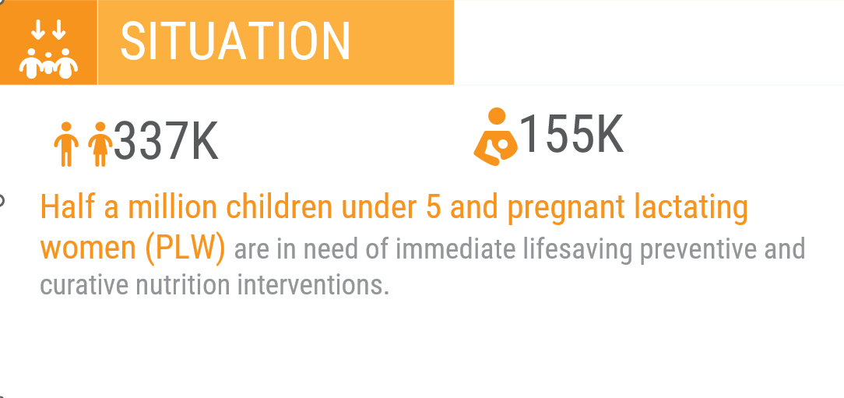
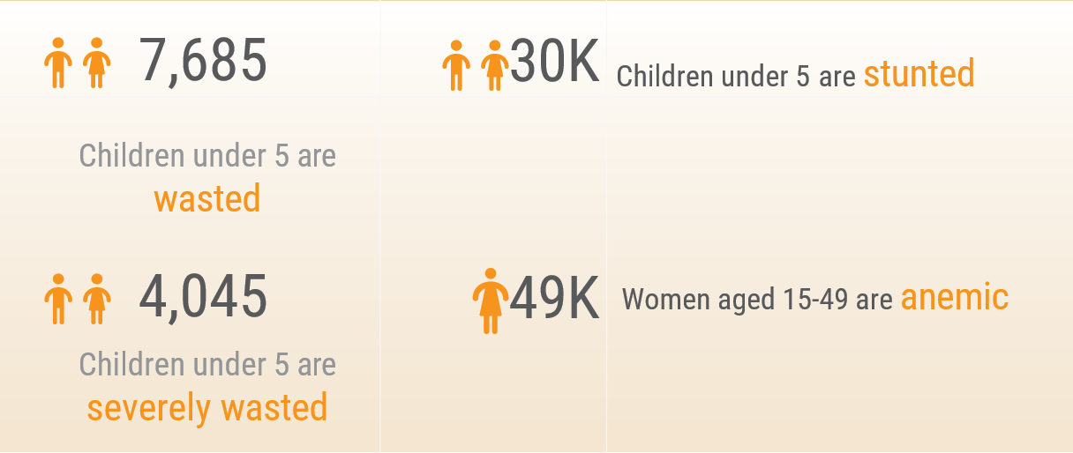
Pre-crisis: Children under 5 and pregnant and lactating women (PLW) in need in Gaza Strip

Gaza North
98K
Gaza
166K
Deir al Balah
70K
Khan Younis
97K
People in Need
Children under 5 and PLW
Rafah
<50K
50K-80K
80K-100K
>100K
61K
MICS 2019, Population figures- UNOCHA 2023 relief-web, WHO report 2019 (Anemia figures), Child Food Poverty: A Nutrition Crisis in Early Childhood, October 2022
2
2
THE DESIGNATIONS EMPLOYED AND THE PRESENTATION OF THE MATERIAL ON THIS MAP DO NOT IMPLY THE EXPRESSION OF ANY OPINION WHATSOEVER ON THE PART OF THE SECRETARIAT OF THE UNITED NATIONS CONCERNING THE LEGAL STATUS OF ANY COUNTRY, TERRITORY, CITY OR AREA OR OF ITS AUTHORITIES, OR CONCERNING THE DELIMITATION OF ITS FRONTIERS OR BOUNDARIES.
Notes:
The crisis has disrupted access to essential prevention and curative nutrition services to about 337,057 children under 5 and 155,858 PLWs in Gaza Strip.
Given the suspension of services in Gaza Strip, these children and women face an increased risk of malnutrition, disease and death
Nearly 1.5 million people have been displaced across the Gaza Strip since 7 October. Nearly half of them (710,000) are sheltering in 149 UNRWA installations across all five governorates of Gaza*.

Slide 3
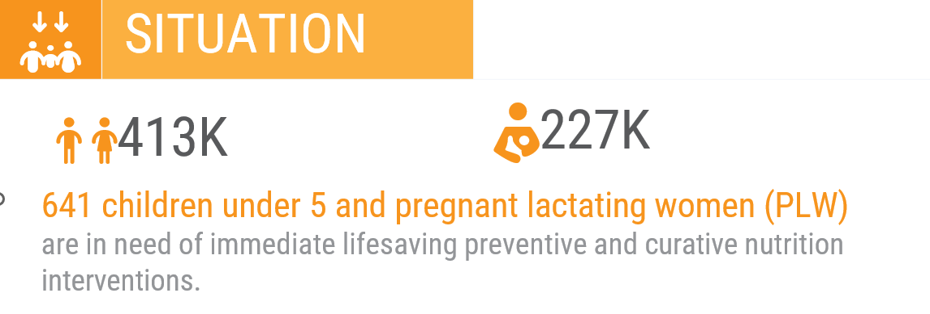
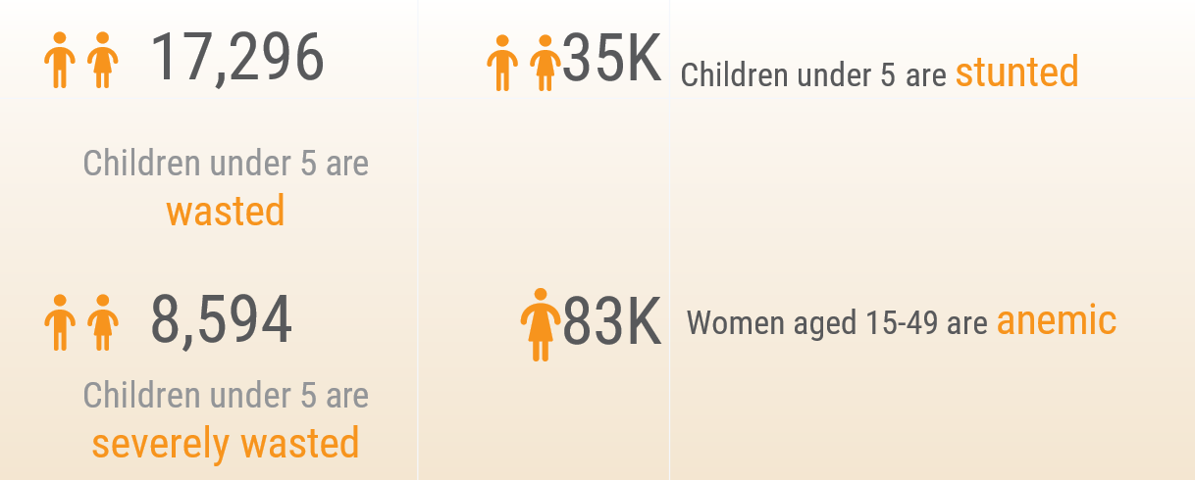
Pre-Crisis: Children under 5 and PLW in need in West Bank
Jenin
Jenin
70K
70K
Tulkarm
Tulkarm
Tubas
40K
Tubas
40K
13K
13K
Nablus
Qalqilya
Nablus
Qalqilya
84K
24K
84K
24K
Salfit
Salfit
16K
16K
Jericho
Ramallah
Jericho
Ramallah
10K
72K
10K
72K
Jerusalem
Jerusalem
96K
96K
People in Need
Children under 5 and PLW
Bethlehem
Bethlehem
47K
47K
<50K
50K-80K
80K-100K
>100K
Hebron
Hebron
106K
106K
MICS 2019, Population figures- UNOCHA 2023 relief-web, WHO report 2019 (Anemia figures), Child Food Poverty: A Nutrition Crisis in Early Childhood, October 2022
3
3
THE DESIGNATIONS EMPLOYED AND THE PRESENTATION OF THE MATERIAL ON THIS MAP DO NOT IMPLY THE EXPRESSION OF ANY OPINION WHATSOEVER ON THE PART OF THE SECRETARIAT OF THE UNITED NATIONS CONCERNING THE LEGAL STATUS OF ANY COUNTRY, TERRITORY, CITY OR AREA OR OF ITS AUTHORITIES, OR CONCERNING THE DELIMITATION OF ITS FRONTIERS OR BOUNDARIES.

Slide 4
SoP was already facing concerning levels of malnutrition even before the recent conflict
 | CHILDREN U5 |  |  | CHILDREN 6-23 months | WOMEN
 | Stunting | Wasting | Severely Wasted | Food poverty-ate less than five of the eight recommended food groups | Anemia
SoP | 65,000 | 24,981 | 12,639 | 124,500 (1 in 2) | 131,252 ( 1 in 3)
GAZA | 30,000 | 7,685 | 4,045 | 56,000 | 49,316
WEST- BANK | 35,000 | 17,296 | 8,594 | 68,50 | 82,936
MICS 2019, Population figures- UNOCHA 2023 relief-web, WHO report 2019 (Anemia figures), Child Food Poverty: A
Nutrition Crisis in Early Childhood, October 2022

Slide 5
People in need in Gaza and WB
Indicator | Gaza Strip | West Bank
Number of SAM children 0-59 mo in need of Inpatient Treatment
 | 404 | 859
Number of SAM children 6-59 mo in need of Outpatient Treatment | 3,640 | 7,735
Number of MAM children 6-59 mo in need | 3,640 | 8,702
Number of children 6-23 mo in need of BFSP | 101,117 | 123,958
Number of children 0-5 months in need of EBF support | 33,706 | 41,319
Number of children 6-23 months in need of Dietary Diversity support (or Minimum Acceptable Diet for children 6-23 months if available) | 101,117 | 123,958
Number of children 0-5 months in need of BMS/RUIF support | 19,111 | 4,339
Number of children 6-59 months in need of micronutrient supplements that contain adequate iron | 303,351 | 371,875
Number of PW in need of micronutrient supplements that contain adequate iron | 89,062 | 130,276
Number of PW in need of calcium supplements during pregnancy | 89,062 | 130,276
Number of PW in need of multiple micronutrient supplements during pregnancy | 89,062 | 130,276
Number of PLW in need of balanced energy protein supplements during pregnancy and breastfeeding | 155,858 | 227,983
Number of children 6-59 months in need of Vitamin A supplementation | 303,351 | 371,875
Number of children 6-59 months in need of Zinc supplementation | 303,351 | 371,875
Number of children 12-59 months in need of deworming | 269,646 | 330,555

