Slide 1



Preliminary Results of Nutrition Assessment among Children and their Families in Gaza, Prior to Conflict of 2023
UNRWA Health Department
29 November 2023

Slide 2
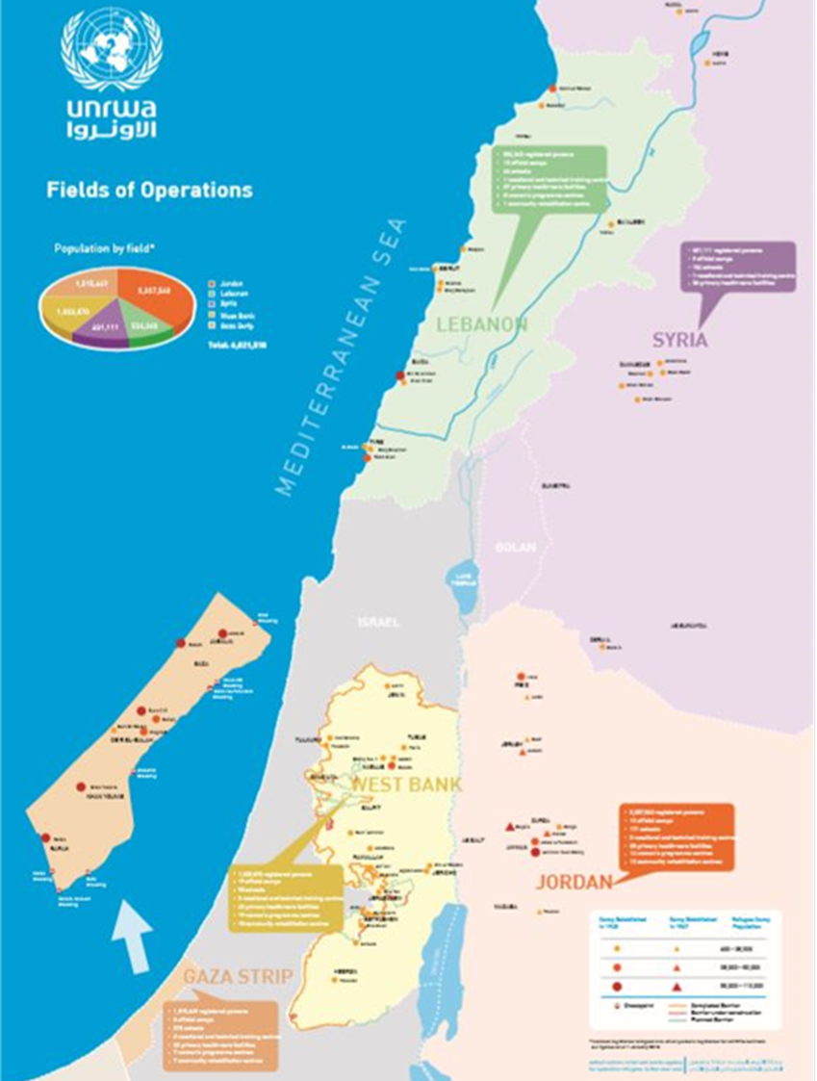
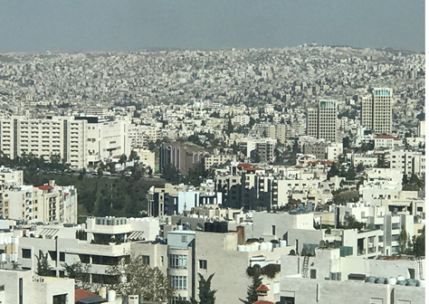
United Nations Relief and Works Agency for Palestine Refugee in the Near East (UNRWA)
Established in 1949, mandated
by the United Nations General
Assembly
Headquartered in Amman,
Jordan
Provides direct relief and social, educational and health programs serving 5.6 m Palestine Refugees in 5 “Fields of Operation”: Gaza Strip, West Bank, Jordan, Syria and Lebanon
Supplementation of iron for anemia prevention and treatment for children and women
Folic acid supplementation for preconcentual, pregnant and postnatal women
Vitamin A supplementation for children
Calcium supplementation for high-risk pregnant women
Notes:
30 sec

Slide 3
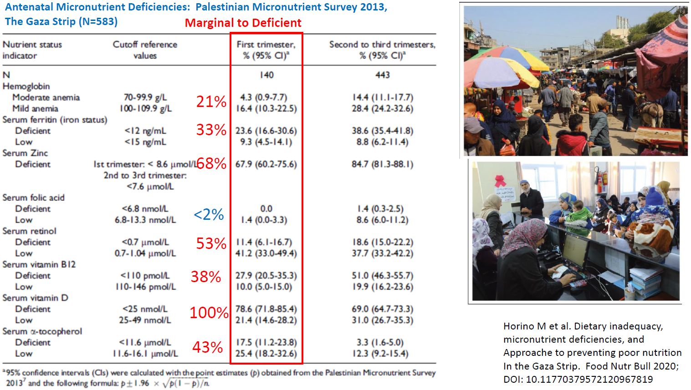

Slide 4
First Grader Nutrition Assessment
July-Sept 2023
School Entrance Health Screening at UNWRA Clinics (April-Sept each year)
Sampled 1-in-3 1st graders in all five Gaza Areas
Assessed N=3,229 children (~10% of all 1st graders)
  Anthropometry, Hemoglobin, Usual Food Frequencies
  Household food security (Arab Family Food Security Score)*
* Sahyoun NR, et al. Development and validation of an Arab Family Food Security Scale.
Development and validation of an Arab family food security scale. J Nutr. 2014;144(5):751-757
Notes:
Each year, UNRWA conducts School Entrance Health Screening for the 1st graders at UNRWA clinics between April and September.
In May of 2023, the UNRWA decided to conduct a survey to assess family food security level of 1st graders.
The data collection was conducted from July to the first week of September.
Every 3rd child was systematically recruited to be in a study from 6 HCs actively screening.
3229 children were enrolled in the study, which is roughly 10% of 1st graders enrolled in UNRWA schools in Gaza.
Data was collected on child anthropometry, hemoglobin, food frequency, and household food security, measured by the Arab Family Food Security Score which has been validated and used frequently to measure food insecurity levels among Arab families.

Slide 5
Household & Child Status | N (%)
Household Status | 3229 (100)
Receiving Food Assistance | 2694 (83.9)
Food Security (7-pt scale)
Food Secure (0-2 pt) | 787 (24.9)
Mild/Mod Food Insecure (3-5 pt) | 1025 (32.5)
Severe Food Insecure (6-7 pt) | 1343 (42.6)
Child Status | 3229 (100%)
< -2 HAZ (Stunting) | 94 (2.9)
< -2 BMIZ (Wasting) | 128 (4.5)
Minimum Dietary Diversity (≤4 Food Groups) | 2225 (68.9)
Anemia (<11.5 g/dL) | 963 (29.8)
Notes:
Among the families with a young children, 84 % relied on food assistance, 33% were moderately food insecure and 43% were severely food insecure.
Among children, 3% was stunted and 5% was wasted and 25% of children were anemic.

Slide 6
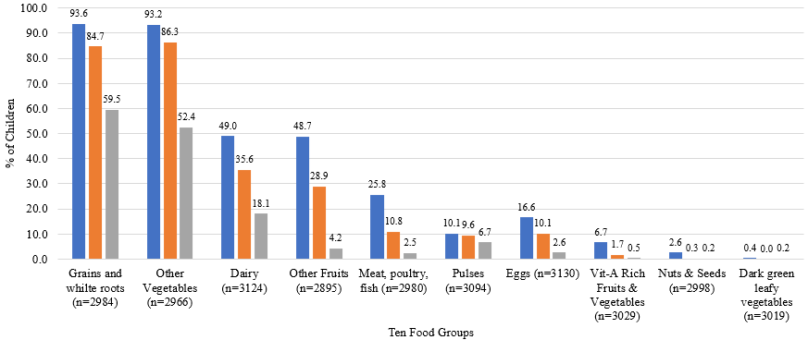
Precent of Children Meeting Daily Equivalent of 10 Nutritious Food Groups by Food Security Classification, 1st Graders, Gaza Strip, July-Sept 2023 (N=2895~3124)
Food Secure Households
Moderately Food Insecure Households
Severely Food Insecure Households

Slide 7
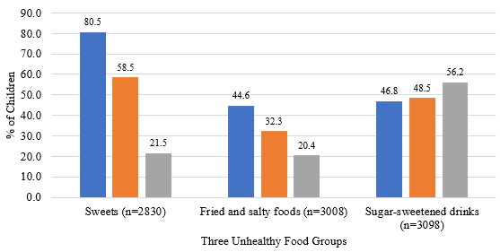
Precent of Children Meeting Daily Equivalent of 3 Unhealthy Food Groups by Food Security Classification, 1st Graders, Gaza Strip, July-Sept 2023 (N=2830~3098)
Food Secure Households
Moderately Food Insecure Households
Severely Food Insecure Households

Slide 8
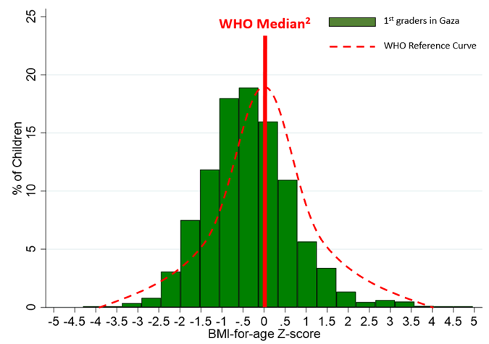
BMI-for-Age Z-score of Gaza 1st Graders
July-Sept 2023 (N=2915)
Notes:
This is a distribution of weight-for-height z-score among 1st graders. As you can see, the distribution of children in Gaza is shifted to the left compared to the WHO media. With the current situation in Gaza, with massive destruction, dislocation, limited access to water and food supplies, the distribution is expected to shift further to the left.

Slide 9
BMI-for-Age Z-score by Household Food Insecurity Classification, children entering 1st grade, Gaza, July – September 2023 (N=2854)
Household Food Security Classification | Total N (%) | BMI-for-Age Z-score² N (%)
 |  | <-2 | -2 to -1.01 | -1 to -0.01 | 0 to 0.99 | ≥1
Food Security²
All Categories | 2854 (100) | 128 (4.5) | 625 (21.9) | 1116 (39.1) | 713 (25.0) | 272 (9.5)
Food Secure (0-2) | 691 (24.2) | 27 (3.9) | 147 (21.3) | 254 (36.8) | 187 (27.1) | 76 (11.0)
Moderate Food Insecure (3-5) | 936 (32.8) | 37 (4.0) | 170 (18.2) | 368 (39.3) | 255 (27.2) | 106 (11.3)
Severe Food Insecure (6-7) | 1227 (43.0) | 64 (5.2) | 308 (25.1) | 494 (40.3) | 271 (22.1) | 90 (7.3)

Slide 10
Conclusion
A final and unique view of food security, nutrition and diet of families and children in Gaza before the current war
Study revealed a highly food insecure population with marginally malnourished children entering 1st grade, likely being maintained by heavy dependence of food aid
Poor dietary diversity is likely the underlying cause of widespread micronutrient deficiencies and anemia in Gaza
With current disruption, dislocation, very limited access to water, food, electricity and medical supplies, families and children in Gaza risk dehydration, starvation, infectious disease and mortality.
Any mitigating relief programs are in an immediate need
Notes:
The study reveals that families in Gaza were heavily dependent on food aid, highly food insecure, and marginally nourished with undernourished children especially in the families with severe food insecurity.
However with the massive disruption, dislocation, without very limited supply of water, fuel and food aid and medical supplies, families and children in Gaza risk dehydration, starvation, infectious disease and mortality.

Slide 11
Recommendations
Any mitigating relief programs are in an immediate need
  Vitamin A supplementation to reduce child mortality
  Zinc tablets with oral rehydration salts
  Micronutrient powder for children
  Multiple Micronutrient Supplementation for pregnant women
  Ready to eat therapeutic/non-therapeutic foods
Notes:
The study reveals that families in Gaza were heavily dependent on food aid, highly food insecure, and marginally nourished with undernourished children especially in the families with severe food insecurity.
However with the massive disruption, dislocation, without very limited supply of water, fuel and food aid and medical supplies, families and children in Gaza risk dehydration, starvation, infectious disease and mortality.

Slide 12
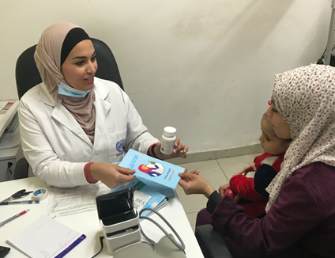
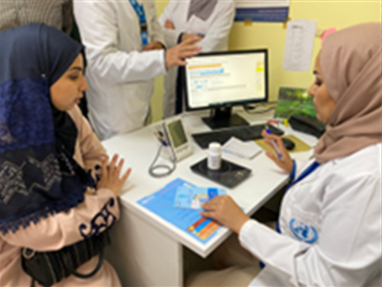
UNRWA’s MMS Programme & Implementation Research
WHO Guideline (2020) recommends use of MMS in the context of rigorous research
Implementation Research on MMS in Jordan (March 2022 to Jan/Feb 2023)
  10-month Program Evaluation
  MMS (13 clinics) vs IFA (12 clinics)
  Acceptability
  Adherence
  Coverage
  Fidelity
Lessons learned will be applied to other fields (Palestine, Lebanon, Syria)

Slide 13
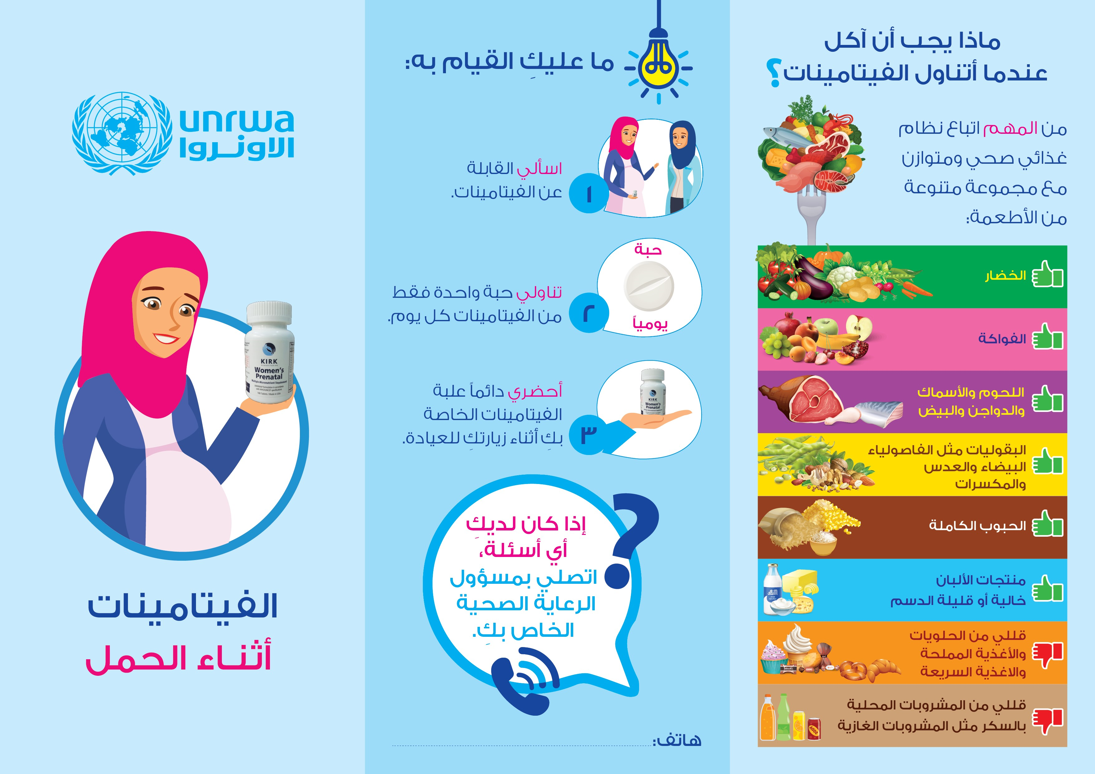
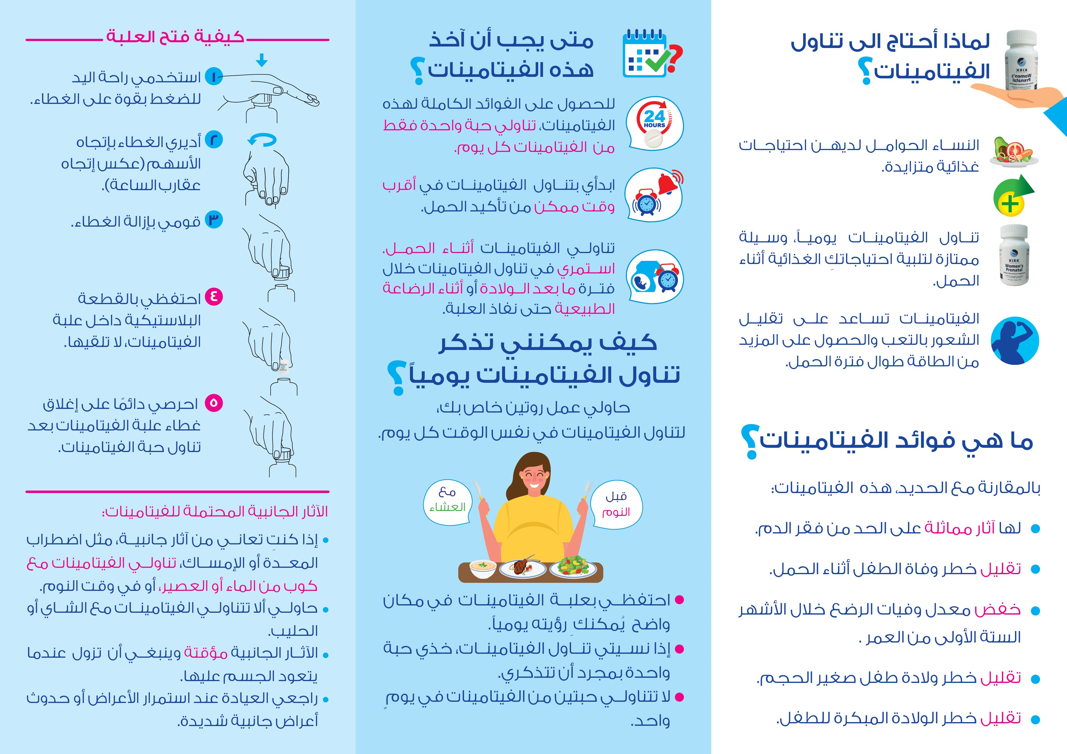
MMS Education Handout

Slide 14
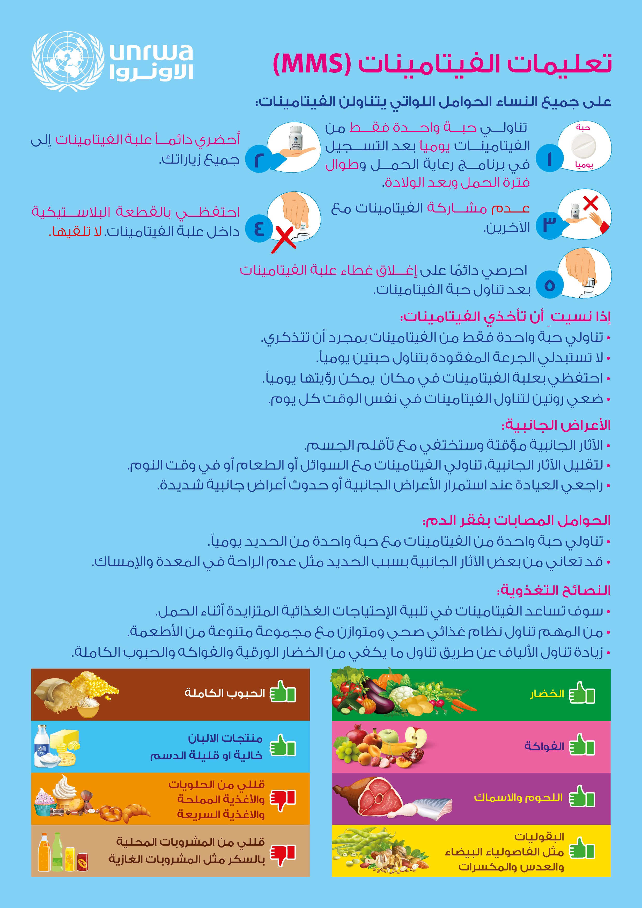

Slide 15
Thank You!

