Slide 1


ESA Regional
Meeting
nutritioncluster.net
East and South Africa Regional Nutrition Consultation Meeting
Day 2
Movenpick Hotel, Nairobi
30-31 January 2024

Slide 2

Localisation
Denis Kioko Matheka
Martha Nakakande
Alexa Humphreys

Slide 3


What is localisation?
There is no single definition and interpretations of the term “localisation” vary across stakeholders and contexts
GNC Anti-racism & Localisation Working Group:
“Localisation is based on the recognition of an imbalance of power between international actors and the communities that they serve. Localisation is a restorative process involving recognition, respect, appreciation, and investment in local and national humanitarian capacities, leadership, and local and national resources. The aim is to replace this imbalance with locally-driven, locally-led, and locally-owned response to better and more sustainably meet the needs of affected populations"
- Inspired by The Grand Bargain, Arbie Baguios, and Oxfam
The Grand Bargain frames localisation as being:
“as local as possible, as international as necessary”
Signatories have pledged to increase cash programming, strengthen the humanitarian-development nexus, promote greater participation of affected persons in decision-making, and provide more support to national and local responders.
Session Title: Localisation
Date: 31 January 2024
ESA Regional
Meeting
Notes:
The first question you may have is, what is localisation?
There is no globally agreed upon definition of the term "Localisation"
The Grand Bargain focused on some characteristics but did not issue a clear definition
To help the GNC understand localisation for our work, the Anti-racism & Localisation Working Group developed the following understanding of localisation.
However, we also acknowledge that the term localisation is top-down in nature and will likely be replaced in the future.

Slide 4
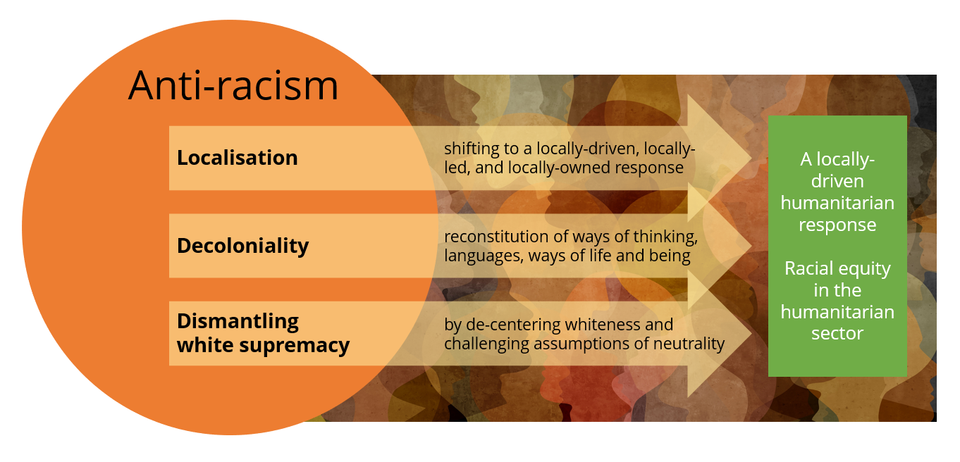
How the GNC connects Anti-racism and Localisation
Session Title: Localisation
Date: 31 January 2024
ESA Regional
Meeting
Notes:
Further, this working group believes that when localisation is implemented as a restorative process, it contributes to anti-racism efforts and the ultimate vision of racial equity in the humanitarian sector. Furthermore, the working group acknowledges that critiques of the Localisation Agenda highlight that racism in the sector has not been sufficiently addressed. Therefore, localisation contributes to anti-racism efforts, but localisation alone is not sufficient for transformative change. Combining anti-racism with localisation provides a more comprehensive manner to meet our main objective while meaningfully confronting racism and power imbalances as manifested in our work.

Slide 5
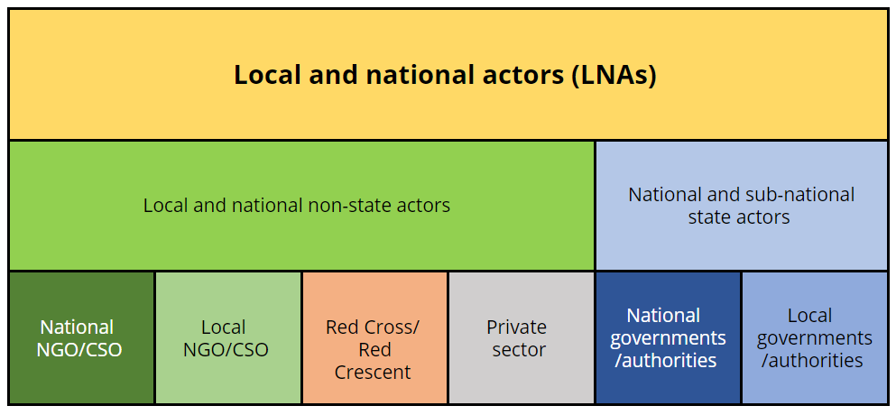
Who is a local or national actor?
These are generally the types of actors that are considered local or national, depending on the context
Session Title: Localisation
Date: 31 January 2024
ESA Regional
Meeting
Notes:
The second question you may have is, who is a local or national actor?
The question of who is ‘local’ is debated within the sector, and the official Inter-Agency Standing Committee (IASC) definition is highly contested by many home-grown organisations across the Global South because it allows for international actors to “localize” their operations. Generally speaking, and without getting lost in definitions, these are the types of actors that are considered local or national in our sector, however, these are context specific and should always be discussed with in-country actors.

Slide 6














Panel Discussion
Linnet Achieng'
Nutrition Manager
Kenya Red Cross Society
Abdi Omar
Program Manager
Waso Resource Development Agency
Firaol Bekele Bayecha
Nutrition Focal Person
Ethiopian Disaster Risk Management Commission
Ines Lezama
Nutrition Cluster Coordinator
UNICEF
Blessings Muwalo
Deputy Director of Nutrition
Malawi Ministry of Health
Stanley Mwase
Nutrition Specialist
UNICEF
Session Title: Localisation Date: 31 January 2024

Slide 7



Support and resources for localisation
Newly established Localisation Helpdesk
Inter-Agency Toolkit on Localisation in Humanitarian Coordination
The Ops Team is partnering with various actors to provide on demand organizational capacity strengthening opportunities for LNAs (funding dependent)
Coming soon Localisation
e-learning module targeting cluster coordination groups
Session Title: Localisation
Date: 31 January 2024
ESA Regional
Meeting

Slide 8


ESA Regional
Meeting
asante
Mwebale
አመሰግናለሁ
Zikomo kwambiRi
Gracias
Thank you
Denis Kioko Matheka
dmatheka@unicef.org
Martha Nakakande
mnakakande@internationalmedicalcorps.org
Alexa Humphreys
ahumphreys@actionagainsthunger.ca

Slide 9

Advancing a HDP Nexus approach to nutrition
31st January 2024

Slide 10
Introduction

Slide 11
Session objectives
Sharing country experiences in advancing a Nexus approach to nutrition
Identifying common constraints and exploring how they can be overcome
Discussing the role of the Nutrition Cluster at country, regional & global levels
ESA Regional
Meeting

Slide 12
Session plan
Definitions (5 mins)
Ethiopia (10 mins)
Yemen (10 mins)
Madagascar (5 mins)
Kenya (5 mins)
South Sudan (5 mins)
Reactions from participants (15 mins)
Summary and next steps (5 mins)
ESA Regional
Meeting

Slide 13
What is a HDP Nexus approach?
Collective outcomes: Reduce needs, risks and vulnerabilities – prevent, prepare and respond to malnutrition – sustainably.
A collaborative and coherent way of working between humanitarian, development and peace actors
Drawing on respective comparative advantages
Convergence of HDP actions on the same at-risk populations
ESA Regional
Meeting

Slide 14
Ethiopia
Notes:
I’ve been asked to provide a general overview on the HDP Nexus and global experiences. I want to set the scene by giving you a sense of how the overall work on the Nexus has been proceeding at the country level and in Ethiopia. The following presentations in the training will provide deeper dives into the issue of the HDP Nexus in nutrition – examples, challenges, etc. Collaboration for the reduction of humanitarian needs and vulnerabilities across on the most pressing issues faced by a given country, requires a multi-stakeholder, multi-actor and a systems approach, something that we are working on here in Ethiopia. That means that all actors and sectors must contribute to the development and operationalization of the approach. That is why this initiative on Nexus and Nutrition by MoH is so welcome and important.

Slide 15
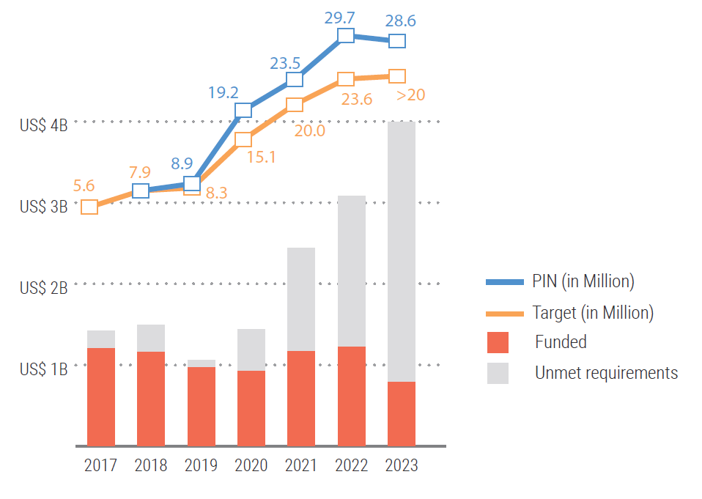
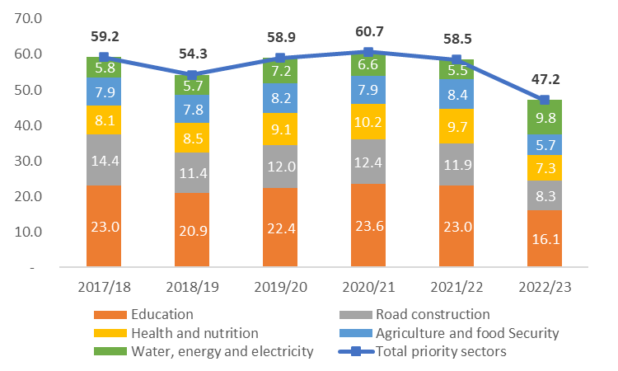
HDP Challenges in Ethiopia
Persistently high and growing levels of year-to-year humanitarian needs
Volatile security context and trends toward intensifying natural shocks and disasters, due to climate change
Humanitarian action in “fire-fighting mode” and unable to fully meet all the needs
Challenging financial environment – economic, humanitarian and dev aid
Disconnects between H-D systems and HDP actors at national/subnational levels
Limited joint planning frameworks, coordination systems and financing divides
Fragmentation among development actors and peace actors

Slide 16
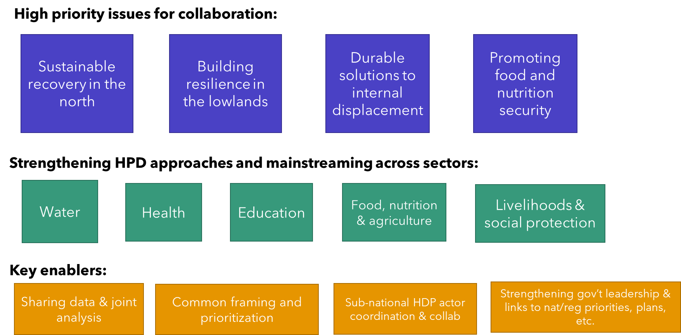
DPG-HCT Nexus Priorities in Ethiopia
Multi-sectoral and multi-sectoral in Ethiopia - Development Partners Group and the Humanitarian Country Team – the two biggest aid coordination bodies in Ethiopia – agreed in May 2023 to establish joint coordination structures at national level and have outlined a series of points for the way forward to strengthen HDP Nexus collaboration.
16

Slide 17





Ministry of Health (MoH) and Action Against Hunger (ACF)
Materialization of Nutrition Centric-Humanitarian, Development and Peace Triple Nexus Initiative (NC-HDPTN) in Ethiopia

Slide 18
Background
This agenda has been raised and received global attention on World Humanitarian Summit since 2016.
Despite this, there is no clear road map/framework to facilitate the materialization of this initiative in Ethiopia.
Ethiopia has planned to start materialization of the NC-HDPTN initiative this year and this has been an Advocacy Priority in 2023 SUN Joint Annual Assessment.
Ministry of Health (MoH) through her Excellency Dr. Lia Tadesse, Minister of Health, has initiated the initiative after high level discussion with ACF regional and country directors
The materialization of NC-HDPTN is now started with the support from Action Against Hunger.
As a starter, we aim to develop an Operational Guide (OG) and Implementation Roadmap (IR) that will serve all stakeholders in operationalizing the NC-HDPTN.

Slide 19
Milestones/Phases
Phase 1: Situation Analysis and Stakeholder Consultations on the NC-HDPTN in Ethiopia (6 weeks)
Phase 2: Draft NC-HDPTN OG and IR and Stakeholders Consultation Workshop (10 weeks)
Phase 3: Validation of NC-HDPTN Operational Guideline and Implementation Roadmap (5 weeks)
Phase 4: Rollout of NC-HDPTN Operational Guideline and Implementation Roadmap (12 months)
Phase 5: Establishing NC-HDPTN Monitoring and Evaluation System
Phase 6: Developing and implementing NC-HDPTN Advocacy and Communication guide

Slide 20
Stakeholders for NC-HDPTN
Government Sector Ministries: EDRMC, MoA, MoE, MoWE, MoF, MoPD, MoPeace, MoWSA
Donors: USAID, FCDO, IRISH AID, ECHO, EU…
UN: Office of the UN Resident coordination, ENCU, UN OCHA, UNICEF, WFP and FAO
DPG-HCT Group
Cluster Coordination's: Nutrition Cluster, Food cluster, Agriculture Cluster, WASH Cluster, Education Cluster, Health Cluster:
NGOs: ACF, World Vision, Save the Children, Dan Church Aid, Concern World Wide, Oxfam GB, CRS, NCA, HELVETAS, People in Need, WELTHUNGER HILFE, R2G Partnership…
SUN Networks: ECSC SUN, SUN Academia, SUN Business, SUN UN Nutrition and SUN Donor Network
Networks: Ethiopian Peace Building Network (EPBN)

Slide 21
Looking ahead
DPG – HCT will be looking to develop a common HDP Nexus Framework in the coming year
Regional HDP Nexus coordination likely to begin in the coming year
Somali Region, under its Multi-Year Resilience Plan, early pilot region
Sectors and clusters currently kick-starting collaboration on developing joint HDP Nexus thinking and approach
MoH Nutrition HDP Nexus initiative will be contributing to and will be reinforced by overall approach

Slide 22
Some key considerations for Nutrition HDP initiative
Ensure initiative does not reinforce sector or issue a silo but as a part of a broader, mutli-sectoral HDP Nexus approach, looking at possibility of simultaneous need reductions across several sectors.
Ensure that Nutrition HDP initiative is informed by multi-sectoral analysis of root causes
Conceptualize framework in terms of interlinkages with other issues (system approach)
Inter-sectoral govt collab and clear links to national/regional plans (3 YDP, food systems, etc.)
Consider the incremental piloting, phasing and scaling of the approach – will support area-based approaches
Link with other multi-sectoral Nexus, resilience, recovery initiatives/coordination structures where possible.
Conceptualize links between nutrition, conflict sensitivity, social cohesion/peace

Slide 23
N4D activities and reflections
N4D is working with MoH and ACF in Ethiopia for the nutrition centric HDPTN
N4D has reviewed the situation analysis and proposed improvements
Ongoing support from N4D on the development of OG and IR
Development of a Theory of Change for NCHDPN for OG
Need for a review of current broader institutional arrangements and initiatives to strengthen HDPN in Ethiopia, how these will align with and support NC-HDPTN and how cross-learning will take place.
Emergency NC-HDPTN approach will need a clearly articulated communication and advocacy strategy to ensure complementarity and alignment with ongoing HDPTN initiatives
n4d.group
Notes:
TABLE

Slide 24
Yemen
Lessons relevant for ESAR

Slide 25
What is happening to advance a Nexus approach to nutrition in Yemen?
The SUN Yemen Secretariat (Ministry of Planning) = the national mechanism responsible for coordinating all HDP nutrition actions across sectors and throughout the country.
It is accountable to a multistakeholder high level Steering Committee bringing together HDP actors, with representation from Line Ministries (across the political divide), donors, UN, Yemeni and international NGOs.
The Secretariat facilitates Technical Working Groups on NIS, financing, advocacy and an overall multisectoral technical team. - provide technical spaces for HDP actors (Line Ministries, Clusters etc) to collaborate.
The Yemen Multisectoral Nutrition Action Plan = overarching strategic framework for all HDP nutrition actions. Currently being updated up to 2030. Integrates nutrition relevant interventions implemented by the Nutrition &other Clusters from the HRP.
The Secretariat is leading the development of National Guidelines on a HDP Nexus approach to nutrition – present the consensus of all HDP actors on how they collaborate to coherently & sustainably reduce all forms of malnutrition.
Yemen Partners Nutrition Working Group – provides space for international partners to coordinate and align their support in SUN Yemen processes.
The Nutrition Cluster is increasingly involved to ensure integration of HRP nutrition actions into MSNAP and ensure a coordinated approach in implementation, monitoring etc
ESA Regional
Meeting

Slide 26
Achievements to date. Factors contributing to progress.
Increased recognition amongst national and international actors of:
Role of SUN Yemen structures in coordinating HDP actions across sectors.
Ability of the SUN Yemen Secretariat to bridge the political divides.
The MSNAP as the overarching strategic actions for all HDP actions relevant to nutrition.
Nutrition is providing a focus for bridging political divides by encouraging dialogue and trust building at a technical level.
Increased recognition that progress can be made at a technical level and local systems can be supported and strengthened whilst ¨maintaining distance¨ from de facto political authorities.
Nutrition is providing a focus for increased collaboration and trust between HDP actors (Line Ministries, Clusters, UN agencies, donors etc) – setting an example for a wider HDP Nexus approach.
Key enabling factor: Intensive engagement by the SUN Yemen Secretariat with senior management of international partners (e.g. UN RC/HC, Heads of UN & donor agencies) in order to raise awareness of its role and to build trust and confidence in its ability to withstand political interference.
ESA Regional
Meeting

Slide 27
Key constraints and solutions.
Despite achievements a lot remains to be done to turn commitments to a Nexus approach into action and improved nutrition outcomes for vulnerable people.
Progress has been constrained by a lack understanding about the role of the SUN Yemen Secretariat & the way in which it was trying to work across the political divide and across the country in order to facilitate and coordinate multisectoral nutrition actions.
Better political economy analysis to identify existing national and local actors & systems & analyse their existing and potential roles and interests, their commitment to ensuring services reach the most vulnerable and how they can be supported to play their role and withstand political pressures.
On-going engagement with partners with senior managers and technical specialists to encourage proactive participation and collaboration across the Nexus.
Need advocacy in donor capitals to raise awareness of opportunities to support and strengthen nationally led technical processes and scale up multisectoral development actions alongside humanitarian assistance.
ESA Regional
Meeting

Slide 28
What further support can the Nutrition Cluster provide?
National Nutrition Cluster
Share information on plans & implementation under the HRP
Support identification and targeting of non-HRP interventions under the MSNAP particularly on prevention and systems strengthening
Support strengthening of national Nutrition Information System building on Cluster information systems
Mobilise other Clusters to engage and also do above
Support from regional and global GNC
Help countries capture and share learning
Advice to National Nutrition Clusters on how to contribute to a Nexus approach whilst maintaining focus on core mandate
Engagement with other Clusters at global and regional levels to agree a joined up approach to help advance the Nexus at country level.
ESA Regional
Meeting

Slide 29
Madagascar, Kenya & South Sudan

Slide 30
Questions
What is the National Nutrition Cluster doing to help advance a Nexus approach?
Main achievement to date and what contributed to success?
Main constraint to progress and what needs to be done to overcome that constraint ?
What support has / can the GNC provide from regional or global level?
ESA Regional
Meeting

Slide 31
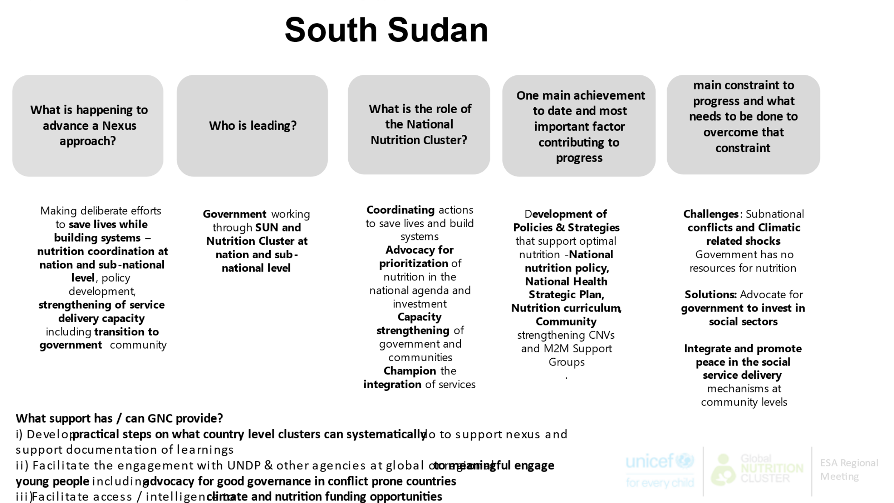

Slide 32
Madagascar
What is happening to advance a Nexus approach?
Transition of the cluster to sectoral coordination / Nutrition Technical Group: hybrid approaches encompassing both development and humanitarian responses affecting the entire territory..
Implementing the Humanitarian Development Nexus through Technical working groups : Prevention and treatment of wasting ,
GAS Committee – Supply for nutrition ,
IYCF Task Force , Nutrition information system,
Accountability for affected population , Adolescent girls and women nutrition
ESA Regional
Meeting

Slide 33
Role and lead of sectorial group nutrition
 | Cluster /Sector nutrition
The rôle of sectorial nutrition group | Strengthening local capacities and national systems for emergency preparedness and response, + Humanitarian-Development Nexus.
Who is leading | National: Lead: National Office of Nutrition (ONN) Co-lead: Ministry of Health's Nutrition Service Co-coordination: UNICEF
reunion | Regional: Lead: Regional Office of Nutrition (ORN) Co-lead: Regional Health Directorate Co-coordination: UNICEF or NGO
 | District: Lead: District Health Service (Lead) Co-lead: Regional Office of Nutrition Supervisor (Co-lead) Co-coordination: UNICEF or another NGO
Nutrition Cluster is officially activated for 21 districts and 6 regions of the South and Southeast, but contingency planning at national level (for floods and cyclones)

Slide 34
One main achievement to date and most important factor contributing to progress
IYCF Task Force
-Infant and Young Child Feeding in emergency contexts: capacity analysis, operational guidelines, donation management plan, and breast milk substitute (Support GNC-TA) -Quality improvement of contingency planning for floods and cyclones, with a strong leadership of the ministry of health/ nutrition services; -Extension of preparedness activities at national level Scale up plan for IYCF, including IYCF-E

Slide 35
Most important factor contributing to progress
Madagascar revised his national nutrition policy and developed a new National Multisectoral Action Plan for Nutrition (2022-2026) in 2022 : this plan includes cross-cutting axis on emergency response.
The IYCF Task Force, led by the Ministry of Health, actively participates in the preparation and response to emergencies.
The role of the Office of Nutrition as the lead of the nutrition sector group and the Ministry of Health's Service Nutrition as the co-lead.
ESA Regional
Meeting

Slide 36
Main constraint to progress and what needs to be done to overcome that constraint
Limitation of resources to implement the activities of the National Multisectoral Action Plan for Nutrition.
Many vulnerable regions in Madagascar are not covered by nutrition partners.
Recommendations ;
- Strengthening partner coordination.
-Prioritize vulnerable areas in the implementation of development activities.
ESA Regional
Meeting

Slide 37
What is the role of the National Nutrition Cluster?
1. Support the delivery of Nutrition services and contribute to ensuring their quality.
2. Guide the strategic decision-making for the Nutrition sector.
3. Plan/support the implementation of existing national sectoral strategies and contribute to the realization of the National Nutrition Policy in collaboration with all nutrition partners and Scaling up Nutrition (SUN) networks.
4. Contribute to monitoring and evaluating activities, interventions, and performance of specific Nutrition programs, as well as, in collaboration with the National Nutrition Observatory (ONN), sensitive programs.

Slide 38
What support has / can GNC provide?
Provide technical support technical

Slide 39
Kenya
What is the National Nutrition Cluster doing to help advance a Nexus approach?
Main achievement to date and what contributed to success?
Main constraint to progress and what needs to be done to overcome that constraint ?
What support has / can the GNC provide from regional or global level?
ESA Regional
Meeting

Slide 40
Plenary discussion

Slide 41
Questions for discussion
What is the role of Nutrition Cluster at country level in advancing a Nexus approach to nutrition?
What support do National Nutrition Clusters need from regional and global levels?
ESA Regional
Meeting

Slide 42
Final reflections
Notes:
I’ve been asked to provide a general overview on the HDP Nexus and global experiences. I want to set the scene by giving you a sense of how the overall work on the Nexus has been proceeding at the country level and in Ethiopia. The following presentations in the training will provide deeper dives into the issue of the HDP Nexus in nutrition – examples, challenges, etc. Collaboration for the reduction of humanitarian needs and vulnerabilities across on the most pressing issues faced by a given country, requires a multi-stakeholder, multi-actor and a systems approach, something that we are working on here in Ethiopia. That means that all actors and sectors must contribute to the development and operationalization of the approach. That is why this initiative on Nexus and Nutrition by MoH is so welcome and important.

Slide 43
Some (not all) takeaways
Do not silo a Nexus initiative. It is not a type of programme requiring separate structures and processes.
It is an approach & a way of working to be integrated into existing coordination, planning and implementation mechanisms.
Ensure a Nexus approach to nutrition is integrated into wider Nexus initiatives.
Localization is fundamental to a Nexus approach.
Be proactive in identifying local and national actors that are committed to lead & deliver multisectoral actions across the Nexus
ESA Regional
Meeting

Slide 44
ESA Regional
Meeting
Thank you

Slide 45

Coffee Break

Slide 46
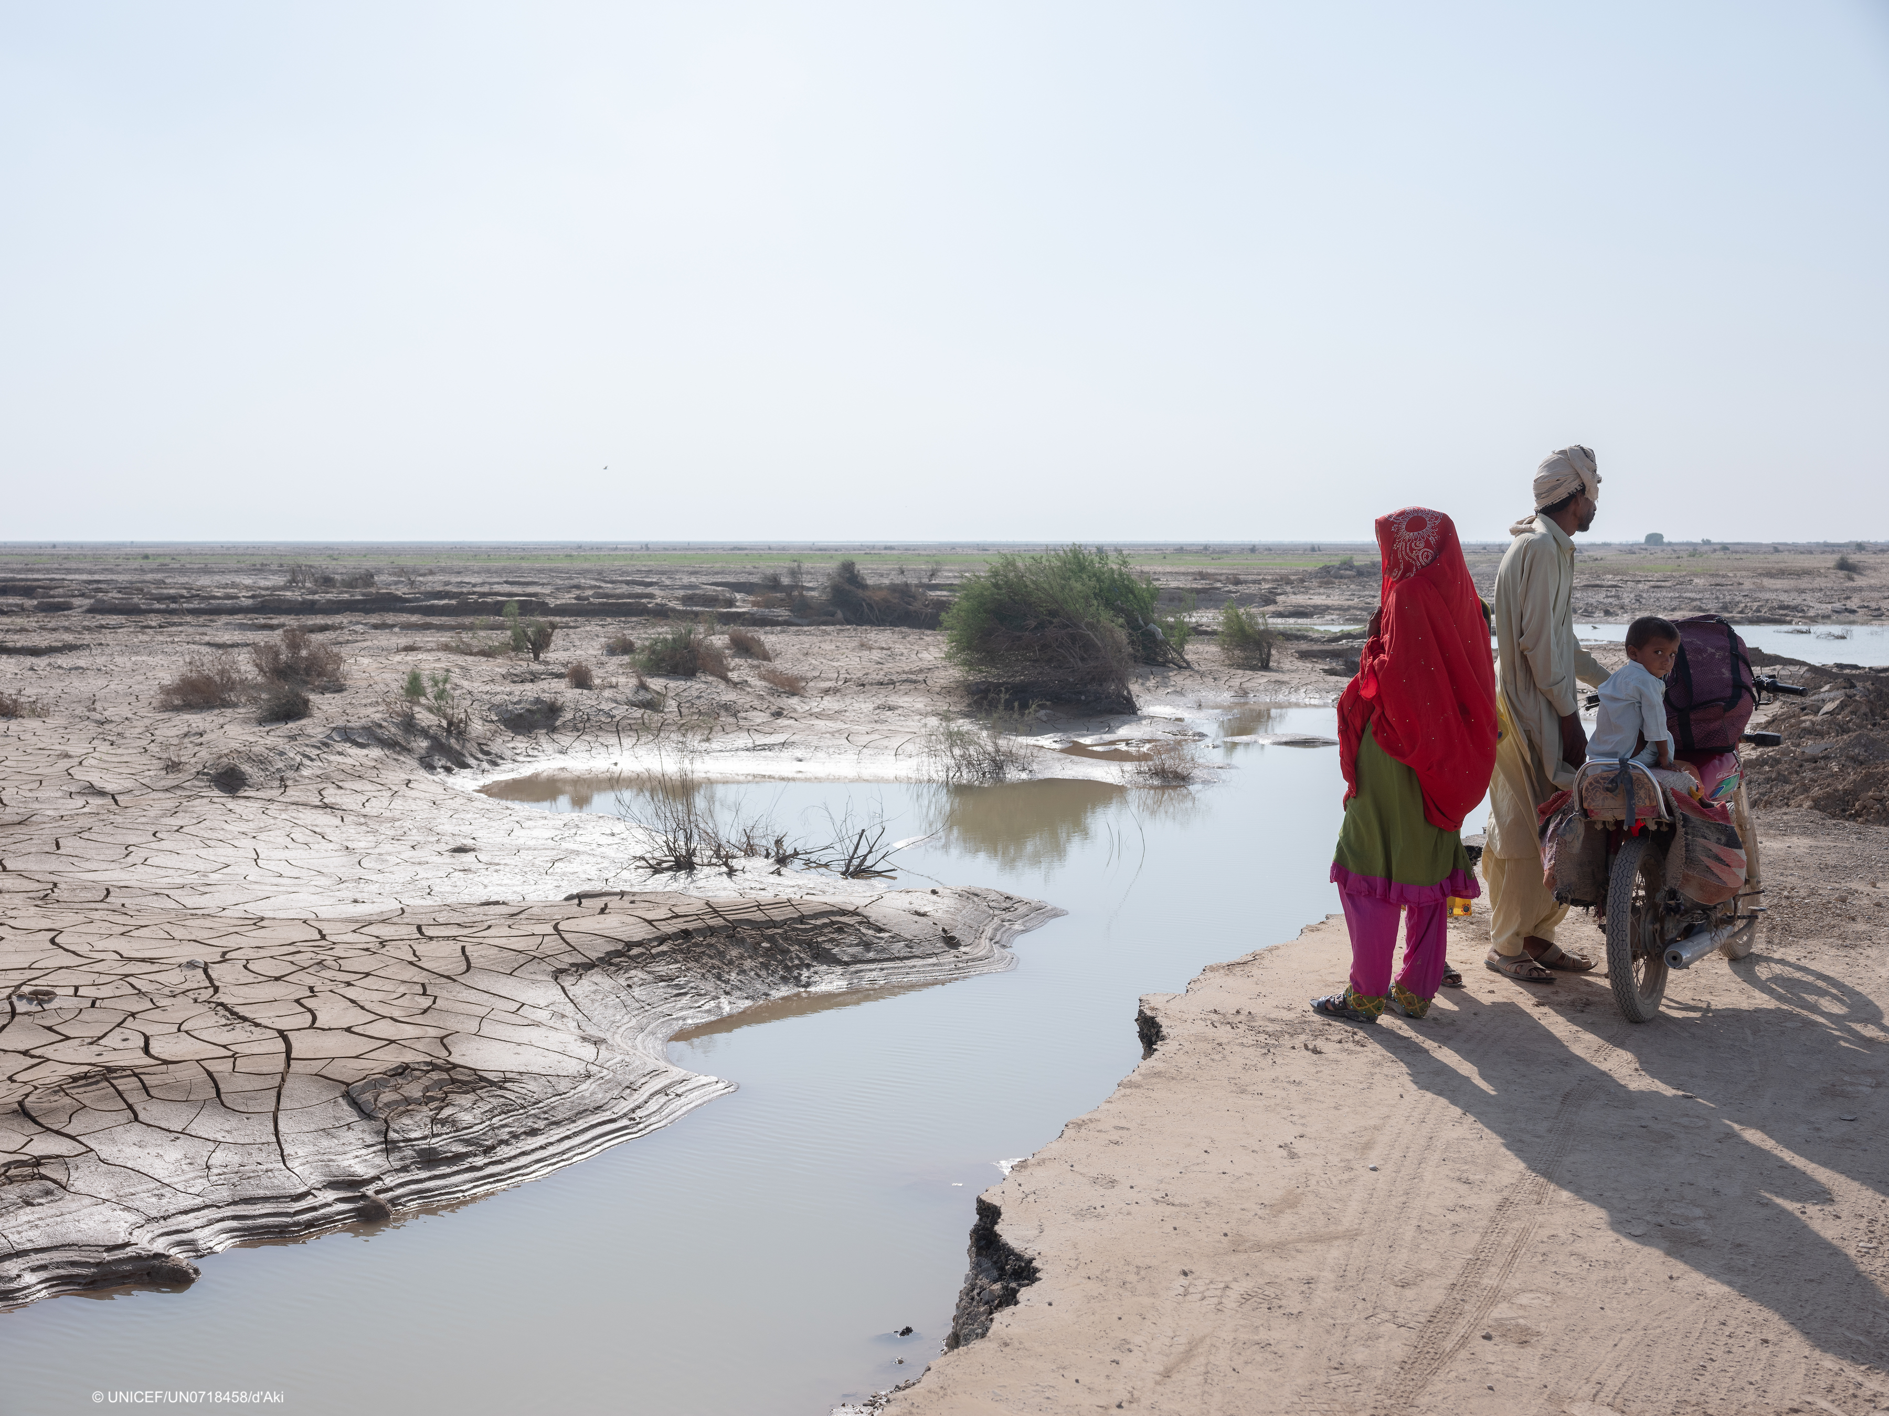
Country Cluster / Sector Carousel
ESA Regional
Meeting

Slide 47
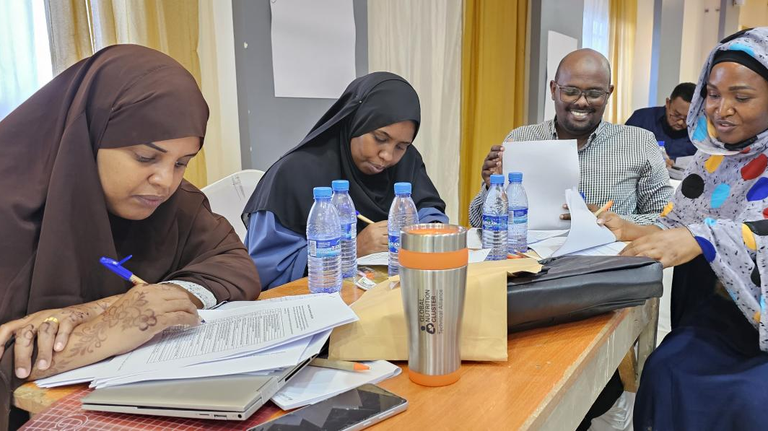
Somalia Nutrition Cluster - Localisation

Slide 48
Objectives
Technical capacity building of national, regional and district level local actors (MOH and NNGOs) in nutrition programming
Support the operational capacity of local actors (FMOH and NNGOs)
Strengthen the participation, decision making, and leadership of local actors in nutrition

Slide 49
Technical Capacity Building - Examples
Prioritization of MOH/NNGOs in all technical capacity building initiatives
Training of inpatient care management targeting MOH/NNGOs managed Stabilization centre – in collaboration with GNC Technical Alliance
IYCF/E - Frequent training targeting MOH/NNGOs (FMOH/UNICEF, SCI)
Mentoring of NNGOs by INGOs – on-jobs training
IPC AMN Training – MOH/NNGOs

Slide 50
Building Operation Capacity
In depth project management capacity building – GNC TA
Priority funding for Somalia Humanitarian Funds (SHF) – >70% of nutrition resources allocated to NNGOs.
Annual workplan support to FMOH and SMOH – UNICEF, WFP, WHO
NNGOs as priority for CLA (UNICEF, WFP) partnership - >70 of PD, FLA
Advocacy INGO and NNGOs partnerships e.g. GREDO – WHH; ACF-WARDI

Slide 51
Governance, Leadership and Coordination
FMOH and SMOH chair of all Cluster Coordination Forums.
Advocacy for Nationals for key positions in CLA and INGO – e.g. co-coordinator, dedicated subnational coordinators etc.
Strengthening integration of nutrition programming in the public health system supported by FMOH/SMOH - minimal NGO/external support or parallel service provision
Integrating nutrition programming reporting into the DHIS2.
Participation the Food Security, Nutrition and Climate Council

Slide 52
Challenges
Weak inclusion of localization agenda in the HNRP process
Proliferation of NNGOs – too many NNGOs, duplications
Verification of NNGOs legal status, operational capacity, field presence etc.
Over reliance on SHF and UNICE/WFP/WHO funding – limited alternative funding opportunities
Low technical capacity of NNGOs – poor quality service provision
Inadequate and unreliable data on nutrition situation and programming

Slide 53
Way Forward
Development of a cluster Localization strategy
Support FMOH to take lead in verification of legal and operation capacity status of NNGOs
Advocate for strengthening nutrition-sensitive (food-based approaches) to prevent acute malnutrition – strengthening local economy and community contribution
Advocate joint comprehensive risk management for local actors- NNGOs
Advocate predictable and flexible funding to local actors – consortiums, diaspora, bilateral/multi-lateral agencies

Slide 54
Way Forward
Strengthen Nutrition Information System e.g. develop a nutrition surveillance dashboard – led FMOH
Strengthen the involvement of local actors in the Social Behavior Change and Communication.
Working with local actors to promote community engagement and including prevention of aid diversion.
Strengthening localized surge capacity – e.g. INGO partnering with NNGOs emergency response.

Slide 55


Mozambique Nutrition Cluster
Judith Barroso Soto
Mozambique Nutrition Cluster Coordinator
Jan 31st 2024

Slide 56




Session Title: Mozambique Nutrition Cluster
Date: Jan 31st 2023
ESA Regional
Meeting

Slide 57
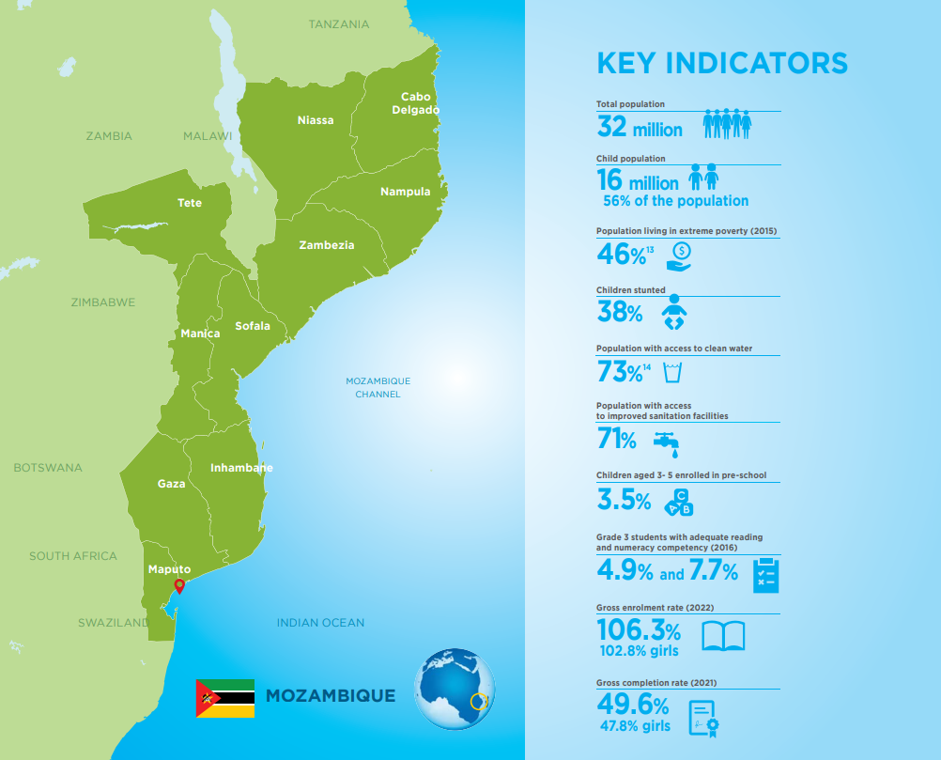
Session Title: Mozambique Nutrition Cluster
Date: Jan 31st 2023
ESA Regional
Meeting

Slide 58
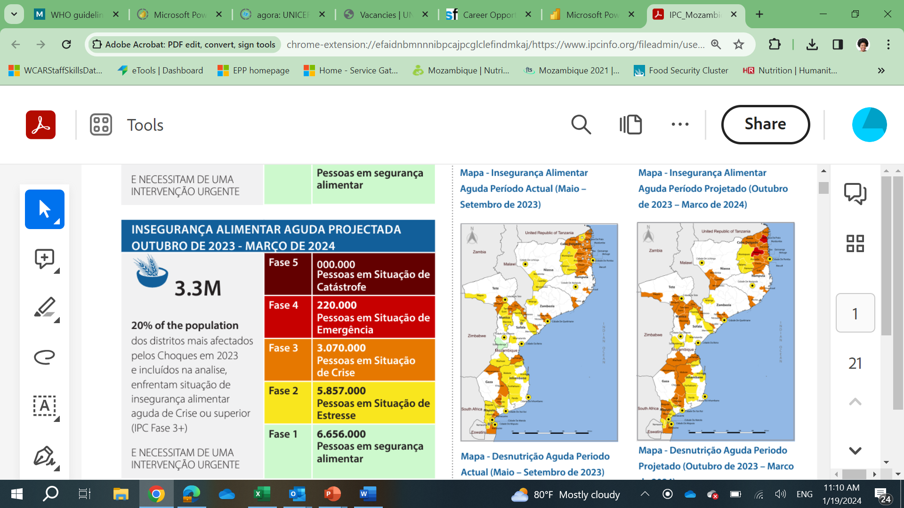
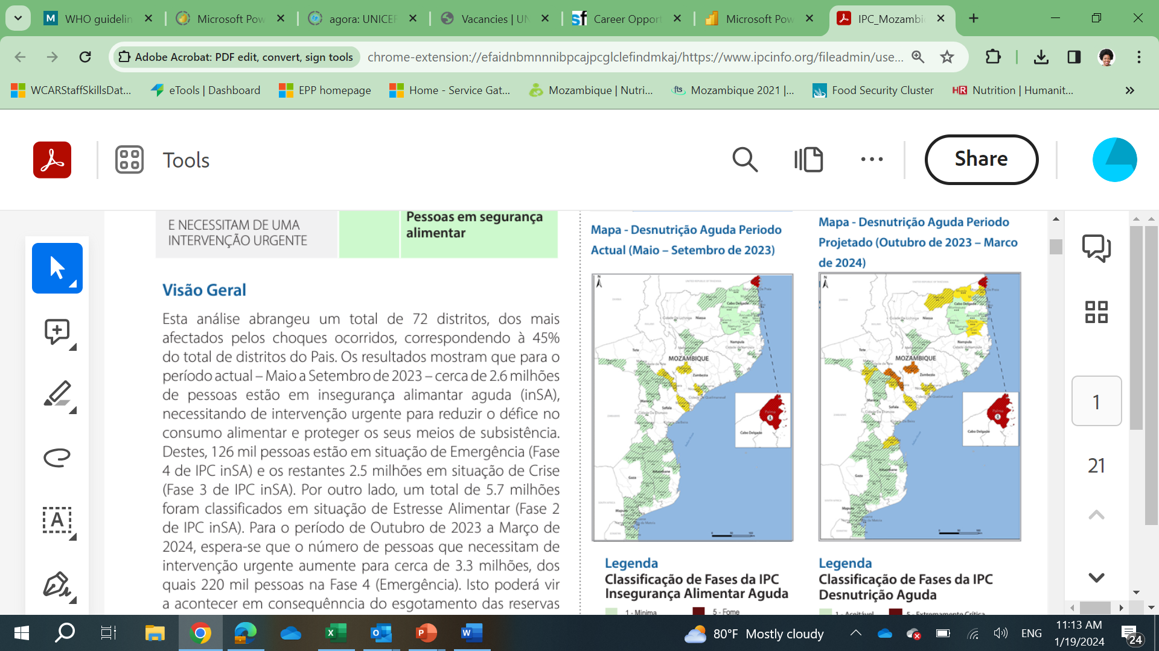
Situation update
Food Security and Acute Malnutrition Situation - October 2023 - March 2024
Mozambique is affected by the worst cholera outbreak the country has seen in 20 years. 30 districts (out of 161) in 7 provinces (out of 11) are affected
Cholera is overwhelming the health systems and limiting delivery of health and nutrition interventions at community level
Reduced coverage of food assistance in quantity and type of food due to limited funding
Limited availability of therapeutic and supplementary nutritional products in the hard-to-reach districts due to challenges in delivery up to the last mile in conflict areas
Persistent residual needs from cyclone Freddy in Zambezia and Sofala requiring NiE support in 2024
El Nino already affecting Southern districts in Gaza – requires regular monitoring of drought impact in increase of wasting cases in CU5 and PBW
3.3 million people food insecure (IPC3+), of which 220,000 people are in IPC Phase 4 to 2
2023/24 agricultural season was poor due to below-average rainfall and above-average temperatures.
Session Title: Mozambique Nutrition Cluster
Date: Jan 31st 2023
ESA Regional
Meeting
Notes:
outcomes are present in southern and central areas most impacted by climate shocks in 2023, where very poor households have already depleted their food stocks earlier than usual.
In Cabo Delgado province, Crisis (IPC Phase 3) outcomes persist in the worst conflict-affected areas

Slide 59
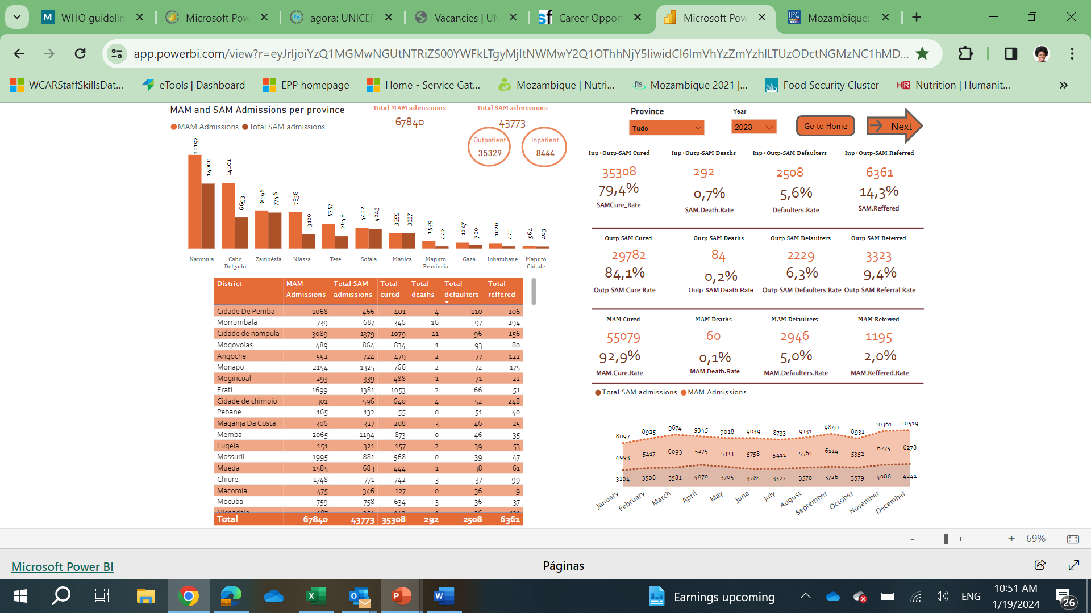
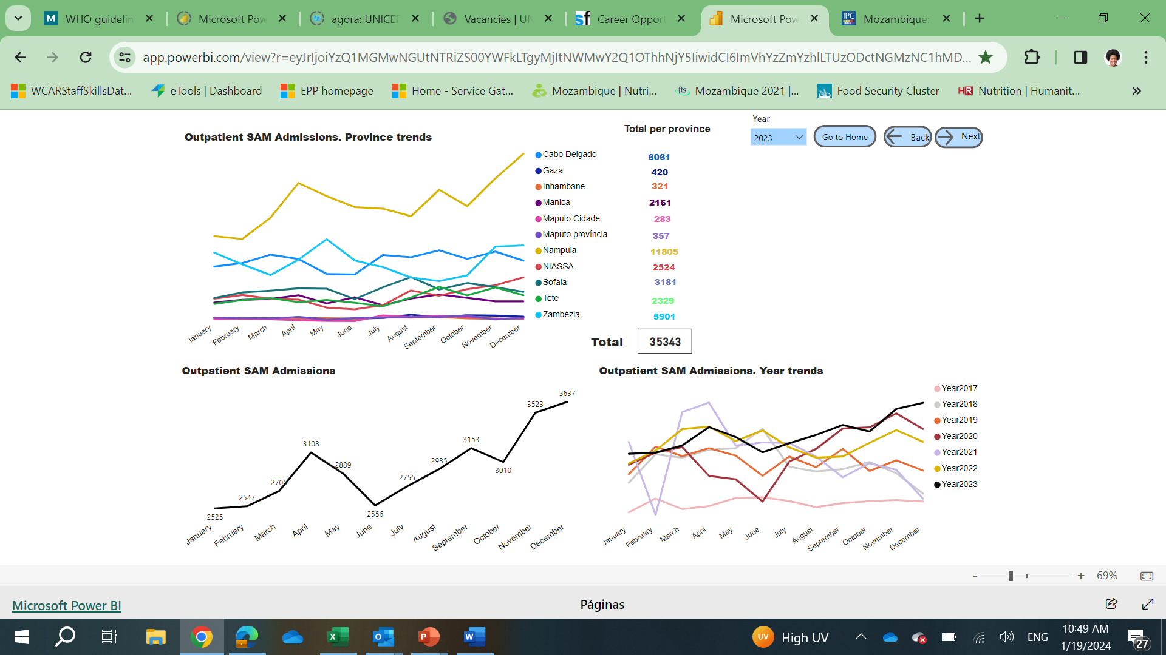
Situation update
Food Security and Acute Malnutrition Situation - October 2023 - March 2024
211,938 U5 in need of lifesaving treatment for wasting (74, 025 SAM & 135,225 MAM) and 72,199 PBW in need of treatment for wasting
Trends in wasting and highlights:
SAM admissions faced a small decline in semester 1 due to the compounding effects of the nationwide cholera outbreak
Significant catch-up in SAM admissions in semester 2
Increase in coverage: 67,840 MAM admissions and 43,733 SAM admissions out of 99,029 SAM cases (>40% coverage)
¾ SPHERE indicators met: 79.4% cure rate, 0.7% mortality rate, 5.6% defaulters
Session Title: Mozambique Nutrition Cluster
Date: Jan 31st 2023
ESA Regional
Meeting

Slide 60
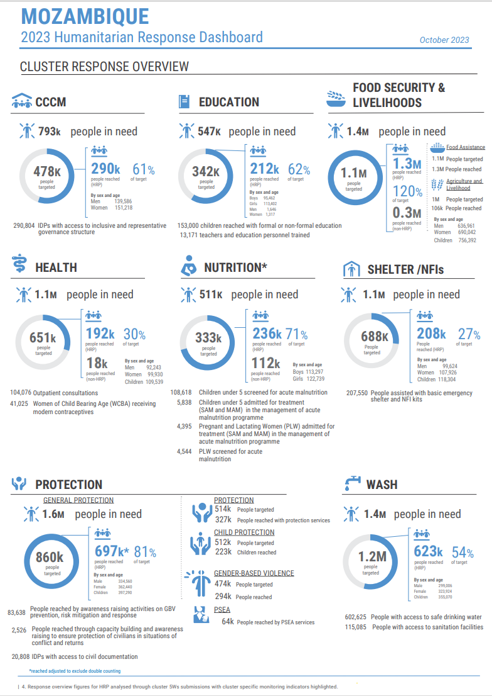
Response
            2023 achievements:
            1,554,578 children under 5 (CU5) out of 1.39 million in need were screened for malnutrition – 111,8% coverage.
            57,449 children out of 99,029 in need received treatment for SAM in community and facility-based platforms– 58% coverage.
            4.2 million children under 5 out of 1,28 million in need received VAS in mobile brigades and integrated measles vaccination and VAS campaign.
            51,312 out of 67,876 CU5 (56% coverage) and 30,361 out of 15,383 (197% coverage) pregnant and breastfeeding women enrolled in targeted supplementary feeding for moderate wasting.
            61,027 children under two enrolled in the Blanket Supplementary Feeding Programme in the districts of Cabo Delgado for prevention of acute malnutrition.
            Technical support to SETSAN to roll out NuVAC in 2024 aligned with the Food and Nutrition Security Information System.
Session Title: Mozambique Nutrition Cluster
Date: Jan 31st 2023
ESA Regional
Meeting

Slide 61
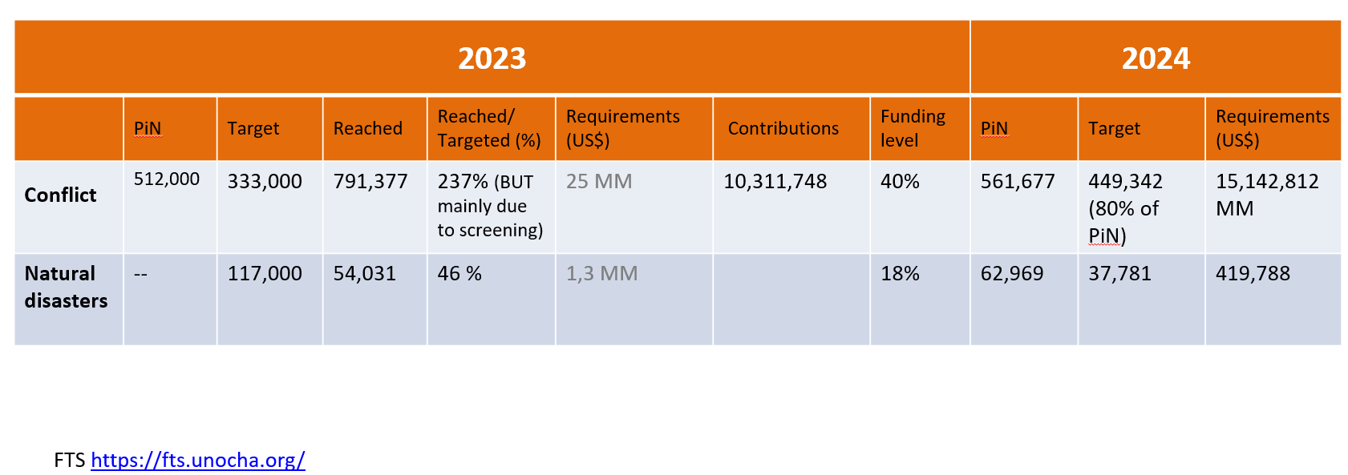
Response
            Challenges
            Enhance the report data, in particular, regarding IDPs and returnees, as well as pregnant and breastfeeding women and children under 2.
              About 50% of the deliveries are outside health facilities and not all registered
              PLW and caregivers do not always speak Portuguese, thus obtaining information can be a challenge.
              Health workers not always disaggregate data for 5W.
            SMART survey uses mostly MUAC measurement that can underdiagnose acute malnutrition
              Yet, low weight in PLW is as high as 18% in the northern provinces.
              Some negative coping mechanisms regarding IYCF and dietary practice have a negative impact.
            Near 50% of pregnancies are in adolescents. Child marriage and pregnancy increase vulnerability for girls.
            Be able to deliver the best quality technical response with 41% of the funding requested in the HRP for 2023 and a decrease of funding request by 40% for 2024.
            Funding gap to procure ready-to-use therapeutic and supplementary food and therapeutic milks F-75 and F-100.
Session Title: Mozambique Nutrition Cluster
Date: Jan 31st 2023
ESA Regional
Meeting

Slide 62
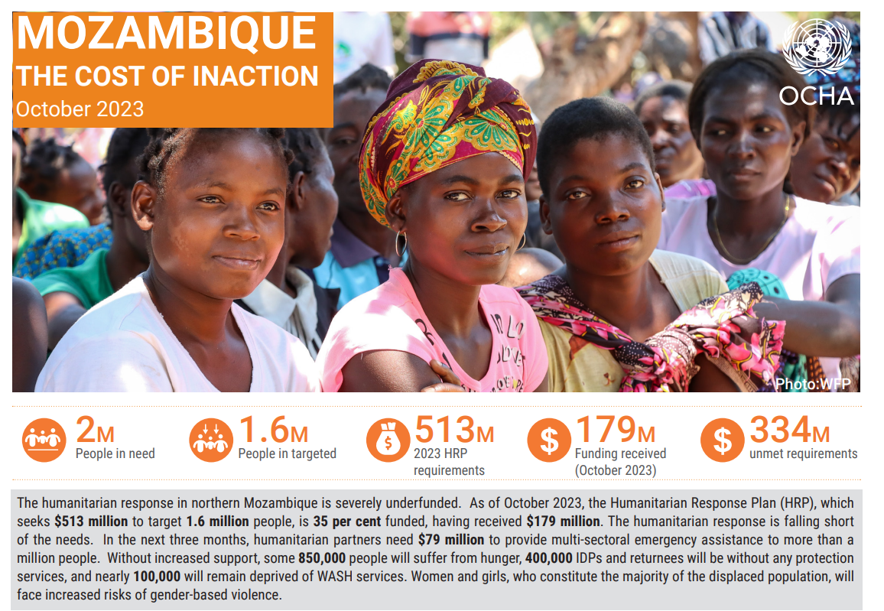
Response
            Key priorities for 2024- strategy
            Enhance the nutrition surveillance and integrated nutrition package at a technical level, and support tracking tools for IDPs/ returnees' population as well as intersectorial networking for case management for conflict areas and those at risk of climate change.
            Advocacy to ensure proper and timely nutrition therapeutic supplies and more accurate reports.
            Ongoing fundraising for SMART survey in Cabo Delgado province by April 2024
            Continue enhancing the partners’ response and intersectoral cluster response with Nutrition, Food Security, WASH, Protection, and Education for conflict and emergency areas.
              The capacity will depend on the human resources of UN, NGOs, and government and funding
            Technical support for the 2024 Emergency Plan of the Government of Mozambique.
            Promotion of quality technical approach of acute malnutrition according to national and international guidelines. Due to the prioritized population, inclusive programming is a must.
Session Title: Mozambique Nutrition Cluster
Date: Jan 31st 2023
ESA Regional
Meeting

Slide 63

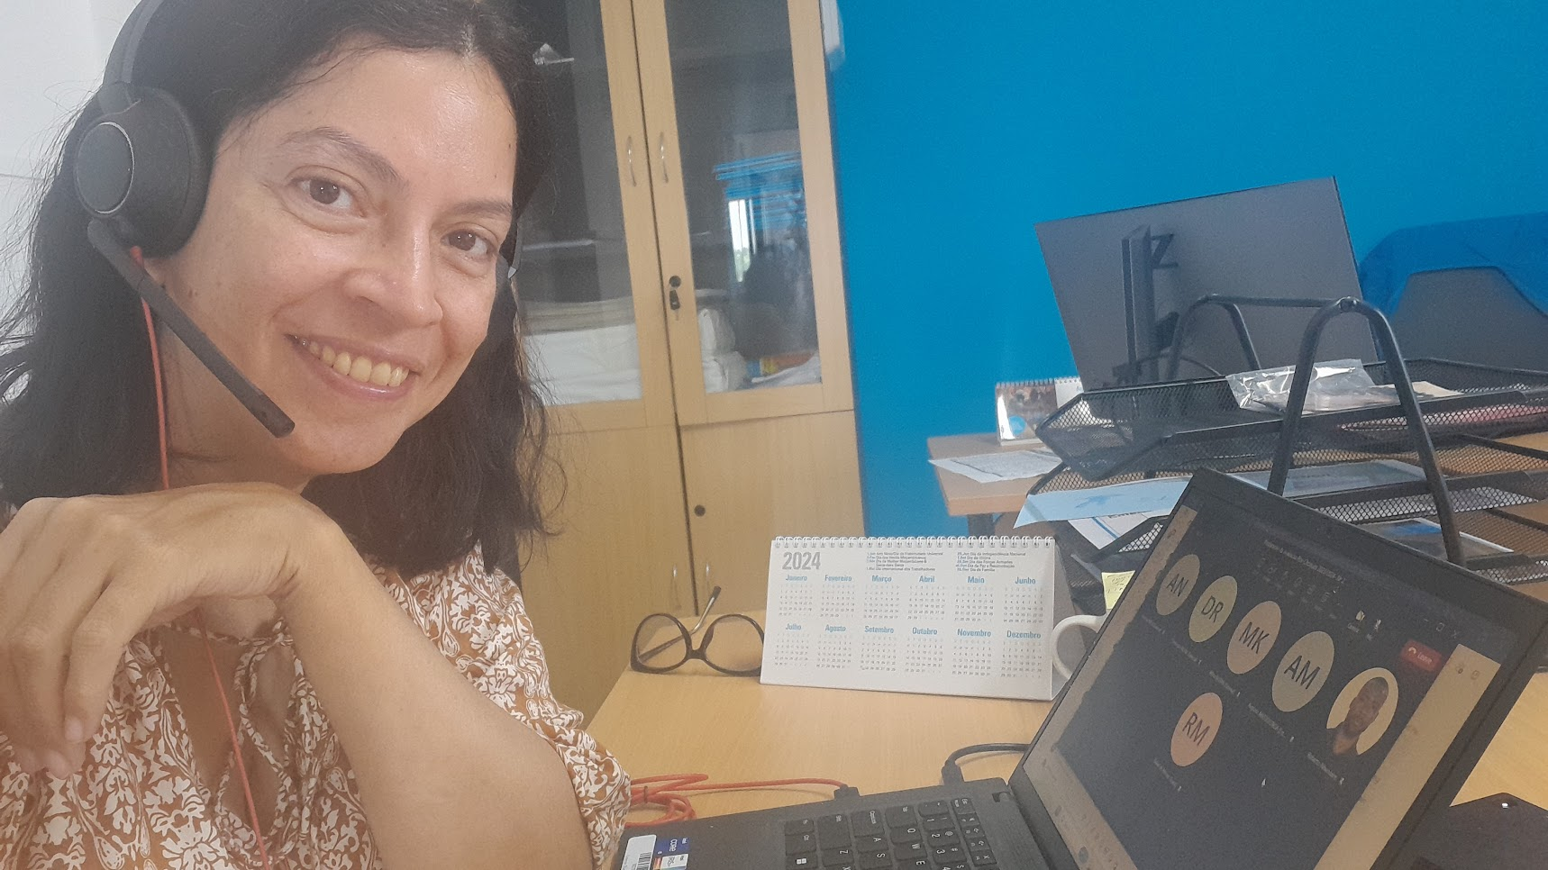

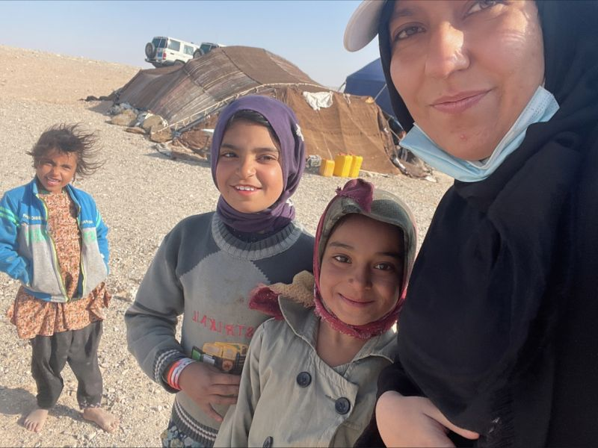
ESA Regional
Meeting
Thank you
Judith Barroso Cluster Coordinator
jbarroso@unicef.org
Roberto Nhambire Cluster IMO
rnhambire@unicef.org
Habiba Atify Upcoming Cluster IMO
hatify@unicef.org

Slide 64
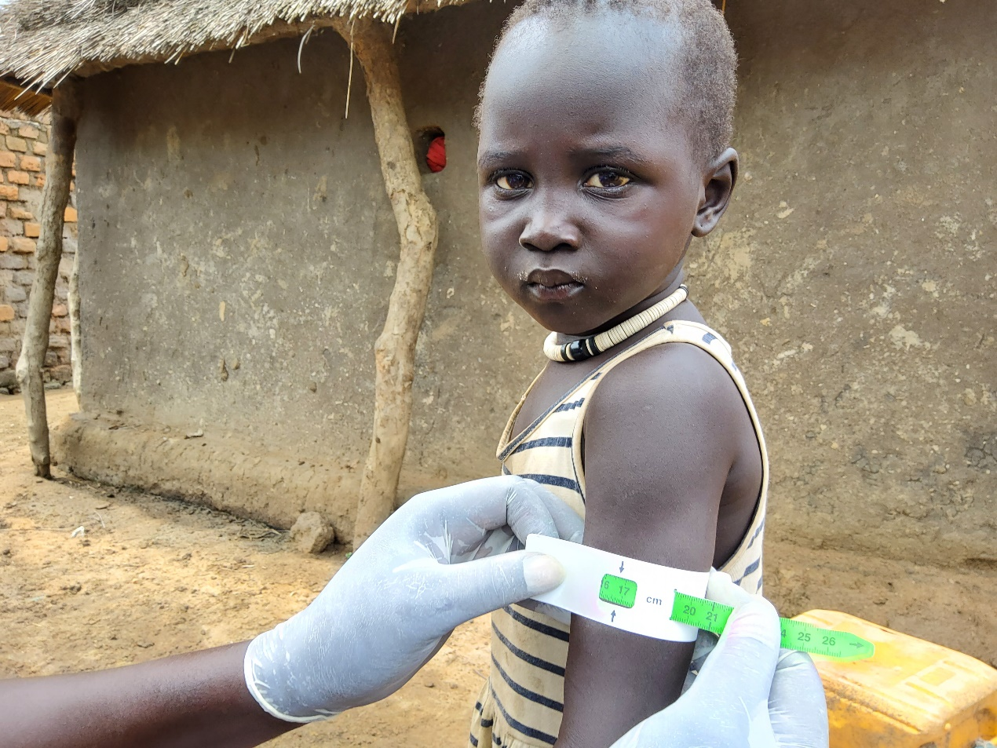
Learning Together – A moment to Reflect on the Rationalization Process in South Sudan
Presenter: Mama Khamisa Ayoub -Director of Nutrition (Ministry of Health)
Date: 31 January 2024

Slide 65
Presentation Outline
South Sudan context-burden of malnutrition and drivers
Why rationalization
Rationalization Process
Progress & Results
Lessons Learnt
Recommendations and way forward
A moment to Reflect on the Rationalization
Date: 30/01/2024
ESA Regional
Meeting

Slide 66

South Sudan Context
01
02
03
04
Persistent high levels of wasting nationally and in 46/80 Counties above the WHO emergency threshold of 15%.
Further deterioration expected during the period April to June 2024(66 counties)*
--18 Counties have high levels of multiple deprivations**
Approximately 5.8 million are food insecure
2.5 M children and women with Acute Malnutrition***
50% of the population Lack of safe water and Sanitation
High child morbidity (Malaria , Diarrhea and Upper Respiratory Tract Infections)-
5% Children get Minimum Acceptable diet
Influx of Returnees and Refugees from IPC regions 3 and 4 of Sudan
1/5 children entering South Sudan from Sudan are malnourished
A moment to Reflect on the Rationalization
Date: 30/01/2024
Notes:
* IPC report October 2023( 49 Counties in IPC4), 1 county in IPC 5 -Rubkona County, Unity state
**Deprivation Criteria- Gaps in Wash, Health and Protection
*** 0.48 M Children with Severe wasting , 1.16 M children with moderate wasting and 0.87M PLW

Slide 67
Why Rationalization in Nutrition Service Delivery ?
Reduction in Donor funding – need to Increase efficiency (doing more with less)
Multiple partners in same location Difficult to coordinate, duplication of resources and possible double dipping
Inefficiency resulting from Inconsistences in distribution of partners Multiple sites within small coverage areas in counties 1300 nutrition sites,253 Stand alone sites, 50 Partners
WHY
Lack of standardised nutrition services provided in the nutrition sites SAM and MAM Services not Integrated at some sites
Limited transfer of capacity to support the transition of Nutrition service delivery to government
A moment to Reflect on the
Rationalization
Date: 30/01/2024
Notes:
By 2022- 1300 Nutrition sits, 253 stand alone sites, 50 implementing partners

Slide 68
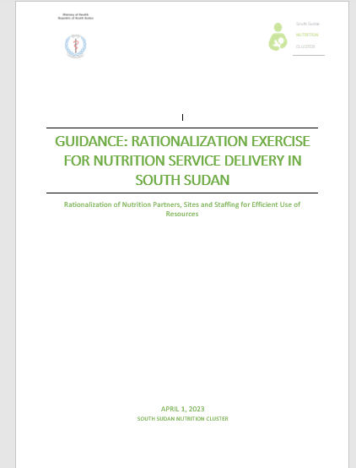
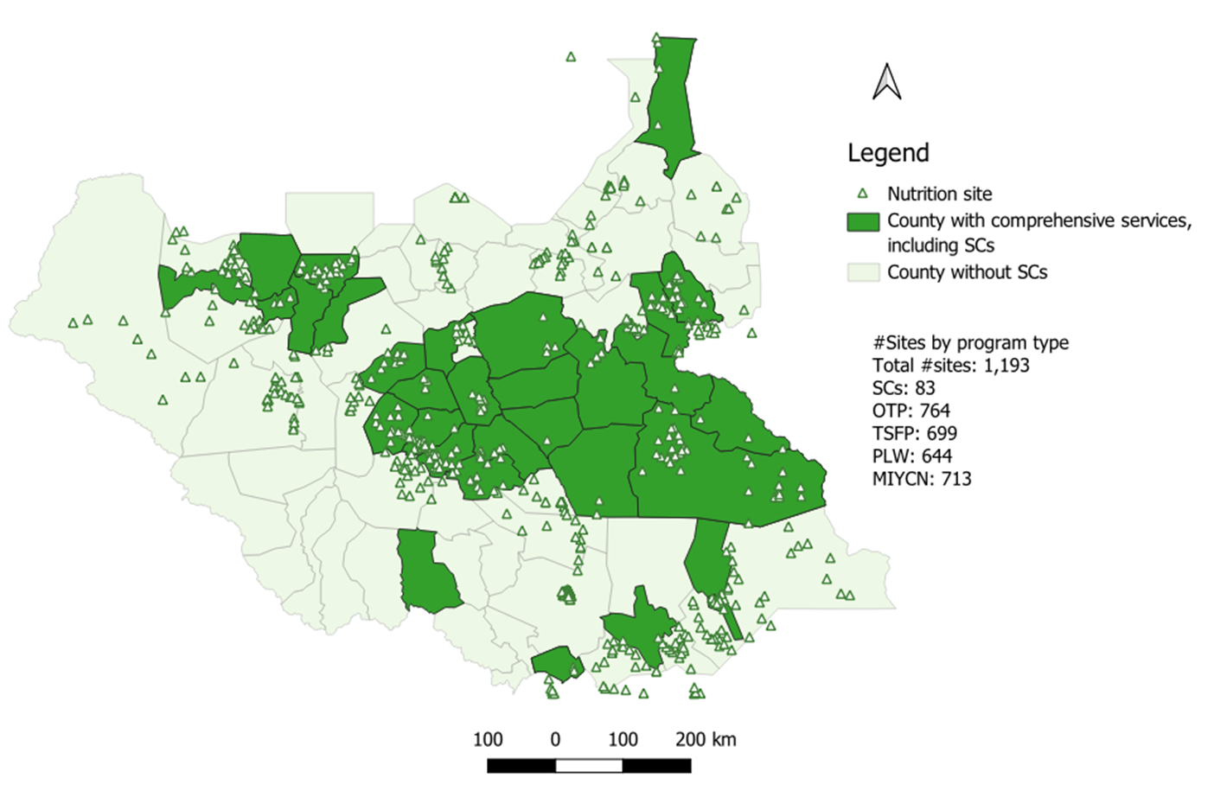
Our Journey….
Aug 2022
Jan –April 2023
Partners per county
Co- location of health and Nutrition Services
Review Nutrition Sites per county
Standardize Staffing –quantity & quality + alignment of incentives
Guiding Documents/ Tools
Partner transitions
Geolocations for nutrition sites
Lessons Learnt
Sept – Dec 2022
May- Sept 2023
A moment to Reflect on the Rationalization
Date: 30/01/2024

Slide 69
Rationalization Process
How many staff/ site are required to ensure quality services?
How are the norms guided by SS Basic Service Health Package being implemented?
Consolidate efforts of partners to few partners per county. Aim for one nutrition per county as relevant.
01
03
Staffing –quantity & quality &
alignment of incentives
Partners per county
Co-location of Services
Nutrition Sites per county
How many sites are required to maintain high& quality coverage.
How do we ensure integration?
When do we need mobile/ static/ outreach?
04
Ensure implementation of The Basic Package of Health and Nutrition Services in Primary Health Care
How do we ensure continuum of care ?
How do we ensure integration with health services?
Pending
02
Completed
Ongoing
A moment to Reflect on the Rationalization
Date: 30/01/2024

Slide 70
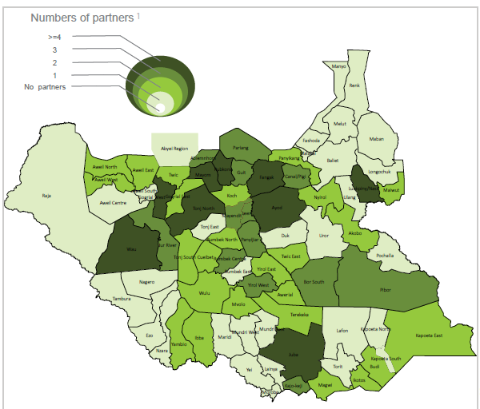
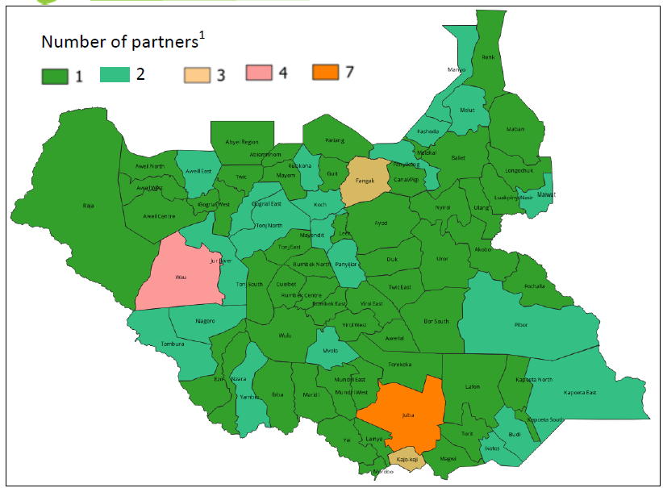
Results-Co-location of service and reduction in # of partners
2022
2023
100% colocation and alignment of UNICEF & WFP partners
Majority of Counties have 1 – 2 partners . Only 4 counties have more than 2
A moment to Reflect on the Rationalization
Date: 30/01/2024

Slide 71
Progress & Results
Program | Unit Cost ($) in 2022 | Unit Cost ($) in 2023 | change
SAM | 358 | 193 | 165
MAM | 58 | 51 | 7
PLW | 76 | 72 | 4
BSFP U5 | 151 | 62 | 89
BSFP PLW | 151 | 118 | 33
Reduction in unit costs
A moment to Reflect on the Rationalization
Date: 30/01/2024

Slide 72

Reported Challenges During Rationalization Process
Mixed understanding and communication about the rationalization exercise among stakeholders leading to confusion between national and subnational stakeholders - this resulted to delayed transition of partners in some locations negatively affecting the provision of nutrition services.
2. In other locations, the County Health Department demanded a letter from WFP/UNICEF directing the partner change.
3. The timing of transition of partners was too short and unfavorable (during the December festive season).
A moment to Reflect on the Rationalization
Date: 30/01/2024

Slide 73
Reported Challenges During Rationalization Process continued
1. Rationalization exercise largely focused on the nutrition component and there were no resources to integrate with health and WASH.
.
A moment to Reflect on the Rationalization
Date: 30/01/2024

Slide 74
Recommendations
Strengthen integration of nutrition into the health system pillars, integrate wasting treatment within routine primary health-care services, focusing on the most vulnerable children and monitoring implementation.
  Harmonize incentives for nutrition human resources with other cadres in the health sector/system – with clear job descriptions, functions, and responsibilities, and reporting structure.
  Have CHD lead the hand-over; joint selection and recruitment of
  human resources.
  integrated reporting; harmonized payment schedule (for both health and nutrition personnel – BHWs and CNVs)
A moment to Reflect on the Rationalization
Date: 30/01/2024

Slide 75
Recommendations
Improve partner transition processes and communication to ensure continuity of services when undertaking changes/ reduction of partners in the counties
  Develop a SOP for communication during the transition process to have a clear communication protocol – with clear chain from the national to the field offices; from cluster to IPs, and between the IPs themselves; and between IPs and the local authorities.
  Put the community – (beneficiaries) at the center of the rationalization exercise , ensure one-step, achieving efficiency and thus benefits/profits by bringing all the needed services at one place to the beneficiaries
A moment to Reflect on the Rationalization
Date: 30/01/2024

Slide 76
What Next?
01
02
03
04
Complete the Geo-tagging exercise-taking GPS coorinates.
Produce county level maps with health & nutrition sites, partners, catchment
population, nutrition needs at community level and distance to other site
Update the rationalization guidance
Roll-out the rationalization of sites and staffing by State using phased approach
A moment to Reflect on the Rationalization
Date: 30/01/2024

Slide 77
ESA Regional
Meeting
Thank you

Slide 78
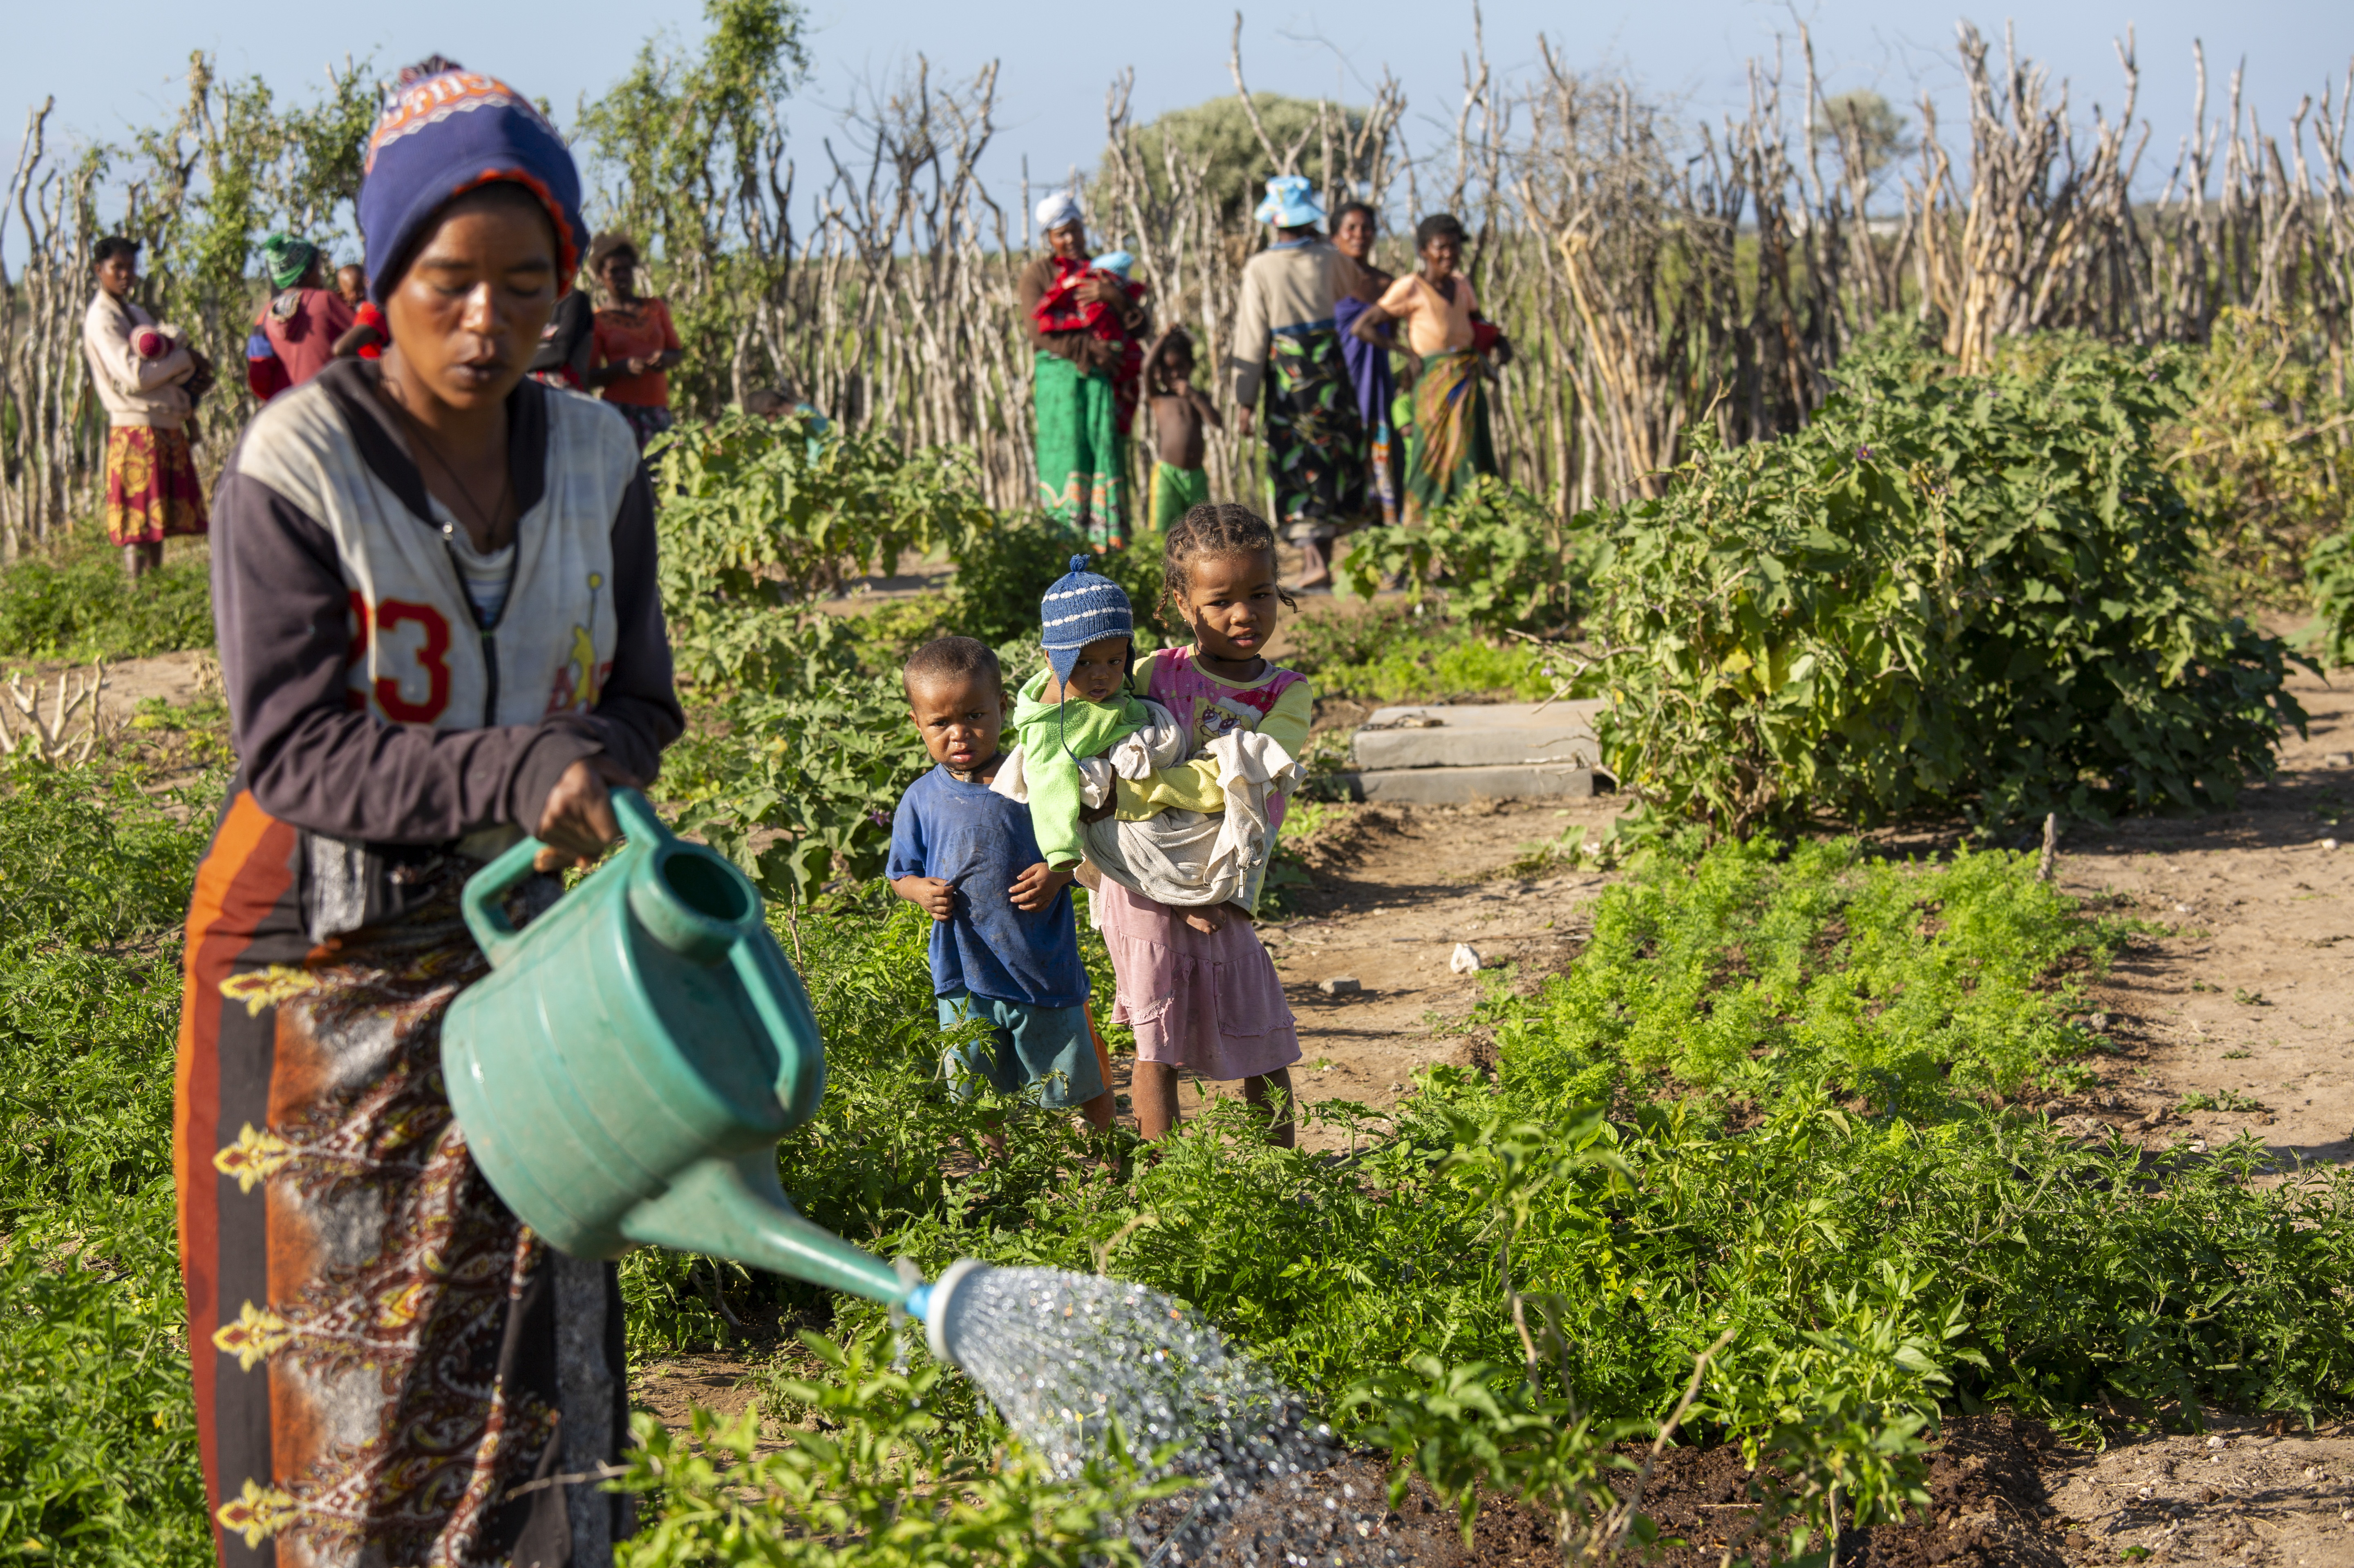
MADAGASCAR NUTRITION CLUSTER

Slide 79
NUTRITION CLUSTER/SECTOR IN MADAGASCAR
Activation of 3 regional clusters in the Grand South in 2019, following periodic droughts and a significant food and nutritional insecurity - (SMART April ‘23 : 9.2% GAM)
Activation of the 3 regional clusters in the Southeast Grand region in 2022, following the impact of powerful cyclones (2022/2023) and the degradation of livelihoods - (SMART May '23: 7.2% GAM)
Revision of the national nutrition policy + new National Multisectoral Action Plan for Nutrition (2022-2026) in 2022 : 01 cross-cutting axis on emergency response.
Transition of the cluster to sectoral coordination / Nutrition Technical Group: hybrid approaches encompassing both development and humanitarian responses affecting the entire territory..

Slide 80
NUTRITION CLUSTER/SECTOR IN MADAGASCAR
 | Cluster /Sector nutrition
Terms of Reference | Strengthening local capacities and national systems for emergency preparedness and response, + Humanitarian-Development Nexus.
Structure and Governance. | National: Lead: National Office of Nutrition (ONN) Co-lead: Ministry of Health's Nutrition Service Co-coordination: UNICEF
reunion | Regional: Lead: Regional Office of Nutrition (ORN) Co-lead: Regional Health Directorate Co-coordination: UNICEF or NGO
 | District: Lead: District Health Service (Lead) Co-lead: Regional Office of Nutrition Supervisor (Co-lead) Co-coordination: UNICEF or another NGO
Nutrition Cluster is officially activated for 21 districts and 6 regions of the South and Southeast, but contingency planning at national level (for floods and cyclones)

Slide 81
Implementing the Humanitarian Development Nexus through Technical working groups
Prevention and treatment of wasting
1
GAS Committee – Supply for nutrition
2
IYCF Task Force
3
Nutrition information system
4
Accountability for affected population
5
Adolescent girls and women nutrition
6
Monthly meetings and ad hoc workshops – updates from each group during the cluster meeting

Slide 82
Prevention and treatment of wasting
Insure quality and coverage of prevention, detection and treatment of wasting
Improve the link and transition between development to humanitarian programmes
Integration of nutrition care into community and primary health cares
-
Analyze and road map on the Continuum of Care : prevention – MAM- SAM (support GNC-TA)
Lead the update of the national protocol, in line with the recommendations WHO guideline
Pilot the Moderate Wasting Initiative (ACF/Irish Aid)
Front runner country for the joint approach for the acceleration of the programmatic shift for prevention and treatment of wasting (WfP- UNICEF)
Lead: Nutrition Service, ministry of Health
Members: ONN, UN agencies, NGOs, and partners working in CMAM
Monthly meetings and ad hoc meetings / workshop as needed.
From a « typical » cluster working group to a recognized technical group, leading the national discussions on wasting protocols
TOR / Objectives
Organisation
Main realization
Nexus type

Slide 83
IYCF Task Force
Ensures the coordination of IYCF activities with all sectors
-Infant and Young Child Feeding in emergency contexts: capacity analysis, operational guidelines, donation management plan, and breast milk substitute (Support GNC-TA)
-Quality improvement of contingency planning for floods and cyclones, with a strong leadership of the ministry of health/ nutrition services;
-Extension of preparedness activities at national level
Scale up plan for IYCF, including IYCF-E
From development to emergency: Integration on IYCF in Emergency in national IYCF strategies and ensuring the leadership of the ministry of Health for preparedness and response
Lead by the Nutrition Service, ministry of Health
Multisectoral members: ONN, UN agencies, NGOs, and partners working on nutritional resilience
Quarterly meetings and ad hoc meetings as needed - monthly meetings planned in 2024
TOR / Objectives
Organisation
Main realization
Nexus type

Slide 84
Nutrition Information System
Organizes, analyzes, and validates nutritional surveillance data, surveys, and analyses. Ensures the establishment and monitoring of the nutritional surveillance system.
Pilot of the NUVAC Initiative : Implementation of monitoring indicators for IPC risk factors National annual Nutrition Evaluation Plan
Lead of the IPC Acute malnutrition exercise
Harmonization of survey methodologies (SMARTs, WB program)
Validation of all data by the group before presentation to the cluster
Digitalization of nutrition information
From a cluster IM working group to a national group leading all the nutrition related information and strengthening the national system
Led by the Nutrition Service
Members: Monitoring and Evaluation teams of all nutrition stakeholders. National Institute of Statistics, National Office for Risk and Disaster Management.…
TOR / Objectives
Organisation
Main realization
Nexus type

Slide 85
Nutrition Supply Management
Characteristics: Ensures quantification, estimation, and proper utilization of nutrition supplies up to the last mile.
Progressive integration of the nutritional input supply through the government's central procurement system (SALAMA)
National quantification – using cluster estimates for humanitarian area
Work at national and regional level against misuse of nutrition supply
prepositioning of nutrition supplies before the cyclone period through the SALAMA supply system.
Integration of all actors at national level – with lessons learned from the humanitarian actions to inform the strategy at national level
Led by the Ministry of Health's Pharmacy Directorate
Multisectoral members: Responsible for health and nutritional supplies
Meetings: Quarterly
TOR / Objectives
Organisation
Main realization
Nexus type

Slide 86
Accountability to affected population
Ensures the establishment of the accountability for affected population mechanisms
Questionnaire adaptation (based on ECHO AAP tool) and testing
Training of field actors (MoH, local and international NGOs, Civil society organizations)
Data collection during routine activities
Analysis of the pilot results
Led by the Nutrition Service
Members: UNICEF, All nutrition stakeholders
Monthly meetings
Intersectoral coordination –
National lead and appropriation of humanitarian concepts
TOR / Objectives
Organisation
Main realization
Nexus type

Slide 87
Adolescent girls and women’s nutrition
Integrating adolescent girls and women needs in the nutrition programmation
Development of a roadmap for women nutrition in a multi-system approach
Advocacy in both development and humanitarian fora
Led by : National Office for Nutrition
Members: All nutrition stakeholders
Ad hoc working group. Bi-annual follow up by the cluster
Join cluster/ sector work from the beginning of the actions –
Development of a national roadmap with a focus on special needs in humanitarian settings
TOR / Objectives
Organisation
Main realization
Nexus type

Slide 88
NEXT STEPS / PRIORITIES
Update the terms of references of each group to better reflect the humanitarian-development continuity
Development of a joint work plan for all thematic working groups to help monitor the implementation of various roadmaps: Women's Nutrition, MAS MAM Continuum of Care, with the technical groups.
(Online)Training on cluster/sector coordination and nutritional emergencies for other districts frequently affected by cyclones and floods.
Preservation of the transition between the cluster- sector : real time adaptation of the structure to the needs

Slide 89
ESA Regional
Meeting
Thank you

Slide 90
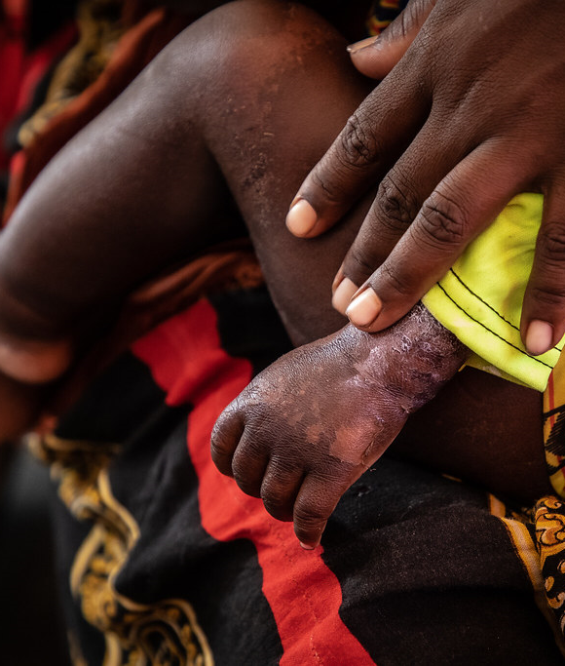
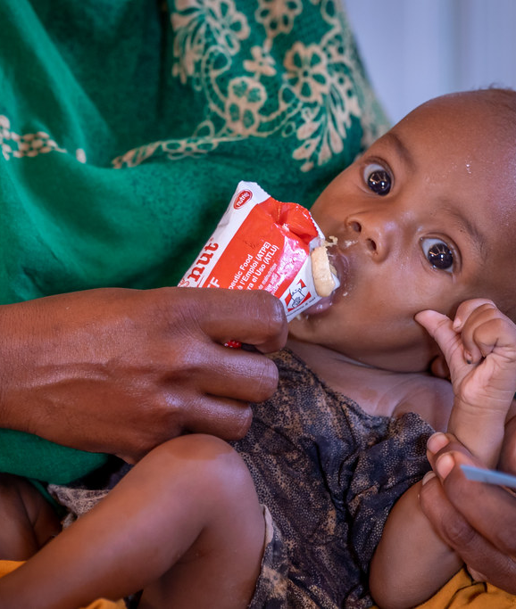



Ethiopia Emergency Nutrition Coordination Unit (ENCU)/ Nutrition Cluster
Nairobi 30-31 January 2024

Slide 91




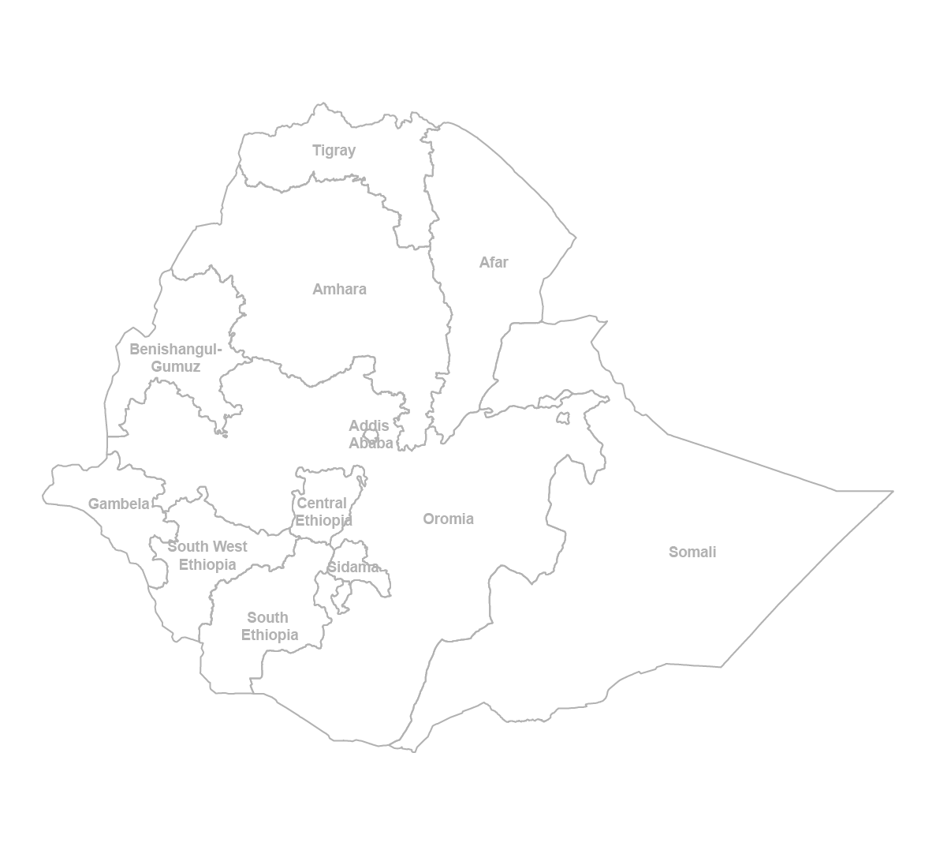


Ethiopia | ENCU/ Nutrition Cluster Coordination MAP | January 2024
National ENCU Nutrition Cluster Team | Addis Ababa
Firaol Bekele (Govt/EDRMC)
Nutrition Focal Point
Ines Lezama P-5
Cluster Coordination Lead
ilezama@unicef.org
encu.addis@gmail.com
Dept Cluster
Coordinator
Position Vacant
Sultan Ahmed P-3
Information Management
Specialist
shamed@unicef.org
National Nutrition Cluster/ENCU
Govt/DRMB Supported Regions
RENCU
Tigray (UNICEF /Govt/DRMB)
UNICEF dedicated staff for coordination in collaboration with Govt/DRMB
Reuel Kirathi Mungai (P-4)
Cluster Coordination Lead –UNICEF
Amhara
Nakai Munikwa (P-3)
Info Management Office
Dedicated - UNICEF
Ermias Amare
RENCU Coordination
Afar (Govt/DRMB)
Amhara (Govt/DRMB)
Kadir Laale
RENCU Coordination
Position Vacant
Info Management Office
Jemberu Dessie RENCU Coordination
Derbew Ayele
IMO Dedicated (Govt/DRMB)
Oromia (Govt/DRMB)
Central/South/SW/Sidama
(Govt/DRMB)
Kelbesse Beyene RENCU Coordination
Abbas Kadir
IMO Dedicated (Govt/DRMB)
Tadele Kibru
RENCU Coordination
Getu Alemu
IMO Dedicated (Govt/DRMB)
Somali (UNICEF/Govt/DRMB)
UNICEF Nutrition staff in field offices in supporting DRMB for AWP –Annual work plan.
Komborero Chirenda (P-3)
Cluster Coordination Lead – UNICEF
Muhyadin Ahmed
IMO Dedicated (Govt/DRMB)
Muhyadin Mohamed
RENCU Coordination
National Nutrition Cluster Webpage:
https://response.reliefweb.int/ethiopia/nutrition
Disclaimer: The administrative boundaries and name shows and designate used on this map to not imply official endorsement or acceptance by the United nation.
Notes:
Both federal and regional ENCU employees were previously staffed by UNICEF, however, as part of promoting localization of the cluster, the GoE/ DRMB is taking lead/ actively involved in the regional coordination staffing.
Regional staff are based in Tigray, Amhara, Central/South/ South West/Sidama (previously- SNNPR),Benishangul Gumuz, Gambela, Afar, Oromia and Somali and UNICEF-staffed federal ENCU members are based in Addis Ababa.
Nutrition Cluster Unit
Co-led by Regional Health Bureau ( RHB) and Regional Emergency Nutrition Coordination Unit( RENCU)
4 Technical Working groups(TWGs) support the operations
CMAM, co-chaired by RHB and UNICEF
IYCF-E, co-chaired by RHB and SCI
Nutrition Information System co-chaired by RHB and RENCU
IMAM, co-chaired by RHB and WFP
Zonal level Health and Nutrition Coordination meetings taking place but irregular.
ENCU Support to various activities including :
Social mobilization
Treatment of SAM through Outpatient programme, inpatient programed /Stabilization Centres and Mobile health nutrition platforms:
Treatment of Moderate Acute Malnutrition
Training of Health Workers and Health Extension Workers on SAM and MAM :
Integrated Supportive supervision :
Infant and Young Child Feeding service provision
Supplies Chain Management
Inter-Cluster/Sector coordination

Slide 92
2023 Achievements RELATED TO CLUSTER CORE Functions
SN | Cluster Core Functions | Achievements
1 | Supporting service delivery | Functional coordination structures with defined TORs and ENCU guidelines at national and 6 regions- active technical working groups (TWG) Promoted and delivered adaptable modalities Inter-Cluster Sectoral Collaboration (ICSC)
2 | Informing strategic decisions | Information sharing on guidelines, new strategies, response indicators, gaps, resources, availability, etc Conducted surveys & Mehel and Belg assessments Use of nutrition surveys and Enhanced Outreach Strategy data for decision-making
3 | Planning and implementing Cluster strategies | 2023 Ethiopia Nutrition Strategic Plan/ HRP Development of guidelines: RRM, Simplified Approaches, CVA & Nutrition Defined community-based approaches and local solutions for nutrition
4 | Monitoring and evaluating performance | ENCU/ RENCU/ Partners/ Government Joint supportive monitoring and Supervision Regional ICCGs joint missions Documentation of best practices i.e. ICSC and use of Simplified Approach
5 | Preparedness and contingency planning | ENCU identified capacity gaps, supported needs and facilitated technical nutrition training Developed and updated Emergency Preparedness and Response Plans (EPRP) ENCU/RENCU in collaboration with EDRMC/ DRMB developed monthly Early Warning reports
6 | Advocacy | Aadvocacy papers was developed for a scaled-up nutrition response and for enhancing intersectoral collaboration
7 | Accountability to affected people | AAP feedback mechanism are used by organization and promoted by ENCU
ENCU
30-31-Jan 2024
ESA Regional
Meeting
Notes:
Coordination within and with other clusters: The ENCU participates and chairs meetings across the GoE, partner and donor spectrum.
ENCU led and chair by HE Ambassador Dr Shiferaw Teklemariam, EDRMC commissioner
MANTF (Multi-Agency Nutrition Task Force): strategy, planning and results, rather than exclusively on information-sharing/ active participation and attendance
Strategic Advisory Group (SAG) to discuss and formulate/review the cluster strategy Launched in 2022
and technical working groups (TWG) to tackle technical issues. (i) CMAM, (ii) IYCF-E, (iii) NIS, (iv) CVA and nutrition, (v) Gender and nutrition core group
Community management of acute malnutrition lead by MoH and UNICEF- Active- EMERGENCY PROTOCOL
Infant and young child feeding practice lead by MoH and UNICEF-Active
Nutrition information system lead by ENCU / Active/- RAPID NEED ASSESMENT GUIDELINES REVIEWED
Targeted Supplementary feeding lead by WFP and ENCU- Active
Cash and nutrition with cash working group- Active
Gender and Nutrition core group
OCHA coordination mechanisms, ICCG/ Inter-cluster coordination groups at federal and subnational level- active in all regions and national
Integrated plan for nutrition in emergencies from EDRMC, MoH and EPHI, with BRE OPM support
Intersectoral collaboration for drought response amongst 5 clusters (nutrition, food, health, WASH and Agriculture) –Pilot in Oromia and Somali regions and advocate for extension- 14 million EHF Humanitarian pooled funding

Slide 93

Locally Produced Supplementary Foods in Mekelle
Ethiopia New Innovations
ESA Regional
Meeting
ENCU
30-31-Jan 2024

Slide 94
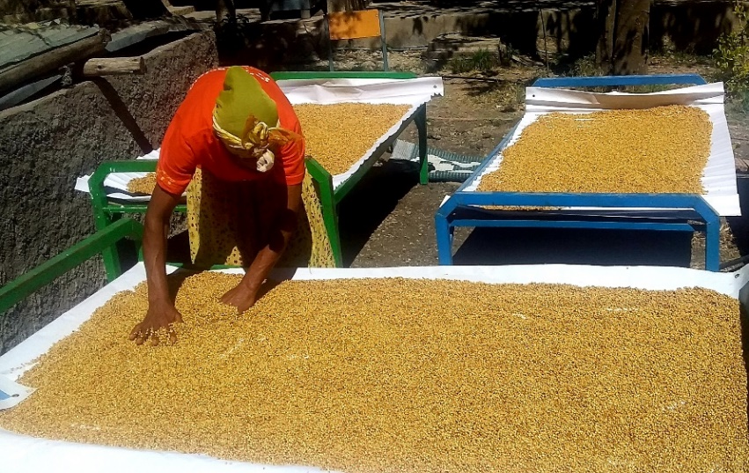
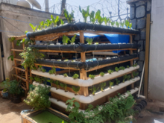
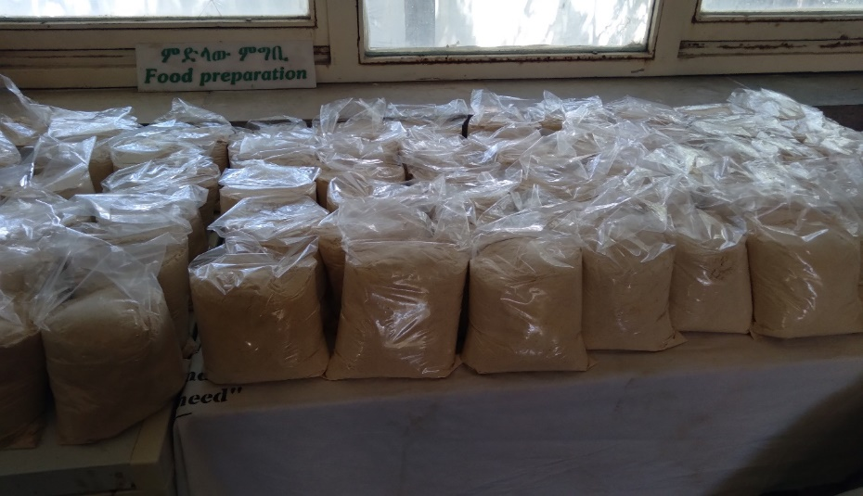
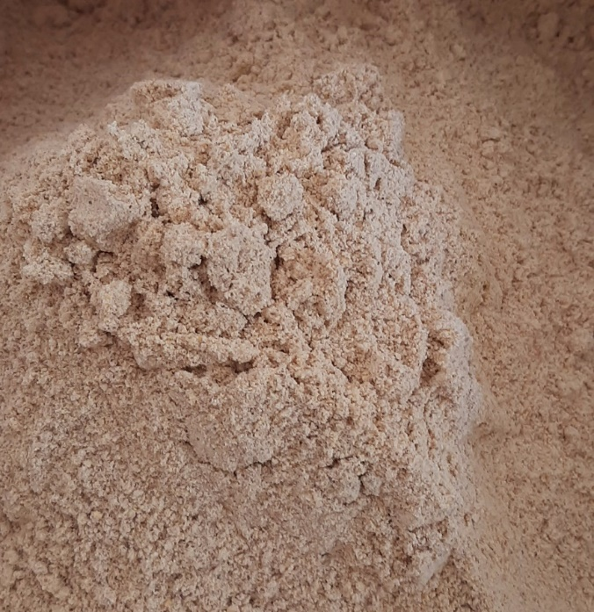
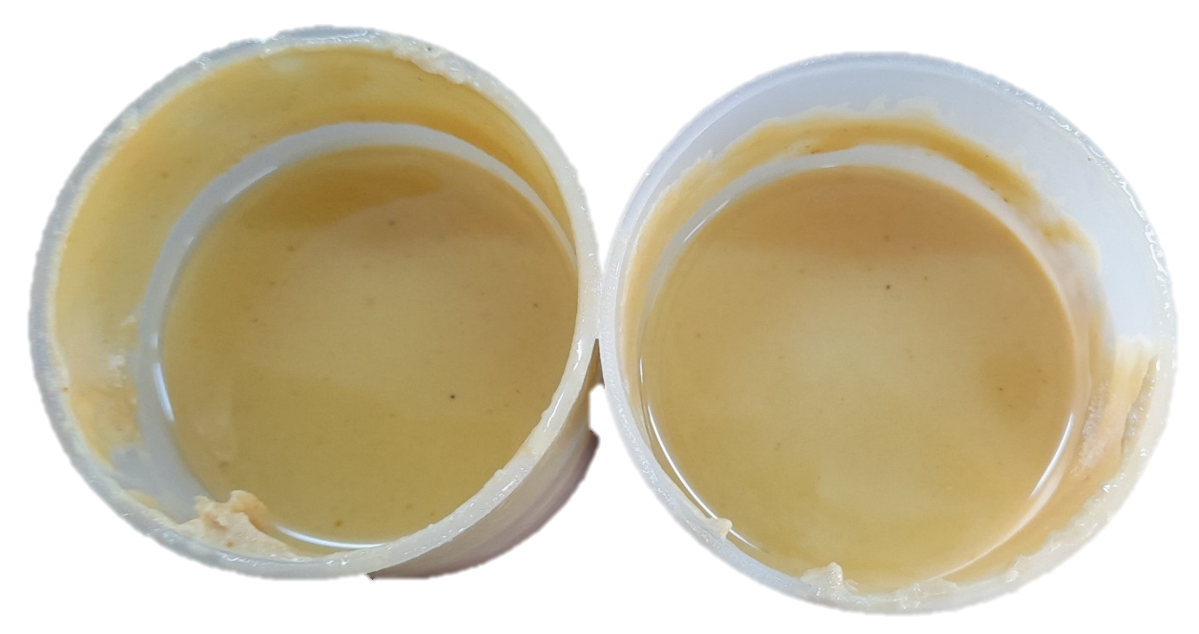
Ethiopia New Innovations: SCALING UP of Local based food Solutions
Simplified hydroponics farming
Simplified Hydroponics Farming and Locally Produced Bahgina
UNICEF, in collaboration with Mekelle University, Regional Health Bureau, Regional Research Institute, and partners, is piloting local solutions to improve household diet diversity in Tigray.
These solutions include simplified hydroponics farming and locally produced Bahgina.
Currently being delivered in only five woredas, but there is a plan to scale up in Q1 2024.
The plan also includes creating demand for the technology, building institutional capacity, and promoting diverse diets and vegetable consumption.
Scale-up plan includes rolling out the hydroponics technology to more households, schools, and farmers' training centers.
Bahgina is also being used to reduce stunting in selected woredas with high stunting rates- Seqota declaration Commitment.
Locally Produced Bahgina
ESA Regional
Meeting
ENCU
30-31-Jan 2024

Slide 95

Way forward

Slide 96
2024 Strategic Area/ Priorities
SN | Key Priorities
1 | Influential & strategic leadership: EDRMC direction and vision is to empower the affected communities to lead and participate in the emergency response and prevention interventions. EDRMC aims to achieve this by strengthening its country-level leadership, fostering a common understanding of the community’s role, identifying and exchanging best practices, and promoting local and climate-sensitive solutions that integrate humanitarian and resilience aspects for nutrition outcomes.
2 | Analysis & communication of information: (i) ENCU/Nutrition cluster is focused on enhancing the quality and effectiveness of nutrition assessments through the implementation of SMART Plus and an enhanced SOP, (ii) Develop methodology for multisectoral nutrition centered risk analysis, emphasizing consensus on the interpretation and utilization of key nutrition (plus) data to inform decisions, (iii) Optimized the use of CDC proposed tools and data (prioritization and identification of HRMAM) and AI/Machine learning, modeling, ensuring that information communication and analysis are both efficient and impactful.
3 | Advocacy for improved humanitarian outcomes and support resource mobilization: including nexus. Advocacy road map for 2024 –SAG to define advocacy priorities
4 | Monitoring of the response: Development and optimization of an IM tool kit, development of the systematization of the AAP and its monitoring (focus on the participation of the affected population), regional operational plans and micro-plans at woreda level, cost analysis of CMAM interventions, promotion of guidelines for the use of CVA for nutrition, gender and nutrition approach, promotion of the inter-cluster sectoral approach and collaboration of 5 Plus clusters, mainstreaming of the nutrition response in the multi-sectoral rapid response mechanisms and surge capacity.
5 | Strengthening of local capacity to be prepared, respond and lead: Provide autonomy, leadership and tools for the necessary anticipation, preparedness and response actions. Focus on transition towards new CMAM guidelines and exceptional response with simplified approaches and to unify and promote guidelines (ENCU guidelines, Gov bodies coordination...).
ESA Regional
Meeting
ENCU
30-31-Jan 2024

Slide 97
Development of an appropriate community-led response to the nutrition challenge in Ethiopia
1. Extend the coverage of the nutrition response- Reaching the population targeted
2. ADAPT the response of nutrition- Reaching people in greatest need
Ensure enough inputs for covering all the population targeted (buffer and enough quantities)- Urges
Health facilities functioning with nut services- static and outreach (HR and geographical access)
Bottlenecks for access to nutrition services (effective coverage) are lifted (women workload, distance, awareness, defaulter rates,…)- BNA analysis?
Massive actions for early detection and early care- Urges
Expansion of quality IMAM services-continuum of care
Simplified approaches- implementing and monitoring the protocol for simplified approaches in exceptional circumstances- Urges
Rapid response mechanisms for nutrition in areas of concern- Urges
Adaptation of the response to the needs of pregnant and lactating women (care, psychosocial support..) Adaptation of the response to infants, improving the feeding practices
3. anticipate with evidence-based decision making- Strengthening systems to alert and early response
4. Prevent cases of acute malnutrition in children and pregnant and lactating women - Incorporating integrated local solutions and interventions
Unify nutrition monitoring system of all partners and propose transitional mechanisms- DHIS2 nutrition data and TFP dataset -Urges
Regular and reliant data- decentralized decisions
Early warning system for anticipatory actions on nutrition (readiness and preparedness to be included)- based on enhanced surveillance available and community early warning systems
Scalable and affordable options and package of interventions to be defined and implemented at community level (Family MUAC, Gardens, Community awareness..)-Urges
Intersectoral collaboration promotion (Health, nutrition, WASH, food, Agriculture..)
Social accountability in nutrition –model of accountability for nutrition
ESA Regional
Meeting
ENCU
30-31-Jan 2024

Slide 98
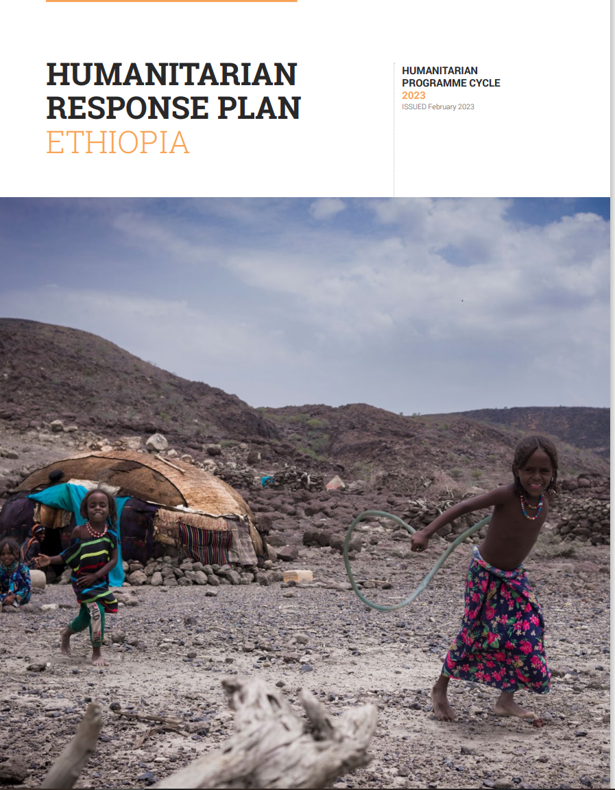
ESA Regional
Meeting
Thank you
https://twitter.com/UNICEFEthiopia/status/1700053592491573681

Slide 99

MALAWI NUTRITION SECTOR

Slide 100
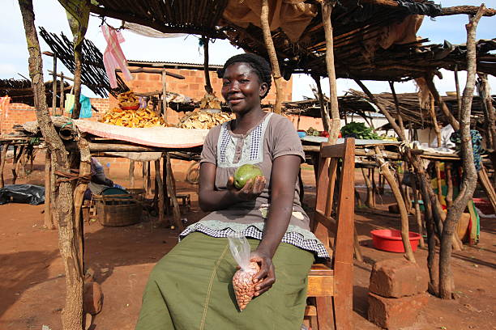
ZAMBIA NUTRITION SECTOR

Slide 101
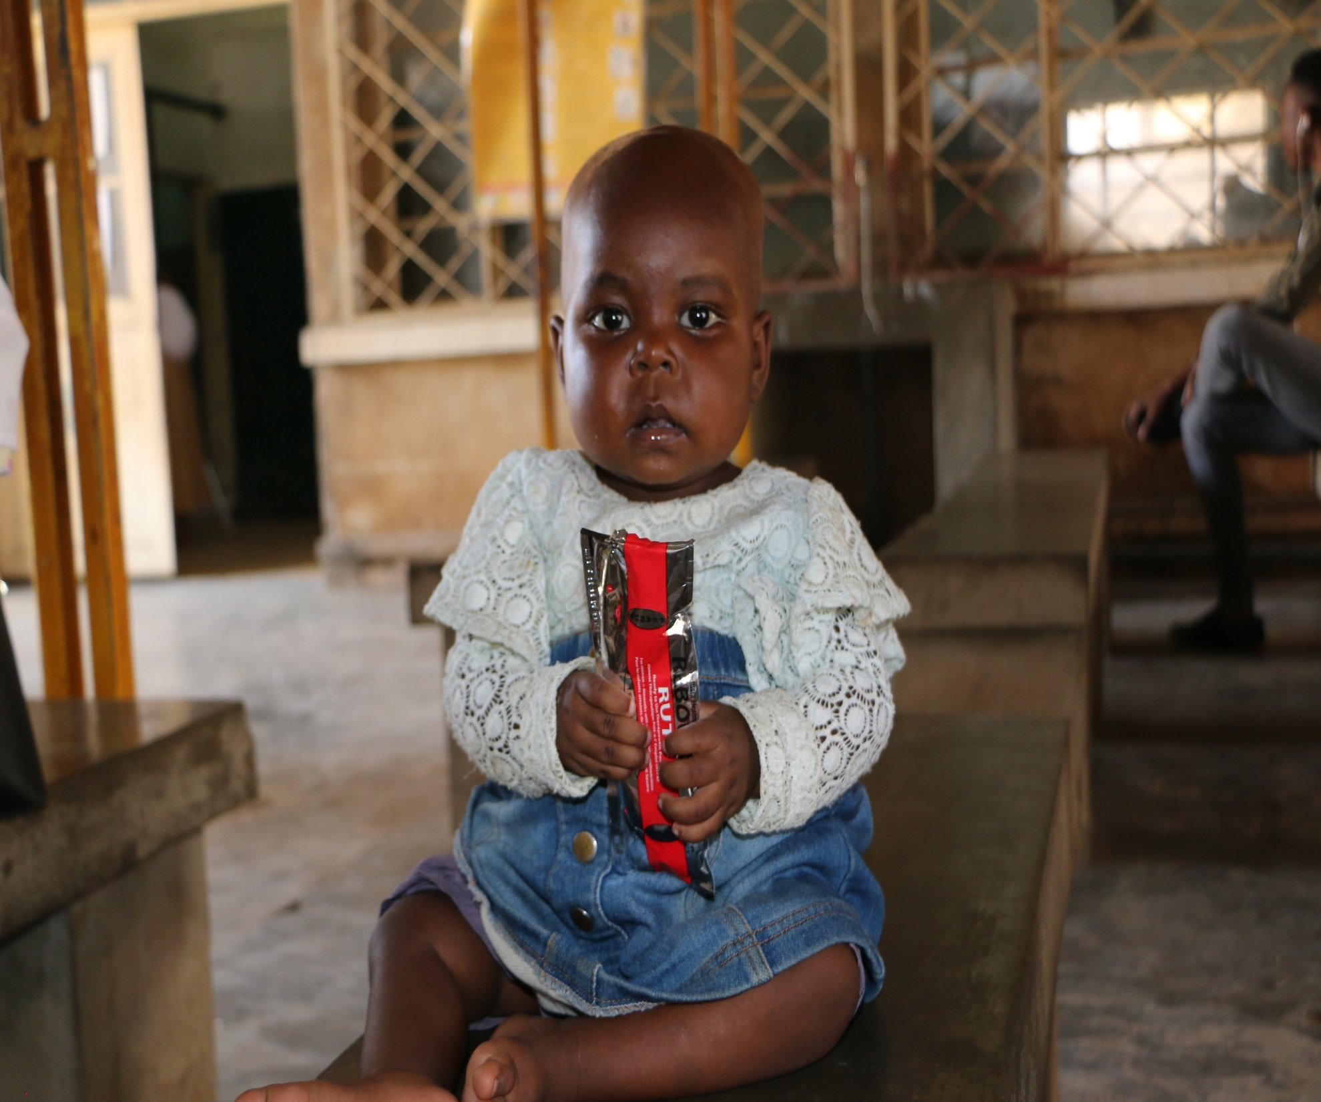
Burundi Coordination Team presentations
Presenter
January 31st, 2024

Slide 102
Context
Socio economic
13.4 million population, 2.4 million Under 5 years: (INSBU 2023);
Human Development Index Burundi ranked 187 out of 191 countries (UNDP, 2022);
87% of the population below the World Bank’s poverty threshold of US$1.9 per day;
Poverty rate: Household income (51.47% - EICVMB, 2020), Multidimensional child ( 61.7% - MODA 2022);
Vulnerability to natural disasters, persistent inflation, rising fuel prices.
GAM and STUNTING
Dietary and Breastfeeding
GAM: 4.5% in 2018, 6.1% in 2020 and 4.8% in 2022 (SMART);
STUNTING: 57% in 2018, 52.2% in 2020 and 55.8% in 2022 (SMART);
Min dietary diversity: 7.7% in 2020 and 20.6% in 2022;
Acceptable dietary intake : 6.8% in 2020 and 13.3% in 2022;
Exclusive breastfeeding : 83.1% in 2020 and 85% in 2022.
Session Title: ESA Regional Meeting - Coordination Team presentations
Date: January 30th, 2024
ESA Regional
Meeting

Slide 103
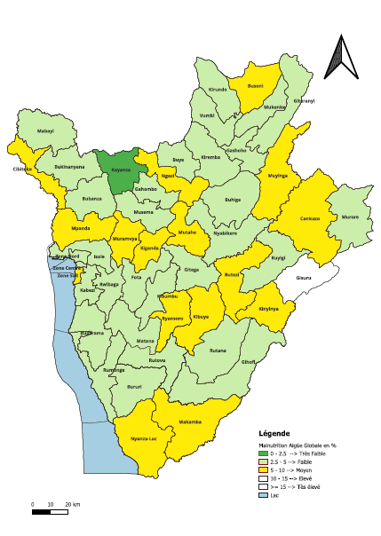
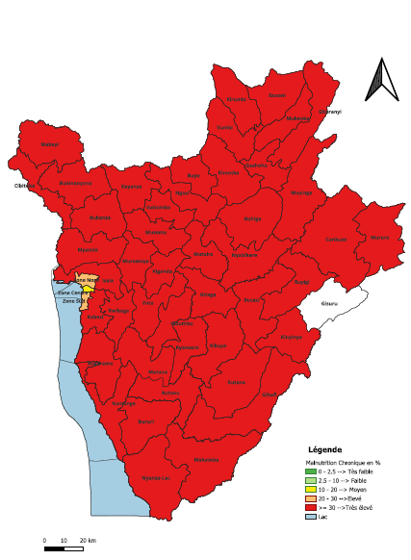
Context: GAM/Stunting prevalence
Prevalence of global acute malnutrition SMART 2022
Prevalence of chronic malnutrition SMART 2022

Slide 104
Context : GAM & Stunting prevalence trend
Threshold

Slide 105
Context : Infant and young child feeding practices
WHA target

Slide 106
Key interventions
Management and treatment of acute malnutrition | Prevention of all forms of malnutrition
Early detection of child wasting - screening for children aged 6–59-month, referral and treatment Early stimulation of children under 5 at health facility level Nutrition procurement and supply chain strengthening Capacities building on CMAM Nutritional surveillance Supporting nutrition sector coordination Burundi is GAP/Child Nutrition Fund Country | Infant and young child feeding practices Maternal and adolescent nutrition Prevention and control of micronutrient deficiencies (Multiple micronutrients powder supplementation (6-23 months children), Vitamin A supplementation and deworming, Iron and Folic Acid supplementation for pregnant women and adolescent girls…) Supporting food system to provide nutritious food for children under 5 years old Support through social protection and WASH interventions Early stimulation of children under 5 at community level

Slide 107
Key achievements SAM
Support to 899 health structures (827 STA and 72 SST), 1023 Health workers trained for the management of SAM and MAM and 1274 pharmacists trained to improve RUTF supply chain management;
A total of 58,552 SAM children admitted and treated in 2023 by UNICEF-supported centers and with cure rate at 90%;
Provision of RUTF, therapeutic milk and essential drugs for the management of SAM (33,814 cartons of RUTF procured so far);
IYCF messages and other essential family care practices, Vit A supplementation coupled with intestinal de-worming and screening;
Collection of routine program data (DHIS2), 2023 SMART Survey ongoing and regularly Nutrition sector meeting
Collaboration with NGOs, MoH, Other UN agencies and coordination of implementation of all nutrition interventions by nutrition group led by UNICEF
Session Title: ESA Regional Meeting - Coordination Team presentations
Date: January 30th, 2024
ESA Regional
Meeting

Slide 108
Key achievements : SAM reached vis a vis targets

Slide 109
Burundi – sector coordination
Lead: Ministry of Health ,Direction of food and Nutrition
Co-lead: UNICEF, Nutrition Section
Partners 18: 4 NNGO, 6 INGO, 4 UN agencies, 1 Donors, 2 observers, 1 Authority
Meeting every month
Session Title: ESA Regional Meeting - Coordination Team presentations
Date: January 30th, 2024
ESA Regional
Meeting

Slide 110
Burundi – sector in progress plan
Risk Analysis - natural disasters
91% of the internally displaced population due to natural disasters, 1,100 in 2023
  (1) Floods : heavy rains and level rise of Lake Tanganyika, seasonal and twice a year
  (2) drought: hydric deficit in Kirundo, Bugabira and Busoni in Kirundo province
Session Title: ESA Regional Meeting - Coordination Team presentations
Date: January 30th, 2024
ESA Regional
Meeting

Slide 111
Burundi – sector in progress plan
Nutrition Scenario
Floods - Anticipated in need: 56 000 children / 100 000 people, 20 000 children for Nut sector
Drought - Anticipated in need: 28 000 children / 53 000 people, 8 500 for Nut sector,
Major hum actors: MH, UNICEF, IOM and other UN agencies, (I)NGOs, the National Platform for Floods and (FAO, WFP) for Drought ,
Gap: weak capacity to response (Funds, Experience, …)
Session Title: ESA Regional Meeting - Coordination Team presentations
Date: January 30th, 2024
ESA Regional
Meeting

Slide 112
Nutrition sector funding and gaps: SAM
UNICEF |  |  | Donors (contribution in USD)
Year | Target | Fund required | BHA | KFW | GoNL | Cout Total par an | Gap
2021 | 64,000 | 6,400,000 | 1,463,657 | 220,000 |  | 1,683,657 | 4,716,343
2022 | 75,234 | 7,523,400 | 2,800,000 | 440,000 |  | 3,240,000 | 4,283,400
2023 | 84,000 | 8,400,000 | 1,000,000 | 1,540,000 | 555,000 | 3,095,000 | 5,305,000
Session Title: ESA Regional Meeting - Coordination Team presentations
Date: January 30th, 2024
ESA Regional
Meeting

Slide 113
Challenges
Lack of domestic financing for the purchase of nutrition supplies (RUTF, RUSF, MNPs…);
Insuffisient funding for nutrition interventions by the governement
Insufficient fund to cover nutrition supplies need for 2024;
Lack of ownership of the national Nutrition supply chain
High financial dependency of the country on external funding (0.8 % for public financing)
Increase of nutrition supplies cost at global level
Small scale of prevention interventions due to insufficient funding
Multisectoral coordination
Session Title: ESA Regional Meeting - Coordination Team presentations
Date: January 30th, 2024
ESA Regional
Meeting

Slide 114
Perpectives
Continue to:
provide treatment for acute malnourished children.
strengthen the supply chain management of nutritional products and monitor the use of nutritional products to the last mile.
support the monitoring of the CMAM program through supportive supervision, reporting and coordination meetings at national and decentralized levels.
Advocacy for domestic funding
Strengthening multisectoral approach to reduce stunting
Support developpement of a multisectoral nutrition policy and sectoral strategies
Session Title: ESA Regional Meeting - Coordination Team presentations
Date: January 30th, 2024
ESA Regional
Meeting

Slide 115
ESA Regional
Meeting
Thank you

Slide 116
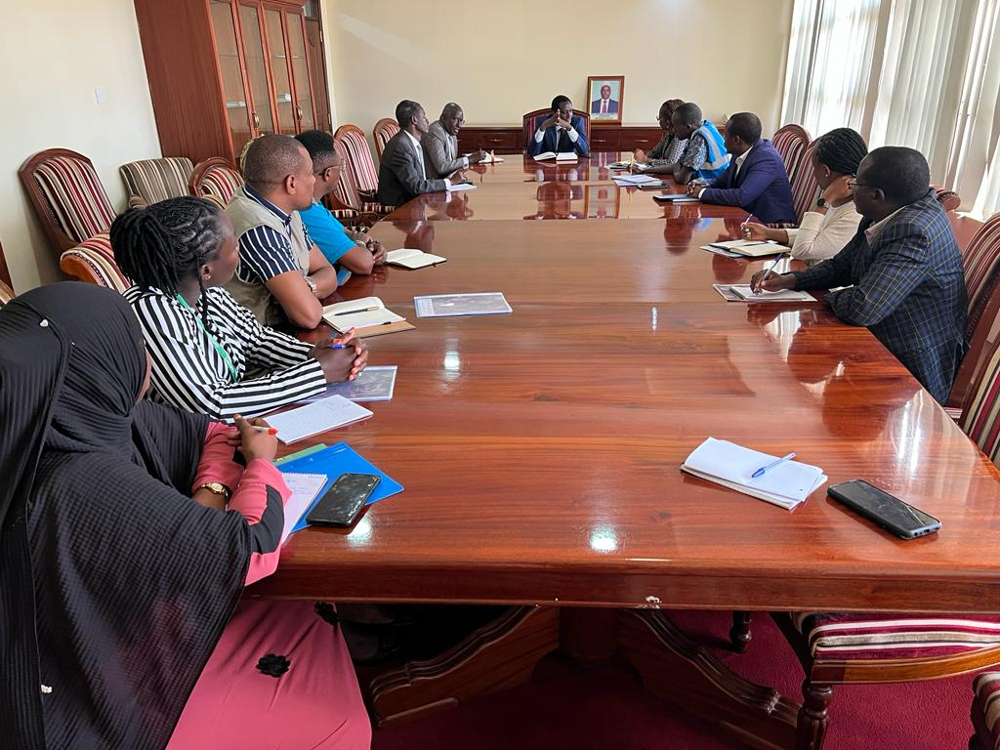

Optimizing Nutrition Coordination for Effective Drought Response in Kenya
Grace Gichohi, Ministry of Health
31 January 2024
Photo Credit © George Kuria/UNICEF NSO Marsabit
Notes:
Photo decription: A meeting with

Slide 117


Constitution/SDGs
Goal 2: End hunger and all forms of malnutrition by 2030
Kenya committed to the 17 Sustainable Development Goals
The Kenya Constitution 2010 recognizes that every person has the right to be free from hunger, and to have adequate food of acceptable quality article 43 1 (c), while article 53 1 (c) states that every child has the right to basic nutrition.
Goal 3: Ensure healthy lives and promote well being for all at all ages
Nutrition as an enabler for other goals

Slide 118
Policy Environment in Kenya
Kenya Vision 2030 which aims for a globally competitive and prosperous country with a high quality of life for the Kenyan population by 2030.
The Big 4 agenda for the period 2018 to 2022 whose one of the main focus areas is to achieve 100% food and nutrition security in Kenya.
Food and Nutrition Security Policy (FSNP) 2011, which aims to ensure that all Kenyans have access to safe food and water in sufficient quantity and quality to meet their nutrition and health needs throughout their lives.
The Food and Nutrition Security Policy Implementation Framework (FSNPIF) 2017-2022 - a road map to the implementation of the Kenya Food and Nutrition Policy (FSNP) 2011
The Kenya Health Policy 2012-2030 with a goal to attain the highest possible standard of health in a manner responsive to the needs of the population.
Kenya Nutrition action plan (KNAP) 2018-2022 whose objective is to accelerate and scale up efforts towards the elimination of malnutrition in Kenya in line with Kenya’s Vision 2030 and sustainable development goals.
KAP-Kenya Action Plan for prevention of Wasting.

Slide 119
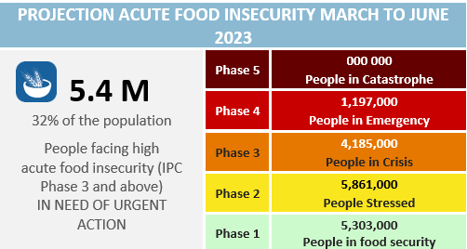
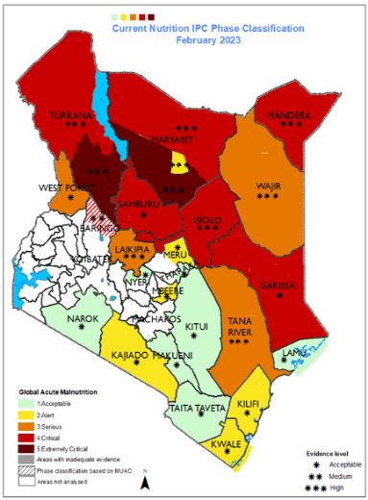
Kenya's L3 Drought Emergency: The Nutrition Challenge
Necessity for Robust Coordinated Response: This included not only the nutrition sector response actions but also integration with broader Food, Health, WASH, and Social protection sector interventions
Innovation Imperative: Need to leverage new technologies, data-driven approaches, and cross-sector collaboration to enhance the effectiveness of interventions.

Slide 120
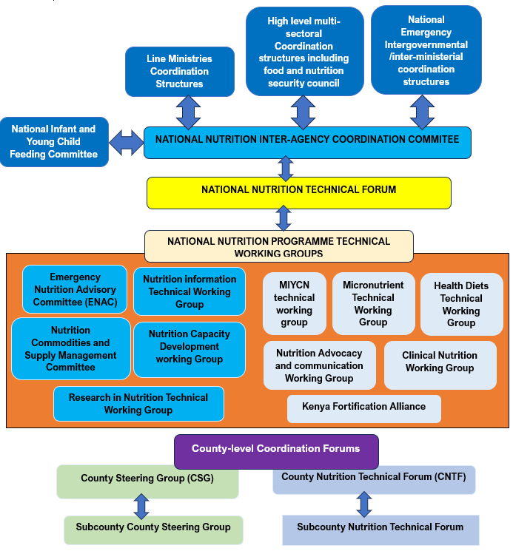
Nutrition Coordination Structures in Kenya
Key structures for emergency nutrition response: ENAC, Nutrition Information, Nutrition Commodities and Supplies Committee, Nutrition Capacity Development Group
Integration with National Drought Management Authority (NDMA): Kenya Food Security Steering Group(KFSSG), Kenya Food Security Meeting(KFSM) and CSG at the County level
Multi-sectoral Engagement through SUN Movement: Networks: Government, UN, Civil Society Alliance (CSA), Donors, Academia and Research, and Business
ESA Regional
Meeting
Notes:
Collaborative financing and implementation of nutrition response interventions: A synergistic approach combining multi-partner/donor funding and joint planning, executed by the County Department(s) of Health with technical support from various partners, ensures efficient resource use, reduces duplication and enhances the relevance and effectiveness of nutrition response interventions.
Virtual Coordination Meetings: Utilized digital platforms to enhance coordination efficiency in nutrition response. It bridged the gap between national and county-level partners, fostering real-time, strategic collaboration and decision-making.
Multi-sector contingency and response planning: Working closely with National Drought Management Authority (NDMA) led County Steering Groups, multi-sector contingency, and response plans developed, streamlining efforts across nutrition, WASH, and social protection for more effective emergency responses.
Sector-Wide Coordinated Monitoring: This method aligns partners in nutrition and related sectors like Health, WASH, Food, and Social Protection. It focuses on enhancing emergency response through the strategic sequencing, layering, and integration of interventions. Results to goal consistency, effective progress tracking, and shared learning for improved sectoral outcomes
Learning Documentation: Implemented a systematic process to document and share experiences from the nutrition drought emergency response. This involved writing articles and organizing regional reflection workshops that facilitated a collective learning environment and guided future strategic improvements in emergency nutrition response.

Slide 121
Multisectoral Nutrition as a System
Not just a program
Not just a plan
Not just a policy
Nutrition is a complex and dynamic system
Multi-sectoral: Health, Agriculture, Education, Gender, Water, Trade, Industry…
Multi-stakeholder: Government, UN, NGOs, CSOs, FBOs, Academia
Multi-level : National, country, sub-county, Community, HH .etc.
Intra and Inter secotoral coordination

Slide 122





Innovative Approaches in Nutrition Coordination
Collaborative Financing and Implementation for efficient use of resources.
Virtual Coordination Meetings between National and County governments, partners, donors
Nutrition Data-Driven targeting and Response across sectors
Multisector Joint Monitoring including donors
Learning Documentation Process
ESA Regional
Meeting
Notes:
Collaborative financing and implementation of nutrition response interventions: A synergistic approach combining multi-partner/donor funding and joint planning, executed by the County Department(s) of Health with technical support from various partners, ensures efficient resource use, reduces duplication and enhances the relevance and effectiveness of nutrition response interventions.
Virtual Coordination Meetings: Utilized digital platforms to enhance coordination efficiency in nutrition response. It bridged the gap between national and county-level partners, fostering real-time, strategic collaboration and decision-making.
Multi-sector contingency and response planning: Working closely with National Drought Management Authority (NDMA) led County Steering Groups, multi-sector contingency, and response plans developed, streamlining efforts across nutrition, WASH, and social protection for more effective emergency responses.
Sector-Wide Coordinated Monitoring: This method aligns partners in nutrition and related sectors like Health, WASH, Food, and Social Protection. It focuses on enhancing emergency response through the strategic sequencing, layering, and integration of interventions. Results to goal consistency, effective progress tracking, and shared learning for improved sectoral outcomes
Learning Documentation: Implemented a systematic process to document and share experiences from the nutrition drought emergency response. This involved writing articles and organizing regional reflection workshops that facilitated a collective learning environment and guided future strategic improvements in emergency nutrition response.

Slide 123





Evolving Nutrition Coordination: Next Steps
Enhancing Multi-Sector Data Integration
Expanding Learning Documentation
Fostering Sustainable Partnerships
Advocacy and Policy Influence
Consolidating Innovations
ESA Regional
Meeting
Notes:
Consolidating Innovations: Focus on embedding successful innovations like collaborative financing and implementation and virtual coordination into standard practice.
Enhancing Multi-Sector Data Integration: Continued development of systems for real-time, cross-sector data sharing to anticipate and respond to nutritional needs more proactively.
Expanding Learning Documentation: Scale up the Learning Documentation process to include a wider array of sectors and stakeholders, ensuring comprehensive knowledge exchange and capacity building.
Fostering Sustainable Partnerships: Strengthening and sustaining multi-stakeholder partnerships to support a collaborative approach in nutrition coordination, focusing on mutual goals and resource optimization."
Advocacy and Policy Influence: Utilizing documented learnings and evidence-based practices to advocate for policy enhancements and increased investment in nutrition coordination frameworks.

Slide 124
ESA Regional
Meeting
Thank you

Slide 125

Notes:
Laura – 10 minutes

Slide 126

Partners Forum Marketplace & Quick Talks

Slide 127


A streamlined approach to Wasting treatment.
Everlyne Adhiambo
TA nutrition policy and research uptake - IRC
31st January 2024.

Slide 128
Background
Globally, nearly 50 million children under the age of 5 suffer from acute malnutrition at any given time.
The IRC estimates 18 million of these children are living in the humanitarian contexts where we operate.
These figures reflect the number of children with malnutrition at a given point in time.
Nearly 100-200 million children are malnourished over the course of a year.
Session Title: Partners Forum Marketplace and Quick Talks
Date: 31st January, 2024.
ESA Regional
Meeting

Slide 129
Background
A proven treatment has existed for decades — Ready-to-Use Therapeutic Food (RUTF) .
But coverage has stagnated for many years at about 20%, even though it costs just $100-$150 per child to deliver treatment.
Barrier to scaling treatment is that global system to deliver treatment is complex, costly, and underfunded.
Session Title: Partners Forum Marketplace and Quick Talks
Date: 31st January, 2024.
ESA Regional
Meeting
Notes:
Currently, malnourished children are divided into two categories - moderate acute malnutrition (MAM) and severe acute malnutrition (SAM), even though malnutrition is a continuum condition. MAM and SAM treatment is delivered by different UN agencies — the UN World Food Programme (WFP) and UNICEF, respectively — in separate programs and separate facilities with different protocols and RUTF products, requiring separate supply chains that have consistent breakages.
IRC has developed a simplified and combined treatment protocol, using a single product at a single point of service as well as simplified diagnosis and dosing that provides continuity of care for moderate and severe malnutrition. This approach eliminates the unnecessary duplication, division and complexity that impede the reach of the prevailing system.

Slide 130
IRC’s approach
Research and innovation.
Across four countries, we advanced research on simplified approaches to fill evidence gaps and test new optimizations, allowing us to continuously improve how treatment is delivered.
We conducted research in pilots, RCT, costing research and scenario modeling. The results have demonstrated the effectiveness, cost-effectiveness, and scalability of simplified approaches.
Over the past six years, the IRC has treated over 100,000 children across six countries with the simplified, combined protocol, demonstrating the effectiveness and cost-effectiveness of simplified treatment approaches in multiple contexts.
Session Title: Partners Forum Marketplace and Quick Talks
Date: 31st January, 2024.
ESA Regional
Meeting

Slide 131
What have we learned?
The simplified protocol is highly effective: Between 85-95% of all children have recovered, demonstrating that the simplified protocol is as effective as the standard approach.
The simplified protocol saves money: The simplified protocol costs 21% less than the standard protocol; we believe the savings will be greater at scale, due to research costs currently factored in.
That the simplified protocol does not on its own resolve issues related to distance from treatment unless it is used to decentralize treatment to be provided by CHWs at the village level.
Community Health Workers can effectively deliver care: CHW-delivered treatment has resulted in a recovery rate in children of 94%, demonstrating that decentralization out of health facilities is possible and effective with a simplified protocol.
Session Title: Partners Forum Marketplace and Quick Talks
Date: 31st January, 2024.
ESA Regional
Meeting

Slide 132
What have we done?
Scaling treatment and expanding the use of approaches that are simple, effective and efficient requires changing policy and ways of doing business at global and national levels. This change can lead countries to leverage solutions widely and better resource the pathway to scale.
IRC has placed 1 regional and National Nutrition Advocacy experts in 4 countries in West and Central to catalyze policy and practice shifts through sharing critical evidence, reviewing policy options, and supporting nationally-led planning processes for scaling treatment.
We partnered with UNICEF this past year, and generated strong initial demand for technical support directly from 10 countries.
IRC’s approach in the coming years will focus on adopting and rolling out policies and approaches to radically simplify and scale acute malnutrition treatment.
In doing this, we are confident that malnourished children will have access to high coverage, simplified, quality and cost-efficient treatment.
Session Title: Partners Forum Marketplace and Quick Talks
Date: 31st January, 2024.
ESA Regional
Meeting
Notes:
In Somalia, advocacy efforts led by the IRC and other nutrition actors have led to policy gains. The IRC worked closely with the MoH and the Nutrition Cluster, as co-chair of the IMAM WG, to establish national adaptation of the use of simplified approaches in exceptional circumstances.

Slide 133
Conclusion
IRC calls for global and local initiatives to simplify, streamline, and scale the provision of acute malnutrition treatment, maximizing cost-effectiveness and advancing the goal that no child dies from acute malnutrition.
We see opportunities to advance systems toward this goal.
Session Title: Partners Forum Marketplace and Quick Talks
Date: 31st January, 2024.
ESA Regional
Meeting
Notes:
The 2021 Nutrition for Growth and 2022 G7 summits collectively raised over $31 billion in donor commitments for food security and nutrition, a small portion of which was earmarked for wasting prevention and treatment. The US led the resource mobilization of $577 million for wasting treatment culminating at the UNGA 2022, spurring the expansion of the Child Nutrition Fund within UNICEF. .

Slide 134
ESA Regional
Meeting
Thank you!

Slide 135

ESA Regional
Meeting
before you go, Please scan the qr code to fill out a short evaluation survey
Thank you

