Slide 1

GNC Partners Call
Emergency Nutrition Response in Sudan
23 August 2023
Notes:
Insert map of the country with affected areas/districts or photos

Slide 2
Partner Call Agenda
Welcome and Introduction (5 minutes)
Update from Sudan Coordination team (30 minutes)
UNHCR update on Sudan and refugee situation and response (15 minutes)
Q&A (15 minutes)
Next Steps and Wrap-up (5 minutes)

Slide 3
Sudan update
Situation: General overview and the Nutrition situation in particular (using available data & recent SMART surveys results)
Response strategies: current achievements & gaps
  Geographical and treatment coverage
  Reporting rate
  Sudan NC developed different response scenarios and key programs shifts
  Updates on using the simplified approaches in the management of wasting under Sudan response
  Coordination with UNHCR at country office level
Partners operational presence and factors affecting that
Nutrition supplies pipeline status
Funding gaps
Sudan nutrition cluster information platforms & Sudan Nutrition Cluster capacity enhancement
Challenges
Upcoming priorities

Slide 4
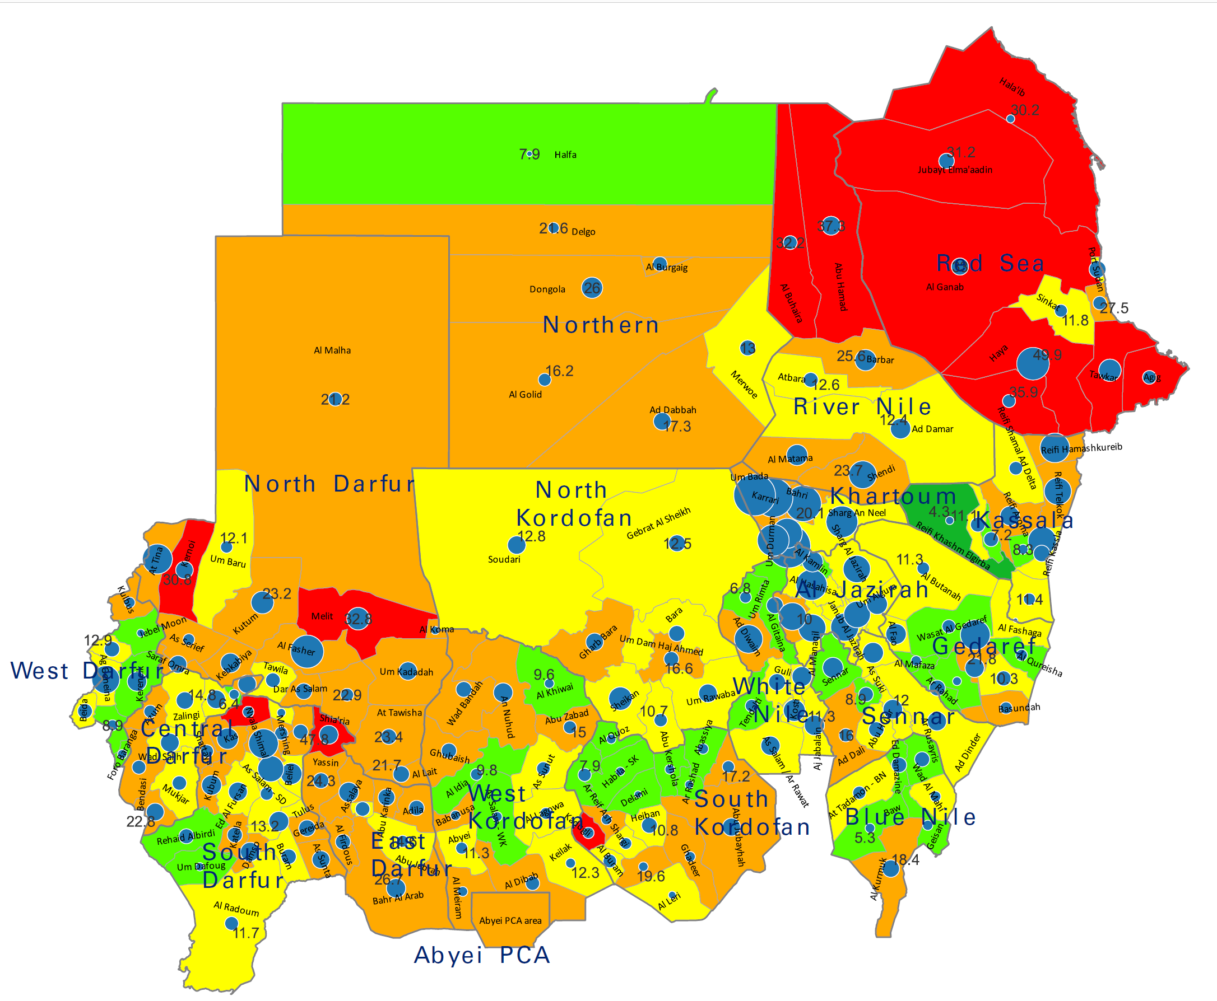
1a) Nutrition Situation in Sudan prior to Conflict
Stunting: 36%
Anaemia U5: 48%
Dietary Diversification: 25%
EBF: 62%
Recent SMART surveys: Mar 2023
Kalemando- ND:
GAM 20.6% and SAM 4.8%
Reif Al Shergi-SK
GAM 10.9% and SAM 1.3%
MUAC screening results
  Refugees
  Communities

Slide 5


1b) Current Acute Malnutrition Situation
3.4 million children aged 6-59 months acutely malnourished. This includes over 690,00 children severely malnourished.
IN NEED OF TREATMENT
1 million pregnant and breastfeeding women and girls (PBW/G) acutely malnourished.
IN NEED OF TREATMENT
The revised Humanitarian Response Plan (HRP) in May 2023 projected a
30% increase in the caseload of acute malnutrition in hotspot areas of Khartoum, Darfur, and Kordofan states.
15% increase in the caseload of acute malnutrition in IDP hosting localities.
10% increase in the caseload of acute malnutrition in the rest of the country.
PIN increased by 13% from 3.99M to 4.52M
SAM PIN increased by 13% from 611,556 to 690,677
PIN for SAM inpatient increased from 90,000 to 103,598
MAM PIN increased by 13.3% from 2.44M to 2.77M

Slide 6
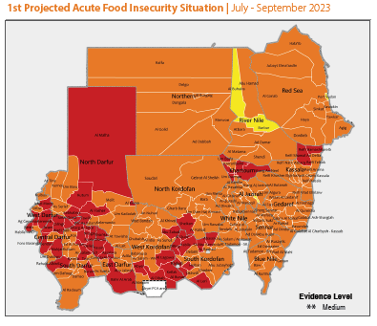
Nutrition situation: IPC Acute Food Insecurity June 2023 - February 2024
  Over 20.3 million people, representing 42% of the population, increased by 74% from 11.7M to 20.3M when compared to the same period from last year’s projection
  About 96% of acute malnutrition caseload (SAM and MAM) live in localities with IPC-AFI phase 3 (66%) and 4 (30%)
  The eight states in Darfur, West and South Kordofan and Khartoum
    Over 40 percent of the population is projected to suffer from acute food insecurity
    About half (50%) of the national caseload of acute malnutrition live in those 8 states
Decline in Food security
Decrease in the availability and accessibility of nutritious and diverse food
Increased malnutrition vulnerable children, pregnant women, and breastfeeding women and girls

Slide 7
1d) Admissions Trends 2020-2023

Slide 8
Nutrition situation: New Admission Trends Analysis
Reports of increased admissions in partners operational areas
Notes:
Our reach in the Darfur region and Khartoum compared to last year and compared to the target remains to be very low!
- We are only reaching 17% of the annual SAM target, hence behind by 83%

Slide 9
New Admissions Trends in WN Refugee Camp
UNHCR and MSF Spain started operating in Jul with additional number of nutrition promoters in July (slide from WN -SMOH). Refugee camp admissions trends in WN

Slide 10
2 a) Nutrition Sector Treatment Coverage Against Annual Target
PROGRAM | Target JAN 2023 | Revised Annual Target | Change in 2023 | % of Change |  | 7-mo Target (Jun- Dec 2023) | JAN 2023 % of Target vs PIN | May 2023 % of Target vs PIN | Reach up to Jun/Jul 2023) Against Annual Target
SAM OTP (6-59mo) | 456,007 | 559,446 | 103,439 | ↑ | 18.5% | 471,400 | 83% | 90.0%* | 140,741 (25.2%)
SAM SC (0-59mo) | 64,211 | 72,518 | 8,307 | ↑ | 11.5% | 42,302 | 70.0% | 70%** | 12,334 (17.0%)
TSFPs (6-59mo) | 1,211,977 | 1,374,160 | 162,183 | ↑ | 11.8% | 480,956 | 55% | 33%** | 76,323* (5.6%)
TSFPs (PLW) | 515,025 | 578,383 | 63,358 | ↑ | 11.0% | 202,434 | 55.0% | 33%** | 25,215* (4.4%)
e-BSFP for children 6-59 month | 101,936 | 418,666 | 316,730 | ↑ | 75.7% | 341,911 | 14.0% | 70%**
e-BSFP for PLW | 89,919 | 224,799 | 134,879 | ↑ | 60.0% | 183,585 | 23.0% | 70%**
Vitamin A | 5,917,508 | 5,917,508 | - |  | 0.0% | 5,917,508 | 85.0% | 85.0%
MYCN | 1,637,337 | 1,637,337 | - |  | 0.0% | 955,113 | 85.0%
*Based on annual program PINs
** Based on 7 months estimated PINs (May to Dec 2023)
Per reports collected so far, as actual will be higher than this, however couldn't received all reports

Slide 11
2 b) Sudan Sector Response Scenarios and Key Programme Shifts
For the first time, Sudan Nutrition sector response scenario was developed in discussion with sector partners, SAG and stakeholders
Response scenarios were categorized by:
  Hotspot areas:
    Front line/hotspot localities
    Darfur Region
    Kordofan Region
  States not directly affected by conflict: eastern and central states
  * Due to evolving situation, the strategy will be revised to reflect changes in population movement
Scenarios accounted for whether: (i) status-quo situation continues, or (ii) improvement in assess/security situation
Inclusion of critical sector response actions (from sector 2023 HRP activities)
Programmatic shifts and response modalities were contextualized for each region

Slide 12
2 c) National Guidelines on Simplified Approach for Management of Acute Wasting in U5
Updated guidelines for management of SAM without medical complications admitted in OTPs to be treated with RUTF until fully cured
Scale up of preventive community interventions including growth monitoring and mother support groups
Monitoring of cases of MAM in areas where TSFP services were unavailable
One of the main changes in the circular shared earlier in the year, restricting the use of RUTF supplies for management of SAM only even in areas where TSFP services were disrupted

Slide 13
2 d) Coordination with UNHCR in Sudan
Member of the Nutrition sector SAG and Nutrition sector partner
UNHCR update sector partners on weekly basis on the nutrition situation, responses and gaps in the camps
Sector coordination following up nutrition situation and responses in the refugees' camps
Sector coordination team visits refugee camps when on mission e.g. in White Nile
Sector organizes and advocates for dedicated or special meetings on responses in refugee camps as needed

Slide 14
2 e) Gaps in nutrition responses
Geographical coverage: 20% of SCs, 24% of OTP and 66% of TSFP not operational
Low coverage in IDP camps: e.g OTP: 45% in 11 camps and 48% in 93 camp like settings
Low coverage of preventive nutrition services (e.g BSFP, MNP, Vit A campaign)
Partial functionality of nutrition sites due to insecurity, limited access, and low staff
Delayed resumption of TSFP due to funding shortfall
Low reporting rate (OTP- only 70%, SC-53%)
Supplies stock out especially in the TSFP relative to other programmes
Limited supervision and monitoring especially in SMOH supported facilities
Inadequate staffing in the facilities
Limited analysis and triangulation of nutrition information and forecasting

Slide 15
Partners Presence Pre-Conflict (April 2023):
North Darfur:
Auttash Organization for Peace and Developement
Deutsche Welthungerhilfe e.V. (German Agro Action)
GOAL
Kuwait Patients Helping Fund
National Plan Organization (NPO)
Relief International
Rural Development Network
SAHARI ORGANIZATION FOR DEVELOPMENT
Save the Children
SMOH
North Kordafan:
Islamic Relief Worldwide
SMOH
River Nile:
Building Foundation for Development
SMOH
Red Sea:
Life Support for Civilian War Victims ONG Onlus
Kuwait Patients Helping Fund
Save the Children
SMOH
Sudanese Red Crescent Society
Northern:
SMOH
Kassala:
ALIGHT
American Refugee Committee /Alight
CARE International in Sudan
JASMAR Human Security Organization
Kuwait Patients Helping Fund
Plan International
Samaritan's Purse
SMOH
Sudanese Red Crescent Society
West Daruf:
Catholic Relief Services
Concern Worldwide
International Medical Corps
Save the Children
SMOH
Sudanese Red Crescent Society
World Relief
Northern
Red Sea
River Nile
Central Darfur:
ACT Alliance / Norwegian Church Aid
Action Against Hunger
Catholic Relief Services
FUNDACION ACCION CONTRA EL HAMBRE SUDAN
International Medical Corps
Islamic Relief Worldwide
MSF
SAEKER VOLUNTARY ORGANIZATION
Save the Children
SMOH
World Relief
Khartoum:
Almanar Voluntary Organization
Life Support for Civilian War Victims ONG Onlus
Kuwait Patients Helping Fund
SMOH
North Darfur
Kassala
Khartoum
Gedaref:
American Refugee Committee /Alight
CARE International in Sudan
Deutsche Welthungerhilfe e.V. (German Agro Action)
MedGlobal
Medical Teams International
SMOH
North Kordofan
Aj Jazirah
South Darfur:
ACT Alliance / Norwegian Church Aid
ALIGHT
American Refugee Committee /Alight
CARE International in Sudan
Life Support for Civilian War Victims ONG Onlus
International Medical Corps
Mercy Corps
National Initiative Development Organization
Rufaida Health Foundation
SMOH
World Vision International
Gedaref
West Darfur
Central Darfur
White Nile
Sennar
Sennar:
Save the Children
SMOH
Aj Jazirah
Building Foundation for Development
Kuwait Patients Helping Fund
SMOH
South Darfur
West Kordofan
East Darfur
South Kordofan
Blue Nile
Abyei PCA
South Kordofan:
Action Against Hunger
Almanar Voluntary Organization
Concern Worldwide
GOAL
International Medical Corps
Islamic Relief Worldwide
Save the Children
SMOH
40 Partners
East Darfur:
ALIGHT
Almanar Voluntary Organization
American Refugee Committee /Alight
CARE International in Sudan
National Initiative Development Organization
SMOH
World Vision International
Blue Nile:
Action Against Hunger
International Medical Corps
Relief International
Save the Children
SMOH
White Nile:
Action Against Hunger
Plan International
SMOH
West Kordofan:
Concern Worldwide
Islamic Relief Worldwide
SMOH

Slide 16
Partners Presence During Conflict (Jul 2023):
12 partners suspended services in some areas
River Nile:
Save the Children
North Darfur:
ALIMA
Humanity for Development and Prosperity Int.(HDPO)
National Plan Organization (NPO)
Relief International (RI)
SAHARI Organization for Development
Save the Children
Red Sea:
Save the Children
Khartoum:
Almanar Voluntary Organization
International Rescue Committee
OVCI Ia Nostra Famiglia
Northern
Red Sea
Kassala:
ALIGHT
CARE International in Sudan
Plan International
Sudanese Red Crescent Society
River Nile
West Daruf:
Catholic Relief Services(CRS)
Concern Worldwide
Save the Children
Sudanese Red Crescent Society
World Relief
Gedaref:
American Refugee Committee /Alight
CARE International in Sudan
International Rescue Committee
Medical Teams International
Premiere Urgence Internationale
Welthungerhilfe
North Darfur
North Kordafan:
Save the Children
Khartoum
Kassala
North Kordofan
Aj Jazirah
Gedaref
Central Darfur:
Action Against Hunger
Catholic Relief Services
International Medical Corps
Islamic Relief Worldwide
Save the Children
World Relief
West Darfur
White Nile
Aj Jazirah
International Rescue Committe
Premiere Urgence Internationale
Save the Children
Central Darfur
Sennar
South Darfur
West Kordofan
East Darfur
South Kordofan
Blue Nile
White Nile:
Action Against Hunger
Plan International
Save the Children
South Darfur:
ALIGHT
CARE International in Sudan
Mercy Corps
National Initiative Development Organization(NIDO)
Abyei PCA
Blue Nile:
Action Against Hunger
International Medical Corps
Medair
Relief International
Save the Children
IOM
South Kordofan:
Action Against Hunger
ALIMA
Almanar Voluntary Organization
Concern Worldwide
Save the Children
East Darfur:
ALIGHT
Almanar Voluntary Organization
CARE International in Sudan
West Kordofan:
Almanar Voluntary Organization
Concern Worldwide

Slide 17
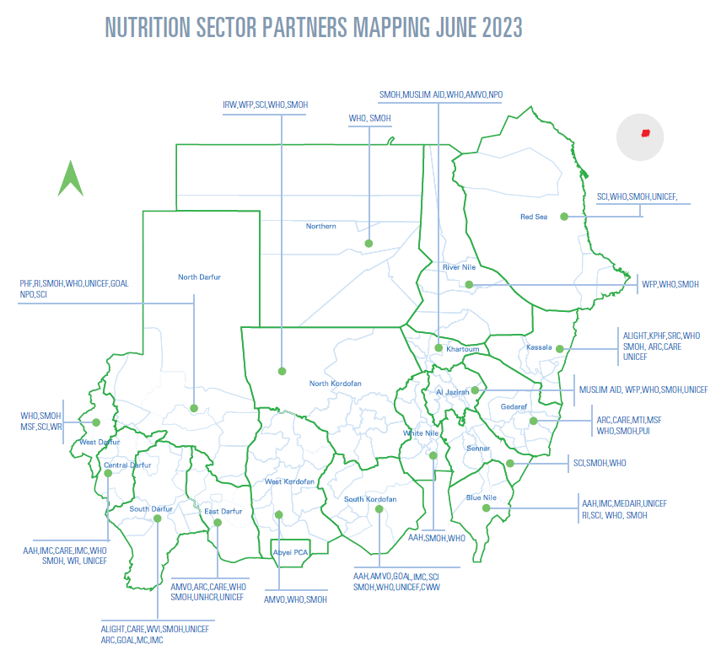
3 a) Nutrition sector response: Partners presence
Response strategies:
Sustaining the existing services
Scaling up early detection and treatment
Scaling up prevention
Mass MUAC screening
Integration with other sectors
Programmatic shift in front line areas (can be done and what can be suspended)
Advocacy for special access in front line areas
Timely replenishment of supplies
Supporting nutrition staff with allowance/incentives
WFP

Slide 18
3 b) Response: Treatment of SAM with SAM with Medic Comp (SCs) – end of Jul 2023
Operational in the Area
Partially Operational
SMOH, WHO
Reached:
Jan-Jul: 12,334
Apr-Jul: 6,683
SCs operational: 81%
Stabilization centers:
According to 6 NGOs:
Total # reported: 21
  Operational: 15 (71.4%)
  Partially Operational: 3 (14.2%)
  Suspended: 3 (14.2%)
Capacity to Respond: 16 (76.1%)
Utilization: 12 (57.1%)
Red Sea
Northern
SCI, SMOH, WHO
WHO, SMOH
River Nile
SMOH, WHO
North Darfur
CARE, SMOH, WHO
Khartoum
Kassala
ALIMA, RI, SMOH, WHO
SMOH, WHO
North Kordofan
Aj Jazirah
SMOH, WHO
Gedaref
CARE, SMOH, WHO
CONCERN, SMOH, WHO
West Darfur
SMOH, WHO
White Nile
Sennar
AAH, SMOH, WHO
Central Darfur
AAH, IMC, SMOH, WHO
AAH, RI, SMOH, WHO
According to WHO (13 partners supporting 39 SCs currently :
As of 17th August
Total # reported: 160
  Operational: 100 (62.5%)
  Partially operational: 32 (20%)
  Suspended: 28 (17.5%)
Capacity to Respond:
  Need to mobilize additional capacity to respond: 130 (81.25%)
West Kordofan
South Kordofan
Blue Nile
East Darfur
CONCERN, SMOH, WHO
ALIGHT, CARE, SMOH, WHO
South Darfur
Abyei PCA
ALIGHT, SMOH, WHO
SMOH, WHO
AAH, CONCERN, SCI, SMOH, WHO

Slide 19
3 b) Response: Treatment of SAM without Medical Comp (OTP) – end of Jul 2023
Operational in the Area
Present but not Operational
MEDGLOBAL, UNICEF
ALMANAR, IRC, OVCI, UNICEF
Reached
Jan-Jul: 140,740 (77% RR)
Apr-Jul: 66,984
OTP functional 76%
OTPs:
According to 31 NGOs
Total # reported: 542
  Operational: 352 (64.9%)
  Partially Operational: 53 (9.8%)
  Suspended: 137 (25.3%)
Capacity to Respond: 389 (71.8%)
Utilization: 394 (72.7%)
SCI, SAHARI, UNICEF
Red Sea
Northern
SCI, UNICEF
River Nile
SCI, UNICEF
PI, SRCS(14,7), UNICEF
North Darfur
Khartoum
Kassala
ALIMA, RI, SCI(14,7), HDPO, NPO, UNICEF
North Kordofan
CARE, IRC, SCI, PUI, UNICEF
Aj Jazirah
Gedaref
CARE, IRC, PUI, MTI, WELTHUNGERHILFR, UNICEF
CONCERN, CRS(5,5), SRCS(5,3), SCI, WR, UNICEF
West Darfur
Sennar
AAH, PI, SCI UNICEF
White Nile
Central Darfur
UNICEF
AAH, CRS, IMC, SCI, IRW, WR, UNICEF
AAH, IOM, IRC, IMC, SCI, RI, MEDAIR, UNICEF
West Kordofan
South Kordofan
Blue Nile
South Darfur
East Darfur
ALIGHT, CARE, NIDO, MERCY CORP, UNICEF
CONCERN, ALMANAR, UNICEF
Abyei PCA
ALMANAR, ALIMA(2,3), AAH, CONCERN, SCI, UNICEF
ALMANAR, CARE,NIDO, UNICEF
UNICEF

Slide 20
3 c) Response: Targeted Supplementary Feeding Program (TSFP) – end of Jul 2023
Operational in the Area
Present but not Operational
Reached: <5s
Jan- Jun: 76,323
Apr-Jun: 38,950
Reached: PLW
Jan-Jun: 25,215
Apr-Jun: 15,946
TSFP operational: 500
WFP
TSFPs:
According to 16 NGOs
Total # Reported: 181
  Operational: 76 (14.0%)
  Partially Operational: 29 (5.4%)
  Suspended: 76 (14.0%)
Capacity to Respond: 87 (16.1%)
Limited Utilization: 99 (18.3%)
Northern
Red Sea
River Nile
WFP
North Darfur
CARE, PI, WFP
RI, HDPO, SAHARI, WFP
Khartoum
Kassala
North Kordofan
SCI,WFP
WFP
Aj Jazirah
Gedaref
CARE, MTI, WELTHUNGERHILFE, WFP
West Darfur
SCI, WFP
Sennar
White Nile
AAH, WFP
Central Darfur
AAH, CRS, WFP, SCI
AAH, IOM MEDAIR, WFP,RI
West Kordofan
South Kordofan
Blue Nile
South Darfur
East Darfur
CARE, WFP
Abyei PCA
CARE, WFP
AAH, WFP, SCI

Slide 21



Agenda 4a) Nutrition Sector Core Supply Update (as of 21st August 2023)
Types of Supplies | Number of beneficiaries to be reached in by end of 2023 | Available/In Pipeline | Duration (Time likely to last (mo) | Gaps in SAM Kits (coming 6 months) | Gaps in Funding (coming 6 months (US$)
SAM Kits (5 modules) | 64,200 SAM with Med Comp | 1,012 modules of SAM kits in country- under distribution 719 SAM Kits modules in pipeline | 1-2 months | 2,667 | 4.4 M
Operational Cost | 120 Stabilization Centers (excluding NGO supported) |  |  |  | 4.6 M
1,066 (SAM Kits-Modules) distributed during the crises Recent distribution: SAM Kits-modules distributed to Kassala, River Nile, Northern, Blue Nile, White Nile and Sennar
Supply | Available in country (ctns) | Expected/in pipeline (ctns) | Duration | Gaps (ctns) | Funding needed (US $) | Remarks
RUTF | 279,500 distributed and 44,000 in UNICEF central warehouse | 325,000 | Until end of Nov of 2023 | 139,000 | 12,510,000 | 12 states have supplies for 2 months. UNICEF is working on replenishing supplies by considering different route options.
F-100 | 899 distributed and 366 in UNICEF central warehouse | 2,125 | until the end of 2023. | 0 | 0 | 13 states have supplies for 1 to 2 months. UNICEF is working on replenishing supplies by considering different route options.
F-75 | 1,625 distributed and 540 in UNICEF central warehouse | 3,661 | until November of 2023 | 2,745 | 181,057 | 10 states have supplies for 1 to 2 months. UNICEF is working on replenishing supplies by considering different route options.

Slide 22
4b) Core supplies availability – NGO Partners Update (up to 31st July 2023)
Stabilization Centers (SCs)
SAM Kits Status
Bi-weekly Reporting Period | No. Stockout 0 Day | Stockout During the previous 14 days of reporting | Total # of SCs Reported
14th May – 1st June | 1 (100.0%) | 0 (0.0%) | 1
1st – 14th June | 4 (100.0%) | 0 (0.0%) | 4
15th – 30th June | 14 (100.0%) | 0 (0.0%) | 14
1st – 15th July | 11 (100.0%) | 0 (0.0%) | 11
16th – 31st July | 7 (100.0% | 0 (0.0%) | 7*
Therapeutic Milk (F-100/F-75) Status
Bi-weekly Reporting Period | No. Stockout 0 Day | Stockout During the previous 14 days of reporting | Total # of SCs Reported
14th May – 1st June | 1 (100.0%) | 0 (0.0%) | 1
1st – 14th June | 3 (75.0%) | 1 (25.0%) | 4
15th – 30th June | 14 (92.9%) | 1 (7.1%) | 14
1st – 15th July | 11 (100.0%) | 0 (0.0%) | 11
16th – 31st July | 7 (100.0% | 0 (0.0%) | 7*
14th May – 1st June: 1 NGO
1st – 14th June: 2 NGOs (3 States, 4 Localities)
15th – 30th June: 6 NGOs + SMOH + UNHCR (7 States, 13 localities)
1st – 15th July: 5 NGOs (9 States, 11 localities)
16th – 31st July: 4 NGOs (4 States, 7 localities). *7 of the 9 reported SCs were operational
Supply Status
Supplies at Warehouses: 3 SCs
Current stock to support services for:
  SAM Kits: 1 week to 3 months
  F-100/F-75: 2 weeks to 3 months

Slide 23
4b) Core supplies availability – NGO Partners Update (up to 31st July 2023)
Outpatient Therapeutic feeding Program (OTP)
RUTF Status
Bi-weekly Reporting Period | No. Stockout 0 Day | Stockout During the previous 14 days of reporting | Total # of OTP sites/MTs reported
14th May – 1st June | 17 | 11 | 28
1st – 14th June | 125 (90.6%) | 13 (9.4%) | 138
15th – 30th June | 238 (83.5%) | 47 (16.5%) | 285
1st – 15th July | 169 (81.3%) | 39 (18.7%) | 208
16th – 31st July | 135 (63.3%) | 78 (36.7%) | 213*
14th May – 1st June: 5 NGOs (5 States, 9 Localities)
1st – 14th June: 11 NGOs (12 States, 14 Localities)
15th – 30th June: 16 NGOs + SMOH + UNHCR (13 States, 78 Localities)
1st – 15th July: 15 NGOs (11 States, 55 Localities) – Unknown supply status for 34 OTP sites
16th – 31st July: 17 NGOs (12 States, 56 Localities) – *Unknown supply status for 32 OTP sites and 7 MTs that were operational of total 312 OTP sites reported
Reason for stockout
Challenge in transportation due to insecurity/poor road conditions
Increased admissions
Action Taken
Following up on supply delivery with SMOH/UNICEF
Current supply to support services for:
< 1 month: 46 OTP sites
1 -2 months: 61 OTP sites
> 2 months: 12 OTP sites
Unknown: 16 OTP sites
Stockouts in: BN, CD, ND, SK, WD, WK States

Slide 24
4b) Core supplies availability – NGO Partners Update (up to 31st July 2023)
Targeted Supplementary Feeding programme (TSFP)
RUSF Status
Bi-weekly Reporting Period | No. Stockout 0 Day | Stockout During the previous 14 days of reporting | Total # of TSFP sites/MTs reported
14th May – 1st June | 3 (21.4%) | 11 (78.6%) | 14
1st – 14th June | 6 (18.2%) | 27 (81.8%) | 33
15th – 30th June | 19 (46.3%) | 22 (53.7%) | 41
1st – 15th July | 72 (82.8%) | 15 (17.2%) | 87
16th – 31st July | 7 (11.9%) | 52 (88.1%) | 59 (Incl 1 MT in IDP camp)
14th May – 1st June: 3 NGOs (2 States, 6 Localities)
1st – 14th June: 4 NGOs (4 States, 14 Localities)
15th – 30 June: 4 NGOs (6 States, 17 Localities) – Including 9 TSFP sites supported by UNHCR + 4 NGOs (2 States, 7 Localities)
1st – 15th July: 8 NGOs (8 States, 35 Localities) – Unknown supply status in 32 TSFP sites
16th – 31st July: 11 NGOs (8 States, 20 Localities) – Unknown supply status in 16 TSFP sites. 95 TSFP sites were nonoperational out of 154 sites that reported
Reason for stockout
Stockout at state level
New FLA not yet signed
Action Taken
‘Implementation of revised Simplified Approach (i.e., management of SAM using RUTF until cured’
Current supply to support services for:
< 1 month: 2 TSFP sites
1 -2 months: 23 TSFP sites
> 2 months: 9 TSFP sites
Stockouts in: Aj Jazeera, CD, Gedaref, SK and WD States

Slide 25
5) Nutrition Sector Funding requirements 2023
Flagship programmes | Initial funding req HRP 12months US$ (Million) | Proposed Sector HRP Requirement (Jan-Dec) US$ (million)** | Revised and Final HRP May-Dec (7months) US$ (million ) | % change | Funding received in FTS (OCHA)* US$ (Million)
Overall funding requirements | 190.9 | 596 | 350.1 | ↑ 83.4% | 65.2 (18.6%)
Treatment of SAM SC (0-59mo) | 22.0 | 38.8 | 23.82 | ↑ 8.3%
Treatment of SAM OTP (6-59mo) | 62.7 | 139.86 | 117.85 | ↑ 88%
Treatment of MAM | 96.1 | 136.67 | 47.84 | ↓ 50.2%
Preventive interventions | 5.9 | 222.6 | 160.6
*As of 21st August 2023
Urgent funding requirement for core supplies and operational cost
SAM in SC: US$ 5M SC Operational cost US$ 4.6 M
SAM in OTP: US$ 17.62M OTP Operational cost: US$ 137 M
TSFP: US$ 7M
** Not approved

Slide 26
6) Nutrition Sector capacity enhancement
Sector coordination
  Recruiting Roving Sub national coordinator to strengthen coordination at State level
Information management Officer (IMO)
  IMO support from SBP for since 20th July to 20th Sept
  IMO –TA for one year (under- recruitment)
Communication nutrition vulnerability in Sudan: Global Task Force on Sudan (in the making) to support analysis, prioritization, projection of situation
Capacity strengthening for partners and NIE: in discussion with the GNC

Slide 27
7) Challenges
Insecurity and limited access among partners to the affected areas
Delayed replenishing supplies in nutrition sites supported by both partners and the SMOH (need ad hoc modality of supporting delivering supplies to sites supported by SMOH)
Limited availability of cash among partners to support the ongoing activities
Difficulties in paying staff salaries/incentives by operational nutrition sector partners
Lack of allowances for the nutrition staff at site level. In some of states, 70% of the SMOH are working as volunteers as they have not been paid for several months
Increased operational costs to support the ongoing /new life saving nutrition services
Hiking of prices for basic needs (food, water, doubling of transportation costs etc)
Limited internet connectivity and mobile phones- presenting challenges to communicate with staff in the nutrition sites and reporting mechanisms
Replenishment of partners looted office equipment and assets in particular hotpots localities
Bureaucratic and access impediments (travel notifications, number of check points)
Dysfunction of nutrition information system - last update was in Feb 2023
Limited funding of the nutrition sector

Slide 28
8) Priorities for the coming period
Sustaining ongoing life saving nutrition services; SCs, OTP, TSFP and MYCN-IYCF-E
Scale up of nutrition timely detection and treatment as well as preventive interventions in both host and IDP camps
  Scale up of mass MUAC screening campaigns linked with health and nutrition activities
  Advocating for scale up of community prevention activities – nonfood interventions to overcome prevalent shortfall of nutrition supplies
Optimizing multi-sectoral integration and co-location of responses across the sectors that directly or indirectly impact the nutrition situation and responses (FSL, WASH, Health, Education, Protection etc)
Strengthening collection, monitoring analysis and projection of evolving nutrition and communication with stakeholders and guide 2024 sector response plan
2024 HNO and HRP
Strengthening coordination at state-level and government engagement
Strengthening coordination and collaboration with key humanitarian actors that are non-nutrition sector/cluster partners
Advocating for access and mobilizing for resources

Slide 29
THANK YOU!
Notes:
Insert map of the country with affected areas/districts or photos

