Slide 1
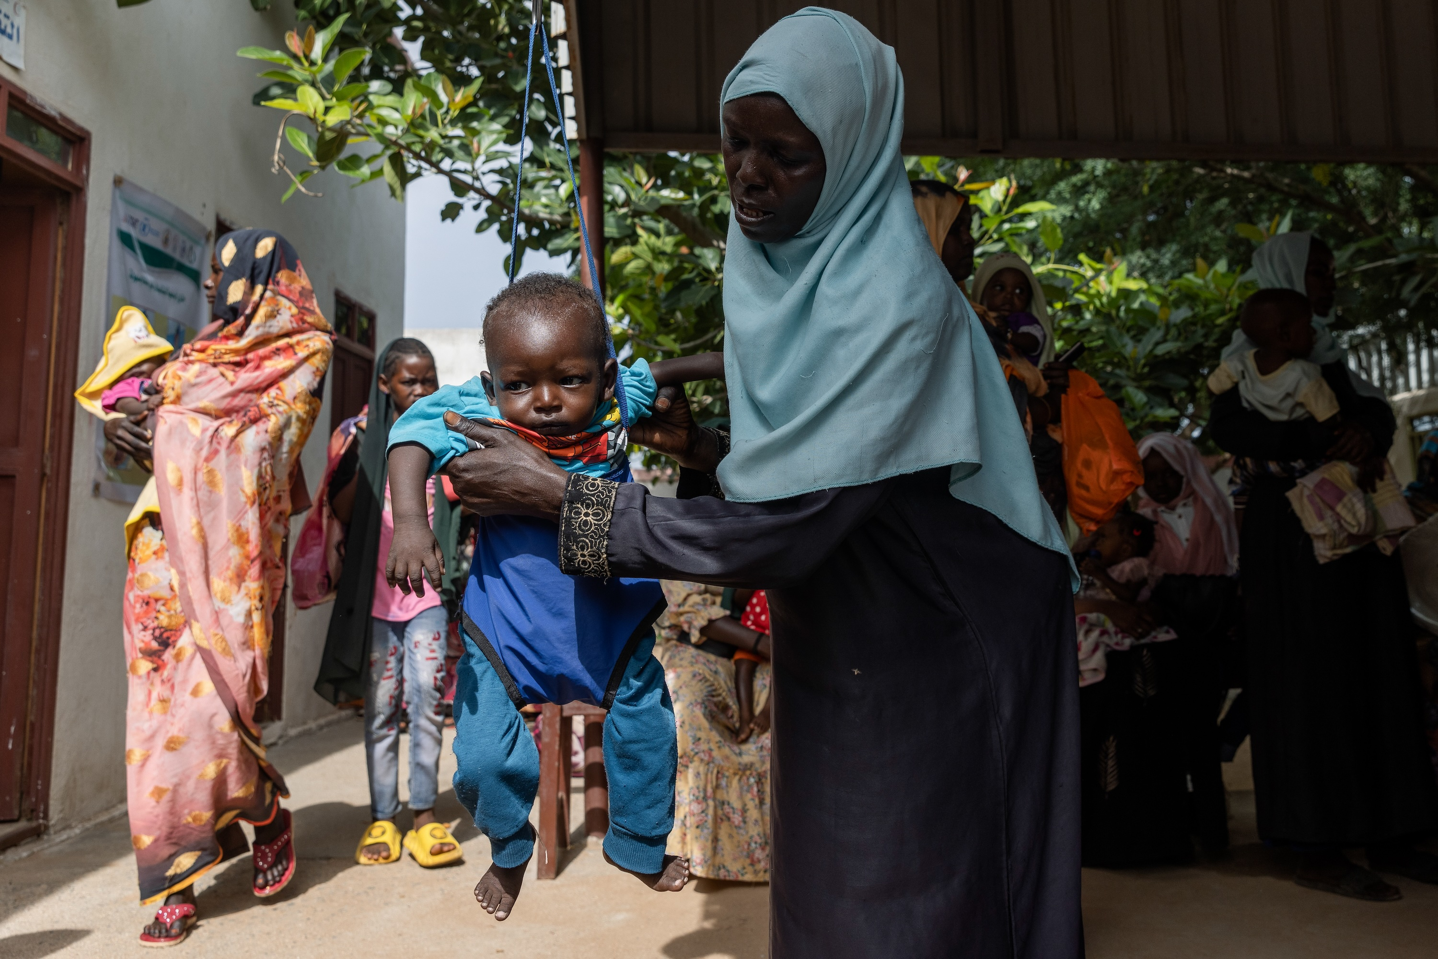

Nutrition Sector Update on Nutrition Situation and Response
22nd February 2024
AGENDA
CURRENT SITUATION + FORECAST
STRATEGIC PRIORITIES
THE RESPONSE
GAPS + CHALLENGES
KEY ASKS

Slide 2
Indicator | PIN 2021 | PIN 2022 | 2023 | Rev-May 2023 | 2024 | Revised interim 2024 PIN | %Increase compared to Jan-2023 PIN
Severe Acute Malnutrition (0-59m) | 570,871 | 618,950 | 611,556 | 690,677 | 710,162 | 729,756 | 19%
Severe Acute Malnutrition with Complication (0-59m) | 85,631 | 92,843 | 91,730 | 103,598 | 106,524 | 109,463 | 19%
Moderate Acute Malnutrition (U5) (0-59mo) | 2,387,068 | 2,451,406 | 2,448,348 | 2,776,080 | 2,841,794 | 2,942,947 | 20%
Moderate Acute Malnutrition (PLW) | 647,623 | 905,004 | 936,409 | 1,051,606 | 1,150,024 | 1,194,279 | 28%
Total PIN | 2,957,939 | 3,975,360 | 3,996,396 | 4,518,363 | 4,701,980 | 4,866,981 | 22%
AGENDA
CURRENT SITUATION + FORECAST
STRATEGIC PRIORITIES
THE RESPONSE
GAPS + CHALLENGES
KEY ASKS
Conflict spreading with over 6M (12.2%) of the Pop are IDPs and
Limited access: Over 71% (135) of 189 localities are hard to reach
Deteriorating humanitarian situation:
  Deterioration of food insecurity (Food insecurity: 17.7M (37% )of the pop in IPC 3+, low food production)
  Limited coverage of WASH services
  70% of the health facilities not operational in hotspot areas and 1 in 11 at national level
Deterioration of nutrition situation: 3 out of 4 SMART surveys
MSF rapid assessment and from other partner's in Darfur- high Malnutrition and emergency death levels
Delayed clearance of goods at the port.

Slide 3
1:Advocating for response need-driven access
2: Prioritization of responses (high-level acute malnutrition areas and IDPs sites)
3: Resuming and scaling up minimum preventive and curative life-saving responses
4: Timely delivery and replenishment of life-saving supplies (the pipeline of nutrition preventive supplies
SAM Kits 701 secured until March 2024 • Therapeutic milk 6814 ctn secured until June
RUTF 402,375 ctn secured until July • RUSF 1791 MT secured until June +360 in Chad
(MQ/SQ LNS 1377 MT is secured till Mid Jul + 424 MT in Chad
5: Resource/funding mobilizing and advocacy at national and global levels
6: Evidence generation
  SMART surveys and MUAC screening in the accessible areas
  Strengthening nutrition information analysis and communication
  Monitoring of nutrition response and supplies at facility level
7: Strengthening sub-national cluster and stakeholders' coordination and collaboration
8: Supporting frontline nutrition workers with incentives depending on resource availability
9: Supporting rehabilitating nutrition facilities and replenishment of partners (looted assets)
AGENDA
CURRENT SITUATION + FORECAST
STRATEGIC PRIORITIES
THE RESPONSE
GAPS + CHALLENGES
KEY ASKS

Slide 4
Functionality of Curative Nutrition Services and Gaps as of Jan 2024
Programme Type | UN agencies update | NGOs update | Functionality
 | Total nutrition sites | Functional | Partially | Closed
SAM (with med comp)-SC | 160 | 104 (65%) | 29 (18%) | 27 (17%)
OTP without med comp)-OTP | 1885 | 1486 (79%) | 103 (5%) | 296 (16%)
MAM- TSFP | 1482 | 559 (38%) |  | 923 (62%)
AGENDA
CURRENT SITUATION + FORECAST
STRATEGIC PRIORITIES
THE RESPONSE
GAPS + CHALLENGES
KEY ASKS
Programme NGOs | NGOs partners updates in their operational areas depending on those reported | NGOs update | Functionality
SAM (with med comp)-SC (8 NGOs) | 35 | 31 (88.6%) | 2(5.7%) | 2 (5.7%)
OTP without med comp)-OTP (20 NGOs) | 593 | 475 (80.1%) | 57 (9.6%) | 61 (10.3%)
MAM- TSFP (12 NGOs) | 260 | 188 (72.3%) | 4 (1.5%) | 68 (26.2%)
NGOs support about 32% of the functional OTP; 47% of TSFP

Slide 5
Nutrition Response Scale Up Plan: Partners commitments Feb 2024)
Programme by Partners (21) | # of sites to be reopened or scale up | # of sites to be scaled up or reopened in Darfur | # of sites to be scaled up or reopened in Kordofan | # of sites to be scaled up or reopened in Khartoum
SAM (with med comp)-SC | 74 | 59 | 8 | 7
OTP without med comp)-OTP | 465 | 273 | 160 | 32
MAM- TSFP | 365 | 208 | 118 | 39
BSFP | 35 | 8 | 0 | 27
MIYC-IYCF | 450 | 290 | 80 | 80
UN Agencies
UNICEF- OTP (HRP) | 600
WFP-TSFP 300 (HRP) | 850
WHO- SC (HRP) | 71 | 35 | 10 | 17
AGENDA
CURRENT SITUATION + FORECAST
STRATEGIC PRIORITIES
THE RESPONSE
GAPS + CHALLENGES
KEY ASKS
BSFP Priority: Active conflict areas, IDPs, refugees and new IDPs in non conflict areas
Partners that expressed interest in scaling up or reopening of the sites are:
Darfur States ( Alight, WR, ALIMA, CARE, CWW, HDPO, IMC, NPO, PIS, RI, SCI, GOAL and SAHARI, IOM, CRS, SRCS)
Kordofan States (GOAL, ACF, IMC, CWW, SCI, SMOH and IRW)
Khartoum State (ALIMA, IRC, NPO, MEDAIR, NIDO and IMC)

Slide 6
Main Gaps:
Low treatment coverage in host community and IDPs
Program | Program PIN 2023 | 2023 target | 2023 Reach | PIN Coverage (%) | Target Coverage (%)
SC | 97,690 | 72,518 | 28,206 | 29% | 37%%
OTP | 586,159 | 559,446 | 293,239 | 50% | 54%
TSFP | 2,334,809 | 1,374,160 | 401,949 | 17% | 29%
PLW | 1,007,752 | 578,383 | 105,049 | 11% | 18%
AGENDA
CURRENT SITUATION + FORECAST
STRATEGIC PRIORITIES
THE RESPONSE
GAPS + CHALLENGES
KEY ASKS
Low (36% of 5228) geographical coverage of nutrition services in Sudan.
Inadequate staffing in the nutrition sites- due to displacements
Low nutrition services coverage in the IDPs
Low targets annual target (2024) for some of the HRP strategic programmes e.g. BSFP
Lack of recent nutrition situation data at locality and national levels
Dysfunctional nutrition information system

Slide 7
Access constraints:
  Over 71% (135) of 189 localities are hard to reach
  Only 42% (114,930) of SAM annual target in Darfur, Kordofan and Khartoum states reached in 2023.
  Only 4% (26,574) of MAM cases annual target in Darfur, Kordofan and Khartoum are reached in 2023
Delayed resumption of life-saving nutrition services due to access
Bureaucratic implements (up to six approvals before responding in some areas)
Low funding status: 23% of the 2023 HRP -US$ 350M received (OCHA- FTS) e.g
Delayed disbursement of funding for some of the programmes
Low reporting rate below 70% for OTP and late sharing of information
Lack of incentives for frontline nutrition workers (not paid for the last 10 month
Limited Supervision and monitoring limited of nutrition services
Limited communication and connectivity across the country
AGENDA
CURRENT SITUATION + FORECAST
STRATEGIC PRIORITIES
THE RESPONSE
GAPS + CHALLENGES
KEY ASKS

Slide 8
Continued advocacy for unhindered access & removing administrative impediments
Technical support on information analysis and communication
Adequate funding for nutrition and other sectors: Health, WASH and FSL:
Nutrition cluster funding has 30% from US$ 350m to US$ 454.1M
  Treatment of acute malnutrition US$ 290.8M
  Live saving preventive US$ 163.3M
    UNICEF current funding gap: 120 M
    WFP current funding gap: 52.1M
    WHO – running out of funds for SAM kits gap supplies only US $ 5M
NGOs with HQs outside Sudan to Support their Country offices to accelerate the resumption of services where access allows
Continue to strengthen capacity (training and funding) for national NGOs/CBOs on nutrition in emergencies e.g. the GNC support to Sudan
AGENDA
CURRENT SITUATION + FORECAST
STRATEGIC PRIORITIES
THE RESPONSE
GAPS + CHALLENGES
KEY ASKS

Slide 9
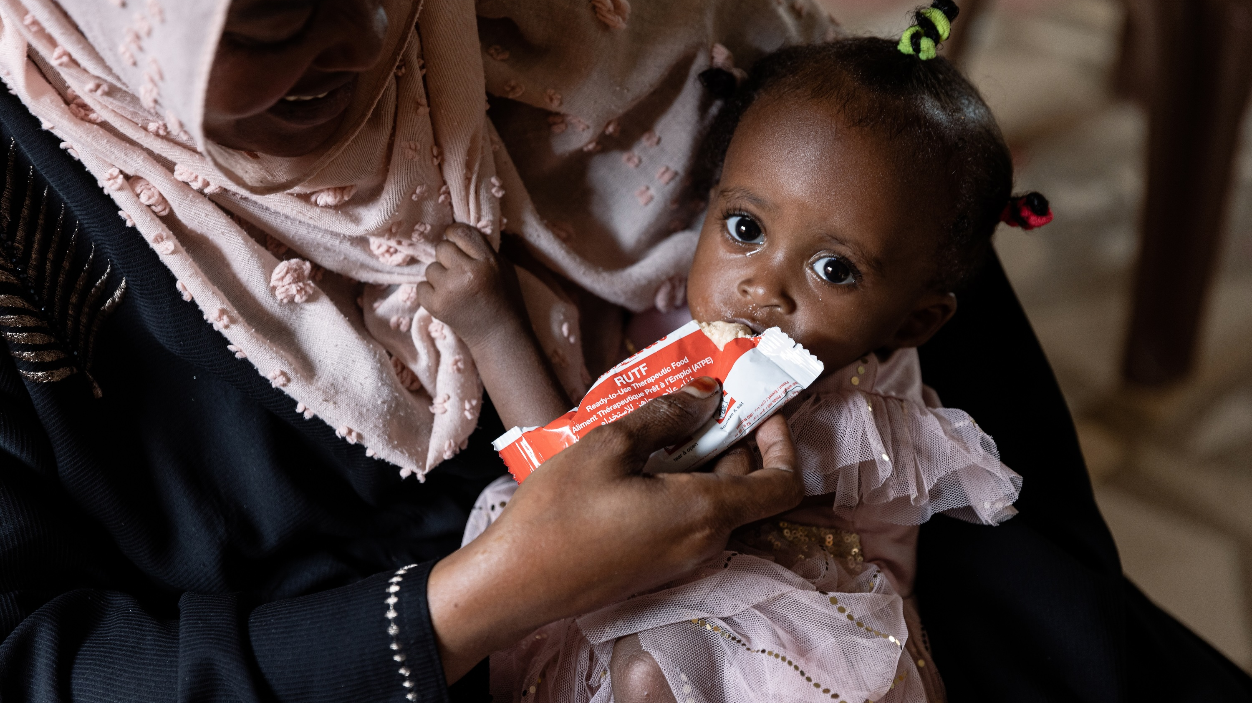
THANK YOU

